Slide 1
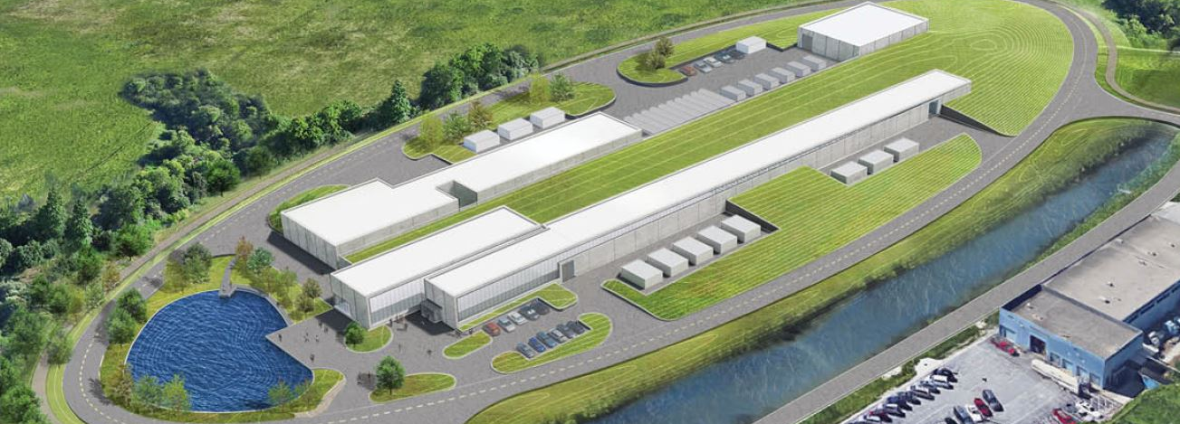
PIP-II Jamboree – RDS and ICD Meeting
Fernanda G. Garcia
Alex Martinez
January 29, 2019

Slide 2
Welcome to PIP-II Jamboree 2019
Goal: get confirmation from each L3M that the data submitted is accurate and the level of uncertainty is correct based on the current understanding. Collect signatures.
Next steps:
Technical system requirements documented in the RDS will be a controlled document and kept in TC (#ED0009544)
Requirements will be used by A&E firm for infrastructure design
RDS requirements MUST be captured in the sub-systems TRS

Slide 3
How the day will look like …
Goal: get confirmation from each L3M that the data submitted is accurate and the level of uncertainty is correct based on the current understanding.
Agreement reached -- collect signatures
If further discussion is needed, all parties involved will continue discussion with POC at the Visitor’s Room and work out details
Consensus achieved -- POC will apply the modifications to the file, return to Huddle and sign the signature sheet
Consensus not achieved -- POC will schedule a follow-up meeting to resolve the issue this week – collect signature by EBD January 31st.

