Slide 1
Review of Wideband Cavity Technology
Chihiro Ohmori
KEK/J-PARC

Slide 2
Contents
1.Wideband Cavity Technology
2.J-PARC MR Cavity
3.J-PARC RCS Cavtiy
4.CERN LIU-RF Collaboration
5. Extension of Frequency band
ELENA – 100 keV, 100 kHz RF
40 MHz Wideband Cavity Technology
6. Large Core Production for Transportation System

Slide 3
1. Wideband Cavity Technology
Cavity Impedance is improved by magnetic annealing.
Domain Wall
RF B-field
RF B-field
Domain Wall displacement
Magnetic Domain Rotation
~2013 for large cores
Annealing under B-field
Good Finemet® core

Slide 4
Mass Prodution : J-PARC/KEK-made magnetic annealing oven
J-PARC MR: 300 Cores, CERN PSB:342

Slide 5
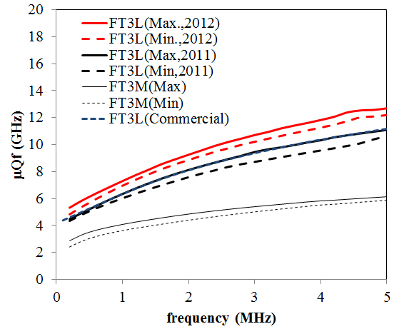
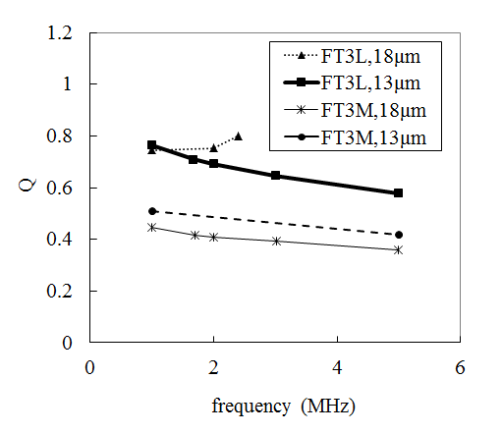
Magnetic Annealing
Keeping high permeability, increase Q
With B-field
With B-field
w/o B-field
w/o B-field

Slide 6
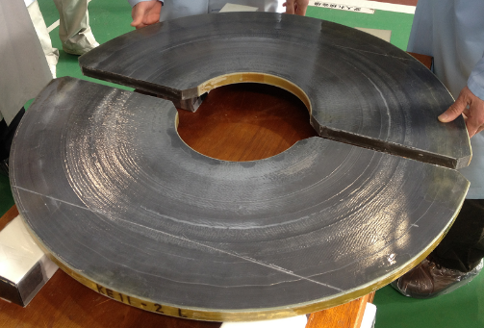
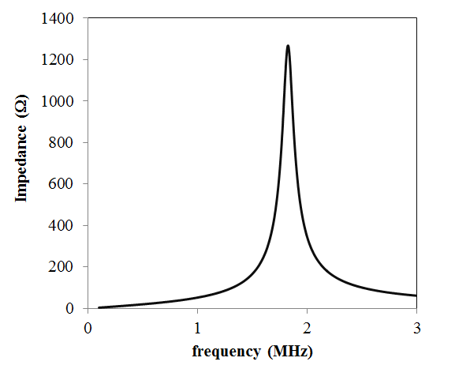
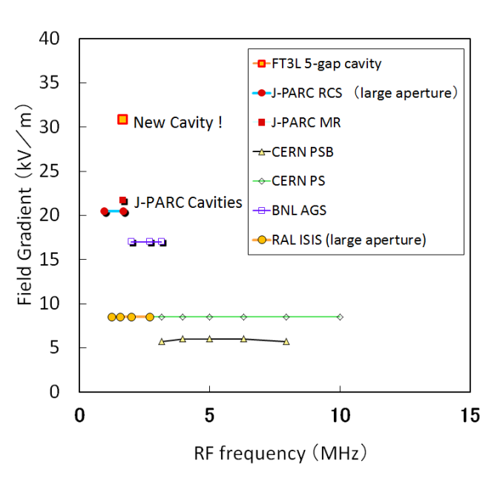
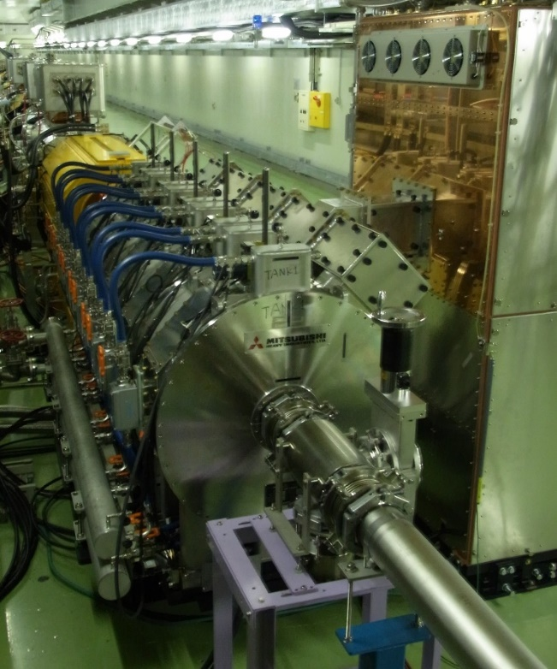
2. MR Cavity
H=9
Q=26
H < Q
MR is high intensity machine & periodic transient beam loading
6 Cavities for acceleration
2 Cavity for 2nd Harmonic RF
1 Spare

Slide 7
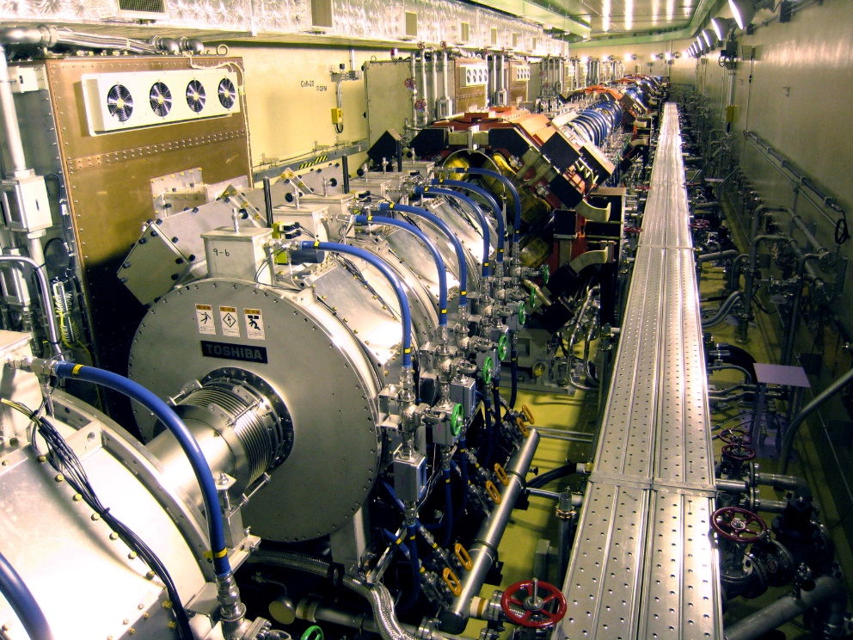
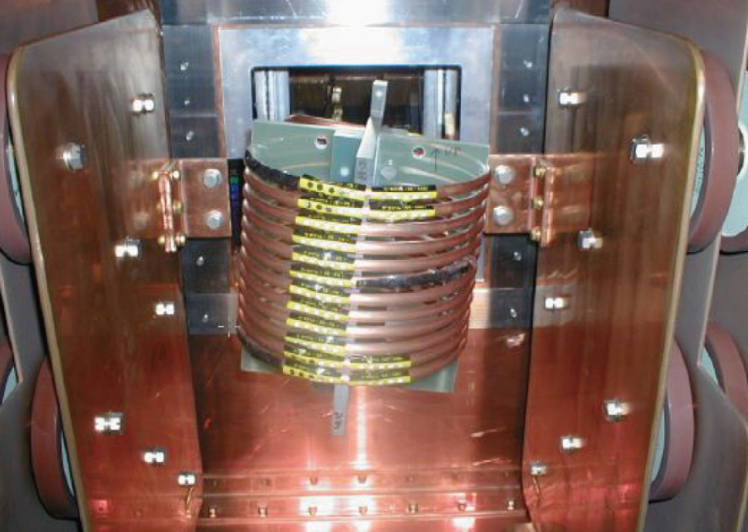
3. J-PARC RCS Cavity
RCS is high intensity machine & 2nd Harmonic RF & large frequency change => Q=2
External inductor in tube amplifier
for Q=2

Slide 8
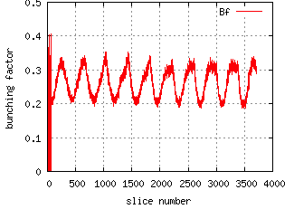
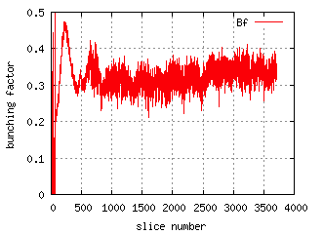
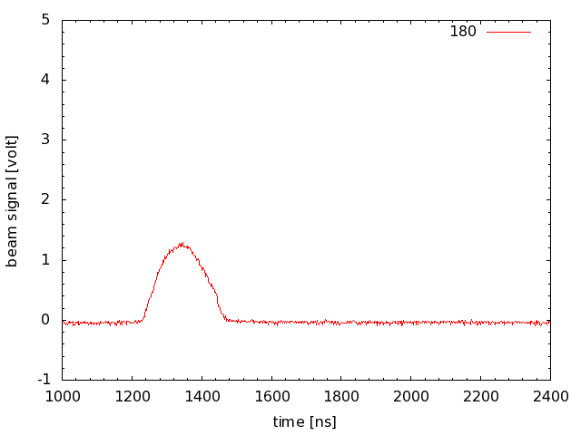
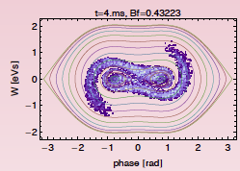
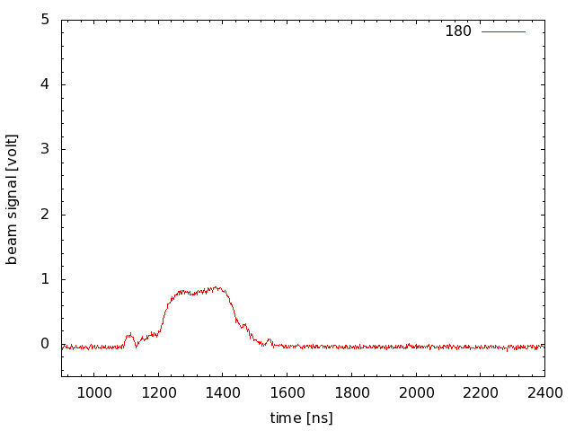
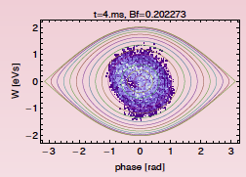
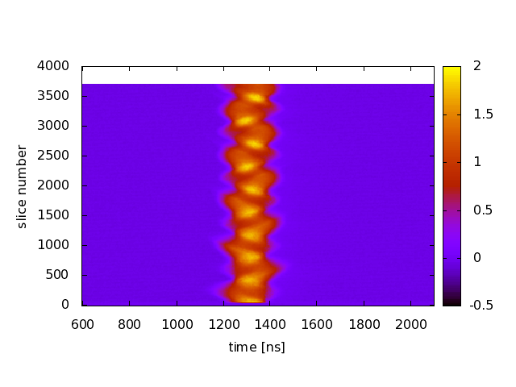
Longitudinal Profiles with High Intensity Beam of 500 kW equivalent
F. Tamura
(100 kV, 0 kV)
Bunching factor
0.2 ~ 0.3
Bunch length
~200 ns
(100 kV, 70 kV)
Bunching factor
0.3 ~ 0.4
Bunch length
~400 ns
Simulation
(100 kV, 0 kV)
Simulation
(100 kV, 70 kV)

Slide 9
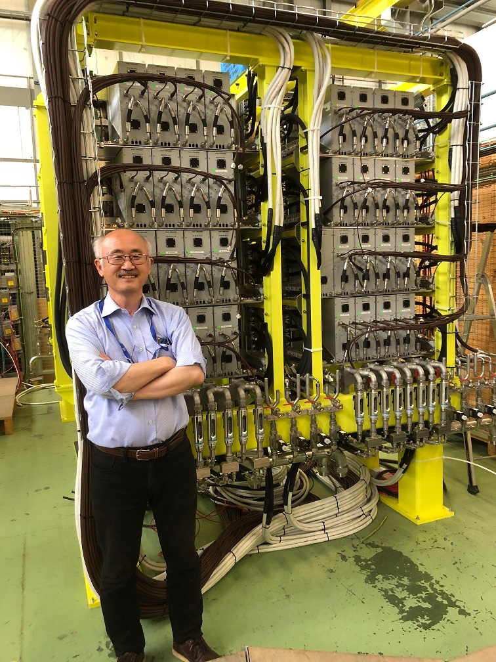
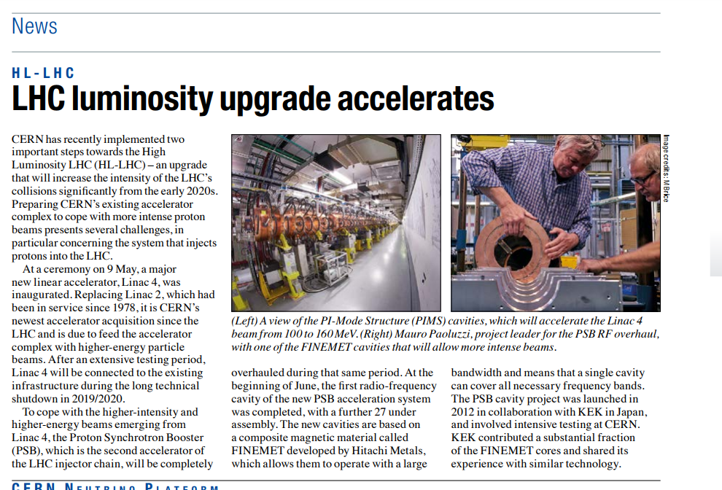
4.LIU-PS Booster RF
Replacements of all ferrite-loaded cavity systems to new Finemet®-base wideband system
All systems to install in LS2 are ready.
KEK contributes:
Cavity Design using FT3L
Productions : Oven & 132 cores
Tests : Quality control
CERN Courier 2017, July

Slide 10
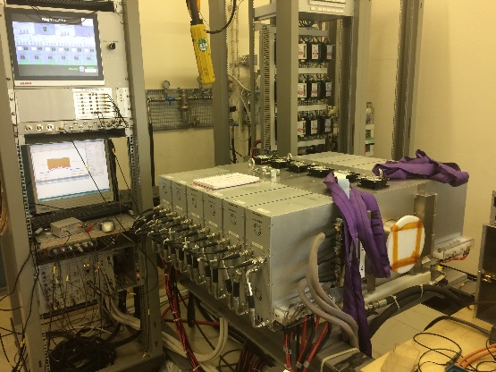
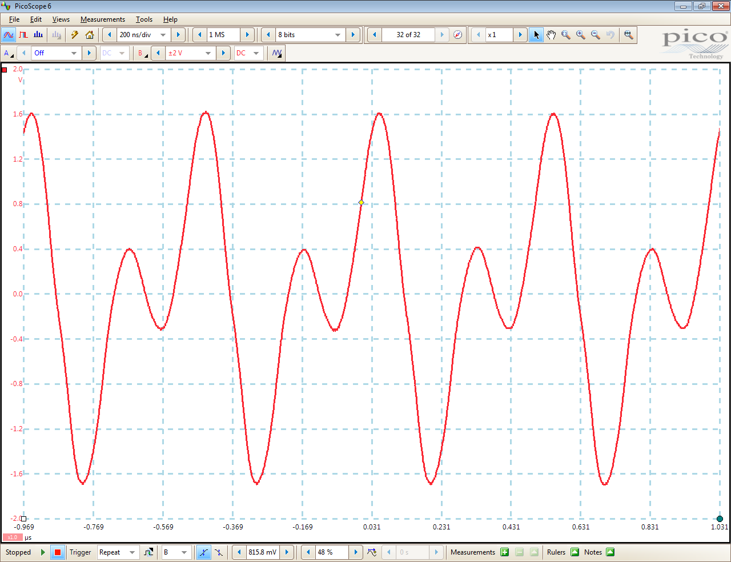
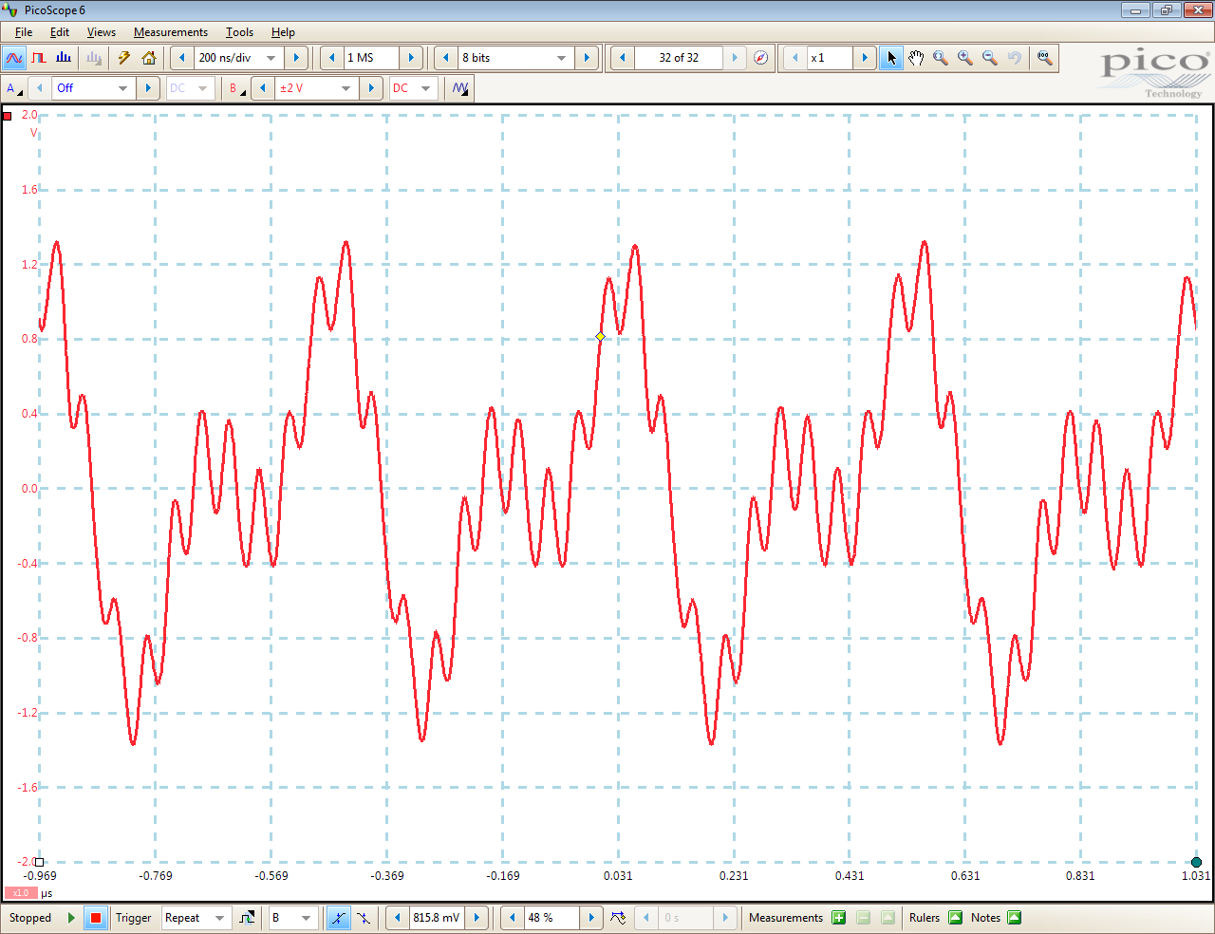
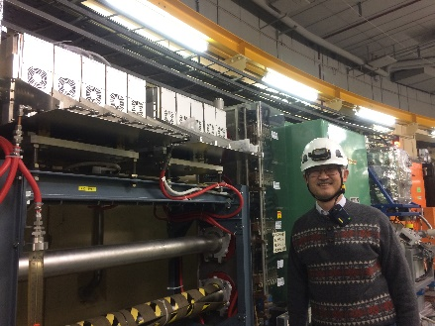
Power Test of new PSB cavities ： Mixing of 3 harmonics
H=1
H=1,2
H=1,2,10
M. paoluzzi
All cavities can work as fundamental (acceleration), 2nd Harmonic RF and blow-up one.
Reliability
10-Cell Finemet Cavity shows >99% availability
Maria Elena Angoletta

Slide 11
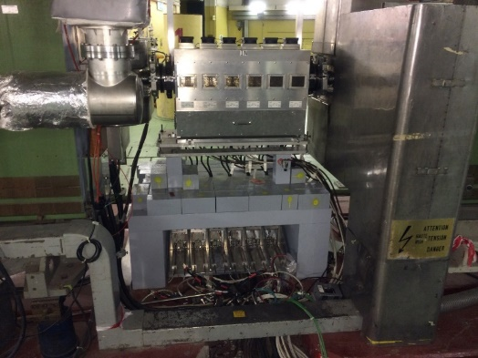
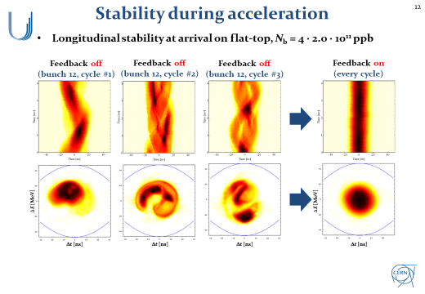
PS Damper for longitudinal instability
Longitudinal Coupled bunch instability at CERN PS causes emittance growth for LHC-type beam.
Wideband Damper system works for dipole mode.
H. Damerau
But, Qudarupole mode was observed at >2e11 ppb. Need to damp the mode by a Landau cavity.

Slide 12
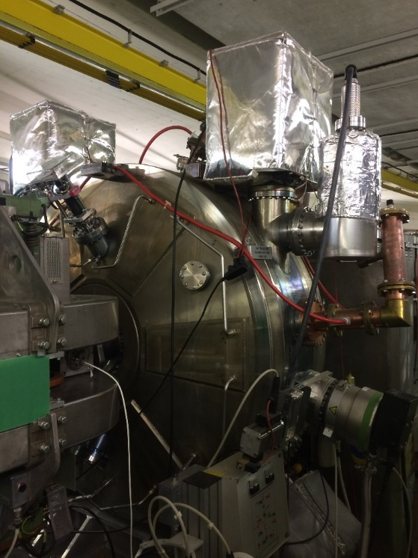
Landau cavity
Beam studies with a Landau cavity.
Existing 40 MHz cavity to damp Quadrupole Mode
H. Damerau
This year, reached 2.6 E11 ppb, 25 ns 72 bunches !

Slide 13
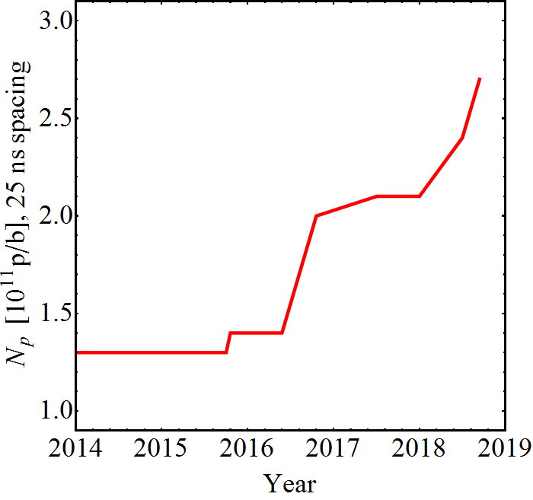
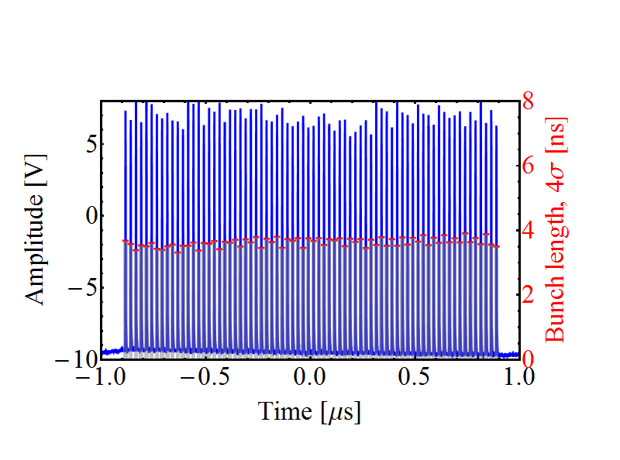
Intensity evolution (25 ns, 72 bunches)
Intensity per bunch at extraction
Multi-harmonic feedbacks
C40-78 as Landau RF system
LIU baseline
Suspected feedback saturation
Optimization 2017
Study WG started
Finemet dipole-mode
coupled-bunch feedback
Reach with C10-86/96 coupled-bunch feedback (2005)*
Bunch profile/length
*Intensities >1.3 ∙ 10¹¹ ppb were delivered <2016, but not with sufficient quality for LHC
Wealth of beam measurements at 2.6 ∙ 10¹¹ p/b (LIU intensity)
No more protons until end of 2020
H. Damerau

Slide 14
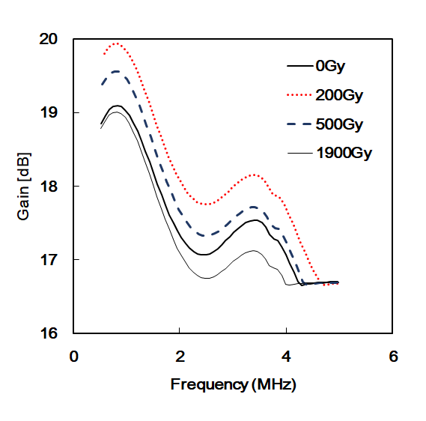
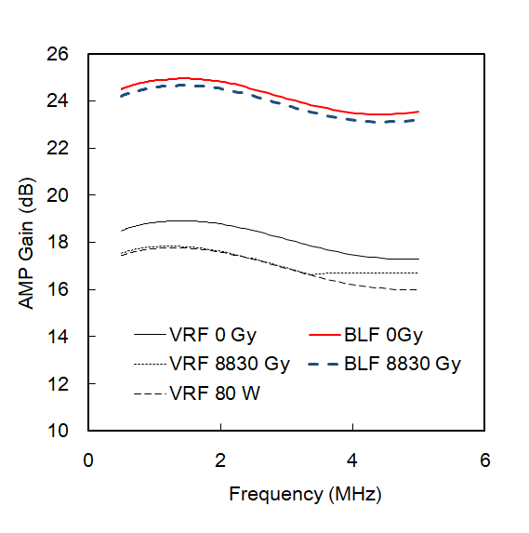
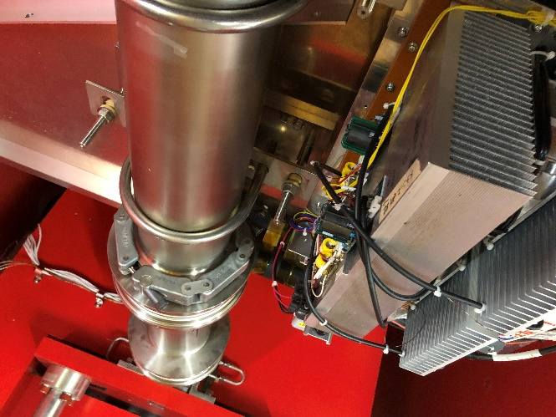
. Rad-Hard Solid-State Amplifier
To use many solid state amplifier in Accelerator Tunnel, Rad-Hard type is developed .
Control of bias point of each MOSFET improves life time.
We have tested the scheme at: 3 Co-60 facilities, J-PARC, CERN-CHARM, PSI
CHARM: 1.9 kGy mixed field- 100 years in PSB & QST-Takasaki (Co-60):8.8 kGy
Small gain change (~ 1dB)
Next Test at J-PARC for 10 kGy mixed field for 10 years in PS to improve feedback.
1.9 kGy mixed field
8.8 kGy gamma-ray
~1kGy/day in T2K run
>10 kGy mixed field at J-PARC
The results were submitted to IEEE TNS. The work is supported by KEK,CERN,JSPS-Kakenhi.

Slide 15
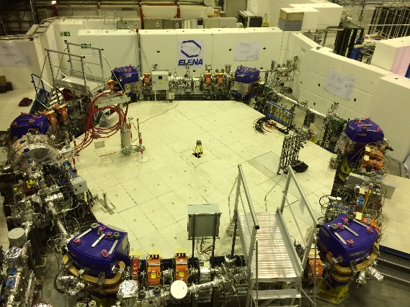
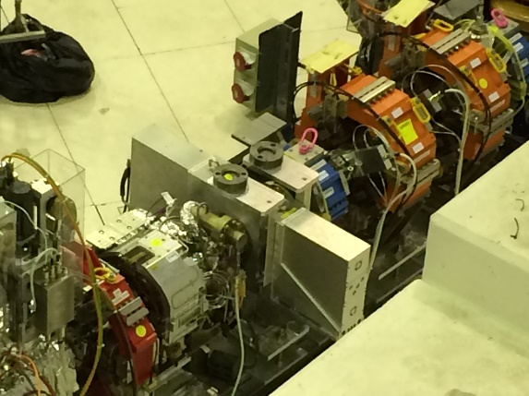
5. Benefits of Wideband Technology Success of $\overline{P}$ Deceleration
Maria Elena Angoletta
ELENA needs deceleration from 5.3 MeV to 100 keV !
Revolution Frequency :1.045 MHz to 144 kHz

Slide 16
40 MHz Wideband Cavity Technology Finemet®-base Landau Cavity R&D
M. paoluzzi
The test at CERN shows a good result.
Test cavity is under testing at KEK/J-PARC with the best MA cores.
40 MHz Cavity R&D may be useful for future applications.

Slide 17
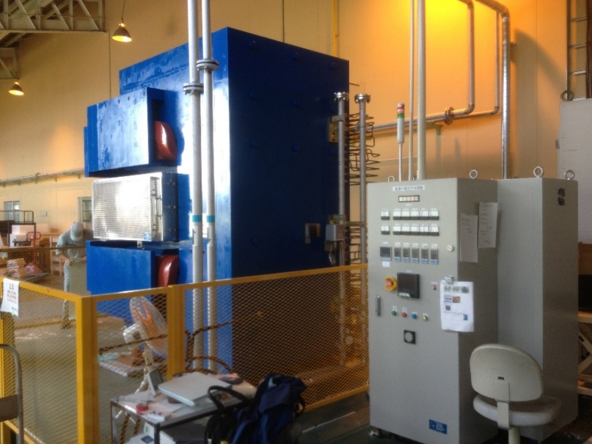
6. Technology Transfer and Contribution to Society
KEK/J-PARC has developed a large core production system- magnetic annealing oven in 2013.
The oven may be used to produce transformer cores for power supplies of transportation systems. KEK and Hitachi Metal Ltd. agreed to use the system and R&D has been started in 2018.
KEK-made Mag. Annealing oven
Wideband Cavity Technology will contribute to downsize transformers, to reduce power consumption and to Conservation of the global environment.

Slide 18
Comparison of material for transformer uses
Hitachi Metal Co.

Slide 19
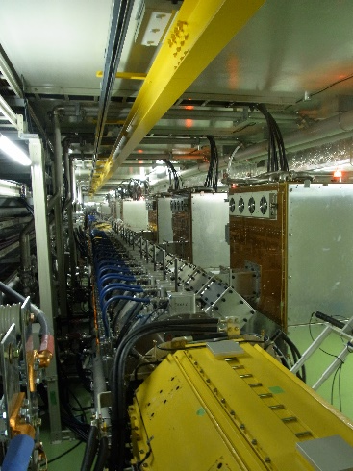
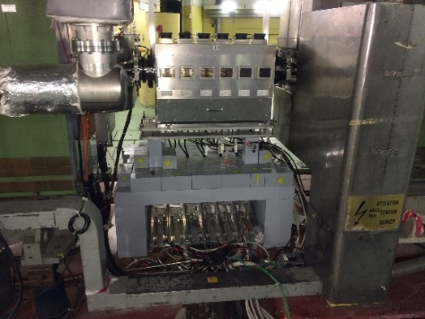
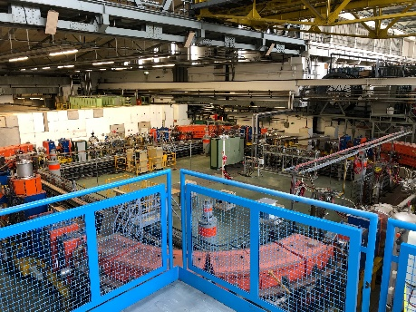
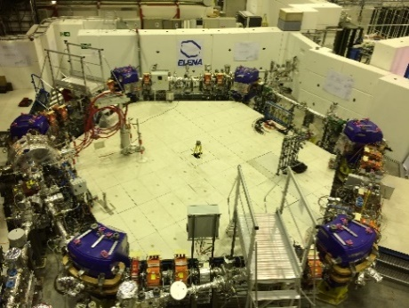
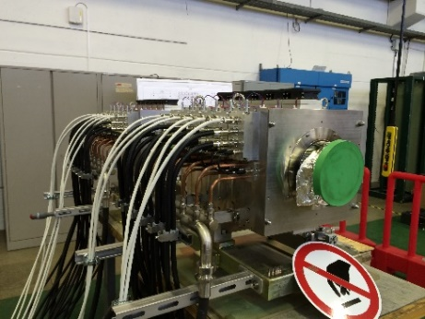
Wideband Cavity Technology is spreading !
Large Core Production
Magnetic Annealing
J-PARC PSB PS
LEIR ELENA Med-Autstron
Public Transportation

