Slide 1
Longitudinal Dynamics During Capture At Injection In Booster
C.Y. Tan, C. Bhat & V. Grzelak
US-Japan Collaboration Meeting 2019
19 March 2019

Slide 2
Booster Parameters
Circumference = 2PI x 75.47 meters
Injection energy = 400 Mev (kinetic)
Extraction energy = 8 Gev (kinetic)
Cycle time = 1/15 sec
Harmonic number, h = 84
Transition gamma = 5.45
Injection Frequency = 37.77 Mhz
Extraction Frequency = 52.81 Mhz
Maximum RF voltage = 0.86 MV
Longitudinal emittance = 0.25 eV sec
Horizontal Beta Max = 33.7 meters
Vertical Beta max = 20.5 meters
Maximum dispersion = 3.2 meters
Tune vx = vy = 6.7
Transverse emittance(normalized) = 12PI mm mrad
Bend magnet length = 2.9 meters
Standard cell length = 19.76 meters
Bend magnets per cell = 4
Bend magnets total = 96
Typical intensity = 4.5e12
Phase advance per cell = 96 degs
Cell type = FOFDOOD (DOODFOF)

Slide 3
Goals
PIP goals have been met. We have 4.5e12 ppp at extraction to get 730 kW > 700 kW goal.
PIP1+ goal is to have 900 kW beam. This means that we need to have 5e12 ppp at extraction.
  One limitation are the losses at injection and transition.
  We have to limit the losses to about 500 W in Booster.
  We will concentrate on fixing the losses at injection in this talk
    We spent a year looking closely at transverse dynamics and have found from both measurements and simulations that the major part of the loss does not come from transverse dynamics.
    We started looking at longitudinal dynamics.

Slide 4
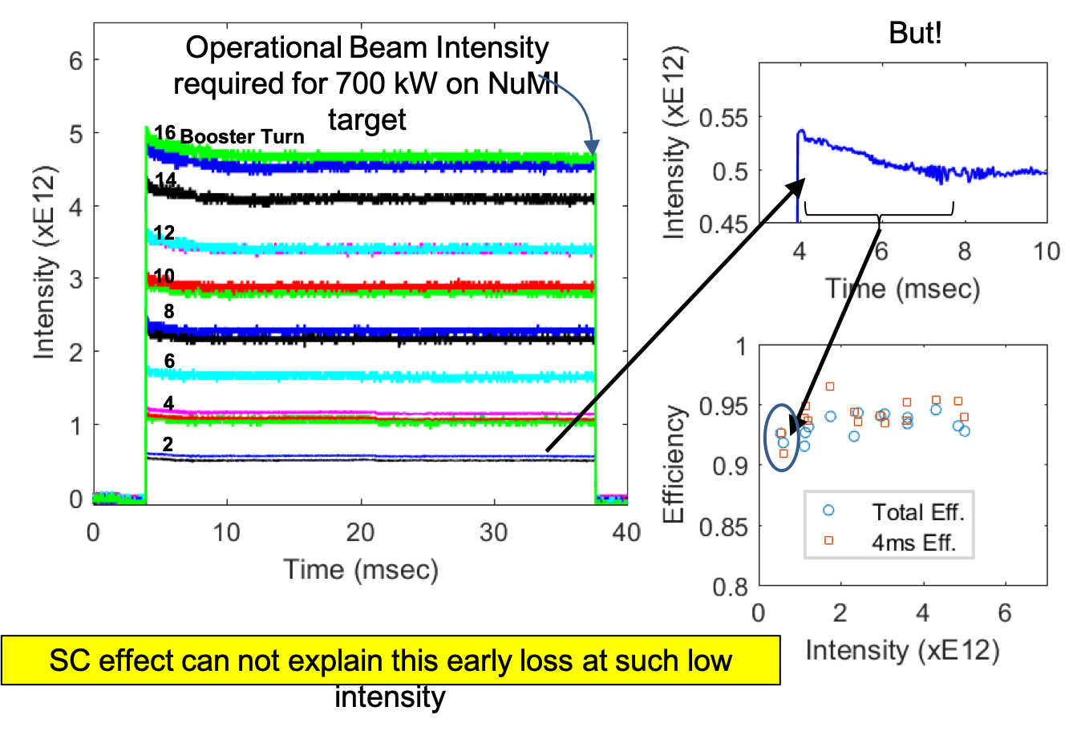
Why is there any injection capture losses?
Simulations say that we should have 100% capture efficiency!
After the RF phase error discovery and fix, we believe that there is still something odd going on with either the LLRF or the HLRF.
  Space charge is *not* the problem.
Our work with simulations in transverse and longitudinal and measurements show that SC is not the problem. It is something else

Slide 5
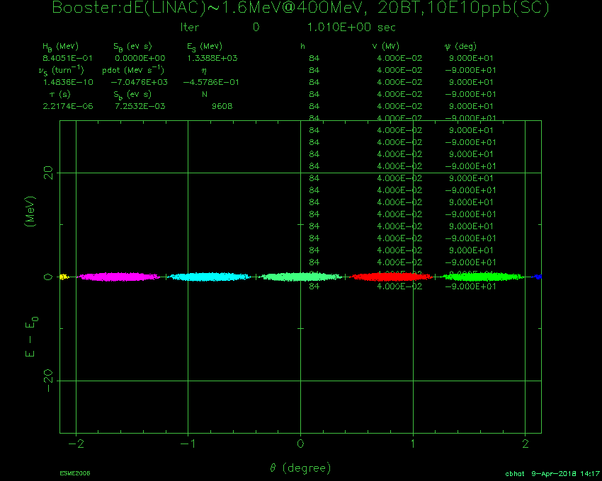
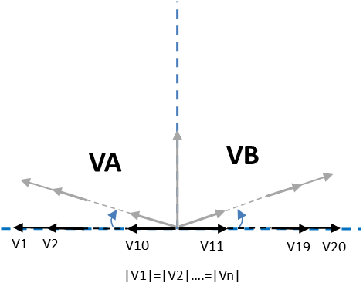
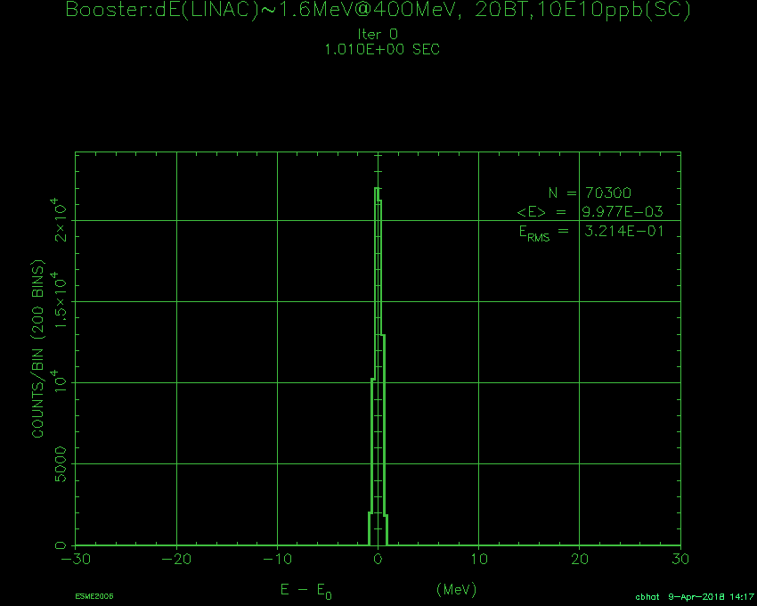
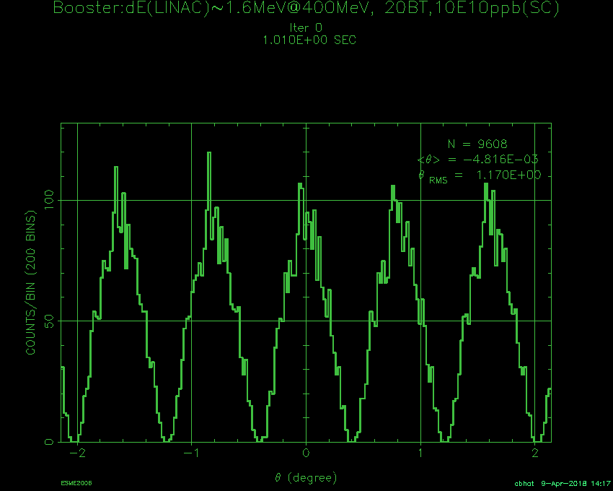
Paraphasing
30
Vrf=0 @ Injection
ΔE Dist.
ΔE-Δt Phase space (8.2E12ppc)
Vrf during
Capture
ΔE (MeV)
0
ΔE@Inj
= 1.5 MeV
-30
Line-Charge Dist.
Simulations suggest
one can achieve <20% emittance growth during capture.
ε_{L}@Exit ~0.06 eVs (95%)
No particle losses
σ_{E} @Exit< 2.75 MeV
-2
0
2
Azimuthal Angle(deg)

Slide 6
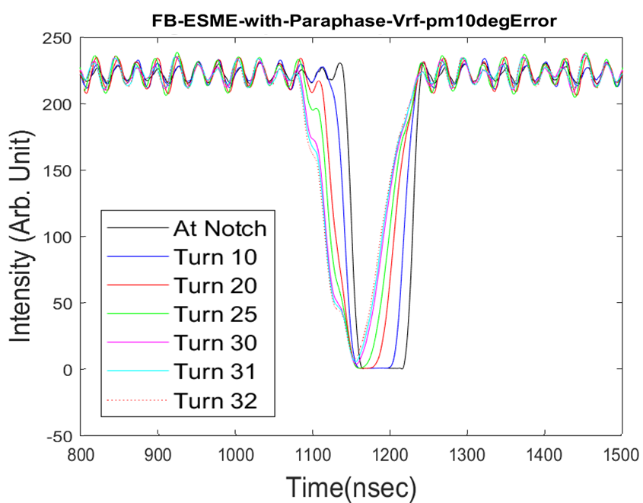
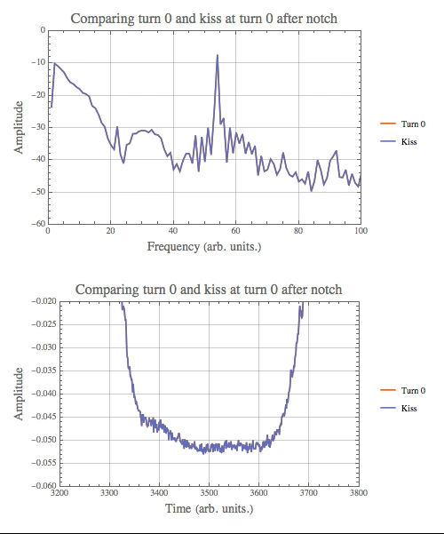
Longitudinal phase cleanup
For adiabatic capture, require essentially 0 volts at the beginning. However, measurements show asymmetric fill of the notch.
ESME simulations show the same effect if the RF stations are not phased correctly. Required large errors > 5 deg!

Slide 7
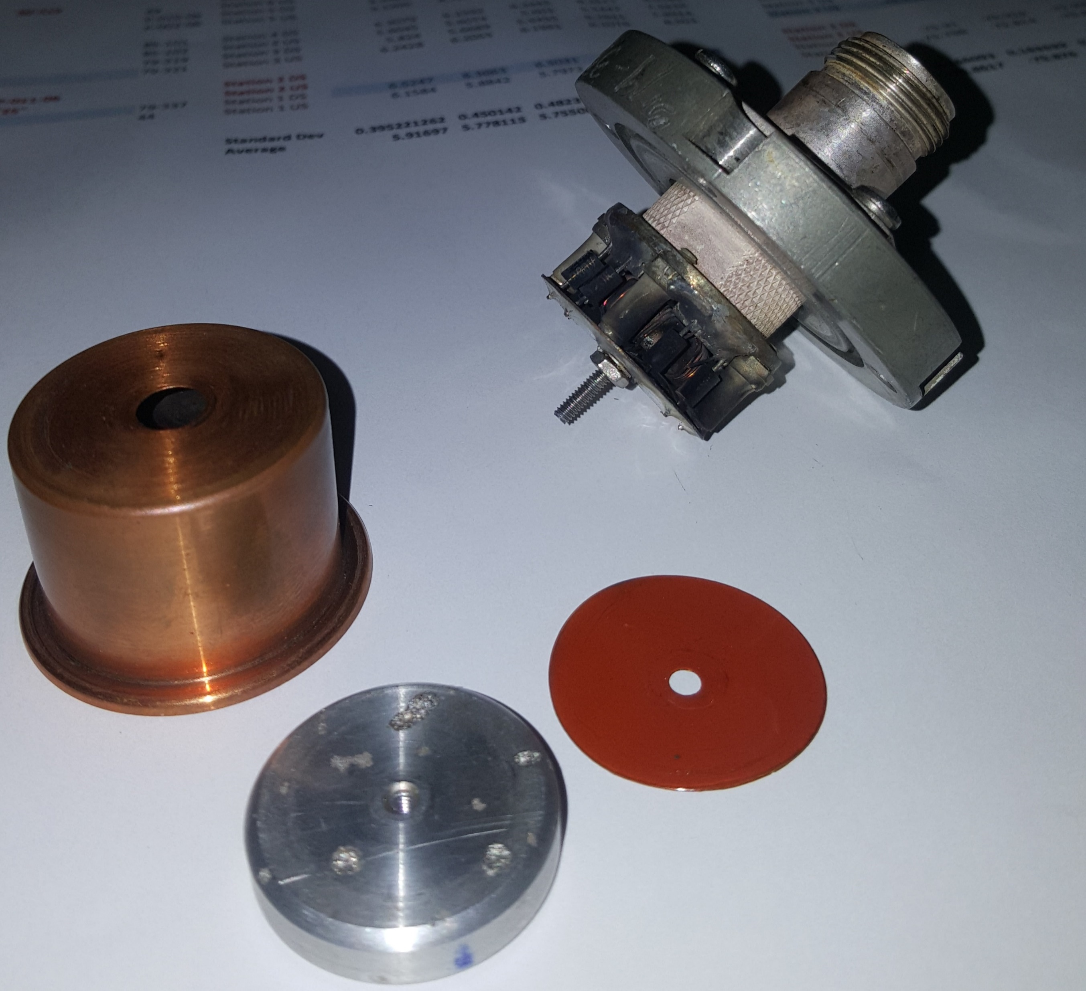
Measured results
Verdict: Yes there were large errors exactly where we said they were.
Blown gap monitor in station 9
Delay errors fixed!

Slide 8
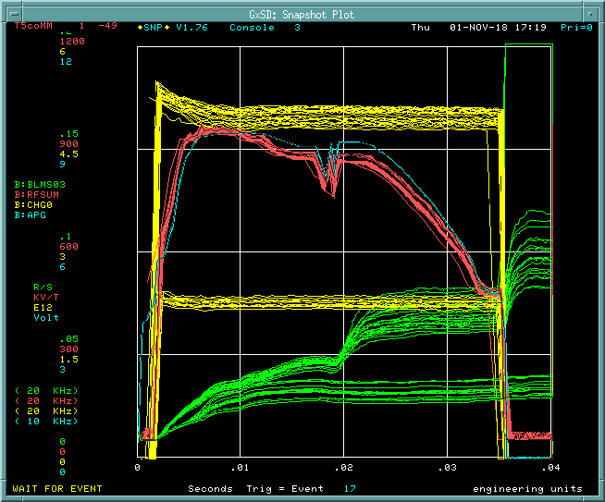
Improvements from fix
Replacing one Booster station with another does not require a lot of tuning any more – good for operations!
However did not see any improvement at injection ☹
What else is going on?
  LLRF?
  HLRF?
Two pronged attack
  This talk will concentrate on HLRF

Slide 9
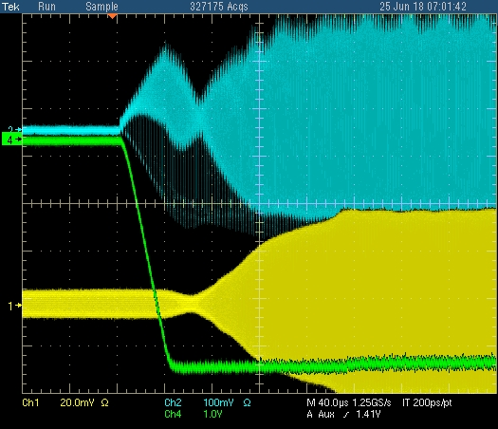
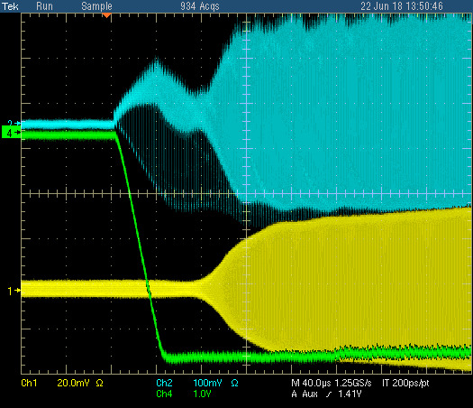
Neck … why does it even exist?
Resistive wall
Quad oscillations still remain. Have to tune this out!
neck
RF sum
CH0
Normal HEP with 20 stations.
Clearly a neck that comes from paraphrasing going to zero *after* the beam is captured, i.e. there is a re-capture!
neck is gone! (Bill’s curve)
However quadrupole oscillations remain.
Capture efficiency is worse!

Slide 10
Why worry about the neck?
It is very peculiar
  There is no reason why the neck is there.
  We have tried tuning out the neck, but empirically, the losses with the neck is smaller than losses with the neck.
  Our simulations show that adiabatic capture is very robust and *none* of them require a neck.
    In fact, for the dE ~ 1.5 MeV (95%) that we have, we should have 100% capture!
    BUT we don’t!
  Without understanding why there is a neck, we cannot proceed to figuring out how to fix injection problems.
    Many explanations have been given:
      Microbunching?
      Space charge?

Slide 11
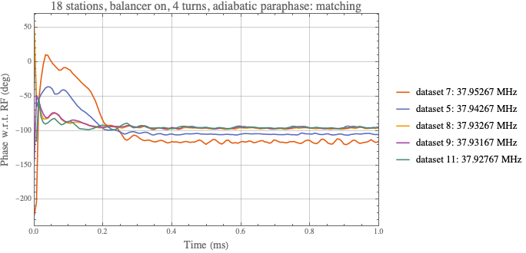
DC ramp to the rescue
We go into DC ramp mode
  This means that Booster does not ramp and sits at 400 MeV.
  In this mode, we get rid of the complexities of the ramp and feedback systems.
    Both phase and radial feedback systems are off.
We measured the phase of the injected beam w.r.t. the RF and found that there is a phase slip.
This phase slip tells us that the injected beam has an energy error which is small compared to 400 MeV (< 5 MeV)
For this experiment we corrected the phase slip by changing the RF frequency.
Chandra noticed the slip. This is an important discovery! It opens up a simple explanation for the neck!

Slide 12
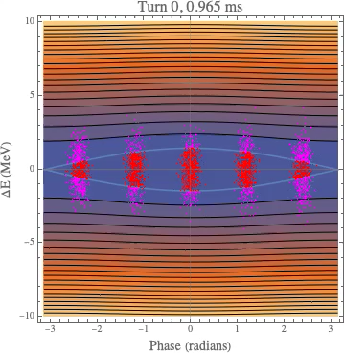
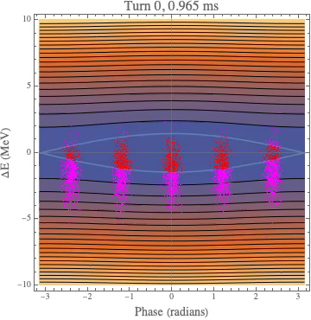

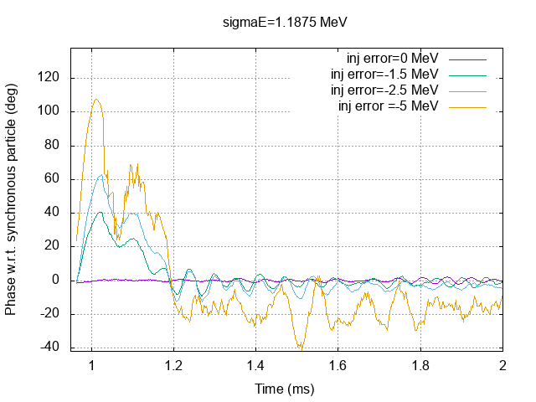
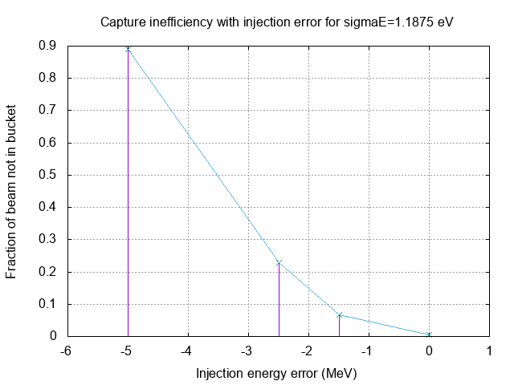
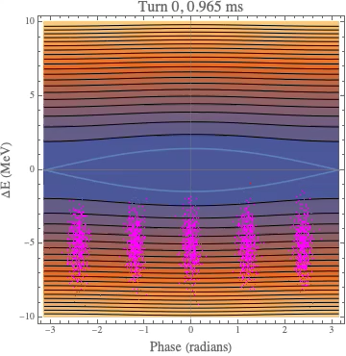
We can reproduce the results (σE = 1.875 MeV ) with simple simulations!
No injection energy error
Injection error = -1.5 MeV
Injection error = -2.5 MeV
Injection error=-5 MeV
The phase slip is qualitatively similar. It took 200 μs for the measured data and also in this sim to get to equilibrium. But this is probably dependent on the actual paraphase curve.

Slide 13
Comparison with measured data
The behavior between simulations and measurements are similar. I’m not sure that the beam loss is similar or not because we cannot distinguish captured/uncaptured beam in the measurements. (See previous slide) Even the double hump structure during phase slip is seen in the simulation!
Time scale and shape for phase slip is probably dependent on the paraphase curve. In this case they look very similar to the measurements although I’m not using the actual paraphase curve during DC studies.

Slide 14
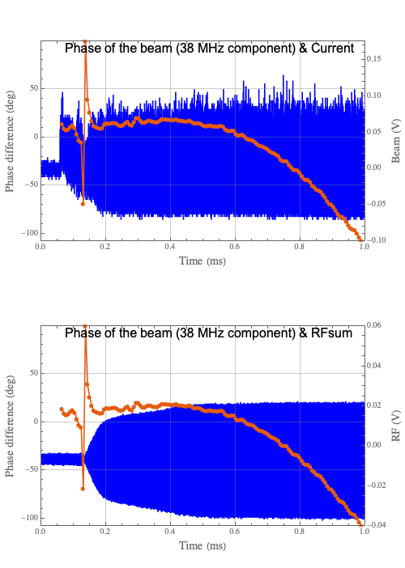
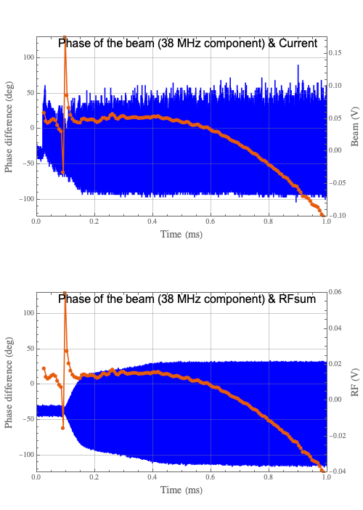
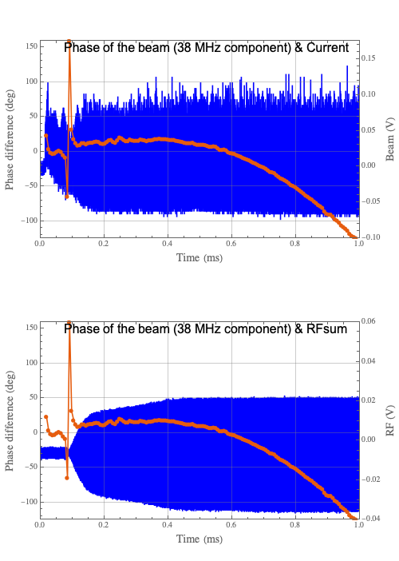
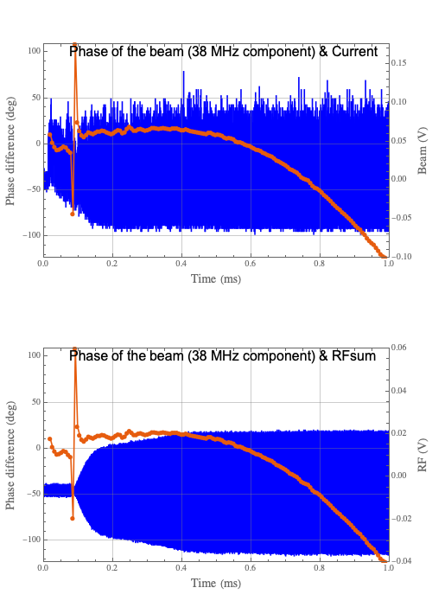
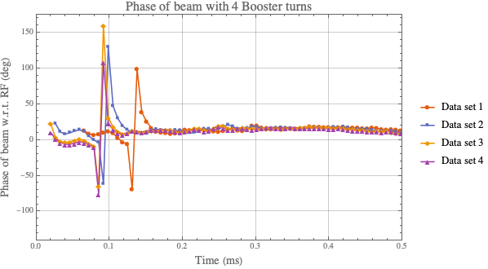
HEP ramp with 4 turns (flat injection)
1
2
3
4
Jitter where notch occurs.
76 us

Slide 15
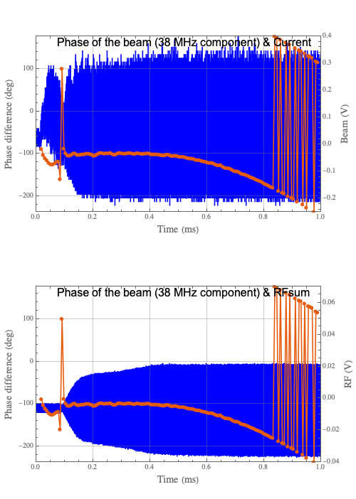
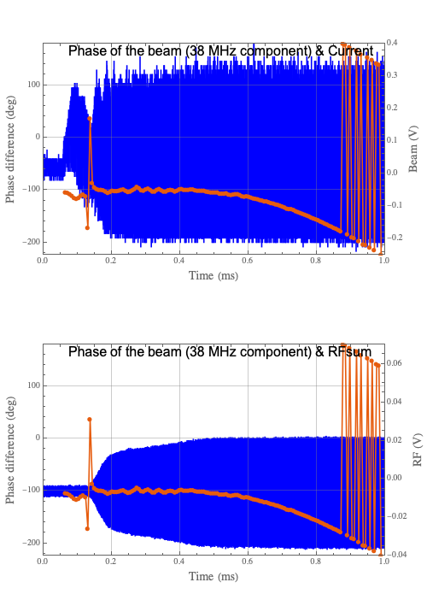
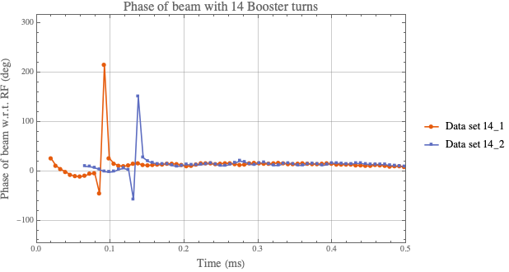
14 turn HEP data (flat injection)
Notice that the phase jump does not occur at the same spot! I think, this means that the neck is not at the same spot as well.
The 2 peaks are 76 us apart

Slide 16
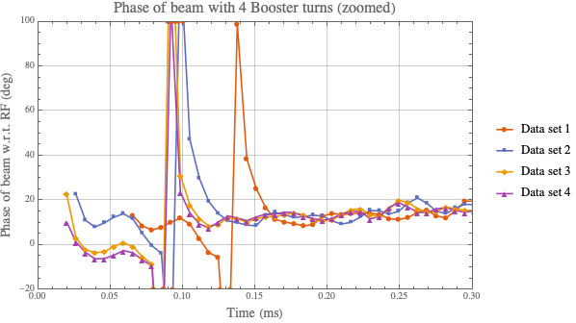
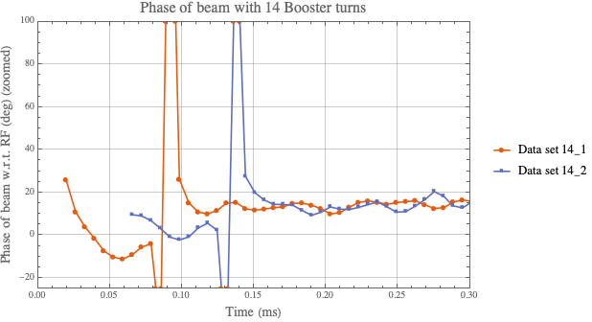
Zoomed in view of phase slipping and settling
There seems to be a phase slip of between 20 – 30 deg for 4 turns injection. May be larger before the beam is bunched which I cannot measure.
It is interesting to see that after the neck the phase jumps back up to 20 deg and there is a small slope as well. But this could be due to the ramp because flat injection is done.
For 14 turns, only one data set is good, which shows maybe 20 – 30 deg phase slip. However, it settles to the same phase after the neck. And there is a small slope as well.
30 deg
20 deg
40 deg
For 14 turns, phase slip of about 20 to 30 deg.
30 deg

Slide 17
Finally, we have a simple hypothesis for the neck
Beam has wrong energy and wants to be at a different radius compared to the RF.
Beam then phase slips to match the RF.
There’s beam outside the buckets.
To improve capture, we have to debunch the beam to redo adiabatic capture. ⟵ This is the reason for the neck!
Simulations are still preliminary, (not quite right yet) we just thought up this hypothesis last week.

Slide 18
Study plan
Check to see if we can match energy from Linac either by changing incoming beam energy or the dipole field of Booster.
  We have to change RF frequency.
However, if we change the RF frequency, we have to make sure that the radial position is put back to its HEP position.
  Note RPOS will not see phase slip because it only sees 38 MHz component and thus cannot see any phase slips.
We will test this out during studies on Wednesday (20 March).

Slide 19
Backup slides

Slide 20
Timing and curves during normal HEP

