Slide 1
RCS collaboration
US-Japan Meeting on Accelerators and Beam Equipment for High-Intensity Neutrino Beams
Kazami Yamamoto
Accelerator Division
Japan Atomic Energy Agency (JAEA)

Slide 2
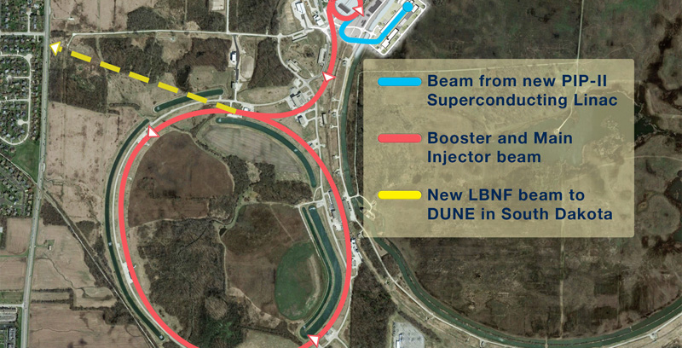

Slide 3
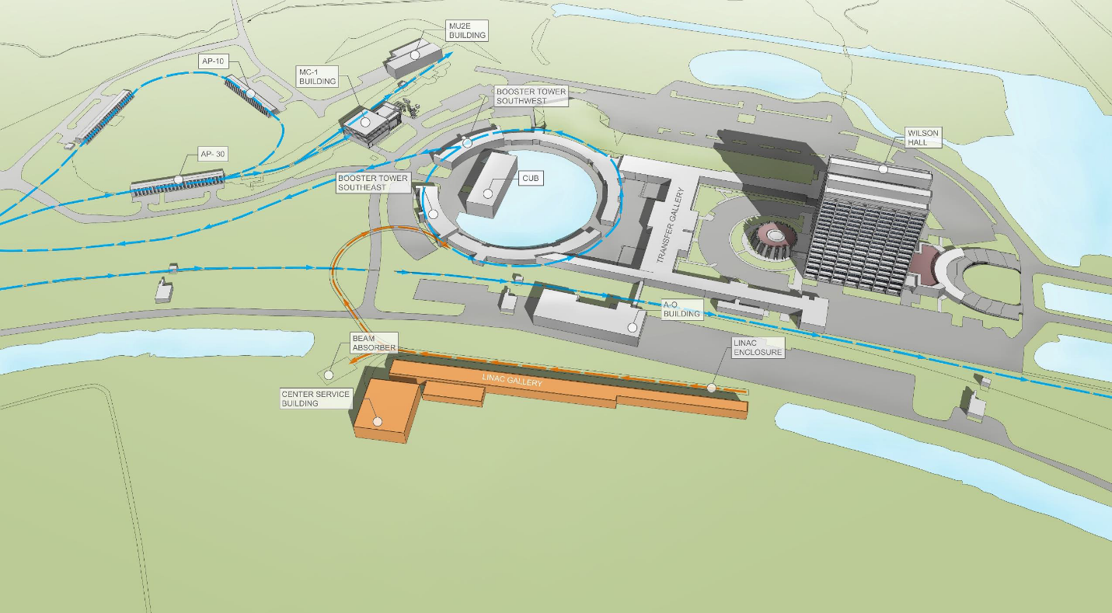

Slide 4
Project Title: Fermilab – Japan parametrization of a high intensity rapid cycling synchrotron RCS (PIP III) Doc Beams-doc-7097-v1
US Principal Investigator CY Tan and Japan Principal Investigator Michikazu Kinsho Investigators: Fermilab members: Dr. Chandra Bhat, Dr. Kiyomi Seyia, William Pellico Japan members: Michikazu Kinsho Deputy Leader of Accelerator Division Hideaki Hotchi: Beam commissioning leader of J-PARC RCS/Senior Researcher Hiroyuki Harada: Beam commissioning expert of the RCS/Deputy Chief Researcher
Abstract: Fermilab, for the past 10+ years, has been planning the next stage of the laboratory's and our nation’s HEP accelerator(s). The focus on the accelerator side of the planning has focused mainly upon upgrading the 15 Hz (50-year-old) normal conducting 400 MeV Linac to a 20 Hz SRF Linac capable of being upgraded to CW operations. The present plan is a staged upgrade with the first stage having a new SRF linac inject 800 MeV (PIP2) [4] into the 50+ year old 15 Hz Booster modified to operate at 20 Hz. The next stage would be to replace the Booster with a new RCS capable of reaching MW Neutrino beam powers. In recent discussions, this new RCS is often referred to as PIP3. Neither viability or significant power above 1.2 MW can be expected with the present Booster. However, at this point we have no concept or defined parameters for such important piece of our future. Project Description: The first stage of our accelerator upgrades PIP2 has a goal to deliver 1.2 MW of beam power to our flagship neutrino program LBNF/DUNE. The present plan is run at this power for 3 to 5 years or until the new RCS is operating. Figure 1 below gives an estimated timeline based upon recent PIP2 and LBNF discussions. Figure 1 Present Beam and Power Timeline
Without slip stacking in the Recycler, the new RCS will have to deliver significantly higher pulse intensities at 20 Hz. Fermilab and the nations HEP program is assuming the following three significant assumptions: 1)The Booster, 60 years old when the new RLS comes on line, will remain viable till 2030.[1] 2) The design, approval process, building and commissioning the new RCS will be done by 2030. 3) A design for the new RCS to meet the constraints/parameters required for MW operations can be accomplished. Looking at recent efforts, the process of designing, approval process, funding, building and then commissioning an accelerator, ten years is not a lot of time.

Slide 5
Item | Booster | RCS
RF Power | 1.2 MW | ~ 6MW
RF Cavity design | Standard parallel 2 gap 50 KV | ?
Lattice | FOFDOOD Semi-periodic H=84 | Periodic H= 94?..... Longer straights?
Gamma | 5.2 GeV | 10 GeV?
Injection/extraction | 400 MeV - 8 GeV 800 MeV – 8 GeV | ?
Magnets | Combined Function | ?
Mechanical Sys Vacuum, beam pipe | No beam Pipe | ?

Slide 6
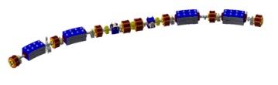
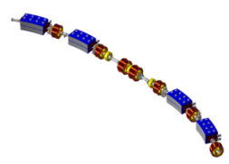
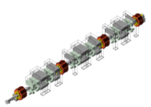
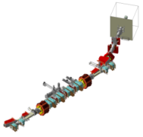
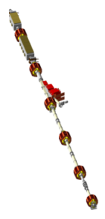
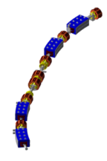
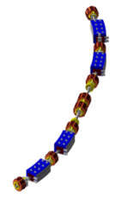
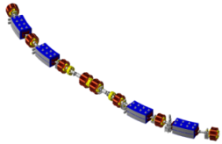
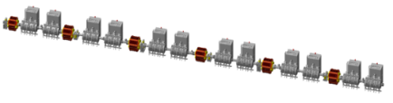

3GeV-RCS in J-PARC
The beams are extracted by kicker magnets and DC septum magnets at the extraction section and then transported either to MLF or to MR with a pulsed bending magnet placed in the 3NBT line.
Design parameters
Circumference | 348.333 m
Superperiodicity | 3
Harmonic number | 2
No of bunch | 2
Injection energy | 400 MeV
Extraction energy | 3 GeV
Repetition rate | 25 Hz
Particles per pulse | 8.3e13 with 1 MW
Output beam power | 0.5 MW (1 MW)
Transition gamma | 9.14
Number of dipoles | 24
quadrupoles | 60 (7 families)
sextupoles | 18 (3 families)
steerings | 52
RF cavities | 12
The H0 dump is used to dump unstripped beams at the stripping foil. The capacity is 4kW.
The stripping foil in the injection section is used to convert H- beam from the linac into protons.
H0 Dump
(4 kW)
1st arc
section
Beam
Collimator
Extraction
section
from
LINAC
Foil
Injection
section
RCS has a three-fold symmetric lattice
whose circumference is 348.3m.
to
MR&MLF
3rd arc
section
2nd arc
section
RF section
One of the three-fold symmetric lattice comprises two arc modules and a long straight insertion.
Each arc module has a missing-bend cell.

Slide 7


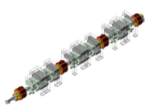
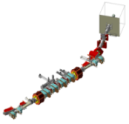
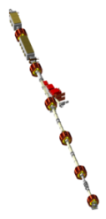



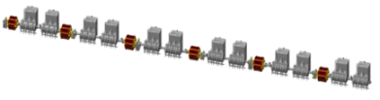

Concept of the lattice design
We have chosen the lattice with three-folding symmetry in order to keep three long straight sections.
  One is dedicated to the long RF acceleration section, which should be isolated from the other straight sections;
  One for the injection and collimation, and the other for the extraction, both of which will be radioactive.
The circumference of the RCS is limited.
  One is the beam pulse length of less than 1μs for the neutron production,
  The other is the circumference of the MR. The ratio of those circumferences should be the rational number.(2/9)
1st arc
section
Beam
Collimator
Foil
Extraction
section
Injection
section
3rd arc
section
RF section
2nd arc
section
Loss localization in the collimator to achieve 1 W/m criteria.
Keep enough Acceptance
->Large aperture magnet
Painting 216 π mm-mrad
Collimation 324 π mm-mrad
Physical Aperture >486 π mm-mrad

Slide 8
Concept of the lattice design
-reduction of the uncontrolled loss-
Large painting injection to mitigate space charge effect.
The transition gamma is chosen enough high value than the operation gamma. In this case it is 9.14 and 4.2
  The beam loss inherent to the transition crossing will be thus avoided.
The straight sections are made dispersion free in order to avoid the synchro-betatron coupling.
Bunch to Bucket injection to avoid loss adiabatic capture process.
In the former ISIS synchrotron case, the acceptance of the extraction beam line was smaller than the ring collimator acceptance. Such situation made large amount loss at the extraction line.
  Secure the same acceptance by the extraction beam line and the ring collimator(324 πmm-mrad). same acceptance is kept to the neutron target in MLF
  However, due to the budget, transport line to MR could not secured same acceptance. It has only the acceptance of 84 πmm-mrad. (this value corresponds to the emittance after damping of 324 πmm-mrad.)

Slide 9
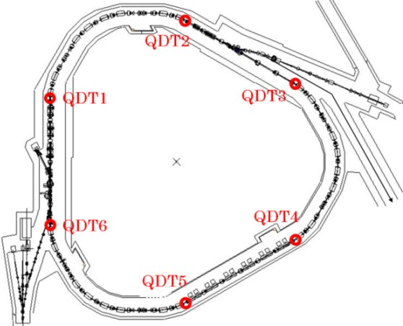
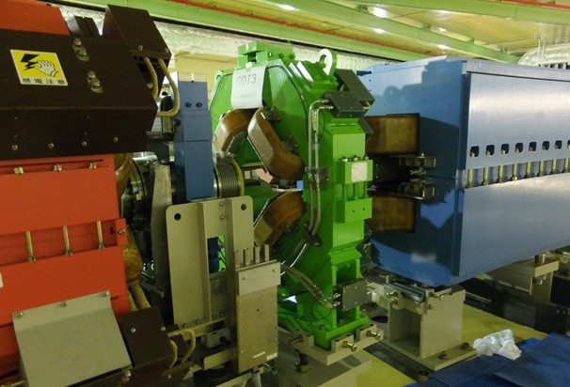
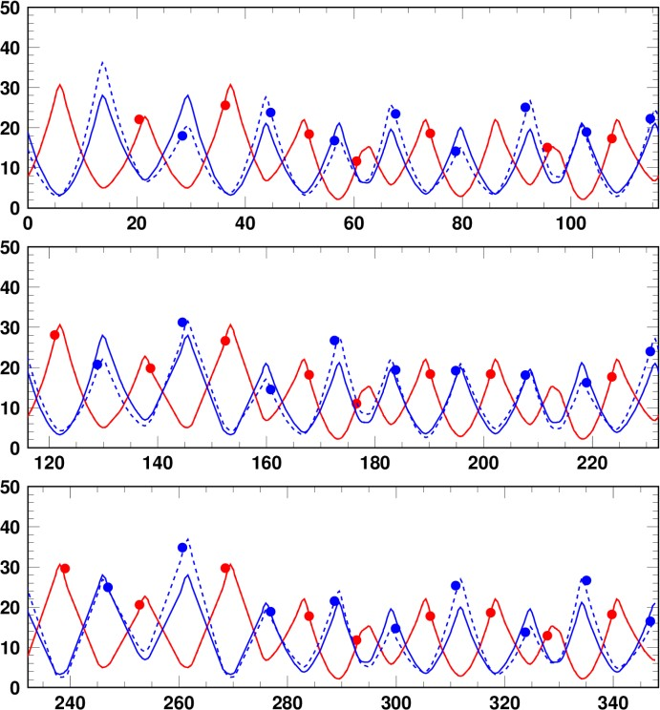
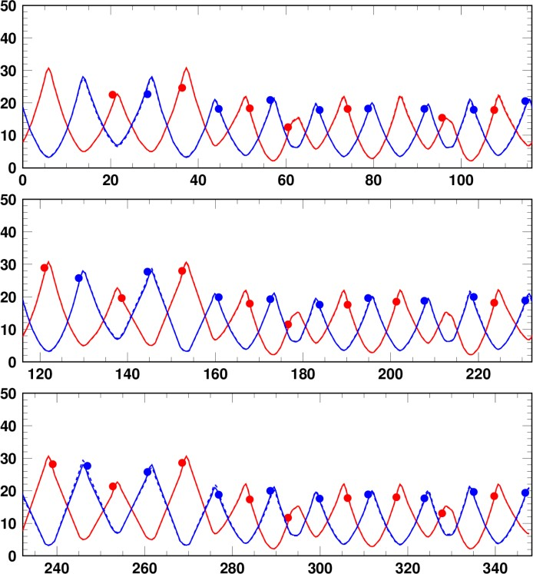
Correction of beta function beating
We have recently installed 6 sets of pulse type quadrupole correctors (QDTs),
to compensate beta function beating, by which the effect of the random resonances can be minimized through the recovery of the super-periodic condition.
QDT
Beta function beating correction by the quadrupole correctors
Before correction After correction
1st super-period
Vertical beta function beating was successfully corrected by QDTs, while keeping the super- periodic condition
on the horizontal plane.
Beta functions (m)
Beta functions (m)
2nd super-period
3rd super-period
s (m)
s (m)

Slide 10
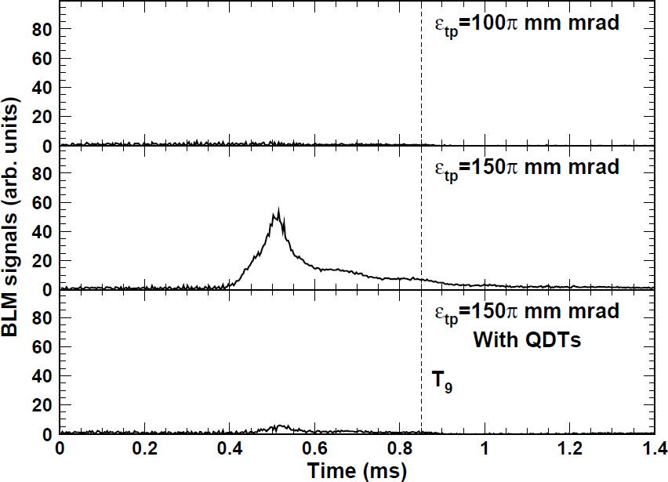
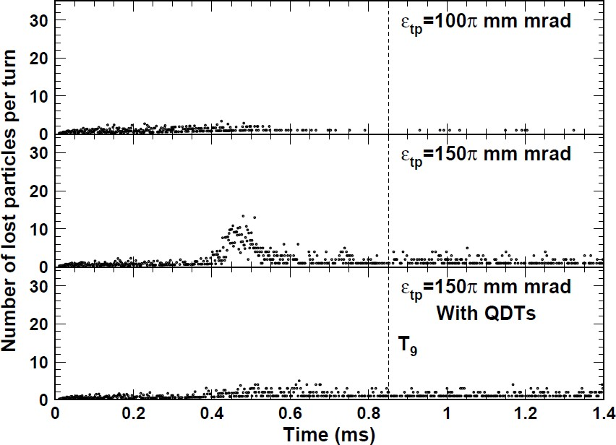
Measurements vs Numerical simulations
Measurements
(BLM signals at the collimator section)  Numerical simulations
“Correlated painting”
The experimental results were well reproduced by numerical simulations.
We investigated more detailed beam loss mechanism using the numerical simulation results.

Slide 11
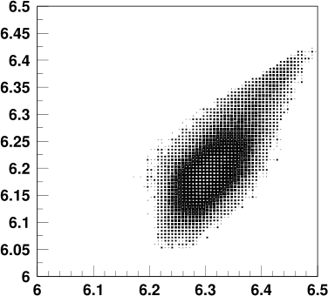
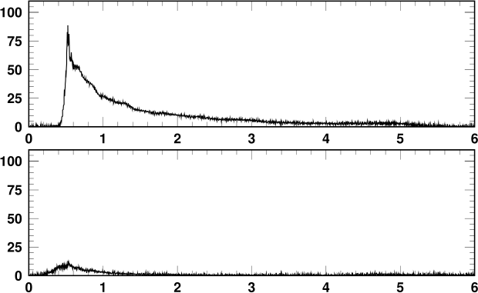

1-MW beam test in 2016
BLM signals @ collimator
Tune footprint @ injection
ν_{x}+2ν_{y}=19
Measurement
Loss ~1.81%
Correlated painting (ε_{tp}=200π mm mrad)
With edge focus corr. by QDTs
Sextupole magnets : off
Vertical tune ν_{y}
BLM signals (arb.)
2ν_{x}-2ν_{y}=0
Anti-correlated painting (ε_{tp}=200π mm mrad)
With edge focus corr. by QDTs
Sextupole magnets : off
(6.45, 6.38)
Loss ~0.25%
BLM HV=-300V
Horizontal tune ν_{x}
Time (ms)
Issues in realizing a large transverse painting were ν_{x}+2ν_{y}=19 and 2ν_{x}−2ν_{y}=0; they cause a shrinkage of the dynamic aperture and make additional beam loss when the transverse painting area is enlarged to ε_{tp}>100π mm mrad.
By minimizing the effects of ν_{x}+2ν_{y}=19 and 2ν_{x}−2ν_{y}=0,
the transverse painting area was successfully expanded to 200π mm mrad.
We achieved a 1-MW beam acceleration with a very small beam loss of a couple of 10⁻³. Loss: ~0.25% at ~400 MeV ⇒ 333 W ・・・ Small, but not negligible for machine activation
We tried further beam loss mitigation.
11

Slide 12
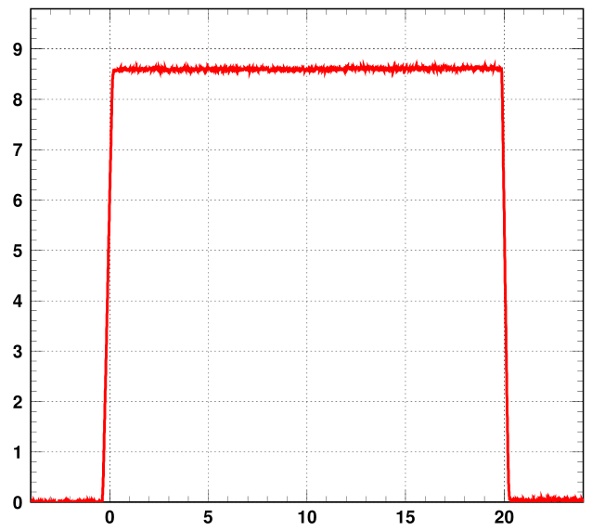
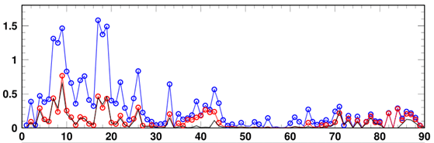
1-MW 1-hr continuous operation
Courtesy : H. Hotchi
BLM signals before and after beam commissioning
（Before:blue⇒after:red）
Amount of loss << 1%
-> almost same as 400 kW
(Black line), 1 bunch operation
Beam current
Collimator
Arc
Extr.
Arc
RF
Arc
Inj.
H0
dump
Injection
Extraction
Beam loss signals at commissioning
Particles/pulse
BLM signal (arb.)
Reflection from 3N dump
Time (ms)
No significant loss
BLM IDs
12

Slide 13
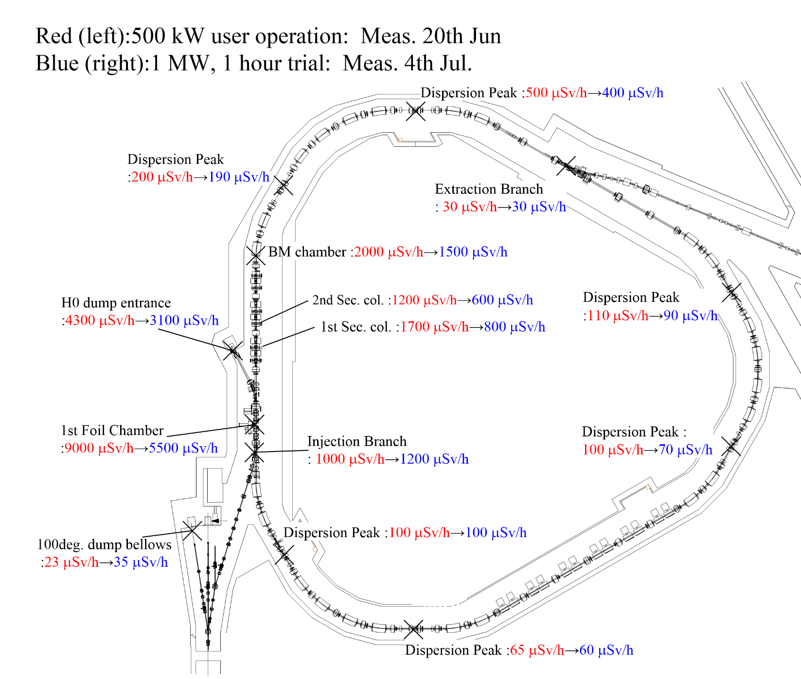
1-MW 1-hr continuous operation： Residual dose
There were no significant changes before and after 1 MW operation.

Slide 14
Summary
We have just started corroboration.
We will continue to study new RCS.

