Slide 1
Ion Profile Monitor 10kV Proposed Switch Design
Greg Saewert
US-Japan Meeting: Equipment for High-Intensity Neutrino Beams
21/03/2019

Slide 2
Topics
IPMs at Fermilab
IPM high voltage switch requirements
Proposed switch design

Slide 3
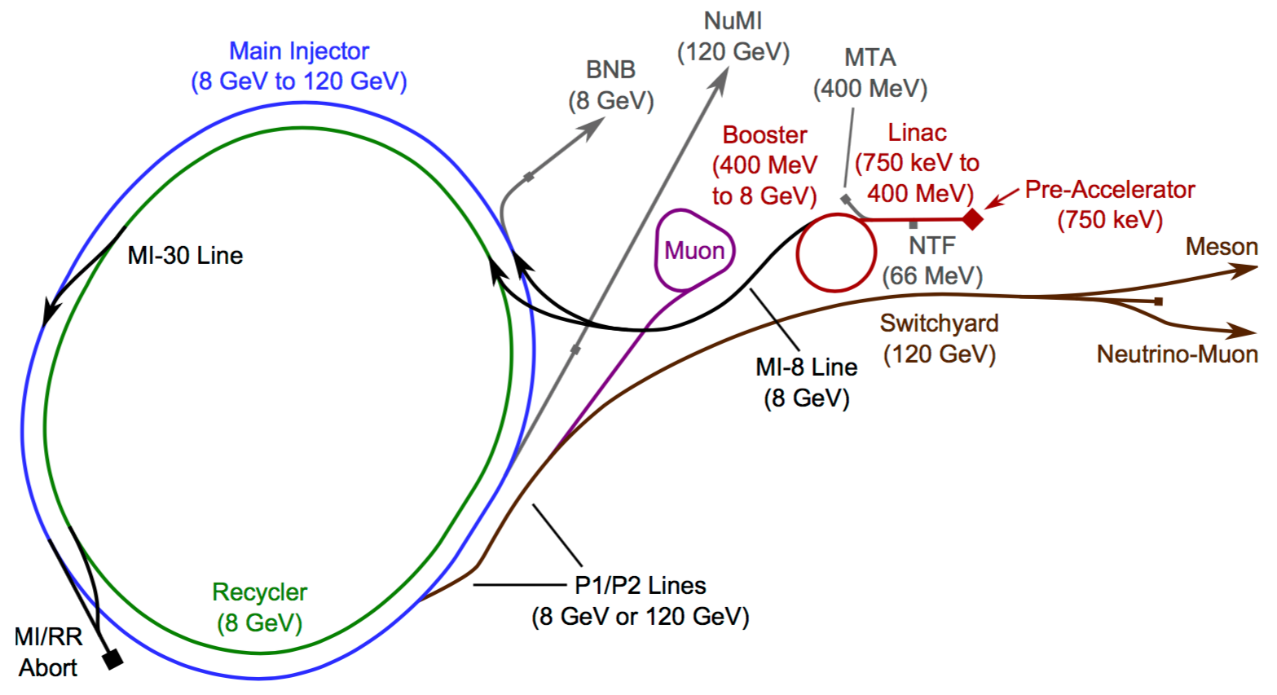
FNAL Accelerator Complex
g-2
Mu2e
Main Injector and Recycler IPM’s (4)
Booster IPM’s (4)

Slide 4
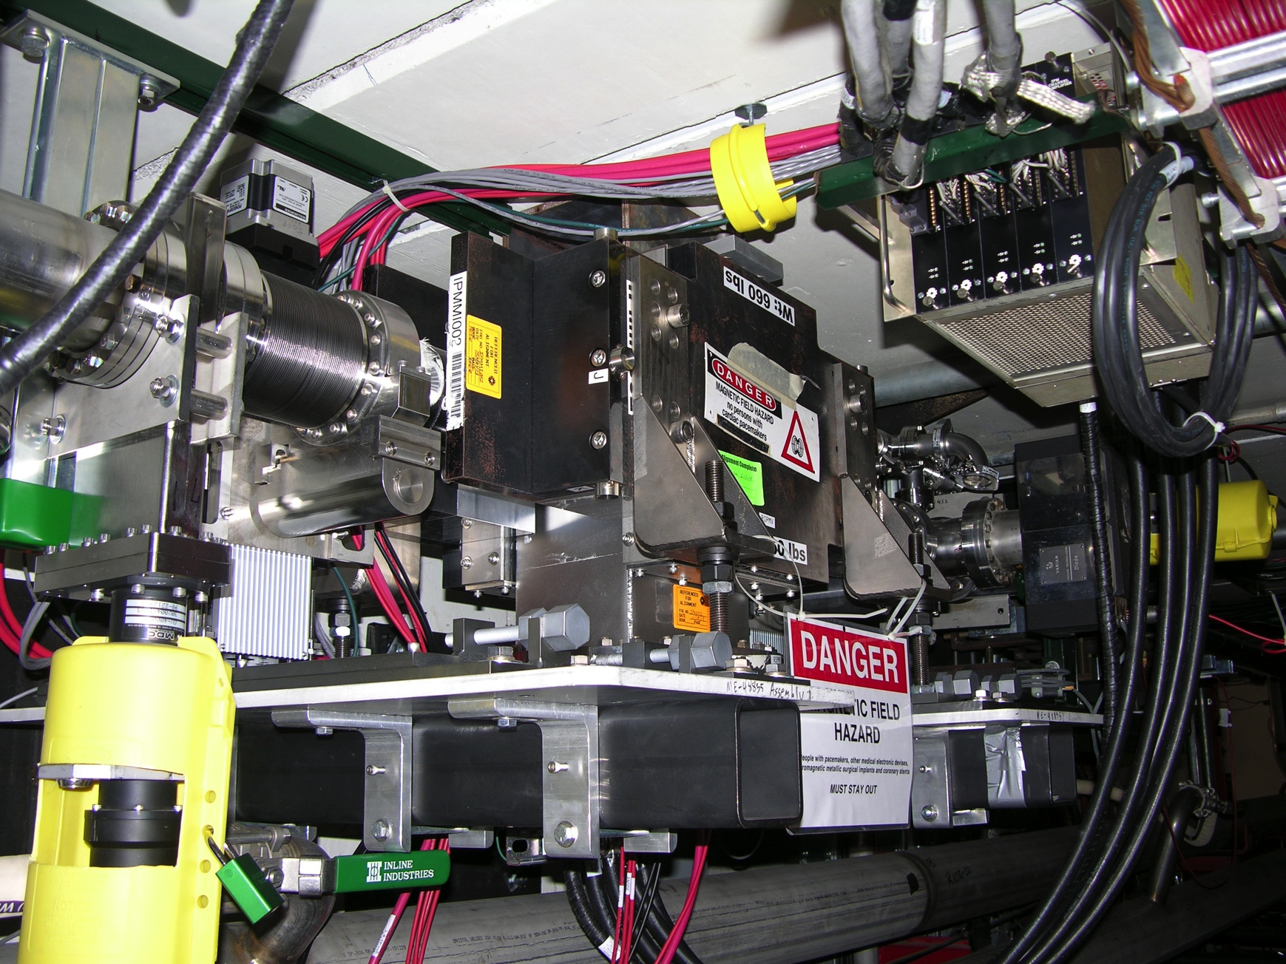
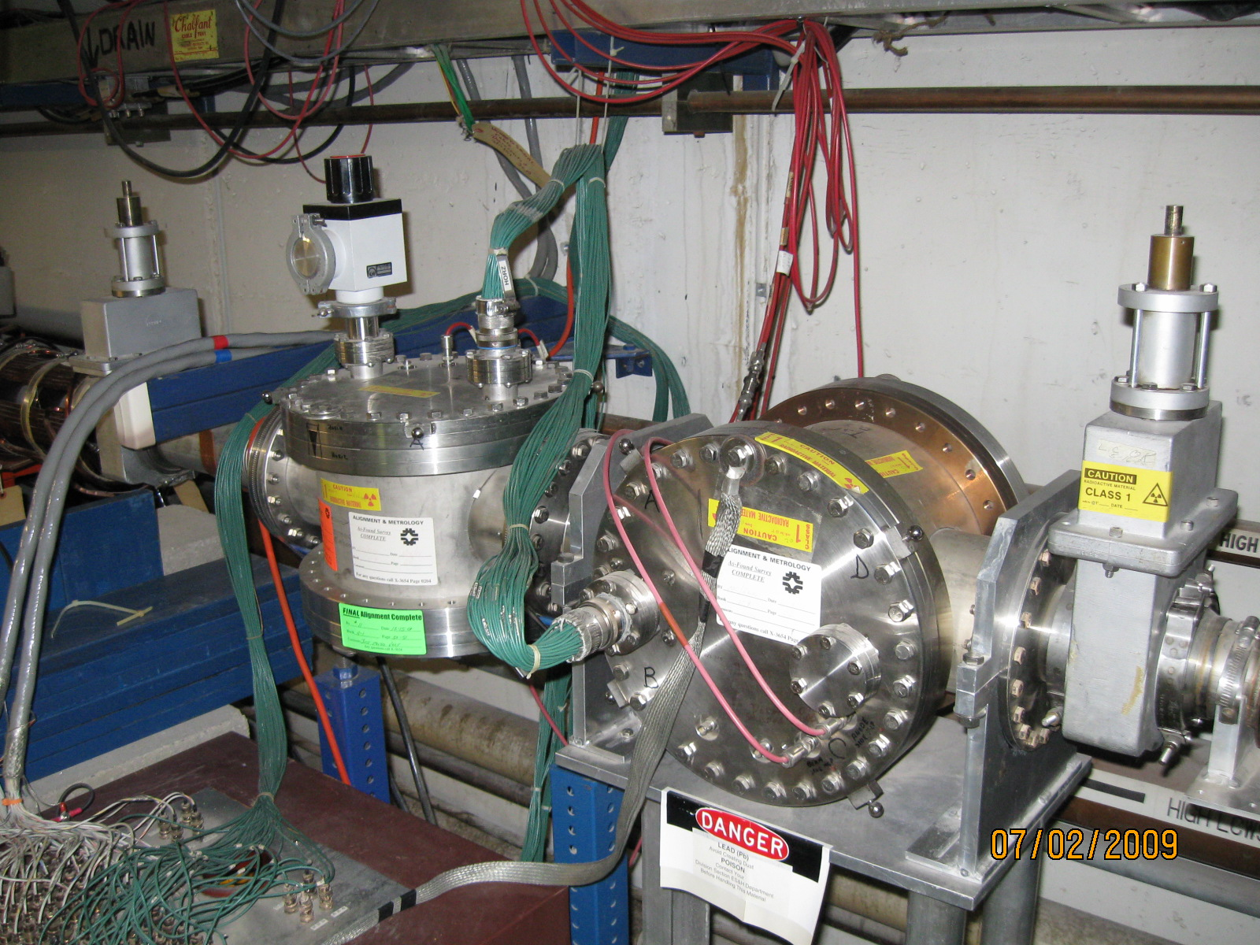
Operational Ion Profile Monitors
Main Injector H/V and Recycler H/V
  1 kGauss Permanent magnetic field
  -10 kV clearing field
  120 anode strips per plane, 96 digitized, 0.5mm pitch, 1.5mm sigma
  Flash test strip for testing system
  Improved control grid gating is being pursued
30 kV Electrostatic IPM – Booster Long 4
  No magnetic field
  ≤30 kV clearing field, helps mitigate space charge measurement distortion
  40 anode strips per plane, 1.5mm pitch, ~4mm sigma
  Flash test strip
10 kV Electrostatic IPM – Booster Long 5
  10 kV clearing field
  30 anode strips per plane
  To be upgraded (?)
Recycler Vertical
Booster Long 5

Slide 5
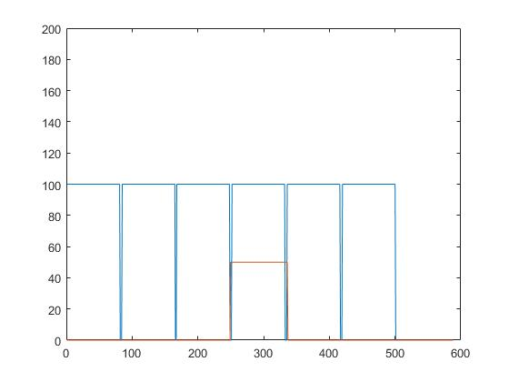
Objective: Gate IPMs on in Main Injector
MI Beam Batches
Gate duration
MI Beam bunch numbers, 84 bunches/batch
Gate IPMs on for short duration is to preserve micro-channel life time
  Gated ON every machine revolution (89 kHz) for <1 sec duration
  1.5 us on-time pulse width
  ~200 ns turn-on/off time between batches

Slide 6
10kV Switch requirements
Switch located upstairs
  Switch at 89 kHz
  Must terminate the cable
    If 93 Ω => 1MW load
If switch is located downstairs
  Switch on/off at 89 kHz
  Short cable
  Load is ~200 pF only, no load resistor
  Switch circuit dissipates 1800 W for <1 sec
  Components must be radiation-tolerant
One solution for building a switch could be a HV tube
  50W filament transformer must have high isolation (low capacitance)
  Filament regulation circuitry
  250V pulsed grid driver
  Long turn-on/off times: >1 us
Proposal: a fast semiconductor switch

Slide 7
Switch now installed to gate the control grid
Switch location for Main Injector IPMs is upstairs
This is NOT a desirable solution
  Long cable not terminated
  NOT switching every revolution
Troy Petersen | Ionization Profile Monitors

Slide 8
Main Injector measured radiation levels
Short term dose levels
  Up to 628 Rads/day
    This could amount to >200 kRad/year
Longer term average dose
  60 kRads/yr
  This figure includes machine time
Radiation levels will only be expected to go up

Slide 9
Semiconductor radiation tolerance
Semiconductor radiation tolerance:
  MOSFET
    Least tolerant unless specially designed
    Very sensitive to excess charge at insulating gate oxide interface
    Our experience: commercial 10 kV MOSFET switch failed in 1-2 weeks
  Bipolar
    Bipolar amplifiers are routinely located in the tunnel
  BiFET and CMOS integrated circuits are build to be radiation tolerant
  JFET SiC
    Tested at doses >5 MRads
    Gate leakage current degrades but only up into nAmps
  GaN
    Tested at doses >5 MRads
Proposal for a 10 kV switch
  JFET SiC FETs to build the 10 kV, multi-FET switch
    “Super cascode” topology with 11 JFETs.
  GaN FETs to build discrete logic and low level circuitry

Slide 10
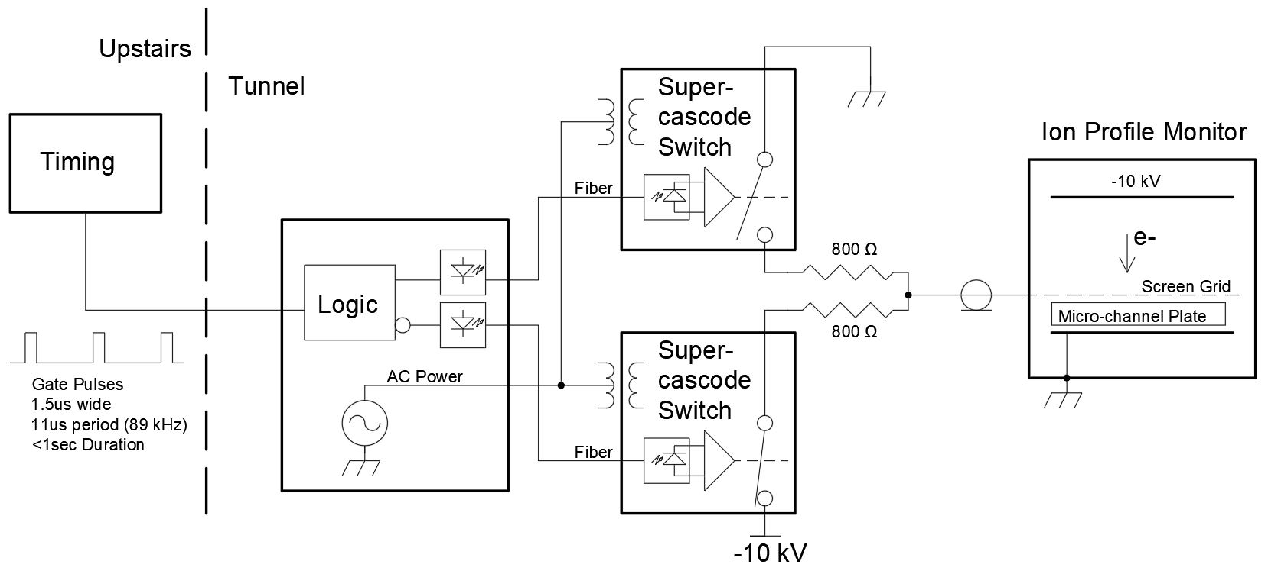
Proposal: IPM and high voltage switch system
Bipolar switch design is composed of 2 identical switches
Bipolar pulsed voltage has fast turn-on and turn-off
Capacitive load power dissipation must be dissipated in resistors

Slide 11
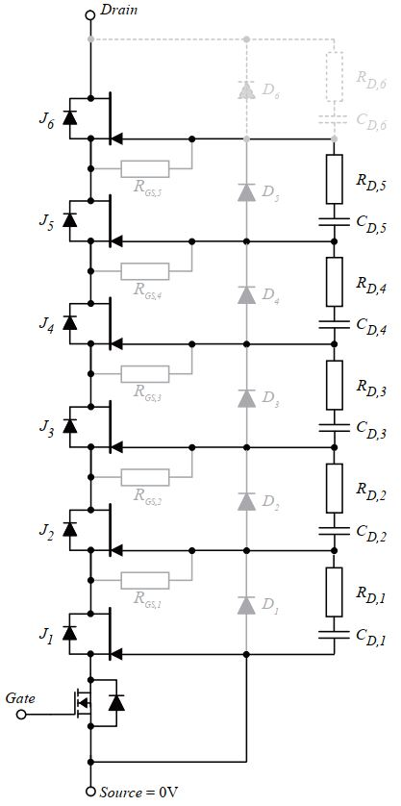

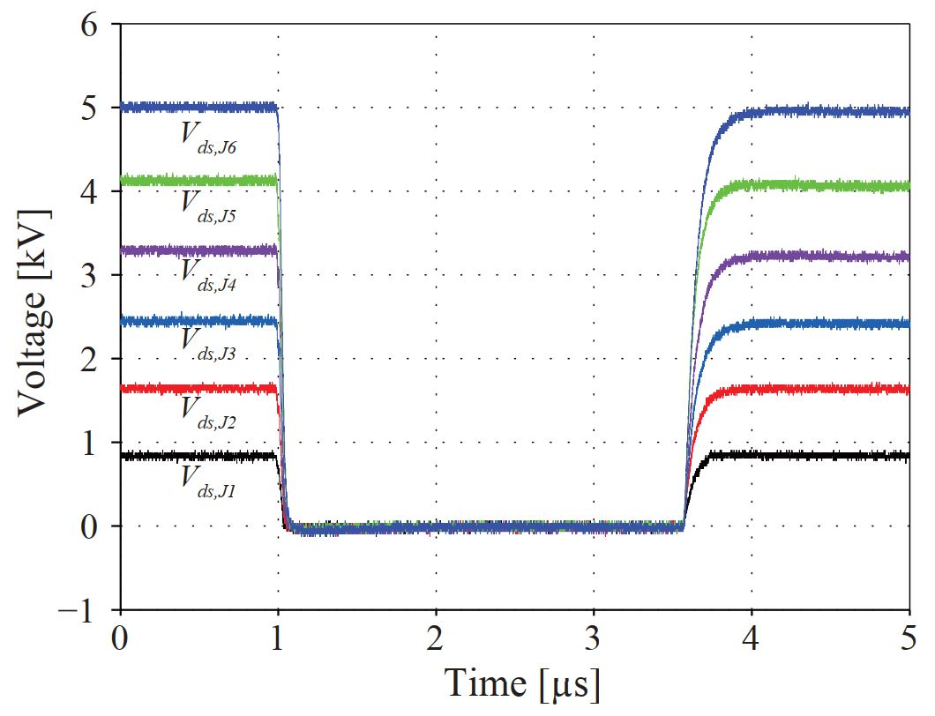
5 kV Super Cascode switch
Voltage Sharing

Slide 12
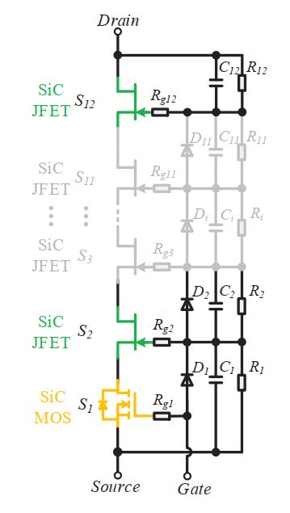
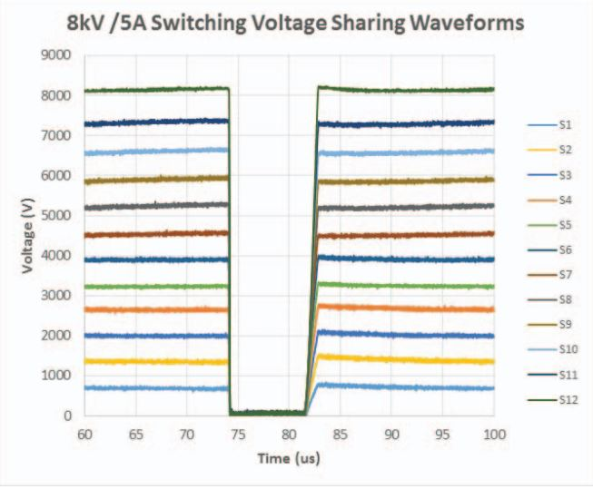
8 kV Super-cascode switch
15kV/40A FREEDM Super-Cascode: A Cost
Effective SiC High Voltage and High Frequency Power Switch
NSF FREEDM System Center
North Carolina State University
Raleigh, North Carolina 27695, USA

Slide 13
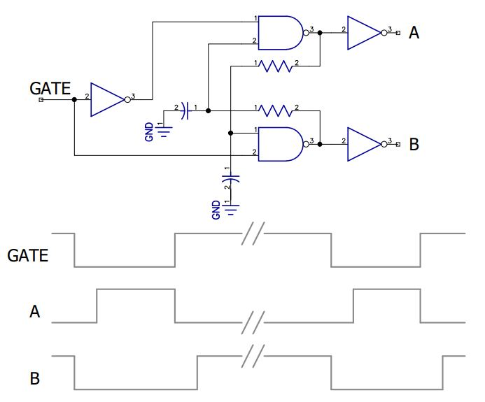
Simple circuit controls bipolar switch timing
“Dead Time” Delay Circuit
Dead Time
Switches are prevented from being ON simultaneously with “dead time” delay
Simple cross-coupled NAND gates – with delay – provide timing control

Slide 14
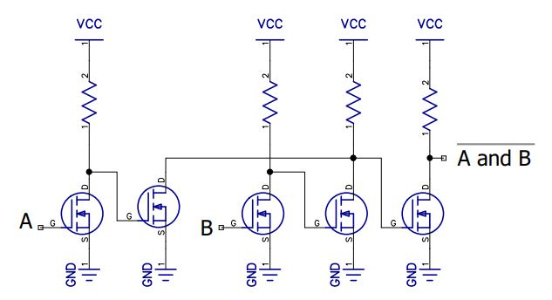
Gates are constructed with FETs
Single NAND Gate
A or B
INVERTERS are made with a single FET
NOR gates are constructed with 2 FETs
NAND gates are constructed with 5 FETs
  A and B = A or B

Slide 15
Remaining electronics in the tunnel
Fiber optic transmitter and receiver are bipolar technology
Bipolar amplifier monitors the grid voltage
AC power delivery circuit also made with several GaN FETs

Slide 16
Conclusion
The main issue with switching the IPM control grid is dealing with radiation
High voltage switches built with JFETs is has been done
SiC JFETs are (or should be) radiation tolerant
Low level electronics can be build GaN FETs
We intend to build this switch system in the near future

