Slide 1
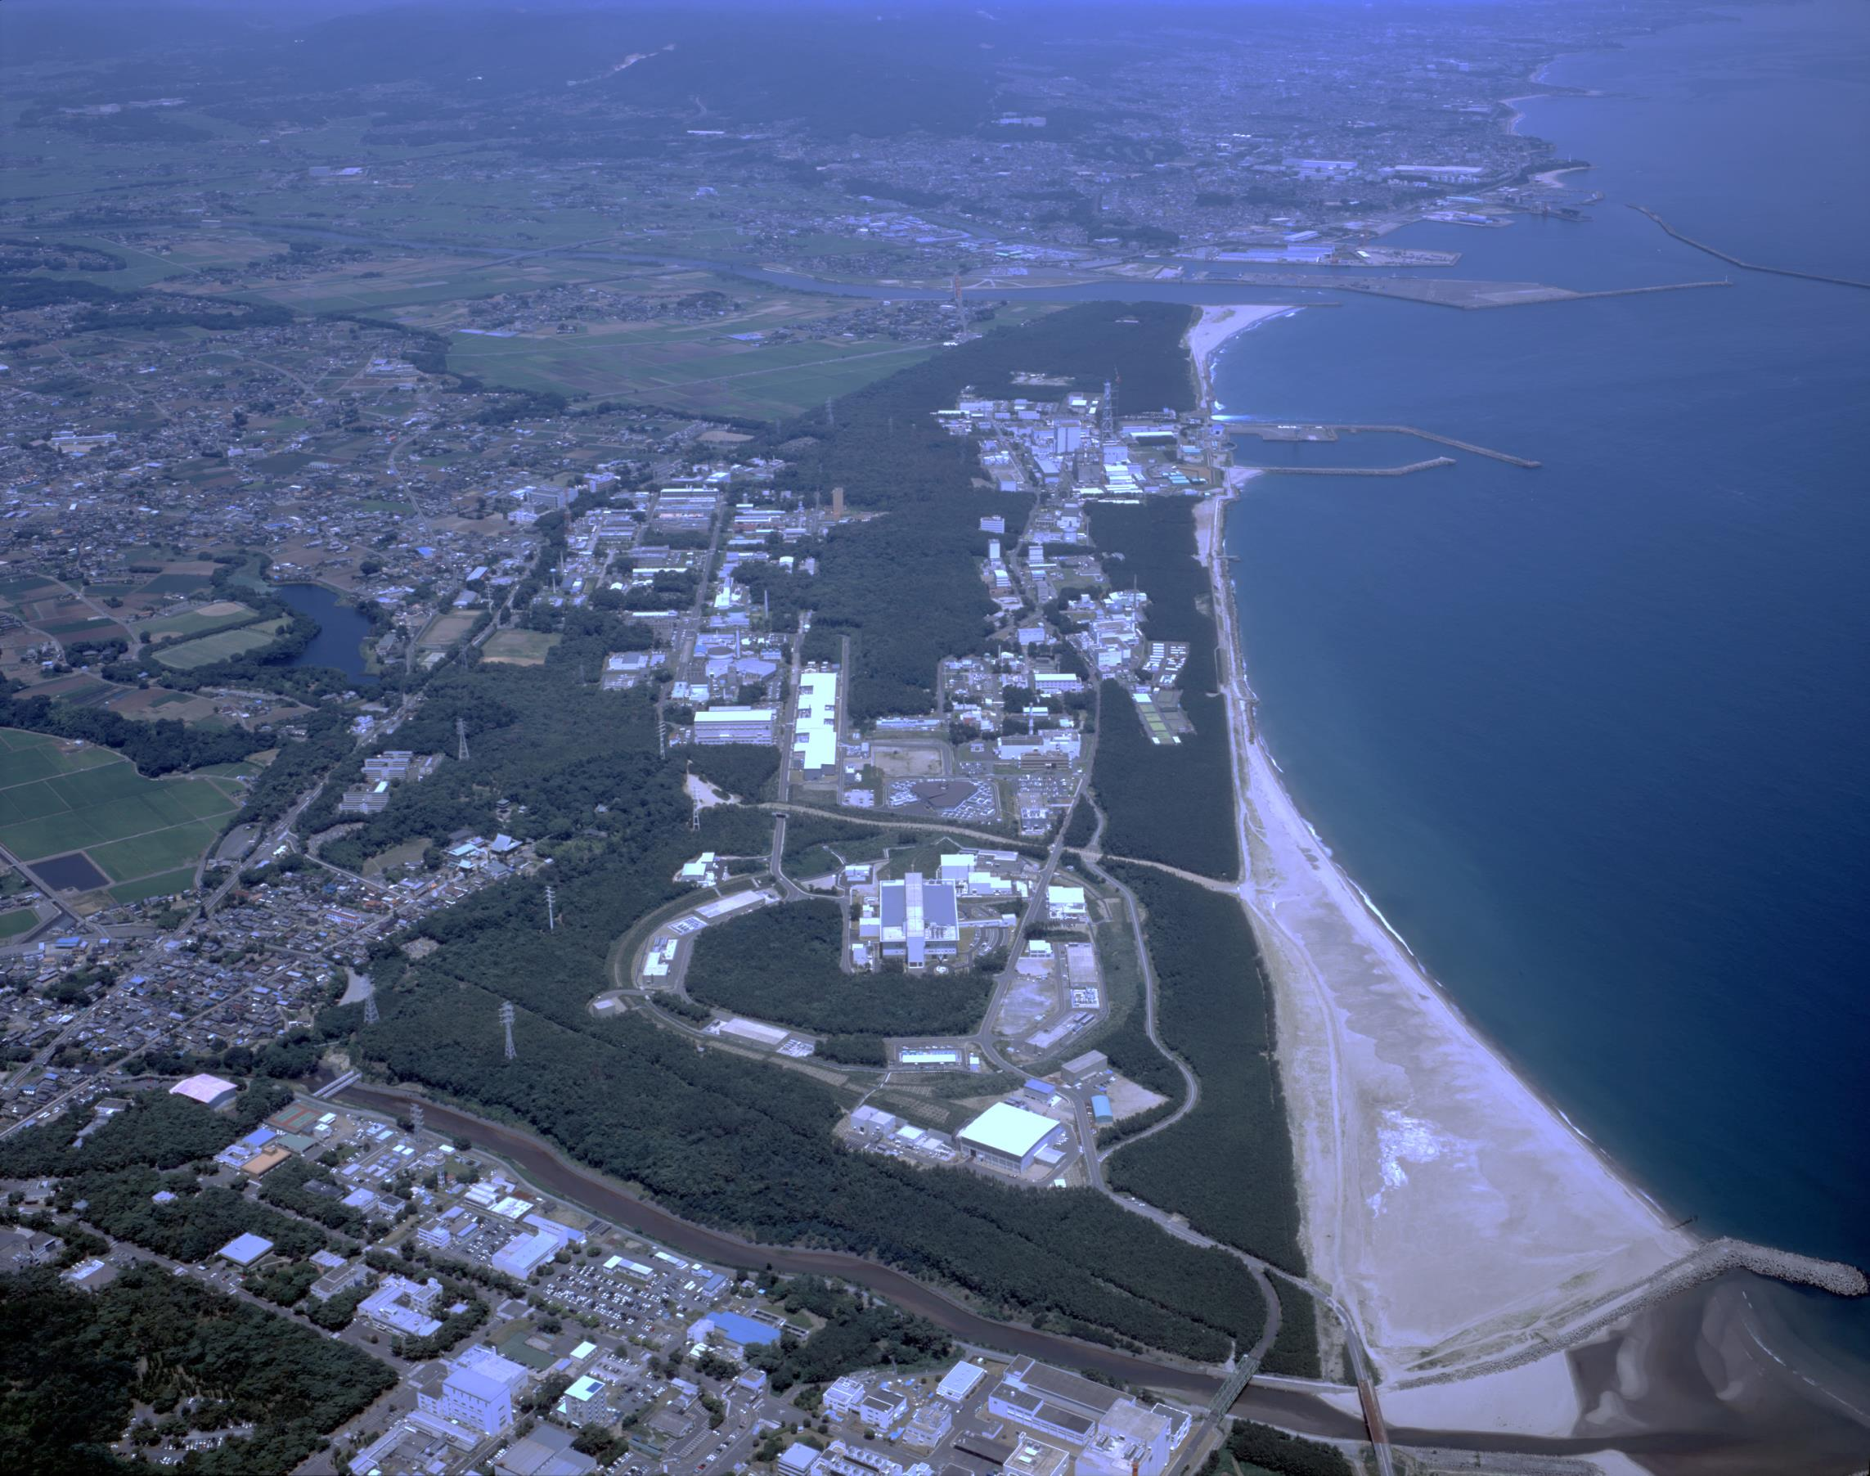
US-Japan Collaboration on high-intensity neutrino beams
Laser manipulation of H⁻ beams -- JFY2018 Progress status at J-PARC
Pranab K. Saha
On behalf of J-PARC laser stripping group
2019 collaboration meeting at Fermilab, March 21

Slide 2
Introduction and collaboration outlook
■ Laser manipulations of the H⁻ beam for utilization in stripping,
chopping, beam diagnostic and other purposes are an important
subject for the present and next-generation high-intensity
proton accelerators.
■ Non-destructive and highly required not only for the existing
high intensity machines but also to realize multi-MW beam power.
The collaboration aims at
Developing a framework for an effective laser manipulation
of the H⁻ beam
→ Achieve maximum efficiency with a minimum laser power.
Explore for multi-dimensional applications.
. . . . . . . . . . . .

Slide 3
Activities at J-PARC
Two major activities for:
1. Proof-of-principle (POP) demonstration for 400 MeV H⁻ stripping to protons by using only lasers.
--- Ultimate goal is to realize laser stripping of 400 MeV
H- charge exchange system.
2. Multi-dimensional laser manipulations of 3 MeV H⁻
at RFQ-TF.
--- H- neutralization, transverse and longitudinal H- beam diagnostics, etc by using roof-top laser profile and/or two-mirror non-resonant laser cavity.
→ Strong feedback to the 400 MeV laser stripping and beam instrumentations.

Slide 4
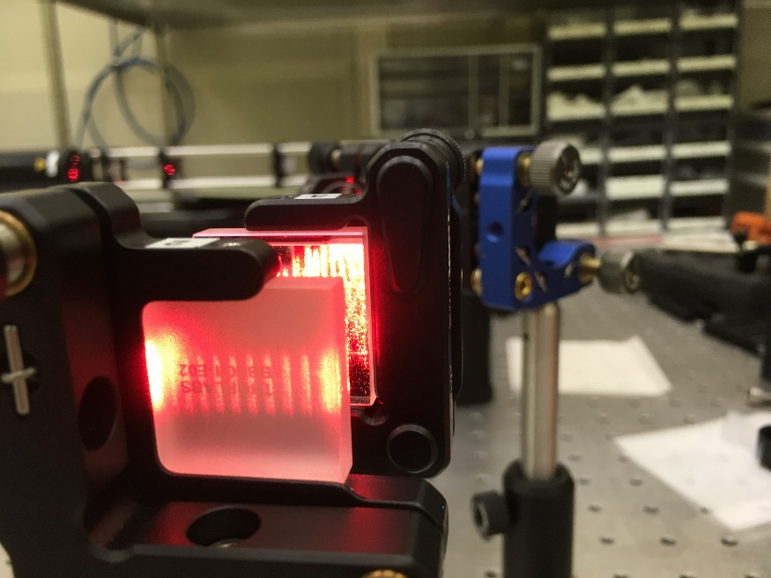
Progress highlights in JFY 2018
1. Collaboration between JAEA & UEC (Univ. of Electro-Communications)
has been established for development of the laser systems for 400
MeV H- laser stripping POP demonstration and also for ultimate goal.
Development of the laser system is in progress.
2. David Johnson from Fermilab visited J-PARC in March 2-16
as KEK short-term invited fellow.
Demonstrated two-mirror laser cavity
with roof-top laser profile. We used
HeNe laser for the demonstration.
Ultimately, we will develop a system
with YAG laser.
Would be highly essential for laser
stripping, future applications of beam
diagnostics.

Slide 5
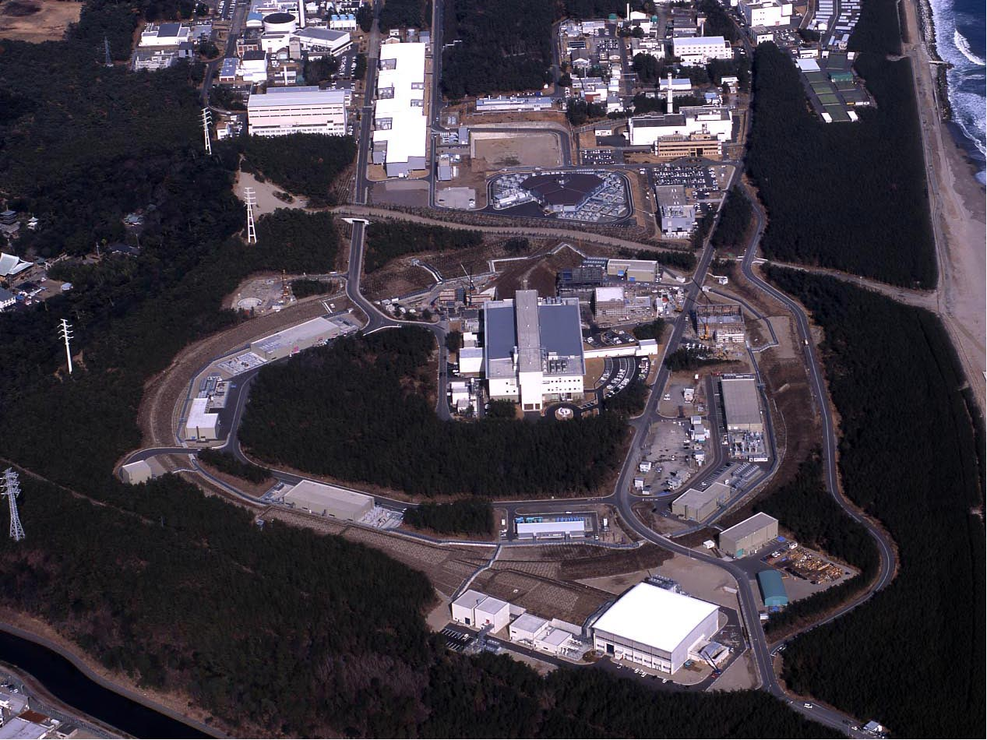
J-PARC
KEK & JAEA)
400 MeV H⁻ Linac
Transmutation Experimental Facility (TEF)
H⁻ →p
3 GeV Rapid Cycling Synchrotron (RCS)
Fast Extraction
Neutrino experiment (NU)
30 GeV Main Ring Synchrotron (MR)
Materials & Life Science Facility (MLF)
Slow Extraction
Hadron experiments (HD)

Slide 6
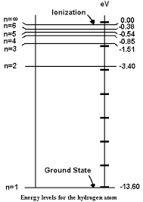
Principle of H⁻ stripping by only lasers
Isao Yamane, Hiroyuki Harada, Saha Pranab and Shinichi Kato
PASJ, Vol. 13, 2016, 1-11 (in Japanese)
Nd: YAG Laser
λ=1064 nm
Nd: YAG Laser
λ=1064 nm
UV laser
λ ~ 200 nm
H⁻
H⁰
H^{0*}
ΔE=12.1 eV
ΔE = hc/λ₀
λ₀= 102 nm
e⁻
p
e⁻
90°
e⁻
50°
90°
e⁻
Step 2:
Excitation of H⁰
H⁰ + γ → H⁰* (n=3)
Step 1:
H⁻ + γ → H⁰ + e⁻
Step 3:
H^{0*} + γ → p + e⁻
Process | E_{ph} (eV) | λ (nm) | α (deg.) | λ₀ (nm) | Laser
H⁻→ H⁰ | 1.67 | 1064 | 90 | 743 | Nd:YAG
H⁰→H⁰* | 12.1 | 212 | 50 | 102 | 5th H of YAG
H⁰*→p | 1.67 | 1064 | 90 | 743 | ND:YAG
Doppler effect of the 400
MeV H⁻ beam:
β = 0.713, γ = 1.426
λ = λ₀ (1 + β cosα)γ

Slide 7
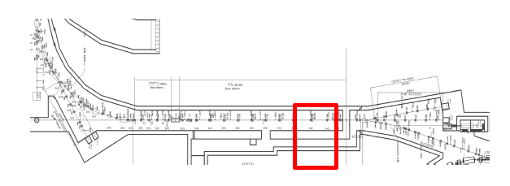
POP Experimental area, beamline
The POP experiment will be performed at the end section of
L-3BT (Linac to the 3-GeV Beam Transport)
All three charge fractions
can be simultaneously measured.
H⁻
p
H⁰
H⁻

Slide 8
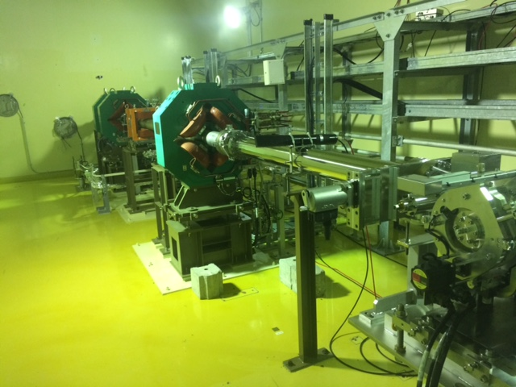
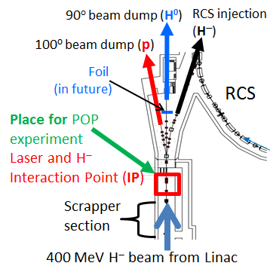
POP experimental devices setup
End section of Linac to 3-GeV
Beam Transport
QM61
~1.5m
Chamber for the
POP demonstration
H⁻ beam

Slide 9
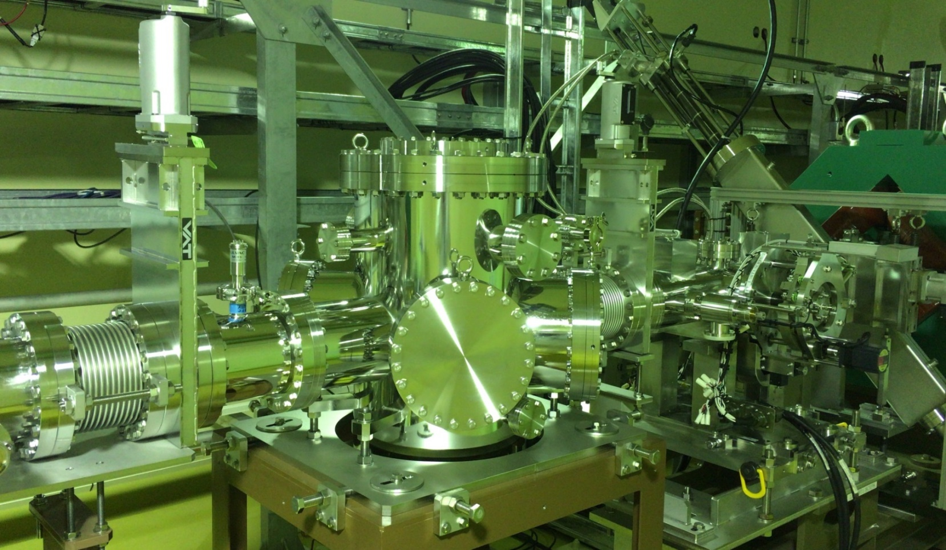
Vacuum chamber for the POP demonstration --- Installed
Nd:YAG laser
Ｙ
Z
X
H⁻ beam
×
UV laser
Vacuum
chamber
Big laser windows: For UV laser with angle variation one can try H0 promotions to different state up to direct ionization.
α = 27º , λ₀ = 91.2 nm λ = λ₀(1 + βcosα)γ

Slide 10
Laser energy/pulse for POP demonstration
RCS
40ms
0.5ms
For the POP demonstration, we will use
only a single 324 MHz micro pulse of ~100ps.
The IR laser energy/pulse is ~10 mJ
for > 90% neutralization and stripping.
The laser energy strongly depends on
the H- beam sizes, which are adjustable.
For the H0 excitation, SNS demonstrated
> 90% excitation efficiency by using
~1 MW peak power UV laser.
We will also need a similar UV laser power.
. . .
Cycle (25 Hz)
Macro pulse
814ns
456ns
. . .
Intermediate pulses (1.2285 MHz)
(Structure @ injecting into the RCS)
3.08ns
0.1ns
Micro pulses (324 MHz)
. . .

Slide 11
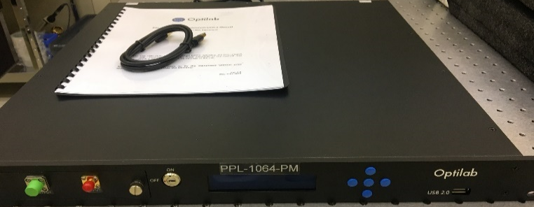
R&D Status of the Lasers
Measured by
biplanar
photodiode
The present Nd:YAG laser: (25 Hz, 0.2J)
Temporal profile: Spiky and also pulse
length too broad (>10 ns).
10ns/div
A new Nd:YAG laser system is under development
J-PARC-UEC (Tokyo) collaboration
Laser specification: 100 ps, 10 mJ/pulse
For 324 MHz laser pulse we also have to
develop optical cavity
US-Japan
Collaboration
JFY2019 bottom line
Modulator (EOM)
(0.1 nJ, <100 ps, 81 MHz)
Preamplifier
double core fiber
JFY2019
LMC fiber
amp
YAG rod amp
RF
Clock
1mJ
~10mJ?
Optical cavity
To be assembled

Slide 12
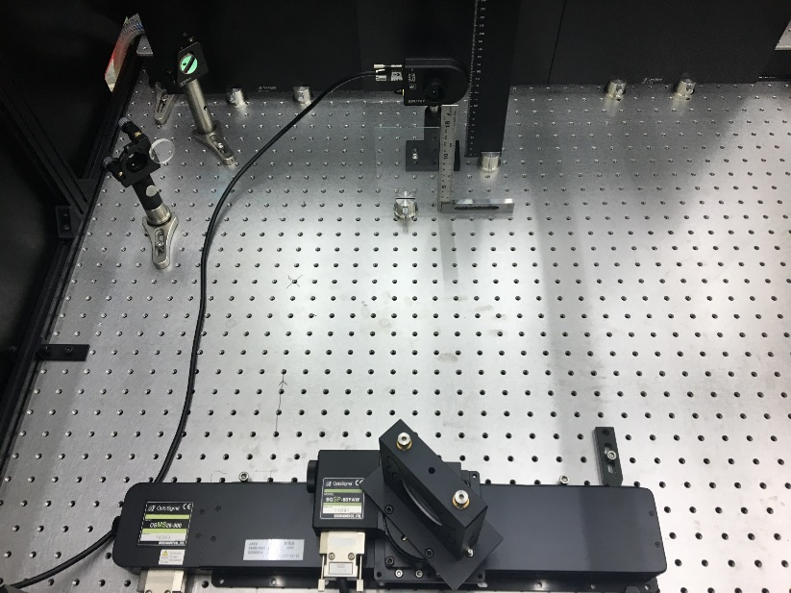
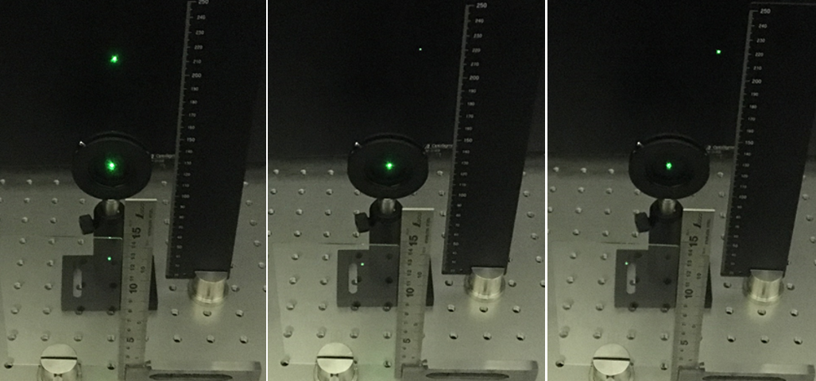
Laser angle control and variation tested
H. Harada
Monitor (IP)
The interaction angle, α is very important,
especially for the H0 excitation
λ = λ₀ (1 + β cos α)γ
Angle control system
Rotation
Laser
Eventually changing α₀
Moving
・ Different excitation level
and even direct ionization
・ Wavelength dependence
cross section, etc.
Δθ = 0 Deg.
Δθ = 10 Deg.
Δθ = 15 Deg.
IP
（pinhole）
The POP chamber windows are made wider for large angle variation.
Glass plate

Slide 13
To reduce the laser power, especially for the H0 excitation 1) Dispersion derivative (D’) and 2) minimization of betatron angular spread (α_{x} ~0) are very essential.
Required maximum angular spread $({{∆α}_{l})}_{m}$of the laser pulse
to cover ion beam (Ref: I. Yamane)
$$({{∆α}_{l})}_{m}=\left(\frac{β(β+cosα)}{1+βcosα}\left(\frac{Δp}{p}\right)+ \frac{βsinα}{1+βcosα}({∆θ)}_{m} \right)×\frac{1+ βcosα}{βsinα}$$
Utilize dispersion
Derivative, D’
Reduce betatron
angular spread
V. Danilov, PRST-AB, 2003
Eliminate transition frequency spread
Uniform laser beam
γ₁
● Laser beam with no divergence
● Hydrogen atom with different energies
have the same laser light frequency
in their rest frame.
→ Gain on the laser peak power.
H⁰
γ₂
α
H^{0∗}
γ₃
γ_{n}
$D^{,}$= $−\frac{β+cosα}{sinα}$= −1.3

Slide 14
Optimization of betatron angular spread
{
X’
X’
$$\sqrt{εγ}$$
φ
α = 0
X
X
α = 0, β enlarge
Transverse beam emittance:
ε = γx² + 2αxx’ + βx’²
γ = (1+α²)/β
tan(2φ) = 2α/(γ-β)
α, β, γ, ε are twiss parameters
Angular spread is controlled by optimizing α to zero and also with large β.
As for the vertical size of the H⁻ beam, a smaller size is required to
gain on the beam density. At SNS, σ_{v} = 0.15 mm achieved.

Slide 15
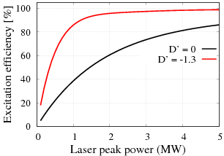
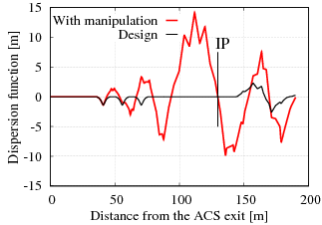
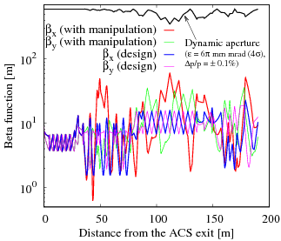
Possibility to obtain D’=-1.3 at the IP: Simulation results
Laser power reduction by utilizing dispersion derivative.
→ 1/5 reduction possible
Simulations
D’ = -1.3
Experimental studies will be done

Slide 16
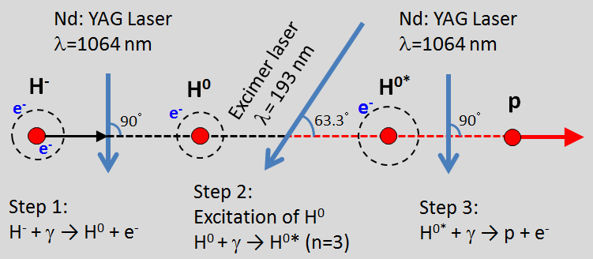
Laser stripping of 400 MeV H- beam --- Scheduled step by step
H⁻ neutralization
study first.
JFY 2019: A set of IR laser system for 400 MeV H- neutralization.
JFY 2020: The 400 MeV H- neutralization studies.
For stripping, UV laser is needed for H0 promotion to higher states.
JFY 2021: Hopefully, 400 MeV H- stripping studies can be started.

Slide 17
Laser manipulations of 3 MeV H- beam at J-PARC RFQ-TF -- Multi-dimensional studies are planned
In addition to 400 MeV laser stripping, we also planned for establishment of multi-dimensional applications of laser
manipulations of H- beam for 3 MeV first at J-PARC
RFQ TF as follows:
H- neutralization, beam diagnostic systems, beam cleaning/extinction, chopping, etc.
Schematic view of J-PARC
RFQ-TF beam line:
3 MeV H- neutralization studies
were done for only 10W beam
for another purpose.
324 MHz
Bend
H⁻
0°
RFQ
IS
H⁰
11°
23°
LASER

Slide 18
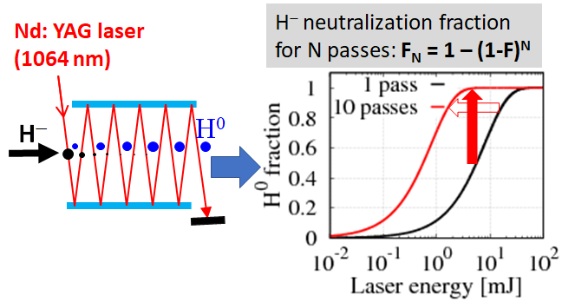
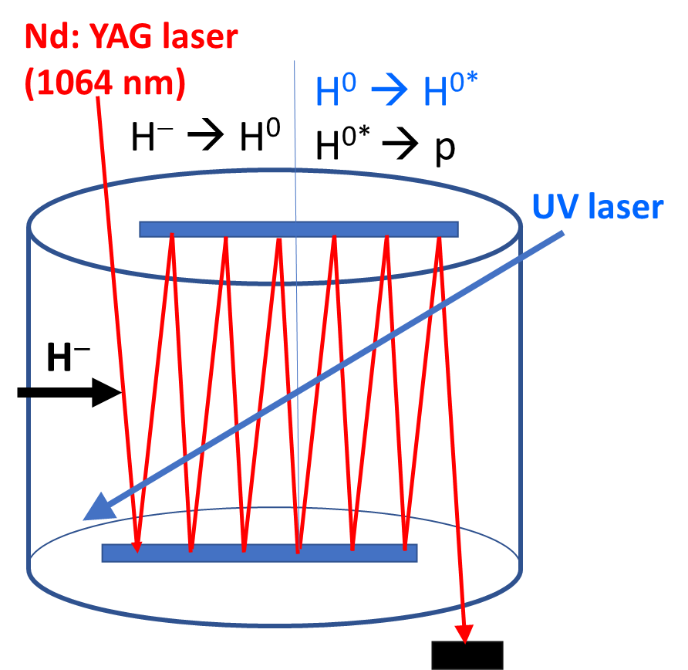
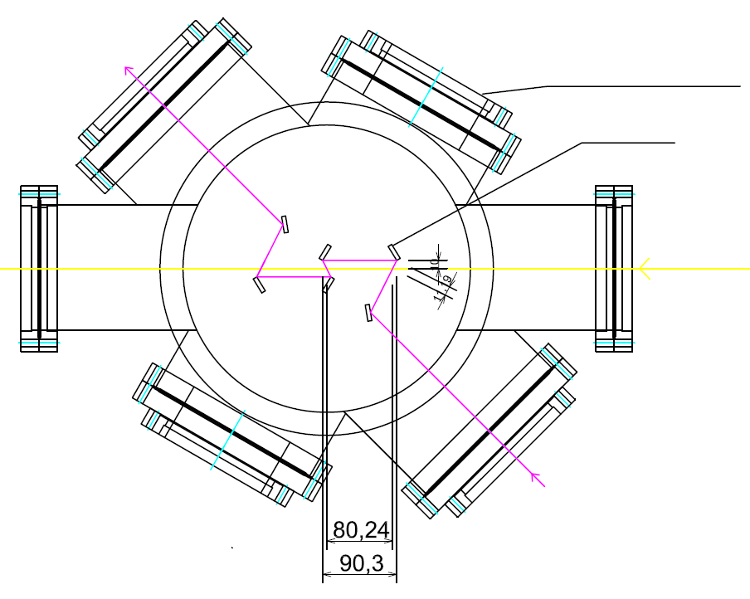
Application of Fermilab two-mirror laser cavity
Courtesy:
D. Johnson
T. Johnson
Laser power can be significantly reduced by the
application of two mirror laser cavity system.
Finding ways for applying J-PARC laser stripping.
1/10 reduction of the laser can
easily be achieved
Feasibility, stripping efficiency both improved.
Applicable to 400 MeV laser stripping
Two-mirror UV laser cavity for the H0 excitation?
Even if 1 pass gives 75% excitation eff.,
> 95% by 3 passes
p
UV mirror coating are
big Issues. UEC already
started a separate program.

Slide 19
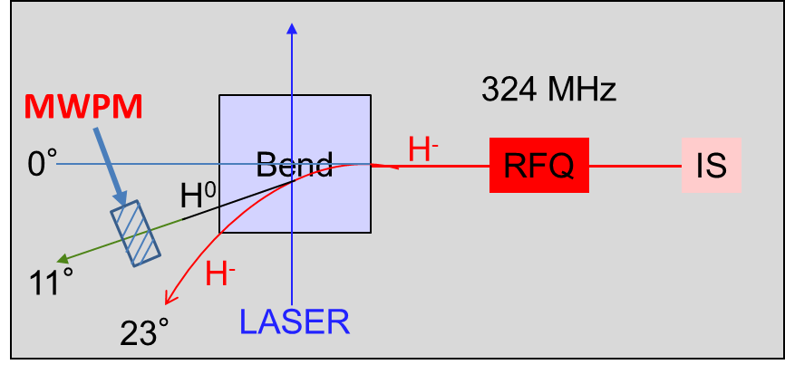
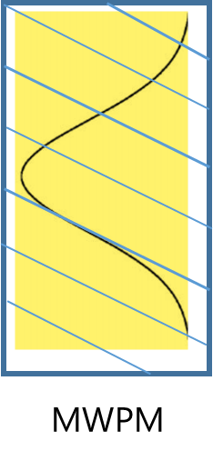
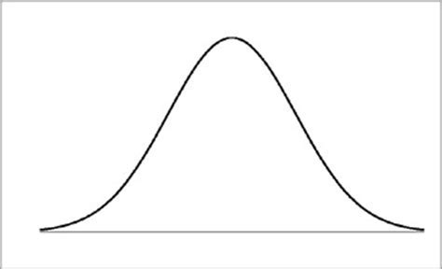
Development of a new transverse H- beam profile monitor system
Laser: 1064 nm Nd:YAG and
Utilize roof-top transverse laser profile.
H⁻ + γ = H⁰ +e⁻
Measure H0 profile by using a MWPM.
(H0 by a MWPM was previously measured)
Easy and straightforward way to measure
transverse H- beam profiles.
Intensity/SC dependent profile
(should have advantages than using electron
collection or H- wire profile scanner..)
Measurement easy at the arc section, but
in the straight section, local bump (chicane) can
be done to separate H0 and H- for measurement.
→ Measurement possible for any section of the Linac
J-PARC L3BT beam pipes diameters: 12 cm
H⁻
H⁰
Roof-top laser
transverse
profile

Slide 20
Development of Longitudinal H- beam profile monitor system
・Measurement can be done by BPM.
・Completely non-destructive.
Short pulse laser is required.
Micro pulse width: >100 ps (σ) at
the L-3BT → Possible to measure.
However, it is may be <<100 ps at the
RFQ exit. → Difficult to measure?
324 MHz H- temporal profile
Intensity
. . . . .
time
Shot pulse Laser
Scan laser through the micro pulse.
Measure H0 yield (through stripping to p by foil)
or estimate the reduction of H- yield with laser on
Gives the longitudinal H- profile.

Slide 21
Summary
We are progressing step by step to demonstrate 400 MeV H-
stripping by using only lasers at J-PARC and also for the ultimate
design of the laser system for the laser stripping injection.
The laser system is under development collaborating with UEC.
● The H- neutralization studies is expected to start in JFY 2020.
● The POP demonstration of 400 MeV H- stripping in 2021.
David Johnson’s visit to J-PARC was one very remarkable event.
We had two fruitful weeks. Learned about roof-top laser profile
generation and use that for the two mirror cavity.
We have planned multi-dimensional laser manipulations of the
3-MeV H- beams at J-PARC RFQ-TF.
Would be very essential for the laser stripping.
The US-Japan collaboration in this subject also plays significant roles
for next generation laser manipulations of the H- beam.

