Slide 1
Flat injection
Kiyomi Seiya, Chandra Bhat, Salah Chaurize, George Krafczyk, Howie Pfeffer, Bill Pellico, Kent Triplett, Cheng-Yang Tan
US-JAPAN collaboration meeting
19 March, 2019

Slide 2
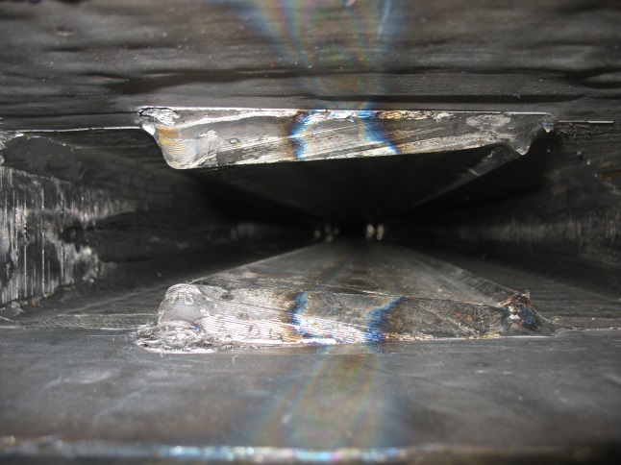
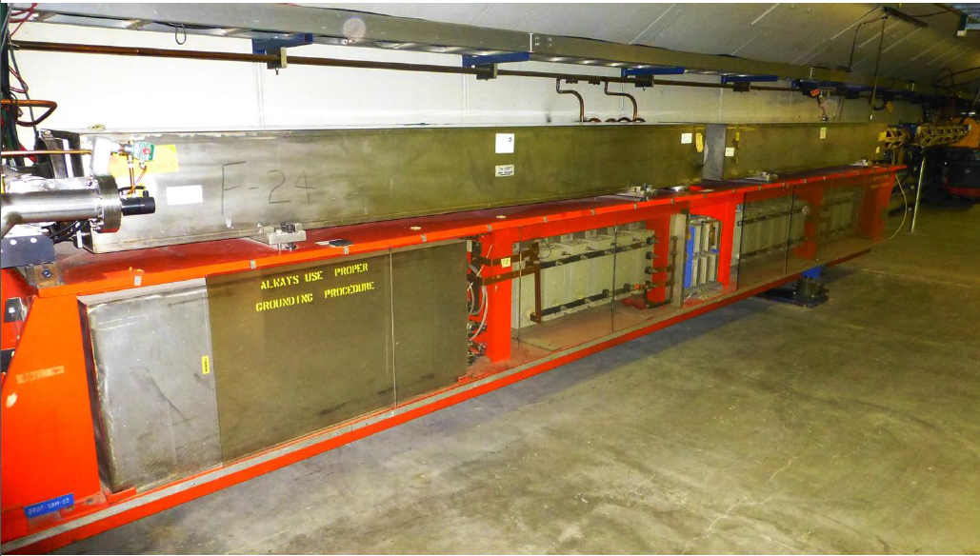
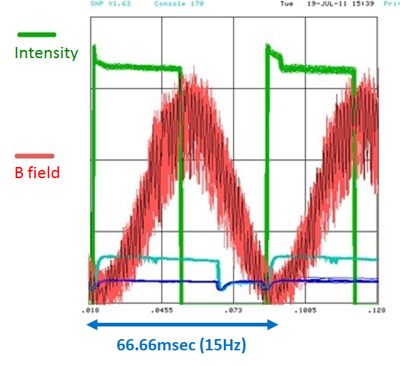
Booster - 15 Hz Resonant Circuit Synchrotron
D-Magnet
F-Magnet
Resonant Capacitor
Choke
Proton Kinetic Energy
@ Injection → @ Extraction
400MeV 8GeV in 33.33msec

Slide 3
Booster injection field
15Hz operation
PIP-II 20Hz operation
Injection: ~ 40 μsec
Adiabatic Capture: ~200 μsec
Orbit excursion: 2mm
Injection: ~ 600 μsec
Bucket to bucket transfer
Orbit excursion : 5mm

Slide 4
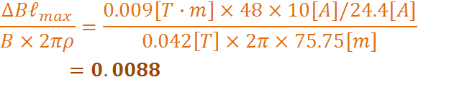
Flatting injection field with 48 dipole correctors for present 15Hz operation
B field error ~1% can be compensated.
The required maximum current is 0.83[A] and the slew rate is 3.00 [Tm/s] which is less than the maximum slew rate 3.24[Tm/s] we can handle with the present system.

Slide 5
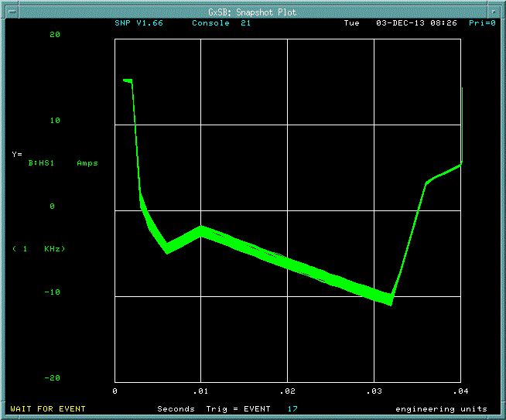
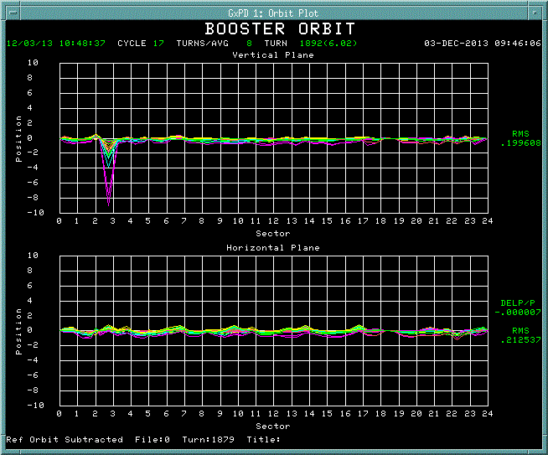
Effect on beam orbit with +/-1A corrector current
Corrector current
Orbit difference
Corrector current : +/- 1A
Orbit change < 1mm

Slide 6
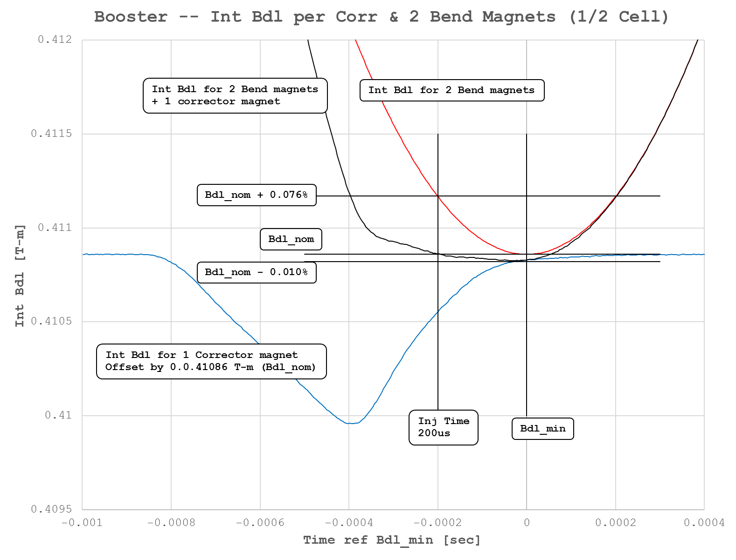
Asymmetric field compensation
Total Int B dl
Int B dl for 2 bending magnet
Int B dl for 1 corrector magnet
Smooth transition from flat injection field to acceleration field

Slide 7
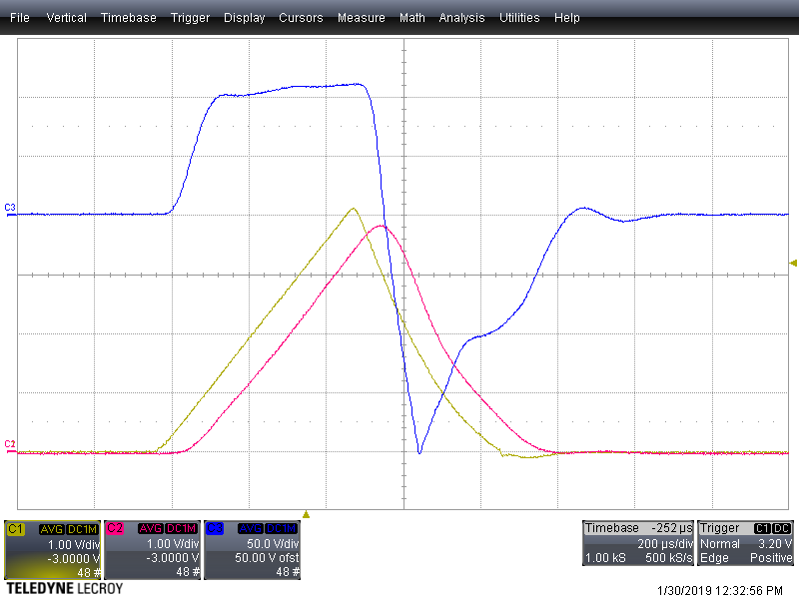
Corrector current sent from 473 card
Current set on 473
Current plays on correctors
70 usec delay due to the PS bandwidth

Slide 8
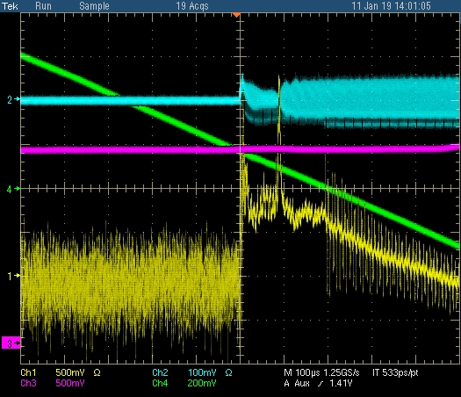
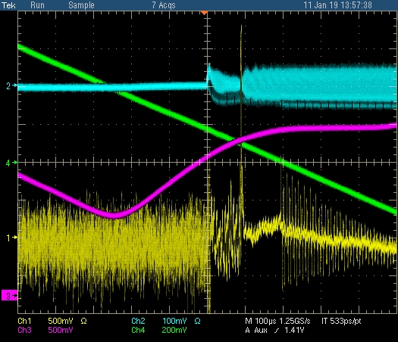
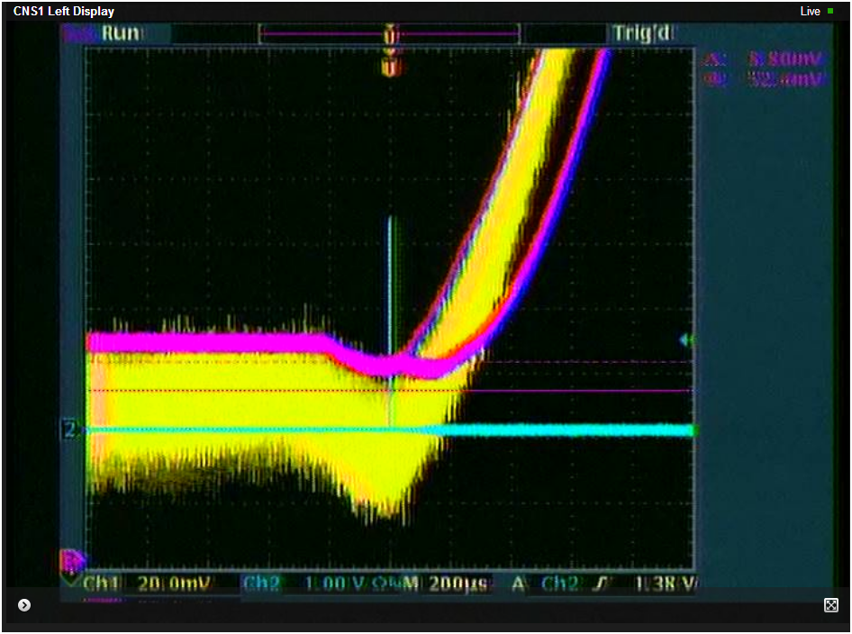
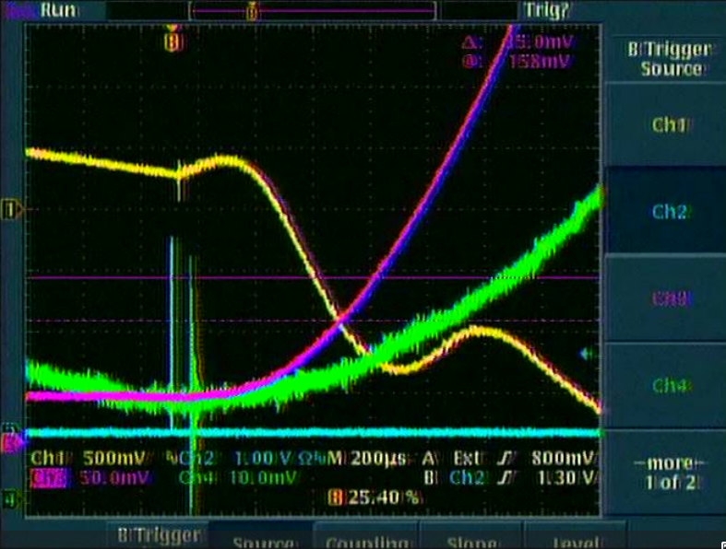
Beam studies on $17
Wall Current Monitor
Corrector current
BDOT
(dI/dt)
100usec /div
Frequency curve
B field
(Transductor)
200usec /div

Slide 9
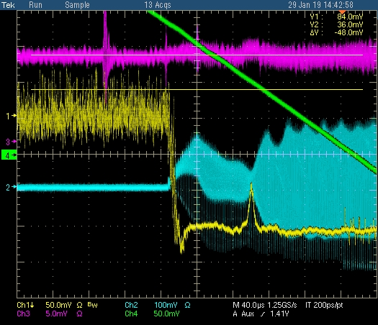
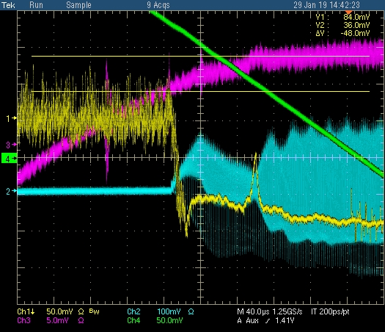
Optimization of the corrector current and timing
Corrector
0.83A
WCM
(beam)
RPOS
(Horizontal
Position)
BDOT
BDOT

Slide 10
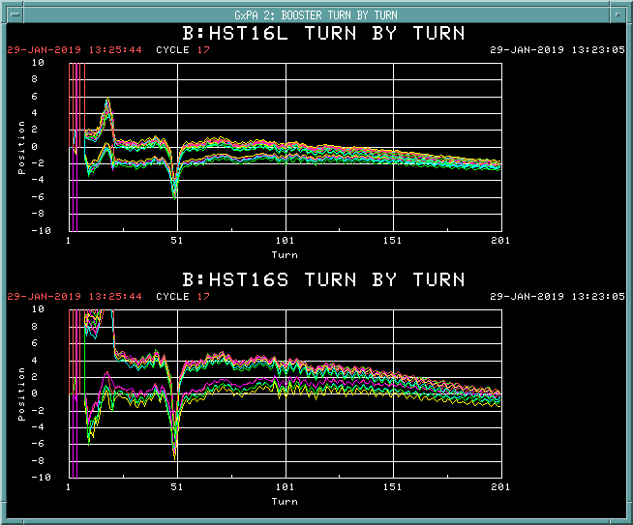
Orbit difference with and without correction
With compensation
HL16
w/o compensation
HS16
200usec
BDOT
Orbit difference was much larger ( > 4mm) than the estimation( < 2mm)
Field compensation current was 0A at 200 usec later than we expected
Eddy currents might delay the B field

Slide 11
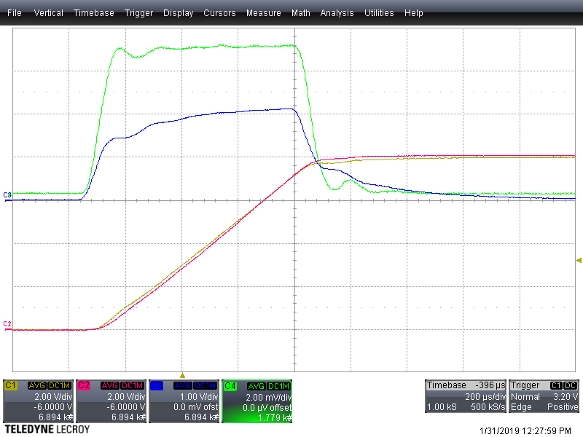
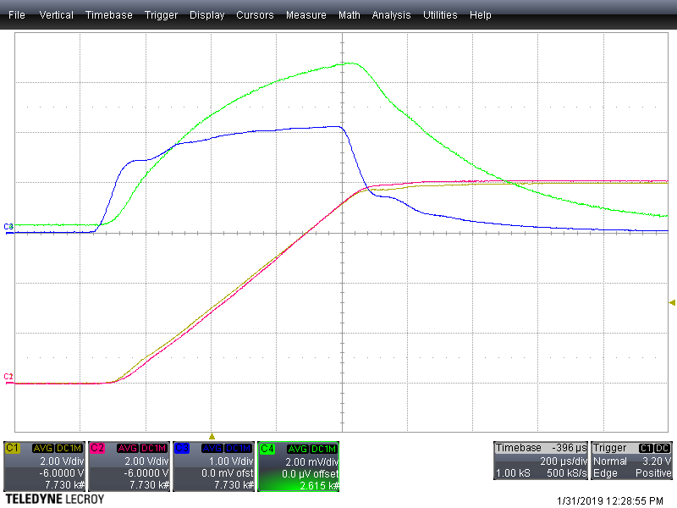
Measurement of the Eddy current effect
without Beam pipe
with Beam pipe
Bdot in magnet WITHOUT beam pipe
Bdot in magnet WITH beam pipe
voltage on magnet with beam pipe
voltage on magnet with beam pipe
Current on magnet w/o beam pipe
Current on magnet w/o beam pipe
Current on magnet with beam pipe
Current on magnet with beam pipe
200usec/div

Slide 12
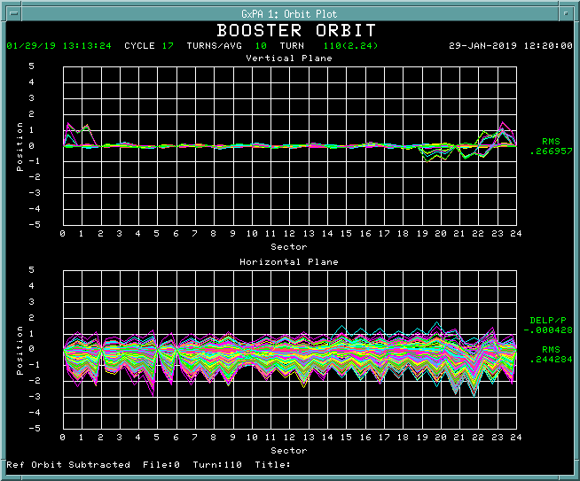
Amplitude and timing jitters on B field
1mm /div
Vertical
Horizontal
Amplitude jitter: ~103 +/- 0.05 [A] ( ~103 +/- 0.1 [A] daily)
beam orbit at injection varies +/- 1 mm from pulse to pulse
Timing jitter: +/- 3 usec ( ← +/- 20 usec)

Slide 13
Plan
Realtime field compensation with FPGA board
Optimize field including eddy currents
Optimize frequency curve
Improve GMPS (Gradient Magnet Power Supply) regulation
  Reduce amplitude and timing jitter
  Feedforward
  GMPS regulation with ML

Slide 14
Field correction using cogging board or 473 card
Cogging
48 horizontal dipole correctors
+
Cogging
473 card
+

Slide 15
Setup of the compensation system at Booster LL room
48 horizontal dipole correctors
473 card
Cogging

Slide 16
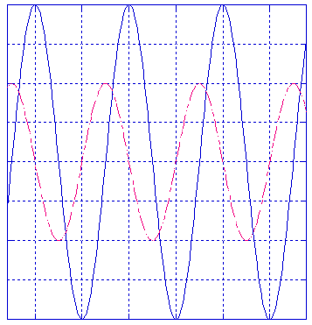
Improvement of timing jitter between BDOT and BOOSTER Reset Event
BDOT: B field minimum
Booster reset event $10: reference for beam injection
B_dot
B_field
BDOT
timing jitter
$10
RESET DELAY = 30990 usec
+/- 20usec
T1
T2
T3
T_avg - N
$10
RESET DELAY = 1026 usec
+/- 3usec

Slide 17
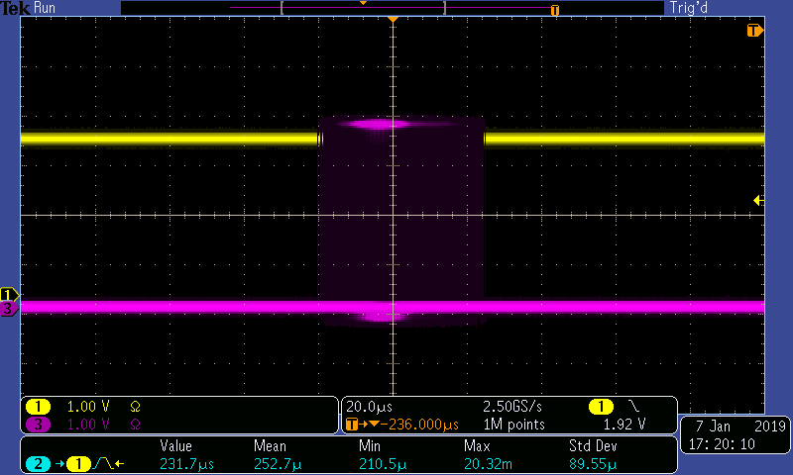
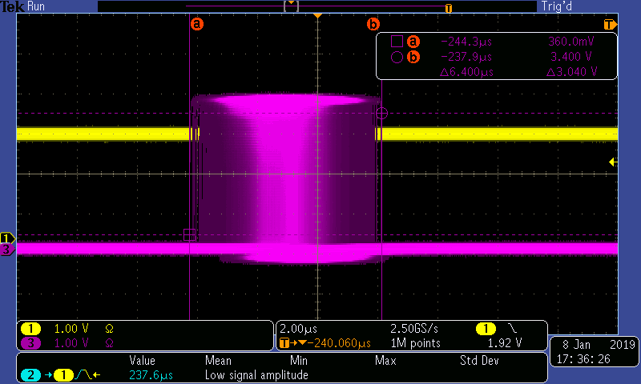
BDOT signals triggered with Booster reset events
20usec /div
2usec /div
+/- 20usec
+/- 3usec

Slide 18
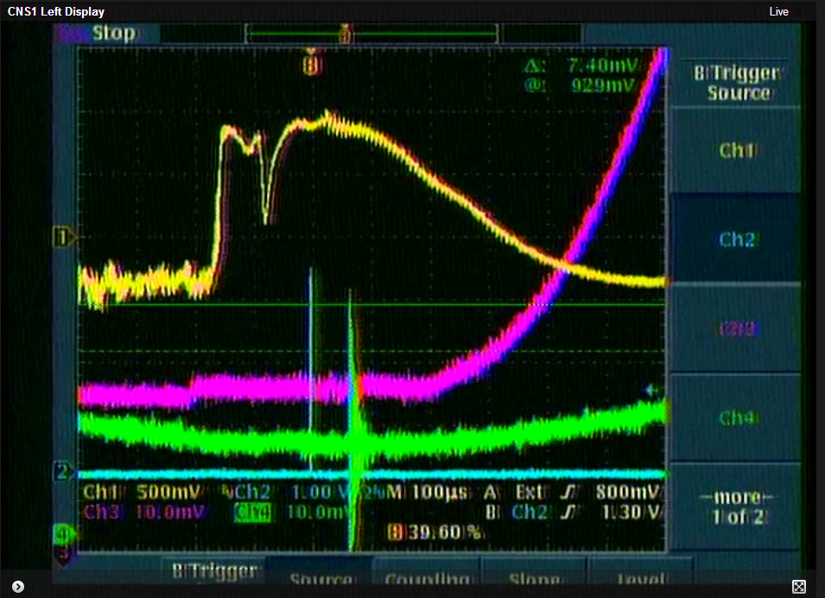
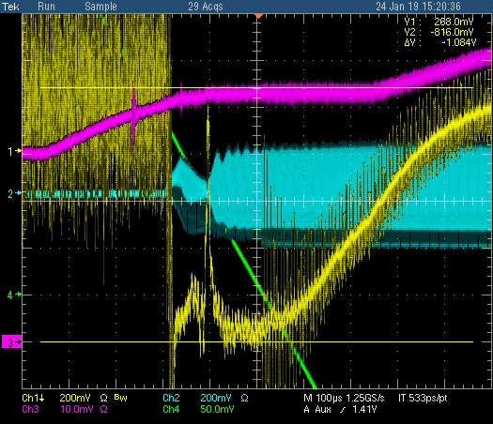
Operation status of flat injection ( on operational cycles)
BDOT
Frequency curve
B field
(Transductor)
-200 usec: Beam Injection
-160 usec: End of injection
-15usec: Notch creation
RF Feedback ON
0sec: BDOT
100usec /div

