Slide 1
MI/RR Machine Status
Kyle J. Hazelwood
09:00 Meeting
February 1, 2019

Slide 2
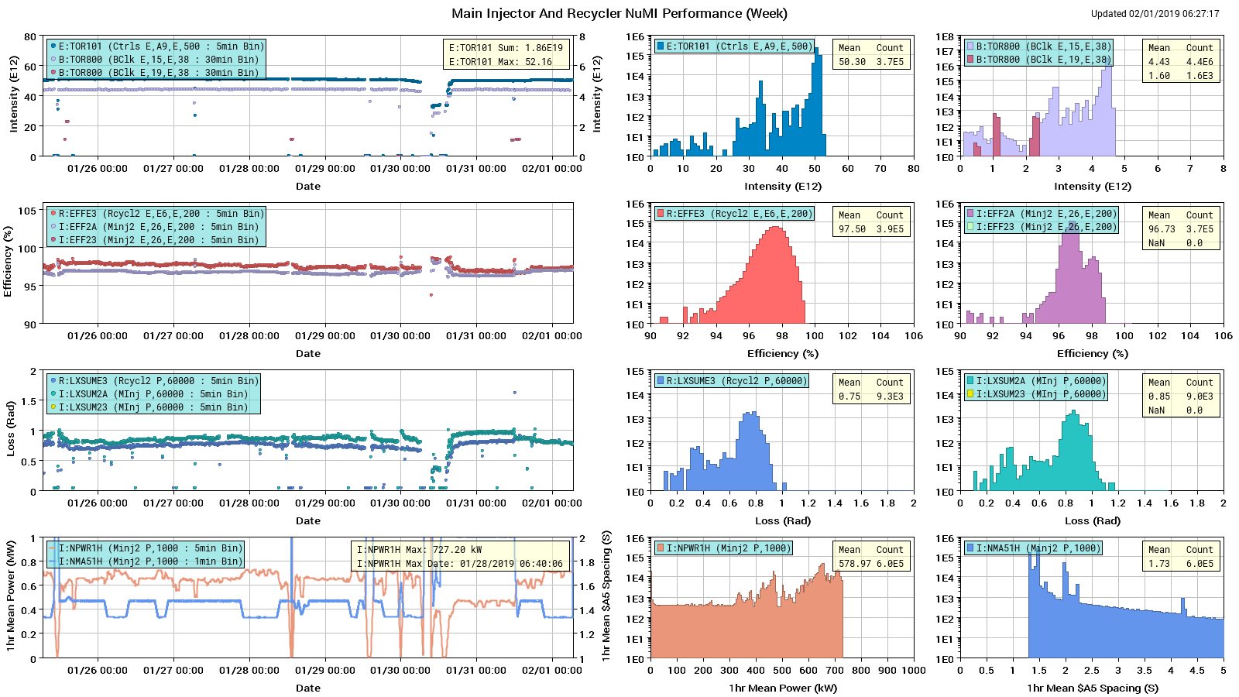
NuMI Performance

Slide 3
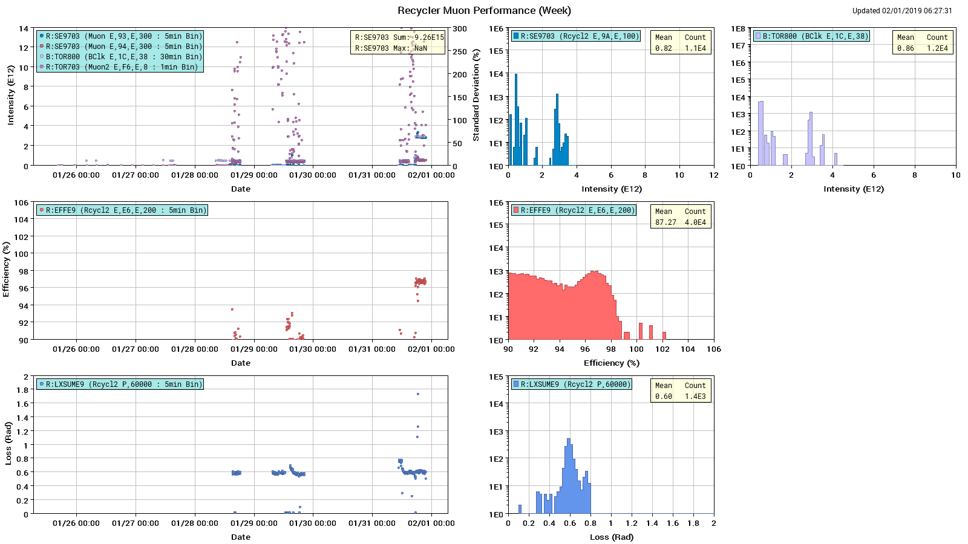
Muon Performance

Slide 4
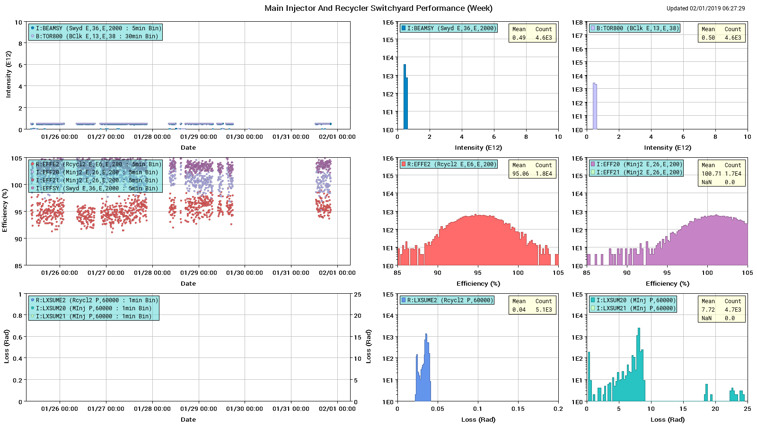
Switchyard Performance

Slide 5
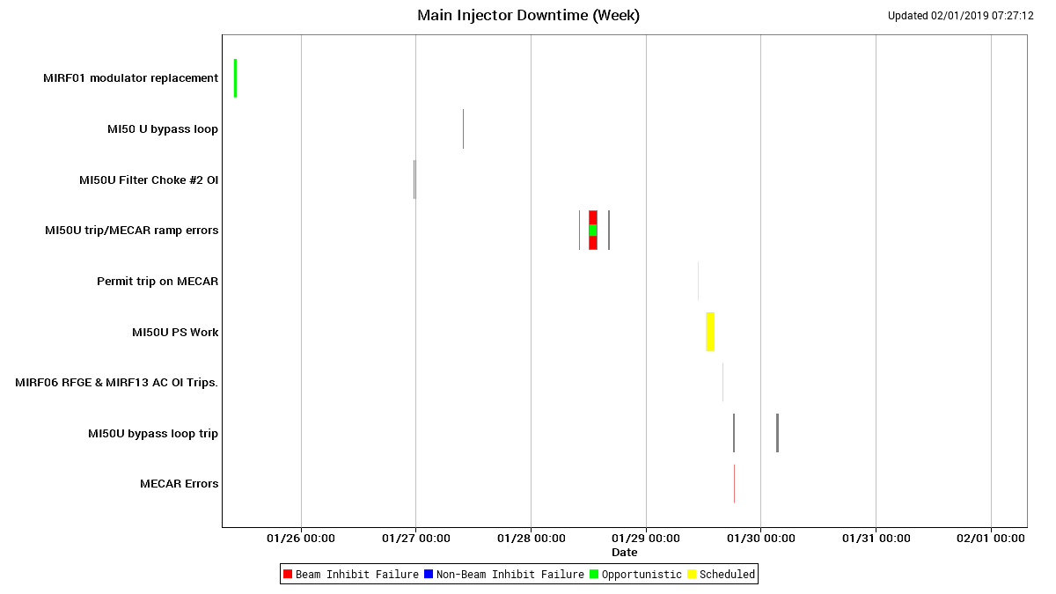
Main Injector Downtime

Slide 6
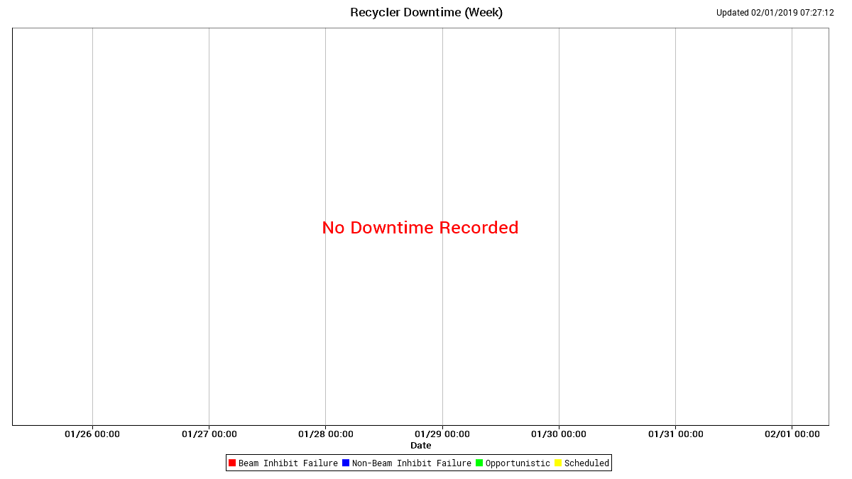
Recycler Downtime

Slide 7
Summary
Issues
MI50U supply
Studies
1.2 second ramp studies
One event in SC, few hours at a time
MITUNE SY commissioning
Possibly need SY cycle with no users for SY MITUNE
MI8 collimators scan to allow 16+ turn intensities

