Slide 1
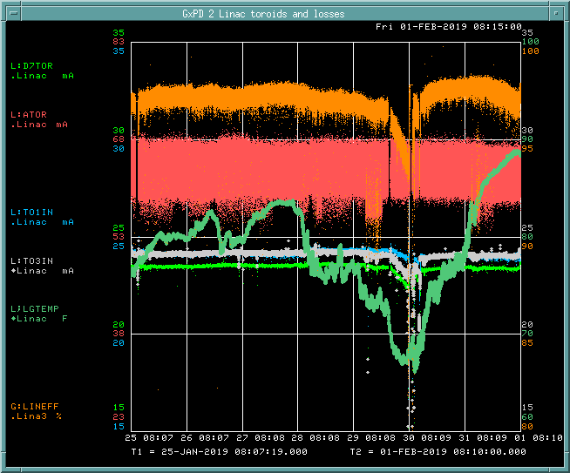
PREACC/LINAC Weekly Performance (January 25 – February 01, 2019)
ATOR: 63.3 mA
TO1IN: 24.1 mA
D7TOR: 23.4 mA
LINAC Gallery Temp.
LINAC efficiency:
97.0%

Slide 2
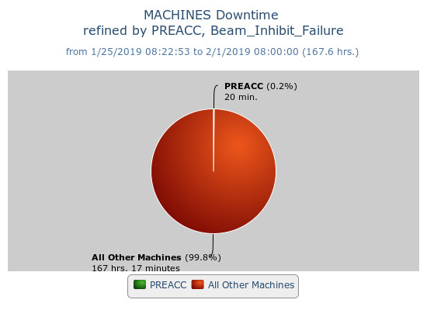
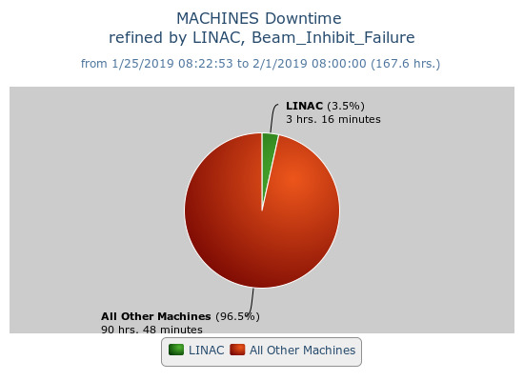
Beam inhibit downtime PREACC: (20 min)
LINAC: (3 hr 15 min)
Issues
KRF6 Filament PS timeout due to the GMPS trip (1/29)
Tank1 Scroll pump replacement (1/30)
KRF3 CS firing circuit replacement (1/30)
RFQ tuning due to the low gallery temperature(1/30)
BPM crates failure on LNBP09 and B400BPM3
Request
Klystron RF skid#2 flow meter replacement (8hrs)

