Slide 1
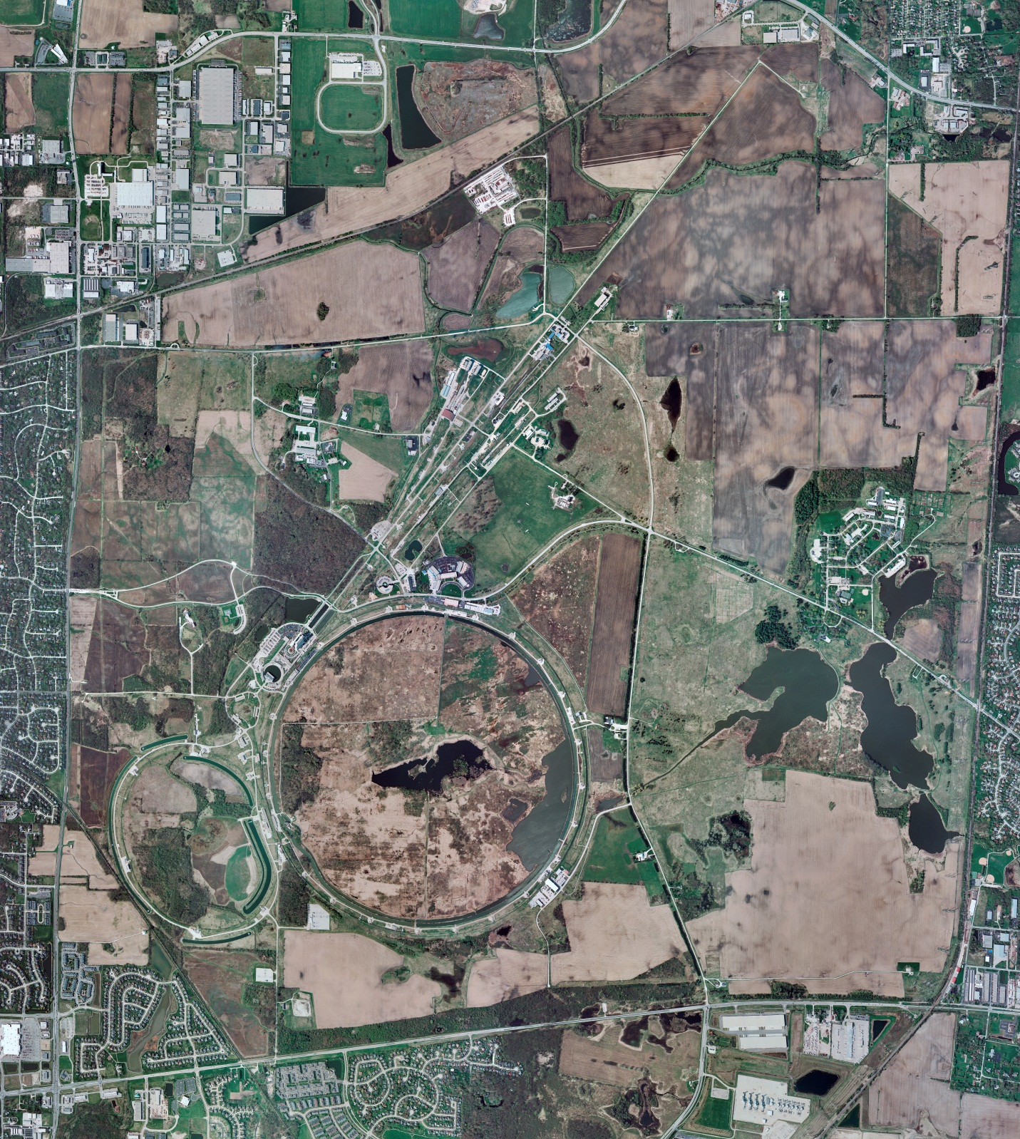
Helium Cryogenics
Status 2/1/2019 J.Makara
CMTF: Linde SCP cold at 5 K and operating on four comprs.
CMTS1 CM14 LOTO’ed and in process for replacement
MCTF: Warm, shut down, isolated; LN2 system still online only for Purifier compr and its oil removal skid bakeout in progress; Purifier warmup/regeneration in progress.
MDB/HTS: at RT
MDB/STC: at RT
MDB Magnet: at RT
NML/FAST: Lab-B North/South comprs online with North/South Fridges running but recovering from system upset
CC1/CC2/CM: cold at 2 K but not at proper LHe levels; being recovered
MTA: shut down and isolated at RT
IB1: Cold and operating test stands
HAB: BA compr/Fridge at RT, shut down, isolated, though LN2 system still active.
STF: at RT, isolated, and under LOTO
Muon Campus: A0 comprs (3) online with cryogenic system cold at 5 K, including g-2 magnet
MISC: LN2 deliveries ok thru bad weather conditions.

Slide 2
Helium Cryogenics status 1/25/2019 J.Makara
Cryo:
CMTF: Linde SCP cold at 5 K and operating on four comprs.
CMTS1 CM14 CM14 LOTO’ed and in process for replacement
NML/FAST: Lab-B North/South comprs online with North/South Fridges running but recovering from system upset
CC1/CC2/CM: cold at 2 K but not at proper LHe levels; being recovered
HAB: BA compr/Fridge at RT, shut down, isolated, though LN2 system still active.
STF: at RT, isolated, and under LOTO
MCTF: Warm, shut down, isolated; LN2 system still online only for Purifier compr and its oil removal skid bakeout in progress; Purifier warmup/regeneration in progress.
MDB/HTS: at RT
MDB/STC: at RT
MDB Magnet: at RT
MTA: shut down and isolated at RT
IB1: Cold and operating test stands.
Muon Campus: A0 comprs (3) online with cryogenic system cold at 5 K, including g-2 magnet.
MISC: LN2 deliveries ok thru bad weather conditions

Slide 3
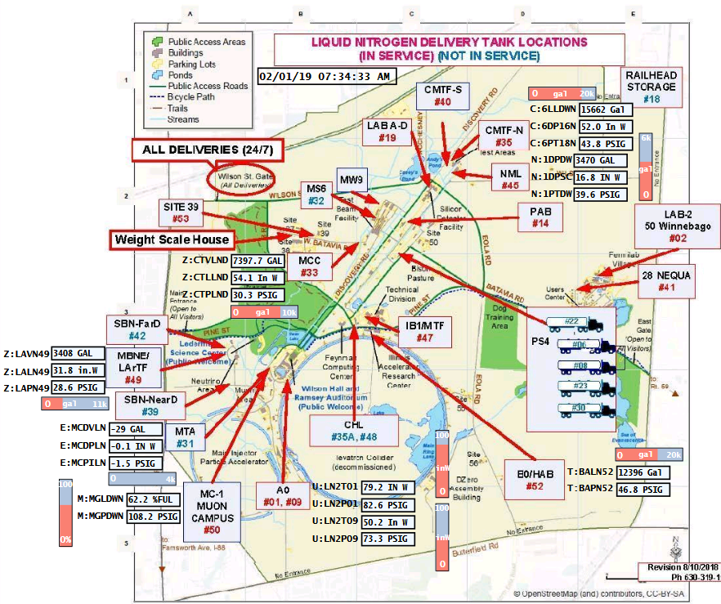
ACNET F45
Sitewide LN2 delivery locations and levels

