Slide 1
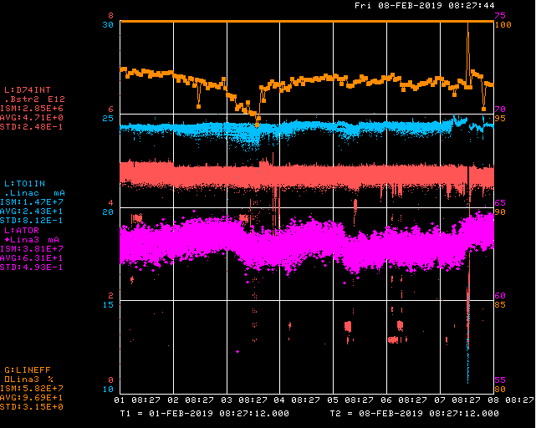
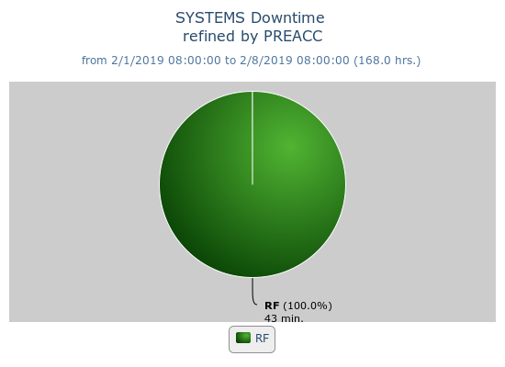
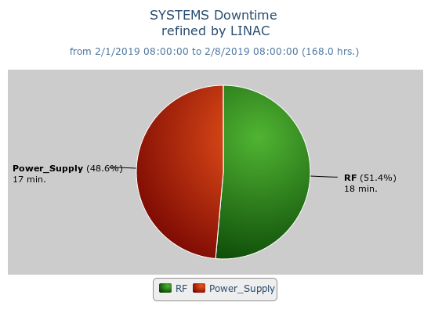
Preacc/Linac Weekly Performance
Weekend Replaced QPS509 P3 card
Ops tuned source for weather
Tuesday RFQ vacuum turbo pump failure
Wednesday KRF waveguide air compressor trip

Slide 2
Current Conditions/Plans
Source A – 63 mA
Linac input – 24 mA
Linac output – 23 mA, 4.7E12 /pulse
Opportunistic Downtime:
Change penetration chipmunk
KRF skid 2 checkout

