Slide 1
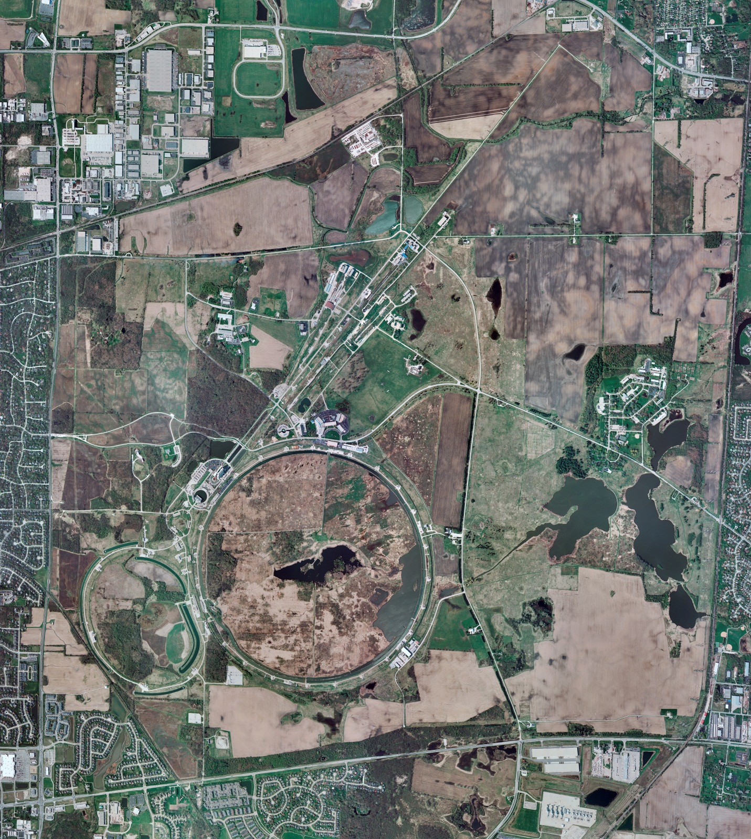
Helium Cryogenics
Status 2/8/2019 J.Makara
CMTF: Linde SCP cold at 5 K and operating on four comprs.
CMTS1 CM15 installation in progress; expected cooldown next week.
MCTF: Warm, shut down, isolated; LN2 system still online only for Purifier compr and its oil removal skid bakeout in progress; Purifier warmup/regeneration in progress.
MDB/HTS: at RT
MDB/STC: at RT
MDB Magnet: at RT
NML/FAST: Lab-B North/South comprs online with North/South Fridges running fine.
CC1/CC2/CM: cold at 2 K
MTA: shut down and isolated at RT; to be decommissioned soon.
IB1: Cold and operating test stands
HAB: BA compr/Fridge at RT, shut down, isolated, though LN2 system still active.
STF: at RT, isolated, and under LOTO
Muon Campus: A0 comprs (3) online with cryogenic system cold at 5 K, including g-2 magnet with occasional powering; Fridge performance issues being investigated.
MISC:

Slide 2
Helium Cryogenics status 2/8/2019 J.Makara
Cryo:
CMTF: Linde SCP cold at 5 K and operating on four comprs.
CMTS1 CM15 installation in progress; expected cooldown next week.
NML/FAST: Lab-B North/South comprs online with North/South Fridges running fine.
CC1/CC2/CM: cold at 2 K but not at proper LHe levels; being recovered
HAB: BA compr/Fridge at RT, shut down, isolated, though LN2 system still active.
STF: at RT, isolated, and under LOTO
MCTF: Warm, shut down, isolated; LN2 system still online only for Purifier compr and its oil removal skid bakeout in progress; Purifier warmup/regeneration in progress.
MDB/HTS: at RT
MDB/STC: at RT
MDB Magnet: at RT
MTA: shut down and isolated at RT
IB1: Cold and operating test stands.
Muon Campus: A0 comprs (3) online with cryogenic system cold at 5 K, including g-2 magnet with occasional powering; Fridge performance issues being investigated.
MISC:

Slide 3
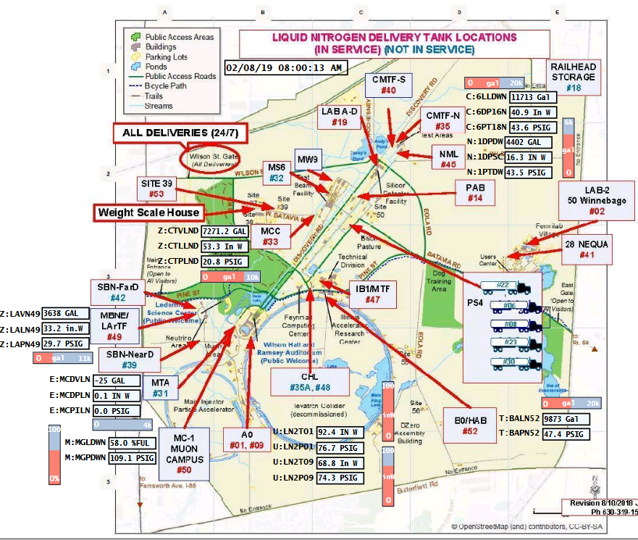
ACNET F45
Sitewide LN2 delivery locations and levels

