Slide 1
Status of Multithreaded LArSoft Work
Michael Wang with Erica Snider and Paul Russo
12 Feb 2019

Slide 2
Introduction
Background
Since version 3, ART now has multithreaded capability and can run multiple events belonging to the same SubRun in parallel
However LArSoft is not thread-safe, and therefore, the goal is to refactor its services and modules to make it so, and allow it to take advantage of ART v3’s multithreading.
We chose the LArFFT service and CalWireDUNE module as a test case on which to focus our initial refactoring effort. This was good choice since:
It was a major consumer of CPU time and would easily benefit from multithreaded operation
It was a fairly complex application that involved many services and underlying libraries
Provide a brief update on the status of this effort.

Slide 3
Deconstructing deconvolution
SignalShapingServiceDUNE
-fColSignalShaping -fIndUSSignalShaping -fIndVSSignalShaping
+SignalShaping() +Convolute() +Deconvolute()
SignalShaping
-fConvKernel -fDeconvKernel
+ConvKernel() +DeconvKernel() +Convolute() +Deconvolute()
LArFFT_service
-fSize -fFreqSize -fFFT -fInverseFFT
+FFTSize() +FFTOptions() +Deconvolute() +Convolute()
ROOT
TFFTComplexReal
#fIn #fOut #fPlan
+Init +SetPointComplex() +Transform() +GetPointReal()
TFFTRealComplex
#fIn #fOut #fPlan
+Init() +SetPoint() +Transform() +GetPointComplex()
CalWireDUNE10kt module
Art::ServiceHandle<util::SignalShapingServiceDUNE>sss;
.
.
// Loop over all wires
for(size_t rdIter=0;rdIter < digitVecHandle->size();++rdIter)
{
.
.
// Do deconvolution
sss->Deconvolute(channel,holder)
.
.
}
fftw3
fftw_malloc() fftw_plan() fftw_execute fftw_free fftw_destroy_plan
CalWire also uses:
ChannelMappingService
ChannelStatusProvider
Notes:
Derrida's “deconstruction” → “conducting readings of texts with an ear to what runs counter to the intended meaning or structural unity of a particular text”

Slide 4
Deconstructing deconvolution
SignalShapingServiceDUNE
-fColSignalShaping -fIndUSSignalShaping -fIndVSSignalShaping
+SignalShaping() +Convolute() +Deconvolute()
SignalShaping
-fConvKernel -fDeconvKernel
+ConvKernel() +DeconvKernel() +Convolute() +Deconvolute()
LArFFT_service
-fSize -fFreqSize -fFFT -fInverseFFT
+FFTSize() +FFTOptions() +Deconvolute() +Convolute()
ROOT
TFFTRealComplex
#fIn #fOut #fPlan
+Init +SetPointComplex() +Transform() +GetPointReal()
TFFTRealComplex
#fIn #fOut #fPlan
+Init +SetPoint() +Transform() +GetPointComplex()
CalWireDUNE10kt module
Art::ServiceHandle<util::SignalShapingServiceDUNE>sss;
.
.
// Loop over all wires
for(size_t rdIter=0;rdIter < digitVecHandle->size();++rdIter)
{
.
.
// Do deconvolution
sss->Deconvolute(channel,holder)
.
.
}
fftw3
fftw_malloc() fftw_plan() fftw_execute fftw_free fftw_destroy_plan

Slide 5
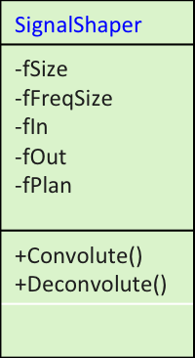
Reconstructing deconvolution
SignalShapingServiceDUNE
-fColSignalShaping -fIndUSSignalShaping -fIndVSSignalShaping
+SignalShaping() +Convolute() +Deconvolute()
SignalShaping
-fConvKernel -fDeconvKernel
+ConvKernel() +DeconvKernel() +Convolute() +Deconvolute()
SignalShaper
-fSize -fFreqSize -fIn -fOut -fPlan
+Convolute() +Deconvolute()
tbb:parallel_for
+GetDeconvKernel()
CalWireDUNE10kt module
Art::ServiceHandle<util::SignalShapingServiceDUNE>sss;
.
// Loop over all wires
for(size_t rdIter=0;rdIter < digitVecHandle->size();++rdIter)
{
// Construct SignalShaper Object
util::SignalShaper ssr(transformSize, fPlan, rPlan);
.
.
// Do deconvolution
ssr->Deconvolute(channel,holder);
.
}
fftw3
fftw_malloc() fftw_plan() fftw_execute fftw_free fftw_destroy_plan

Slide 6
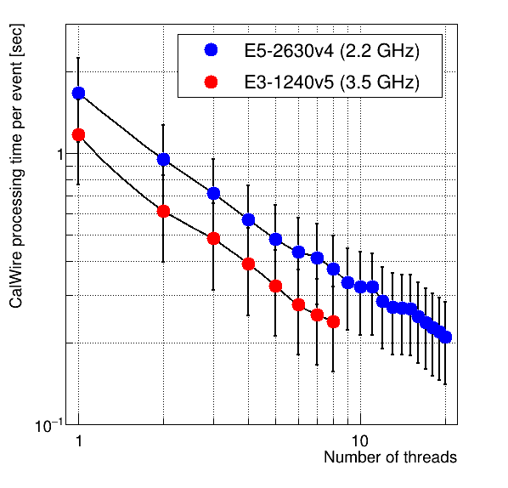
Processing times vs number of number of threads
10 core
4 core
~8x
~5x

Slide 7
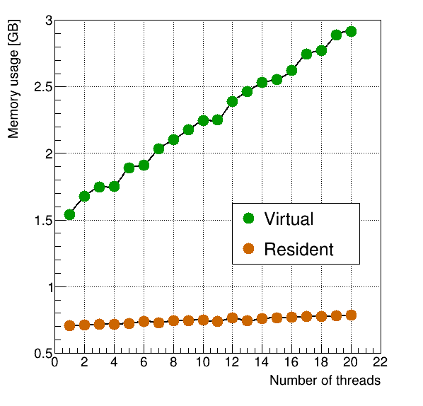
Memory usage vs number of threads

Slide 8
Various factors determining the startup time
Getting up to speed with:
Multithreading concepts
LArSoft and art
Understanding functionality of various LArSoft components and how they interact with each other:
CalWire module, SignalShaping service, SignalShaping class, LArFFT service
Replacing ROOT functionality and understanding how to use fftw3 in a thread-safe way
Understanding how to use TBB

Slide 9
Remaining work on SignalShaper
Factor out experiment-dependent parts
Implement remaining functions in LArFFT
Replace fitting and histogramming operations based on ROOT
Make SignalShaperPlan thread-safe across parallel events
Set up LArSoft + art v3 and run multiple events in parallel
Make sure services used by CalWire module are thread safe
Verify all changes made to SignalShaping service are fine
Learn to use the thread sanitizer to easily identify non-thread-safe portions of code

Slide 10
End

