Slide 1
Coil Support Structure Initial Design
Colin Narug
8 March 2019

Slide 2
Requirements
Five coils broken up into two types, A and B
Arranged in pattern A B A B A
B coils known as Side coils
A coils known as Shield/Center Coils
Shield Coil
6m from center
Exerts 2.2 MN away from center
Side Coil
2.5 m from center
Exerts 6.81 MN at the center
Coil Dimensions of 25cm x 25 cm

Slide 3
Minimum Requirements
Using generic aluminum and steel yields with SF of 2
Allowable yield of 145 MPa for steel
Allowable yield of 138 MPa for aluminum
Calculated minimum required area to prevent failure
Without any cross supports, welds, bolts , etc.
Final mass could be significantly larger
Steel
Shield to Side
Area = 0.015 m^2
Mass = 181.841 kg
Side to Center
Area = 0.047 m^2
Mass=938.136 kg
Aluminum
Shield to Side
Area = 0.016 m^2
Mass = 64.565 kg
Side to Center
Area = 0.049 m^2
Mass = 333.098 kg

Slide 4
Minimum Requirements Cont.
Coil will apply pressure on support structure
Pressure on Side Coil is about 1.196 MPa
Pressure on Shield Coil is about 1.186 MPa
Assuming density of copper for Coil
Side Coil is about 12,750 kg (125,100 N)
Shield Coil is about 1,385 kg (13,580 N)

Slide 5
Initial Design
Create 2 structures, Inner and Outer Frames.
Inner Frame
Inner structure made of support rings, coils and coil connections
Support each coil in a Support Ring
Connect each support ring longitudinally
Link inner and outer frames at coil B
Outer Frame
Outer frame connects to outside world
Supports weight of coils, resists inner forces
Can serve other purposes
Insulate, cable lead through, maintain environment

Slide 6
Inner Frame Initial Design
Create 2 structures, Inner and Outer Frames.
Line Bodies used to create initial analysis/design
Not the most accurate, but quick and good for truss analysis
Using Aluminum Hollow Structural Sections an initial, solution has been found
HSS 304.8 x 203.2 x 12.7
Not optimized, crosses through stay clears, but workable
Front View
Iso. View
Side View

Slide 7
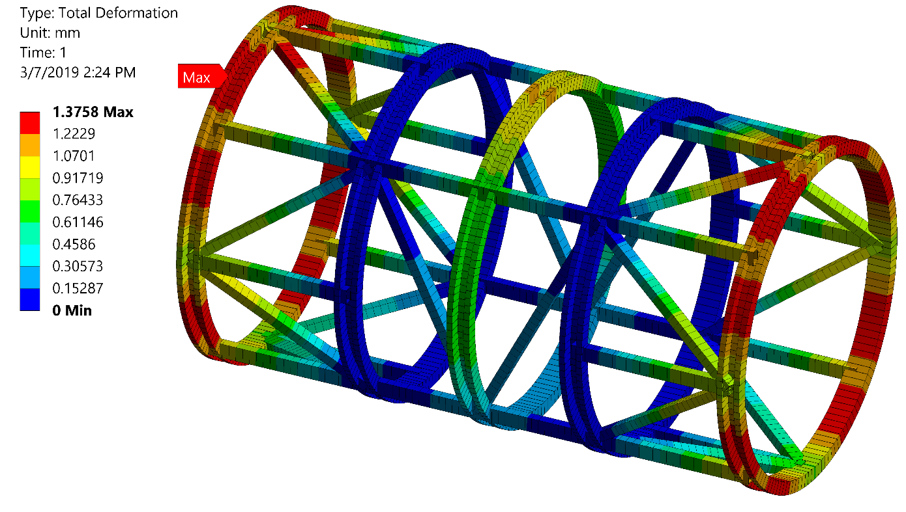
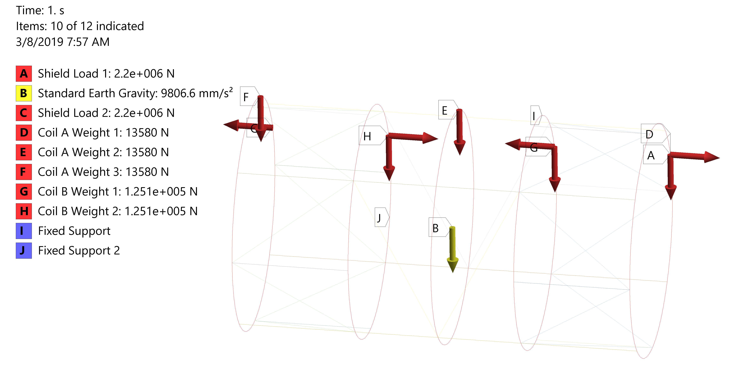
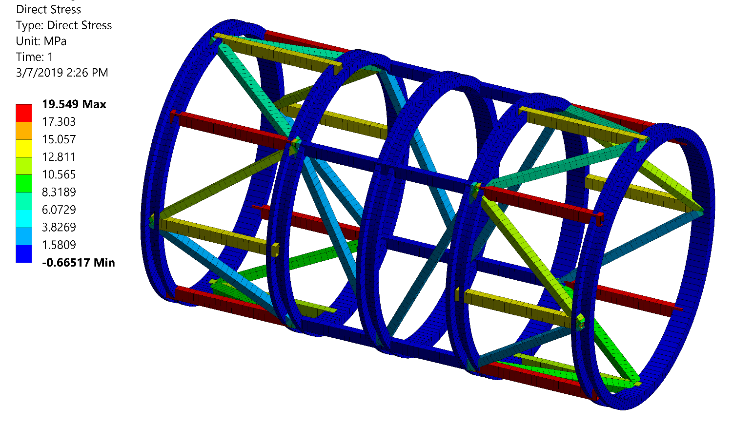
Simulation Results

Slide 8
Summary
Deformation Less than 2 mm
1.07 mm vertical
1.26 mm horizontal
Stress in structure less than allowable
19.5 MPa
Edits to structure, methods of connection, etc. still needed.
Currently has a mass of 4,391 kg in coil connecters
Coil Support has mass of 23,010 kg

