Slide 1
Summary of Fermilab Robotic Workshop
Katsuya Yonehara
TSD Topical Meeting
2/28/2019

Slide 2
1st Robotic Workshop at Fermilab
Held on February 6, 2019
https://indico.fnal.gov/event/19436/overview
> 50 attendees
  Many Fermilab folks
  Three national labs
    CERN, SNS, and ANL
  Five universities
    UIC, IIT, NIU, Lewis, and U of Chicago

Slide 3
Scope of the Workshop
Fermilab proposes to build a MW-class high energy beam facility for the intensity frontier experiments. We recognize that robotic and autonomous technologies are a key element to successfully operate accelerator machines under severe radioactive environments. We discern state-of-the-art robotic and autonomous technologies in accelerator facilities. We set the workshop charge as follows:
To understand the potential applications of robotic and autonomous devices in the operations and maintenance of the accelerator that leads to increased efficiency of work and safety of personnel
To learn of existing technologies that can be applied right away
To identify potential areas of long-term collaboration with universities, other national laboratories, and industry

Slide 4
Structure of Workshop
Morning session
  Current issues on Fermilab AD presented by each AD Dept. delegate
  State of the Art Robotic Tech. presented by visitors
Afternoon session
  Brainstorming
Follow up
  Report the outcome to AD Director

Slide 5
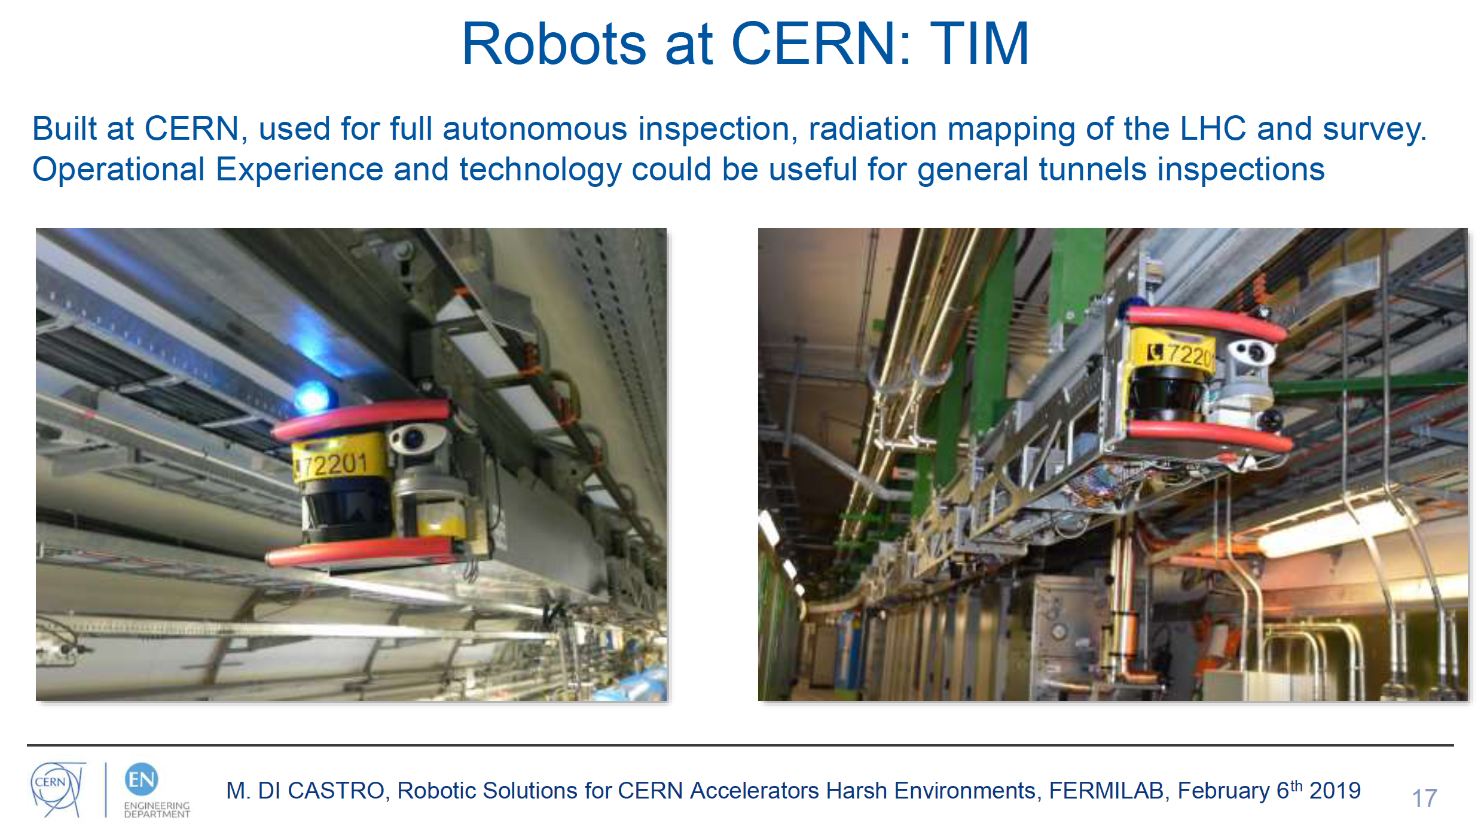

Slide 6
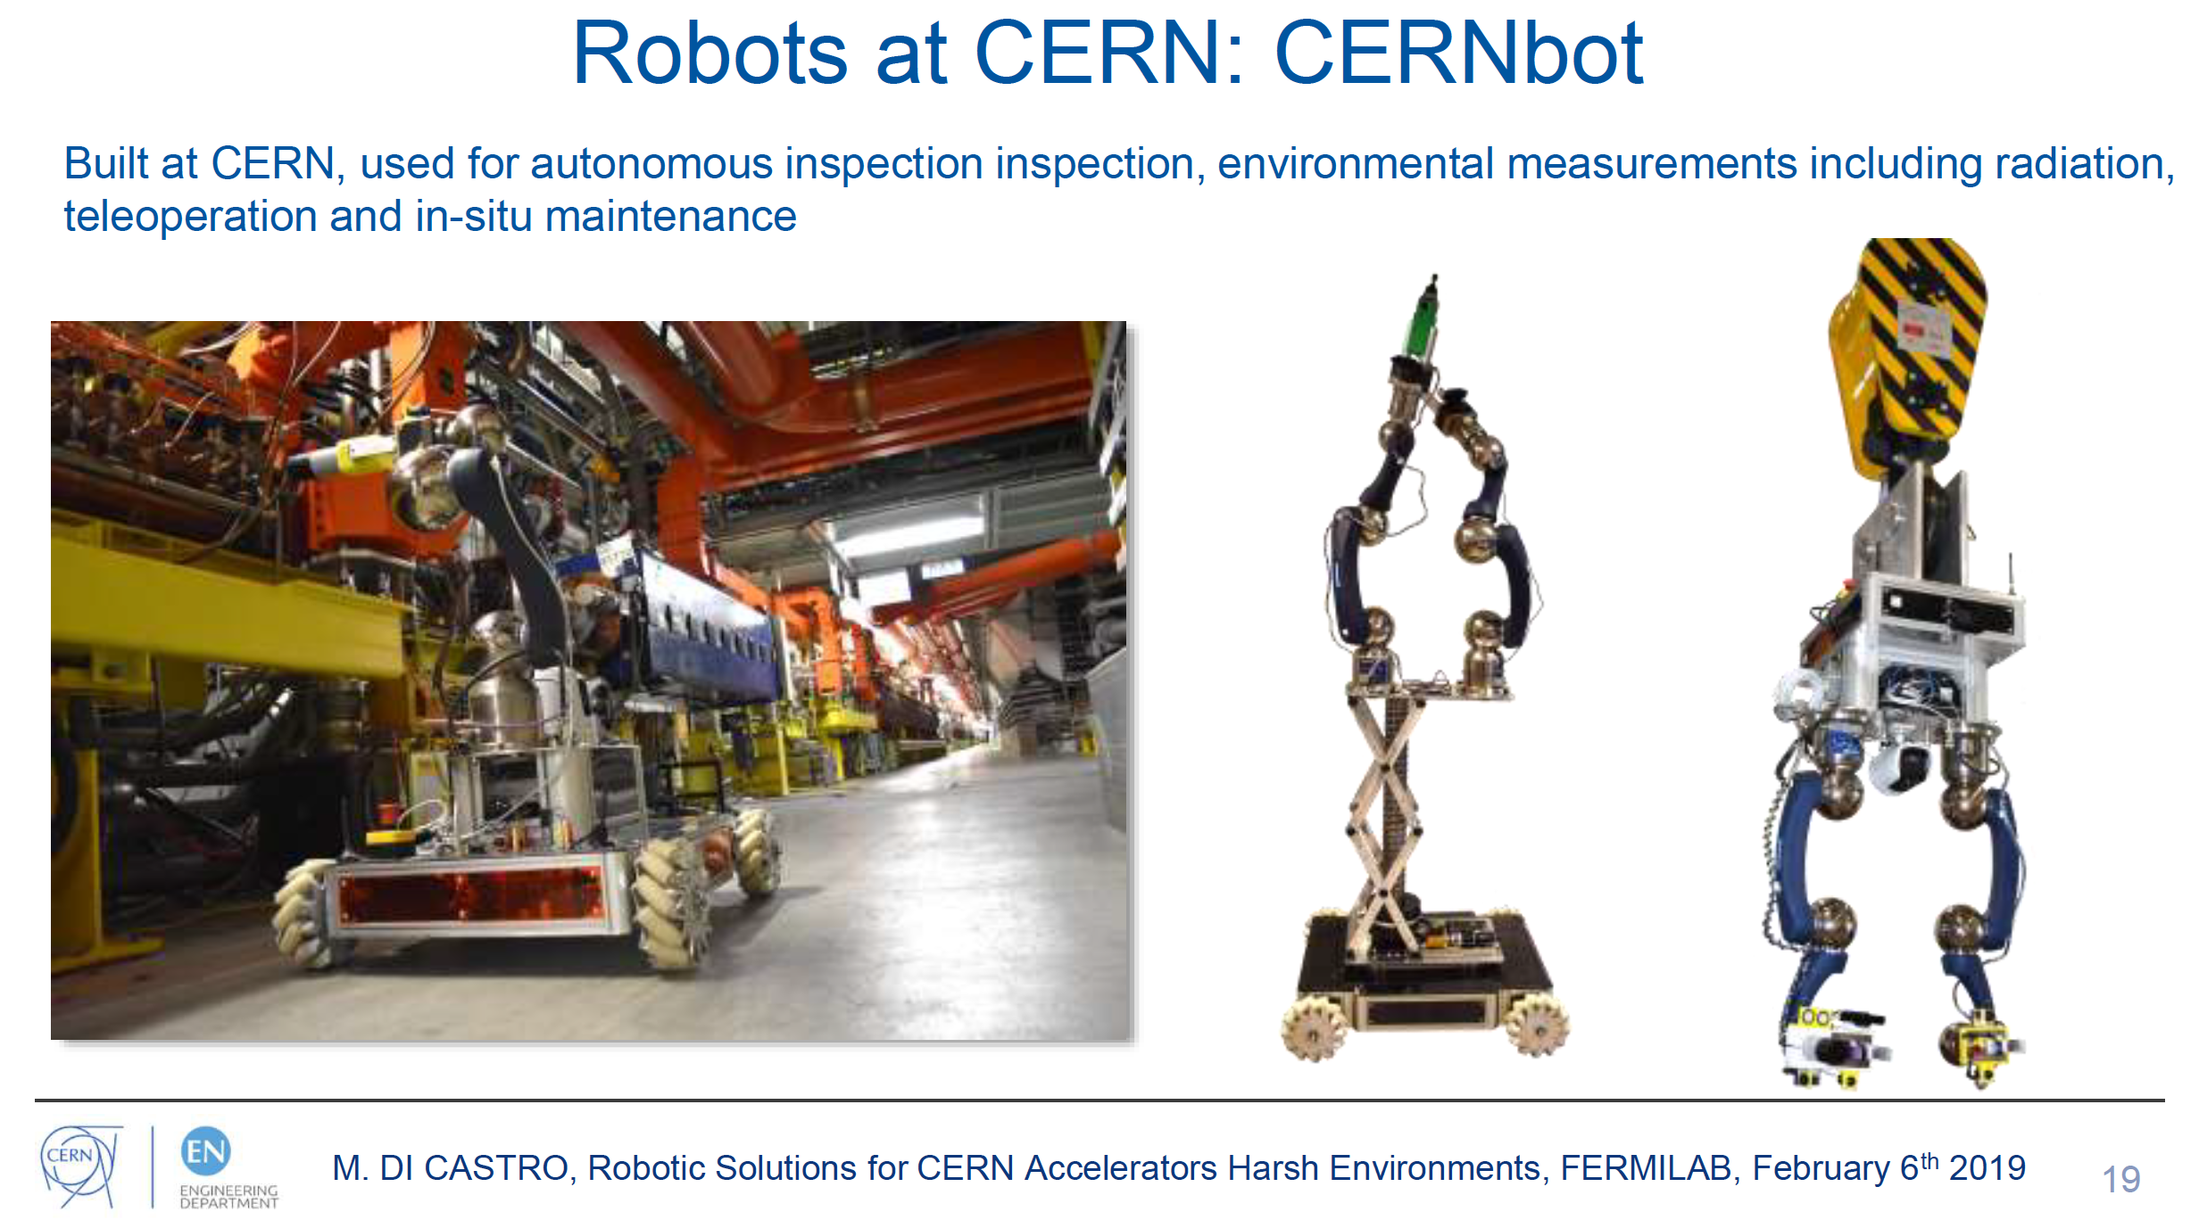

Slide 7
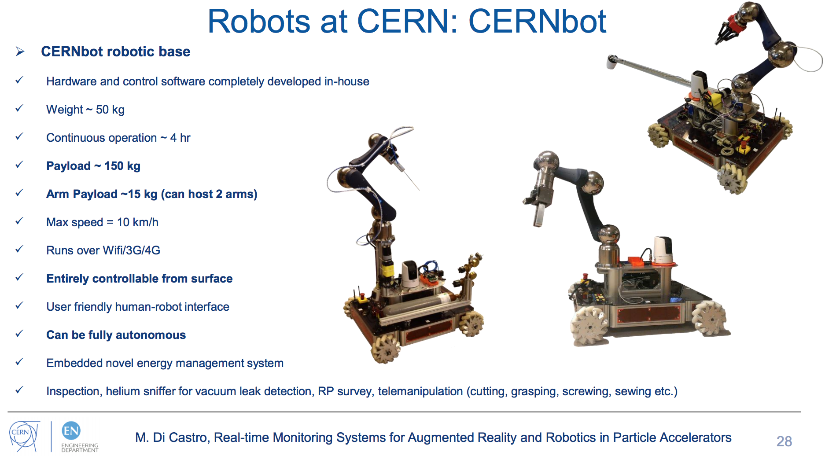

Slide 8
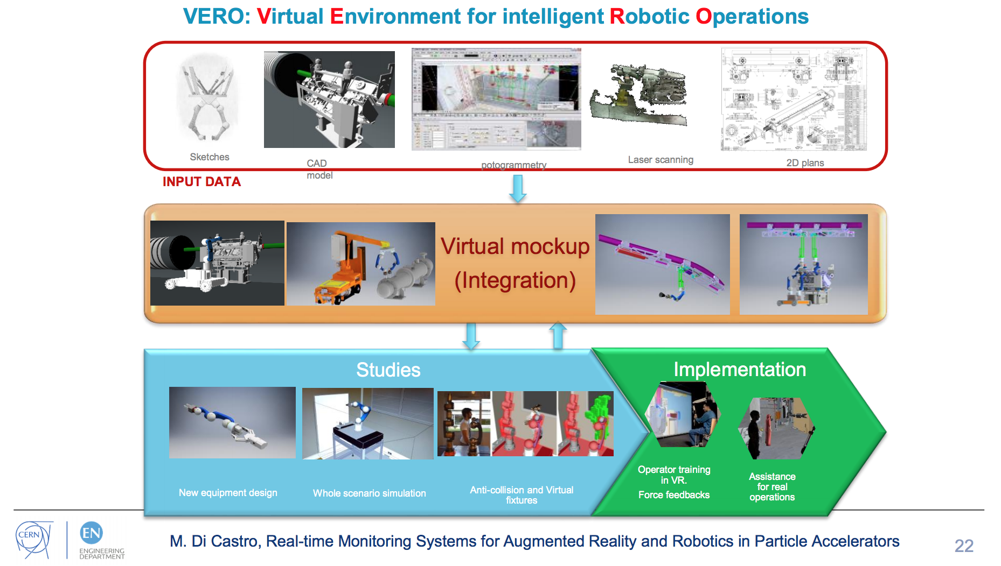

Slide 9
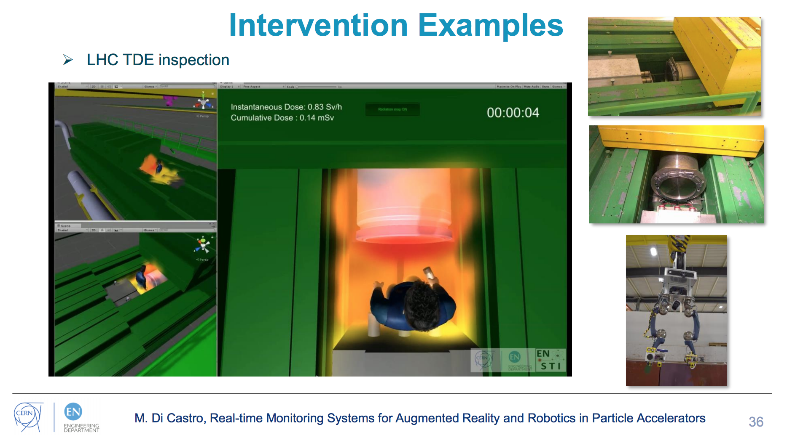

Slide 10
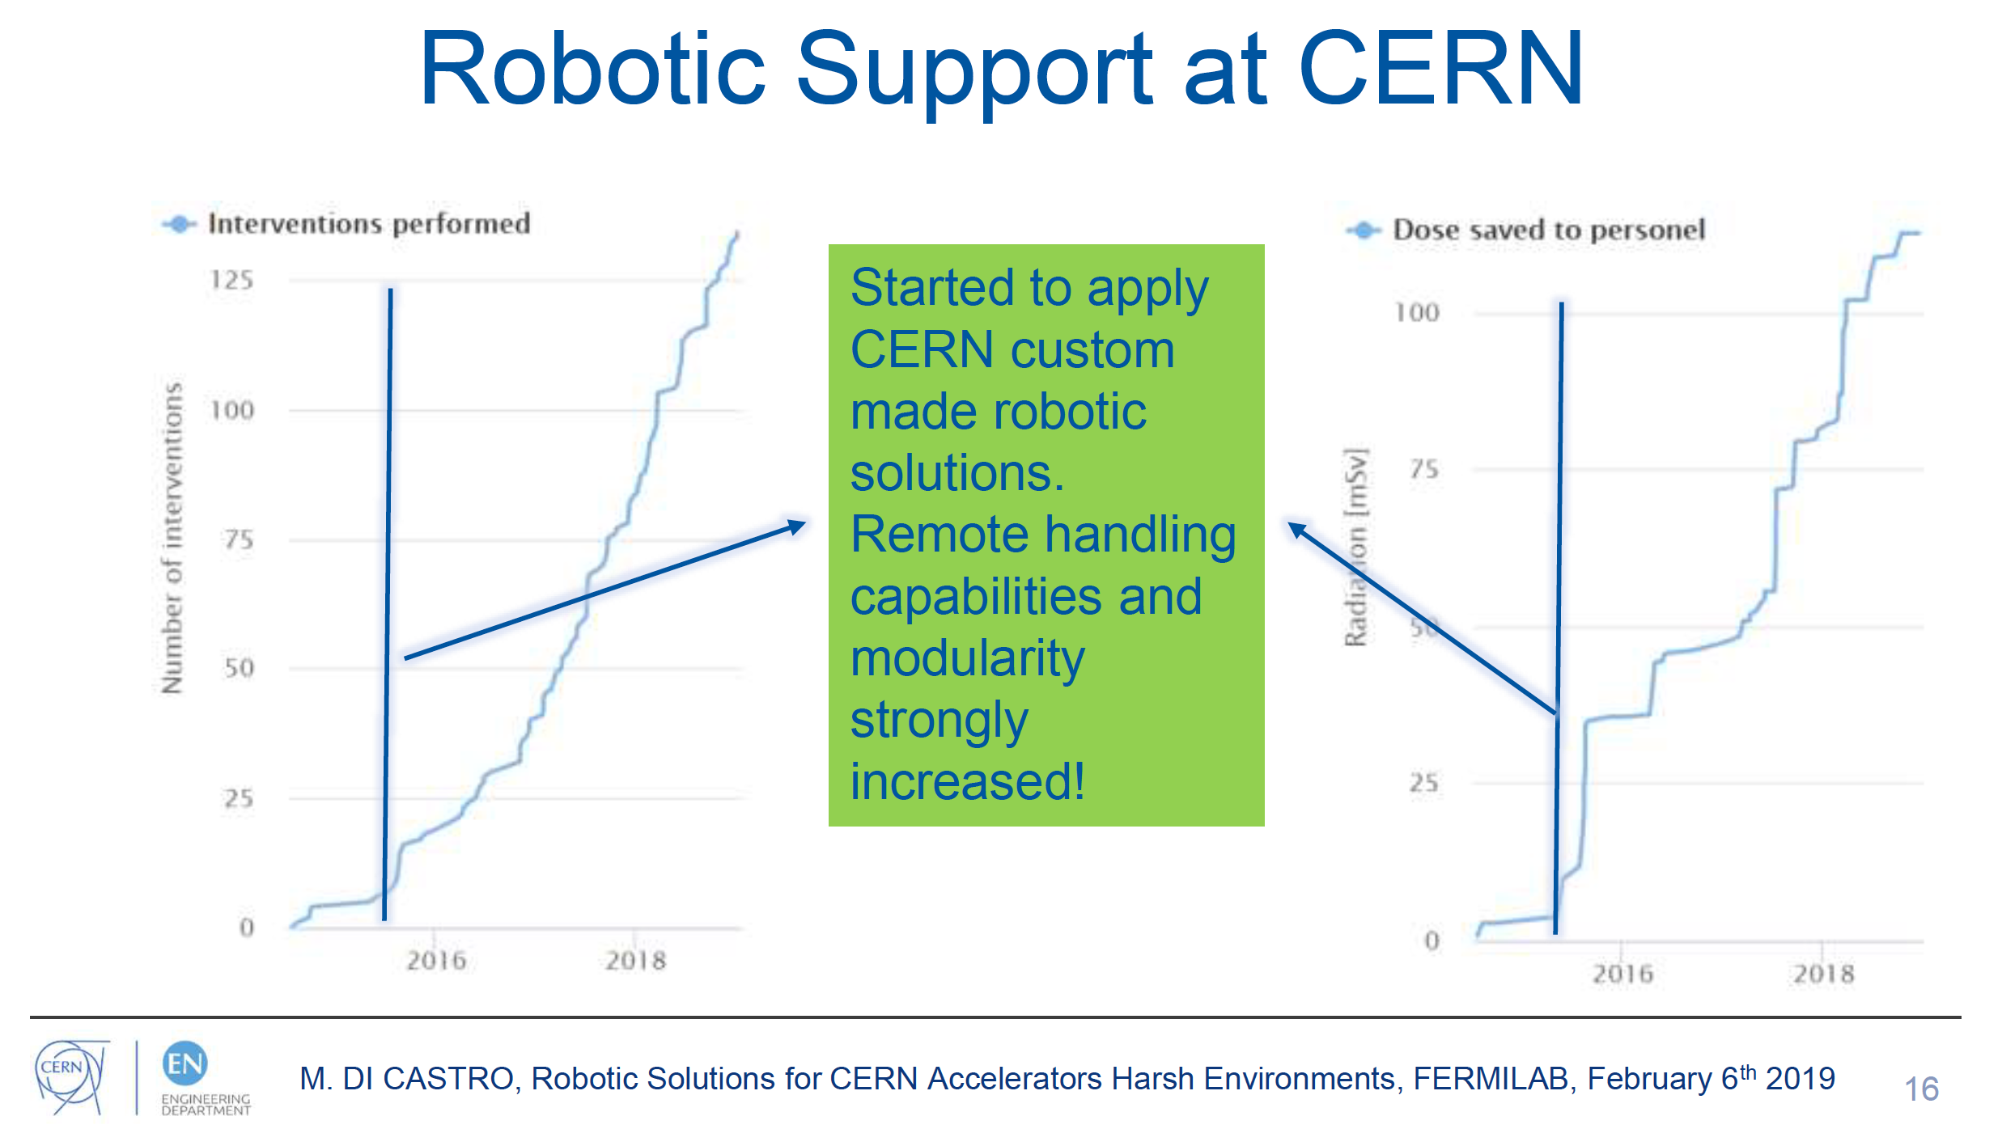

Slide 11
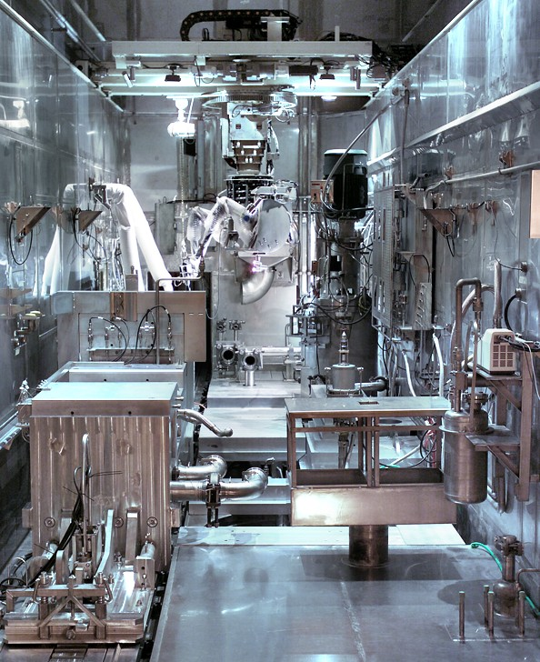
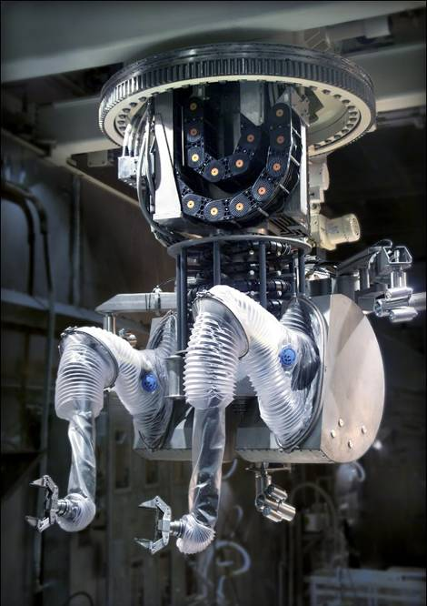
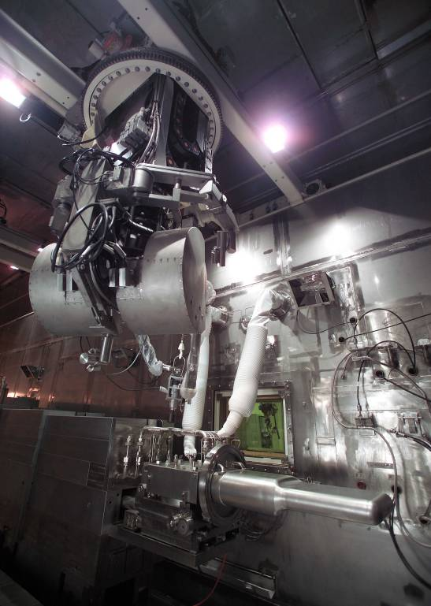
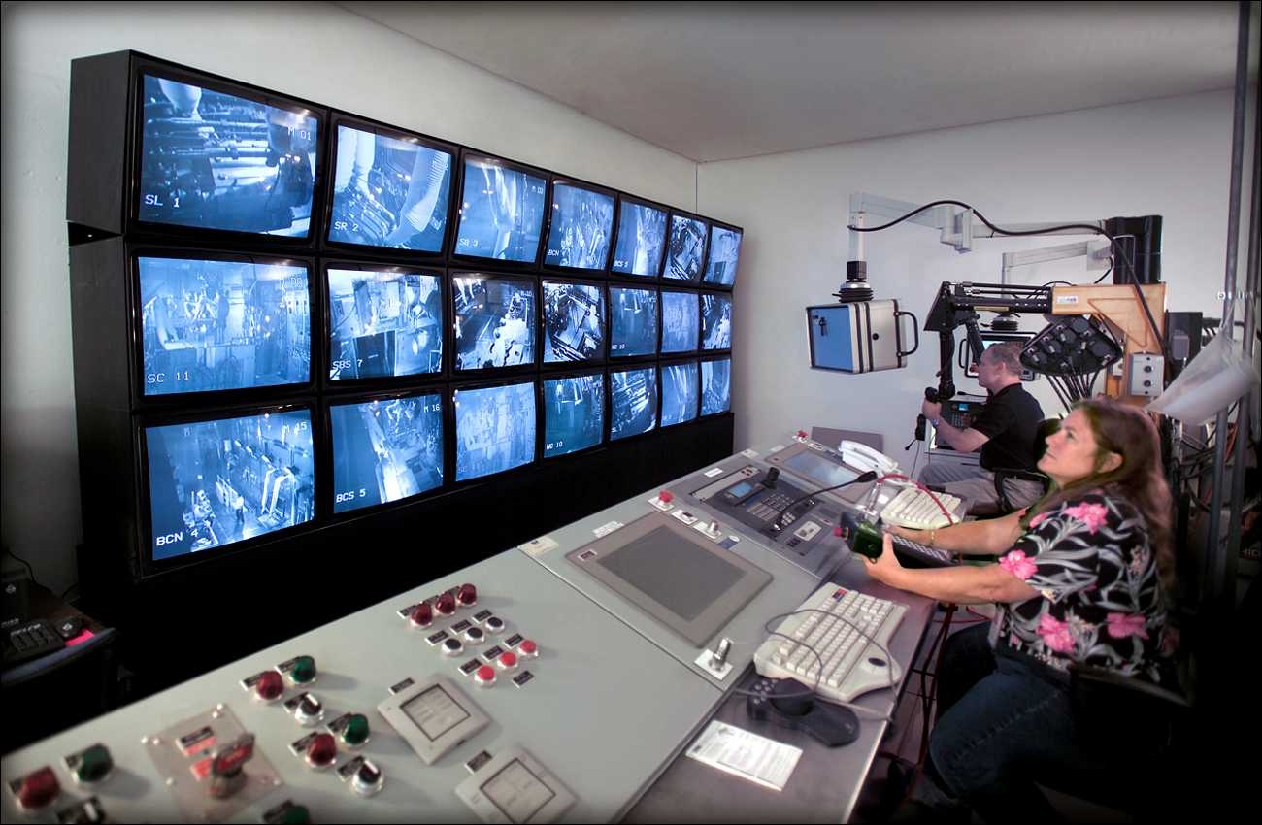
SNS target cell remote systems:
SNS target facility is a rare US remote Hot Cell – Late 2000
Remote Controlled Servomanipulator
Mercury Target Process Cell
Target
Remote Handling Control Room
Notes:
On the left you see the SNS hot cell itself…all stainless steel lined complete with process equipment specifically designed for remote maintenance…and yes we are all too well aware that that is not typical in many if not most D&D type applications. Most DOE facilities were not designed to be D&D’d.
These two shots show the commercial manipulator system that was specified and procured for SNS. Actually two such systems were bought for different parts of the facility.
The final shot is the operator control area.

Slide 12
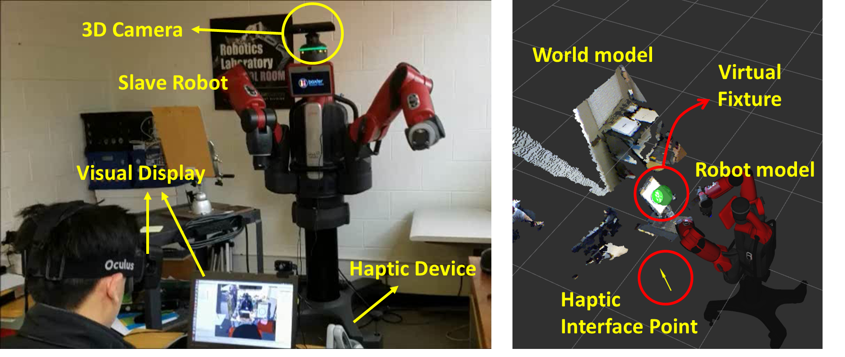
Augmented Teleoperation
Robotic at ANL
Telerobotic System
Mixed-Reality Operator Interface

Slide 13
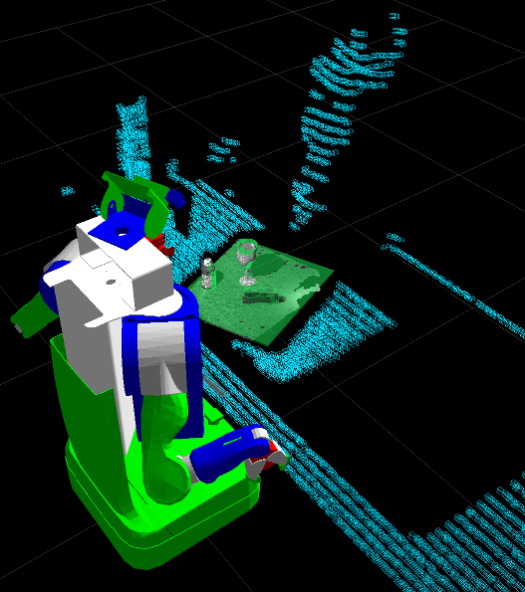
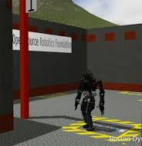
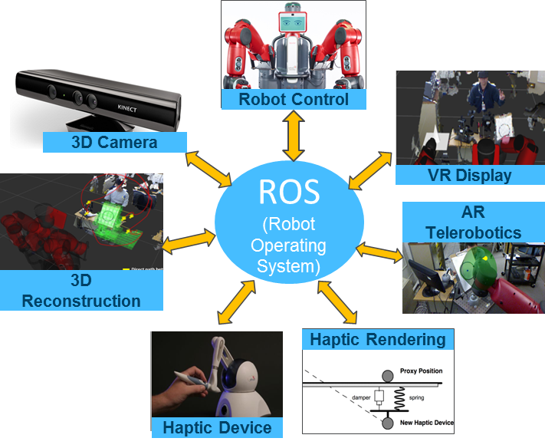
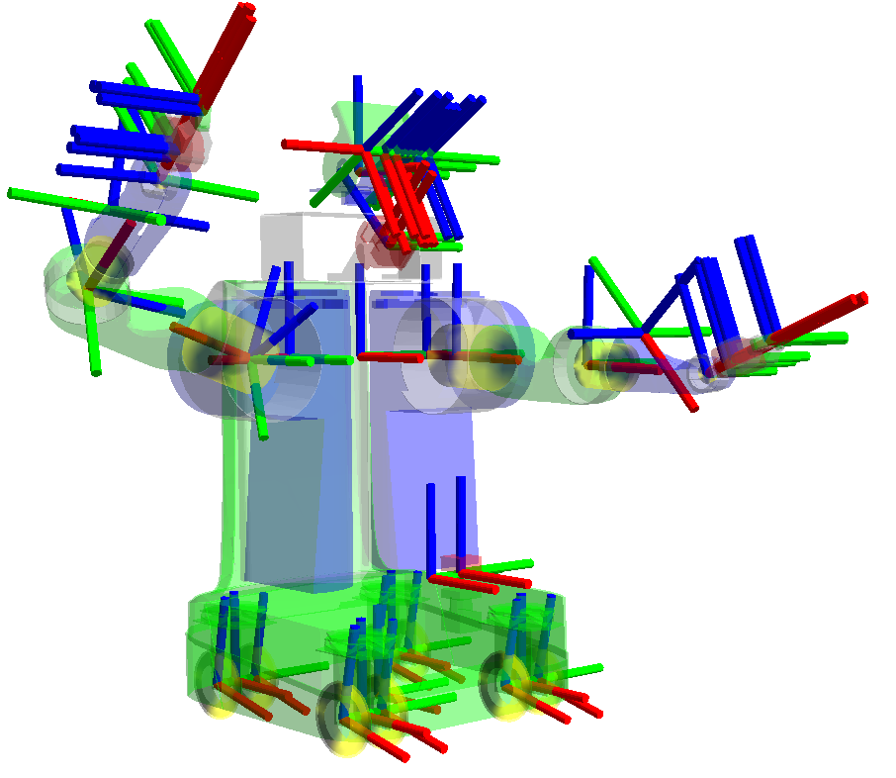
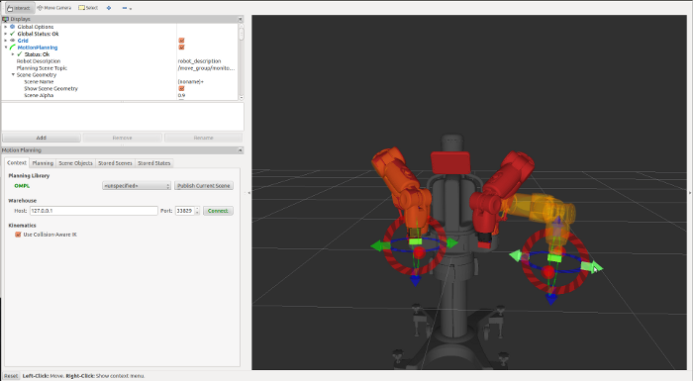
Robot Operating System (ROS) for System integration
Robotic at ANL
Rviz - Visualization
Gazebo - 3D Simulation
ROS for System Integration
MoveIt! - Motion Planning
TF - Transformations

Slide 14
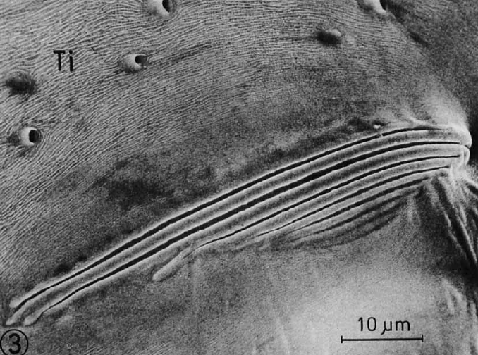
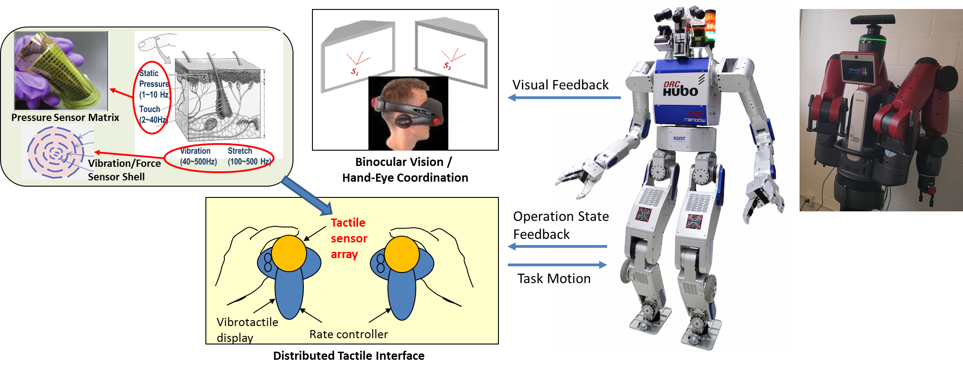
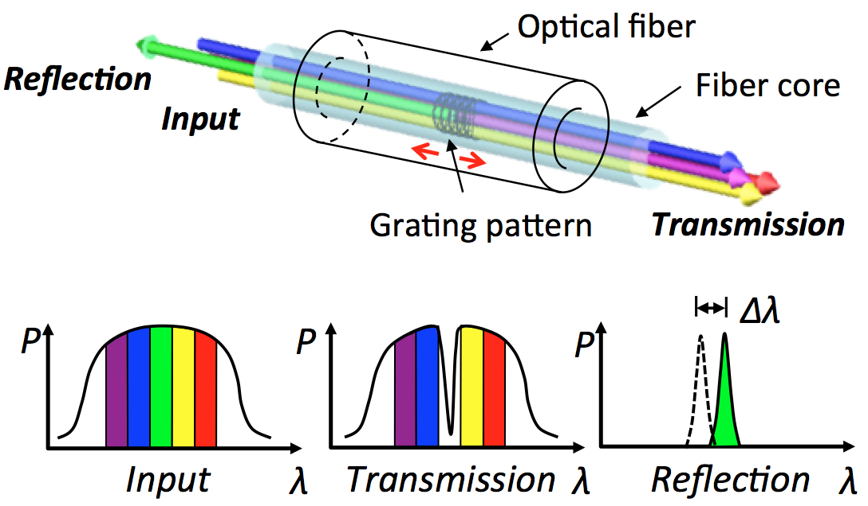
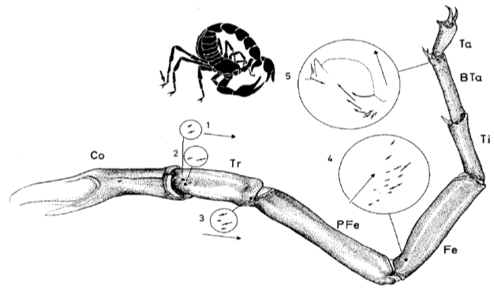
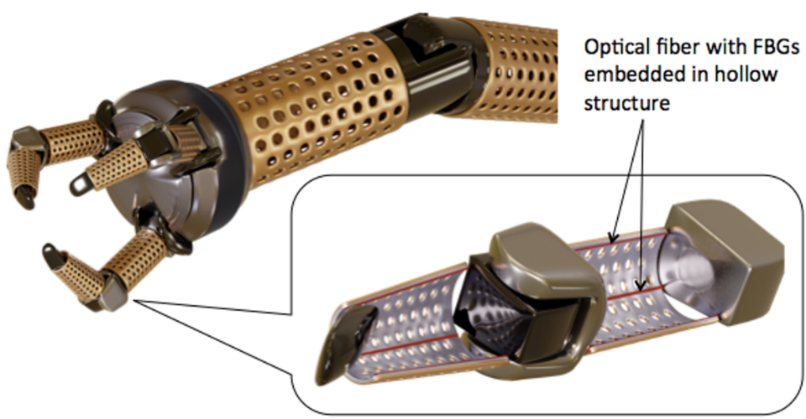
Human-Robot Interaction
Robotic at ANL
Teleoperator Interface
Whole-arm Sensitive Manipulator
Wearable Robotic Devices
Slit Sensilla
10 m
Scorpion

Slide 15
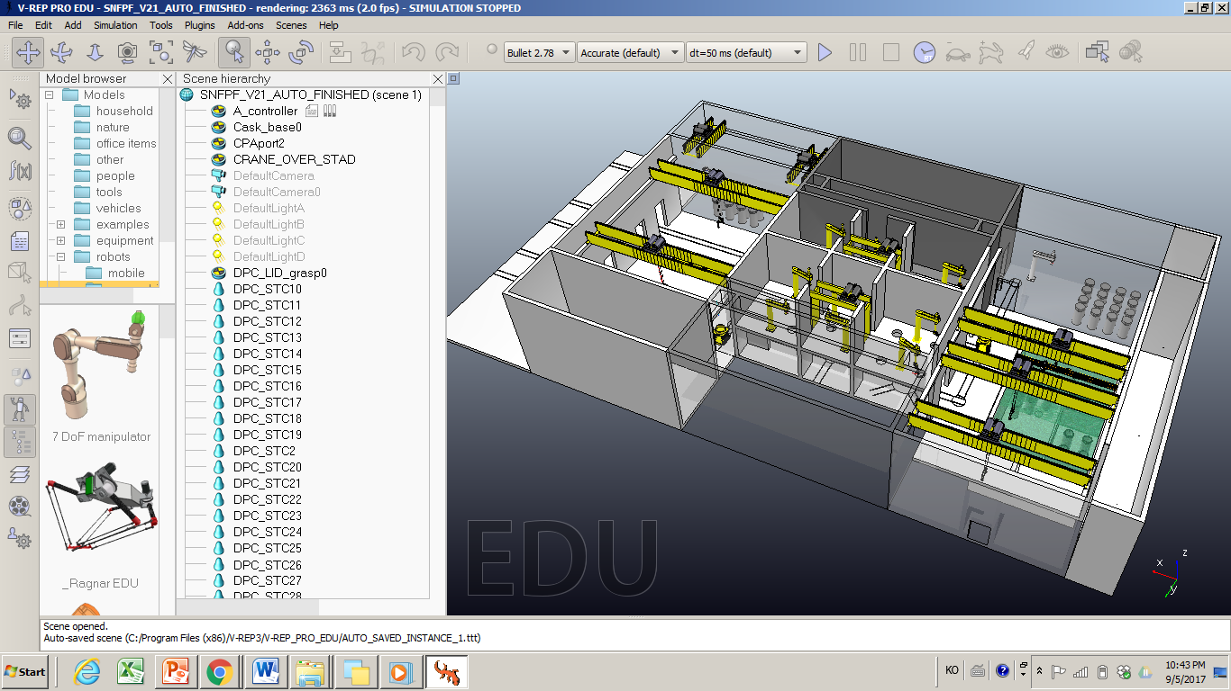
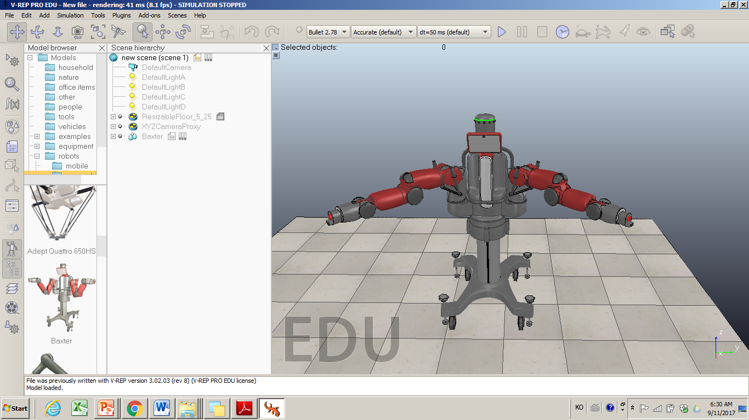
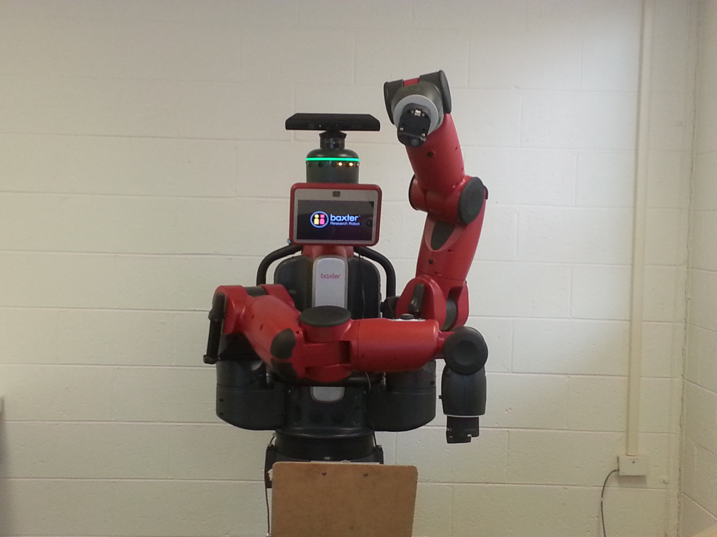
Robotic at ANL
Digital prototyping and 3D Simulation
Nuclear Waste Management Simulation: (TBD)
  Large-scale virtual robotic simulation of spent nuclear fuel repackaging facility operation
VR/AR Display
Hardware-inclusive Simulation of robotics and automations concepts

Slide 16
Recap
Robotic tech can significantly improve our working environment
  Reduce personnel dose
  Reduce accidental event
Increase working efficiency
  Assist human activity
    Lift, carry, support for a heavy stuff for long time
    Make a special action that human being never makes it
What is so hard to introduce robot?
  Most object is designed for human being
  Most robot has a single function; Making a multi-function robot significantly complicate
  Besides, robot is less flexible than human being; Most robot cannot respond to any unpredicted events

Slide 17
Comment from AD Director
Recognized a world-wide activity of robotic R&D for Accelerator Applications
Encourage Fermilab employee to get support from DOE
  Consider R&D
  Build a strategic plan
He has a small amount of money to hire a couple of summer students
  This can be a seed of the robotic activity at Fermilab

Slide 18
TSD responsibility
Build a strategic plan for TSD
  Identify existing robot/remote handling
  Prioritize the issue
  Estimate cost

Slide 19
From my thought about R&D…
Develop robot communication technology
  Robot communicates with other robot & share information
    Ex) one found a broken part & water leak & hot spot
  Team work
    Form a robot team by themselves
    Make a strategy to fix the issue
    Carry out
  Inform human being
    Modify their strategy
    Verify the plan
    Monitor their activity

