Slide 1
1MW Horn Stripline + Air Diverter Wind-Tunnel Testing
Cory Crowley, George Lolov, & Lionel Pittman
TSD Topical Meeting
2/28/2019

Slide 2
Outline
Cory
1MW Stripline Motivation & Requirements
Testing & Design Goals
T-Block Air Diverter
George
Testing Setups
Upgraded Diverter Design
Data Acquisition / Analysis
Cory + George
Current Status
TSD Topical Meeting / 1MW Horn Stripline + Air Diverter Wind-Tunnel Testing
2/28/19

Slide 3
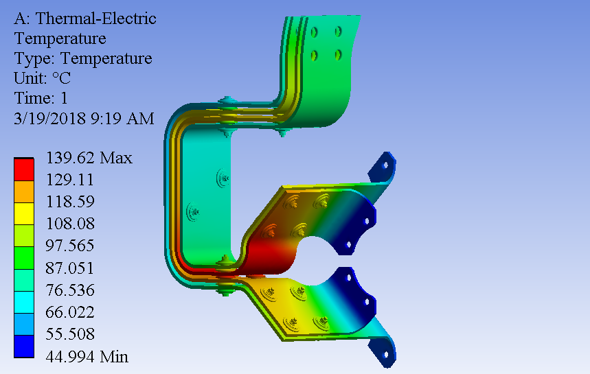
1MW Stripline Motivation & Requirements
Existing 700kW stripline & air diverter system is not a viable solution at 1MW.
Max stripline temperature desired to be less than 100C at any point.
Must maintain 100,000,000 pulse lifetime requirement. Temperature & resultant material creep makes pulse life determination impossible.
New Stripline
Must mate to existing NOvA Horn conductor flange geometry.
Improve material selection where possible (6013 aluminum).
Improve air cooling to stripline structure.
Analysis Credit: Zhijing Tang
TSD Topical Meeting / 1MW Horn Stripline + Air Diverter Wind-Tunnel Testing
2/28/19

Slide 4
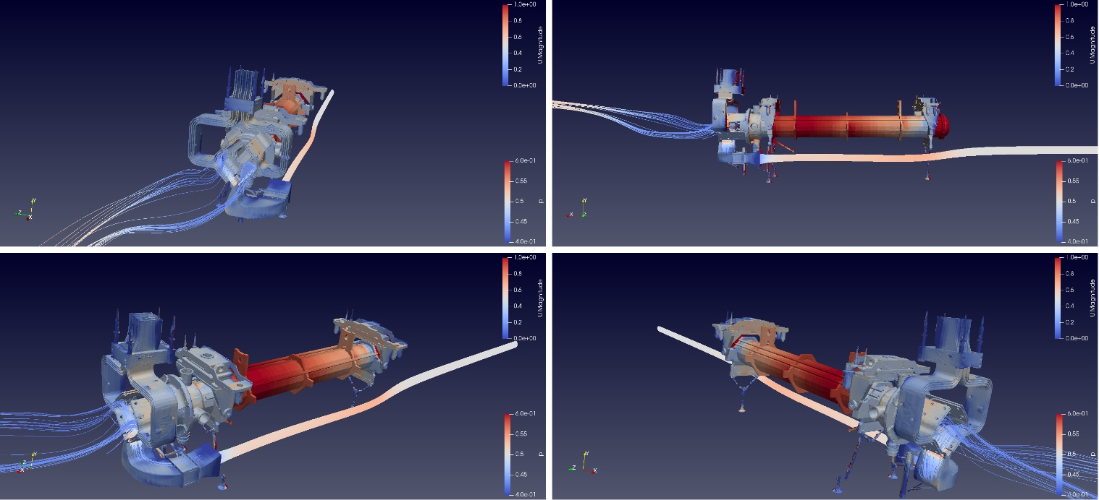
Testing & Design Goals
Understand existing air flow characteristics & heat transfer.
Identify improvements to existing structures & verify through iterative theoretical & experimental testing.
Verify conclusions and final production design with repeat wind tunnel & heat transfer test.
Analysis Credit: Lionel Pittman
TSD Topical Meeting / 1MW Horn Stripline + Air Diverter Wind-Tunnel Testing
2/28/19

Slide 5
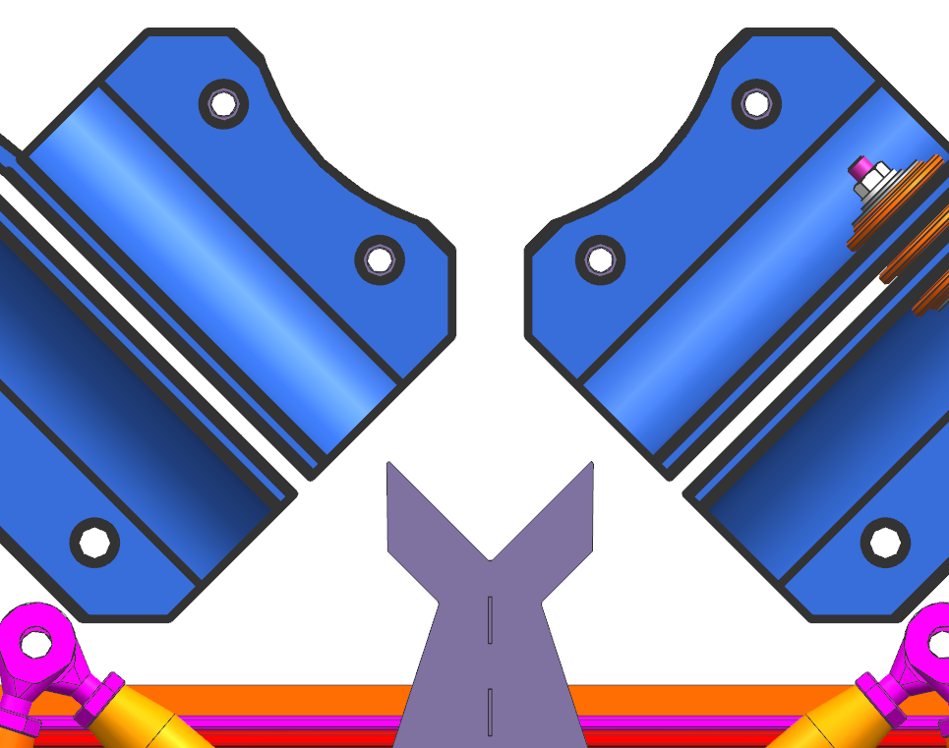
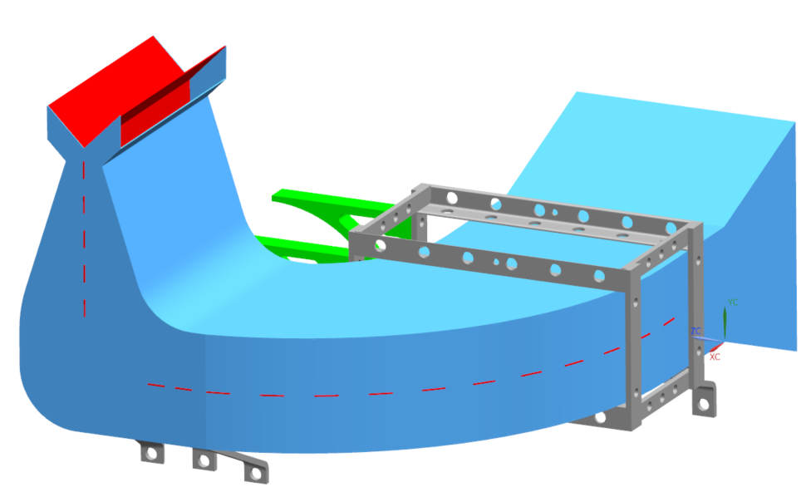
CFD Conclusions of Existing Diverter
Provides good flow for inner lower flags; moderate flow for inner upper flags.
Sharp edges and pinch points appear to impeded air velocity.
Initial thoughts were that they created eddy currents to improve flow.
Theoretical simulations show these can be improved (George to discuss further).
Sharp Edges
Outlet Duct
Middle Duct
Divider
Mounting Bracket
Inlet Duct
Low Airflow
Low Airflow
TSD Topical Meeting / 1MW Horn Stripline + Air Diverter Wind-Tunnel Testing
2/28/19

Slide 6
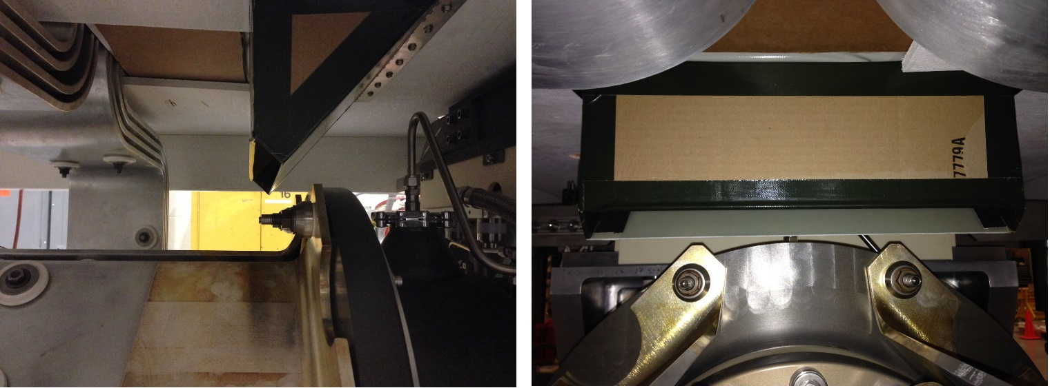
T-Block Air Diverter
Solution needed to address stripline upper flags and vertical side spans.
Two realistic solutions:
Pipe air down through stripline block.
Dedicate T-block with internal duct.
Internal duct chosen because of direct access to hot upper flags.
Air deflection from T-block appears to greatly help vertical side spans as well.
Multiple diverter angles tested; winner is 45 degrees at ~600 CFM.
TSD Topical Meeting / 1MW Horn Stripline + Air Diverter Wind-Tunnel Testing
2/28/19

Slide 7
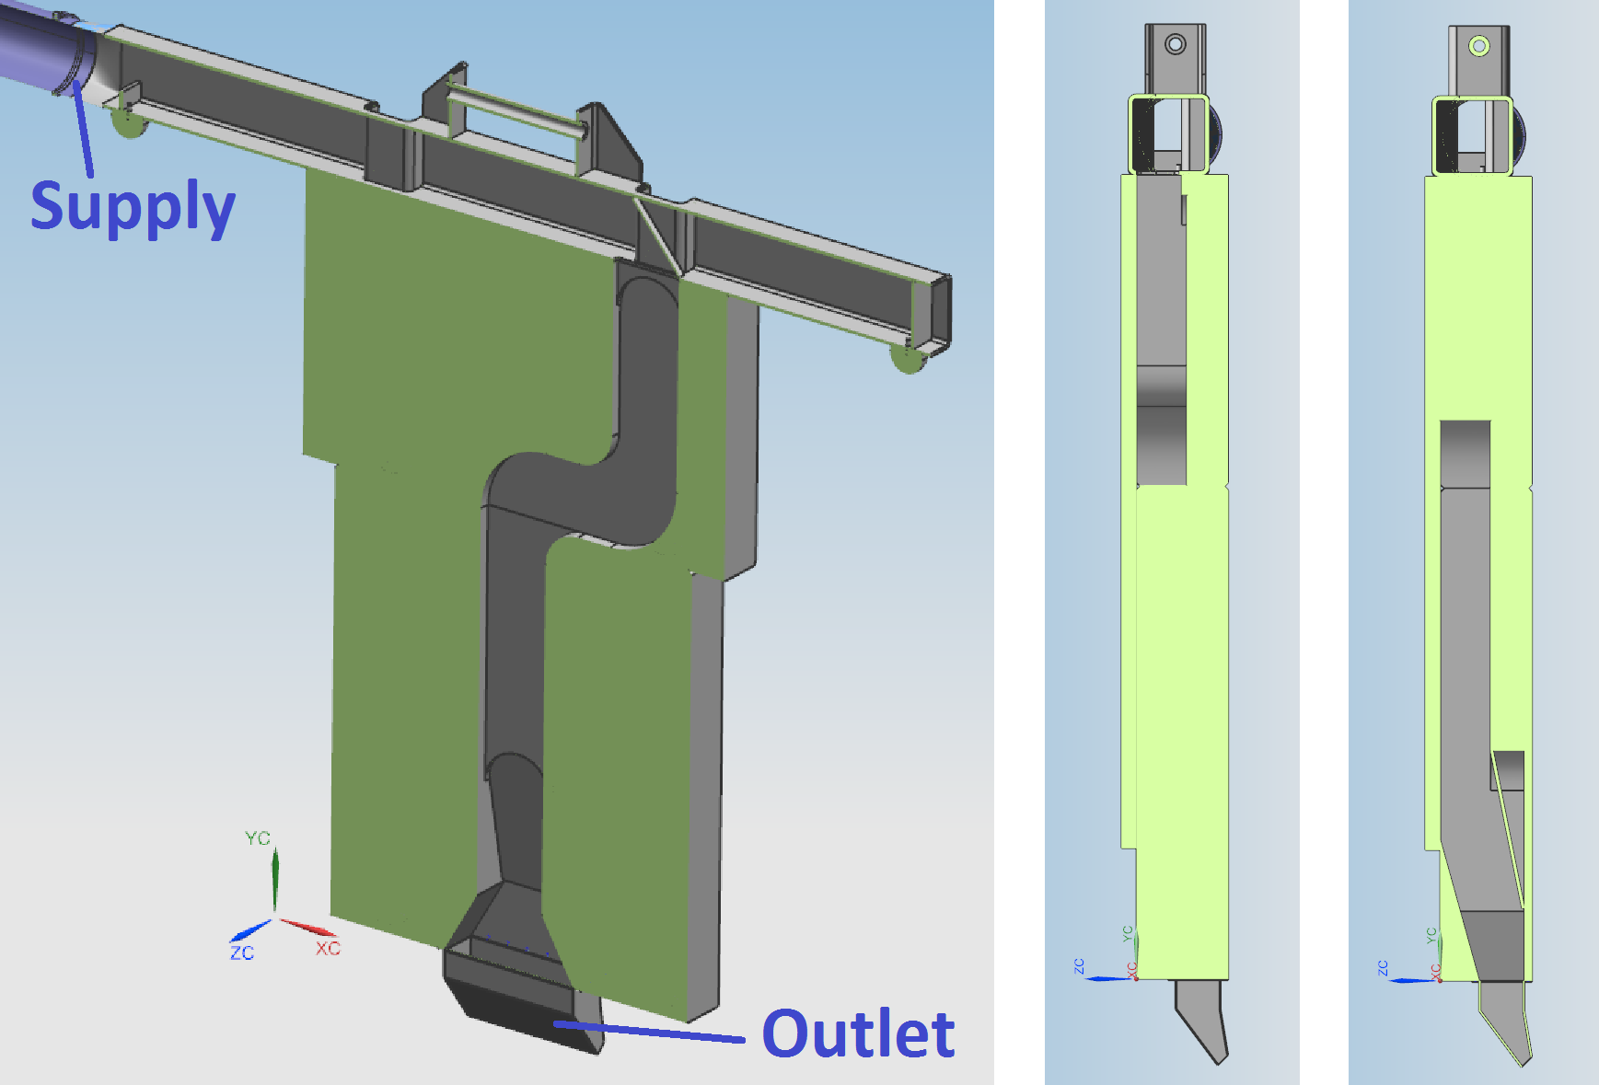
T-Block Air Diverter
Drop in replacement T-block.
Channel dimensions minimized (8” wide X 4” deep).
Labyrinth dogleg direction is opposite that of stripline block to minimize effect on shielding.
Supply fed through structural box beam support on beam left & will employ quick disconnect coupling.
TSD Topical Meeting / 1MW Horn Stripline + Air Diverter Wind-Tunnel Testing
2/28/19

Slide 8
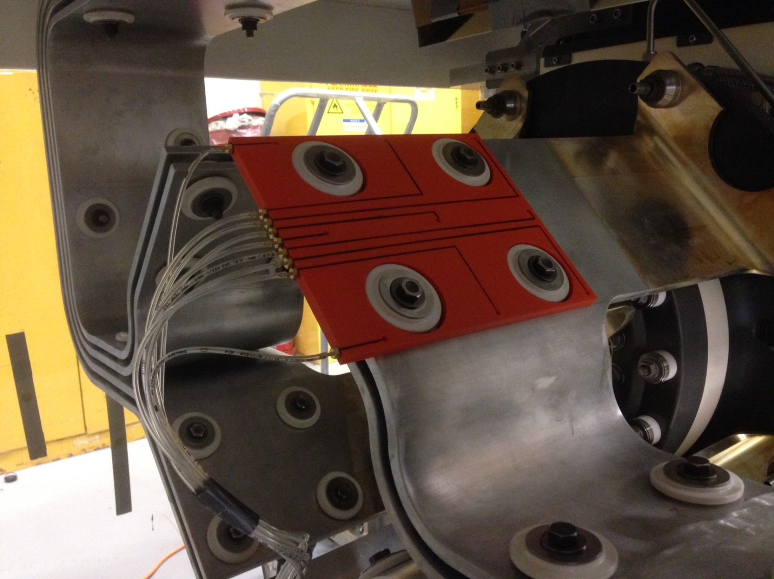
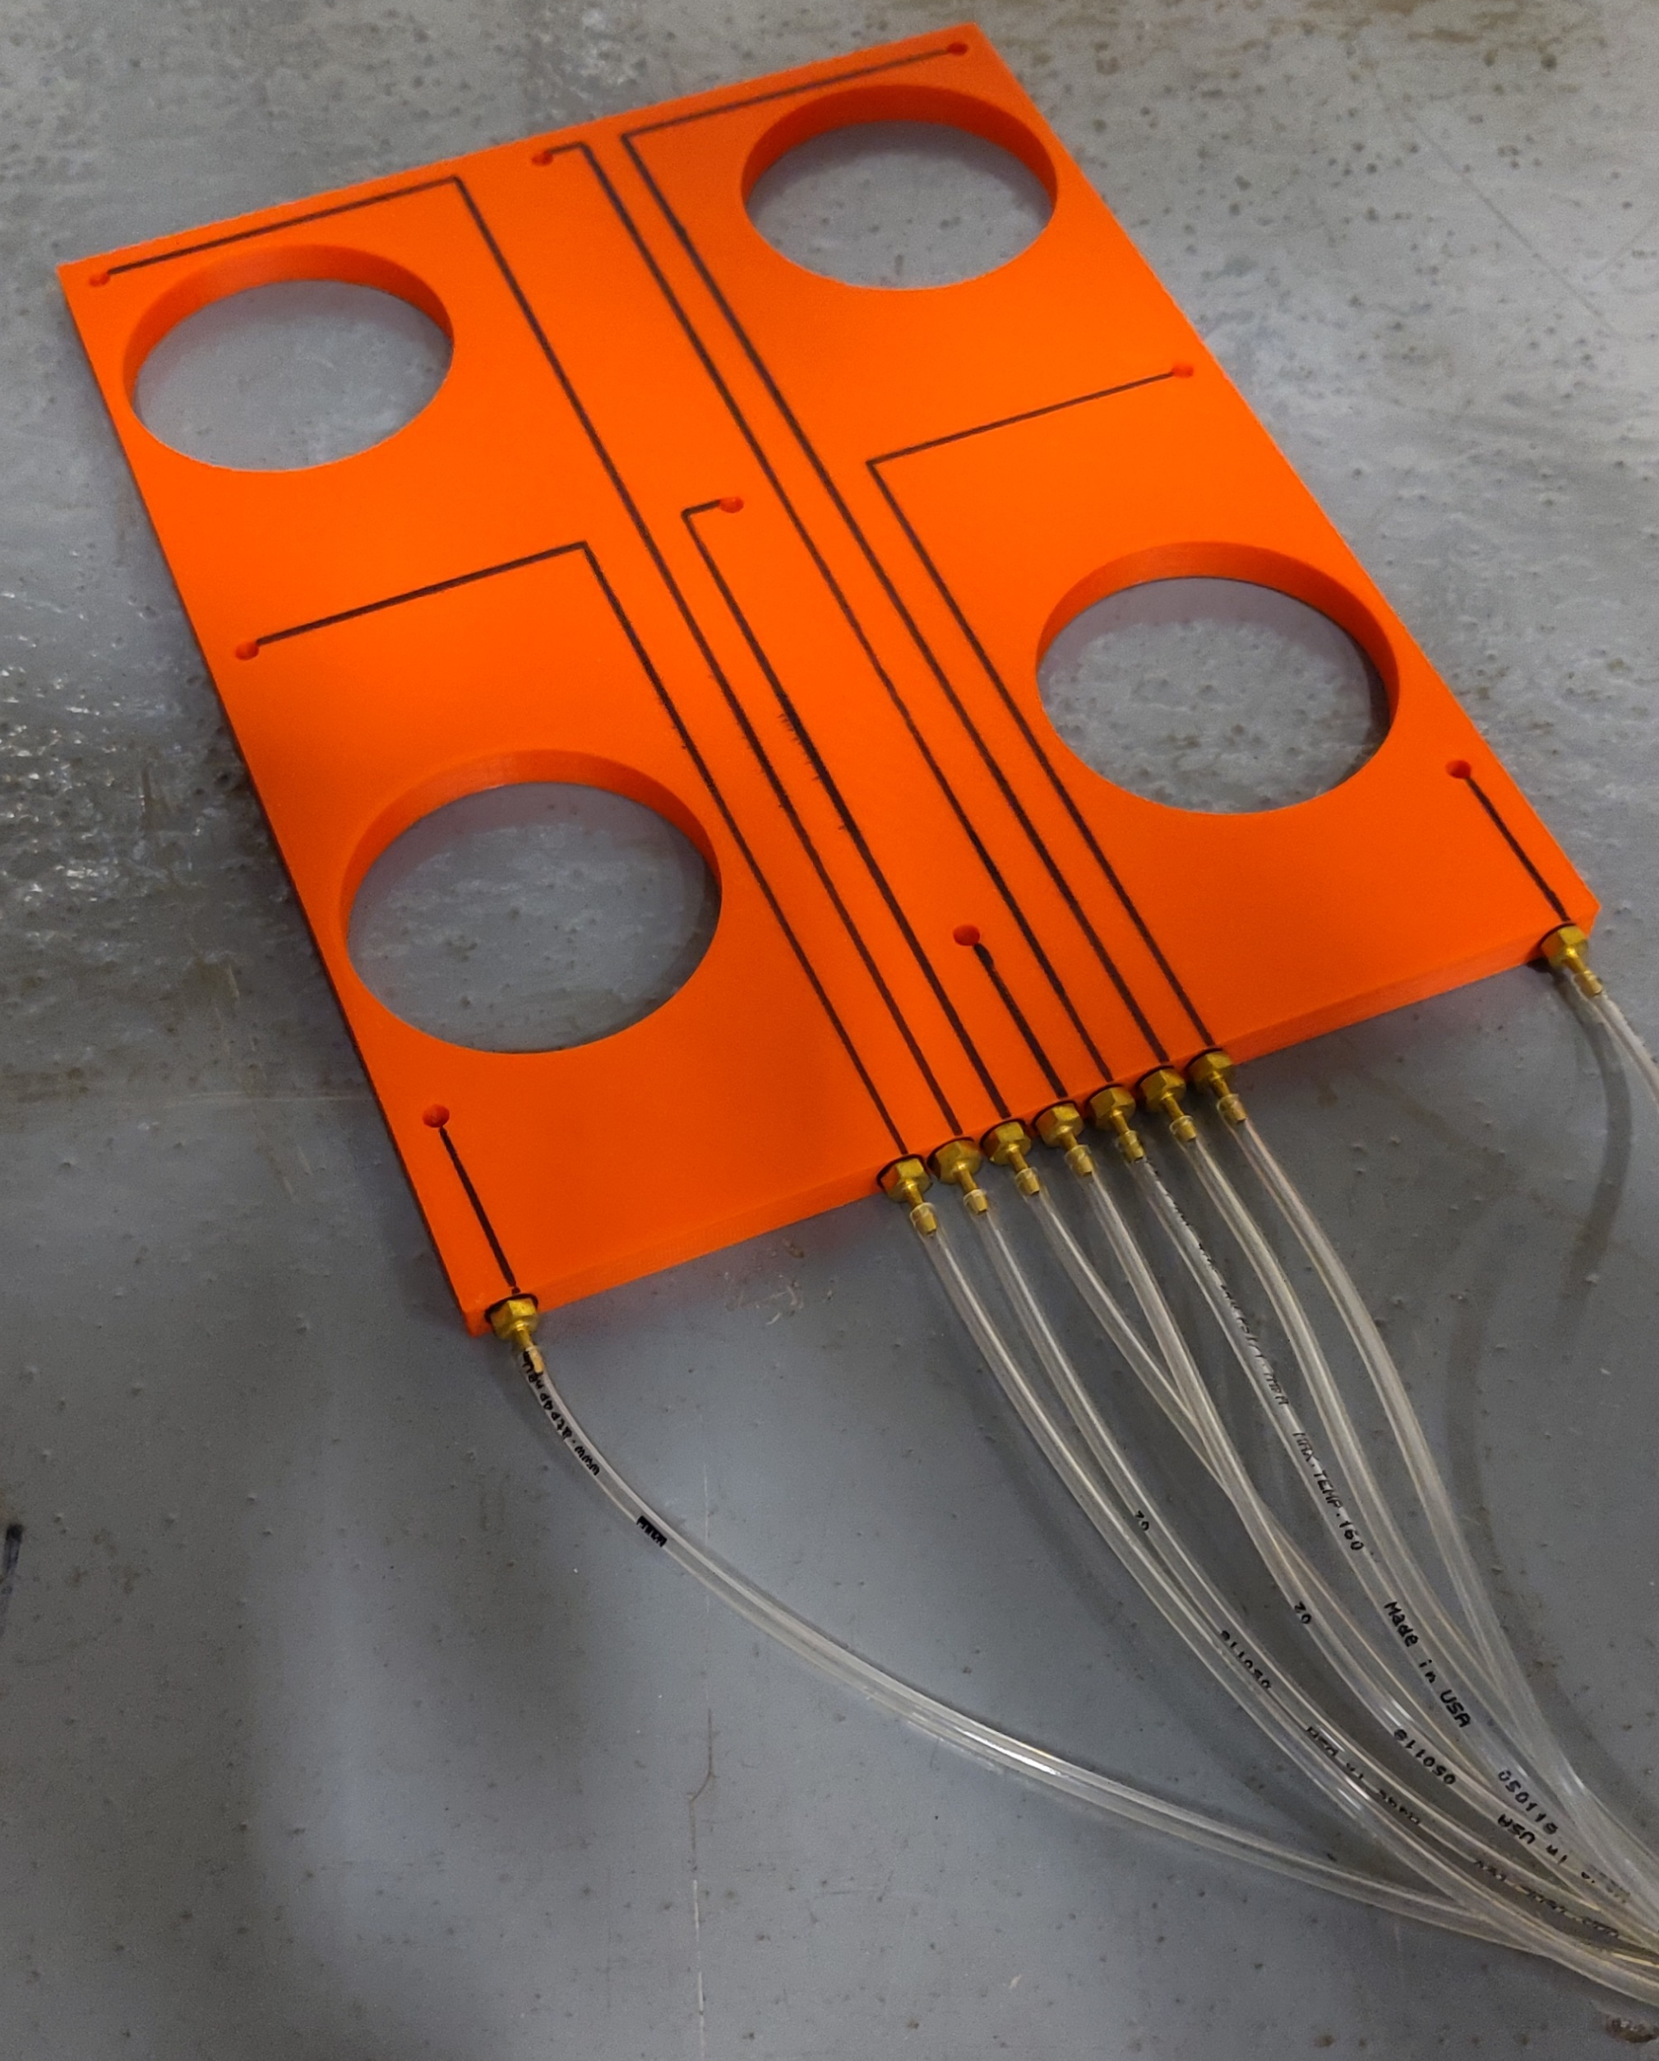
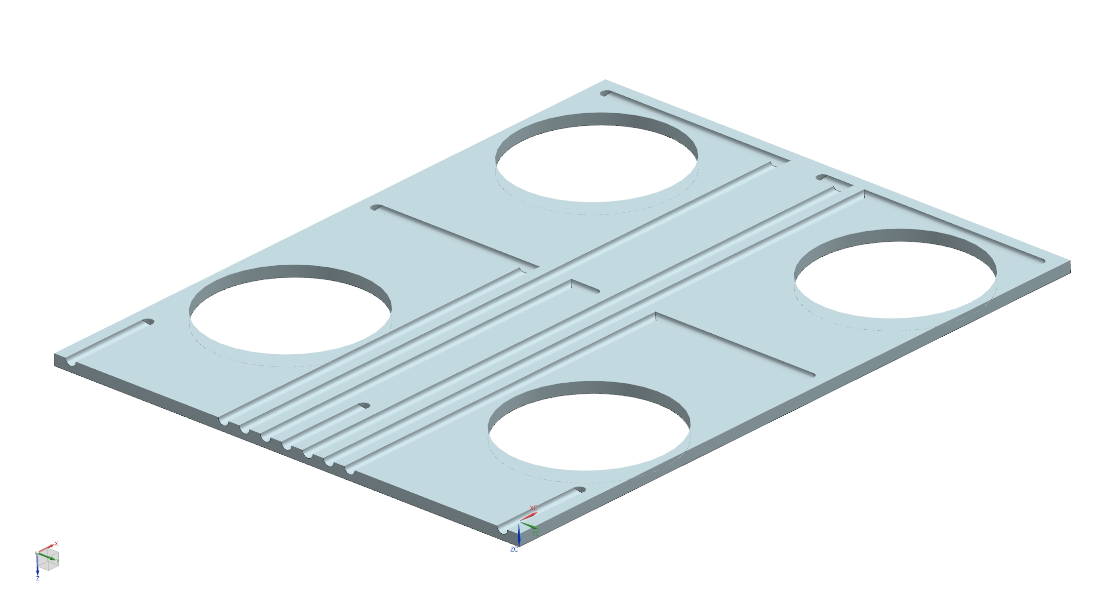
Test Setup - Pressure Testing Trials
Fixed on each of the 8 flag faces and measured airflow pressure at 9 locations on the flag surfaces
TSD Topical Meeting / 1MW Horn Stripline + Air Diverter Wind-Tunnel Testing
2/28/19

Slide 9
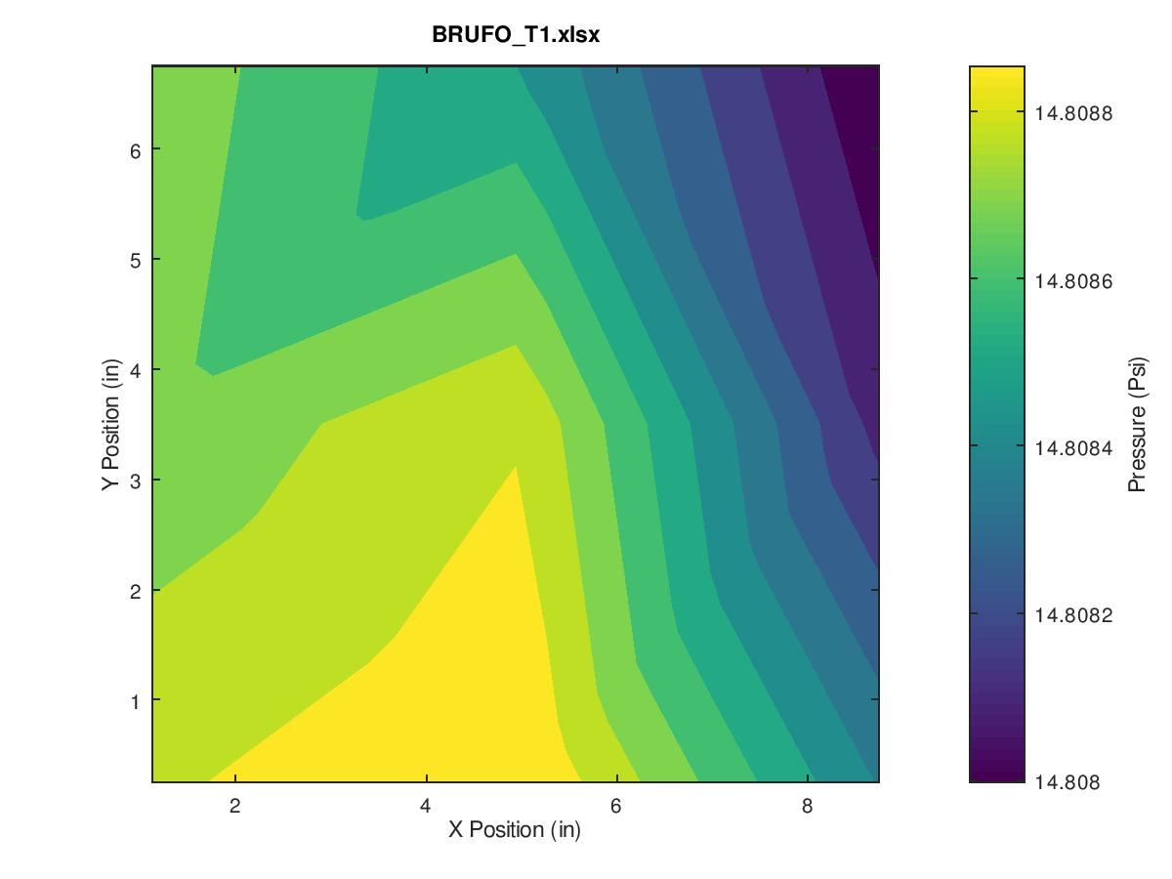
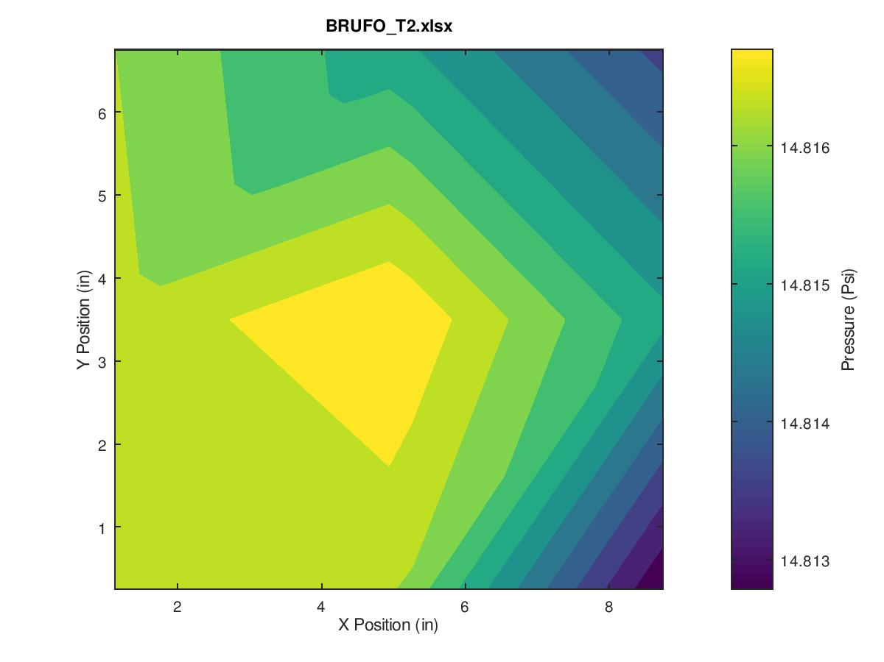
Pressure Testing
Ran pressure tests for each iteration of the top and bottom diverters.
Results mostly inconclusive. Pressure drop not large enough to provide reliable data.
TSD Topical Meeting / 1MW Horn Stripline + Air Diverter Wind-Tunnel Testing
2/28/19

Slide 10
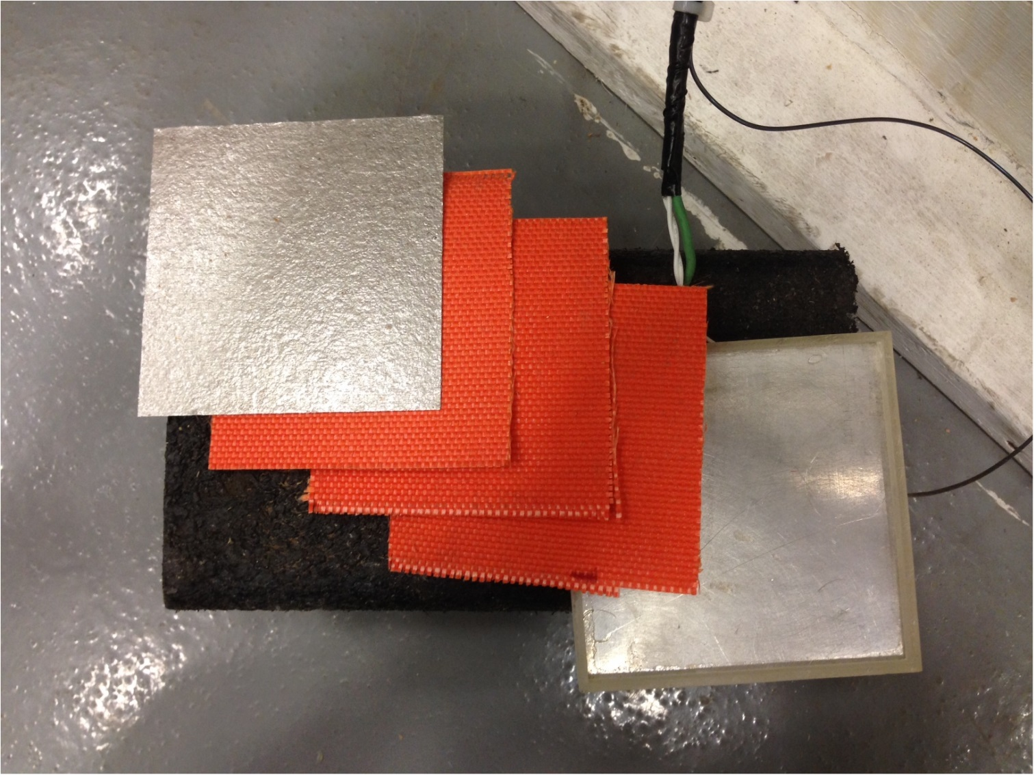
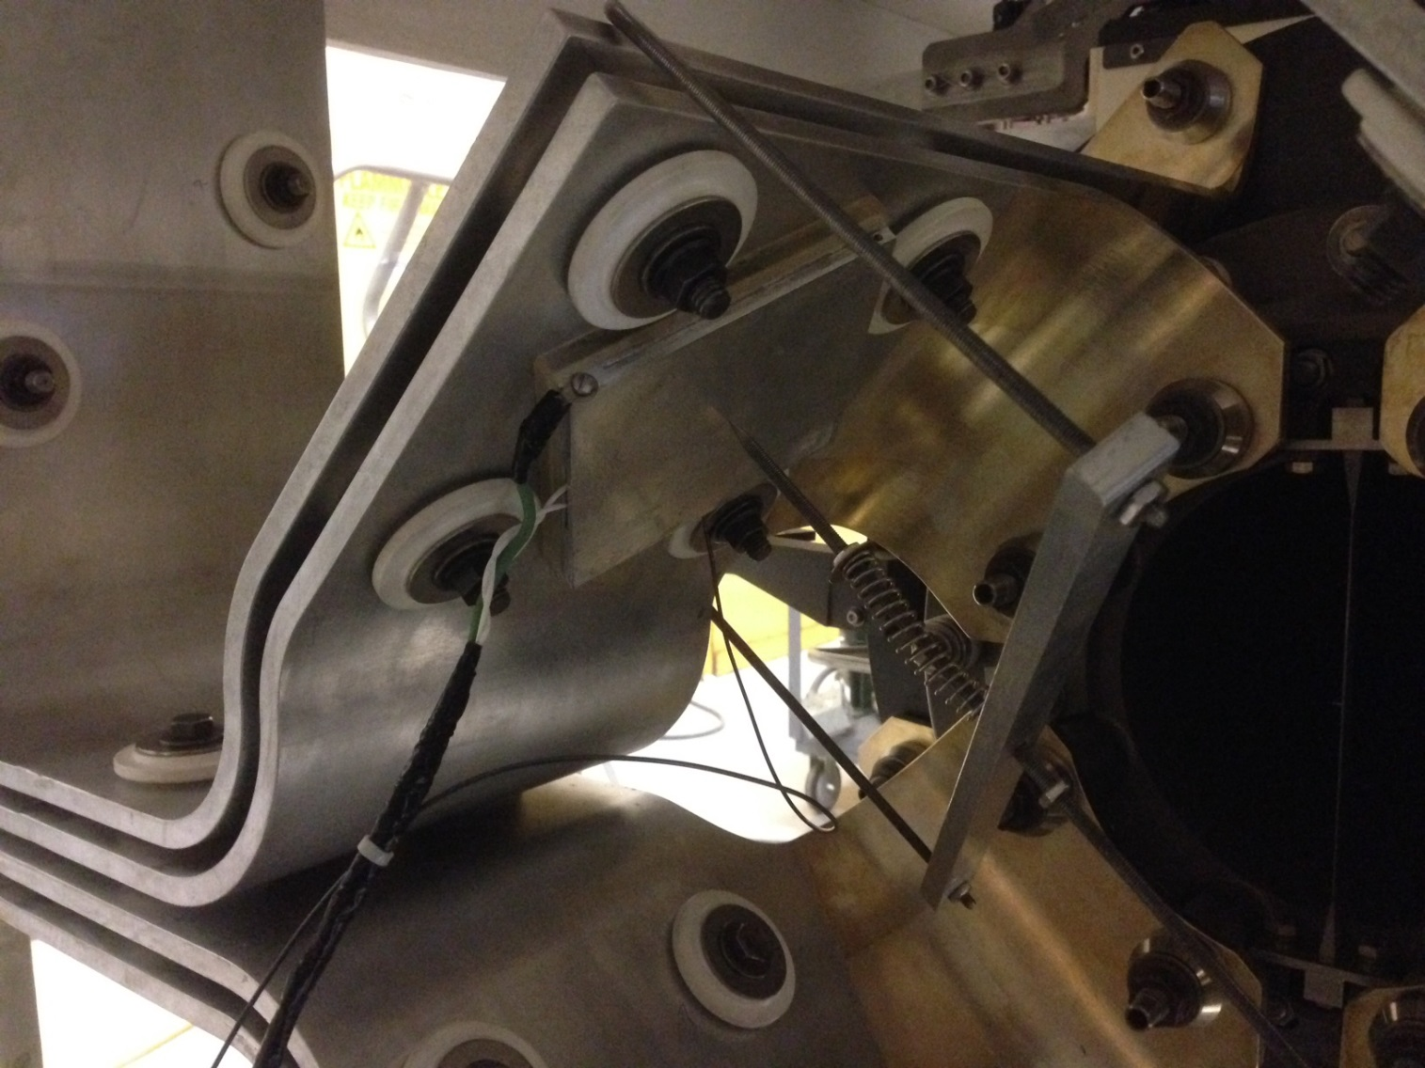
Convection Coefficient Testing
Al coupon with heating pad and thermocouple inside.
Set on each of the flag faces, set to 80W, turned on the airflow, observed cooling curve.
Identical to original method used, with slightly improved thermal isolation of coupon.
TSD Topical Meeting / 1MW Horn Stripline + Air Diverter Wind-Tunnel Testing
2/28/19

Slide 11
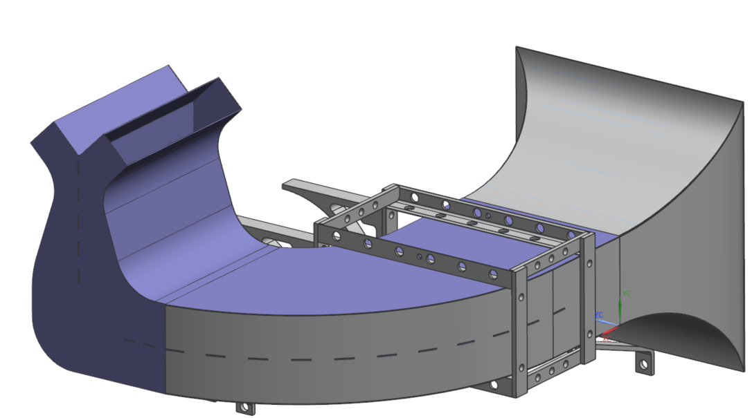
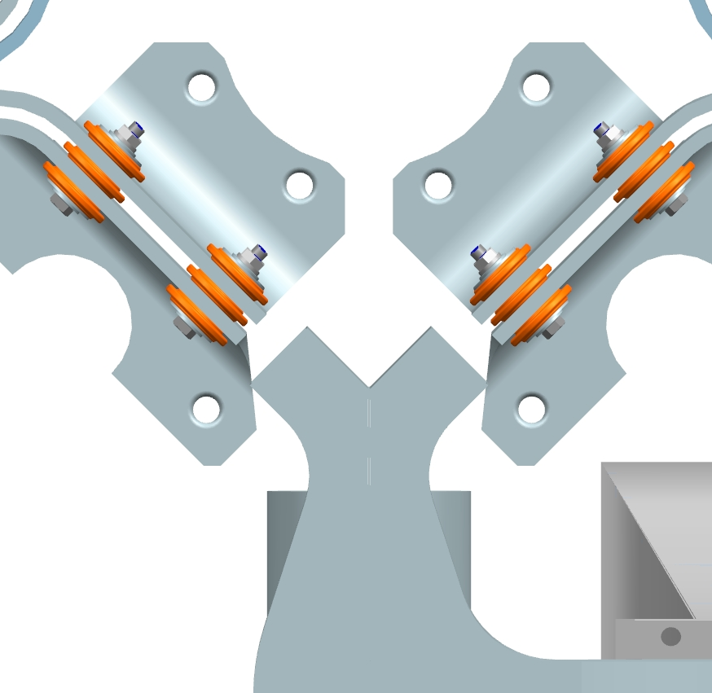
Old / New Diverter Comparison
Sharp Edges
Low Airflow
Low Airflow
Outlet Duct
Middle Duct
Divider
Mounting Bracket
Inlet Duct
Smooth Edges
Balanced Airflow
Outlet Duct
Middle Duct
Divider
Mounting Bracket
Inlet Duct
TSD Topical Meeting / 1MW Horn Stripline + Air Diverter Wind-Tunnel Testing
2/28/19

Slide 12
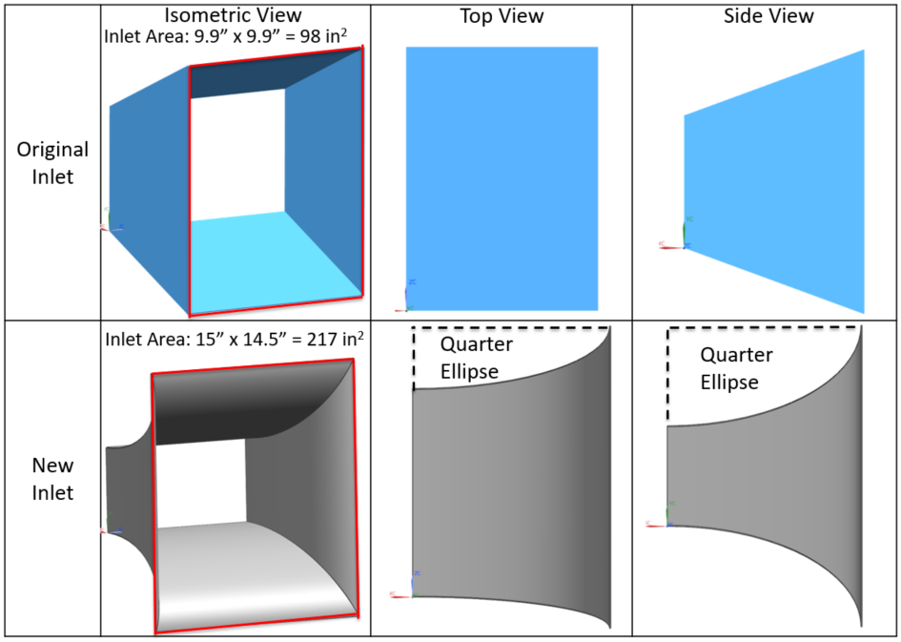
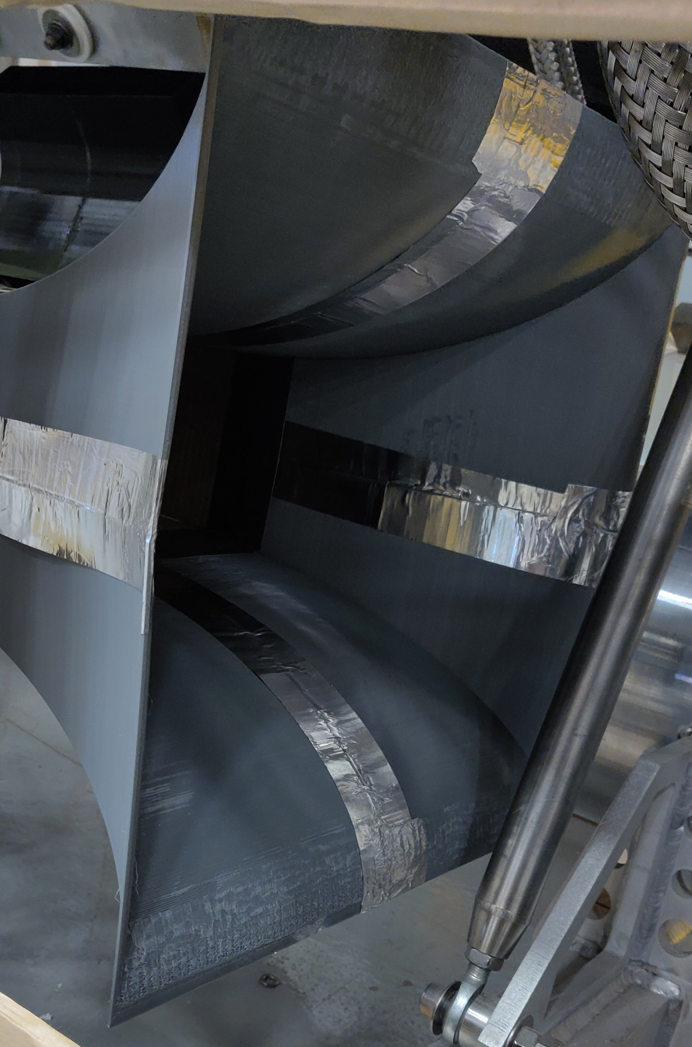
New Diverter Design
New Inlet features 4 sheets curved into elliptical geometry.
Initially tried creating from cardboard- didn’t turn out so well.
Split into 4 sections and 3D printed – worked really well (Thanks Keith!)
TSD Topical Meeting / 1MW Horn Stripline + Air Diverter Wind-Tunnel Testing
2/28/19

Slide 13
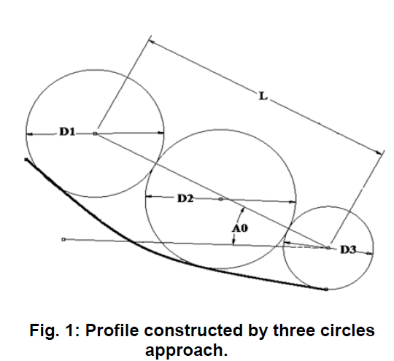
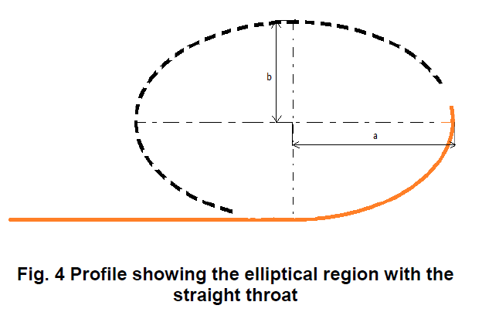
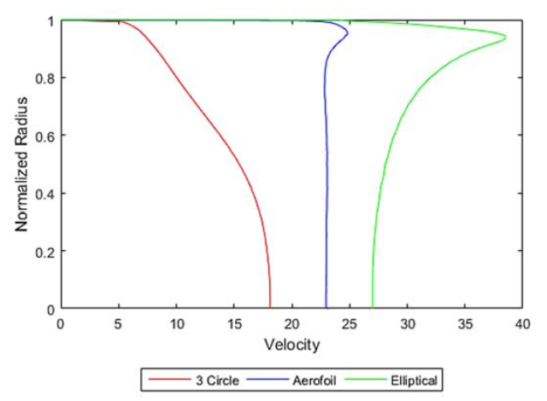
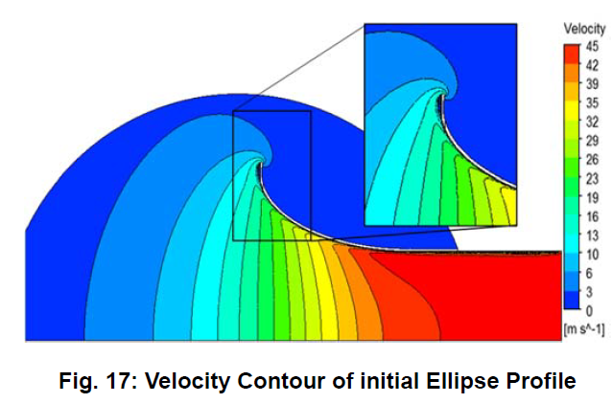
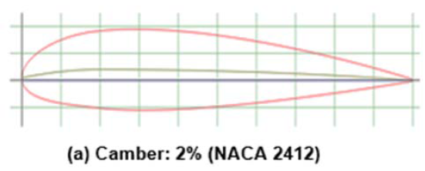
New Diverter Design: Inlet
DEVELOPMENT OF BELL MOUTH FOR LOW SPEED AXIAL FLOW
COMPRESSOR TESTING FACILITY
Apurva Tiwari Et al.
TSD Topical Meeting / 1MW Horn Stripline + Air Diverter Wind-Tunnel Testing
2/28/19

Slide 14
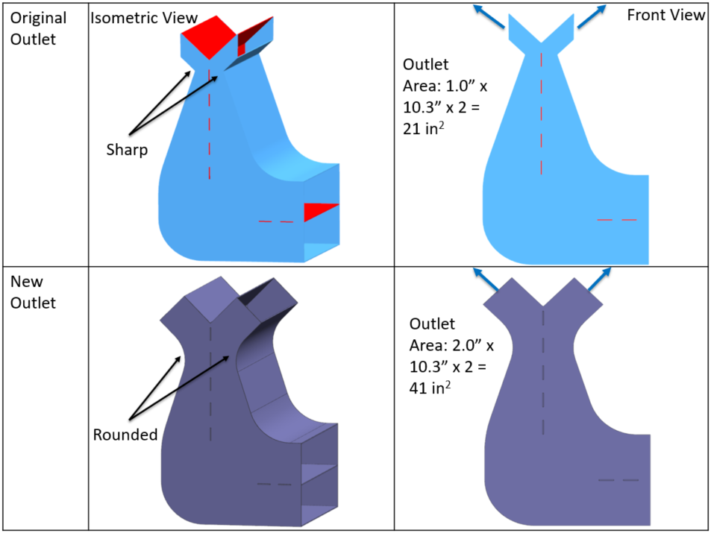
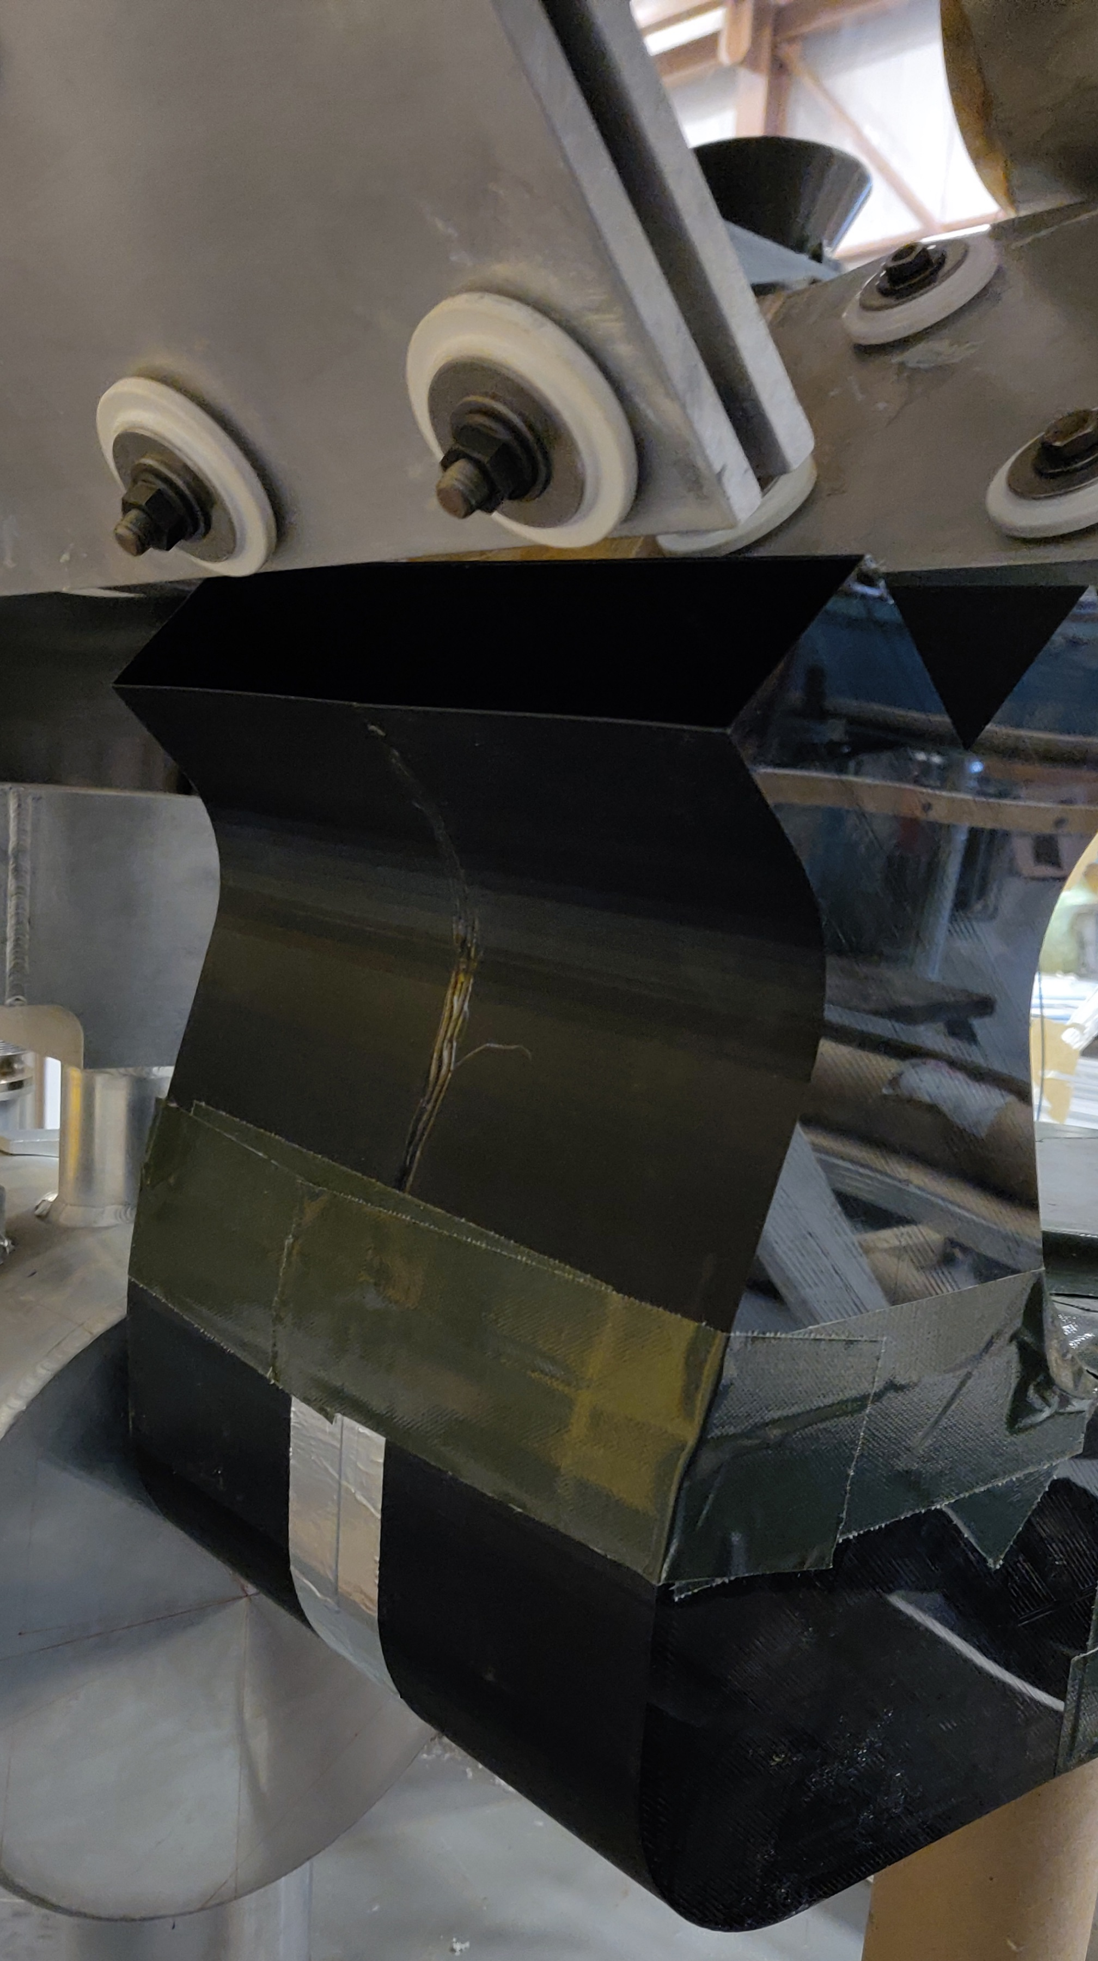
New Diverter Design: Outlet
Because we doubled the inlet area, we also doubled the outlet area – airflow covers more flag surface area.
Didn’t bother with cardboard, split up into 4 pieces and 3D printed.
TSD Topical Meeting / 1MW Horn Stripline + Air Diverter Wind-Tunnel Testing
2/28/19

Slide 15
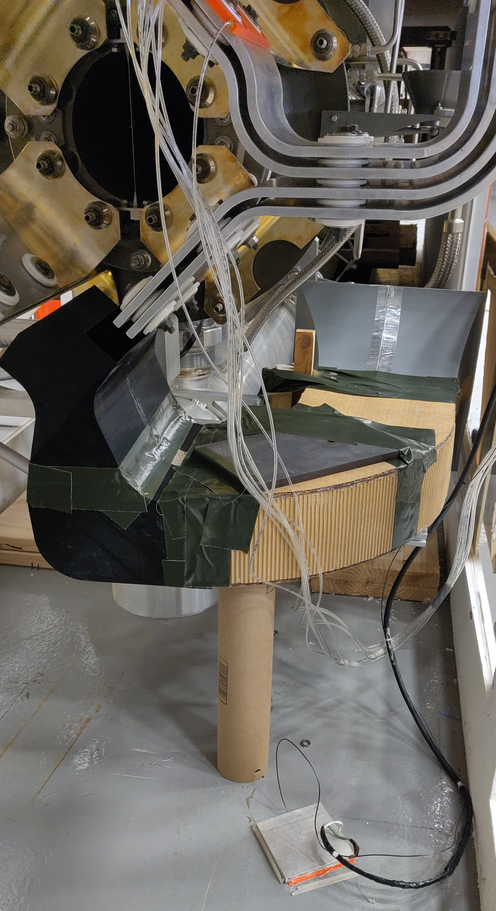
Diverter Prototype
3D Printed Inlet
Strategically Placed Counterweight using Principles of Statics
Cardboard Middle Section with Cardboard Divider
Highly Engineered Support Structure
3D Printed Outlet
TSD Topical Meeting / 1MW Horn Stripline + Air Diverter Wind-Tunnel Testing
2/28/19

Slide 16
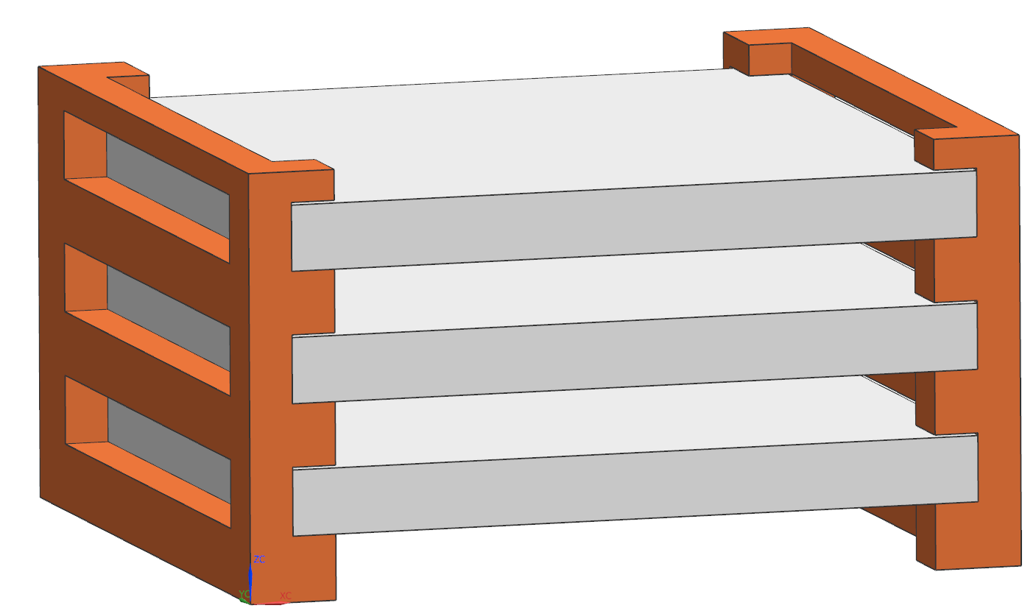
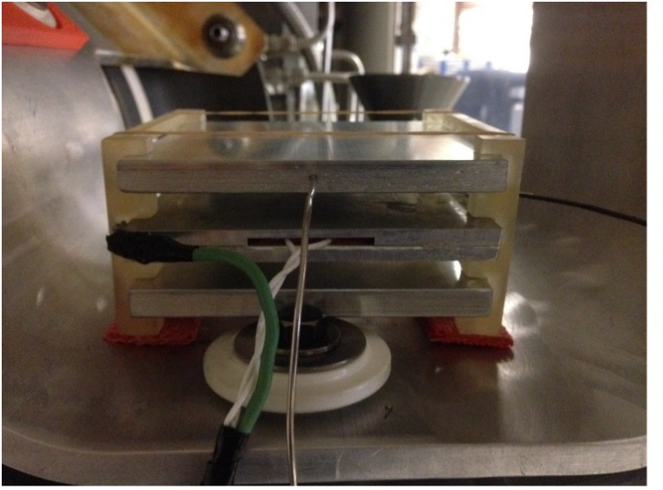
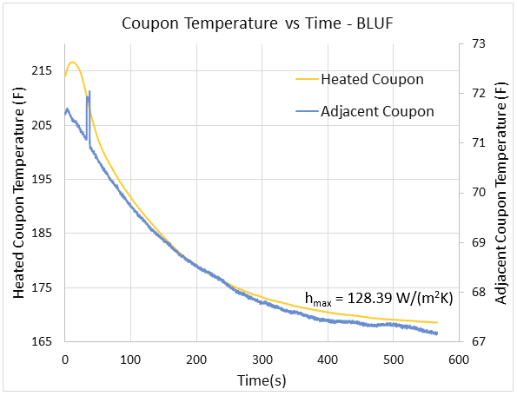
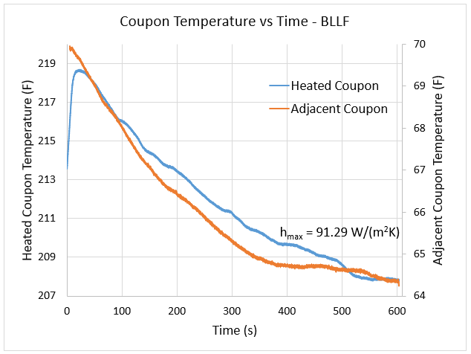
Convection Coefficient Testing
Assumed stagnant air convection coefficient between the striplines unless proven otherwise.
Simulations showed inner stripline temps to be too high.
Experimentally determined convection coefficient for most problematic areas.
4.25”
J-Type Thermocouple
4.25”
T
Adjacent Coupon
3/8”
T
3/8”
Heating Pad
3/8”
3/8”
3/8”
TSD Topical Meeting / 1MW Horn Stripline + Air Diverter Wind-Tunnel Testing
2/28/19

Slide 17
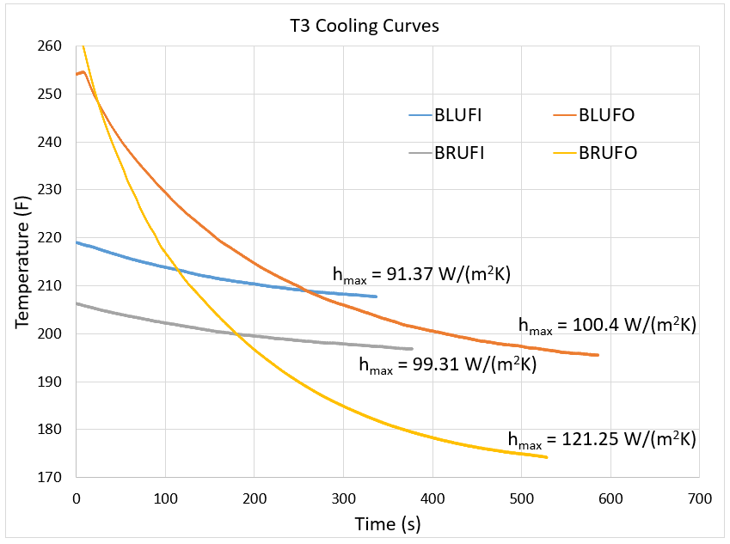
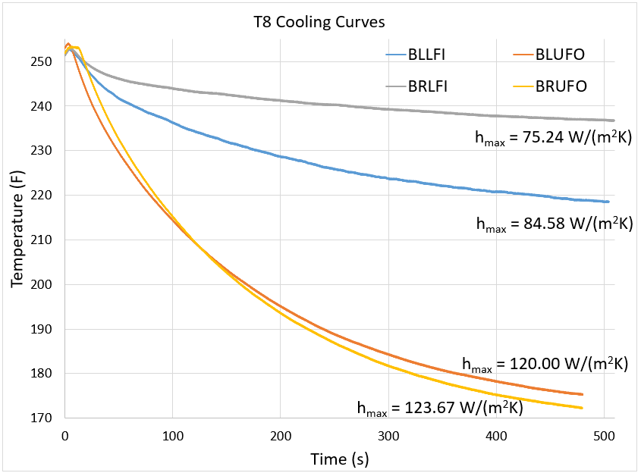
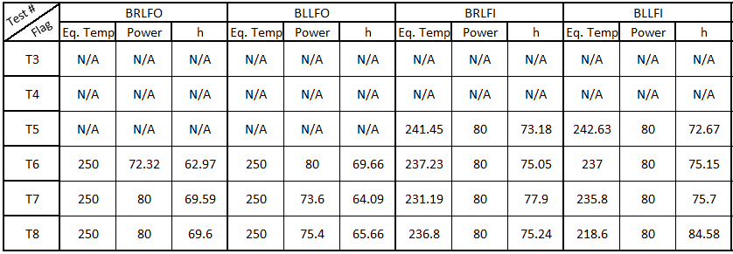
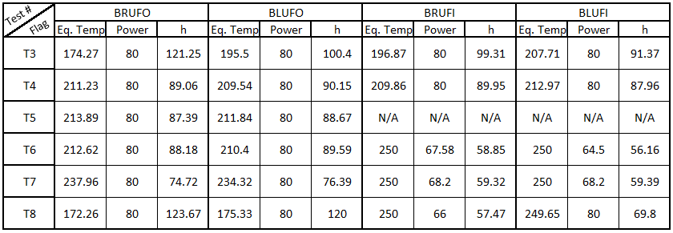
Convection Coefficient Testing
6 Total Tests – changed top/bottom diverter designs, added insulation.
Not all flags showed cooling at 80W, Wattage had to be adjusted to equilibrium.
$$\dot{Q}=hA\left(T_{S}−T_{Surr}\right) h=\frac{\dot{Q}}{A{(T}_{S}−T_{Surr})}$$
TSD Topical Meeting / 1MW Horn Stripline + Air Diverter Wind-Tunnel Testing
2/28/19

Slide 18
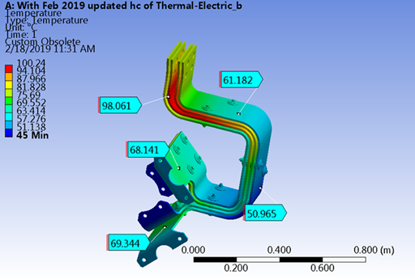
Updated Results
Steady state temperatures @ 1MW appear to meet requirements of <100C.
Hot spots are result of remaining conservative cooling coefficients. Further testing could reduce further but design goals are met.
Final FEA planned for March finish.
Final report to be released thereafter.
TSD Topical Meeting / 1MW Horn Stripline + Air Diverter Wind-Tunnel Testing
2/28/19

