Slide 1


Structural Criteria
Eric Anderssen
HL-LHC AUP Magnets, LBNL
Review of MQXFAP2 Shell

Slide 2

Outline
Metallic Component Criteria
Scope
Static Stress Limits
Limiting Stress Values
Fracture Assessment
Conclusion

Slide 3
Scope of this Structural Design Criteria
Scope of Design Criteria is to define Static Stress Limits using values consistent with the FAD, using language similar to the B&PVC for plastic limits and some conservatism on fast fracture limits
Have augmented the approach considering the issue with short shell of MQXFAP02
Some new methods developed to investigate the shell stress and failure

Slide 4
Static Stress Limits
Static Stress limit represents a catastrophic failure of the component limiting it’s ability provide required loads
Failure can occur by Plastic Collapse or Fast Fracture
The design criteria presented in this document approach those presented in the B&PVC for Plastic Collapse
Load factors for Fast Fracture approach those presented in FFS-1

Slide 5
Limiting Stress Values (1)
Plastic collapse assumes the formation of a plastic hinge through the component cross-section (non localized as might occur at a peak stress location)
For this document onset of yield at 0.2% offset is used as an assessment criteria unless relevant data is available to calculate the flow stress at cryogenic temperatures
  Serrated yielding may make yield stress the most reliable value
Conservatism presented in the codes, e.g. limiting primary stress (σ_{m} + σ_{b}) to 2/3 σ_{y} predates extensive use of FEA and material databases
In the codes, S_{m} the limiting stress value is limited to 2/3 σ_{y} or 1/3 σ_{u} . (we do not use σ_{u}, except in context of σ_{c} )
We use S_{m} = 0.8 σ_{y} or σ_{c} here to be more consistent with the FAD, and modify enhancement factors (‘K-Factors’ in the code) accordingly

Slide 6
Limiting Stress Values (2)
The choice of 0.8 also relates to the load factor for fracture assessment
K_{Ic} is used as the primary fracture assessment value, but a load factor equivalent of 0.8 on the yield axis for the FAD is also applied for fracture—presented later.
Material properties have been largely determined by LARP/CERN while some will be furnished by AUP
Use of 0.8 versus 2/3 is commensurate with the more extended use of FEA and availability of material test data at relevant temperatures

Slide 7
A comment on Material Properties used for Assessment Criteria
Limiting stress values described before use so-called ‘A-Basis’ properties where available
  A-Basis is where at least 99% of the population equals or exceeds value with 95% confidence
  For normally distributed population, this is mean minus 3 sigma
MIL-HDBK-5 reports A-Basis properties at Room and Elevated temps (some down to LH2)
  Some less common materials use B-Basis (90% pop at 95% CL
  Will test materials at 4K and generate A-Basis values for use
MIL-HDBK-5 and other standards have methods to handle non-normally distributed data
  Defined tests for Normality, and/or use of Weibull Distribution to establish similar confidence limits
Assessment values in this design criteria do not include additional factors of safety above this confidence limit
Have started a test regimen, determined relevant measures, will now generate statistics

Slide 8



Load Factor versus Factor of Safety
Iron
$$K_{I}=Yσ\sqrt{a}$$
Load point moves on 45deg line for increasing stress in FAD space, not along load line
Load point trajectory of a propagating crack depends on stress field it propagates into
Stress Increase
Stainless
$$K_{Ic}=150 MPa\sqrt{m} \left(SS\right)$$
$$K_{Ic} = 30 MPa\sqrt{m} \left(iron\right)$$
For the same component made of iron or stainless steel with similar σ_{y}, but differing K_{Ic}, the load factor can vary substantially for the same flaw
Here 0.33 σ/σ_{y} (FoS= 3), is clearly sufficient for a component in SS, but inadequate if made of Iron, with identical flaw
The Load factor for Iron is already less than one, but > 2 for SS—note that this ratio is not the ratios of respective K_{Ic}, so Load Factor is not FoS

Slide 9
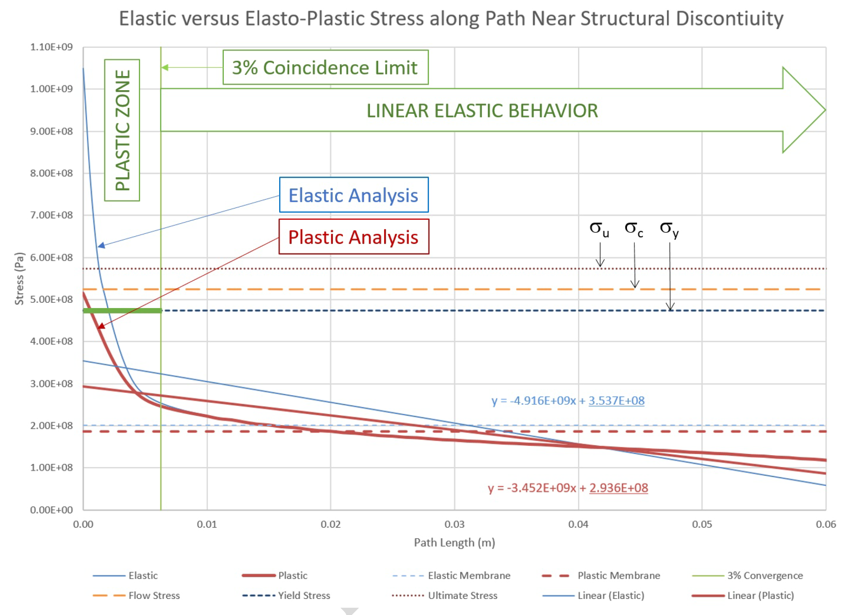
Elasto-Plastic Analysis applicable for both
Plastic Collapse and Fast Fracture
Elasto-Plastic analysis with limited yielding also uses the von Mises limits
Local primary stress decreases, with only small changes to membrane stress
Case above would have passed criteria without the inclusion of the elasto-plastic results, e.g. 480/350 =1.37; EP analysis makes this factor 1.6
Analysis above required for Fracture assessment, with post-mitigation steps limiting the size of the plastic zone to be under the critical flaw size

Slide 10
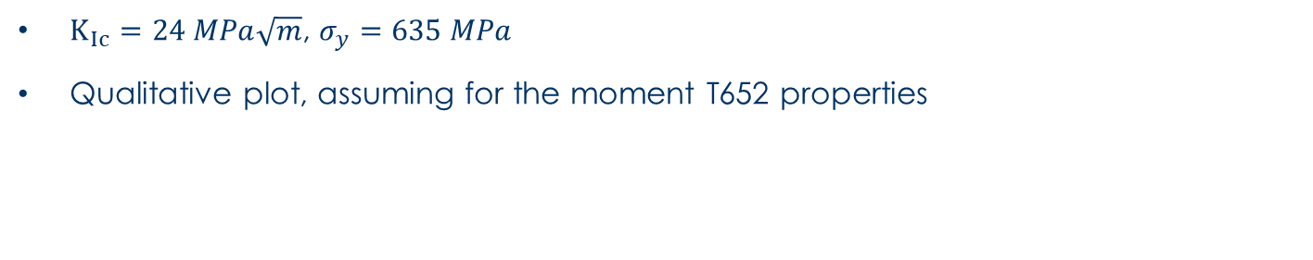
FAD – MQXFAP1b
Plastic zone
$K_{Ic}=24 MPa\sqrt{m}$, $σ_{y}=635 MPa$
Qualitative plot, assuming for the moment T652 properties

Slide 11
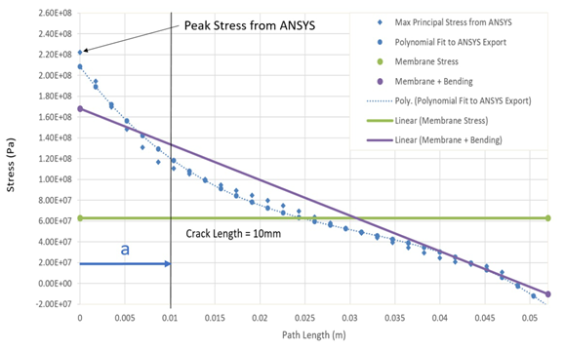
Critical Crack and Self Arrest
It is possible that a crack may propagate in our structures particularly near discontinuities
If the crack propagates to a region of lower stress it is possible that it will self arrest
Less conservative than no stable growth, but criteria allows demonstrating arrest
Locus of points shown schematically of a critical flaw growing to a region of lower stress ratio

Slide 12
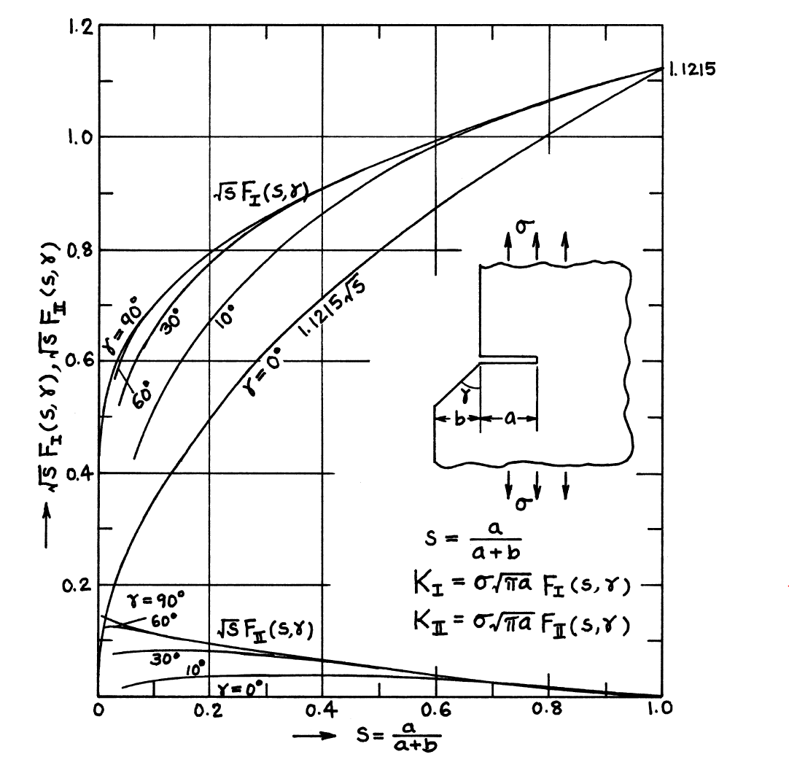
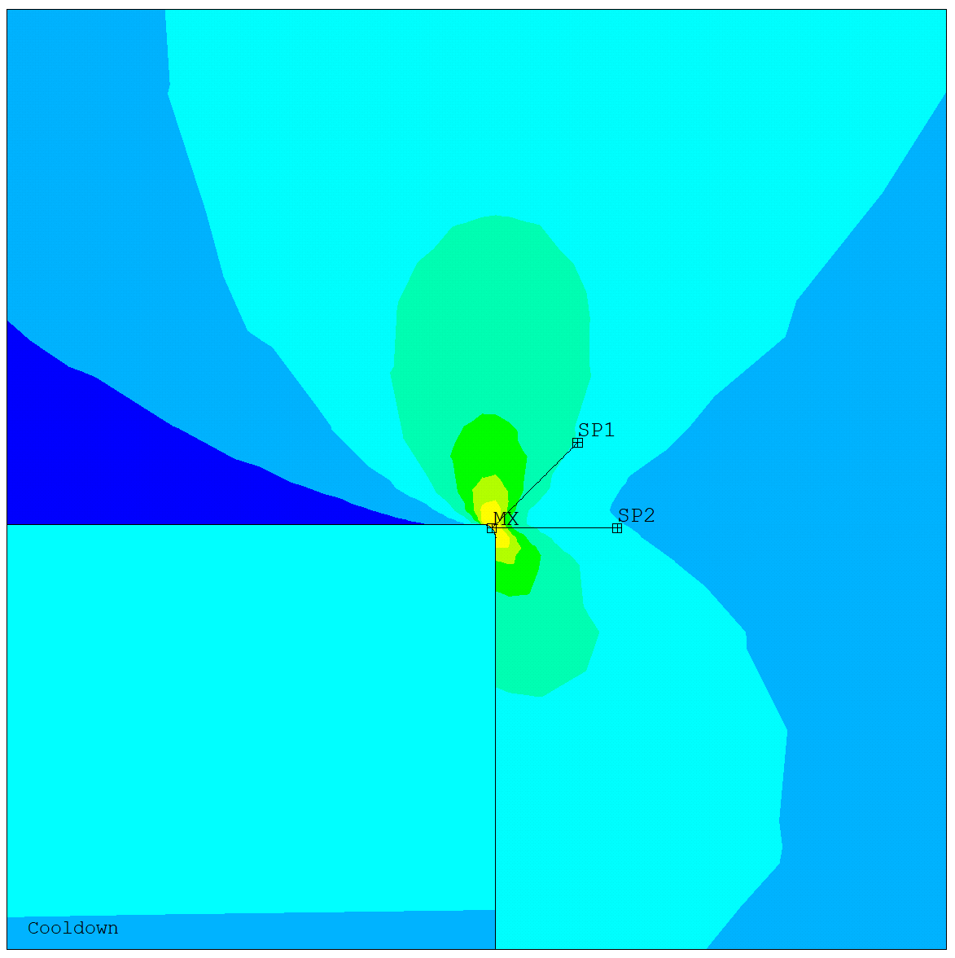
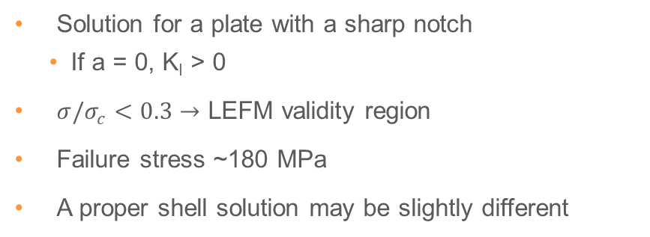
Notched Plate Solution
Solution for a plate with a sharp notch
    If a = 0, K_{I} > 0
$σ/σ_{c}<0.3$ $→$ LEFM validity region
Failure stress ~180 MPa
A proper shell solution may be slightly different
From: Tada, Paris, Irwin (2000)

Slide 13
Flaw Assessment Caveats
Should note that we colloquially say a crack may grow—sub-critical cracks do not grow
We ignore any initiation phenomena by way of stating that we inspect for flaws that may grow to critical size and limit size of plastic zone to same
We ignore crack coalescence as each of these smaller cracks should be sub-critical and should not interact
Fatigue using da/dN rates assumes a load that allows cracks to become critical (grow) cyclically; we design against stable crack growth, so expect no fatigue behavior in our structures
A da/dN analysis for nominal material values shows this is true

Slide 14
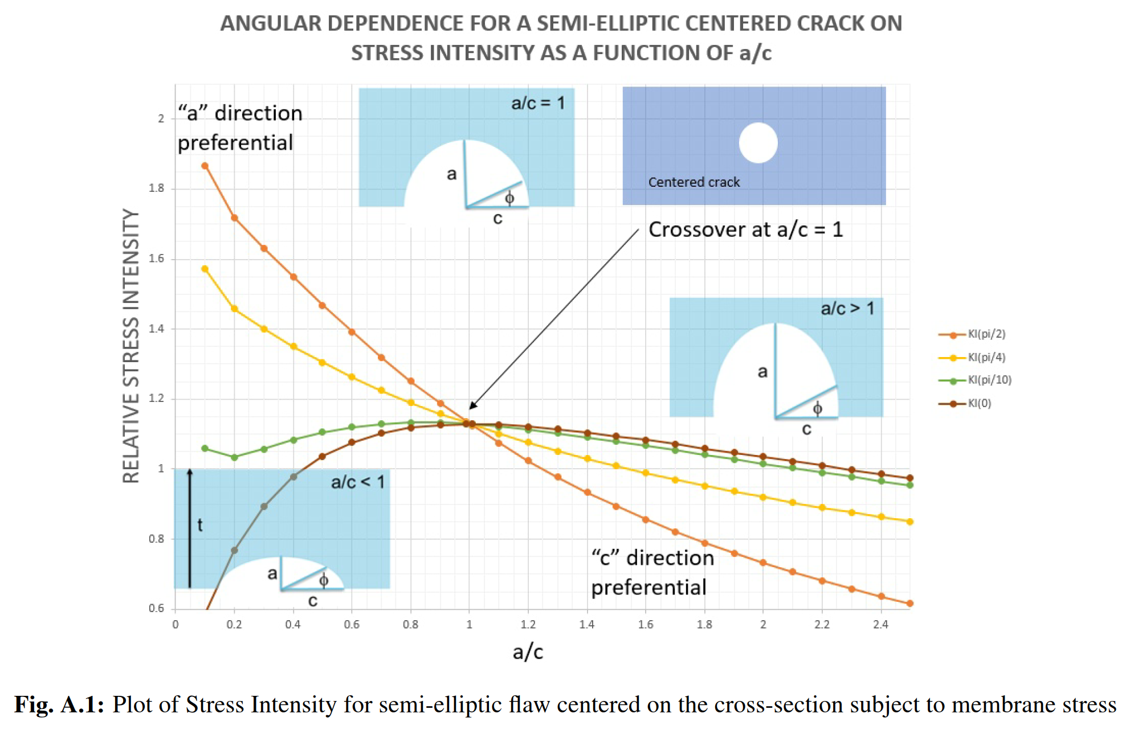
Flaw Shape used in Assessment
A hypothetical ‘critical’ crack that is not round will grow in the ‘a’ or ‘c’ directions until a=c
For an edge crack, a/c approaches 0.8 (other plot in appendix)
Influence coefficients do not vary much between these two cases
Will always use a/c = 1 in Grade IV analysis for this reason

Slide 15
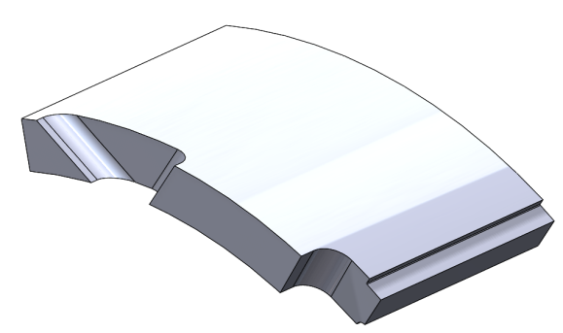
Updated Design – FAD (1)
  10 mm root fillet on the triangle cutout
  15 mm large cutout for weld pocket
  0.5 mm fillet on the weld strip groove
Updated design
    Large rounds added to the most critical features
    The magnet design still allows to regulate the coil preload keeping the shell membrane stress at 130 MPa

Slide 16
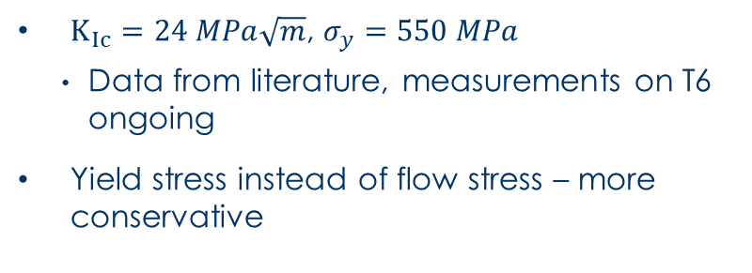
Updated Design – FAD (2)
$K_{Ic}=24 MPa\sqrt{m}$, $σ_{y}=550 MPa$
    Data from literature, measurements on T6 ongoing
Yield stress instead of flow stress – more conservative
Cutouts | Load Factor (2 mm)
Triangle cutout (10 mm) | ~1.4
Weld cutout (15 mm) | ~1.4

Slide 17
Conclusion
MQXFAP2 is outside the margin of Design Criteria
Assessing the failure and investigating K enhancement has been useful to enhance design criteria
New shell designs are well within FAD

Slide 18
Backup Slides

