Slide 1
Review of the MQXFAP2 Al-Shell Issue and Lessons Learned -
Introduction & Charges
Giorgio Ambrosio
Magnets L2
U.S. HL-LHC Accelerator Upgrade Project
Review of the MQXFAP2 Al-Shell Issue and Lessons Learned
March 22, 2019

Slide 2
Outline
Intro to HiLumi Inner Triplet quadrupoles
MQXFA Magnet Design
Structural Design Criteria development
Test of short models and prototypes
Review Goals
Charge
In the same time window

Slide 3
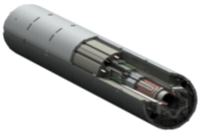
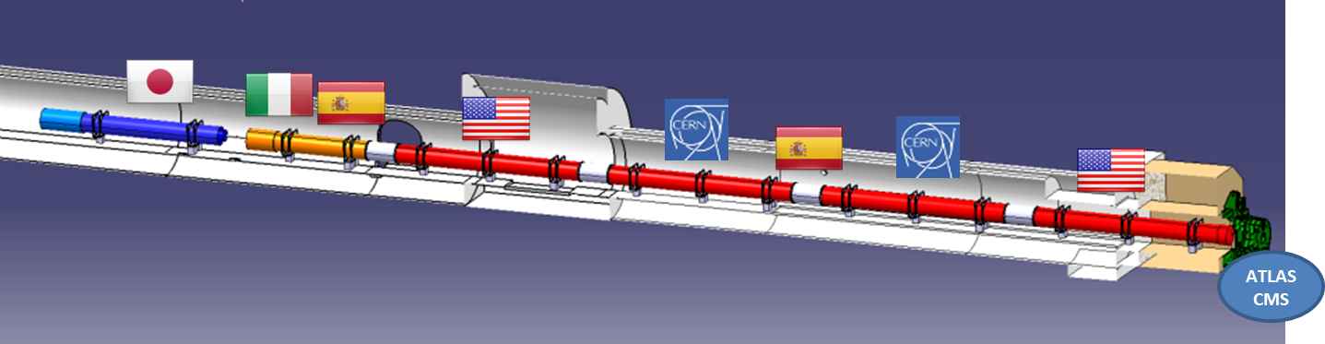
US Contribution to HL-LHC Inner Triplets
10 Q1/Q3 Cryo-assemblies
  20 Magnets (MQXFA) with 4.2 m magnetic length
  Two magnets in each cold mass
Q2 cold masses by CERN
  Magnetic length: 7.15 m (MQXFB)
Magnet
(MQXFA)
US cold mass

Slide 4
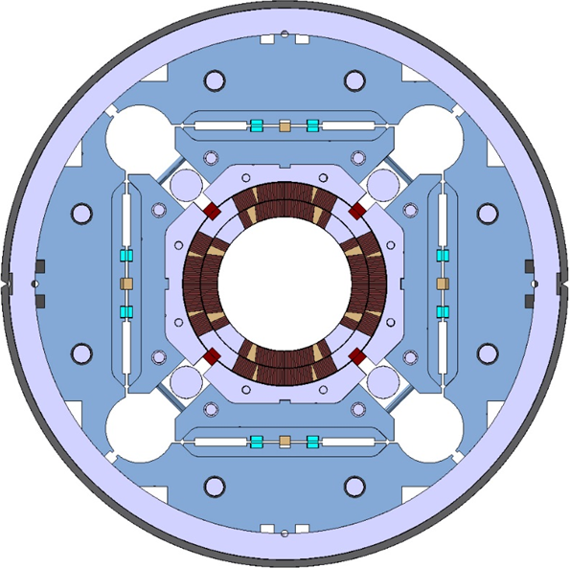
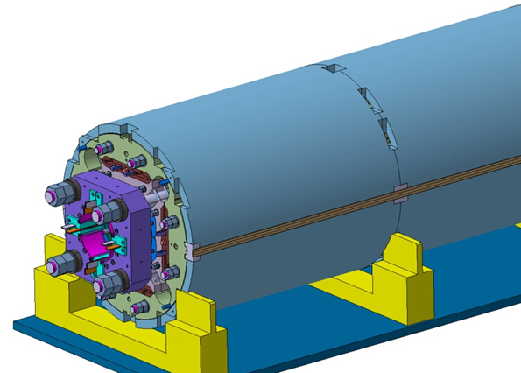
MQXFA/B Main Parameters
Parameter | Unit | MQXFA/B
Coil aperture | mm | 150
Magnetic length | m | 4.2/7.15
N. of layers |  | 2
N. of turns Inner-Outer layer |  | 22-28
Operation temperature | K | 1.9
Nominal gradient | T/m | 132.6
Nominal current | kA | 16.5
Peak field at nom. current | T | 11.4
Stored energy at nom. curr. | MJ/m | 1.2
Diff. inductance | mH/m | 8.2
Strand diameter | mm | 0.85
Strand number |  | 40
Cable width | mm | 18.15
Cable mid thickness | mm | 1.525
Keystone angle |  | 0.4
P. Ferracin et al., “Development of MQXF, the Nb₃Sn Low-β Quadrupole for the HiLumi LHC ” IEEE Trans App. Supercond. Vol. 26, no. 4, 4000207
G. Ambrosio et al., “MQXFS1 Quadrupole Design Report” LARP DocDB 1074

Slide 5
CD1 recommendation: Create Design Criteria
Create and approve (structural and electrical) design criteria, including criteria for brittle materials, prior to CD-2/3b.
Electrical Design Criteria:
US-HiLumi-doc-826
Design Criteria for MQXFA Superconducting Elements:
US-HiLumi-doc-885
Structural Design Criteria:
US-HiLumi-doc-909
Secure external review of these criteria prior to or during CD-2/3b.
Design Criteria Review resulted in recommendations that are being addressed:
Clarify criteria for use of Al-7075-T65
Work performed, reviewed Oct 5th, 2018
Write section on use of non-metallic materials
Short section added to doc-909
Define the expected handling, operational and accidental faulty load conditions (LC) which refer to different design criteria at RT and cold operating temperature.
Improved descriptions have been incorporated
Clarify use of statistics and margins in criteria. They should be self-consistent.
Improved descriptions have been incorporated

Slide 6
A CD1 recommendation to develop and apply Design Criteria has been actively addressed

Slide 7
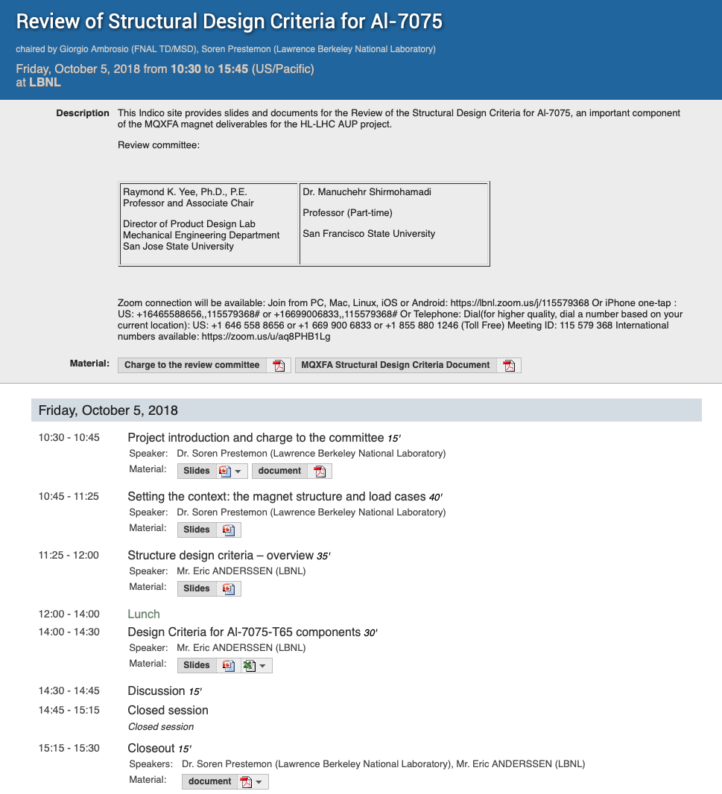
A focused review of the AL-7075-T65 design criteria was performed
Preliminary reviewer feedback:
  " For avoiding failure, we understand you’re considering net section collapse (plastic) and fast fracture (critical flaw size) conditions. In fact you are proposing to use an “R6” equivalent approach, which considers a failure envelope (FAD) based on these two extreme (as well as the intermediate ductile tearing – J-integral/EPFM – condition). The approach at this time seem reasonable (as it is very comprehensive including three different failure modes), but we reserve the final judgement upon seeing and reviewing material behavior at the operational temperatures (where highest stress conditions exist).”
  "Based on the comments from Flaw Detection discussion above, we recommend adding surface flaw detection (e.g. dye penetrant test) on final shell parts to identify any surface flaws, as a complement to the current ultrasonic inspections.”
  " With evidence of adequate stress analysis, proper crack growth analysis during operation (if needed), sufficient material properties measurements (e.g. for KIC at lowest operating temperature), and accurate post fabrication flaw detection on component, the conservative margin of safety used in other codes can be reduced. Thus the use of a static stress limit of 80% and its further use of 80% on the load factor for the FAD would seem reasonable.”
  …

Slide 8
MQXFA shells are designed to meet the Criteria
10mm and 15mm radii at cutouts to reduce stress concentrations
AAA ultrasonic inspection of raw material
Dye-penetrant inspection post-machining to identify surface flaws
Fracture toughness (K_{1c}) measurements on samples are being performed at cryogenic temperature – data used to evaluate margin
  K1c of material samples show
  Analysis using the failure assessment diagram shows that, for the largest non-detectable crack, we have a load factor of >1.35; the design criteria call for a load factor >1.2

Slide 9
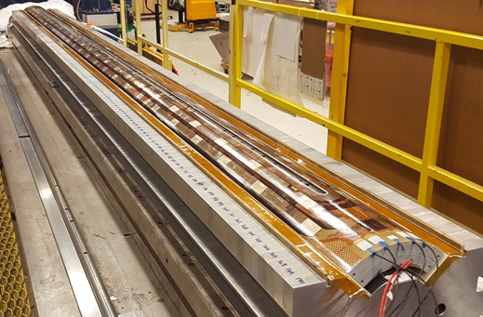
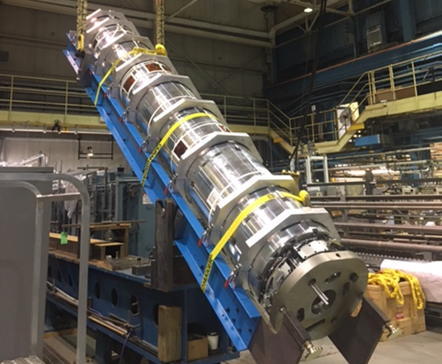
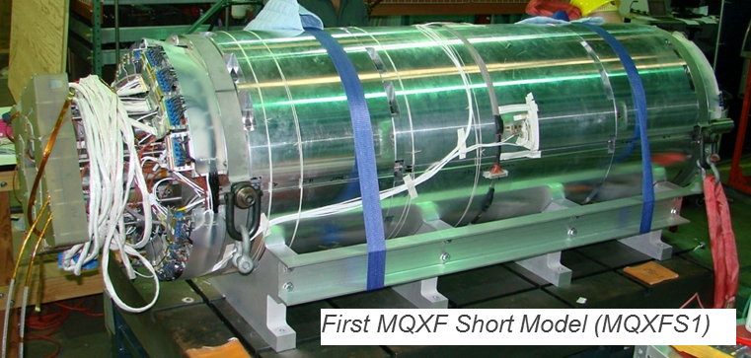
MQXF Design Validation
(by LARP/AUP & CERN)
Design validated through:
Single coil tests:
  Short and long coils
By LARP/AUP
4m coil during assembly in mirror structure
At CERN
Short models: S1a/b/c/d/e S3a/b/c, S5, S4, (S6 soon)
Prototypes: AP1, AP2
1st prototype during preparation for test

Slide 10

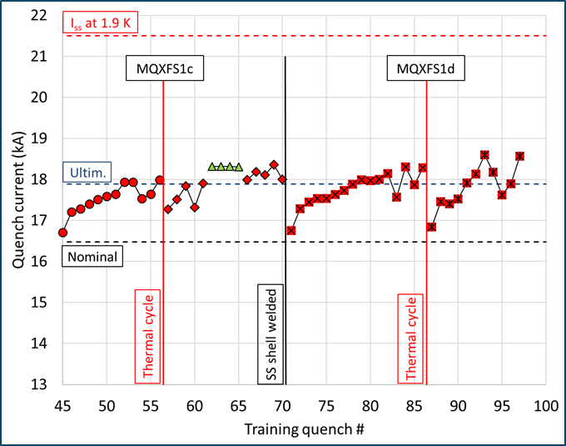
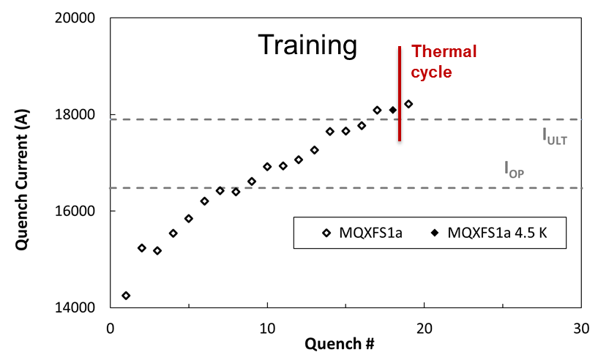
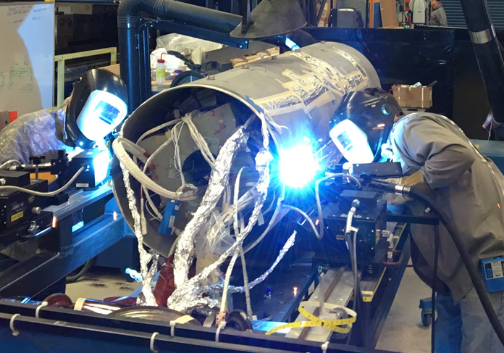
MQXFS1a/b/c/d/e (US)
MQXFS1a ➔ Requirements
  1.2 m coils;
  Demo: Ultimate current, Temp. Margin & Memory
  Quench protection
MQXFS1b/c/d/e ➔ Resilience / Lifetime
  Study of pre-load; SS shell welding; bus-bars
  Demo: Ultimate current after 100s quenches
    Above nominal current after many th. Cycles

Slide 11
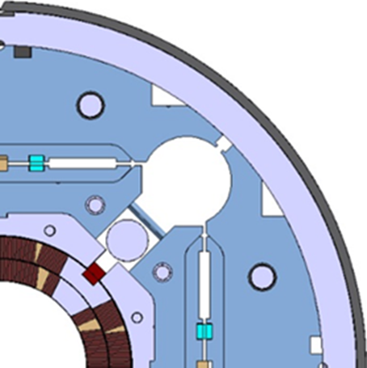
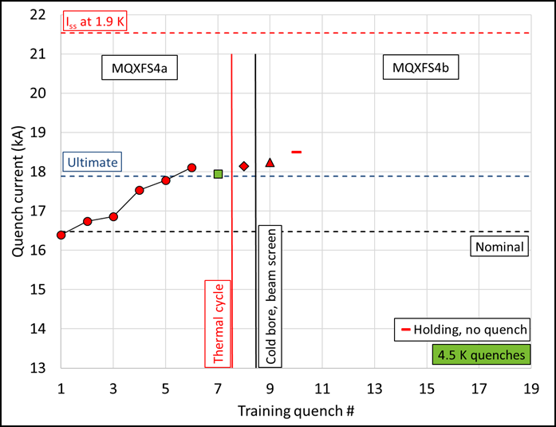
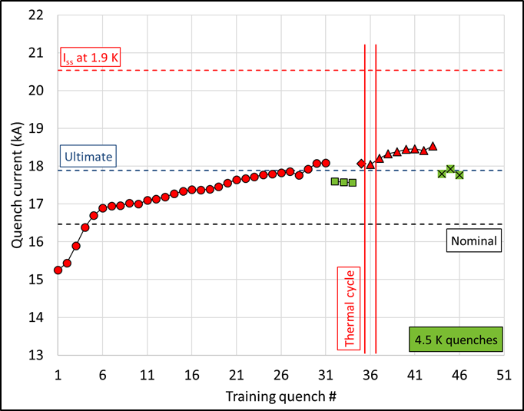
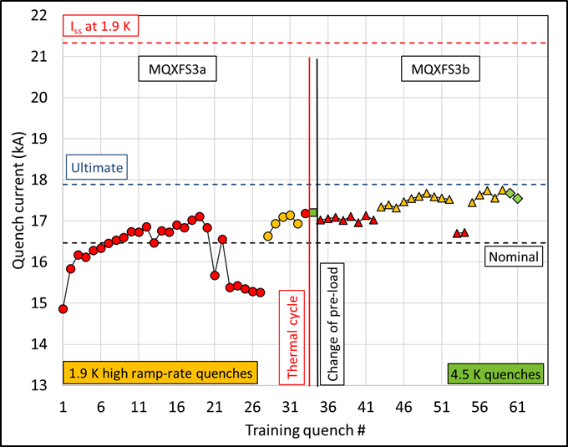
MQXFS3 – S4 – S5 (CERN)
S3: limited performance
  lesson learned: NO collar-key interference
S5 (PIT): I_{ult} at 1.9 K & 4.5 K, with full memory
S4 (RRP): I_{ult} at 1.9 K & 4.5 K, with full memory
  Very short training
Magnet Design
meets requirement
By P. Ferracin

Slide 12
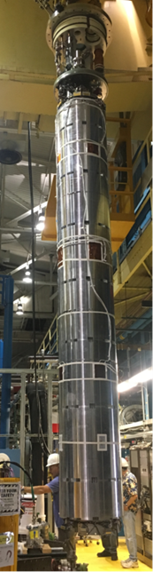

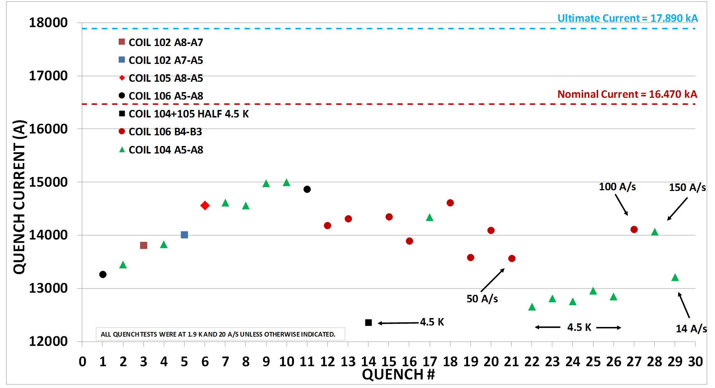
MQXFAP2
  Coils and structure: final dimensions
  GOALS: Meet magnetic requirements
  Meet quench requirements
  Detraining and degradation during test
  Issue localized in return end
@10 kA
X

Slide 13
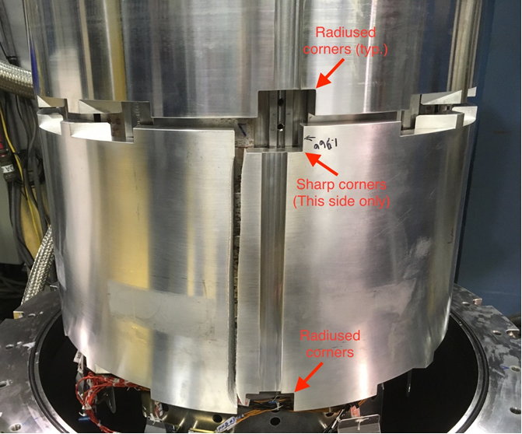
MQXFAP2
Structure Procurement and Inspection
  Root cause(s):
    Bottom shell was manufactured incorrectly: sharp corners on top side
    Was inspected before SDC were completed, and Non-Conformity was accepted
    Material temper different from other shells
      T652 vs T6
Picture from MQXFA FDR, showing 5 mm fillet radius
Longitudinal fracture in return-end shell with crack start at sharp corner

Slide 14
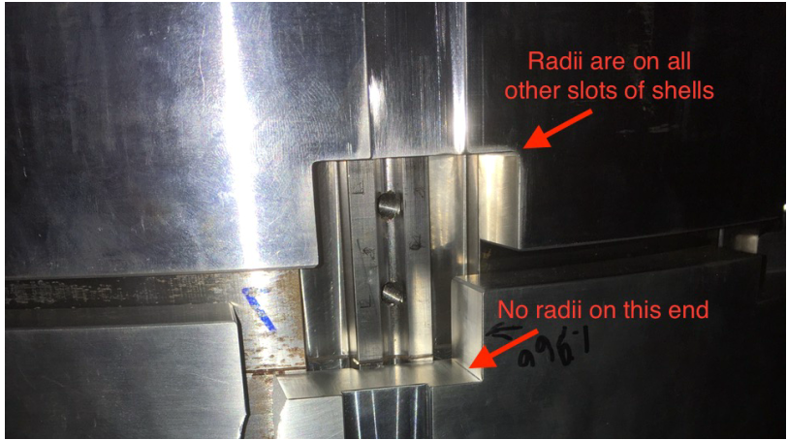
MQXFAP2 visual inspection

Slide 15
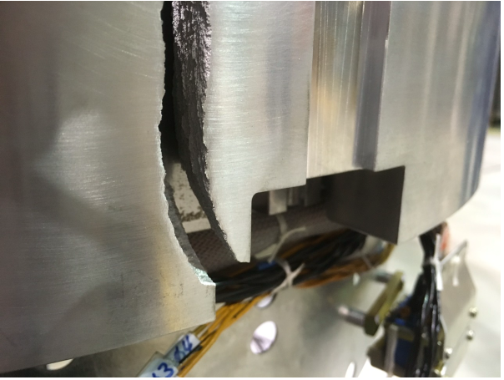
MQXFAP2 visual inspection

Slide 16
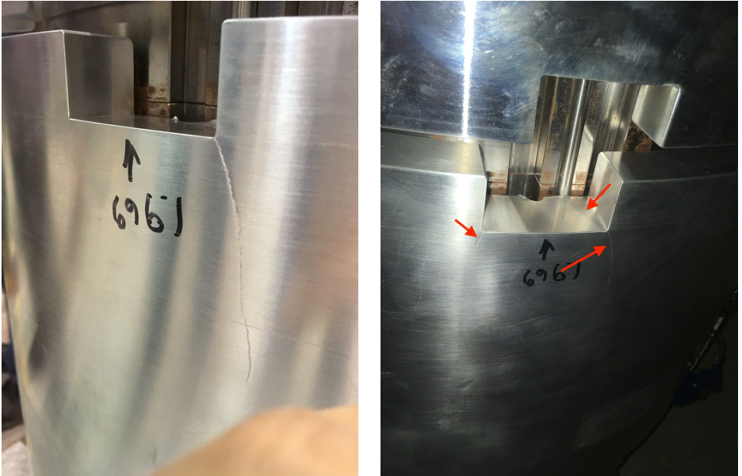
MQXFAP2 visual inspection

Slide 17

MQXFAP2 Shells
Al-7075 T652, rounded corners
Al-7075 T6, rounded corners
Al-7075 T652,
  Top side: sharp corners (<0.02 mm)
  Bottom side: rounded corners

Slide 18
Overview of shells: materials and corners
MQXF short models: 3 structures (procured by CERN)
  Short and long shells (Forgital)
    7175-T74
    No rounded corners; measured radii: 0.1-0.2 mm (2 structures)
AUP MQXFAP1:
  Short and long shells (Metalex)
    7075-T6
    No rounded corners; measured radii: 0.03-0.14 mm
AUP MQXFAP2
  Long shells (Metalex)
    7075-T6
    Rounded corners (1.5 mm)
  Short shells
    7075-T652 (mechanically stress relieved after forging)
    Rounded corners
    except top side of bottom shell: measured radii: < 0.02 mm*
* Measured at CERN

Slide 19
MQXFA Next Steps
Assembly and test of 3 Pre-Series magnets
  Designed, fabricated, inspected and tested according to AUP criteria & Feedback from this review
    Corners with fillets following Structural Design Criteria,
    Aluminum temper based on samples tested at cold (tensile and K_{1c}),
    QC based on Structural Design Criteria,
    Non-conforming parts will be rejected.
  Procurement of shells for the first 2 pre-series magnets is in progress
AUP plans to have 2 successful tests out of 3 Pre-series magnets

Slide 20

Review Goals
The HL-LHC AUP project is planning to start assembly of MQXFA Pre-series magnets in April 2019. In fall 2018 the second MQXFA prototype (MQXFAP2) demonstrated limited performance caused by the fracture of an aluminum shell.
It is mandatory for the AUP project to assure that all causes of the MQXFAP2 shell failure are understood, and that the proposed design has enough margin to prevent similar failures in future MQXFA magnets.
Samples of shell material (Al-7075) have been tested at cold temperature in order to assess material properties and their dependence from different tempers: T6 samples (proposed for production), T652 samples extracted from the fractured shell, and T652 samples from other shells. Computation of peak stresses and stress intensity factors vs. fault size have been performed.
AUP has developed Structural Design Criteria (SDC) [1], and the SDC for the aluminum shells were reviewed on October 5, 2018 [2].
The reviewers are requested to assess the understanding of the MQXFAP2 issue, and the margin of the proposed design based on measured properties and implementation of the Structural Design Criteria.
MQXFA STRUCTURAL DESIGN CRITERIA, US-HiLumi-doc-909
Preliminary thoughts and feedback from Oct 5 review meeting on the Review of Structural Design Criteria Using Al 7075-T65 in MQXF, US-HiLumi-doc-1696

Slide 21

CHARGE Questions - I
The committee is requested to answer the following questions:
Is the mechanism of the MQXFAP2 issue well understood? Is the explanation satisfactory?
Is the FEM analysis adequate to understand failure mechanism and identify critical parameters?
Are the cold measurements on shells samples sufficient to assess critical material properties, their variability and dependence from Al-7075 temper?
Do the proposed design (choice of material, temper and fillet radii) and QC plan meet the AUP Structural Design Criteria (SDC)?

Slide 22
CHARGE Questions - II
Have all recommendations of the aluminum shell SDC review been addressed?
Have all Lessons Learned been appropriately addressed, and have all improvements been implemented, from Design Analysis to Non-Conformity Reporting?
Do the proposed design and QC plan provide enough margin to avoid similar issues in MQXFA production magnets?
Do you have any other comment or recommendation to assure MQXFA magnets will not experience the MQXFAP2 issue?

Slide 23
Close-out & Report
We would like to have a Report addressing each charge question with comments and/or recommendations
  I will provide the template
We need it before April 18 (Production Readiness Review for Pre-Series magnets)
The Close-out can be a Zoom mtg with the Review Chairperson

