Slide 1
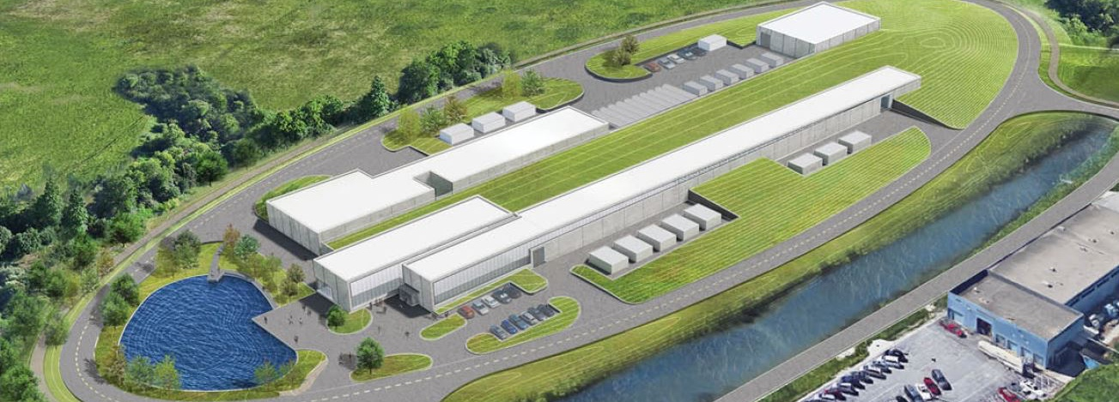
121.04.03 - Test Infrastructure - Overview
Jerry Leibfritz
BOE External Review
4-5 March 2019

Slide 2
Outline
Overview
Test Infrastructure
Scope/Deliverables/Technical Progress
STC
HTS-2
HWR/SSR1
SSR2/650MHz Test Stands
Requirements/Interfaces
Schedule
Cost

Slide 3
About Me:
PIP-II L3 Manager for Test Infrastructure
Senior Principal Engineer, joined Fermilab in 1992
Current responsibilities/roles
Project Leader for Accelerator Division SRF Test Facilities
Cryomodule Test Facility (CMTF)
Cryomodule Test Stand #1 (CMTS1)
PIP-II Injector Test (PIP2IT)
Fermilab Accelerator Science and Technology facility (FAST/IOTA)
CMTS1 Project Manager for LCLS-II Project
SRF Systems Group Leader (Accelerator Division)

Slide 4
Scope
WBS Dictionary: pip2-docdb #599
Test Infrastructure serves an “Interface” role for several sub-system WBS’s and provides very specific resources not captured elsewhere
121.04.03 Linac - Test Infrastructures (TI) | This WBS covers design, procurement, fabrication, installation and testing/commissioning of the test infrastructure necessary for the project. Included are infrastructure services for HWR and SSR1 at PIP2IT, modifications to STC (the spoke test cryostat at Meson Detector Building), and modifications of PIP2IT for 650 MHz and SSR Cryomodule testing.

Slide 5
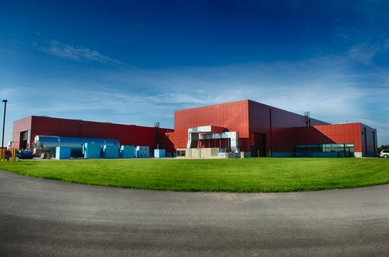
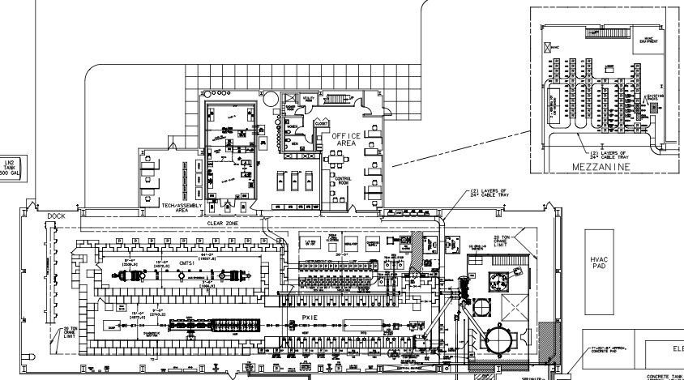
CMTF – Cryomodule Test Facility
The CMTF Building contains two test stands (CMTS1 and PIP2IT)
CMTF Building
CMTS1 Test Cave
PIP2IT Test Cave
Cryogenic Plant

Slide 6
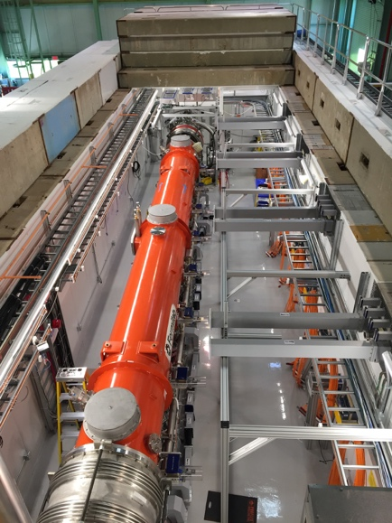
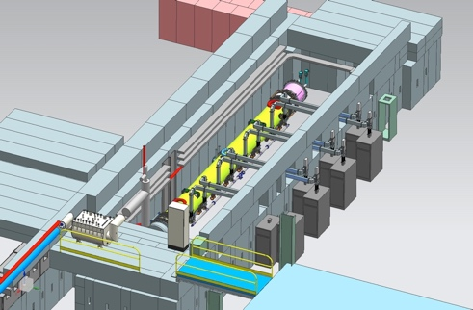
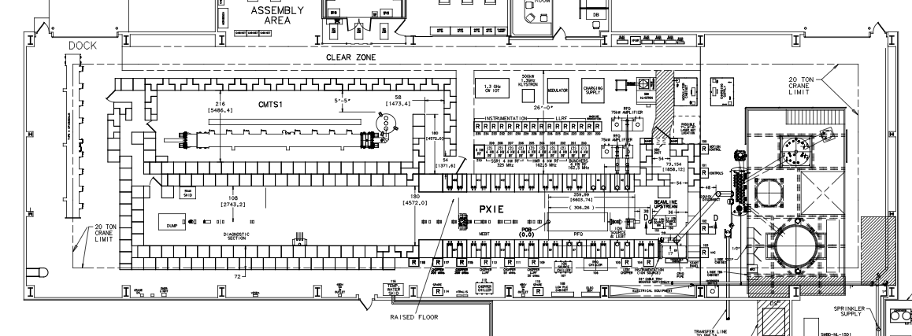
CMTS1
CMTS1 (Cryomodule Test Stand #1)
Fully operational test stand for cold RF testing of cryomodules (no beam)
Currently testing LCLS-II cryomodules (1.3 & 3.9 GHz, CW)
Continuous operation – a new cryomodule tested every 28 days
Not part of PIP-II scope, but good example of similar test stand that will be used for PIP-II cryomodule testing
CMTS1 Test Cave
CMTS1 Test Stand
3-D model of current CMTS1

Slide 7
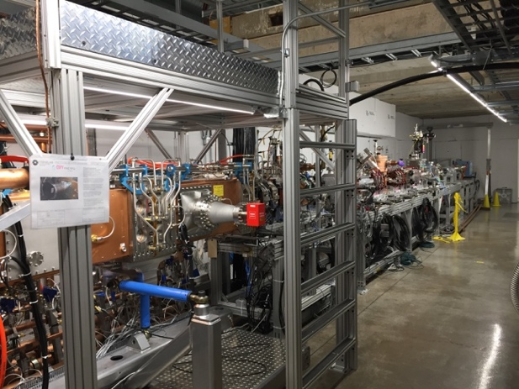
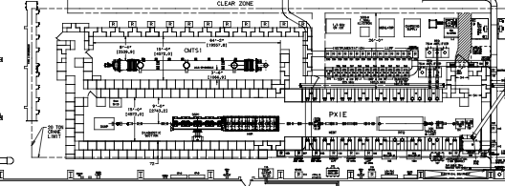
PIP2IT - Overview
PIP2IT (PIP-II Injector Test)
Near full scale test of PIP-II front-end with beam
Half Wave Resonator (HWR) and 1st 325 MHz cryomodule (SSR1-1) will be tested in PIP2IT as part of front-end test
PIP2IT will be converted to a cryomodule test stand to cold RF test the remaining PIP-II cryomodules (no beam)
SSR1-1 test stand will require minimal modifications to accommodate remaining SSR cryomodule testing
HWR test stand will be converted to RF test 650 MHz cryomodules (no beam)
SSR1/325MHz Test Stand
PIP2IT Test Cave
HWR/650 MHz Test Stand
PIP-II Injector Test (PIP2IT)

Slide 8
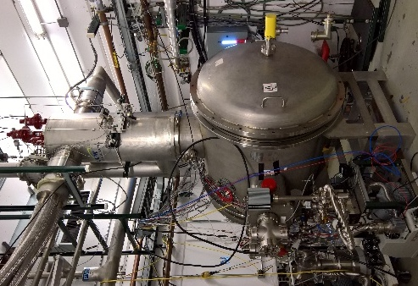
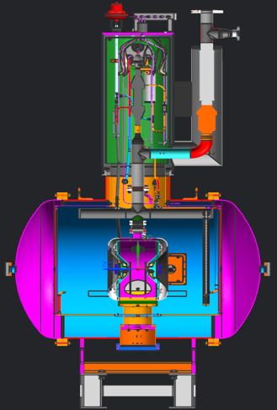
STC - Overview
The Spoke Test Cryostat (STC) is located at the MDB test facility and was designed for testing 325MHz SSR1 cavities at 4K and 2K
STC is used for comprehensive “system-level” tests of cavity+coupler+tuner
STC will be modified to be used for design verification studies and initial qualification for SSR1, SSR2, and HB650 cryomodule cavities
STC cryostat at MDB
SSR1 cavity

Slide 9
WBS Details

Slide 10
STC – 121.04.03.02
Scope
After SSR1 CM1 cavity testing was completed, modifications of STC began to accommodate testing 650MHz elliptical, and SSR2 cavities
Cryostat extension, modified support structure and LHe header
Cryogenic commissioning of these modifications
No changes to cryogenics, instrumentation, or vacuum systems
Installation of 650MHz RF distribution, integration of existing 650MHz IOT with controls/interlocks, and actual cavity testing is not part of the scope of this WBS
Deliverable/Schedule
WBS Deliverable: A modified STC capable of testing dressed HB650MHz elliptical and SSR2 cavities
Modifications commenced after the completion of the SSR1 CM1 cavity test program in November 2018, and are expected to be complete by the end of March 2019
This WBS only includes 2 months of scope after Feb 1, 2019 (BOE starting date)
Design Maturity
The plan is at an advanced stage, installation is nearly complete

Slide 11
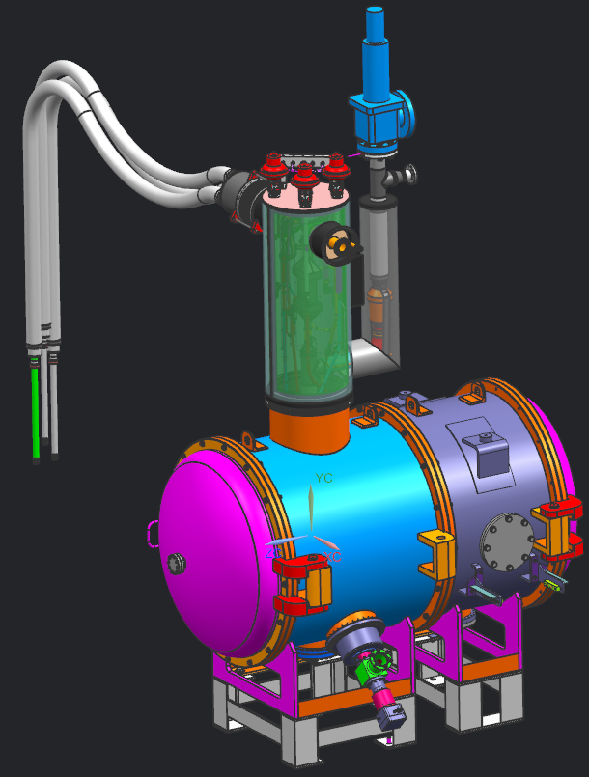
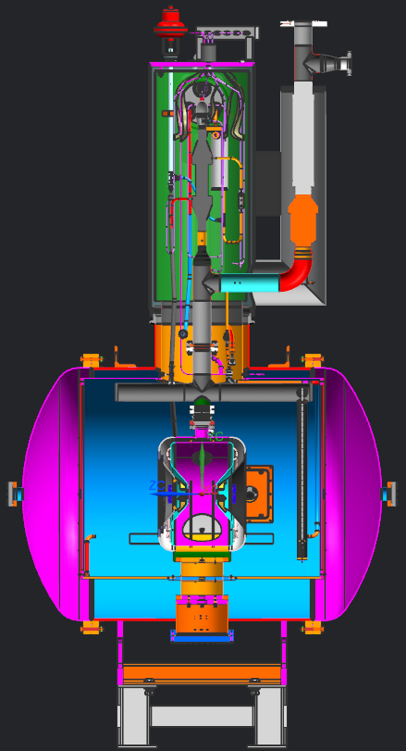
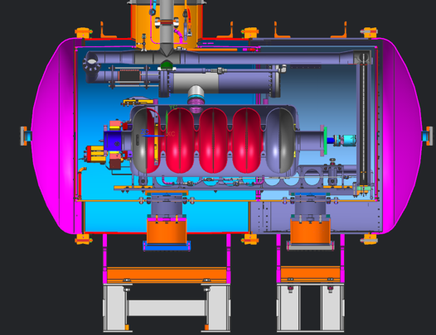
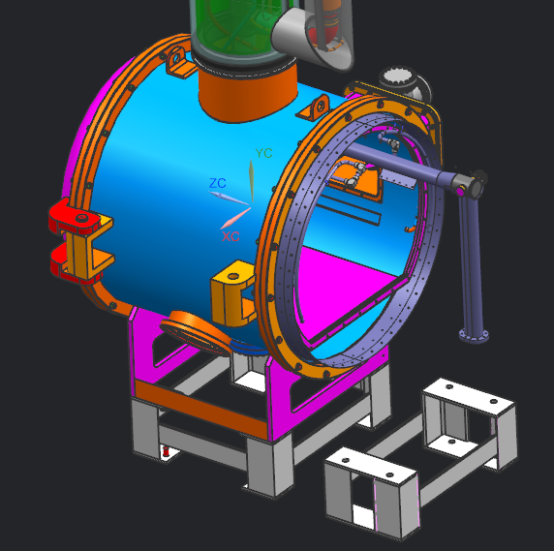
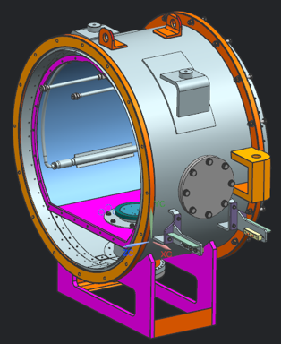
STC - Modifications
Existing STC cryostat as used for SSR1 cavity testing
STC cryostat modified with extension to accommodate 650MHz cavities.
Existing cryostat modified with extended He piping,
SSR1 cavity
Cryostat extension

Slide 12
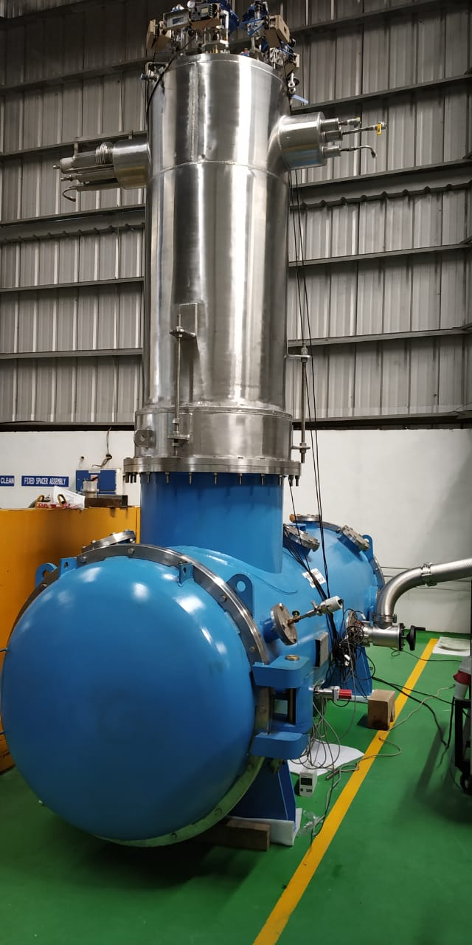
HTS-2 – 121.04.03.06
Scope/Deliverables
Included HTS-2 for completeness
The Horizontal Test Cryostat #2 (HTS-2) is a 650 MHz cavity test cryostat being fabricated by RRCAT
HTS-2 is not planned to be used for PIP-II
All cavity testing is planned to be done at STC
This WBS only covers a small amount of labor to receive HTS-2 and place it in storage.

Slide 13
PIP2IT – HWR/SSR1 – 121.04.03.03
Scope
Infrastructure modifications necessary to install and cooldown the HWR and SSR1 cryomodules and prepare PIP2IT to test them with beam
cave extension, electrical infrastructure, utilities (LCW, air, nitrogen, helium), mechanical infrastructure (stands, supports, cleanrooms), and cryogenic transfer line (CTL) installation
labor for all of the above activities, as well as all of the mechanical technician labor for all installation and vacuum activities for PIP2IT preparation to run beam (Vacuum, WFE, etc.)
Design Maturity
Some of these activities are at an advanced level of maturity and are well underway, while other activities are at a preliminary stage with details still under development
There is an experienced team already in place that developed, operates and maintains all systems associated with PIP2IT and the CMTS1 test stand and this same team of experts are involved in this WBS activity

Slide 14
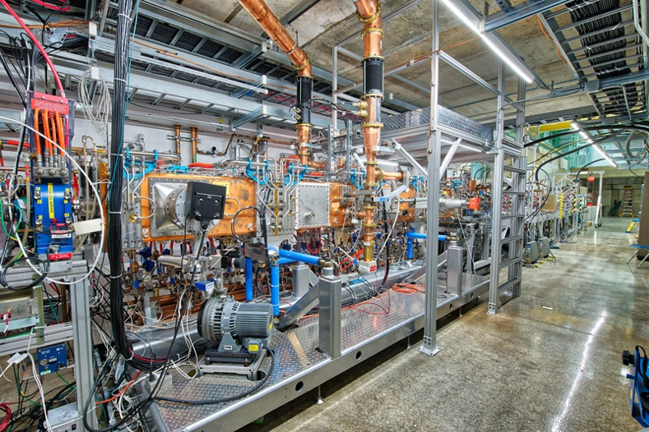
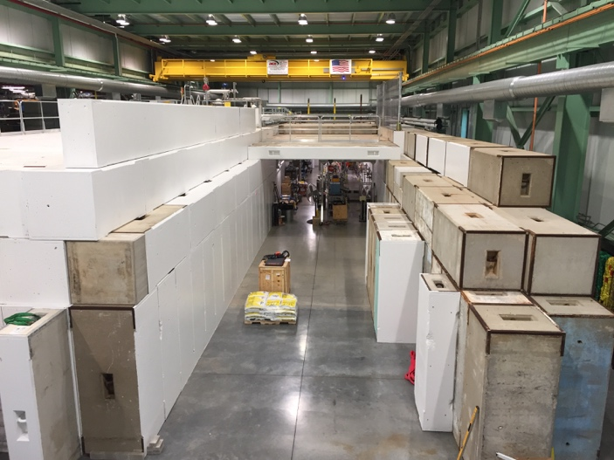
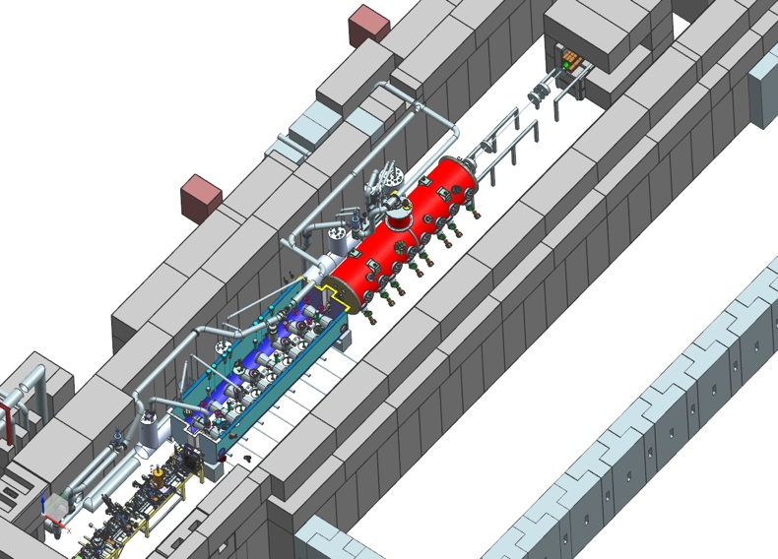
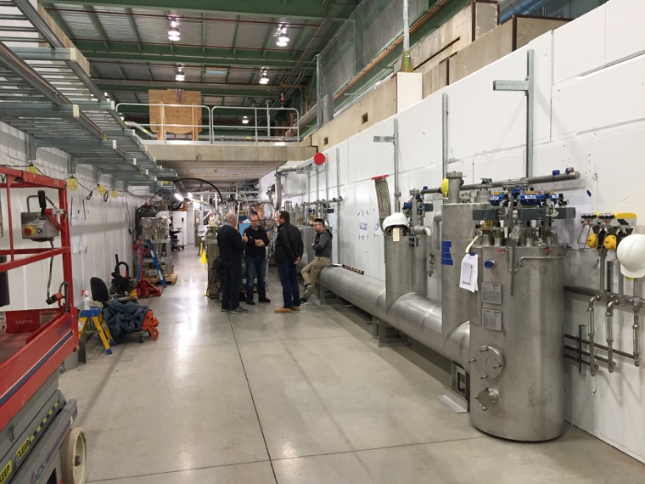
PIP2IT – HWR/SSR1 – Infrastructure
PIP2IT WFE
Cave Extension
3-D of HWR & SSR1
Cryo (CTL) installation

Slide 15
PIP2IT – SSR1-2 & SSR2 Test Stand – 121.04.03.05
Scope
After initial SSR1 (and HWR) cryomodule testing is complete, infrastructure will be reconfigured/modified to accommodate testing PIP-II SSR2 cryomodules in the SSR1 location of PIP2IT
Cryogenic distribution, RF power, mechanical & electrical infrastructure, controls, safety systems, etc.
Design Maturity
This WBS is currently a Planning Package and is at a preliminary level of design maturity. Once the SSR2 cryomodule design is finalized, the design details can be developed further. The scope of work is expected to be similar to, and all estimates are based on, previous experience/costs from constructing and commissioning CMTS1 for LCLS-II
There is an experienced team already in place that developed, operates and maintains all systems associated with PIP2IT and CMTS1 and this same team of experts will be involved in the modifications of PIP2IT

Slide 16
PIP2IT – 650 MHz Test Stand – 121.04.03.04
Scope
After the HWR cryomodule testing is complete, infrastructure will be reconfigured/modified to accommodate testing PIP-II 650 MHz cryomodules in the HWR location of PIP2IT
Cryogenic distribution, RF power, mechanical & electrical infrastructure, controls, safety systems, etc.
Design Maturity
This WBS is currently a Planning Package and is at a preliminary level of design maturity. Once the HB650 cryomodule design is finalized, the design details can be developed further. The scope of work is expected to be similar to, and all estimates are based on, previous experience/costs from constructing and commissioning CMTS1 for LCLS-II
There is an experienced team already in place that developed, operates and maintains all systems associated with PIP2IT and CMTS1 and this same team of experts will be involved in the modifications of PIP2IT

Slide 17
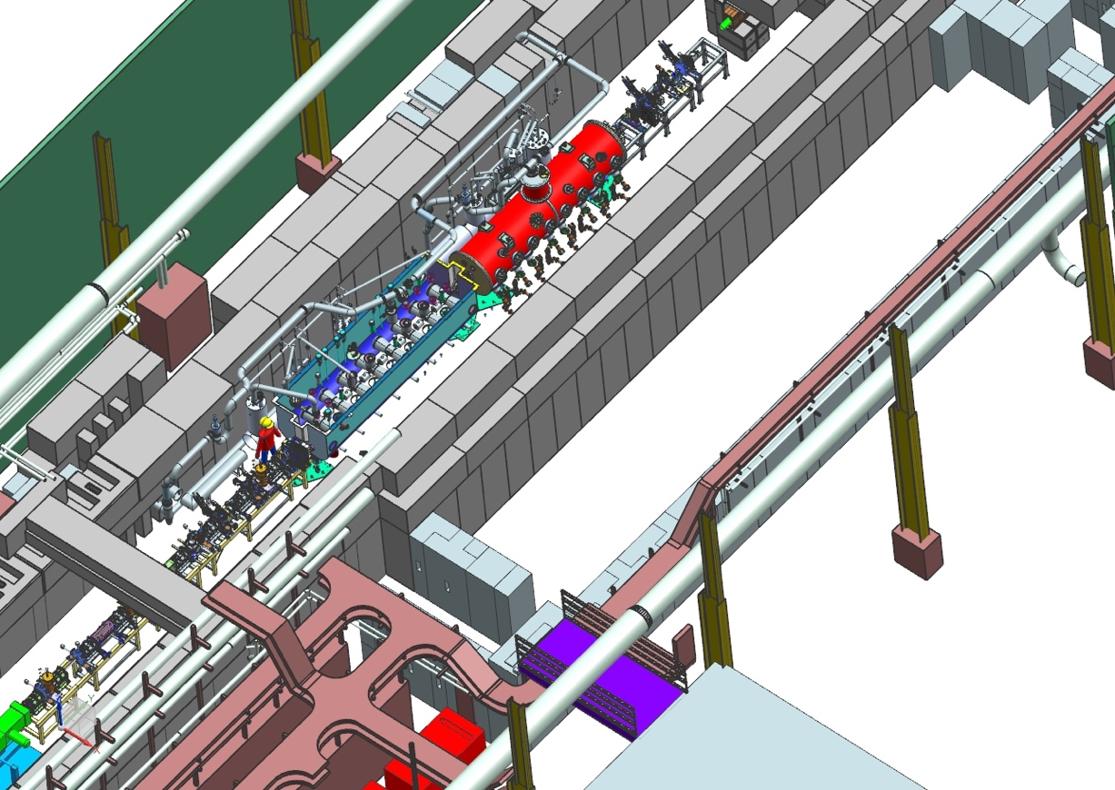
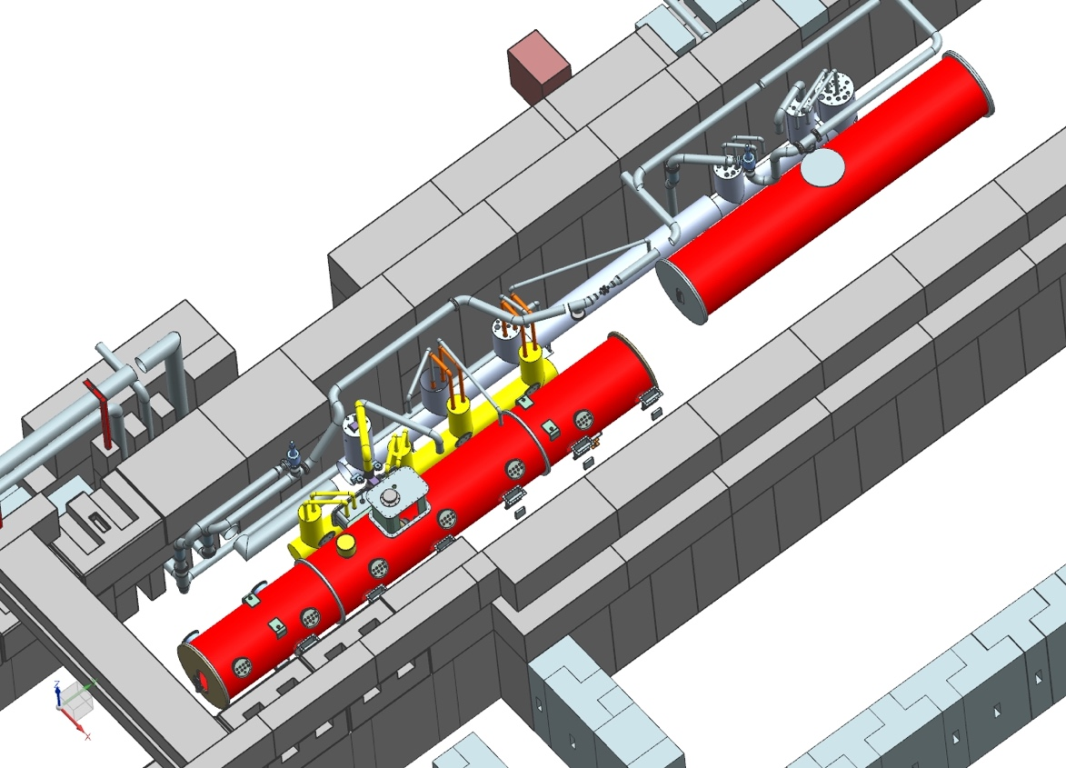
PIP2IT – SSR2 & 650 MHz Test Stands
HB650/SSR2 in PIP2IT
HWR/SSR1 in PIP2IT

Slide 18
Requirements/Interfaces
Requirements are captured in functional/technical requirement specification documents (FRS/TRS), controlled in TeamCenter:
STC : TC# ED0006117 (FRS for STC)
PIP2IT : TC# ED0001223 (FRS for PIP2IT)
Interfaces
Test Infrastructure interfaces with several other WBS’s (HWR, SSR, 650, WFE, HPRF, LLRF, Controls, Magnets/PS, Instrumentation, Vacuum, Safety Systems, etc.) and these interfaces are captured in the Interface Control Document (docdb #2405, TC#ED0007505)

Slide 19
BOE Summary
WBS Number | Title | Docdb #
121.04.03.01 | Test Infrastructure - Project Mgt. and Coordination | 1962
121.04.03.02 | Test Infrastructure - STC | 1965
121.04.03.03 | Test Infrastructure - HWR/SSR1 | 1968
121.04.03.04 | Test Infrastructure - 650 MHz Test Stand | 1971
121.04.03.05 | Test Infrastructure - SSR2 Test Stand | 1974
121.04.03.06 | Test Infrastructure - HTS-2 | 1977

Slide 20
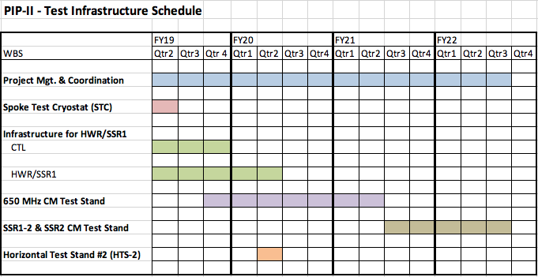
Test Infrastructure – Schedule
STC Modifications (2/2019 – 3/2019) (2 mos.)
HWR/SSR1 Infrastructure (2/2019 – 4/2020) (13 mos.)
650 MHz Test Stand (7/2019 – 6/2021) (24 mos.)
SSR2 Test Stand (4/2021 – 4/2022) (12 mos.)
HTS-2 (3/2020 – 4/2020) (2 mos.)

Slide 21
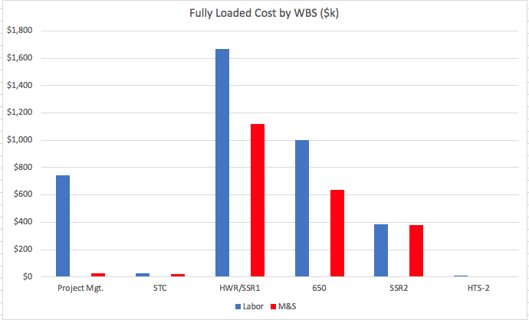
Test Infrastructure – Total Cost
Total Cost by FY
Total Cost by WBS (Labor & M&S)

Slide 22
Thank You!

