Slide 1
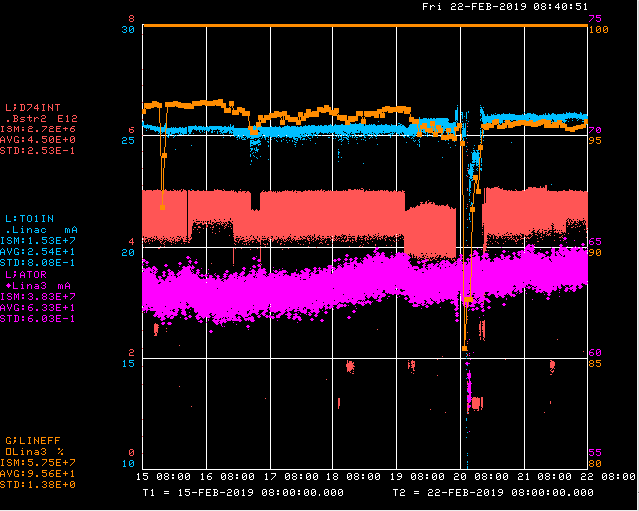
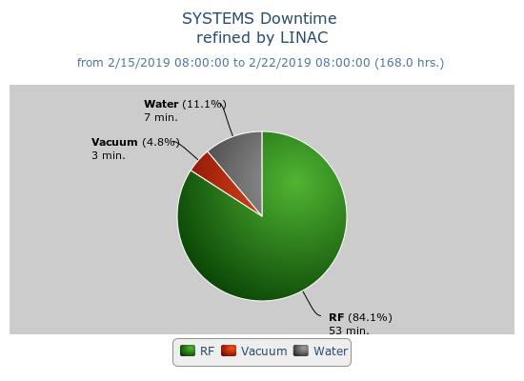
Preacc/Linac Weekly Performance
No Preacc
Downtime
Friday Vernier collector flow restrictor failure
Weekend LRF4 CS PS breaker trip
Phase tuning by Ops
KRF6 ion pump trip/poor vacuum
Wednesday Studies/Maintenance period
Thursday LRF3 gradient drift

Slide 2
Current Conditions/Plans
Source A – 64 mA
Linac input – 26 mA
Linac output – 25 mA, 4.7E12 /pulse
Working with controls to address possible readback issues
Opportunistic downtime request:
15 min. to reboot LRF2 VXI
1 hr. to replace KRFV collector flow restrictor

