Slide 1
Monday 9:00
2019-02-25

Slide 2
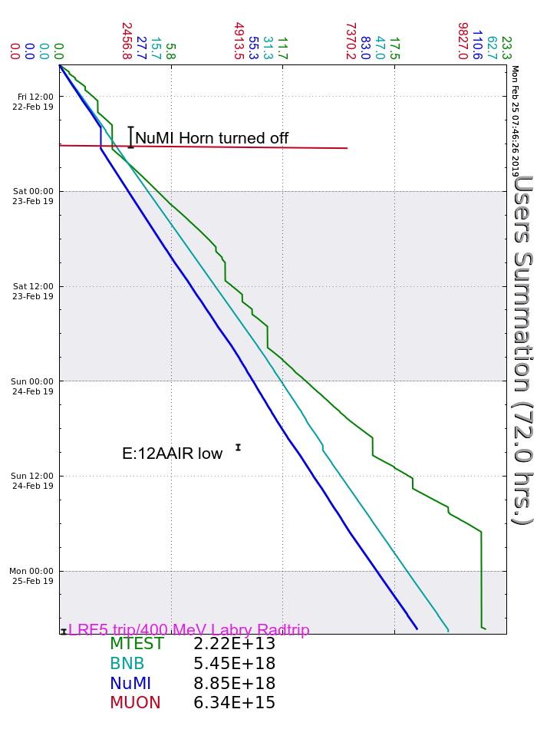
Friday
NuMI Horn trip, experts swapped to charging supply A
Established brief beam to MC-1
Found leak on NM2Q2-1 during S&S training, valved out and informed experts
Saturday
P1 line vacuum burst, reset without issue
MC-1 ODH alarm, Ops replaced ODH heads
Sunday
Booster 023 losses due to damper issues, lowered NuMI $15 intensity
MI-12A Air flow trips due to high winds, consulted with RSO and temporarily lowered limit
NML/FAST Cave dropped for supervised access
Search and secured G2, N01 and NM2 for Interlocks testing
Adjusted source heaters in consultation with experts due to falling temps
Monday
Tuned up RFQ/Buncher phases following low temps
LRF5 Cell trip then Reverse power trips, experts investigating
Current Conditions
LRF5 Investigation

