Slide 1
LSST Next-gen Day 2
Christopher Stubbs, Harvard University
April 2019

Slide 2
Three areas:
Regarding imaging with alternative filters:
Explore marginal gain after LSST survey for shifted bands
Explore notion of spatially-structured passbands
Regarding alternative sensors paving focal plane
Cooling capacity is ~1.5 kW at -100C, and this is a limitation
InGaAs with multiplexer readout seems very interesting, extending reach to 1.8 microns. WINTER is pathbreaker for this.
Ge CCDs would do this as well, but can we get them cold enough?
Regarding fiber-fed spectroscopy
This would sacrifice A-Omega imaging capability, where LSST will remain unique for foreseeable future. Is the marginal gain worth it? Only if spectroscopic figure of merit ~ (N_{fiber}*A*Resolution) is high enough.

Slide 3
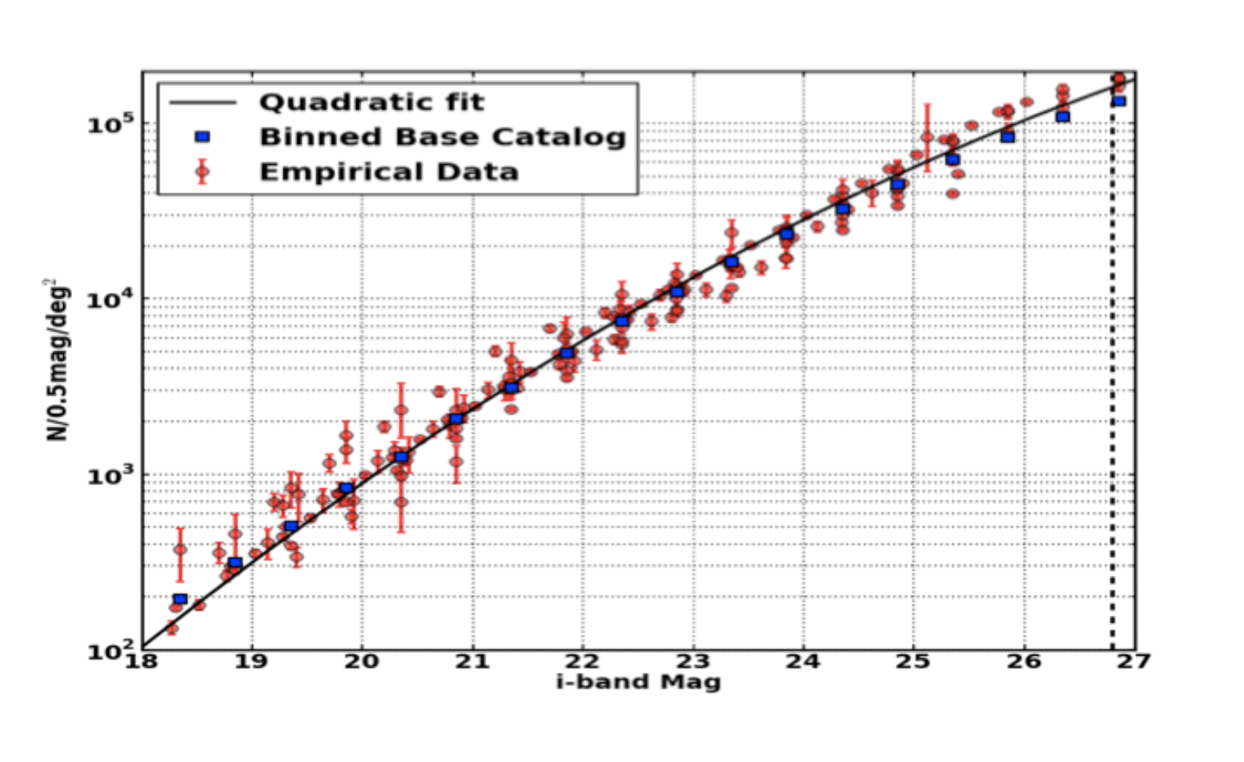
What’s the sweet spot for LSST fiber-fed system?
LSST field of view is 9.6 square degrees
CatSim tool uses the number count model shown in the figure below:
N=(1.8+1.2+0.7+0.5+0.3+0.2)E4~5E4 per square degree, total 20<i<23.5, or 14 per square arc min
That’s 450,000 targets per field, and 29,000 per field with 21.25<m<21.75

Slide 4
How much time is available?
18,000 square degrees = 1875 pointings
Four years (trades operating costs against capital costs, guess 50M$/yr operating and 200M$ for instrument)
Total avail integration time per field is then (4*0.5*0.5*365*24/1875)= 4.6 hr
We’d do this in a layered way, short exposure for m=21.5 brighter and longer for brighter ones. If we could make a 30,000 object system then apart from fiber collisions we’d get i<21.5 in one pass.
N-point correlation studies will require multiple fiber positioning per field, to avoid deadzone of adjacency on the sky. So it’s probably better to imagine 10 hours per field, one hour of integration per configuration, and ten distinct fiber configurations. This cuts the area down to 10,000 square degrees, or extends survey duration to eight years to get full LSST area.
Ten fiber configurations at 30,000 objects per pointing is ~complete to
m< 21.5. LSST will give very high SNR for target selection on these objects.

Slide 5
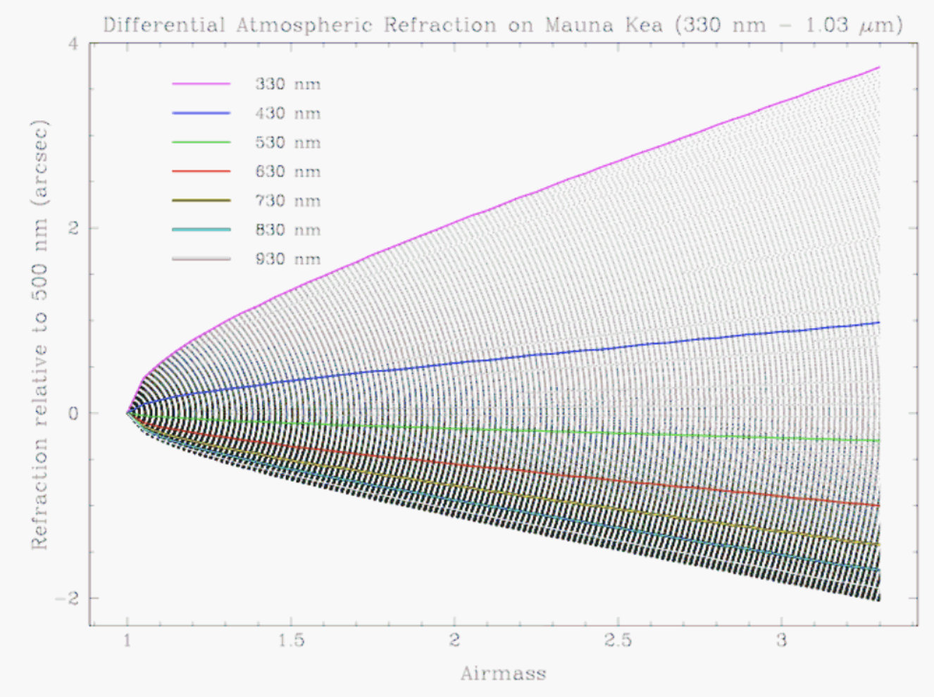
Differential Refraction Concerns
Atmosphere acts like a prism. Light of different wavelengths has angular separation at telescope pupil, makes a small rainbow on focal plane.
Two airmasses is a zenith angle of 60 degrees and gets to declination of +30. An alt-sched-like strategy gets equal exposure coverage across entire LSST footprint. So let’s take two airmasses as tentative limit.

Slide 6
Differential Refraction Concerns
Atmosphere acts like a prism. Light of different wavelengths has angular separation at telescope pupil, makes a small rainbow on focal plane.
Two airmasses is a zenith angle of 60 degrees and gets to declination of +30. An alt-sched-like strategy gets equal exposure coverage across entire LSST footprint. So let’s take two airmasses as tentative limit.
Centers of PSF’s at 350 nm and 900 nm are separated by about 2 arcsec.
That means we need to capture light from an area ~FWHM+2 arcsec
But a single fiber with a diameter of 3-4 arcsec captures more sky than we’d like. Also we’d still suffer from some airmass-dependent systemtic spectrophotometric distortion that depends on surface brightness distribution. So what are the alternatives?
Make an atmospheric dispersion corrector, somehow, for each object
Do low-Fourier-order-correction of spectrophotometry using ugrizy information
Allocate more than one fiber to each object. What geometry?
One-d line of fibers, use rotator to align to parallactic angle
Two-d IFU-like arrangement

Slide 7
One conceptual design, to spark discussion
Construct pupil-reimaging one dimensional array of 5 fibers per object, at 1 arcsec per fiber. Allocate two of them to local sky, and three to the object.
Align to parallactic angle with rotator
2 arcsec lenslets?
100 micron pitch
All identical.
Need to reimage pupil
to get good efficiency
Total linear extent is 20”
or 1mm if sky fibers are
5 arcsec from object
Mimics 2 x 6 arcsec slitlets
Multimode fiber
Pupil image
cladding

Slide 8
Multimode fiber
Pupil image
cladding
Separation between outer edge of donut and inner wall of fiber determines assembly tolerance to microlens array
Angular size of microlens array determines telescope pointing and fiber-module positioning requirements
Diameter of cladding determines angular resolution on the sky.

Slide 9
Implications
A 30,000 object capability seems roughly right. That means each one is responsible for 9.6 sq deg/30,000 = 1.15 sq arc min. At target density of 14 per square arcmin we need around 14 configurations to get all of them.
Patrol area per object bundle is ~60 arcsec*10 microns/0.2 arcsec = 3mm
Range of motion can be 1mm=1000 microns, assuming 9 pointings
Precision requirements are modest, 0.5 arcsec is 25 microns
Footprint of positioner can’t exceed
3mm x 3mm, behind focal plane.
If number of pixels per object is 7 cross-spectral x extent x Nfiber/obj ~ 7*12K*5 = 50Kpix/object, we need 13Gpix. Gives R~6000 at 2 pix/FWHM.

Slide 10
Specific risk-reduction tasks to allow cost assessment
Investigate beam transport fiber properties for LSST-fed system.
Prototype LSST-lenslet-fiber-instrument_feed optical designs
Prototype small-IFU multifiber pupil reimaging unit
underfill ratio on fiber?
cheap replication!
Pursue skipper-output Si CCDs
Pursue skipper-output Ge CCDs (good for dark matter too!)
Pursue dirt-cheap readout electronics
Sketch out spectrograph conceptual design alternatives, with real Zemax analysis. Single-arm or dual? Has to be cheap!
Look into small-motion fiber-nudgers – 1 mm motion, 3x3mm footprint.

Slide 11
Specific risk-reduction tasks to allow cost assessment
Solve the fiber spectrograph sky subtraction problem
Calibration issues, both wavelength and spectrophotometric
Identify and squash all sources of systematic error!
Much of this can be bench-tested.
Think about what filter-changer system would enable 30-band survey.
Investigate fiber technologies- hexagonal? OH suppression?
Cylindrical lens for refraction correction?
Fiber-switching technologies?
Promote high-fill-factor large format InGaAs arrays for NIR.
Improve the acronym.

