Slide 1
Wednesday 9:00
2019-02-27

Slide 2
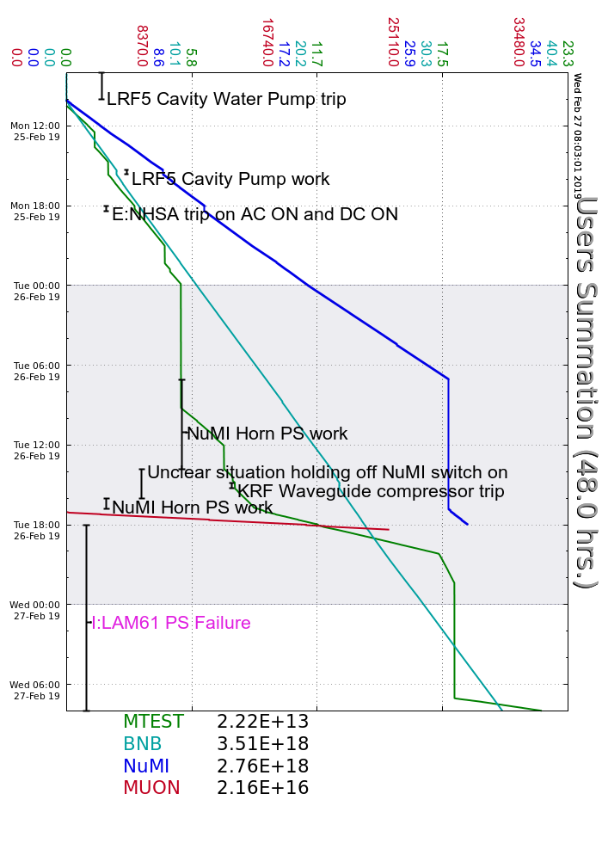
Monday
Recovered from LRF5 Cavity Water Pump trip
B:VBC1 trip, experts investigated
NuMI Horn PS trip, cycled breaker to reset
Tuesday
NuMI Horn polarity swap
MI-60 RF LCW pump #2 smoked itself, running without
KRF Waveguide pressure trips, FESS investigated air compressors
FESS had soft stand-down for 13.8kV+ breaker manipulation
AD followed suit
NuMI Target Hall dehumidifier repair
Beam to NuMI by 17:00
I:LAM61 trip on water temperature, transformer leg overheated, experts investigated and found damage extensive, left off overnight to form plan
Wednesday
Multiwire/SWIC page errors, experts investigating
Current Conditions
Beam to BNB and MTest

Slide 3
