Slide 1
LFD & df/dp Simulations on SSR2 v. 2.6
P. Bhumeshwar
Ion Accelerator Development Division
Bhabha Atomic Research Centre
22 February 2019

Slide 2
Outline
Bare Cavity Analysis
Jacketed Cavity Analysis: Contribution of various cavity regions
Optimization of df/dp
Optimization of LFD with Tuner Stiffness
Effect of Jacket Thickness on LFD
Effect of Cavity Thickness on LFD
LFD for Optimum Cavity Thickness & Jacket Thickness (4mm & 7 mm)
Study of Different Techniques for reducing LFD
Notes:
After 2nd point, include donut rib attached to the Helium Jacket results and its limitation
7) 4mm & 7mm LFD & df/dp

Slide 3
Objective
SSR2 cavity Mechanical design considering Lorentz force detuning (LFD) and Helium pressure fluctuations (df/dp)
Requirements:
|Lorentz Force Detuning Coefficient (k)| ≤ 5 Hz/(MV/m)²
Helium Pressure Sensitivity < 2 Hz/mbar

Slide 4
Parameters varied during the Simulations
Cavity Thickness
Jacket thickness
For LFD
Bellow disc radius
For df/dp
Bellow disc radius
Tuner stiffness
Cavity model changes & boundary conditions
The LFD & df/dp mostly depend on the above parameters and these are varied to get the required values. These parameters are to be observed during the presentation.

Slide 5
Time Progress of LFD on SSR2 Cavity
All the model changes were performed on Bare cavity which has a thickness of 2.83 mm and consists of a total of 8 daisy ribs on each side, one donut rib on each side, a circumferential stiffener running around the cylindrical surface and Helium Jacket which has a thickness of 6.25 mm
Date of Meeting/Completion | Cavity Model Description | LFD (Hz/(MV/m)²)
24th July 2018 | Jacketed cavity with only coupler point fixed | -12.17
26th November 2018 | Cavity thickness increased to 4 mm and Jacket thickness to 7 mm | -6.19
Nov 2018 | Thickening of spoke to 4.82 mm | -4.83 (Feb 2019)
Dec 2018 | Additional 4 Circumferential stiffeners placed
Dec 2018 | Non tuner side jacket thickness increased to 12 mm
Jan 2019 | Tuner side donut rib position changed
Jan 2018 | Spoke Disc inserted

Slide 6
1. Bare Cavity Analysis
Presented on 24th May 2018
Parameter | Value
Cavity Thickness (mm) | 2.83
E_{acc} (MV/m) | 1.767
LFD Coefficient (Hz/(MV/m)²) | -5.44
Circumferential Stiffener
Donut Rib
A total of 16 daisy ribs (beam pipe ribs), 2 donut ribs & 1 Circumferential stiffener are used on the bare cavity and they are present throughout the simulations later on (even on Jacketed cavity).
Beam Pipe Rib
Boundary Condition used:
Both ends of beam pipe fixed (unrealistic)
SSR2 Bare Cavity
Material for the Cavity: Niobium
Young’s Modulus = 105 GPa
Poisson’s Ratio = 0.38

Slide 7
SSR2 Jacketed Cavity Analysis
Boundary Conditions used on the One-fourth Cavity for LFD & df/dp Analysis

Slide 8
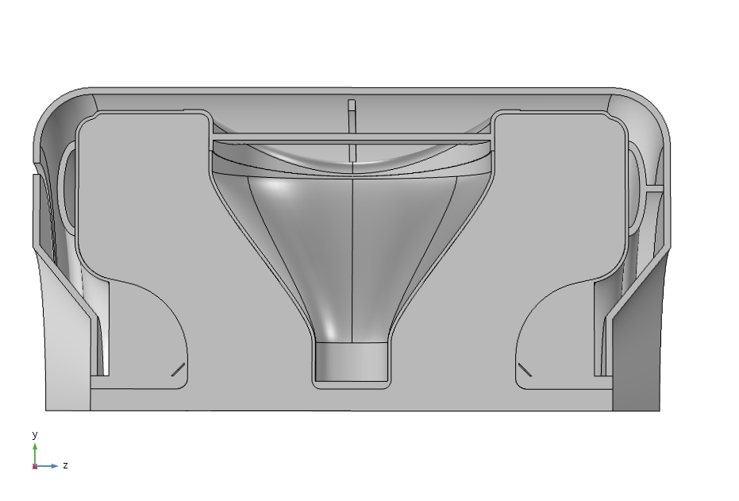
SSR2 Model
Donut Ribs
Spoke
Bellow Disc Radius
End Walls
A model of SSR2 Cavity with Helium Jacket

Slide 9
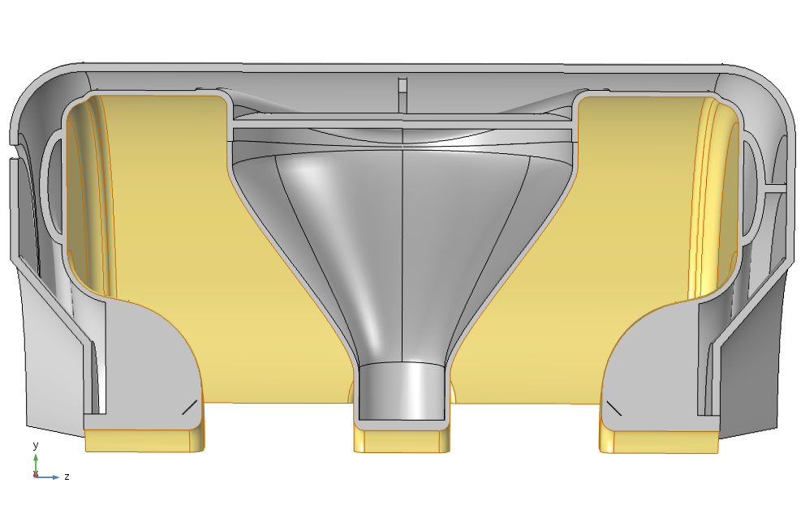
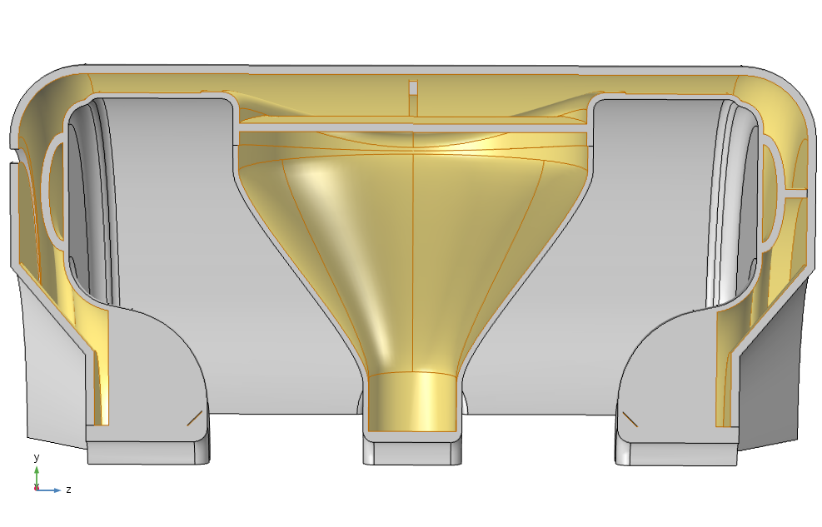
Boundary Conditions
Boundaries over which Lorentz Pressure was applied
Boundaries over which Helium Pressure was applied

Slide 10
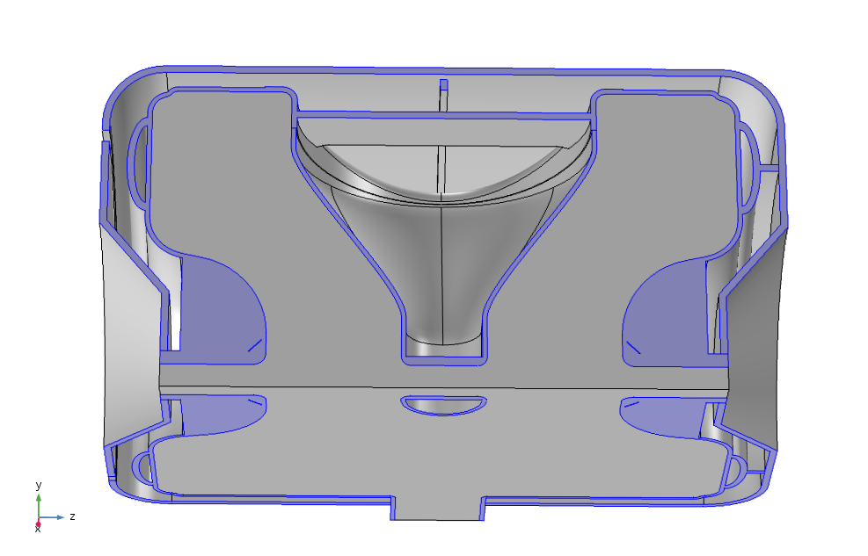
Boundary Conditions continued..
Symmetry conditions used on one-fourth model of SSR2 cavity for simulating complete cavity

Slide 11

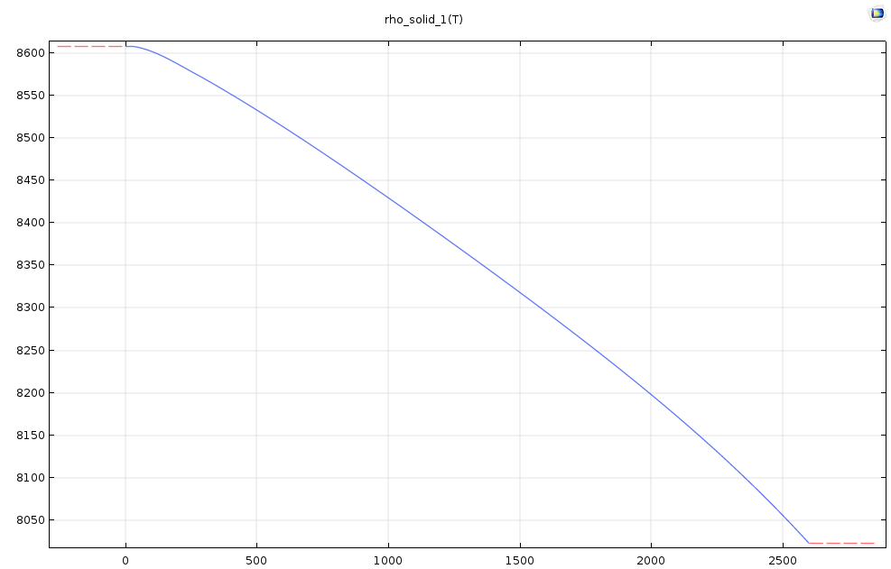

Materials used for the cavity:
RF Volume: Vacuum
Cavity : Niobium
Helium Jacket : Stainless steel
Density of Niobium with Temperature

Slide 12
Boundary Conditions continued..
Model showing boundaries where both beam pipe ends are fixed

Slide 13
Boundary Conditions continued..
Model showing coupler point which is fixed during simulations

Slide 14
Boundary Conditions continued..
Model showing edge where the bellow/Tuner stiffness is applied during the simulations

Slide 15
2. Jacketed Cavity Analysis:
Contribution of Various Cavity Regions to LFD
Presented on 24th July 2018
Parameter | Value
Cavity Thickness (mm) | 2.83
Helium Jacket Thickness (mm) | 6.25
Bellow Disc Radius (mm) | 152.49
Boundary Condition | LFD Coefficient (k) (Hz/(MV/m)²) | df/dp (Hz/mbar)
Both flanges fixed (in x, y, z direction) | -2.565 | 25.58
One flange fixed (in x, y, z direction) | -12.17 | -111.93
One point fixed (x, y, z direction) on coupler port | -12.17 | -112.97
It can observed that LFD number has decreased from -5.44 to -2.56 Hz/(MV/m)² for the condition that both beam pipes were fixed.
However, a more realistic situation can be simulated by fixing a point on coupler port and letting the beam pipes free. For this case, LFD can be observed to be – 12.17 Hz/(MV/m)².

Slide 16
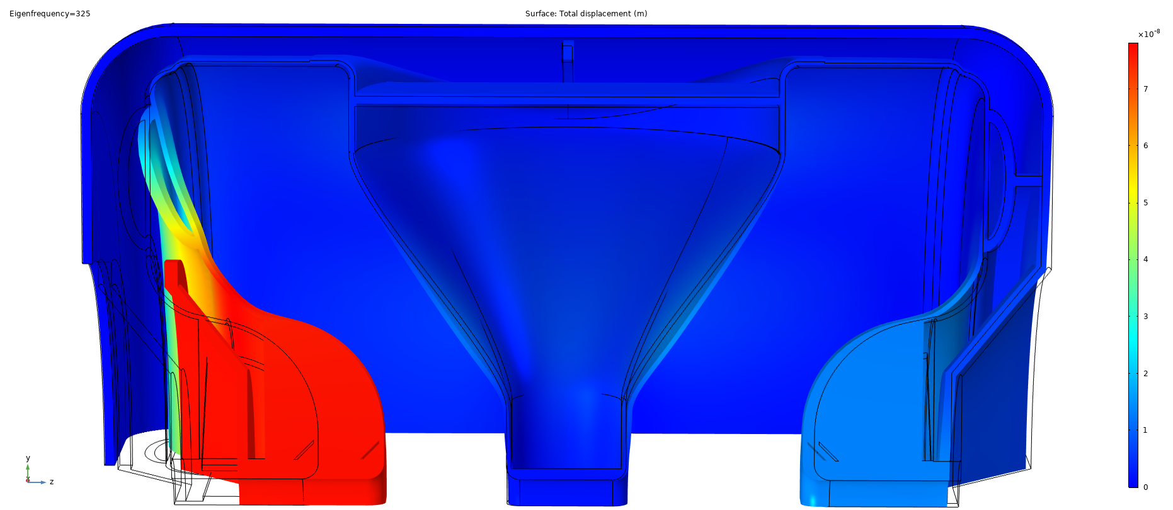
Deformation of Cavity due to Lorentz Forces
The regions on the cavity where high deformations due to Lorentz forces are observed and which contribute majorly to LFD are:
End Walls
Spoke
Cylindrical Surface
Deformation on these regions needs to be restricted to reduce LFD Coefficient
Deformation of cavity due to Lorentz forces when a point on coupler port is fixed
(for a stored energy of 1 J and corresponding E_{acc} = 1.76 MV/m)

Slide 17
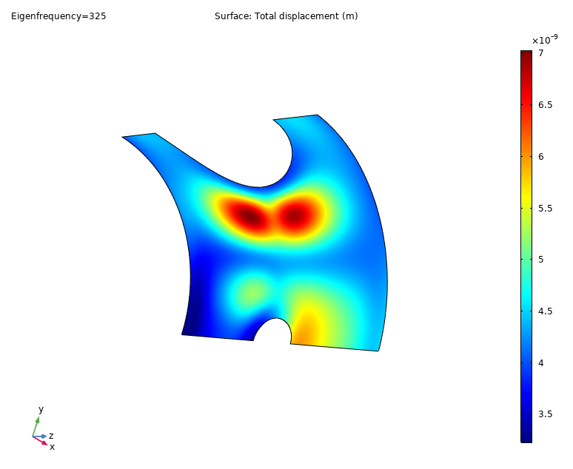
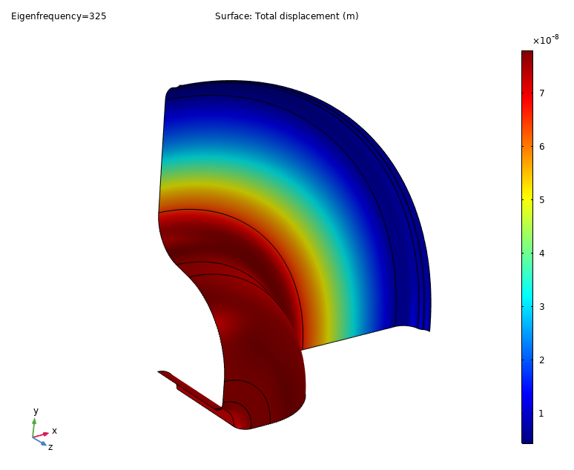
Deformation of Cavity due to Lorentz Forces
Displacement profile on cylindrical surface
Displacement profile on Tuner end wall
A maximum displacement of around 7 nm is observed on cylindrical surface and around 70 nm on tuner end wall

Slide 18
i. Contribution of End Walls towards LFD
Boundary Condition | LFD Coefficient (k) (Hz/(MV/m)²)
One point fixed (x, y, z direction) on coupler port | -12.17
Both flanges fixed (in x, y, z direction) | -2.565
It can be observed that when a point on coupler port was fixed (corresponding to simulating the free cavity) the LFD coefficient is -12.17 Hz/(MV/m)² and LFD coefficient reduced to -2.565 Hz/(MV/m)² when both the flanges (beam pipes) were fixed completely.
This signifies the huge contribution of end walls towards LFD. Hence, it is important to control end wall deformation.
LFD at the non tuner side end wall can be improved by increasing the stiffness at that side. Having higher jacket thickness or shape optimization can be done to reduce the contribution.
LFD at the tuner side can be totally controlled by tuner stiffness. Higher tuner stiffness can reduce LFD.

Slide 19
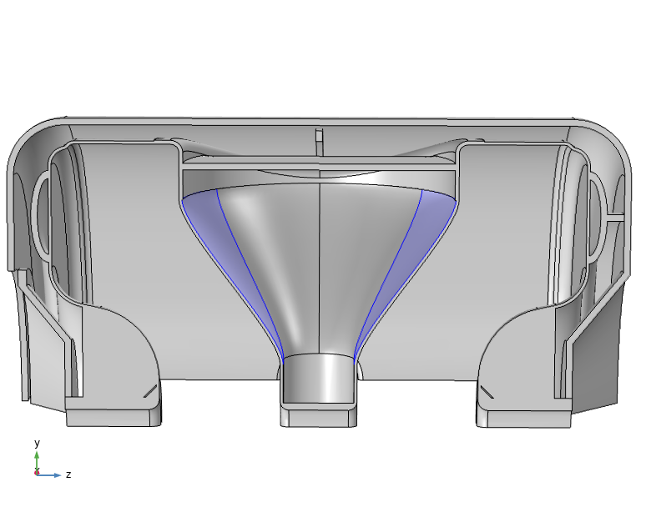
ii. Contribution of Spoke region towards LFD
The boundaries on spoke where maximum deformation is seen is fixed completely to observe its effect on LFD
Initial LFD | -6.16 Hz/(MV/m)²
Changed LFD | -5.45 Hz/(MV/m)²
The contribution to LFD from spoke is less when compared to end walls.
Spoke disc can be inserted on the spoke to restrict the movement of spoke.

Slide 20
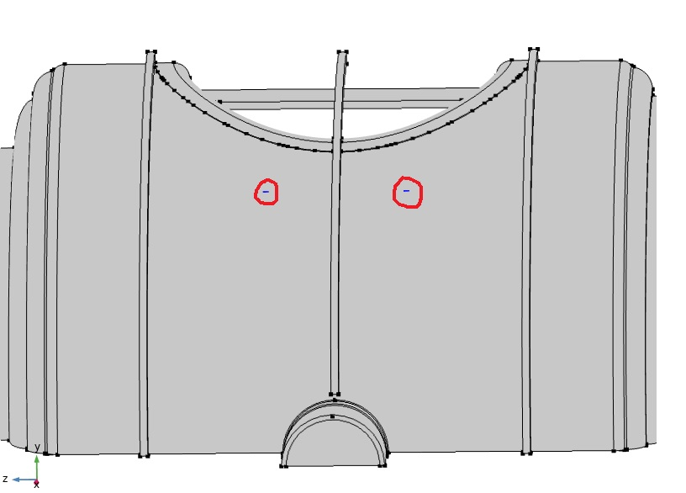
iii. Contribution of Cylindrical region towards LFD
Displacement profile on cylindrical surface
Max deformation points fixed completely
To study the contribution towards LFD, highest displacement points on the surface were completely fixed.

Slide 21
iii. Contribution of Cylindrical region towards LFD
Initial LFD | -6.16 Hz/(MV/m)²
Changed LFD | -5.85 Hz/(MV/m)²
Increasing the Niobium thickness is the only way to reduce this contribution.
As compared to the contribution from end walls, the contribution from cylindrical region is not much towards LFD.

Slide 22
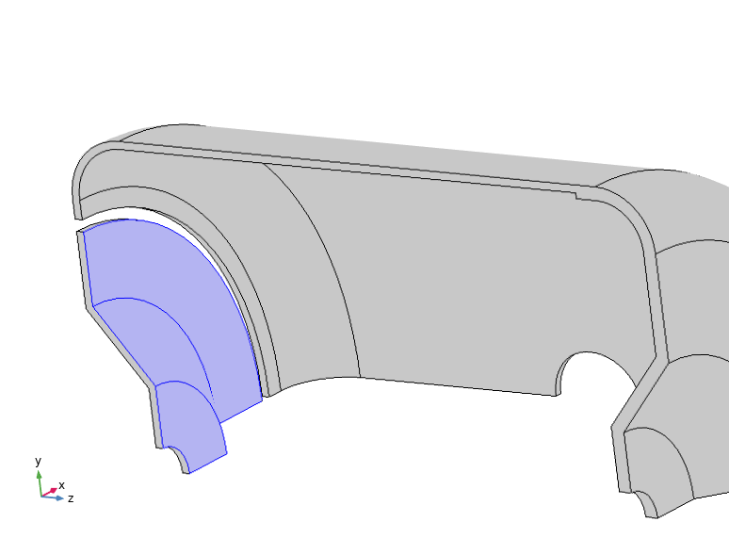
3. Optimization of df/dp
Presented on 26th Sep 2018
Force = Pressure*Area
Pressure being constant at 1 bar on the surface of the disc,
Force α Area α (Radius of disc)²
Larger the force acting on disc surface, the more the deformation of cavity and hence change in frequency
Radius of disc (mm) | df/dp (Hz/mbar)
295.74 | 344.144
197 | 6.68
162.92 | -90
152.49 | -112.972
145.66 | -133
df/dp can be brought to zero, at any time, by optimizing only the disc radius.

Slide 23
4. Optimization of LFD with Tuner Stiffness
Presented on 10th Oct 2018
Parameter | Value
Disc Radius | 197 mm
Cavity Thickness | 2.83 mm
Jacket Thickness | 6.25 mm
LFD at Tuner stiffness = 0 kN/mm | -12.504 Hz/(MV/m)²
df/dp at Tuner stiffness = 0 kN/mm | 6.683 Hz/mbar
Both LFD and df/dp values start getting saturated above a tuner stiffness of 40 kN/mm.
Therefore, this value of tuner stiffness was chosen for future simulations.
LFD at 40 kN/mm Tuner stiffness = -8.32 Hz/(MV/m)² (from graph)
df/dp at 40 kN/mm Tuner stiffness = -16.97 Hz/mbar (from graph)

Slide 24
Optimization of df/dp
Again, Cavity disc radius has been changed from 197 mm to 216 mm to get the df/dp to be zero.
Correspondingly, LFD changed from -8.32 to -8.65 Hz/(MV/m)².
Assuming the graph to be linear over a small range, the slope of the graph was found to be 0.98 (Hz/mbar)/mm
Parameter | Value
Disc Radius | 216 mm
Cavity Thickness | 2.83 mm
Jacket Thickness | 6.25 mm
LFD at Tuner stiffness = 40 kN/mm | -8.65 Hz/(MV/m)²
df/dp at Tuner stiffness = 40 kN/mm | 0.332Hz/mbar
Change in df/dp with disc radius | ~0.98 (Hz/mbar)/mm

Slide 25
5. Effect of Jacket Thickness on LFD
Presented on 20th Nov 2018
Jacket thickness was increased from 6.25 mm to 7 mm keeping the cavity thickness at 2.83 mm and tuner stiffness at 40 kN/mm.
Parameter | Value
Disc Radius | 216 mm
Cavity Thickness | 2.83 mm
Jacket Thickness | 7 mm
LFD at Tuner stiffness = 40 kN/mm | -8.01 Hz/(MV/m)²
df/dp at Tuner stiffness = 40 kN/mm | 8.42 Hz/mbar
LFD Coefficient decreased from -8.65 to -8.01 Hz/(MV/m)².

Slide 26
6. Effect of Cavity Thickness on LFD
Presented on 20th Nov 2018
Cavity thickness was varied from 2.83 mm to 4 mm keeping the Jacket thickness at 6.25 mm and tuner stiffness at 40 kN/mm.
Cavity thickness | LFD (Hz/(MV/m)² )
2.83 mm | -8.65
3.5 mm | -7.23
4 mm | -6.41
4.5 mm | -5.80
4.9 mm | -5.43
LFD Coefficient decreased from -8.65 to -5.43 Hz/(MV/m)² by increasing the cavity thickness to 4.9 mm.
However, Saturation effects can be seen to be starting above 4.5 mm.
Since, very high thickness is also not desirable, we chose Nb thickness of 4 mm as optimal.

Slide 27
7. LFD for Optimum Cavity Thickness & Jacket Thickness
Completed on 26th Nov 2018
From the previous study, effect of cavity & Jacket thickness in LFD has been studied and the model of 4 mm thick cavity and 7 mm thick Jacket has been chosen.
Parameter | Value
Disc Radius | 224 mm
Cavity Thickness | 4 mm
Jacket Thickness | 7 mm
LFD at Tuner stiffness = 40 kN/mm | -6.19 Hz/(MV/m)²
df/dp at Tuner stiffness = 40 kN/mm | 6.92 Hz/mbar
LFD Coefficient decreased from -8.65 to -6.19 Hz/(MV/m)² by increasing the cavity thickness to 4 mm & Jacket thickness to 7 mm simultaneously.

Slide 28
Optimization of df/dp
The bellow disc radius has been adjusted for getting df/dp zero and the corresponding df/dp and LFD are observed.
Parameter | Value
Disc Radius | 215 mm
Cavity Thickness | 4 mm
Jacket Thickness | 7 mm
LFD at Tuner stiffness = 40 kN/mm | -6 Hz/(MV/m)²
df/dp at Tuner stiffness = 40 kN/mm | -0.46 Hz/mbar
Getting the LFD coefficient from -6 to -5 was much more difficult than getting LFD from -12.5 to -6. A lot of techniques were studied and simulated to get it close to -5.
They are discussed in the next slides.

Slide 29
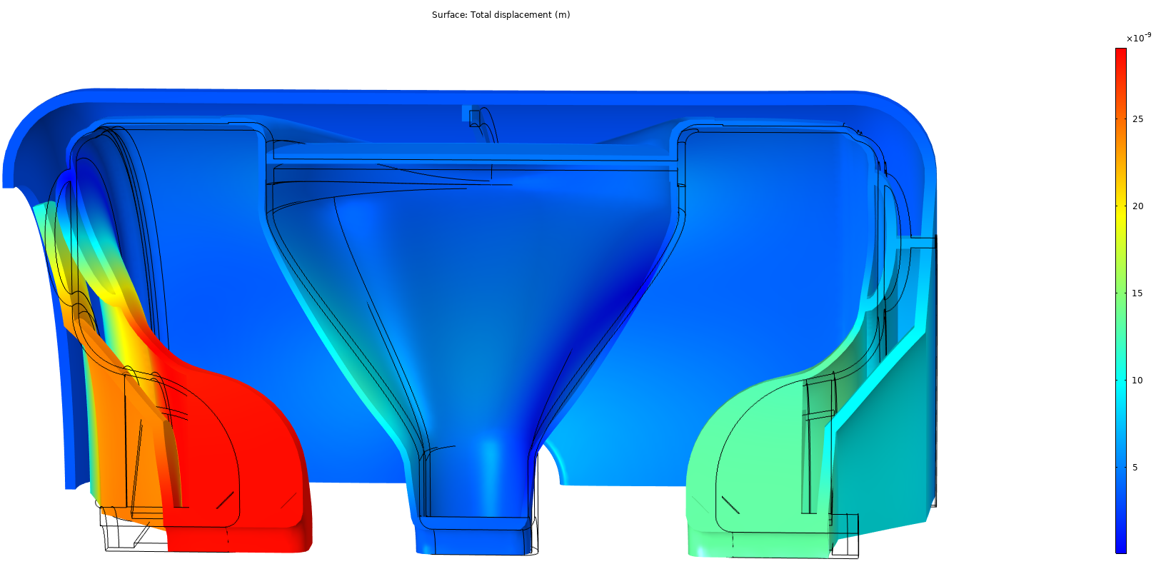
8. Study of Different Techniques for Reducing LFD
Till now, all the simulations are done by fixing a point on coupler port and giving a tuner stiffness of 40 kN/mm.
For further decreasing the LFD, the cavity stiffness at the beam pipes is to be increased as the region is the most sensitive to LFD. Other regions where the cavity has undergone maximum deformation due to Lorentz forces were also studied and accordingly changes to model were done to reduce LFD.
From the figure, most sensitive regions can be identified to be end walls, spoke and the cavity cylindrical surface.

Slide 30
8. Study of Different Techniques for Reducing LFD
In one of the cases, the non bellow side beam pipe was completely fixed (means infinite stiffness) (in addition to coupler point) to study its effect on LFD and LFD number reduced from -6.19 to -5.15.
Therefore, increasing the stiffness at that beam pipe can reduce the LFD and thus some changes to the model were done as explained in the next slides.

Slide 31
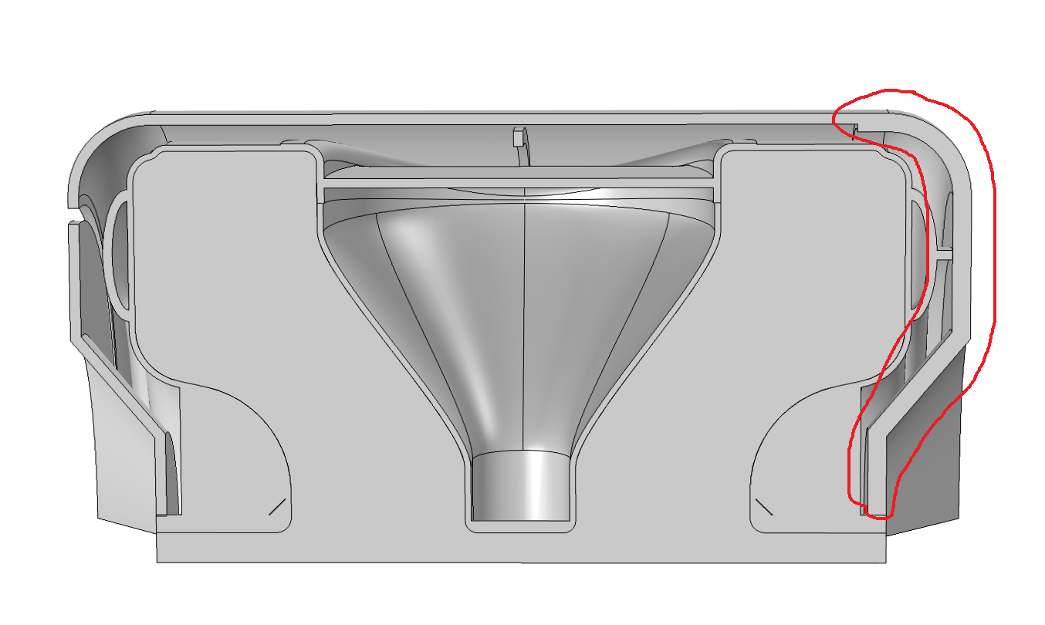
8. Study of Different Techniques for Reducing LFD
Completed on 26th Dec 2018
i. Localized increase in Jacket thickness near non-bellow beam side
Parameter | Value
Disc Radius | 224 mm
Cavity Thickness | 4 mm
Jacket Thickness | 7 mm
From slide 27
Increasing the thickness of the jacket increases the stiffness of the cavity at this end of the beam pipe.

Slide 32
8. Study of Different Techniques for Reducing LFD
i. Localized increase in Jacket thickness near non-bellow beam side
Variation of the Lorentz force detuning coefficient (k) with the localized increase in jacket thickness can be observed from the graph.
The value may saturate at -5.15 with increase in the localized thickness, the value, which was obtained, when this side of the cavity beam pipe was completely fixed (infinite stiffness).

Slide 33
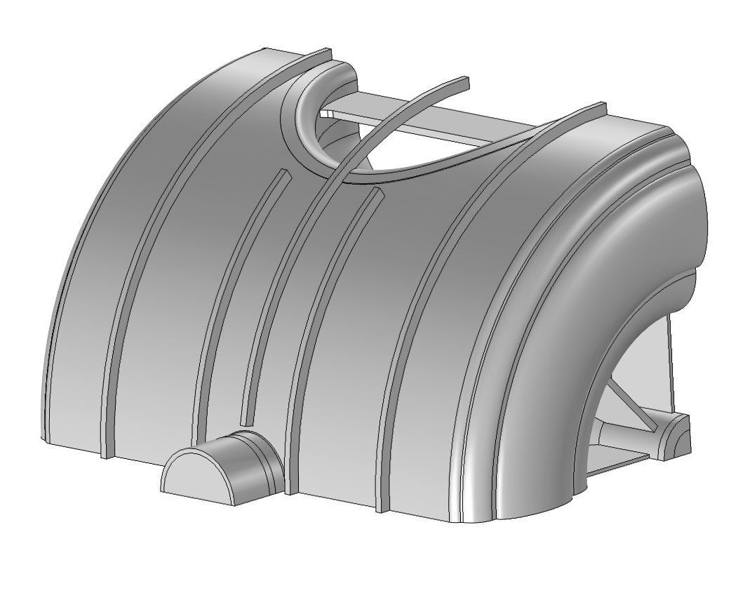
8. Study of Different Techniques for Reducing LFD
Completed on 13th Dec 2018
ii. Circumferential Stiffeners (CS) over the Cavity cylindrical surface
Another region where significant deformations are observed is the cavity circumferential surface.
4 Stiffeners are placed over the surface where deformation of the cavity was observed, of which, two stiffeners run along the entire surface of the cavity near the spoke collar & other two run for some length over the cavity and are placed at maximum displacement points.
Initial LFD | -6.19 Hz/(MV/m)²
Changed LFD | -6.10 Hz/(MV/m)²

Slide 34
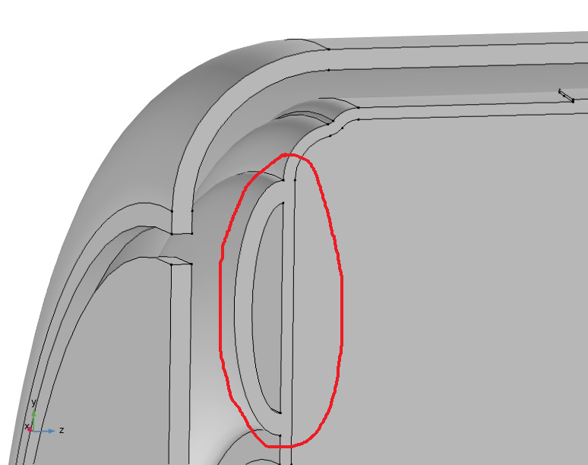
8. Study of Different Techniques for Reducing LFD
Completed on 09th Jan 2019
iii. Changing Donut rib position
Donut rib position influences the stiffness of the cavity at the beam pipe which in turn influences the LFD.
The position of the donut rib was kept in such a way that LFD corresponding to it is minimum.
Parameter | Value
Disc Radius | 224 mm
Cavity Thickness | 4 mm
Jacket Thickness | 7 mm
Initial LFD | -6.19 Hz/(MV/m)²
Changed LFD | -6.14 Hz/(MV/m)²

Slide 35
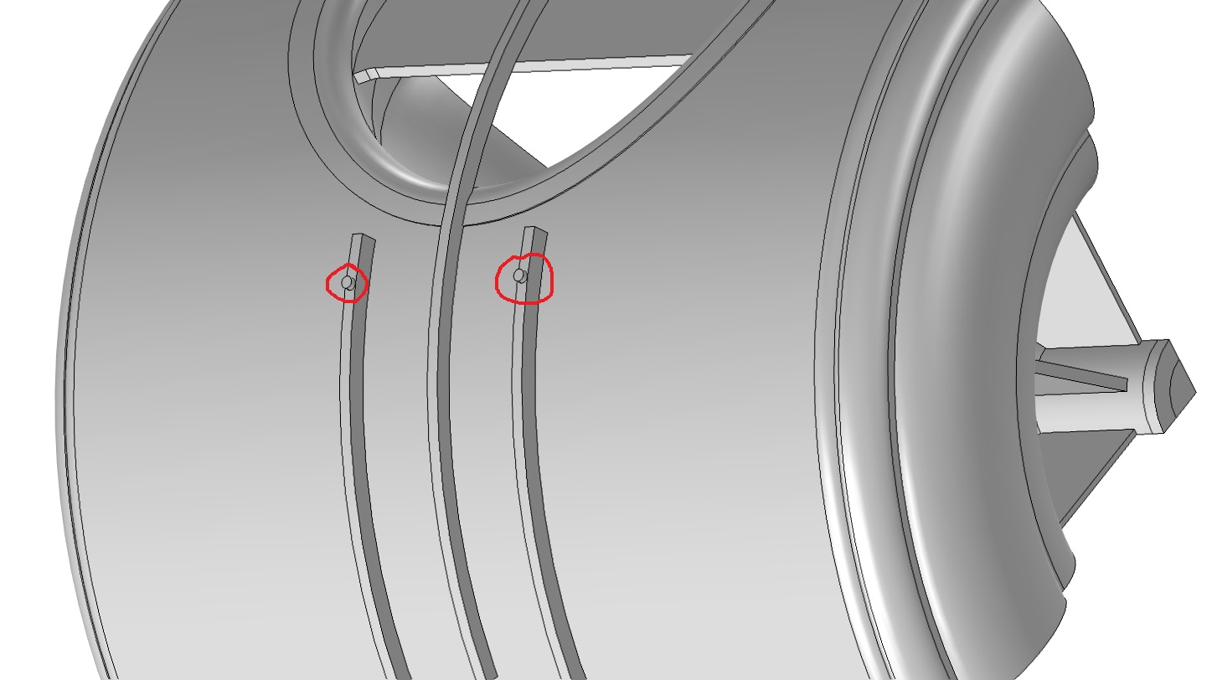
8. Study of Different Techniques for Reducing LFD
Completed on 17th Jan 2019
iv. Circumferential stiffeners (CS) connected to Jacket
Connecting the Jacket to the cavity through the small pins placed over the CS, stops the drifting of the cavity especially at the spoke region which is one of the highly sensitive region to deformations due to LFD.
Parameter | Value
Disc Radius | 224 mm
Cavity Thickness | 4 mm
Jacket Thickness | 7 mm
Initial LFD | -6.19 Hz/(MV/m)²
Changed LFD | -6.01 Hz/(MV/m)²

Slide 36
8. Study of Different Techniques for Reducing LFD
Completed on 23rd Jan 2019
All the four techniques discussed previously are now combined in to a single model and their effect is observed.
Parameter | Value
Disc Radius | 224 mm
Cavity Thickness | 4 mm
Jacket Thickness | 7 mm
Tuner Stiffness | 40 kN/mm
Jacket thickness at non-bellow side | 12 mm
Donut rib moved down by 5 mm
CS connected to Jacket
Initial LFD | -6.19 Hz/(MV/m)²
Changed LFD | -5.49 Hz/(MV/m)²

Slide 37
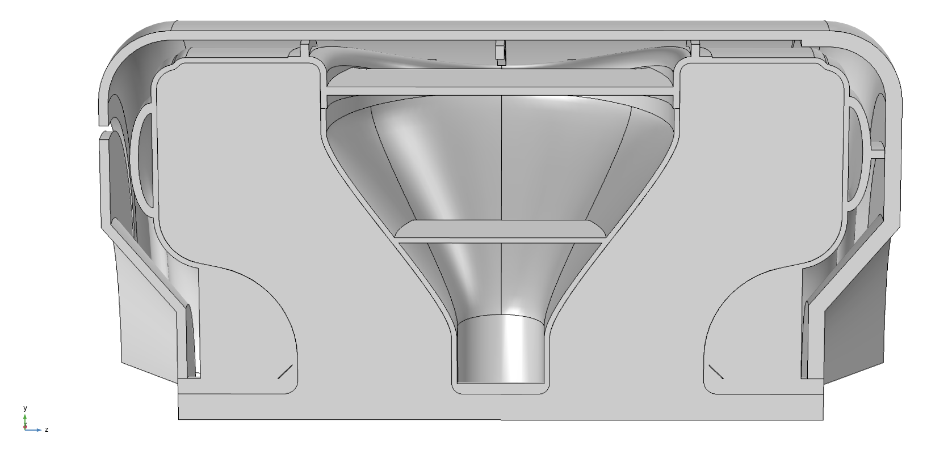
8. Study of Different Techniques for Reducing LFD
Completed on 01st Feb 2019
To the previous model, a spoke disc was also inserted to curb the motion of spoke due to Lorentz forces and the LFD coefficient was calculated.
The model has been adjusted for df/dp to be as close as to zero by changing the bellow disc radius and again the LFD coefficient was calculated.
Parameter | Value
Disc Radius | 214 mm
Cavity Thickness | 4 mm
Jacket Thickness | 7 mm
Tuner Stiffness | 40 kN/mm
Jacket thickness at non-bellow side | 12 mm
Donut rib moved down by 5 mm
CS connected to Jacket
Spoke disc inserted
Initial LFD | -5.49 Hz/(MV/m)²
Final LFD | -4.99 Hz/(MV/m)²
df/dp | 0.328 Hz/mbar

Slide 38
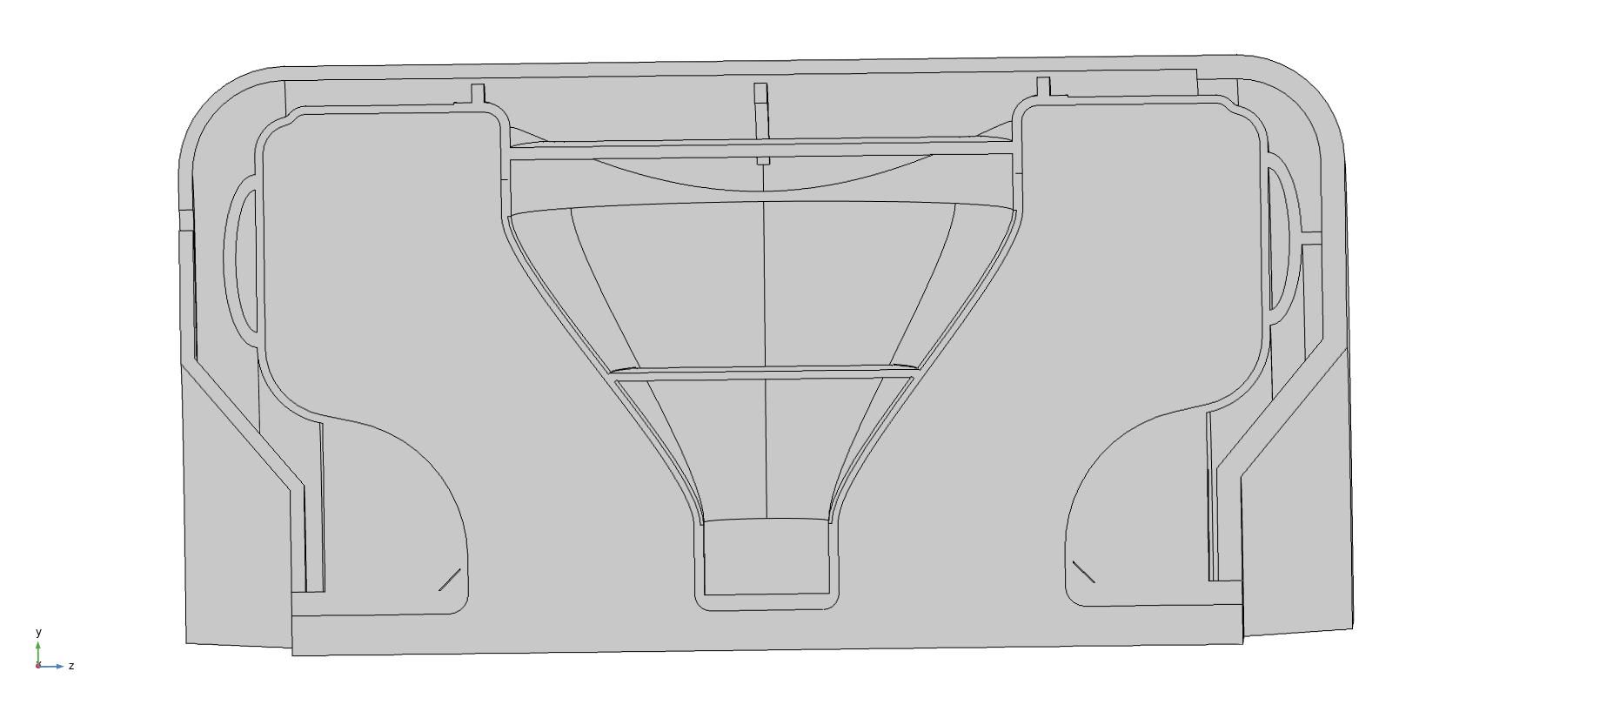
8. Study of Different Techniques for Reducing LFD
Completed on 15th Feb 2019
To the previous model, the thickness of the spoke was increased from 4 mm to 4.82 mm (spoke collar is already at 4.82 mm)
Parameter | Value
Disc Radius | 214 mm
Cavity Thickness | 4 mm
Jacket Thickness | 7 mm
Tuner Stiffness | 40 kN/mm
Jacket thickness at non-bellow side | 12 mm
Donut rib moved down by 5 mm
CS connected to Jacket
Spoke disc inserted
Whole Spoke Thickened to 4.82 mm
Initial LFD | -4.99 Hz/(MV/m)²
Final LFD | -4.74 Hz/(MV/m)²
df/dp | -3.94 Hz/mbar

Slide 39
8. Study of Different Techniques for Reducing LFD
Completed on 15th Feb 2019
A study was done on the previous model to see the Tuner stiffness effect by changing the Tuner stiffness from 0 to 120 kN/mm.
We can observe that by increasing the Tuner stiffness to 120 kN/mm, LFD decreased to -4.28 Hz/(MV/m)².

Slide 40
8. Study of Different Techniques for Reducing LFD
Completed on 19th Feb 2019
Here, the connection between cavity and jacket through small pins over the circumferential stiffeners are removed from the previous model.
Parameter | Value
Disc Radius | 214 mm
Cavity Thickness | 4 mm
Jacket Thickness | 7 mm
Tuner Stiffness | 40 kN/mm
Jacket thickness at non-bellow side | 12 mm
Donut rib moved down by 5 mm
Spoke disc inserted
Whole Spoke Thickened to 4.82 mm
Initial LFD | -4.74 Hz/(MV/m)²
Final LFD | -4.83 Hz/(MV/m)²
df/dp | -1.92 Hz/mbar
Conclusion:
The final values for LFD & df/dp are
LFD = -4.83 Hz/(MV/m)²
df/dp = -1.92 Hz/mbar

Slide 41
Other Possibilities tried
These were done at various stages and the results are produced here indicating whether there was an improvement in the LFD coefficient or degradation of it and reasons why these possibilities are discarded.

Slide 42
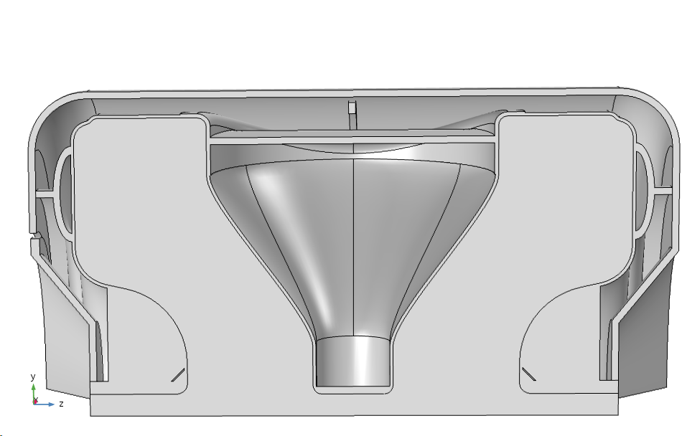
1. Connecting the Donut Rib to Jacket
Presented on 19th Sep 2018
Parameter | Value
Disc Radius | 152 mm
Cavity Thickness | 2.83 mm
Jacket Thickness | 6.25 mm
No tuner stiffness was applied in this case
A point on coupler port was fixed
SSR2 cavity with both the donut ribs attached to He jacket

Slide 43
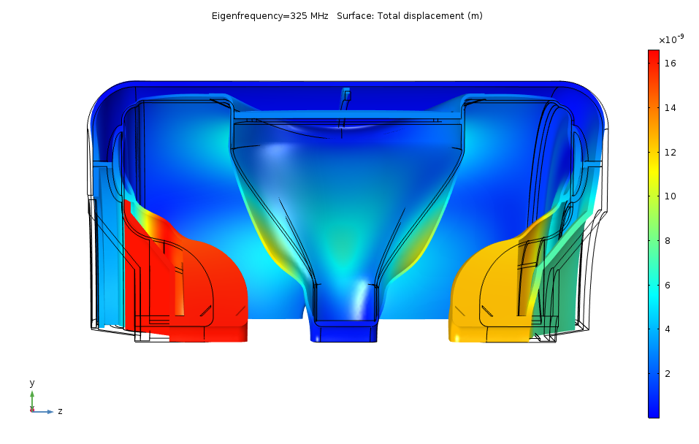
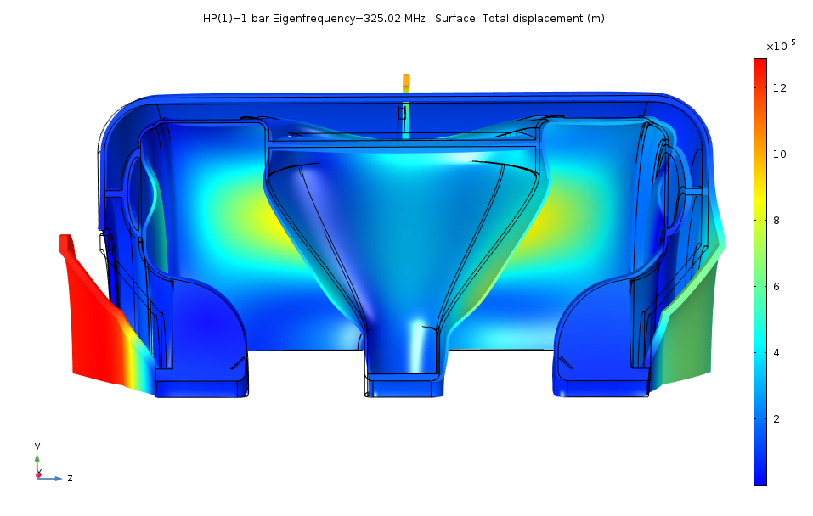
1. Connecting the Donut Rib to Jacket
Deformation of the cavity due to Lorentz forces
Deformation of the cavity due to Helium pressure of 1 bar
Initial LFD | -12.17 Hz/(MV/m)²
Changed LFD | -5.45 Hz/(MV/m)²
df/dp | 18.76 Hz/mbar
In this case, the stiffness of the Cavity at the tuner side beam port increased to a very high value of 88 kN/mm which is very much away from our requirement of ~35 kN/mm. Hence, this case was discarded. Sensitivity was also very low (5.5 kHz/mm).

Slide 44
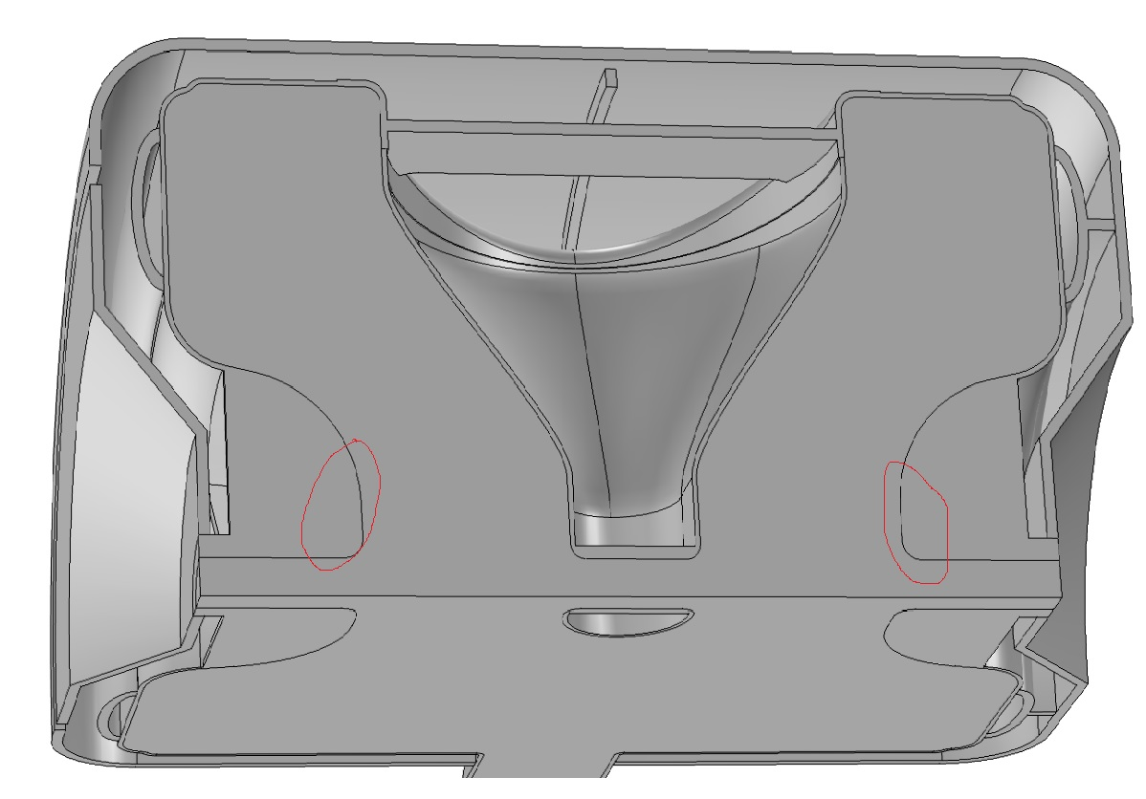
2. Increasing the welding area of beam pipe ribs to the cavity
Completed on 26th Oct 2018
Initial LFD | -8.65 Hz/(MV/m)²
Changed LFD | -8.59 Hz/(MV/m)²

Slide 45
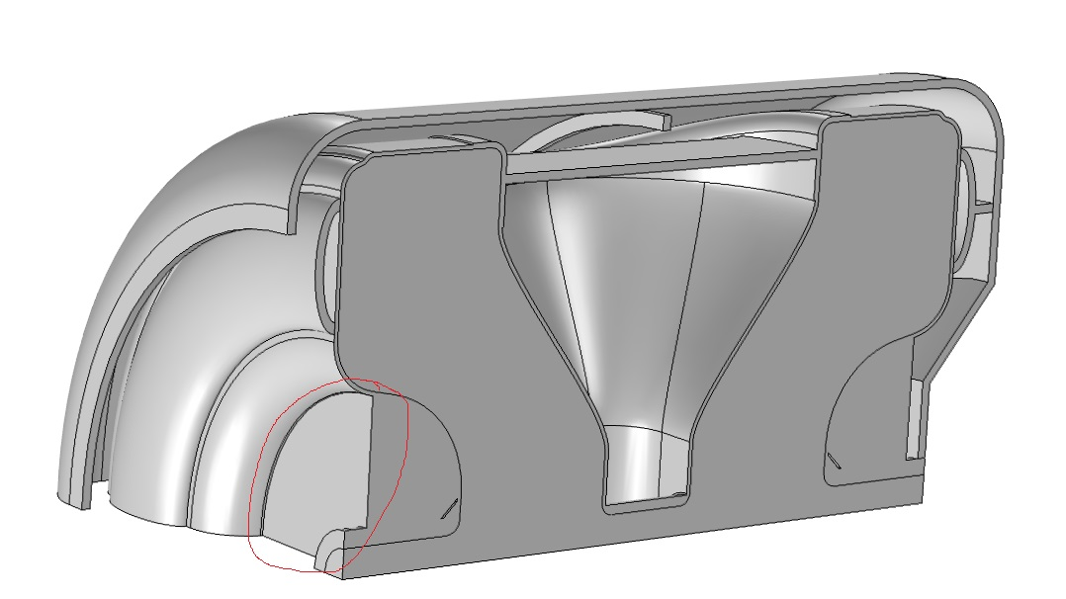
3. Changes performed on the models to reduce LFD
Completed on 25th Oct 2018
Making the beam pipe ribs full 360 degree around the beam pipe to increase the stiffness of the cavity.
Initial LFD | -8.65 Hz/(MV/m)²
Changed LFD | -8.01 Hz/(MV/m)²

Slide 46
Summary
df/dp can always be optimized easily adjusting bellow disc radius
End walls contribute most to LFD. On one side, tuner stiffness can be increased (but saturates beyond 40 kN/mm). On the other side, Jacket thickness can be increased
Next highest contribution is from spoke which can be controlled using spoke disc and increasing spoke thickness.
Least contribution is from cylindrical surface which can be controlled by increasing cavity thickness
Getting the LFD coefficient to -6 Hz/(MV/m)² was relatively easy.
- Tuner side stiffness is increased to 40 kN/mm
- Helium Jacket thickness is increased to 7 mm
- Cavity thickness is increased to 4 mm
Getting the LFD coefficient from -6 to -4.83 Hz/(MV/m)² was difficult.
- Non tuner side jacket thickness increased to 12 mm
- Tuner side donut rib position changed
- Circumferential stiffeners placed over cavity cylindrical region
- Spoke thickness increased to 4.82 mm and a spoke disc is also inserted
Cavity stiffness and sensitivity calculations needs to be done. Also tuning range of cavity needs to be determined.

