Slide 1
Update of noise filtering in protoDUNE
Wenqiang Gu (BNL)
Carlos Sarasty (University of Cincinnati)

Slide 2
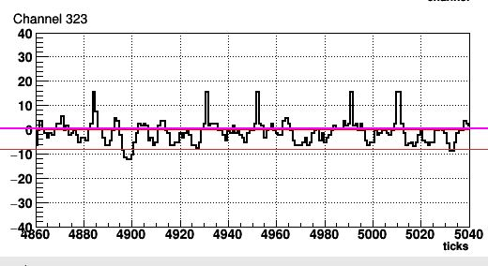
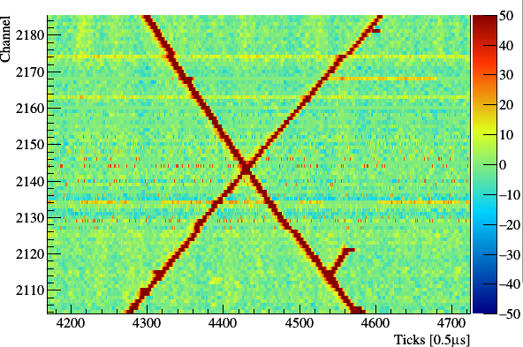
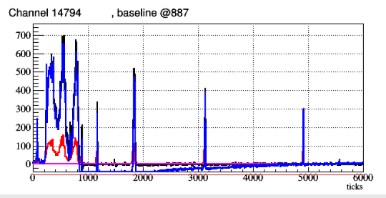
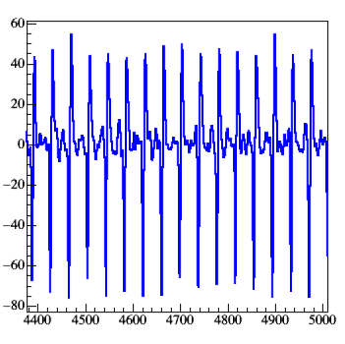
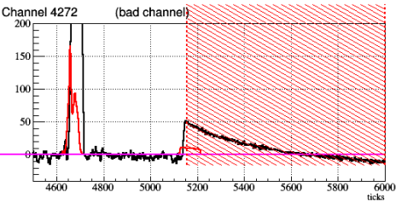
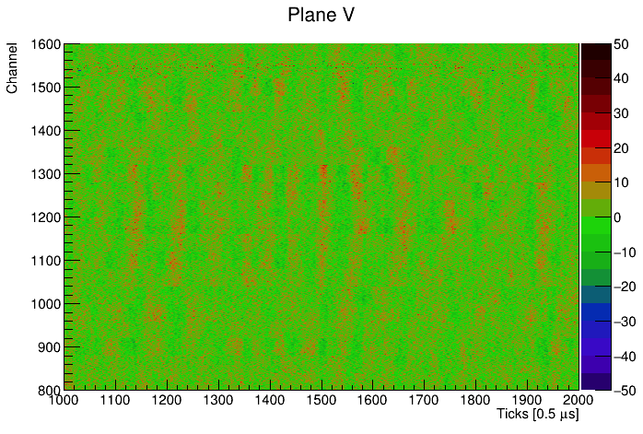
Overview of the noise filtering
Noise filtering (NF) is a key step towards a high-quality signal processing (SP)
“50kHz” noise (collection plane)
Sticky codes
FEMB clock
Undershoot
Coherent noise
Recently, revisited the performance of noise filtering
Some problems, some new ideas, …
Towards a high-quality NF soon
“Ledge” effect
Not talked about today

Slide 3
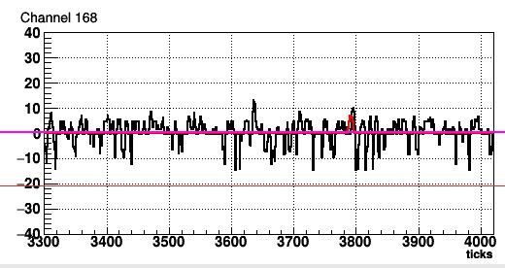
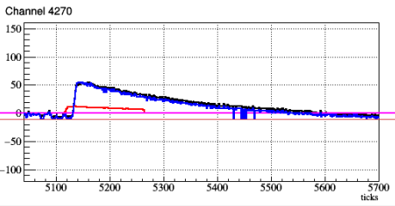
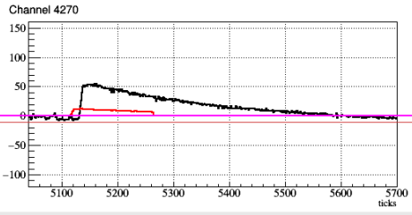
Sticky codes mitigation
Also see prev. analyses by 1) David, 2) Wenqiang
Extra sticky codes
other than Mod64=0,1,63
Apply correction
“noise-like”: linear interpolation + FFT resampling
“signal-like”: FFT resampling
Peak value > 15 ADC, nearby (+/- 1 tick) > 2*RMS
Some additional sticky codes need to be deal with
Mod64 = 7
Sticky on a ledge
Good correction for afterward steps
Resampling in freq.
Inverse FFT
Illustration of “FFT resampling”

Slide 4
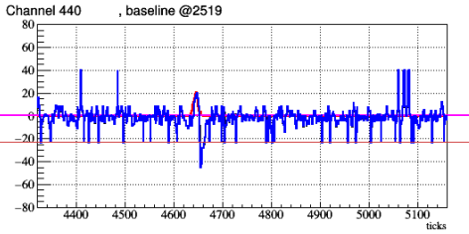
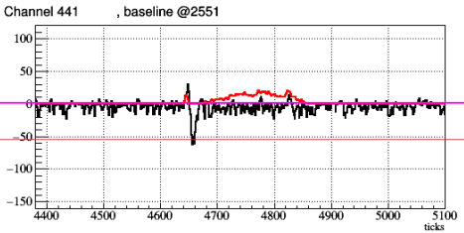
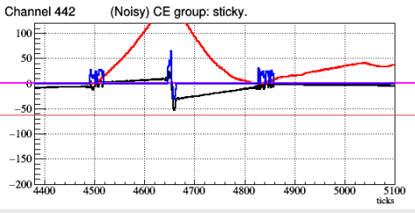
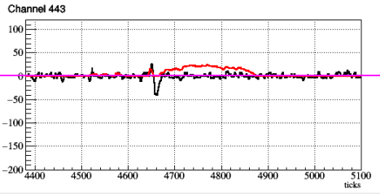
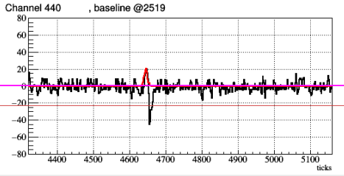
An example of sticky code mitigation
Before mitigation
Sticky at baseline
After mitigation
Deconvolved signal
Deconvolved charge from adjacent channels:
“2D” deconvolution
An extreme sticky channel, an artificial “bipolar” shape after interpolation
=> fake charge
Need more detailed evaluation
Exclude very sticky channels / time regions for SP
Any over-correction for SP?

Slide 5
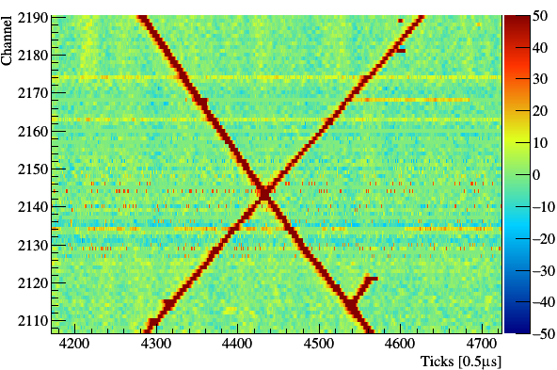
FEMB 302 clock
Also see David & Tom’s talk for resampling in time domain
128 channels in FEMB 302 is “slower” than others
The FFT resampling approach also works here
Extend 5996 samples => 6000 samples in freq. domain
Before correction
After correction

Slide 6
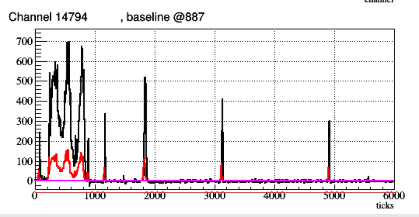
Undershoot correction (i)
Also see Tom’s time-domain RC fixer
Run 5424 Event 10447
After correction
(RC constant 1.1ms)
Before correction
deconvolved signal
Undershoot can be successfully removed by deconvolving the RC response (~ 1.1ms) in frequency domain via FFT
$$R\left(t\right)=δ\left(t\right)−Ae^{−t/τ}$$
$τ$ = 1.1 ms (collection)
$τ$ = 3.3 ms (induction)

Slide 7
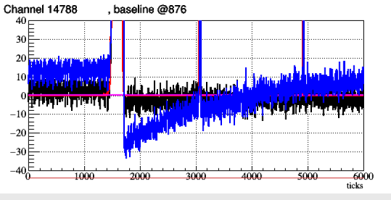
Undershoot correction: another example
Raw waveform
After deconvolving RC response
Another example

Slide 8
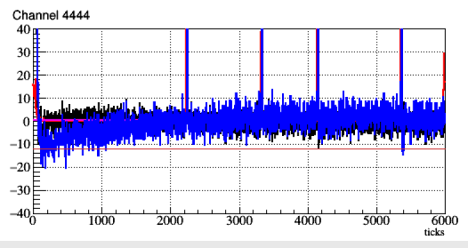
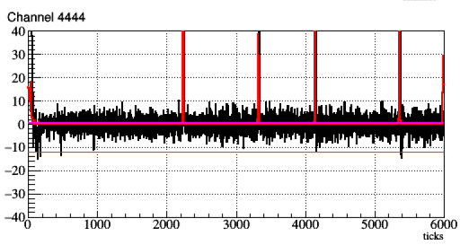
Undershoot correction (ii)
Before correction
After correction
In case that a large signal happens right before the readout window (“partial RC”), an adaptive baseline correction (linear) is applied

Slide 9
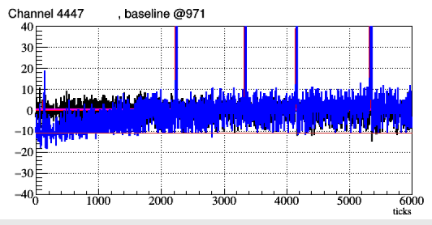
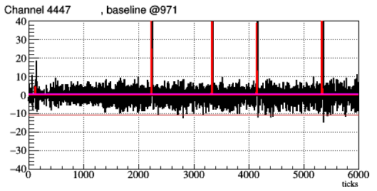
Undershoot correction (ii): another example
Before correction
Another example of “partial RC” correction

Slide 10
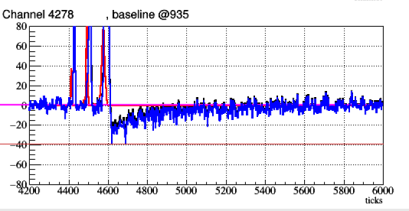
Imperfect electronics response
The RC correction works well, however, still observed some imperfect electronics response even after small signals
Imperfect pole-zero cancellation?
A dedicated calibration could help if indeed an electronics response issue
Current pulser data: too short distance between the positive and the negative pulses
Need more samples for a conclusion
Imperfect pole-zero cancellation?
Time constant ~ 0.2ms

Slide 11
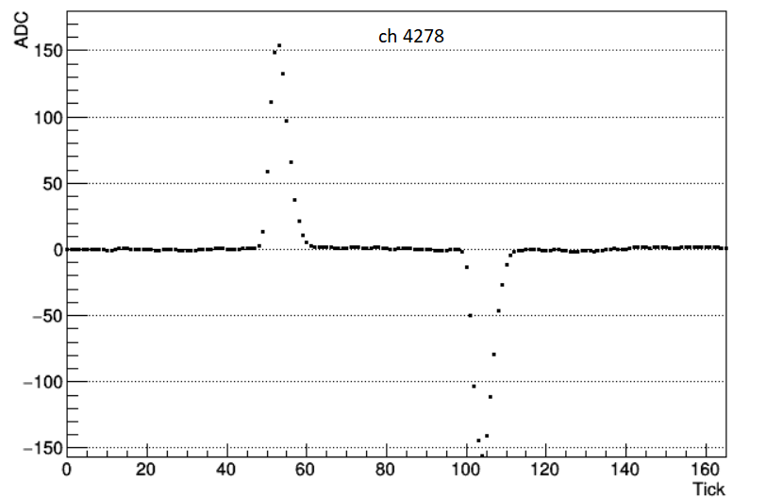
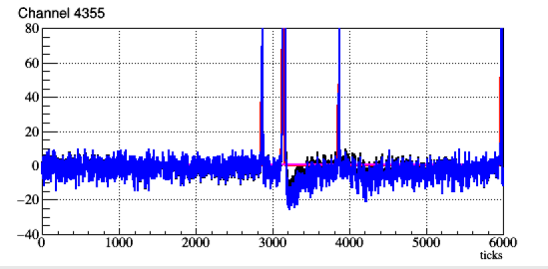
Pulser calibration
Run 6068
Seems to be not consistent?
Cosmic data

Slide 12
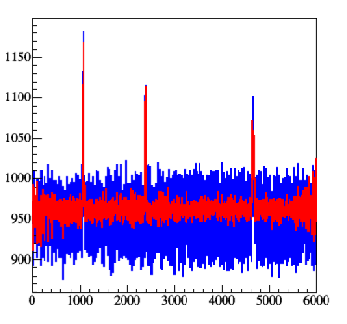
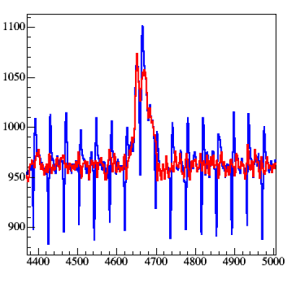
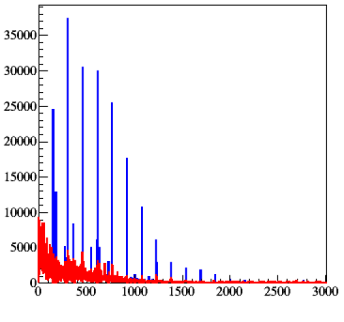
“50 kHz” noise in some collection channels
Also see previous analysis by Carlos: 1 2
--- before NF
--- after NF
--- before NF
--- after NF
Filtered noise component
Looks reasonable!
Freq. bins
Ticks [0.5us]
An automated spike filtering is implemented
Zero-out extreme outliers of each sub-region in frequency domain

Slide 13
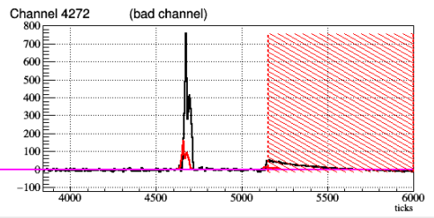
Mask for “ledge” region
Also see previous analysis
Masked region for SP
The bad region of the identified “ledge” will be masked and ignored in the SP
Still need some tuning for the range

Slide 14
Summary
Noise filtering are revisited and the general performance are good
Still need more detailed evaluation/hand scan for sticky code, ledge, undershoot, etc.
Imperfect response shape in some channels
Calibration pulser data could be helpful
Before we tune the SP algorithm, a solid performance of NF is necessary

