Slide 1
Introduction to the Fermilab Scientific Program
James Amundson, Scientific Computing Division Head
Inaugural Meeting of the International Computing Advisory Committee
March 14, 2019

Slide 2
Fermilab
America’s laboratory for particle physics and accelerators
About 1,800 staff at $550M/yr
6,800 acres for federal land including restored prairie
4,000 scientists from across the U.S. and 53 countries use Fermilab’s facilities

Slide 3
Fermilab Program Driven by the P5 Report
Particle Physics Project Prioritization Panel (P5)
  A strategic plan for U.S. particle physics maximizing
    opportunities for breakthrough science
  Explicit prioritization, hard choices made within realistic budget scenarios
Plan:
  Continue U.S. commitment and leading roles in the LHC
  Build a neutrino program at Fermilab that will attract the world community
  Continue U.S. leading efforts in dark matter, dark energy and cosmic microwave background
  Pursue the Fermilab-based muon program
  Invest in the accelerator and detector technologies that we will need in the future

Slide 4
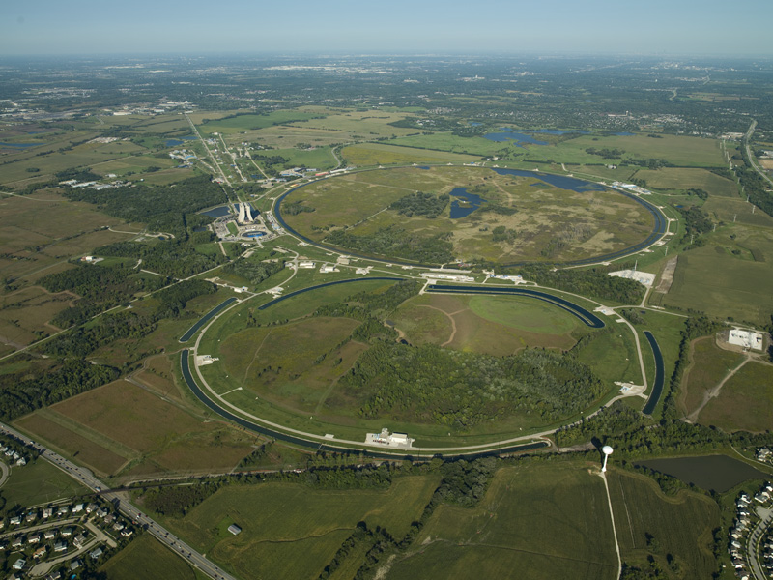
Current Fermilab Accelerators
Booster ν beam
MicroBooNE, SBN program
Booster
proton energy: 8 GeV
NuMI ν beam
NOvA, MINERvA
Main Injector
proton energy: 120 GeV
4

Slide 5
Proton Improvement Plan-II (PIP-II)

Slide 6
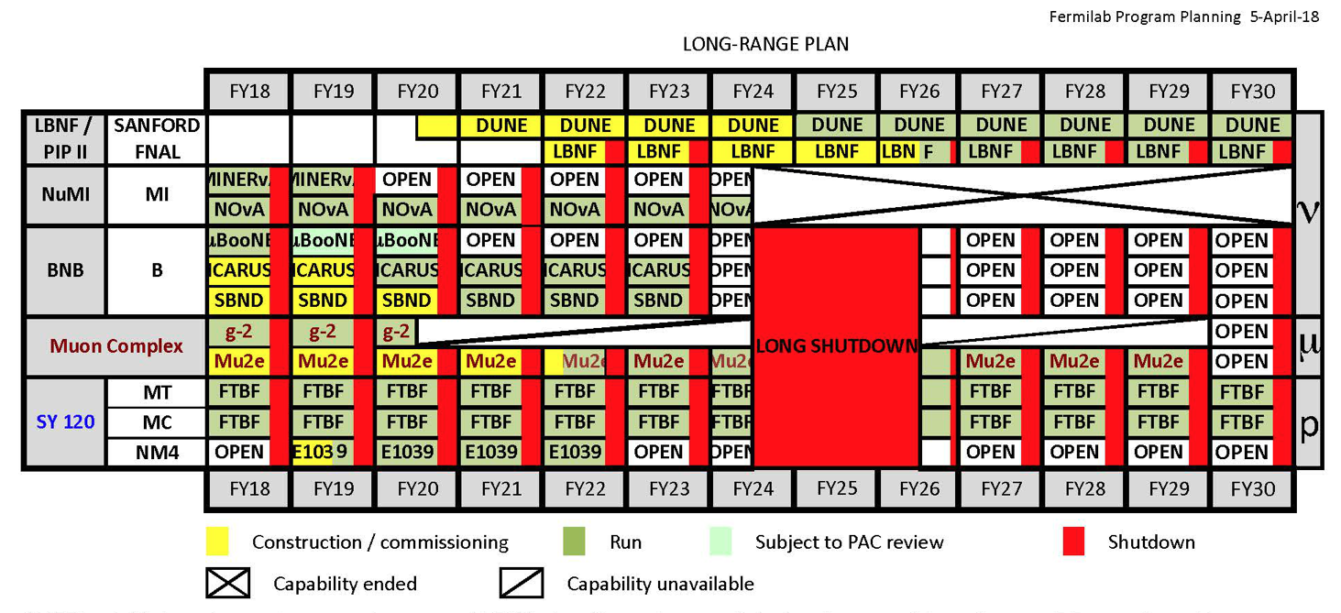
Experiments Utilizing the Fermilab Accelerator Complex

Slide 7
Neutrino Experiments
Current/recent
  MINERvA
  MicroBooNE
  NOvA
New/Upcoming
  ICARUS
  SBND

Slide 8
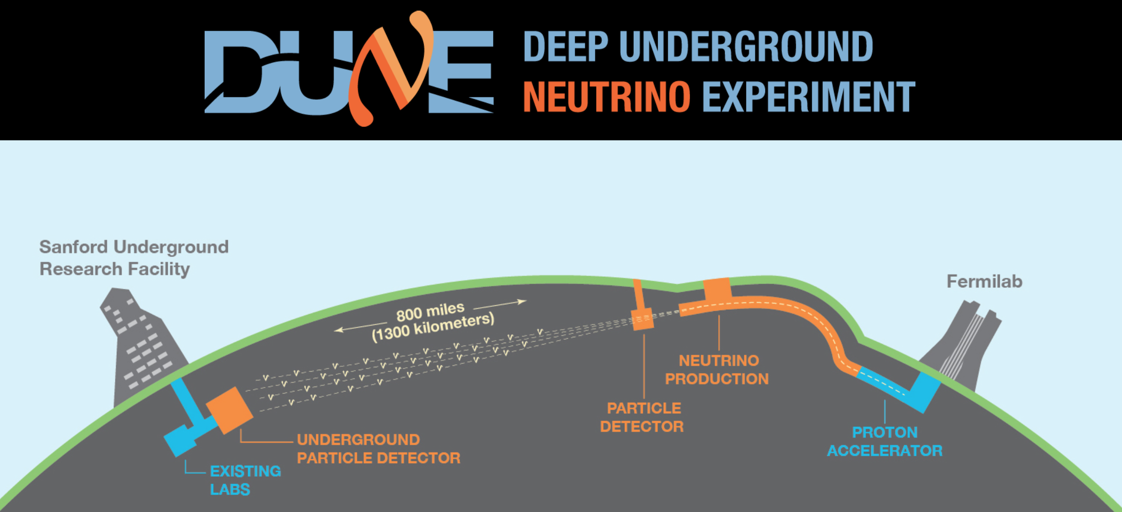
Fermilab’s Future Flagship

Slide 9
Muon Experiments

Slide 10
Fermilab is the U.S. CMS National Lab
CMS T1 Facility
LHC Physics Center
Remote Operations Center
We have been working on CMS for a long time

Slide 11
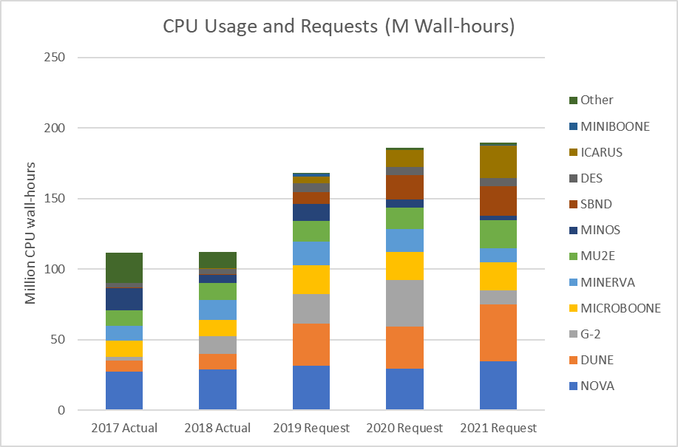
Supporting Fermilab Experiments: CPU
Note: CMS not included
  CMS computing is separately funded

Slide 12
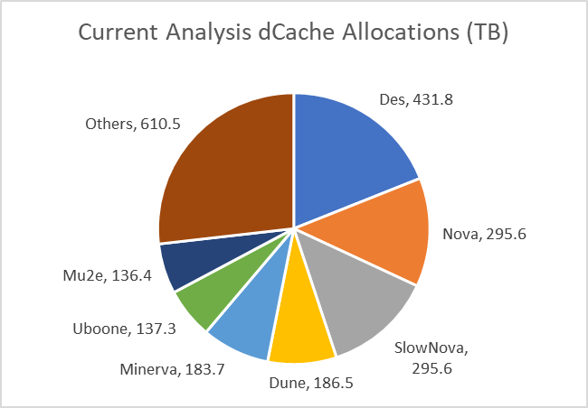
Supporting Fermilab Experiments: Analysis / Persistent Disk
Note: CMS not included
This is disk space that is permanently resident but with no backup
  Allocated via SCPMT / SPPM process
  Management under experiment control
  2.3 PB split across 32 experiment/project users

Slide 13
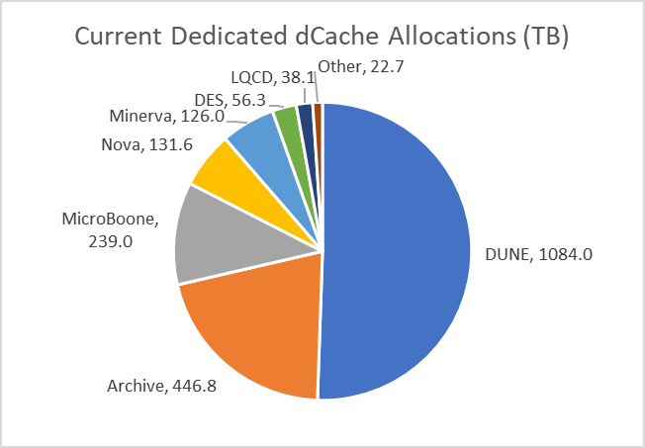
Supporting Fermilab Experiments: Dedicated Disk
Note: CMS not included
This is “tape backed” disk space that is dedicated to a specific experiment
  Allocated via SCPMT / SPPM process
  Typically for raw data ingest or pre-staging
  2.1 PB split across 13 functions

Slide 14
Supporting Fermilab Experiments: CPU
Note: CMS not included

Slide 15
Scientific Computing Program at Fermilab
Support of the accelerator-based particle physics experiments is the primary mission of the Scientific Computing Division
… but it is not the entire mission
Other topics include
  Particle Theory
    Lattice QCD
  Accelerator Physics
    Computational accelerator physics
      Especially collective effects and HPC
  Cosmology
    Computing support for cosmological experiments
      DES (ending), LSST (beginning)
  Artificial Intelligence
    Mostly machine learning applications
  Quantum Computing
    Now in its own organization, but with continuing SCD contributions

Slide 16
Conclusions
The Fermilab Scientific Program has many components
  Fermilab accelerator-based physics
    Neutrinos
    Muons
  CERN accelerator-based physics
    CMS
  Cosmological experiments
The Fermilab accelerator complex is expanding
DUNE will be our flagship experiment
Program includes many smaller computational physics topics
The Scientific Computing Division supports them all

