Slide 1
Cyber Security & Other DOE Mandates
Jon Bakken
International Computing Advisory Committee
March 14, 2019

Slide 2
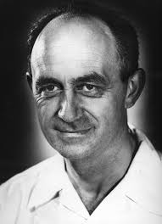
Security Goals
"Scientific thinking & invention flourish best where people are allowed to communicate as much as possible unhampered.”
Enrico Fermi, 1952 speech at University of Chicago celebrating the 10th anniversary of the atomic pile under Stagg Field
Goals:
  Maintain an open network environment supporting worldwide scientific collaboration to support FNAL’s mission
  Ensure taxpayer money is being spent responsibly by abiding by DOE policies & regulations governing computing, especially knowing who is using our computers
These goals are not conflicting. DOE, especially our DOE site office, is a great partner in helping FNAL accomplish its mission
  We constantly balance scientific mission needs against security requirements
  Lab policy: security rules will not unnecessarily disrupt our scientific work

Slide 3
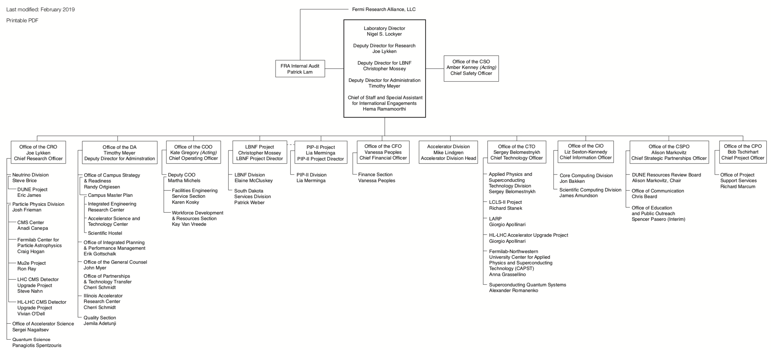
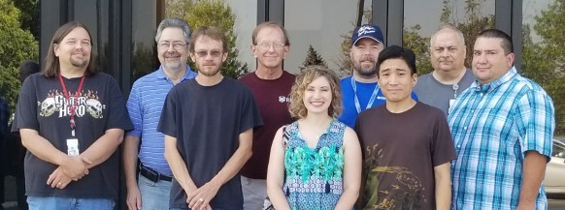
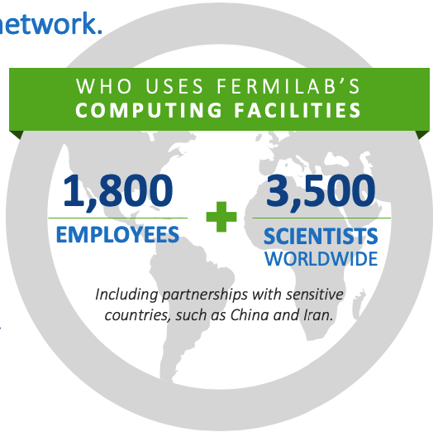
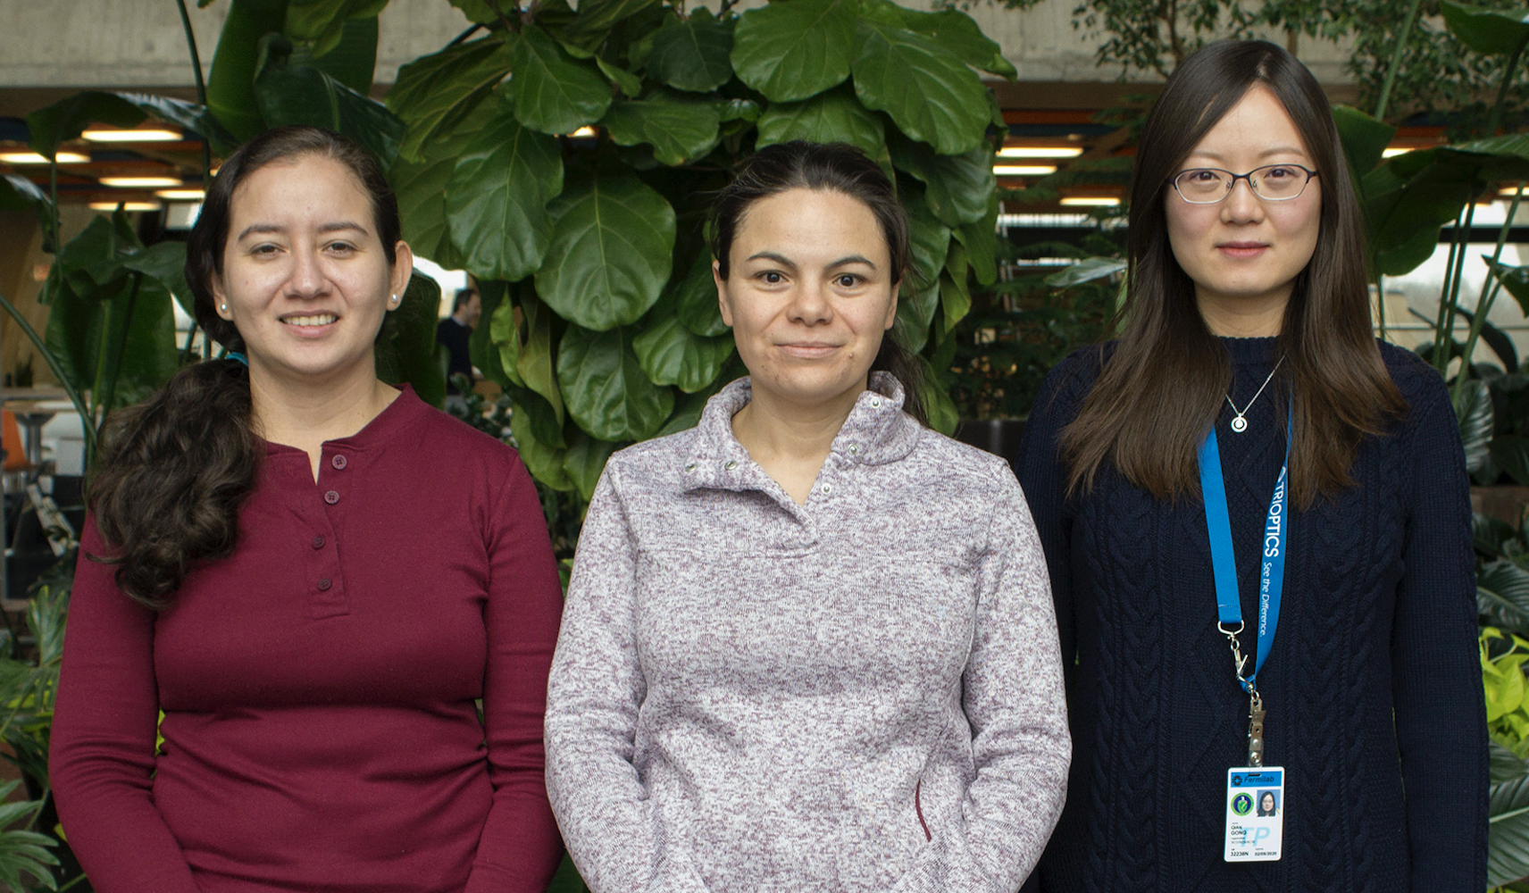
Security Organization
CIO is responsible for Scientific Computing, IT, & Cyber Security
Security, like Safety, is everyone’s responsibility at FNAL
2,000
4,000

Slide 4
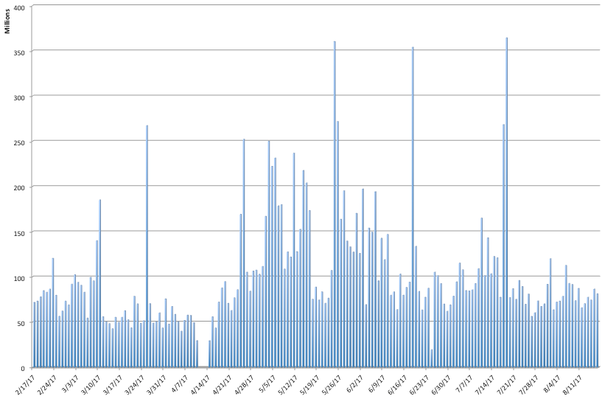
Fermilab Cyber Security Context
FNAL’s scientific mission requires us to support large numbers of visiting researchers who bring their own devices (from phones to laptops to servers, many of which are carried on & off site every day) & need robust, open & enormous bandwidth connections to the Internet
In this environment many traditional defenses cannot work without significantly impacting scientific mission.
  For example, restrictive border protection, rigid configuration management, one-size fits-all solutions, zero-tolerance strategies, end point protections
Instead we rely on defense-in-depth & extreme responsiveness & alertness to recognize & quickly respond to threats.
On a daily basis, FNAL is hit by an average of 75-100 million probes from attackers, with peaks of over 350 Million per day.
300M/day
100M/day

Slide 5
Partnership with DOE HQ & FNAL DOE Site Office
DOE understands the difference between research labs & classified labs
DOE has strongly moved to a framework of delegating acceptance of risks to individual sites. This provides us with:
  Ability to explain to our Site Office what the risks are for our site, & what controls we put in place to reduce these risks to an acceptable level of residual risk.
    These will not be same risks or sets of controls as other labs, especially multipurpose & classified labs
  Lets us listen to Site Office concerns & discuss risk mitigations for our lab
  After decisions, allows Site Office to accept risks on behalf of lab, taking advantage of their knowledge of mission specifics
Example: Multi-Factor Authentication
  Requirement: All users of Federal Systems must use Multi-Factor Authentication (MFA), specifically HSPD-12 smart cards, for all computer & network access
  It was recognized that access to scientific research computing did not bear the same level of risk as access to other government systems, & we were allowed to segment our user populations, & FNAL scientific systems remain free from MFA requirement
    Note: We are implementing MFA for VPN access due to recent attacks

Slide 6
Security Landscape is constantly changing
We can not let our guard down or become complacent.
We work closely with DOE HQ & our FNAL Site Office
We closely follow the work & guidance of the DOE CIO to provide input on the appropriateness of proposed solutions
National Laboratories CIO group has an executive committee that meets monthly with the DOE CIO to discuss security issues.
DOE must strike a careful balance between protecting research mission (that they rightly take great pride in) & responding to directives that come from elsewhere in Executive branch

Slide 7
Enterprise Cyber Security Risks
Cyber Security Incident resulting in embarrassment to lab/DOE
  Example: Website hijacked & used to spread false info
  Mitigation: Training, scanning, monitoring
Cyber Security Incident resulting in large-scale disruptions that impact lab operations.
  Example: Coordinated attack that renders IT systems inoperable
  Mitigation: Defense-in-Depth, Assessments, Rapid response
Theft or Loss of Sensitive Data
  Example: Loss of Personal Identifiable Information (PII)
  Mitigation: Security controls for data, Audits, Training
IT systems are used for illegal activities
  Example: Illegal download of files
  Mitigation: Scanning, training

Slide 8
Cyber Security Program Strengths
Detailed understanding of risk environment (based on NIST 800-53 controls), risk mitigations & residual risks. Reviewed regularly. Partnership with DOE.
24x7 on-call incident response team to identify, manage & contain incidents. Primary & secondary on call at all times.
Defense-in-depth security controls utilizing both home grown & commercial tools.
  Perimeter protection – blocking of specific protocols or sites. Sitewide firewall
  Continuous scanning for vulnerabilities & policy violations, with auto-generated tickets. Dashboard displays.
  Tarpits, honey-pots, blackhole networks, active blocking mechanisms, Intrusion detection systems
  Logging of host and network events
  Web proxy & web antivirus scanning. URL filtering & web content scanning
  Host based protections including local firewalls, virus scanning & endpoint protection
  Centralized authentication
  Required node registration before network connection
  User awareness & training. New anti-phishing exercises & training this past year
Provide maximum protection to most important systems & data
  Financial, HR systems & security infrastructure system are behind behind firewall with multi-factor. Rigid controls. Default deny posture.
Sound Architecture including segmented network, separation of duties.

Slide 9
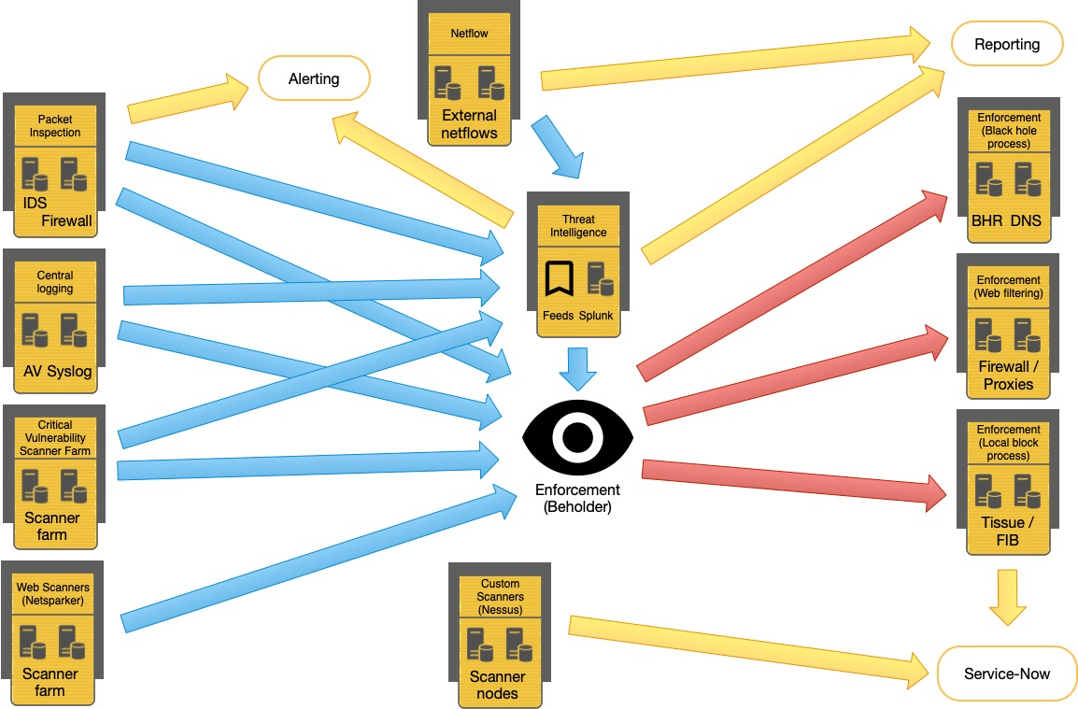
Blue = Data Input, Yellow = Reporting, Red = Control

Slide 10
Flexibility, Defense-in-Depth, Mitigating Factors
We avoid one-size-fits-all solutions, therefore all security rules at FNAL are subject to requests for a variance
  Variance request must include:
    Reasons why standard policy would interfere with mission
    Compensatory security controls which provide same (or better) level of security as standard controls
  Example: kernel update variance. Running experiments (CDF & D0) could not afford to update kernel software on data acquisition systems at the same frequency as standard systems.
    Granted a variance to update kernel software during data taking downtimes,
    Imposed additional compensatory controls limiting access to data acquisition machines to mitigate risks of unpatched kernels
    If an immediate danger was posed by unpatched kernel, we would require an immediate patch

Slide 11
Phishing: #1 attack mode
All email is in Microsoft Office 365 cloud, nothing on premise
Email protected by Microsoft security, which does spam & malicious content filtering, blocks executable code, & blocks many types of attachments thereby catching many phishing attempts
Phishing is further restricted by channeling all email through ProofPoint (commercial email security product) which blocks additional malware & defangs all URL’s in email to prevent click throughs to malicious sites
All email users are required to take anti–phishing training.
  Employees completion = 96.5%
Phishing awareness is an important component of our continuing security awareness program
Security team conducts monthly phishing exercises to continue training, with offenders requires to take further face-to-face remedial phishing awareness training

Slide 12
Recent DOE & DHS Policies to Improve Security (1)
DOE BOD 18-01: enhance email security
  Done: STARTTLS, SSLV2 & SSLV3 disabled, 3DES & RC4 ciphers disabled, SPF/DMARC w policy=none & reporting, DMARC reports to dmarc.cyber.dhs.gov
  In Progress: DMARC policy=reject: serious mission impact on collaborative science, investigating how to implement
Continuous Diagnostics & Mitigation (CDM): fortify networks & systems
  We are already employing a combination of commercial & home made tools to execute all CDM functions
Removable Media: Restrict malware & improve confidentiality
  On-premise business environment:
    Access is behind firewall & requires multi-factor authentication
    All applications run on virtual machines on Citrix servers in locked cabinets in locked rooms. All data is confined behind our “MFA wall”
    These servers do not support email or web browsing, providing primary protection against data exfiltration.
    There are not even any places to put removable media on these servers.
    Disks are destroyed when they are excessed.
  Scientific computing allows removable media, necessary for scientific collaboration, but these endpoints cannot access sensitive data, so only risk of removable media is of malware infection through use of unknown sourced media. We have kiosks to inspect thumb drives for malware.

Slide 13
Recent DOE & DHS Policies to Improve Security (2)
Remote Access: improve understanding of who is accessing FNAL systems
  Accounts requiring multi-factor authentication to our network are in full compliance with DOE policy
  Most “remote accesses” are connections of visiting scientists at home institutions accessing scientific systems, an important part of our lab mission.
    We forbid transmission of authentication credentials over the network to protect against risk of network sniffing of credentials. We use Kerberos authentication.
  In progress: Require MFA for all VPN access. This will require secure delivery of MFA tokens to our large & diverse community.
Social Media:
  All public web sites are being converted to HTTPS
  Old SSL versions & bad ciphers are disabled
  Microsoft OneDrive is our enterprise solution for sharing files
  Lab has an official policy on public communication
  All Lab public websites must be pre-approved by communications office for content & security team & all web ports for unregistered systems are blocked by default

Slide 14
Foreign National Access
Latest area of concern are upcoming new rules regulating foreign citizen access to DOE systems, including the National Labs
Concerns in particular are about US intellectual property, export control, & actions by nation states in cyberspace amplify the need for these new rules
Our Plan: Isolate what needs to be restricted, & continue open-lab access for 99.9% of our scientific mission.
  We are working closely with DOE on defining just what information needs to be controlled. FNAL Deputy Director Joe Lykken is in charge of a DOE committee formulating new rules.
    FNAL does not have any classified information
    Export-controlled and FNAL Intellectual Property are the major categories that will need to be restricted
    Categories that will potentially have restricted access include Quantum Systems, Accelerator Technology, and Machine Learning
  We will do all we can to minimize any disruption to our research & distractions to our researchers

Slide 15
Federated Access Control at Fermilab (1)
Givens:
Scientific computation very heavily relies on international collaboration.
Scientific research at FNAL is open, containing no classified or sensitive information
Foreign researchers routinely need access to data or computing accounts to perform their work.
Therefore:
It is necessary to provide a seamless access management model that makes it easier for scientific collaboration.
Our Plan:
Separate scientific computing infrastructure from the rest of lab, possibly creating a Fermilab.edu to make this explicit.
  This separation ensures that the parts of FNAL with sensitive information remains inaccessible by scientists doing research
  And scientific computing resources have a policy that is in alignment with supporting open science

Slide 16
Federated Access Control at Fermilab (2)
Separation of scientific computing makes it possible to use federation-based access control management.
  Federated access is vital for providing seamless & easy access
  Scientists should not need to create accounts at each institution that they collaborate with.
    Their identities are already vetted by their experiments & their host institutions, such as CERN.
    We trust these institutions to collaborate with them, so why not trust identity information released by them.
    Federation allows non-Fermilab scientists to use identity credentials from their home organizations.
Authorization decision always stays with FNAL & can be managed appropriately

