Slide 1
HPC Strategy & US Exascale Program
James Amundson, Scientific Computing Division Head
Inaugural Meeting of the International Computing Advisory Committee
March 14, 2019

Slide 2
My Perspective
The vast majority of HEP computing to date has been high throughput computing (HTC).
My personal technical experience includes:
  particle theory (ancient history)
  Tevatron Run-II computing
  CMS grid computing (through 2001)
  particle accelerator simulation (after 2001)
    primarily for HPC
I have observed the gap between the HEP and HPC communities from a unique vantage point

Slide 3
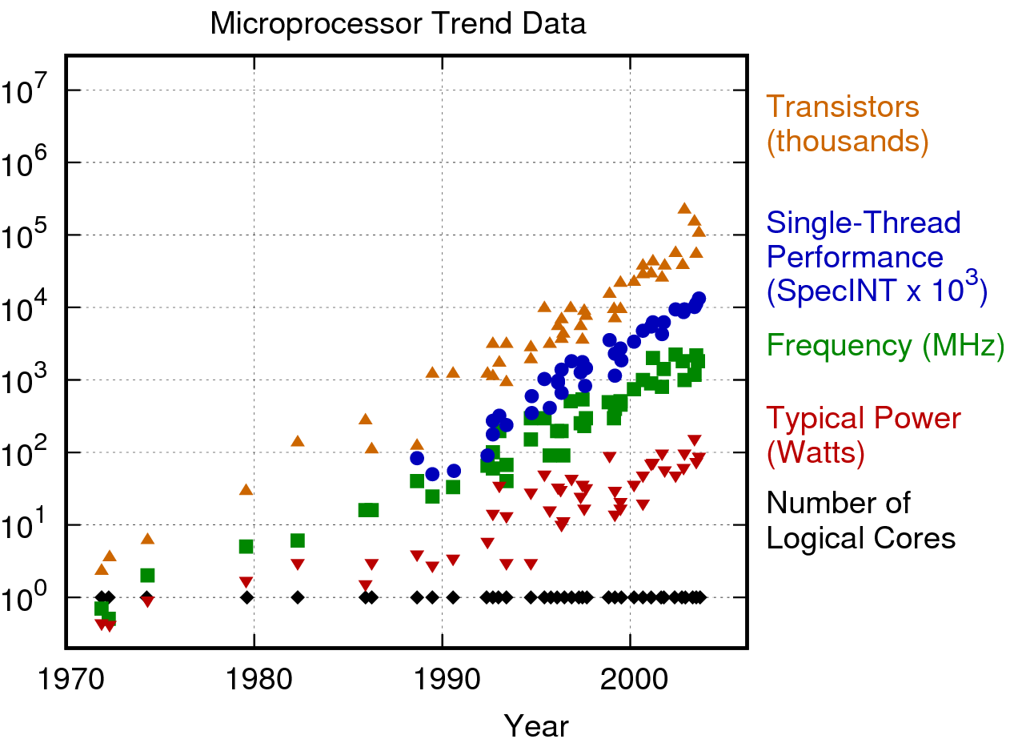
“Moore’s Law” – the good old days
https://www.karlrupp.net/2018/02/42-years-of-microprocessor-trend-data/

Slide 4
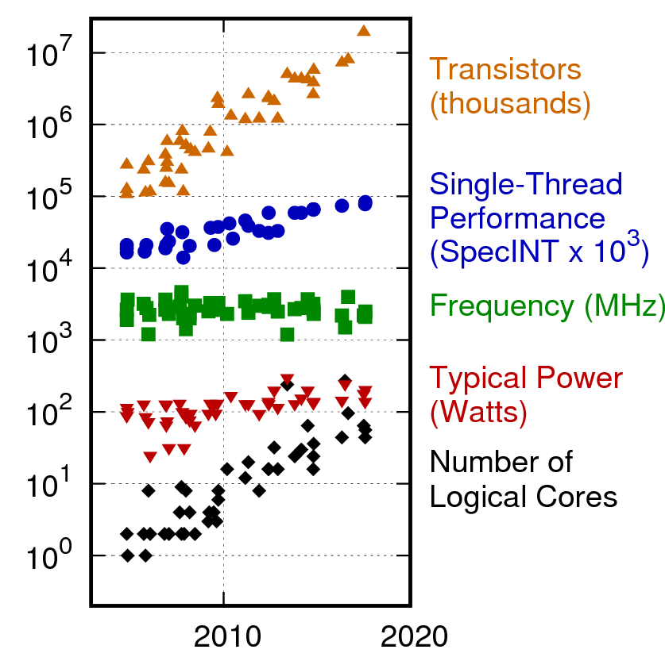
“Moore’s Law” – recent times
Trends have changed

Slide 5
Computing is changing
Architectures are changing
  Driven by solid state physics of CPUs
    Multi-core
    Limited power/core
    Limited memory/core
    Memory bandwidth increasingly limiting
    GPUs are winning the day when they can be used
High Performance Computing (HPC, aka Supercomputers) are becoming increasingly important for HEP
  2000s: HPC meant Linux boxes + low-latency networking
    No advantage for experimental HEP
      Really? Low-latency not very important, but high-bandwidth is
  Now: HPC means power efficiency
    Rapidly becoming important for HEP, everyone else
The old times are never coming back
  Today’s HPC technologies are tomorrow’s commodity technologies

Slide 6
Exascale computing is coming
President Obama, July 29, 2015:
EXECUTIVE ORDER
CREATING A NATIONAL STRATEGIC COMPUTING INITIATIVE
By the authority vested in me as President by the Constitution and the laws of the United States of America, and to maximize benefits of high-performance computing (HPC) research, development, and deployment, it is hereby ordered as follows:
…
Sec. 2. Objectives. Executive departments, agencies, and offices (agencies) participating in the NSCI shall pursue five strategic objectives:
Accelerating delivery of a capable exascale computing system that integrates hardware and software capability to deliver approximately 100 times the performance of current 10 petaflop systems across a range of applications representing government needs.
…
DOE is spending $2B on the Exascale Project

Slide 7
Exascale
http://science.energy.gov/ascr/research/scidac/exascale-challenges/
Power. Power, power, power.
  Naively scaling current supercomputers to exascale would require a dedicated nuclear power plant to operate.
    ALCF’s Mira: 4 MW, 0.01 exaflop
    “The target is 20-40 MW in 2020 for 1 exaflop”
Exascale computing is the leading edge of advances of computing architecture
  The same changes are happening outside of HPC, just not as quickly
    Optimizing for Exascale is really optimizing for the future
Storage of large-scale physics data sets will remain our job
The Exascale machines will be a large fraction of the U.S. computing resources in the HL-LHC/DUNE era

Slide 8
US DOE Supercomputer Centers
NERSC (LBL)
  Most “open” facility
  Allocations are awarded by science offices
  Current: Cori
      Phase I: 2,388 Intel Xeon Haswell processor nodes
      Phase 2: 9,688 Intel Xeon Phi Knight's Landing nodes
        AVX-512
      Top 500 Rank: 12
  Next: Perlmutter
    AMD + GPU
      No AVX-512
    to be delivered in 2020

Slide 9

US DOE Supercomputer Centers
Argonne Leadership Computing Facility (ALCF)
  Time allocated primarily through competitive awards (INCITE, ALCC)
  Current: Theta
    4,392 Intel Xeon Phi Knight's Landing nodes
      Very similar to Cori Phase 2
    Top 500 Rank: 24
  Next: Aurora
    Architecture: unknown*
      Intel
      definitely not Knight’s anything
    Coming in 2021
    Scheduled to be first exascale machine

Slide 10
US DOE Supercomputer Centers
Oak Ridge Leadership Computing Facility (OLCF)
  Time allocated primarily through competitive awards (INCITE, ALCC)
  Current: Summit
    IBM POWER9™ 9,216 CPUs
    NVIDIA Volta™ 27,648 GPUs
    Top 500 Rank: 1
  Next: Frontier
    IBM
    expected 2021, user availability expected in 2022
    exascale

Slide 11
Cultural Observations
HPC tape storage tends to be write only
Storage/CPU ratio much smaller than in HEP
In HEP, jobs are typically allocated in tiny units, down to single cores
  On Theta, the smallest allocatable unit is 8192 cores
Cutting-edge C++ is popular in HEP
  Viewed skeptically in HPC
HPC people expect to use a variety of vendor-supplied compilers
  Clang is rapidly taking over, sometimes as a frontend
HPC users have no control over their surroundings
  However, containers are rapidly gaining traction in HPC
There are many HPC paradigms that are different than HEP paradigms
  Not more or less complicated, just different

Slide 12
Technology Disconnect
Many pieces of software infrastructure are under active development to meet the needs of the Exascale project
  Lower level:
    OpenMP
    HDF5
    MPI
  Higher level:
    Kokkos & Raja
Many things ubiquitous in HEP are unfamiliar (or worse) in the HPC community
  TBB (uncommon, not unknown)
  C++ after 14 (will happen eventually)
  Root (unheard of)

Slide 13
Fermilab Exascale Strategy
Assume significant, but not all, CPU resources will come from Exascale
  Work on Exascale-friendly software
    Actively engage the HPC community
      Pursue ASCR partners
      (Re-)investigate mainstream HPC technologies
  Work closely with our neighbors at Argonne
    Also include work with Oak Ridge
  Utilize HEPCloud to submit to Supercomputer facilities
    more on HEPCloud later
Maintain Fermilab as a primary storage site
  Pursue a Terabit link with Argonne

