Slide 1
Future Facility Plans
Stu Fuess / Scientific Computing Division
2019 ICAC
14 March 2019

Slide 2
Outline
[Side note on operations]
General statement of problem
  Motivation, complications, solution
Specifics on current resources, experiment requests – and plans
  Processing
    Local, grid, allocations, cloud
    “HPC”
      LQCD clusters (new, current, and old)
      Development systems
  Storage
    Disk, tape

Slide 3
[Side note on Facility operations]
Local resources are currently specific to CMS, “Public” (= not CMS, supporting all other experiment activities), or Lattice QCD
Important to note that people operations are (mostly*) in common
  Hardware purchasing and provisioning
  System administration
  Storage systems
  Batch systems
  Supporting services
  * Several services on LQCD clusters traditionally independent, but slowly fixing this
DUNE, Nova, MicroBoone,
ICARUS, SBND, Mu2e, Muon g-2,
many others… Common funding

Slide 4
Motivation for change
Expect to have limited / insufficient local resources
  Need to find more elsewhere
Need to leverage opportunities to utilize new (not traditional HTC) resources
  Cutting edge technology, accelerators, interconnects
  Massive size
  Better economics
Want to break ties of distinct physical resources (clusters, etc.) that are closely matched to their logical function (support of an experiment or project)
  Current model of sharing (WLCG, OSG), as pledges or opportunistic, are largely on similar resources

Slide 5
Complications moving from homogeneous to heterogeneous
Must understand the importance of data locality and networks
Must support variety of architectures
  Need container build and management infrastructure
Must understand local storage limitations (both on node and on system/cluster)
  Often optimized for speed/latency, not capacity
Must deal with In/Out WAN access limitations
  for code (cvmfs), data, workload management, conditions, …
Must work with expanded proposal / allocation / purchase method
Need more extensive and complex monitoring
Need more extensive and complex accounting
Need more complex (federated?) authentication / authorization infrastructure
Need to understand impact of limited support at remote sites

Slide 6
Solution: expand the “facility”
Move to a logical workload description based on characteristics of job, and match to physical resource satisfying those attributes
  Allows significant expansion of types of jobs and match to heterogeneous resources: HPC sites, commercial clouds
Supply a “science gateway” for workloads, implemented as HEPCloud
  Provisioning based on workload / job characteristics
    E.g. memory, MPI, architecture, accelerators, allocations, funding, storage…
  “Best match” made by Decision Engine to resource attributes

Slide 7
HEPCloud
HEPCloud system
  Have DOE ATO and went “live” this Tuesday, 12-March-2019 !
    Accessing local clusters, NERSC, Amazon, Google
  Job submission will look the same, now with additional optional attributes
  On-boarding of experiments serially to ease transition
    CMS – interface to global mechanism
    Nova, Mu2e, DUNE – utilize Fermilab jobsub mechanism
Initially directing location-agnostic processing (compute cycles)
  “Low-hanging fruit”
Matching with storage is more challenging, with continued development
  Move towards unified data management
  Co-scheduling as needed / when possible
Will add more sites in future: LCFs, NSF/XSEDE sites

Slide 8
Processing: Summary of current resources
CMS Tier-1 and LPC: to meet pledge and provide analysis platform, ~27K cores, 285 kHS06
FermiGrid: Intensity Frontier and other HTC usage, ~19K cores, 200 kHS06
LQCD clusters: allocated, high speed interconnect (IB), some GPUs
    Existing:
      pi0 : 5,024 cores --- only ~1/4 allocated to LQCD post 2019
      pi0G : 512 cores, 128 K40 GPUs --- no allocation to LQCD post 2019
      Bc : 7,168 cores ---
      Ds : 6,272 cores | All these are ancient
      DsG : 320 cores, 80 Tesla M2050 GPUs ---
    Bid in progress:
      IC : ~75 nodes (Cascade Lake?) + 5 nodes with dual Voltas --- 92% LQCD allocated
Wilson cluster: development with various accelerators, small HPC

Slide 9
Processing future: CMS use of HEPCloud
2019 Tier-1 pledge: 260 kHS06 (285 kHS06 currently available)
2020-2021 pledge: 338 kHS06 (need to replace retirements, add some)
2019 CMS HPC allocations (requested annually)
  DOE
    NERSC (82M hours Cori)
    ALCF (0.5M hours Theta)
  NSF/XSEDE
    SDCS (Comet), PSC (Bridges), TACC (Stampede)
Eventually expand T1_US_FNAL to include all HPC allocations
  Map workflow characteristics to resource capabilities
  Meet some of the pledge with external resources
  Discussion started if and how some part of the pledge can be met with external resources

Slide 10
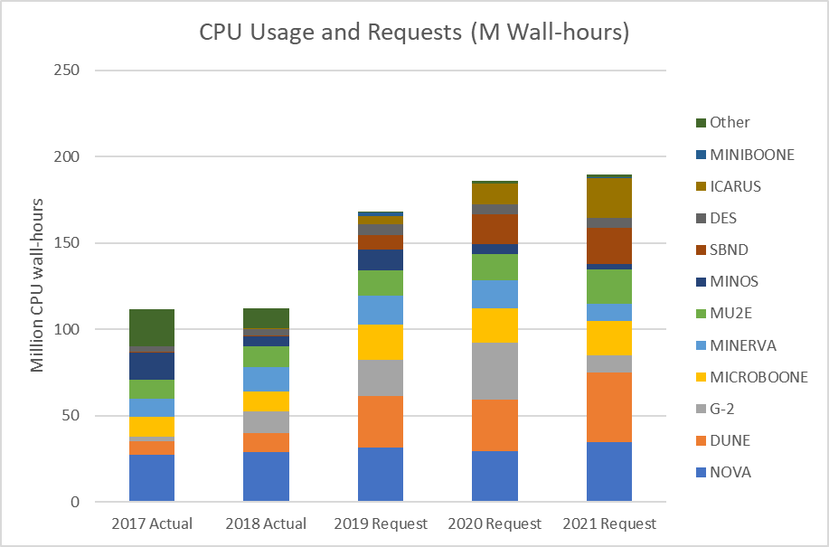
Processing future: Public HTC Requests
Summary of processing history and current requests from all experiments participating in SCPMT:
Add ~ 5M hours/year
to requests for other
local usage
Current capacity
160 M hours/year
Bottom line:
HTC need is to
sustain at approx.
current level
Opportunistic use
from OSG ~ 24M

Slide 11
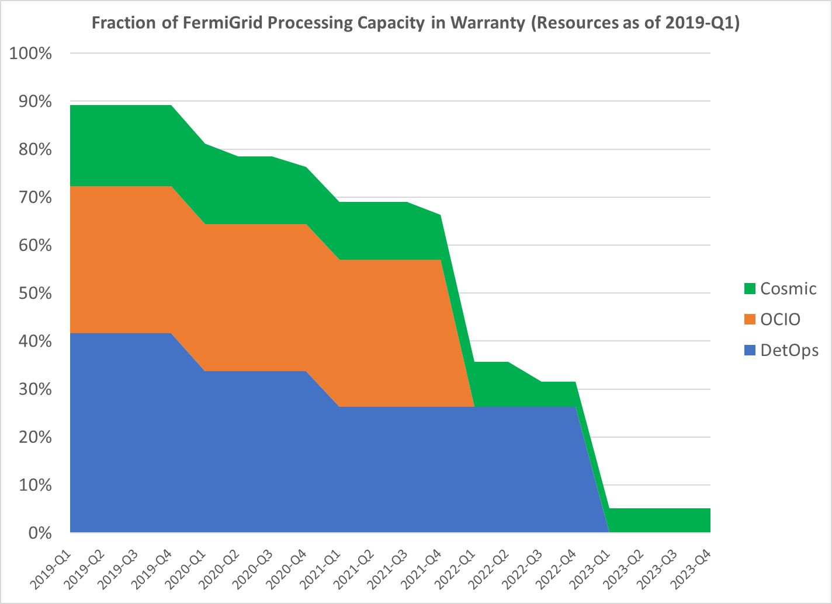
Processing future: Public HTC resources
FermiGrid: shared (all except CMS) worker nodes
  Approximately 19,000 cores of various vintage
    Availability of ~ 160M core-hours per year
    (200 kHS06 units)
    Last purchase using Computing and
    Detector Operations funds was in FY17
    No funds for additions in FY19
      ~ $2M purchase price
      To replenish 20%/year need ~ $400K
  At least 2 GB per core
    some (for DES) have ~ 5-6 GB per core
    (256 GB/node)

Slide 12
Processing future: HPC/accelerator
Existing resources
  pi0G cluster (512 cores, 128 K40 GPUs) will be available for general use in 2020
    “HPC like” in that nodes have no external connectivity
    Limited cluster storage (~1PB Lustre)
  Wilson cluster
    Currently available, small, but very ancient HPC cluster
    Also home of various development platforms:
      5 GPU enabled hosts, 1 KNL host, 1 “Summit” Power9 node (these will move to IC, below)
New/pending resources
  “Institutional Cluster” (*) RFP in progress
    ~75 nodes + 5 nodes with Voltas, IB, ~1PB Lustre
    Operated as a service, with LQCD “purchasing” hours (promised ~92% of available)
  * The “processing as a service” model will be applied to all local resources
    With access via HEPCloud

Slide 13
Processing future: Summary
HEPCloud will be the gateway to both local and external resources
In aggregate, local resources will follow the “Institutional Cluster” model
  “Processing as a service”
  With allocations and “cost” accounting
Local HPC resources provided at a level enabling:
  Code development
  Container development
  Testing at small-to-mid scale

Slide 14
Storage: Current usage
CMS
Public

Slide 15
Storage: Current usage
CMS
Public
Aggregate of Legacy and Intensity
Frontier experiments have more
stored data than CMS Tier-1
Paucity of disk
means far greater
use of tape by
average user

Slide 16
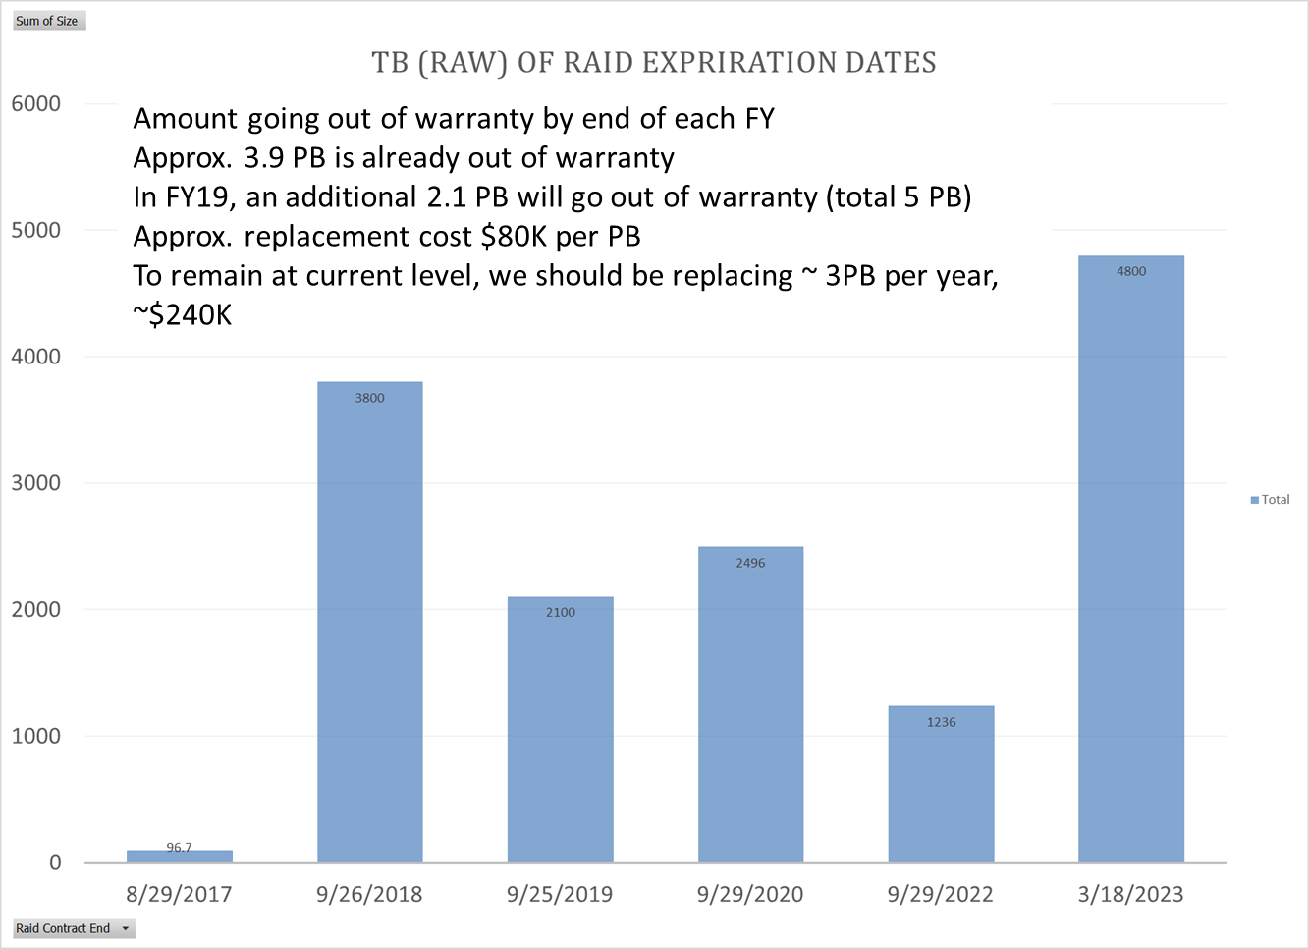
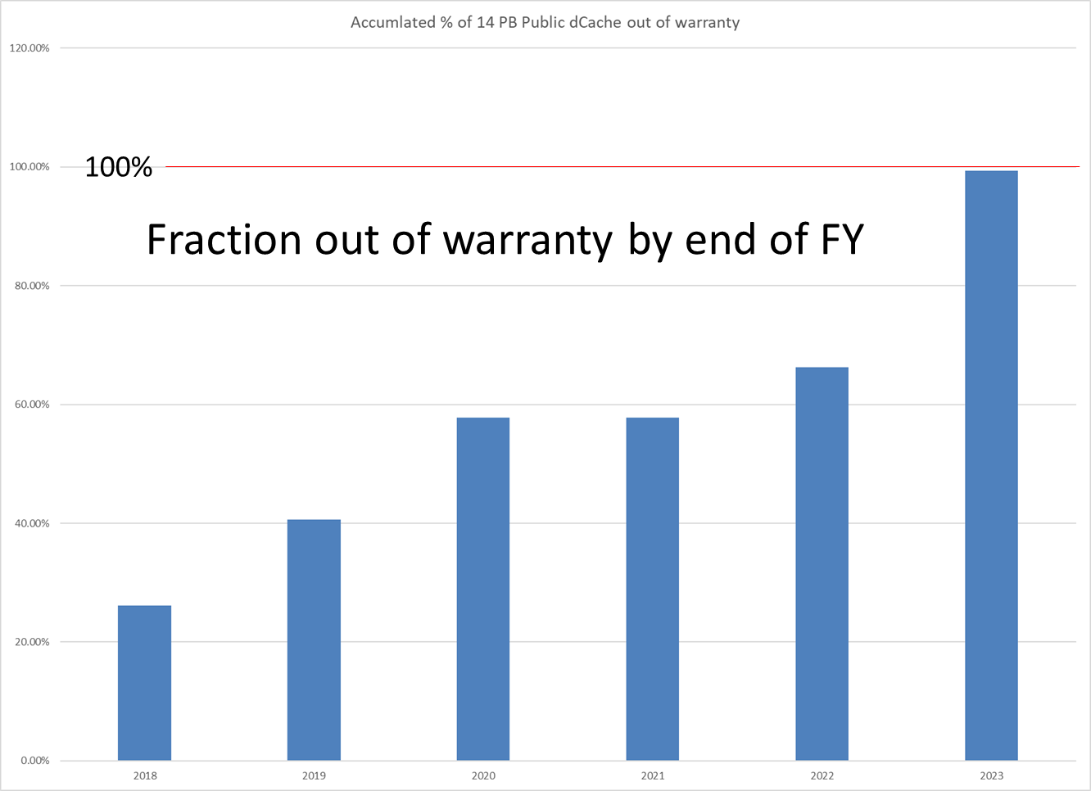
Public dCache disk: Warranty expiration dates
2018 2019 2020 2021 2022 2023
Bottom line:
Funding constraints unlikely
to allow little expansion of
Public disk

Slide 17
Tape: Hardware status
We see no near-term alternative hardware technology for archival storage
Technology change (from Oracle to…):
  At start of 2018 we had 7 10K-slot SL8500 libraries with ~80 enterprise drives
  Have retired 2 libraries, purchased 2 new 8.5K slot IBM libraries (will do 3rd this year)
  Moving to (~100) LTO8 drives with M8/LTO8 media
    With LTO8, each new IBM library is ~ 100PB
Need to both ingest new data and migrate legacy data
    ~140 PB (+20PB CDF, D0) of existing data to potentially migrate

Slide 18
Tape: Software status, plans
Fermilab uses enstore for all tape storage
  Closely connected as HSM to dCache
  enstore also used by another CMS Tier-1 (PIC) and several Tier-2s
  But limited personnel with enstore expertise
CERN has used Castor, moving to CTA
Fermilab will evaluate CTA as future option
  Tape format is a complication
    CERN uses “CERN format” for both Castor and CTA, so can physically “move” tapes to CTA
    enstore uses CPIO format, which would require copying files (so best done at a migration)
  Need to evaluate effort in all surrounding utilities

Slide 19
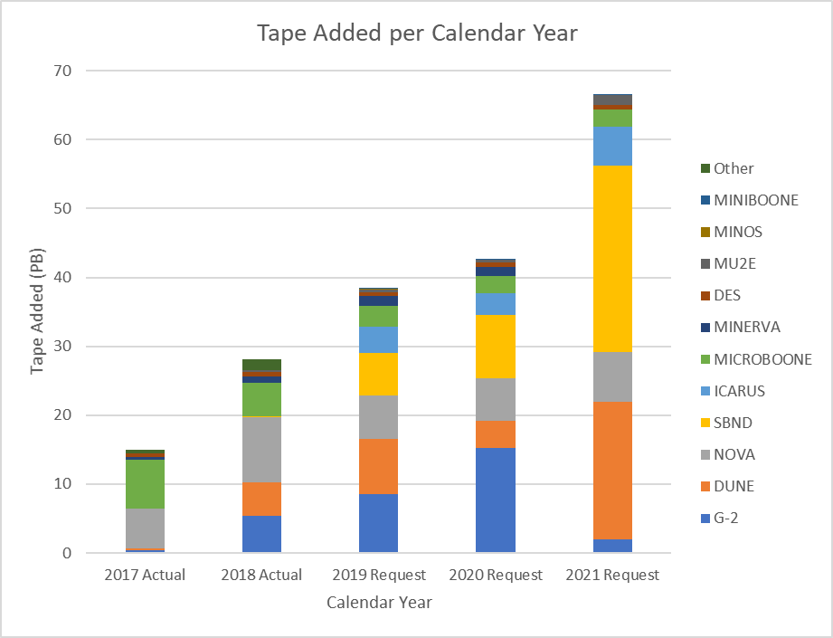
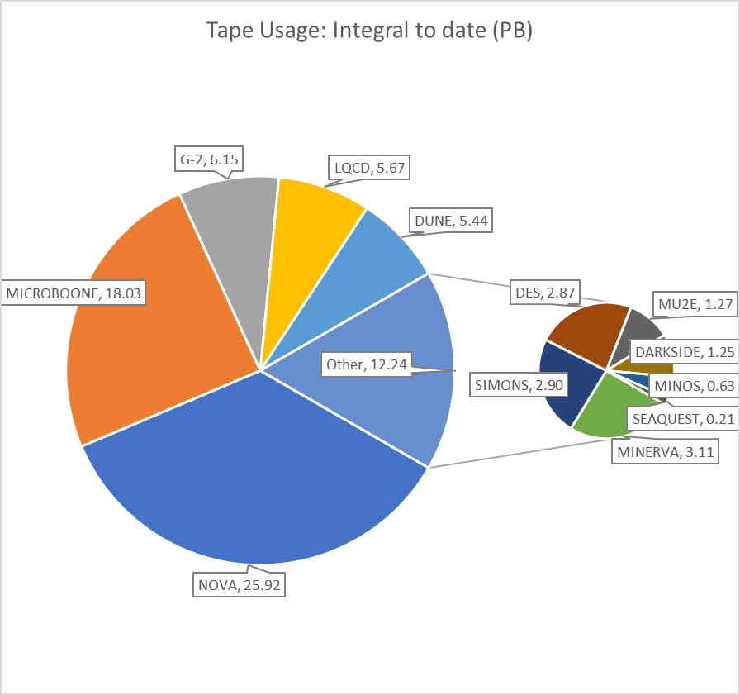
Tape: Volume of “Public” (=not CMS) new tape requests
For reference, the net
tape usage to date:

Slide 20
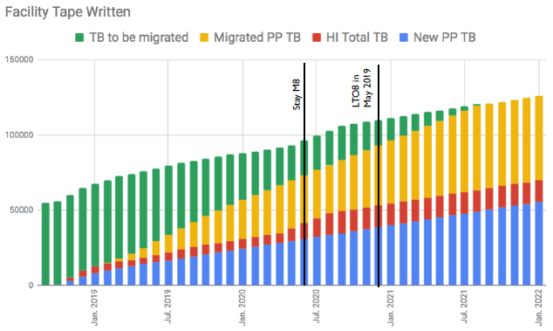
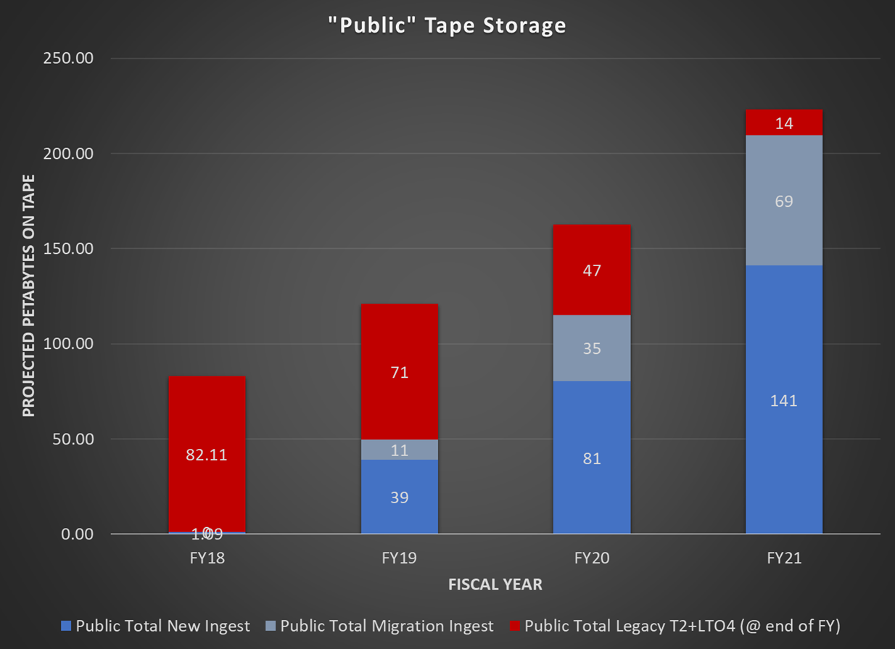
Tape: Integral
  CMS (125PB by 2022) Public (225PB by 2022)

Slide 21
Storage future: Summary
There is a discrepancy between CMS and Public storage architectures and disk/tape balance
  Would like greater coherence of methodologies
Storage architecture decisions will be greatly influenced by plans emerging from HSF etc.
Concern that funding will constrain options for Public systems

Slide 22
Conclusions
HEPCloud is seen as the path for uniform access to heterogeneous processing
  Long path to incorporating more resources, attributes, storage…
Local resources will appear as a “processing service” to which allocations and cost accounting will apply (the “Institutional Cluster” model)
The path of storage architecture evolution is not yet clear

Slide 23
Backup slides

Slide 24
Disk: numbers
Use | Type | Capacity
CMS | dCache disk only | 24 PB
CMS | EOS | 6 PB
CMS | dCache tape | 1 PB
Public | dCache tape | 6 PB
Public | dCache scratch | 2 PB
Public | dCache dedicated | 4 PB
Public | NAS | 2 PB

Slide 25
dCache disk: Resources
dCache is split into a number of pool groups, some for general use and others dedicated to specific experiment or project use
Pool Type | Number of Pools | Available Space (TB)
Read/Write Cache | 2 | 5,695
Scratch Cache | 2 | 2,122
Analysis / Persistent | 32 | 2,277
Expt. Dedicated | 13 | 2,145
Utility | 6 | 438
TOTAL | 55 | 12,677

Slide 26
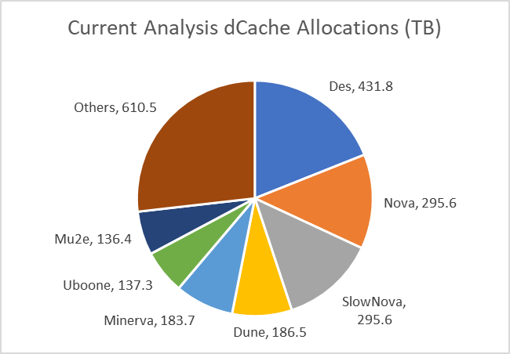
dCache disk: Analysis / Persistent
This is disk space that is permanently resident but with no backup
  Allocated via SCPMT / SPPM process
  Management under experiment control
  2.3 PB split across 32 experiment/project users
Experiment | 2019 Request | 2020 Request | 2021 Request
DES | 400 | 500 | 500
DUNE | 400 | 400 | 800
ICARUS | 100 | 150 | 200
MicroBoone | 300 | 300 | 300
Mu2e | 150 | 200 | 300
g-2 | 150 | 300 | 300
Nova | 450 | 450 | 450
SBND | 100 | 125 | 150
Minerva | 250 | 250 | 250
Others | 450 | 450 | 450
TOTAL | 2,750 | 3,125 | 3,700

Slide 27
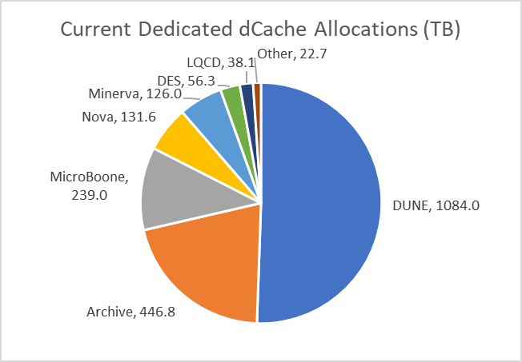
dCache disk: Dedicated
This is “tape backed” disk space that is dedicated to a specific experiment
  Allocated via SCPMT / SPPM process
  Typically for raw data ingest or pre-staging
  2.1 PB split across 13 functions
Experiment | 2019 Request | 2020 Request | 2021 Request
DUNE | 1,100 | 1,100 | 1,500
MicroBoone | ? | ? | ?
Mu2e | 0 | 0 | 60
Nova | 132 | 132 | 132
SBND | 2 | 2 | 2
Minerva | 126 | 126 | 125
Others | 132 | 132 | 132
TOTAL | 1,234 | 1,234 | 1,694
Requests not substantially different
than current allocations

Slide 28
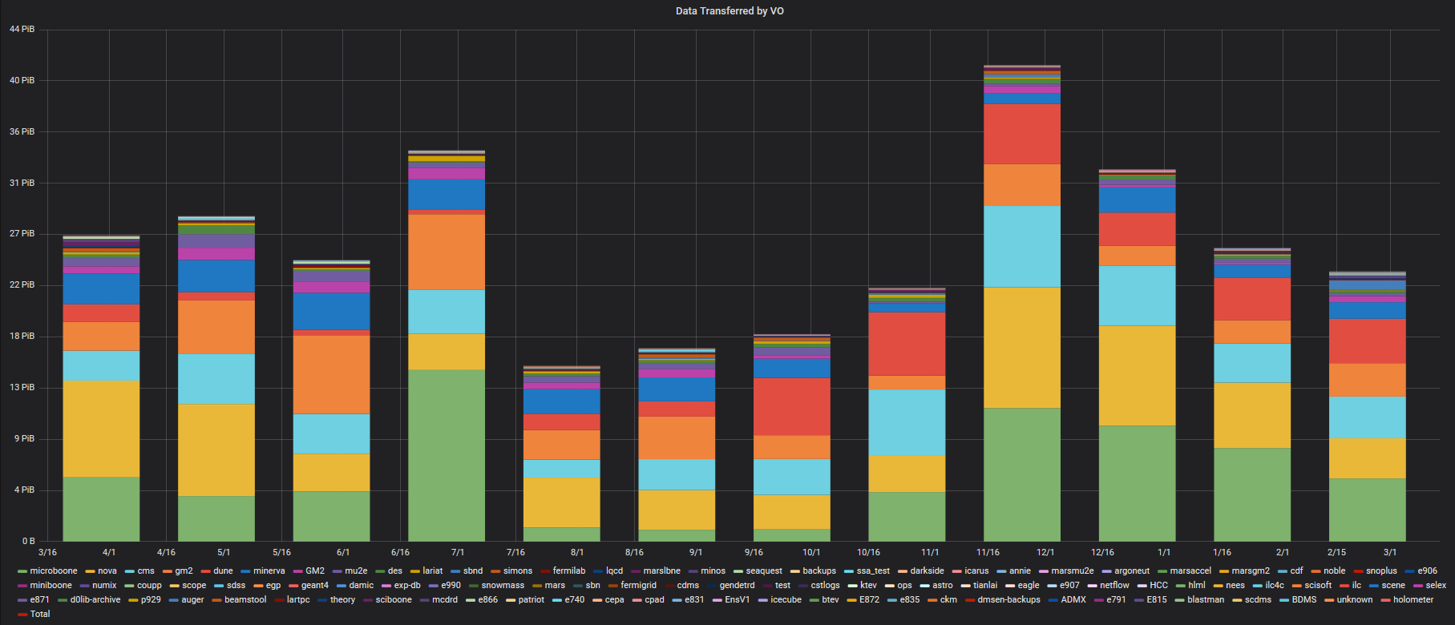
Disk: dCache Transfers by VO (per month)
CMS is light blue

Slide 29
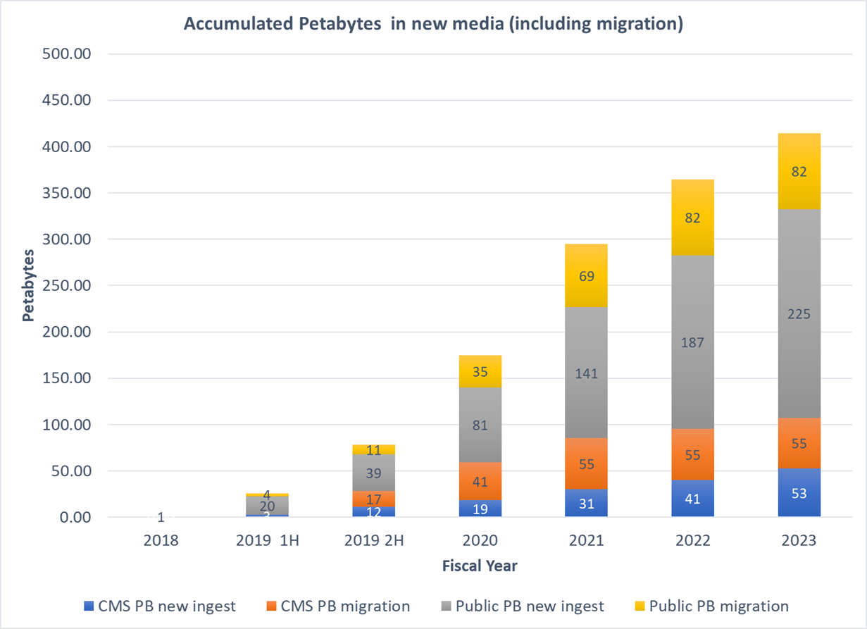
Tape: Integral, CMS & Public on new media

Slide 30
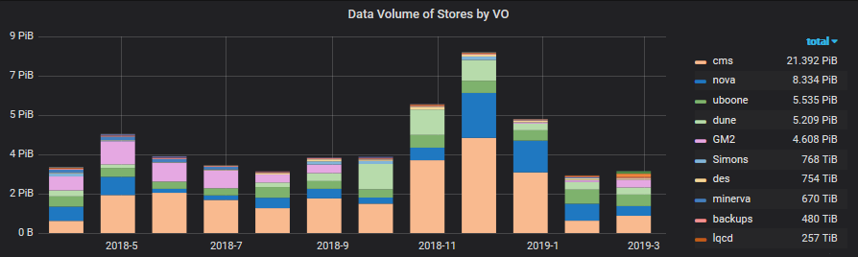
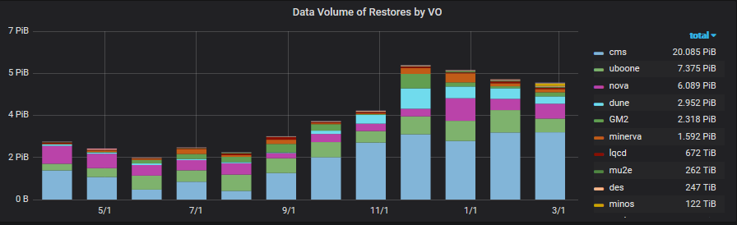
Tape: Transfers by VO (writes, reads per month)
CMS is orange
CMS is blue

