Slide 1
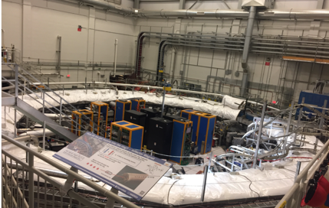
Muon g-2
drhgfdjhngngfmhgmghmghjmghfmf
Peter Winter
Operation Manager
Muon g-2
Argonne National Laboratory

Slide 2
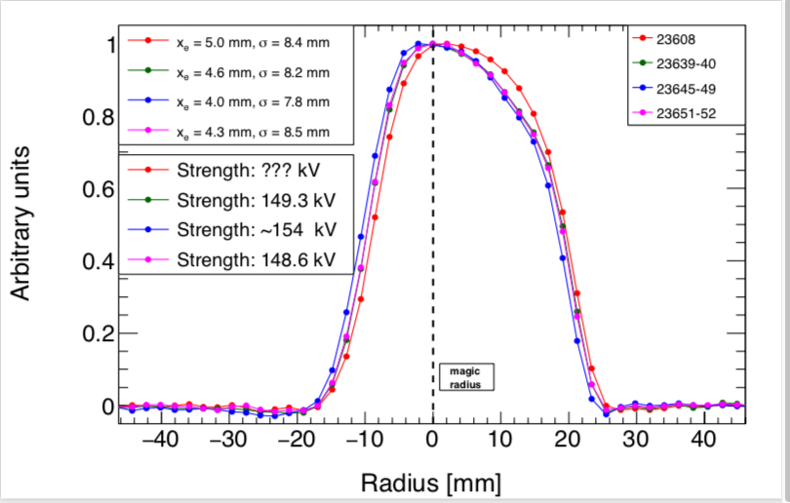
Progress over last month
Kicker system was calibrated and conditioned, 2 out of 3 kickers reached design voltage of 55kV, K3 still struggling because of sparking (repair in progress)
Interference between quadrupoles and kicker system (through sparks worsening the vacuum) is small after reaching stable operation of kickers K1 & K2
Operated all 3kV at ~155kV (design 165kV) with muon beam, preliminary analysis indicates that the muons distribution is closer to the ideal orbit. Once K3 is at 55kV, we should be within 2mm of the ideal orbit (in Run-1: ~7mm away)
148

Slide 3
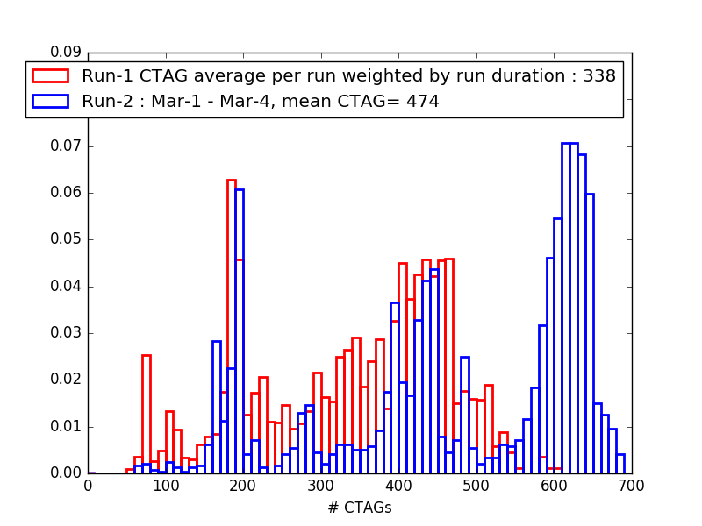
Progress over last month
Beam tuning shows promising increase in stored muons:
Initial test of beamline wedges (w/o any optic tuning) shows 8% flux increase
Magnet and inflector are behaving very well but helium impurities are increasing which limits the intervals of continuous magnet operation
All hardware systems are ready for production data taking
Performed important studies with the laser system and calorimeters to determine the gain and evaluate SiPM temperature behavior for Run-1 analysis

Slide 4
Progress over last month
The field homogeneity has been improved with modification of wedge shims to restore homogeneity at the beginning of Run-1 (~10 ppm RMS)
Collaboration is working hard to analyze the Run-1 data. Successful unblinding exercise of a 60-h dataset by six ω_{a} analysis teams
Production team is focusing on analyzing all datasets from Run-1 for the collaboration meeting in May; they are now preparing to also perform the analysis of Run-2 data starting soon
Before wedge shimming
After wedge shimming

Slide 5
Plan for the next weeks
Finish 40K magnet warm-up to purify helium
Planning to take some days of physics quality data to get feedback from the analyzers that the conditions are good
We have a well defined / limited set of field studies and beam tuning exercises that remain that we will execute in the upcoming days
Then we will switch to uninterrupted, stable physics data taking for ~1month to collect another 1.5x BNL statistics
We are planning to request to switch to 16-bunch mode over the tomorrow or on the weekend for DAQ tune-up in preparation for production running on Monday
Need to (opportunistically) install hall cooling upgrade before temperature rises and our HVAC cannot maintain the +-1C stability

