Slide 1
MQXFA03 Coils QXFA109, QXFA110, QXFA111
Fred Nobrega, CAM/L3
Miao Yu, Deputy L3
Marcellus Parker, Electrical
Coil Fabrication at FNAL
U.S. HL-LHC Accelerator Upgrade Project
MQXFA03 Coils and Shims Review
March 14, 2018

Slide 2
Outline
Requirements & Specifications
Electrical
Mechanical
Coil Fabrication
QC data collected
Electrical
Mechanical
Non-conformities (DR’s)
Summary

Slide 3
Charges
Do coils 109, 110, 111, and 202 meet MQXFA coil specifications [2]?
Are conductor/coil fabrication and QC data of the proposed coils adequate for a thorough evaluation and for allowing MQXFA03 to meet MQXFA requirements [1]?
Are there major non-conformities? If answer is yes, have they been adequately documented and processed?
Is the proposed coil-shim plan properly based on CMM measurements, including measurements of coil ends?
Is the proposed coil-shim plan adequate for allowing MQXFA03 to meet MQXFA requirements [1]?
Do you have any other comment or recommendation regarding conductor, coils or coil-shim plan for allowing MQXFA03 to meet MQXFA requirements [1]?
[1] MQXFA Functional Requirement Specification, US-HiLumi-doc-36.
[2] MQXFA Final Design Report, US-HiLumi-doc-948 section 5.1.1
and QXFA Coil Fabrication Electrical QA, US-HiLumi-doc-521 step 16.

Slide 4
Requirements and Specifications
Charge 1
Coil Acceptance (US-HiLumi-doc-1103)
Free helium passage trough coil poles every 50 mm.
Splices are soldered with CERN approved materials.
Redundant voltage taps on each coil splice.
All coil components withstand 35 MGy.
Functional Requirements Specification (US-HiLumi-doc-36)
Coils meet the requirements established in the FRS
Field quality, coil aperture, magnetic length, helium passage thru pole, voltage taps on lead splices, solder with CERN approved materials, splice lead resistance, withstand voltage levels during hi-pot tests, and the use of radiation hard materials.
Final Design Report (US-HiLumi-doc-948)
Coil fabrication (wind, cure, reaction, & impregnation)
Mechanical tolerances & fabrication parameters
Coil handling & shipping
Coil size measurements made by coordinate measuring machine (CMM) & compared to allowable tolerances. (OD, ID, mid-plane, length)
Electrical QC measurements (US-HiLumi-doc-521)
Compared to the allowable max/min pass/fail criterial for acceptance
Coil Resistance, Inductance, Quality factor.
Heater resistance.
Hi-pot tests: coil to parts, QH to Coil, QH to saddles, saddles to saddles.
Impulse tests.

Slide 5
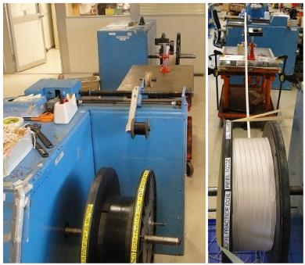
Cable Preparation
Charge 2
Re-spool the insulated cable to verify the total length (min. 441 m including the winding lead).
Split into two reels for L1 coil (min. 195 m) and L2 coil (min. 246 m).
Cable respooling
 | Cable ID | Total (m) | L1 (m) | L2 (m)
QXFA 109 | 1090 | 442.7 | 196 | 246.7
QXFA 110 | 1091 | 440.6 | 194.3 | 246.3
QXFA 111 | 1098 | 446.6 | 198 | 248.6
Cable length in coil
 | Cable ID | Total (m) | L1 (m) | L2 (m)
QXFA 109 | 1090 | 427.2 | 188 | 239.2
QXFA 110 | 1091 | 427.5 | 188.3 | 239.2
QXFA 111 | 1098 | 427.4 | 188.3 | 239.1

Slide 6
Wedge Length and Gap
Charge 2
QXFA 109, 110, 111
Wedge gap: 2 mm 3.75 mm 3.75 mm 3.75 mm 3.75 mm 3.75 mm 2 mm

Slide 7
Pole Gaps
Charge 2
14
12
10
8
6
4
2
0
Pole Gap [mm]
109 110 111
Coil Number

Slide 8
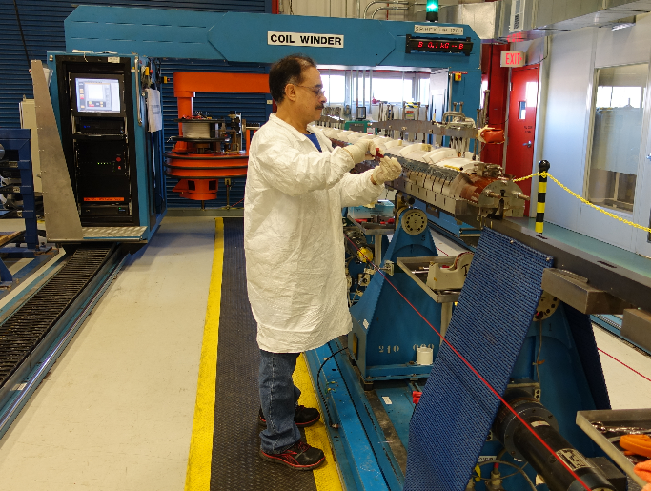
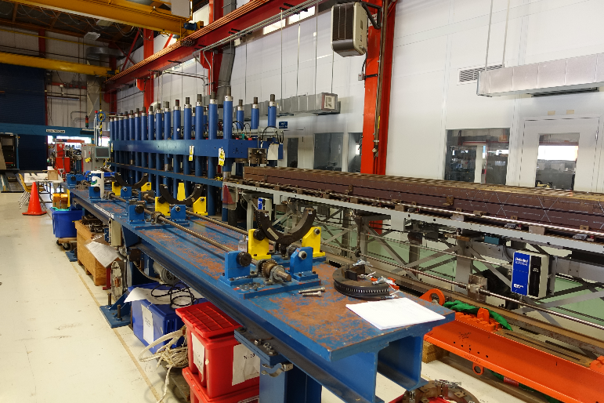
Coil Winding & Curing
Coil winding tension is 15-25 kg depending on turn. Ceramic binder CTD-1202X used at end turns to increase cable stability.
Curing cycle 150° C for 90 minutes in closed cavity with CTD-1202X ceramic binder.
Hydraulic cylinders apply load to close the mold.
Heated with electric cartridge heaters
QXFA coil winding
FNAL curing press
QXFA Coil

Slide 9
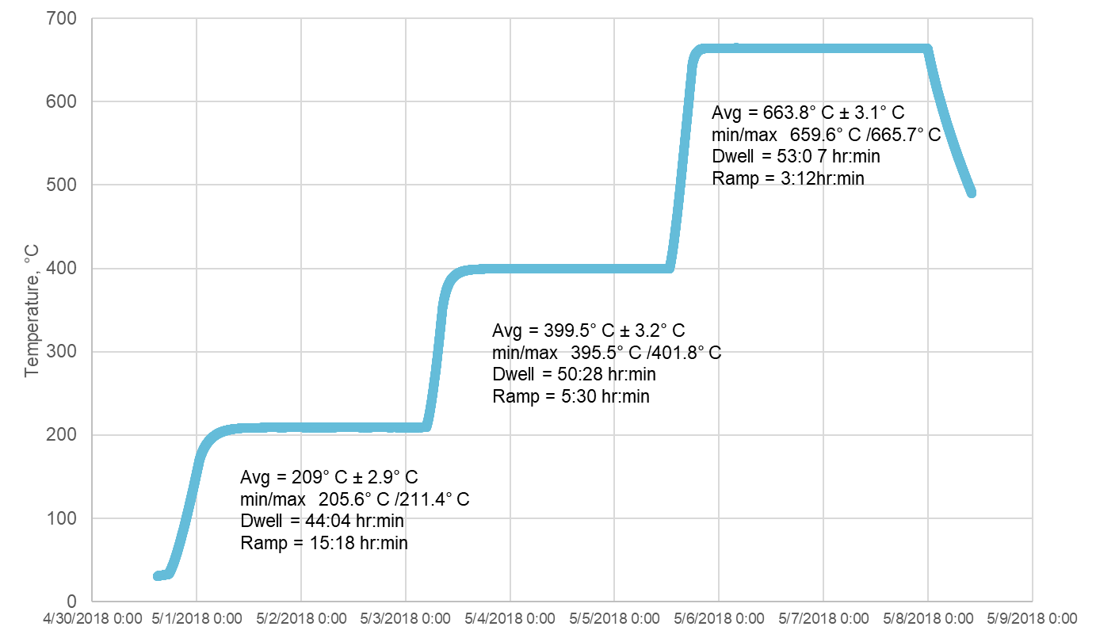
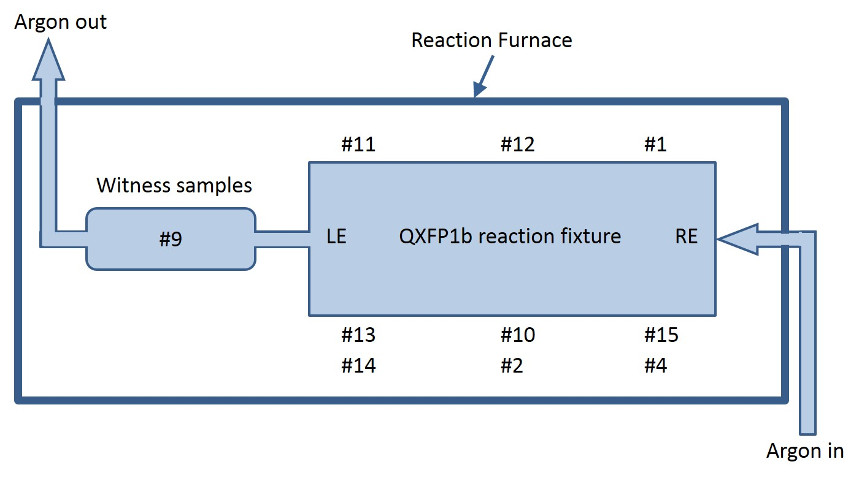
Coil Heat Treatment
Charge 2
Recipe | QXFA109 |  | QXFA110 |  | QXFA111
Plateau, Dwell | Plateau | Dwell | Plateau | Dwell | Plateau | Dwell
210° C, 48 hr | 209.0° C | 44:04 | 209.3 ° C | 47:02 | 209.1° C | 45:30
400° C, 48 hr | 399.5° C | 50:28 | 400.8 ° C | 47:47 | 401.3° C | 47:00
665° C, 50 hr | 663.8° C | 53:07 | 664.2° C | 53:24 | 663.9° C | 52:47
QXFA109 Heat Treatment
QXFA109
LE QXFA110 reaction fixture RE
QXFA111

Slide 10
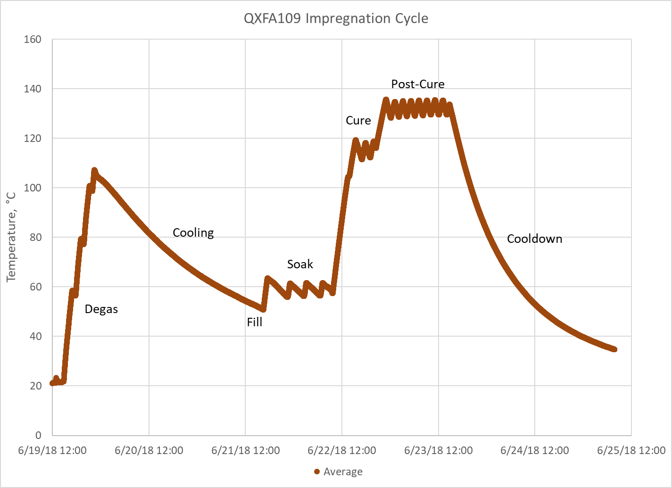
Coil Impregnation
Charge 2

Slide 11
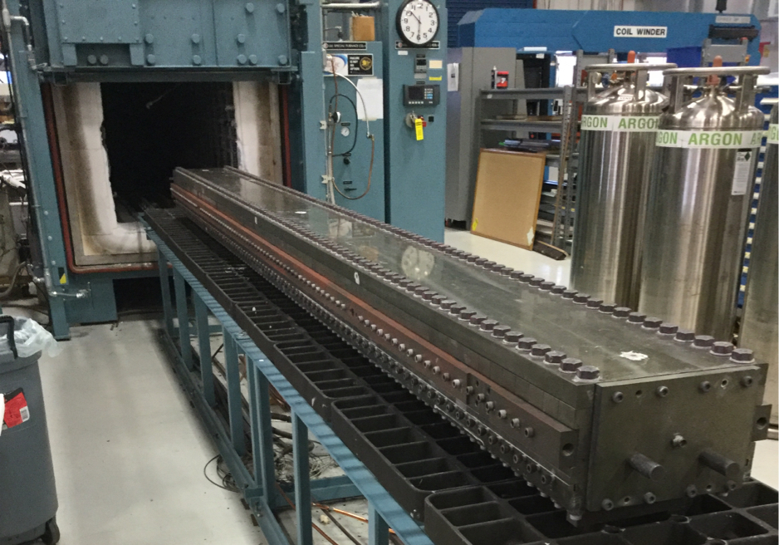
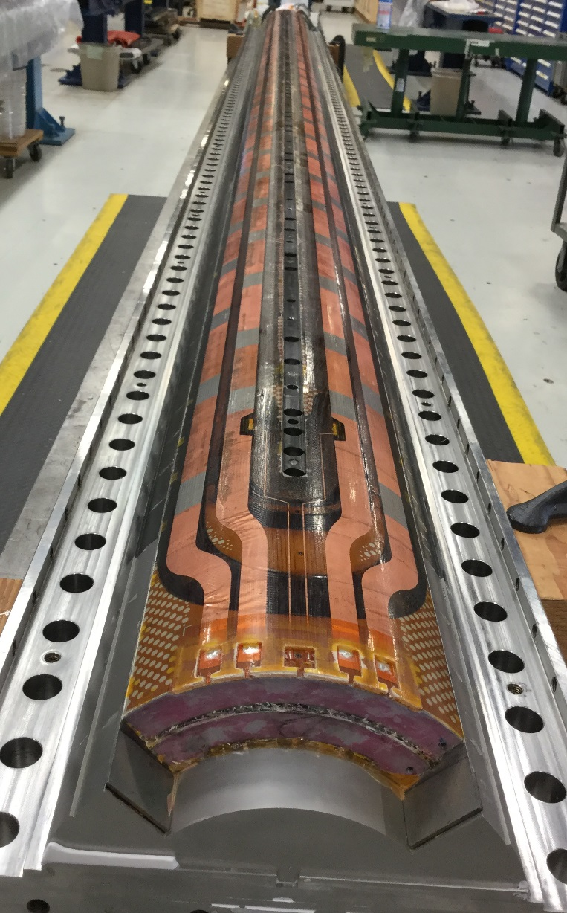
Coil Reaction & Impregnation
CTD101K epoxy impregnation at 30-50 μm Hg and 50° C
Epoxy cure is in the vacuum tank at 110° C for 5 hours then 125° C for 16 hours using external heaters mounted on the tooling.
Reaction Oven
Reaction cycle is in an argon atmosphere and lasts about 11 days including ramp up and cool down.
Witness samples reacted in retort.
Reaction tooling volume is identical to impregnation tooling.
Potted Coil
Reacted Coil
Vacuum Tank & Insertion Table

Slide 12
MQXFA Final Design Report Mechanical Parameters
Charge 2
Coil Name | Coil length 4532 ± 3.5 (mm)
QXFA109 | 4533
QXFA110 | 4532
QXFA111 | 4532
Description | Nominal
Coil inner radius, mm | 74.750
Coil outer radius, mm | 113.376
Coil midplane offset, mm | 0.125

Slide 13
QXFA109 CMM
Charge 2
Section #5 at -1140 mm from LE scale x100 (1box=.1mm)
Alignment is to this cross section only + OD and sides
Section #7 at -1940 mm from LE scale x100 (1box=.1mm)
Alignment is to this cross section only + OD and sides
Section #9 at -2740 mm from LE scale x100 (1box=.1mm)
Alignment is to this cross section only + OD and sides
Section #11 at -3540 mm from LE scale x100 (1box=.1mm)
Alignment is to this cross section only + OD and sides

Slide 14
QXFA110 CMM
Charge 2
Section #5 at -1140 mm from LE scale x100 (1box=.1mm)
Alignment is to this cross section only + OD and sides
Section #7 at -1940 mm from LE scale x100 (1box=.1mm)
Alignment is to this cross section only + OD and sides
Section #9 at -2740 mm from LE scale x100 (1box=.1mm)
Alignment is to this cross section only + OD and sides
Section #11 at -3540 mm from LE scale x100 (1box=.1mm)
Alignment is to this cross section only + OD and sides

Slide 15
QXFA111 CMM
Charge 2
#5 at -1140 mm from LE scale x100 (1box=.25mm x .3mm)
Alignment is to this cross section only + OD and sides
#7 at -1940 mm from LE scale x100 (1box=.25mm x .3mm)
Alignment is to this cross section only + OD and sides
#9 at -2740 mm from LE scale x100 (1box=.25mm x .3mm)
Alignment is to this cross section only + OD and sides
#11 at -3540 mm from LE scale x100 (1box=.25mm x .3mm)
Alignment is to this cross section only + OD and sides

Slide 16
Final Hi-pot and Impulse Tests
Charge 2
 | QXFA109 | QXFA110 | QXFA111
Hi-Pot (<1µA Leakage)
Coil to Pole (V) | 500/500 | 500/500 | 500/500
QH to Coil (V) | 3680/3680 | 3200/3200 | 3200/3200
Coil to Saddle (V) | 1000/1000 | 1000/1000 | 1000/1000
QH to Saddle (V) | 2500/2500 | 2500/2500 | 2500/2500
Saddle to Saddle (V) | 1000/1000 | 1000/1000 | 1000/1000
Impulse (V) | 2500/2500 | 2500/2500 | 2500/2500

Slide 17
Final Electrical Checks
Charge 2
Measurement | QXFA109 | QXFA110 | QXFA111 |  | Avg | StDev | StDev/Avg | Min | Max
Coil R @1 A (mV) | 605.35 | 611.52 | 614 |  | 610.290 | 3.637 | 0.6% | 605.35 | 614
Ls @ 20 Hz (mH) | 4.889 | 4.89 | 4.76 |  | 4.846 | 0.061 | 1.3% | 4.76 | 4.89
Q | 0.79 | 0.79 | 0.758 |  | 0.779 | 0.015 | 1.9% | 0.758 | 0.79
Ls @ 100 Hz (mH) | 3.404 | 3.41 | 3.23 |  | 3.348 | 0.083 | 2.5% | 3.23 | 3.41
Q | 1.627 | 1.62 | 1.569 |  | 1.605 | 0.026 | 1.6% | 1.569 | 1.627
Ls @ 1 kHz (mH) | 1.898 | 1.91 | 1.89 |  | 1.899 | 0.008 | 0.4% | 1.89 | 1.91
Q | 2 | 2.01 | 2.11 |  | 2.040 | 0.050 | 2.4% | 2 | 2.11
VTA1 (mV) | 0.3 | 0.046 | 0.074 |  | 0.140 | 0.114 | 81.2% | 0.046 | 0.3
VTA2 | 0.35 | 0.103 | 0.13 |  | 0.194 | 0.111 | 56.9% | 0.103 | 0.35
VTA3 | 195.42 | 197.3 | 198.5 |  | 197.073 | 1.268 | 0.6% | 195.42 | 198.5
VTA4 | 254.49 | 257.1 | 258.6 |  | 256.730 | 1.698 | 0.7% | 254.49 | 258.6
VTA5 | 254.71 | 257.4 | 258.8 |  | 256.970 | 1.697 | 0.7% | 254.71 | 258.8
VTA6 | 260.48 | 263.3 | 264.6 |  | 262.793 | 1.720 | 0.7% | 260.48 | 264.6
VTA7 | 260.61 | 263.3 | 264.8 |  | 262.903 | 1.733 | 0.7% | 260.61 | 264.8
VTA8 | 265.95 | 268.6 | 270.1 |  | 268.217 | 1.716 | 0.6% | 265.95 | 270.1
VTB8 | 267.3 | 269.3 | 270.5 |  | 269.033 | 1.320 | 0.5% | 267.3 | 270.5
VTB7 | 267.49 | 269.3 | 270.8 |  | 269.197 | 1.353 | 0.5% | 267.49 | 270.8
VTB6 | 273.05 | 274.9 | 276.4 |  | 274.783 | 1.370 | 0.5% | 273.05 | 276.4
VTB5 | 273.42 | 275.2 | 276.8 |  | 275.140 | 1.381 | 0.5% | 273.42 | 276.8
VTB4 | 278.96 | 280.8 | 282.4 |  | 280.720 | 1.406 | 0.5% | 278.96 | 282.4
VTB3 | 421.92 | 424.8 | 427.1 |  | 424.607 | 2.119 | 0.5% | 421.92 | 427.1
VTB2 | 607.03 | 611.3 | 614.7 |  | 611.010 | 3.138 | 0.5% | 607.03 | 614.7
VTB1 | 607.12 | 611.3 | 614.8 |  | 611.073 | 3.139 | 0.5% | 607.12 | 614.8
QHB1 | 1.61 | 1.86 | 1.64 |  | 1.703 | 0.137 | 8.0% | 1.610 | 1.860
QHB2 | 1.65 | 1.87 | 1.7 |  | 1.740 | 0.115 | 6.6% | 1.650 | 1.870
QHB3 | 1.62 | 1.86 | 1.73 |  | 1.737 | 0.120 | 6.9% | 1.620 | 1.860
QHB4 | 1.61 | 1.86 | 1.7 |  | 1.723 | 0.127 | 7.3% | 1.610 | 1.860

Slide 18
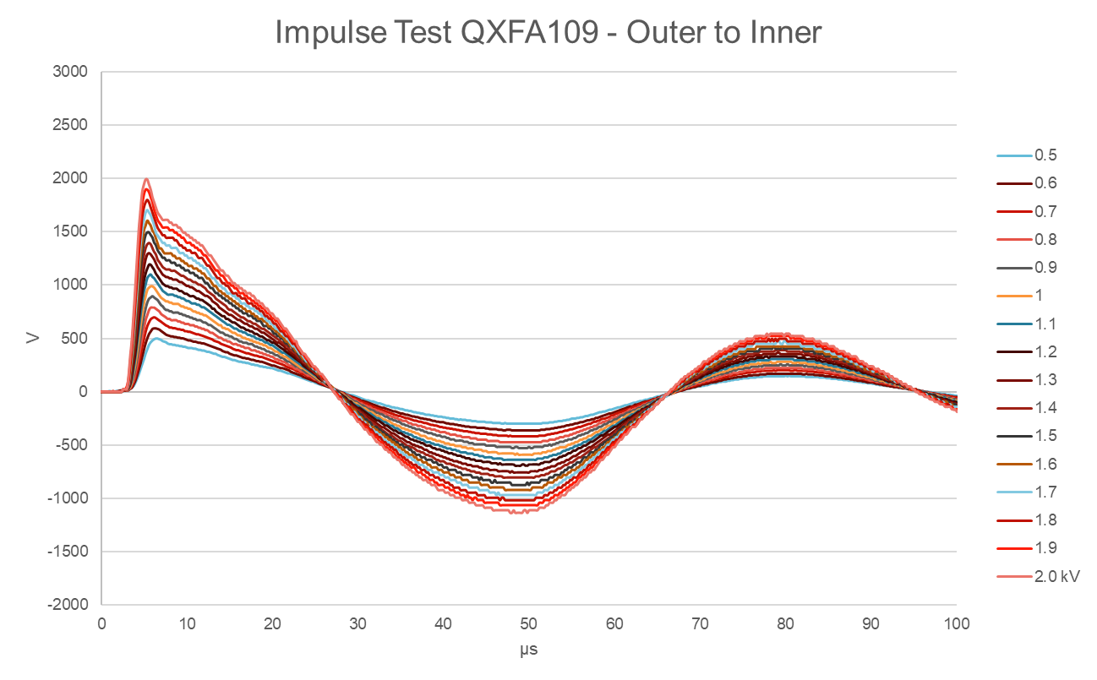
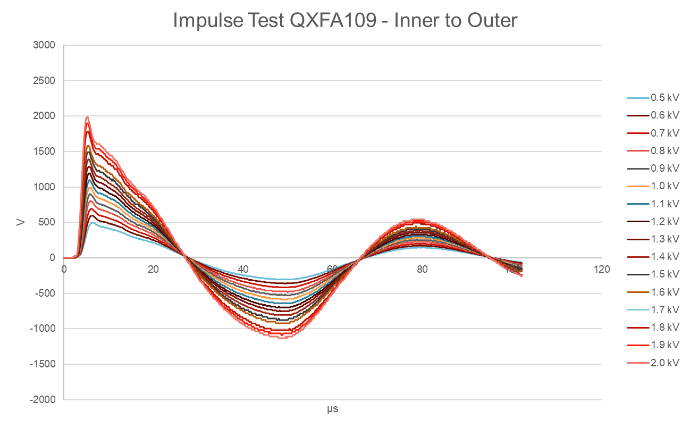
QXFA109 Impulse Test
Charge 2

Slide 19
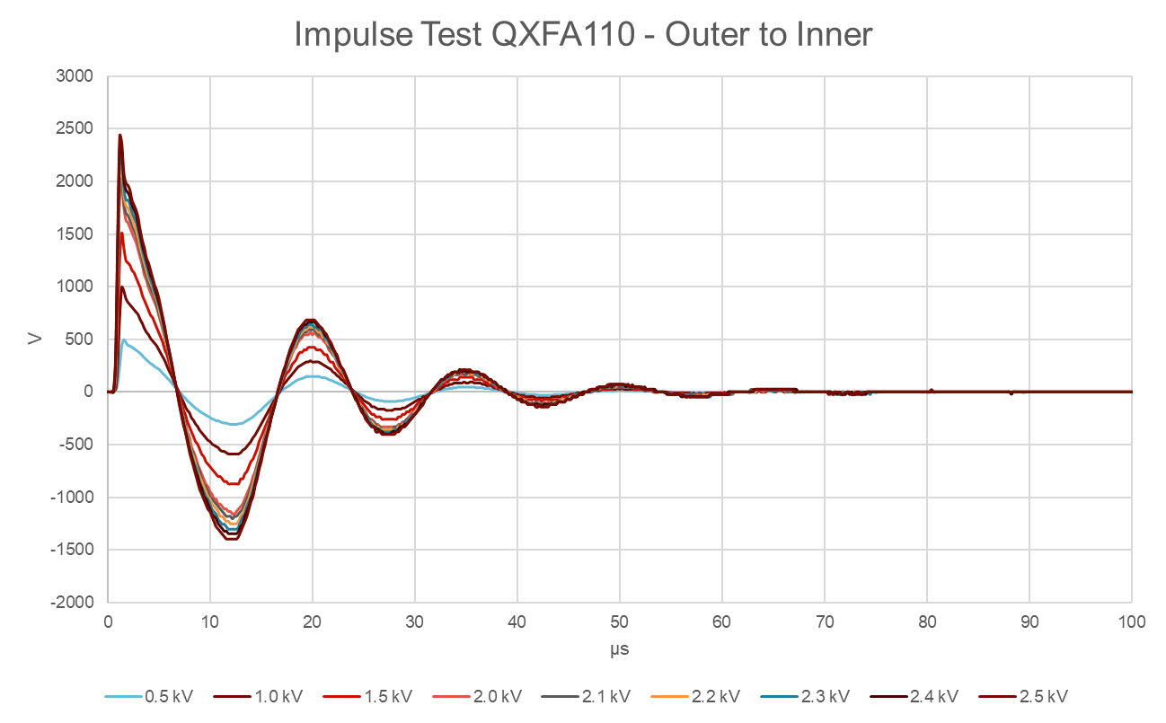
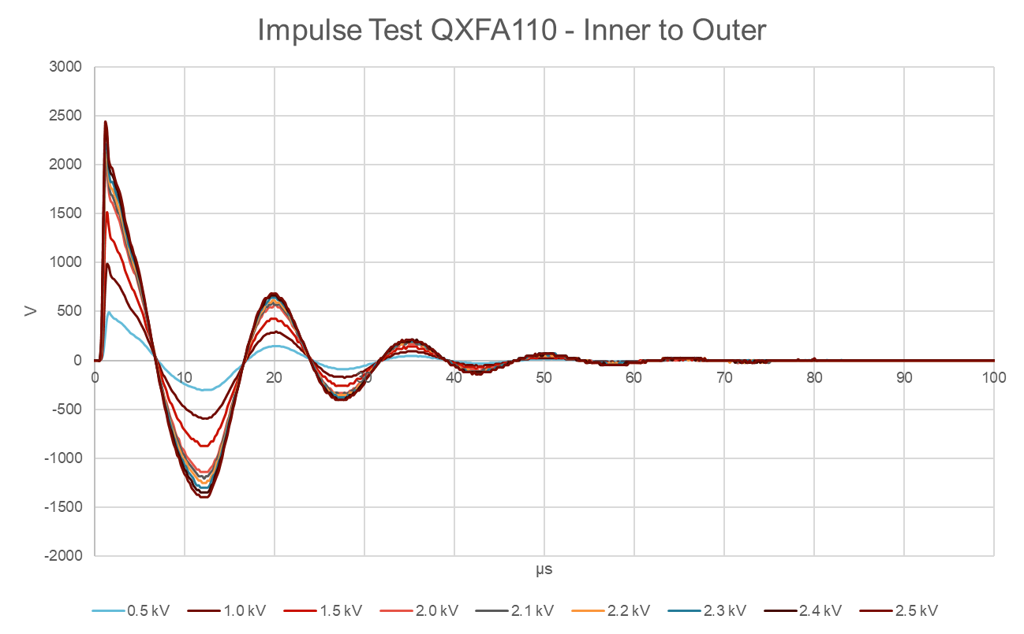
QXFA110 Impulse Test
Charge 2

Slide 20
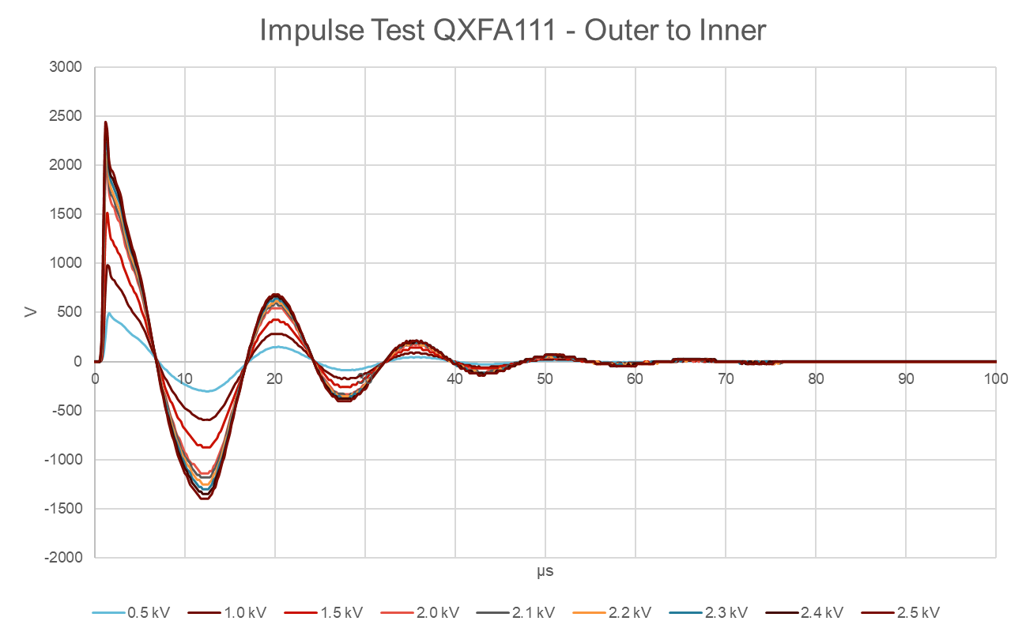
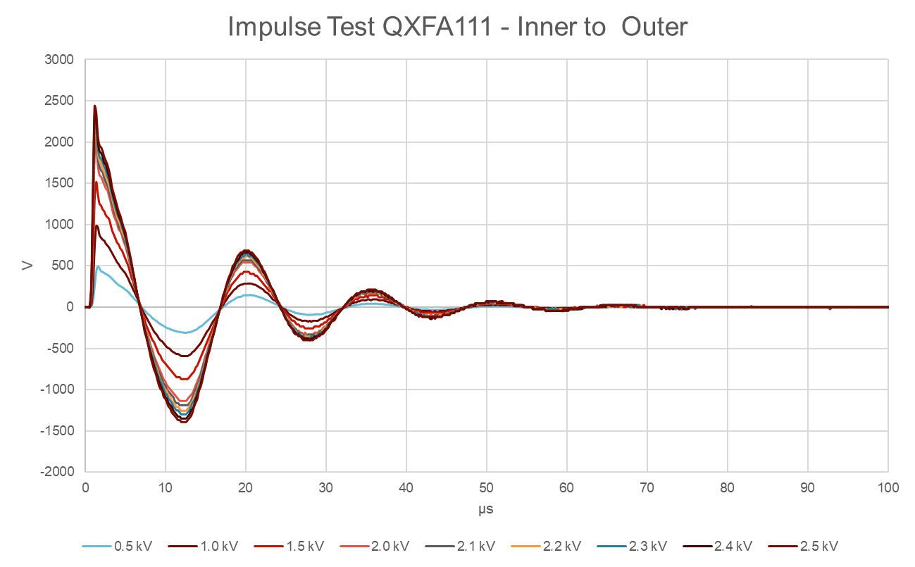
QXFA111 Impulse Test
Charge 2

Slide 21
Discrepancy Reports
Charge 3
DR’s Based on Coil | Quantity Closed+Open
QXFA109 | 11+1
QXFA110 | 9+1
QXFA111 | 5+1
DR’s Based on Travelers | Closed | Summary (all minor)
Prep for Winding & Curing | 3 | Exposed cable (bare spots) during respooling
Winding & Curing | 6 | Cable insulation, end part plasma chip
Reaction | 2 | Broken furnace thermocouple
Splice/Impregnation | 10 | Soldering/tinning, broken VT flags, temperature settings
Electrical Testing | 3 | Continuity measurements after reaction
Shipping | 1 | Accelerometer not initialized
 | Open
Electrical Testing | 3 | Hi-pot was to 3200V instead of 3680V, impulse test to 2500V

Slide 22
Major Non-Conformities
Charge 3
None.

Slide 23
Summary
Charge 2
Coil QXFA109 conditionally meets all coil specifications. The coil impulse test needs to be repeated at LBNL to 2500V.
Coils QXFA110 & 111 conditionally meet all coil specifications. The coils need to be hi-pot tested at LBNL to 3860V to become compliant.

Slide 24
BACKUP SLIDES

Slide 25
Discrepancy Reports
Charge 3
Coil | DR Link | Description | Disposition | Traveler Name
QXFA-CL-109 | 11415 | While attempting to install the L1 RE Spacer 1 (B2-IR1) Me and Dillon noticed that the spacer was very tight and difficult to place around turn number 5 on the return end of the coil. I called down Fred and Miao to come and check out the issue. They came to the conclusion that spacer was stuck together due to the coating. While spreading the spacer apart to get it to fit onto the coil, the coating chipped in one spot along the back side of the spacer. We ended up using 2 small pieces of 5 mil Kapton to avoid damaging the insulation and a small mallet to tap the spacer into place. | As normal procedure, we place a piece of pre-cured 7 mil thick S2 glass tape in between the cable and the end spacer as additional insulation besides the plasma coating. In this case, there is no need to repair the chip-off coating surface on the spacer, and the layer of S2 glass is sufficient to insulate the cable from end spacer. | HL-LHC Magnet QXFA Coil Winding and Curing Traveler
QXFA-CL-109 | 11434 | While taking the L2 LE Spacer 1(B2-OC1) out of its packaging, we noticed that the corner of the spacer was chipped. Even though the S2 glass tape that we apply around the spacer would cover the defect, we wanted to get Miao involved and get his input. After observing the issue, Miao agreed that the S2 glass would cover the defect and told us to continue winding and prepare a DR with pictures on the issue. | Continue with winding. There is one layer of S2 glass between the part and the cable. After curing, double check the insulation still covering the bare part. | HL-LHC Magnet QXFA Coil Winding and Curing Traveler
QXFA-CL-109 | 11438 | While making the 24th turn on the non-transition side, we ran into a bare spot on the cable while approaching the RE of the coil. We cut the insulation around the bare spot and replaced it with 3 mil S2 Glass. This was briefly reported in the previous DR 11417 but without pictures. Attached are actual photos of the defect as well as the repair. | Cut and repair the insulation using 3mil S2 glass tape with 50% overlap. | HL-LHC Magnet QXFA Coil Winding and Curing Traveler
QXFA-CL-110 | 11593 | After making the 14th turn at the RE with the boom location on the east side of the coil and beginning to move the bridge south, the electrical continuity device started to sound off notifying us of a short to ground. I immediately notified Steve G., Miao and Marcellus. After spending some time to find where the short was, we discovered that it was the L1 RE Spacer 2. What we noticed immediately was that the S2 glass on the inside of the L1 RE Spacer 2 had popped up on west side of the coil. Miao decided that we should back wind the last 2 turns on the coil to remove the part for further examination. Upon removing the spacer, we found that the coating had chipped off both corners of the part for some reason. It appears that the chipped corner on the east side of the coil could be the culprit which would make sense being that this was the point where the tension was being applied as I started to move the bridge south. I would like to note that the part was not chipped at all when it was installed. | Swap a new spacer, have the additional S2 glass tape installed in position to cover the bare cable, and continue the winding. | HL-LHC Magnet QXFA Coil Winding and Curing Traveler

Slide 26
Discrepancy Reports
Charge 3
Coil | DR Link | Description | Disposition | Traveler Name
QXFA-CL-111 | 11594 | The following series of discrepancies are all observed faults in the cable insulation that were found in the QXFA cable spooled for coil 111. All measurements of the location were made relative to the lead end. | Apply and cure (for approximately 30 seconds) the CTD 1202 Matrix solution to the problem area going 1/4” before and after the area of failed insulation. Cut the insulation at the lead and tail ends about .25” beyond the insulation blemish. Wrap the exposed cable with 3 mil S2 glass making sure to “half wrap” (half overlap) each turn of S2 insulation about the conductor. The overall thickness of the insulation should then be approximately 6 mils in thickness. Once the insulation has been installed, apply the CTD 1202 binder to hold the S2 glass insulation tape in place. Using a heat gun, cure the binder for about 30 seconds making sure that the no residual binder remains after curing. | HL-LHC Magnet QXFA Coil Winding and Curing Traveler
QXFA-CL-111 | 11595 | The following are a series of discrepancies are located at the following turn and distance relative to the lead edge. The associated discrepancies stem from observed blemishes in the cable insulation. | Apply and cure (for approximately 30 seconds) the CTD 1202 Matrix solution to the problem area going 1/4” before and after the area of failed insulation. Cut the insulation at the lead and tail ends about .25” beyond the insulation blemish. Wrap the exposed cable with 3 mil S2 glass making sure to “half wrap” (half overlap) each turn of S2 insulation about the conductor. The overall thickness of the insulation should then be approximately 6 mils in thickness. Once the insulation has been installed, apply the CTD 1202 binder to hold the S2 glass insulation tape in place. Using a heat gun, cure the binder for about 30 seconds making sure that the no residual binder remains after curing. | HL-LHC Magnet QXFA Coil Winding and Curing Traveler
QXFA-CL-109 | 11501 | Checking the continuity for Coil to LE OL Saddle. It read 9ohms | Take off the saddle, add 3 mil S2 glass tape at the tip, and reinstall the saddle | HL-LHC Magnet QXFA Electrical Testing Traveler
QXFA-CL-109 | 11528 | When performing the electrical test of coil to structure, we are getting a reading of .800 M ohms. | Proceed with coil fabrication. | HL-LHC Magnet QXFA Electrical Testing Traveler
QXFA-CL-110 | 11743 | Template of Electrical ID is incorrect. Protection heater (PH) to coil is written as 3200V/3200V. The requirement is 3680V/3680V. | Perform heater to coil hi-pot tests for coils QXFA110 and QXFA111. | HL-LHC Magnet QXFA Electrical Testing Traveler

Slide 27
Discrepancy Reports
Charge 3
Coil | DR Link | Description | Disposition | Traveler Name
QXFA-CL-111 | 11636 | Pole to pole continuity check with inner coil facing up: pole 4 to pole 5 - 7.8 olms: pole 5 to pole 6 - 3.9 olms: pole 8 to pole 9 - 0.5 olms: pole 9 to pole 10 - 21.1 olms: pole 10 to pole 11 - 4.4 olms | 9.1 Perform continuity checks using a FLUKE Multimeter with the sound function OFF. Contact Engineer (write DR) if something different than OL (Over Load) is displayed, except for "Pole segment to pole segment" (no DR needed just record resistance measurements as comment). Rewrite step 6.1 as the revised step 9.1. | HL-LHC Magnet QXFA Electrical Testing Traveler
QXFA-CL-111 | 11744 | Template of Electrical ID is incorrect. Protection heater (PH) to coil is written as 3200V/3200V. The requirement is 3680V/3680V. | Perform heater to coil hi-pot tests for coils QXFA110 and QXFA111. The coils have been shipped to LBNL and upon arrival are to do electrical tests per the requirement. If coils were hi-potted at 3680V and passed then no further action is needed. If coils were hi-potted at 3000V then the test needs to repeated to a voltage of 3680. | HL-LHC Magnet QXFA Electrical Testing Traveler
QXFA-CL-109 | 11417 | While Steve R. and Dillon were re-spooling the cable, they came across several black spots and a couple of spots with exposed cable. The Locations are as follows: (deleted for this slide) *will add more picture as we run into the spots while winding.* | During winding, repair the insulation where there is the exposed cable. | HL-LHC Magnet QXFA Preparation for Coil Winding and Curing Traveler
QXFA-CL-110 | 11473 | While re-spooling the cable onto the special(outer) cable reel, we came across an area of exposed cable. The spot where the cable is exposed is located at 60.6 meters and is on the outside edge of the thick side of the cable. The exposed area is about 5/8 of an inch long. I would also like to note that this section of cable came from the outside edge of the vendor spool as you will be able to see from the attached pictures. | Repair during winding | HL-LHC Magnet QXFA Preparation for Coil Winding and Curing Traveler
QXFA-CL-111 | 11505 | Below is a report showing the length at which each individual spot of cable was exposed due to wear in the fiberglass sheathing. | Repair during winding | HL-LHC Magnet QXFA Preparation for Coil Winding and Curing Traveler
QXFA-CL-109 | 11488 | While doing the electrical test on the coil. I decided to check the continuity of the voltage taps. Voltage tap A08 on the L1 transition showed and intermittent Open. | Take no action. For reference only. | HL-LHC Magnet QXFA Reaction Traveler
QXFA-CL-109 | 11492 | While preparing to install the thermal couples onto the fixture assembly and inspecting the 6m furnace, we noticed that once of the heaters on the west side of the furnace appeared to be shorted out. Fred asked that I prepare a DR and is also having the issue corrected before we start this section of the reaction process on coil 109. | Replace heating element and ceramic insulator. Measure all heater element resistance and verify against calculated values. | HL-LHC Magnet QXFA Reaction Traveler

Slide 28
Discrepancy Reports
Charge 3
Coil | DR Link | Description | Disposition | Traveler Name
QXFA-CL-109 | 11581 | Accelerometer data for coil 109 was not received upon arrival at Lawrence Berkeley National lab. This occurred because the accelerometer was not properly initialized via the installation software prior to it being activated/initialized (by pushing the button on the accelerometer for a second) at the time of shipping. | To correct this, all accelerometer that are implemented in the shipping process for QXFA coils will be initialized well before their use. | HL-LHC Magnet QXFA Shipping to Lawrence Berkeley National Lab Traveler
QXFA-CL-109 | 11522 | During vacuuming the inner coil. Some areas of the insulation came off. Attach is a picture with a measuring tape pointing the location. The measuring tape start from the LE. | Paint bare areas with GE Varnish, thin with alcohol as needed. | HL-LHC Magnet QXFA Splice / Epoxy Impregnation Traveler
QXFA-CL-109 | 11537 | Control thermocouple number 1 is 57 C. Average temp of all thermocouples is 60 C. Fred asked that we change the epoxy temp from 50 C to 55 C. We also need to adjust the Impregnation heater controller to be 5 degrees lower for next Impregnation. | Increase heat of epoxy by 5C so that the difference between the tooling (60C) and epoxy (55C) temperature is 5C. | HL-LHC Magnet QXFA Splice / Epoxy Impregnation Traveler
QXFA-CL-110 | 11550 | After pretinning the outer power lead, the outer upper corner of the tinning area had no solder on it, we cut a piece of solder to fit the area installed the tinning fixture and reran the heating cycle. After rerunning the heating cycle, there was still a small area that didn't have solder on it. Attached a before and after picture of the power lead. | There was an improvement in the cable tinning with the second tinning. Proceed with the next steps in the traveler. | HL-LHC Magnet QXFA Splice / Epoxy Impregnation Traveler
QXFA-CL-110 | 11555 | The first layer of kapton used is the wrong thickness (0.002mil). Attached is a photo to show the completed work. Please note that this first layer was has been glued to the lead with locktite 404. | Add a 1 mil layer of Kapton onto the second layer of 3 mil Kapton with a minimal amount of Loctite 404 and install per the traveler. The additional 1 mil layer will makeup the difference lost by using the 2 mil Kapton on the first layer. | HL-LHC Magnet QXFA Splice / Epoxy Impregnation Traveler
QXFA-CL-110 | 11567 | In the process of tinning one of the leads I applied too much solder and needed to remove some using the wick method. The wick stuck to the solder and when I pulled it off I broke the lead. The photo attached will show what has happened. | Pre-tin the solder pad and voltage tap trace wire. Make a bronze jumper and connect the solder pad and voltage tap wire trace. Cover with 1/2 mil Kapton assembly tape. The repair has been completed and reviewed by Fred Nobrega and Steve Krave. Photo of repaired trace attached. | HL-LHC Magnet QXFA Splice / Epoxy Impregnation Traveler
QXFA-CL-110 | 11571 | After inspection of the wedges while taping the ends we have found a couple inches of glass that broke/fell off. Please see attached photo for further details. | Trim small piece of 3 mil S-glass and lightly tape over affected area. | HL-LHC Magnet QXFA Splice / Epoxy Impregnation Traveler
QXFA-CL-110 | 11574 | When trying to pretin the inner coil main lead VTA01, VT tap broke off. | Solder tap extension to tap. Exercise caution to ensure minimal buildup of material thickness in region of repair. Repair has been completed successfully. Photos to be added. | HL-LHC Magnet QXFA Splice / Epoxy Impregnation Traveler

Slide 29
Discrepancy Reports
Charge 3
Coil | DR Link | Description | Disposition | Traveler Name
QXFA-CL-110 | 11593 | The peristaltic pump was not set to 20 ml/minute. Instead the pump value of 60 ml/minute was used for an effective flow rate of 30 ml/min. The coil filled with epoxy in 2.5 hours. Typical fill time is 4 hours. | Complete impregnation process. | HL-LHC Magnet QXFA Splice / Epoxy Impregnation Traveler
QXFA-CL-110 | 11596 | Over temperature event occurred while ramping from 110C to 125C causing the controller of the epoxy cure cycle to shut down as programed. | Resume cure cycle at 125C. Set over temperature to 170C from 160C. After the cure cycle is complete, inspect T/C connections and attachment points. Verify that the T/C's are properly attached. Report findings. | HL-LHC Magnet QXFA Splice / Epoxy Impregnation Traveler
QXFA-CL-111 | 11625 | During installation of 2nd layer of Kapton onto inner power lead, voltage tap A2 partially broke off below power lead. | Trim excess VT flag. Pre-tin and solder new VT flag on top of existing VT. Add appropriate relief to underside of G-11 insulating spacer at installation. | HL-LHC Magnet QXFA Splice / Epoxy Impregnation Traveler

Slide 30
Pole Gap

Slide 31
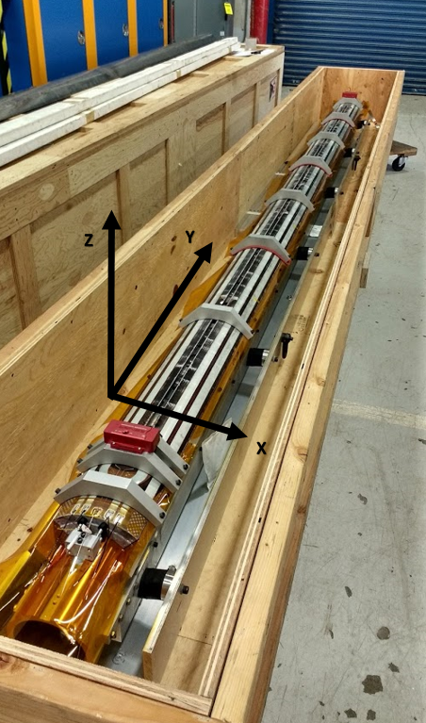
Coil Handling and Shipping
Handling (US-HiLumi-doc-820)
<500 micro-strain
dedicated lifting fixtures
Shipping (US-HiLumi-doc-1686)
<500 micro-strain, shocks <9 g
dedicated shipping fixtures
2 accelerometers on the LE and RE
5g and 10 g shock watches
Air ride dedicated truck

Slide 32
QXFA110 Heat Treatment Average

Slide 33
QXFA111 Heat Treatment Average

Slide 34
Epoxy Impregnation Cycle
Degassing: 20C to 100C at 8C/hr (640 min.)
Cool down: 100C to 50C at 1.7C/hr (1764 min.)
Fill+prep for cure: hold at 50C about 8 hours (480 min.)
Wicking ramp: 50C to 55C at 3C/hr (100 min.)
Hold wicking at 55C for 16 hours (960 min.)
Cure ramp: 55C to 110C at 5C/hr (660 min.)
Hold cure at 110C for 5 hours (300 min.)
Post-Cure ramp: 110C to 125C at 2.5C/hr (360 min.)
Hold post-cure at 125C for 16 hours (960 min.)
Cool down: 125C to 20C at 4.5C/hr (1400 min.)

Slide 35
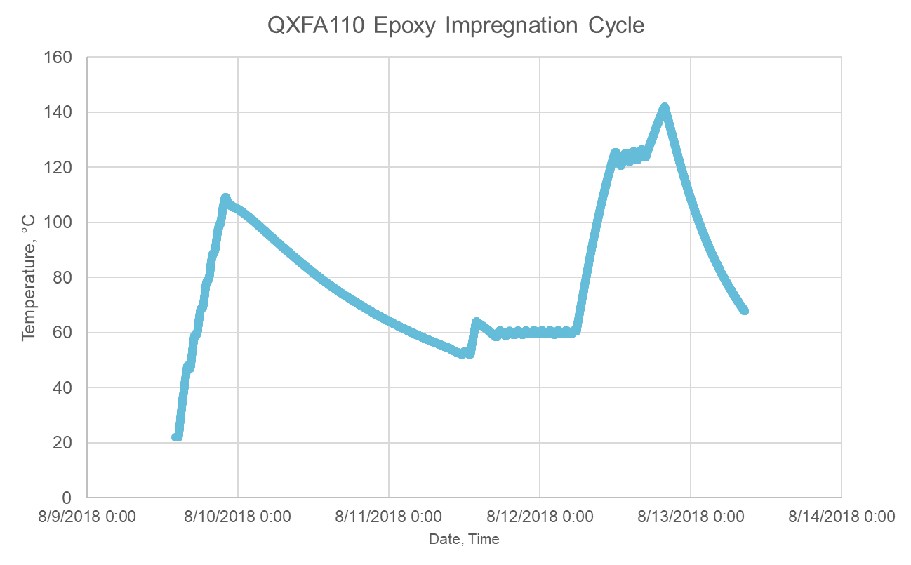
Coil Impregnation
2.5° C/hr
Cure, 5 hrs
5° C/hr
-4.5° C/hr
cooldown
~24 hours
-1.7° C/hr
8 C/hr
Wicking, 16 hrs
Fill
Degassing (> 1 day)

Slide 36
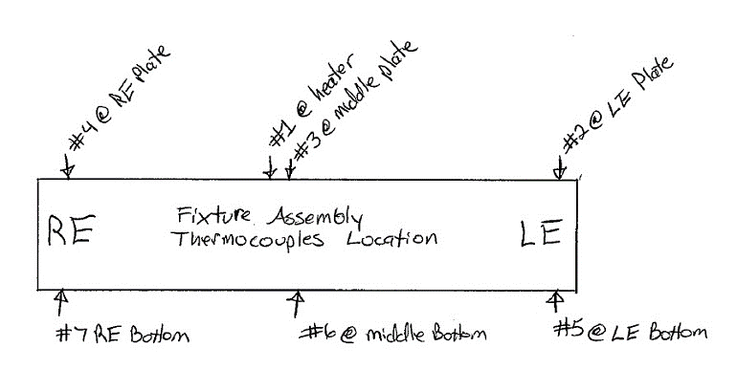
Impregnation T/C Map

Slide 37
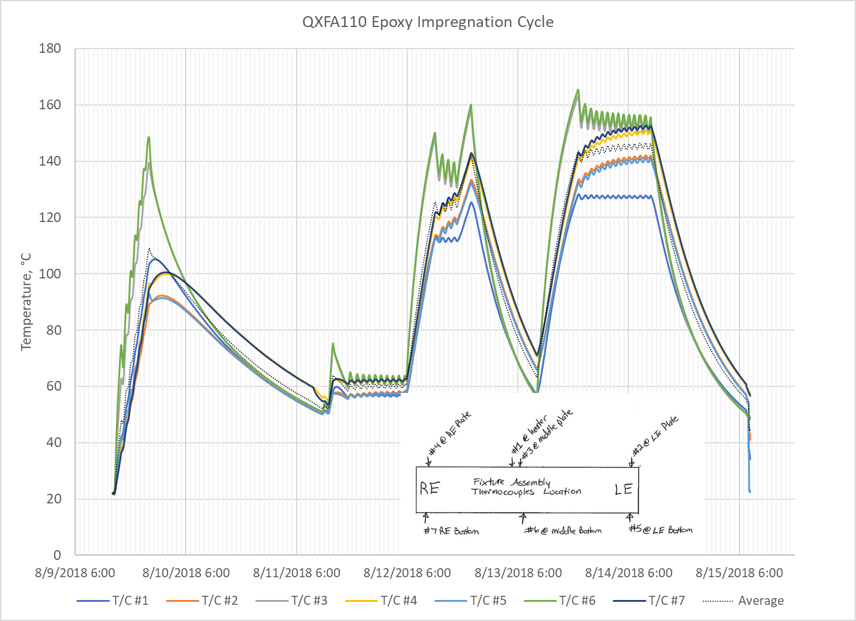
Coil Impregnation

Slide 38
QXFA109 vs QXFA110 Impregnation
Comparing coils A109 to A110 impregnation temperature plots, the control T/C for A110 was less than 10C higher at all temperature ramps than A109. Overall the average temperature profiles tracked each other very well. Therefore, the temperature difference between the ramp cycles might be variability in the process. It is small and acceptable. Visual inspection of the potted coil looks good. Electrical measurements have been completed. The plan is to set the over temperature T/C to 170C and repeat the impregnation process for coil A111.

Slide 39
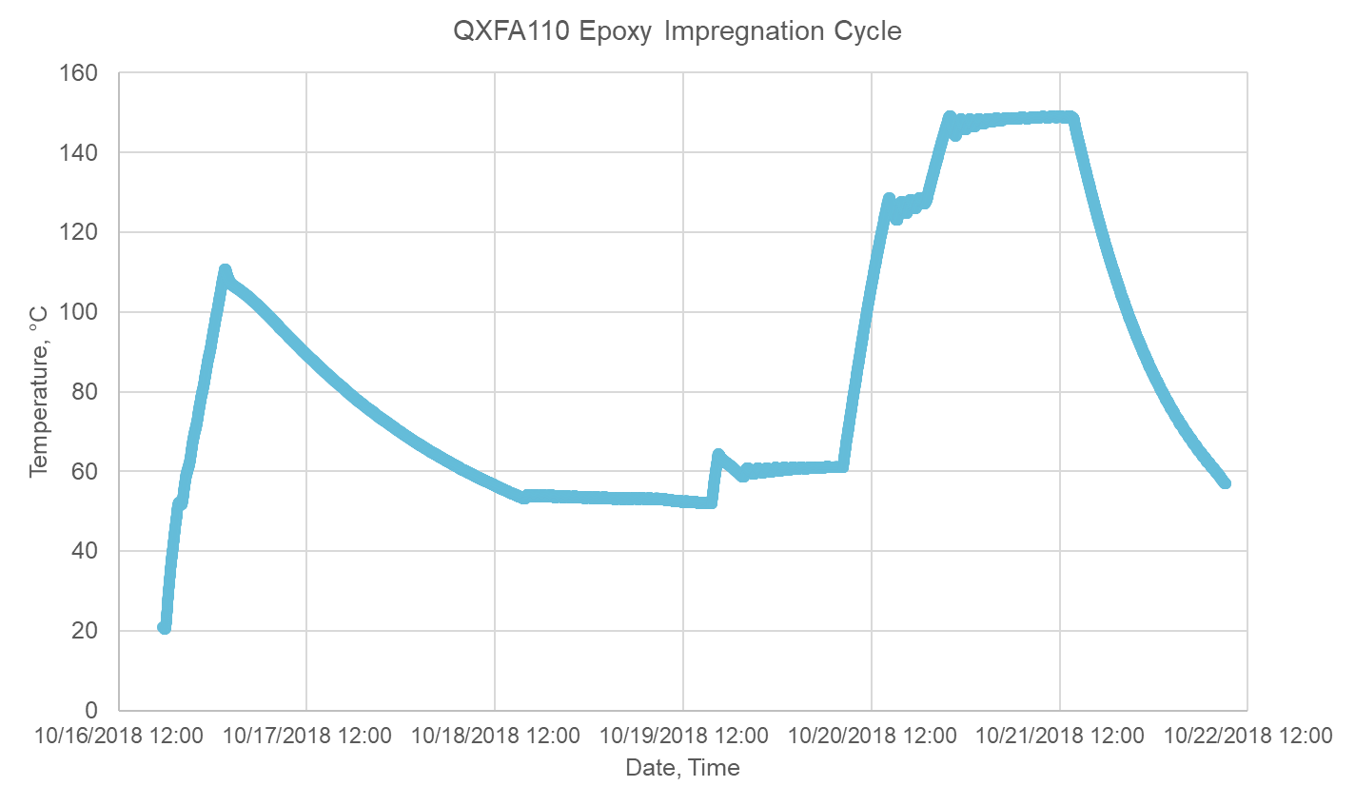
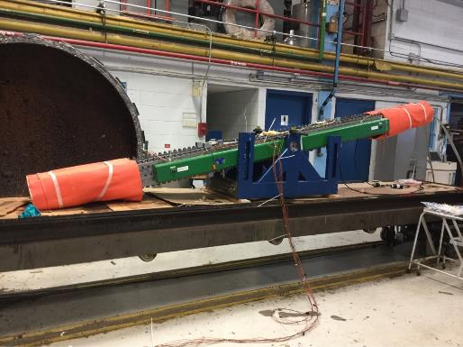
Coil Impregnation
Post-Cure, 16 hrs
2.5° C/hr
-4.5° C/hr
cooldown
~24 hours
Cure, 5 hrs
-1.7° C/hr
5° C/hr
8° C/hr
Wicking, 16 hrs
Fill
Degassing (> 1 day)

Slide 40
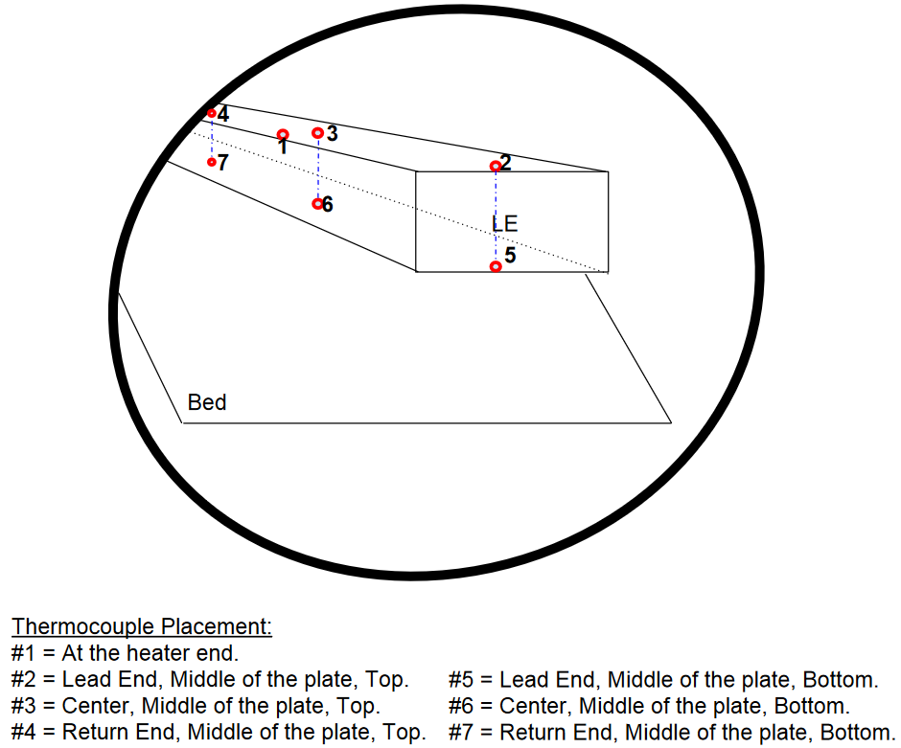
QXFA111 Epoxy Impregnation

Slide 41
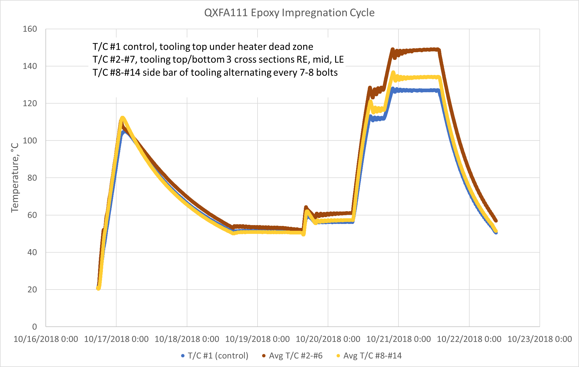
QXFA111 Epoxy Impregnation

