Slide 1
Review of MQXFA03 Coils and Shims
Introduction & Charge
Giorgio Ambrosio
Magnets L2
U.S. HL-LHC Accelerator Upgrade Project
Review of MQXFA03 Coils and Shims
March 14, 2019

Slide 2
Outline
Intro to HiLumi Inner Triplet quadrupoles
MQXFA Magnets, and specifications
Review
Charge

Slide 3
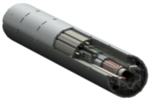
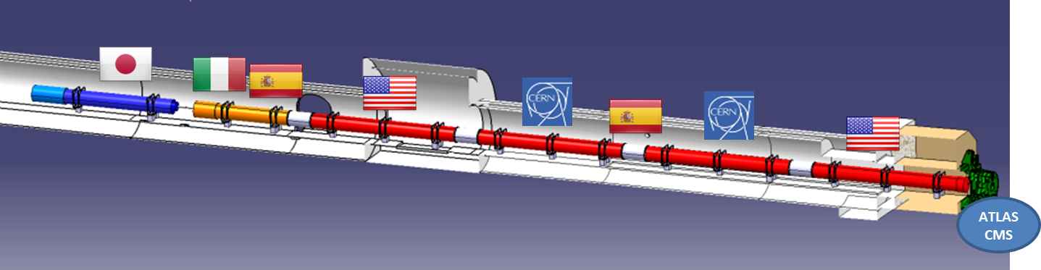
US Contribution to HL-LHC Inner Triplets
10 Q1/Q3 Cryo-assemblies
  20 Magnets (MQXFA) with 4.2 m magnetic length
  Two magnets in each cold mass
Q2 cold masses by CERN
  Magnetic length: 7.15 m (MQXFB)
Magnet
(MQXFA)
US cold mass

Slide 4
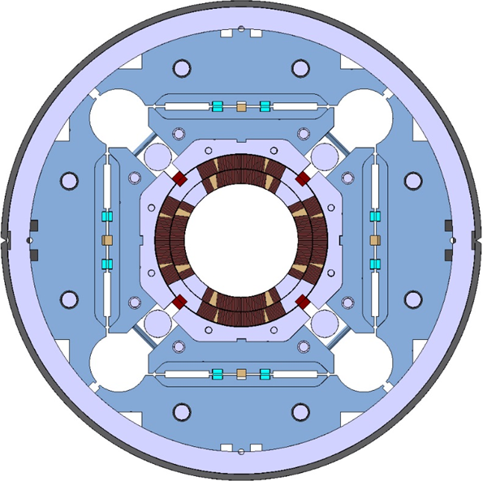
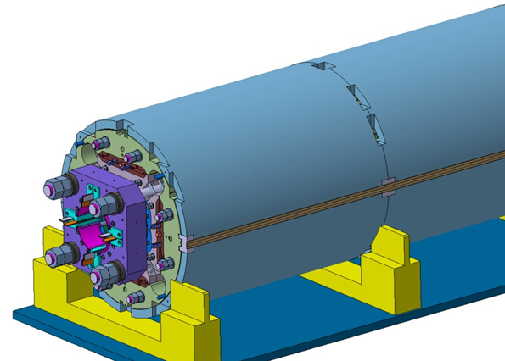
MQXFA/B Main Parameters
Parameter | Unit | MQXFA/B
Coil aperture | mm | 150
Magnetic length | m | 4.2/7.15
N. of layers |  | 2
N. of turns Inner-Outer layer |  | 22-28
Operation temperature | K | 1.9
Nominal gradient | T/m | 132.6
Nominal current | kA | 16.5
Peak field at nom. current | T | 11.4
Stored energy at nom. curr. | MJ/m | 1.2
Diff. inductance | mH/m | 8.2
Strand diameter | mm | 0.85
Strand number |  | 40
Cable width | mm | 18.15
Cable mid thickness | mm | 1.525
Keystone angle |  | 0.4
P. Ferracin et al., “Development of MQXF, the Nb₃Sn Low-β Quadrupole for the HiLumi LHC ” IEEE Trans App. Supercond. Vol. 26, no. 4, 4000207
G. Ambrosio et al., “MQXFS1 Quadrupole Design Report” LARP DocDB 1074

Slide 5
Acceptance Criteria for MQXFA Magnets
Acceptance Plan for Cryo-assembly has 3 parts with Acceptance Criteria:
Acceptance Criteria Part A for MQXFA magnets is approved by CERN
  EDMS# 2031083
  It contains the requirements
US-HiLumi-doc-1103

Slide 6
Acceptance Criteria (with examples)
Based on Acceptance Plan for MQXB magnets (present IT quads at LHC)
Content: Requirements, Verification Method, Procedure summary and References,

Slide 7
MQXFA Final Design Report
Final Design Report was reviewed by external team
FDR is on Review website
It contains Specifications for Strands, Cables and Coils
US-HiLumi-doc-948
Electronic signature on DocDB

Slide 8
Specifications at:
Strand: FDR pp. 11-12
Cable: FDR pp. 12-15
Coils dimensional: FDR pp. 70-71
  We plan to change coil length spec to 4532 +/- 5 mm
Coils electrical: QXFA Coil Fabrication Electrical QA
All docs on review Indico page

Slide 9

Review Goals
The HL-LHC AUP project is planning to start assembly of MQXFA03 magnet in April 2019. MQXFA03 is the first pre-series of the MQXFA low beta quadrupoles to be used in Q1 and Q3 for the High Luminosity LHC. If MQXFA03 meets MQXFA requirements [1] it will be used in the first Q1/Q3 cryo-assembly to be installed in the HL-LHC.
AUP is planning to use QXFA coils 109, 110, 111 and 202 for MQXFA03 assembly. The reviewers are requested to assess that the proposed coils (including the conductor) meet specifications [2], and to evaluate the impact of non-conformities in strands, cables and coils. The reviewers should also evaluate the proposed coil shim plan.
Acceptance Criteria Part A: MQXFA Magnet, US-HiLumi-doc-1103.
MQXFA Final Design Report, US-HiLumi-doc-948 sections 3 and 5.1.1;
and QXFA Coil Fabrication Electrical QA, US-HiLumi-doc-521 step 16.

Slide 10

CHARGE Questions - I
The committee is requested to answer the following questions:
Do coils 109, 110, 111, and 202 meet MQXFA coil specifications [2]?
Are conductor/coil fabrication and QC data of the proposed coils adequate for a thorough evaluation and for allowing MQXFA03 to meet MQXFA requirements [1]?
Are there major non-conformities? If answer is yes, have they been adequately documented and processed?

Slide 11
CHARGE Questions - II
Is the proposed coil-shim plan properly based on CMM measurements, including measurements of coil ends?
Is the proposed coil-shim plan adequate for allowing MQXFA03 to meet MQXFA requirements [1]?
Do you have any other comment or recommendation regarding conductor, coils or coil-shim plan for allowing MQXFA03 to meet MQXFA requirements [1]?

