Slide 1


Magnets 302.2.02 and 03 –
Strand Procurement and Testing
Cable Fabrication
Lance Cooley – FSU (302.2.02 L3)
Vito Lombardo – FNAL (302.2.02 CAM)
Ian Pong – LBNL (302.2.03 L3 and CAM)
Charlie Sanabria – LBNL (302.2.03 L3 and CAM Deputy)
Jonathan Lee – LBNL Intern Student

Slide 2
Outline
Cable Summary
Wire Summary
Cable and Wire Details for Each Coil
  Date and Lengths
  Strand and SS Core ID
  Respooling Wire Diameter
  Cable Mechanical QC
  Braiding Details
  Wire Parameters
    Supplier and Verification QC
    Extracted Strand RRR and Witness I_{C} and RRR
  SSL
Summary

Slide 3
Cable Summary
Coils used:
  202, 109, 110, 111
Corresponding cables:
  P43OL1092, P43OL1090, P43OL1091, P43OL1098
All cables are 2nd generation QXF cables with 108/127 RRP® strands procured under LARP
3 LARP cables, 1 AUP cable

Slide 4
Wire Summary
All “HiLumi” spec, procured by LARP under:
  FNAL PO 624035 Shipment C2
  FNAL PO 624035 Shipment D
  FNAL PO 632982 Shipment A
  FNAL PO 632982 Shipment B
0.85 mm, Ti-doped, reduced Sn
Procurement specification was US-HiLumi-Doc-40, Original Release on 5th of May 2015 (PO 624035); Modification to HT was applied to PO 632982, changing the final stage from 665°C for 75 h to 665°C for 50 h.
Total Volume under FNAL PO 624035 is 208 km; under FNAL PO 632982 is 400 km

Slide 5
Strand Procured by LARP and Supplier’s QC
A change of the heat treatment was approved in 2017 → shift in data
Final step from 665C 75hr to 665C 50hr
  4.9% reduction in I_{c}(15 T) for 14.7% gain in RRR (15% rolled)
Verification testing did not receive HT change notice in time
Round
Rolled
314 A
331 A

Slide 6
Billets in the LARP production run
PO624035
PO632982
AUP
A
B
C
D
Due to HT
Due to Test
Spec (round)
331 A
314 A
Spec (15% rolled)
Supplier is conservative by 2.1% after accounting for heat treatment
2.1% is comparable to the inter-lab test uncertainty (1.6 % in 2015) and past BNL-OST comparison (3% primarily due to strain).

Slide 7
P43OL1090 / Coil 109

Slide 8
P43OL1090 – Cable Date, Lengths
Cable Manufacture Date
  2017 10 27 (Production run)
Cable Length:
  455 m (LBNL, fabricated, including LBNL samples)
  443 m (Measured by FNAL)

Slide 9
P43OL1090 – Strand and SS Core ID
Spool:
  PO08S00157A01U x 4 ULs,
  PO08S00147A02U x 1 ULs,
  PO08S00162A03U x 1 ULs,
  PO08S00080A04U x 2 ULs,
  PO08S00110A01U x 5 ULs,
  PO08S00147A01U x 2 ULs,
  PO08S00147A03U x 5 ULs,
  PO08S00147A05U x 2 ULs,
  PO08S00147A06U x 4 ULs,
  PO08S00152A01U x 1 ULs,
  PO08S00155A02U x 4 ULs,
  PO08S00156A02U x 3 ULs,
  PO08S00162A04U x 4 ULs,
  PO08S00162A05U x 2 ULs,
Core:
  120L55A7322313
    Core width: 12.0 mm; material: 316L;
    Heat: 844979; Lot: 16-597;
    Chemical Properties CoT/CoC 172660-1: 0.14 wt% Co
From 8 billets

Slide 10
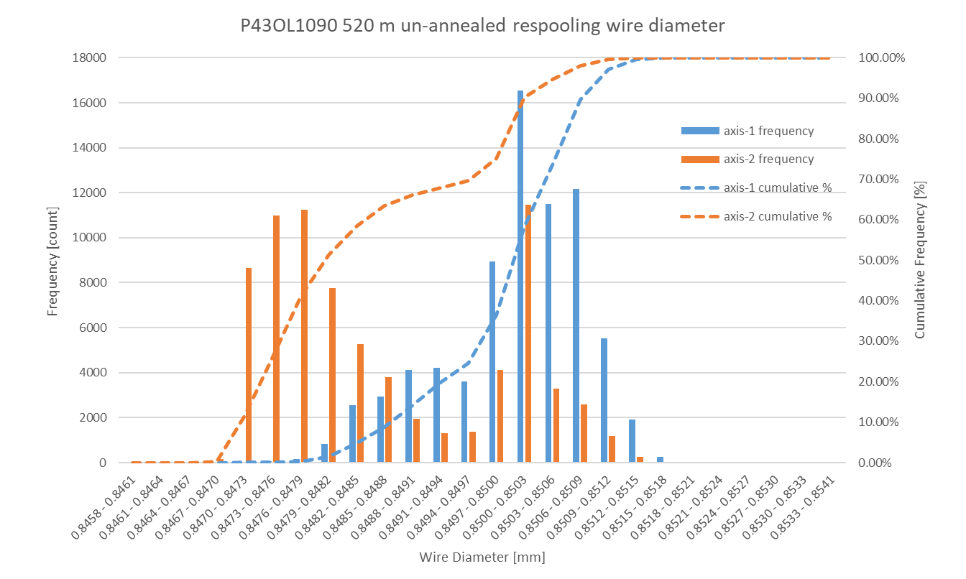
P43OL1090 Respooling Wire Diameter
Below LSL: 0.11%
Above USL: 0.00%
LSL: 0.847 mm
USL: 0.853 mm

Slide 11
P43OL1090 – Cable QC Data Summary
CME:
Residual Twist:
  90°
10-stack:
  Qualification: 1.532 mm
  Production tail end: 1.534 mm
 | Pressure (MPa) | Angle (°) | Width (mm) | Thickness (mm)
Maximum | 17.1 | 0.511 | 18.150 | 1.537
Average | 17.0 | 0.476 | 18.126 | 1.529
Minimum | 16.9 | 0.441 | 18.117 | 1.522
Sigma | 0.02 | 0.012 | 0.005 | 0.002

Slide 12
Rollers: P-91 (2017-08-18) and P-92 (2017-08-18)
DR number: 11358

Slide 13
Rollers: P-91 (2017-08-18) and P-92 (2017-08-18)

Slide 14
DR number: 11358

Slide 15
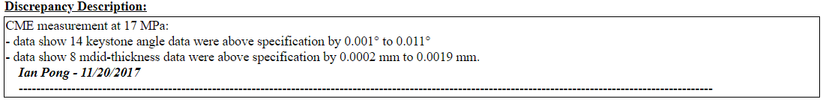
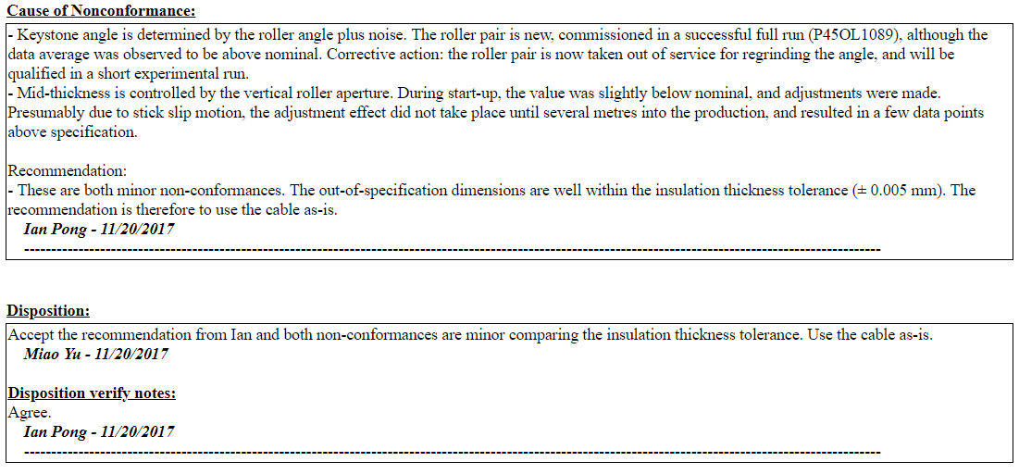
DR number: 11358

Slide 16
P43OL1090 – Braiding
Fibreglass Lot #91309
P/I: 18.9
Spool tension: 10 lbs. (payoff); 12 lbs. (takeup)
Bobbin payoff tension: 0.250 lbs. (min), 0.375 lbs. (max)
NEWT 10-stack QC:
  Cycle #1) 0.150 mm; #2) 0.148 mm; #3) 0.146 mm;
  Mean 0.148 mm
LBNL 10-stack verification QC:
  Cycle #1) 0.144 mm; #2) 0.142 mm; #3) 0.141 mm;
  Mean 0.143 mm
Vector #464342

Slide 17
P43OL1090 – Wire Parameters
Properties | Inspected Average
Wire Diameter | 0.850 ± 0.001 mm (LBNL)¹
Cu ratio ª | 53.8% (OST)
Strand twist pitch ª | 18.7 mm (OST)
RRR (RW) ª | 349 (OST)
RRR (15% rolled) ª | 207 (OST)
I_{C} (4.2 K, 15 T) ª | 376 A (OST)
I_{C} (4.2 K, 14 T) ª | 471 A (OST)
I_{C} (4.2 K, 13 T) ª | 579 A (OST)
I_{C} (4.2 K, 12 T) ª | 702 A (OST)
ª First billet averaged, then weighted average according
to the spool distribution in the cable
¹ As-received, all LBNL respooling data; mean ± 1 sigma

Slide 18
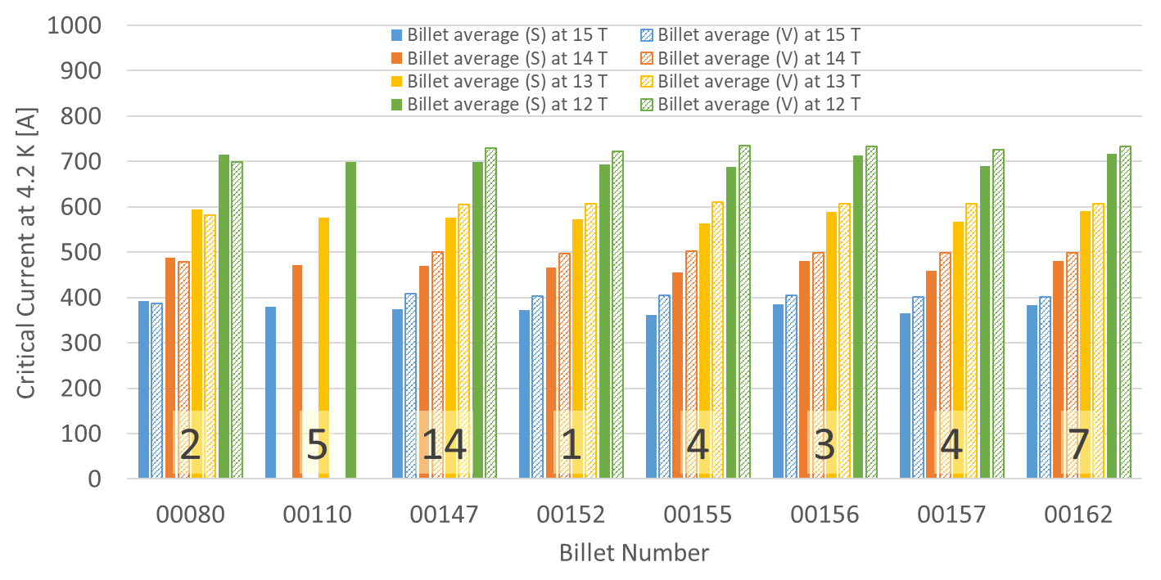
P43OL1090 – Wire Parameters
Supplier (S) and Verification (V) I_{C} Data
Table / graph of Ic and RRR
Number of spools from that billet used in the cable

Slide 19
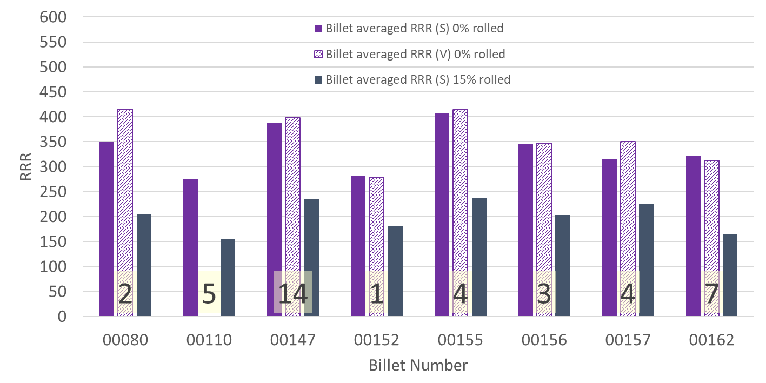
P43OL1090 – Wire Parameters
Supplier (S) and Verification (V) RRR Data
Number of spools from that billet used in the cable

Slide 20
P43OL1090 – Extracted Strand RRR
 | Cable ID | No. of Units from Billet (spool) | HT/sample ID | RRR
ID #1 | P43OL1090AE13E PO08S00110A01U | 5 (5) | FRFC180502 | 278
ID #2 | P43OL1090AE27E PO08S00147A03U | 14 (5) | FRFC180502 | 350
ID #3 | P43OL1090AE42E PO08S00155A02U | 4 (4) | FRFC180502 | 371
ID #4 | P43OL1090AE01E PO08S00157A01U | 4 (4) | FRFC180502 | 284
ID #5 | P43OL1090AE55E PO08S00162A04U | 7 (4) | FRFC180502 | 237
ID #6 | P43OL1090AE35E PO08S00147A06U | 14 (4) | FRFC180502 | 299
Vector #464342

Slide 21
P43OL1090 – Witness Samples
Sample ID | No. of Units from Billet (Spool) | I_{c,} I_{q} (15 T) | I_{c,} I_{q} (14 T) | I_{c,} I_{q} (13 T) | I_{c,} I_{q} (12 T) | RRR (20 K) | RRR IEC
PO08S00147A03U | 14 (5) | 394 410 | 485 505 | 593 612 | 717 734 | 193 | 217
PO08S00162A04U | 7 (4) | 410 421 | 509 522 | 617 633 | 743 760 | 201 | 220
P43OL1090AE24E PO08S00147A03U | 14 (5) | 375 375 | 464 464 | 562 563 | 682 676 | 164 | 180
P43OL1090AE25E PO08S00147A03U | 14 (5) | 359 370 | 450 454 | 551 551 | 657 661 | 127 | 137
P43OL1090AE53E PO08S00162A04U | 7 (4) | 366 373 | 460 461 | 570 570 | 684 689 | 147 | 157
P43OL1090AE54E PO08S00162A04U | 7 (4) | 382 386 | 467 477 | 567 581 | 717 699 | 133 | 144

Slide 22
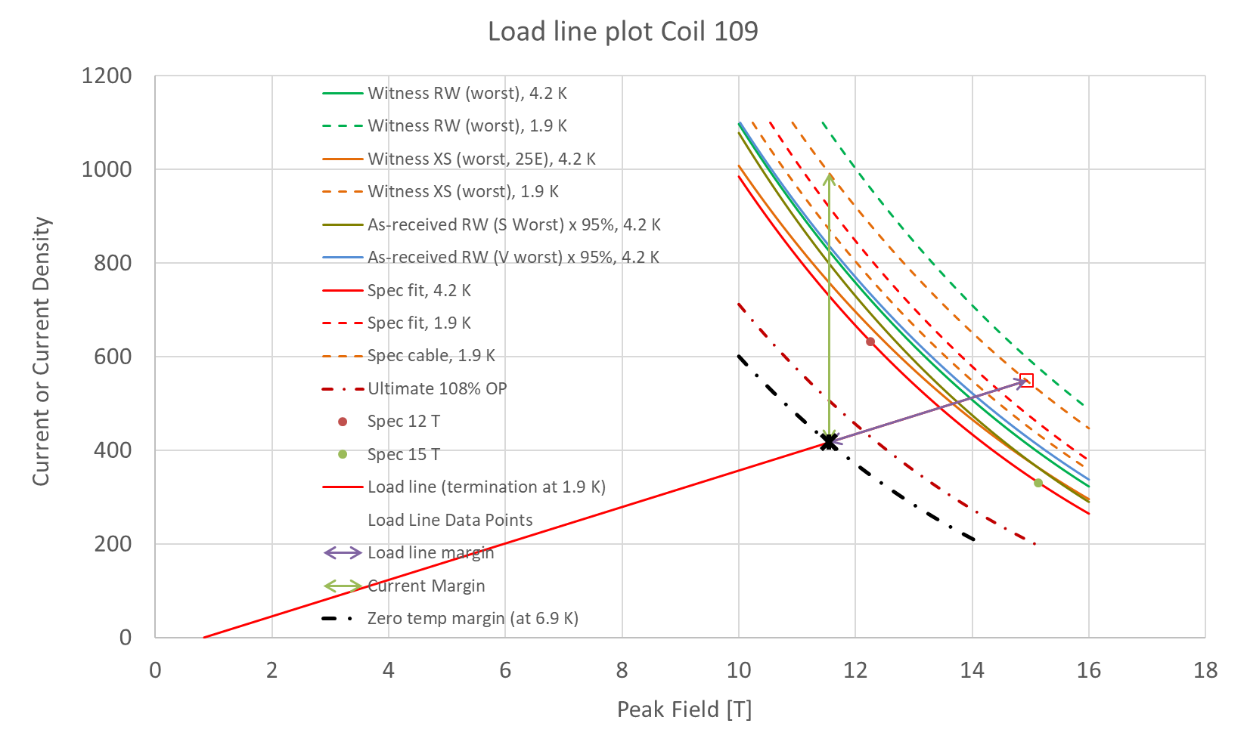
SSL
graph

Slide 23
SSL
Requirements in red
1.9 K SSL intercept 14.94 T, 21.95 kA
16.5 kA Operating point at 75.0% SSL (< 80%)
SSL crosses 11.4 T, 16.5 kA @ T_{CS} = 7.0 K (> 6.1 K)
T_{CS} – T_{OP} = 5.1 K (4.2 K)
Cable I_{C} at 11.4 T = 40.57 kA
16.5 kA I_{OP} = 40.6% Cable I_{C}
RECOMMENDATION: PROCEED

Slide 24
P43OL1091 / Coil 110

Slide 25
P43OL1091 – Cable Date, Lengths
Cable Manufacture Date
  2017 11 02 (Production run)
Cable Length:
  465 m (LBNL, fabricated, including LBNL samples)
  441 m (Measured by FNAL)

Slide 26
P43OL1091 – Strand and SS Core ID
Spool:
  PO08S00153A02U x 13 ULs,
  PO08S00156A03U x 13 ULs,
  PO08S00159A02U x 14 ULs,
Core:
  120L54A7322313
    Core width: 12.0 mm; material: 316L;
    Heat: 844979; Lot: 16-597;
    Chemical Properties CoT/CoC 172660-1: 0.14 wt% Co

Slide 27
P43OL1091 Respooling Wire Diameter
Below LSL: 0.00%
Above USL: 0.00%
LSL: 0.847 mm
USL: 0.853 mm

Slide 28
P43OL1091 – QC Data Summary
CME:
Residual Twist:
  120°
10-stack:
  Qualification: 1.536 mm
  Production tail end: 1.535 mm
 | Pressure (MPa) | Angle (°) | Width (mm) | Thickness (mm)
Maximum | 17.1 | 0.411 | 18.149 | 1.534
Average | 17.0 | 0.385 | 18.122 | 1.528
Minimum | 16.9 | 0.357 | 18.112 | 1.525
Sigma | 0.01 | 0.009 | 0.004 | 0.002

Slide 32
P43OL1091 – Braiding
Fibreglass Lot #91309
P/I: 18.0
Spool tension: 10 lbs. (payoff); 12 lbs. (takeup)
Bobbin payoff tension: 0.125 lbs. (min), 0.250 lbs. (max)
NEWT 10-stack QC:
  Cycle #1) 0.148 mm; #2) 0.144 mm; #3) 0.142 mm;
  Mean 0.145 mm
LBNL 10-stack verification QC:
  Cycle #1) 0.149 mm; #2) 0.144 mm; #3) 0.143 mm;
  Mean 0.145 mm
Vector #464342

Slide 33
P43OL1091 – Wire Parameters
Properties | Inspected Average
Wire Diameter | 0.849 ± 0.001 mm (LBNL)¹
Cu ratio ª | 53.5% (OST)
Strand twist pitch ª | 18.3 mm (OST)
RRR (RW) ª | 357 (OST)
RRR (15% rolled) ª | 234 (OST)
I_{C} (4.2 K, 15 T) ª | 378 A (OST)
I_{C} (4.2 K, 14 T) ª | 474 A (OST)
I_{C} (4.2 K, 13 T) ª | 582 A (OST)
I_{C} (4.2 K, 12 T) ª | 706 A (OST)
ª First billet averaged, then weighted average according
to the spool distribution in the cable
¹ As-received, all LBNL respooling data; mean ± 1 sigma

Slide 34
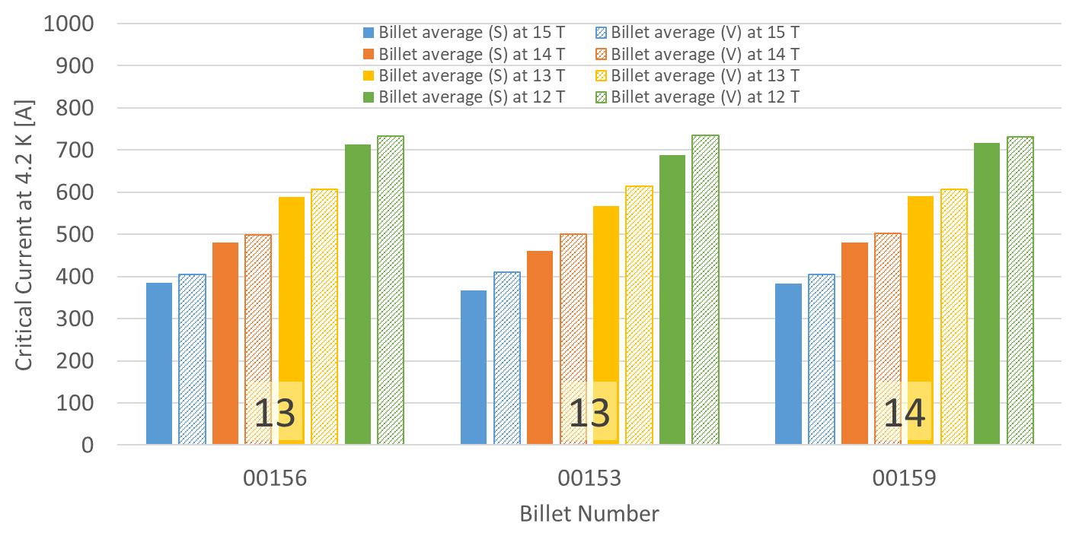
P43OL1091 – Wire Parameters
Supplier (S) and Verification (V) I_{C} Data
Number of spools from that billet used in the cable

Slide 35
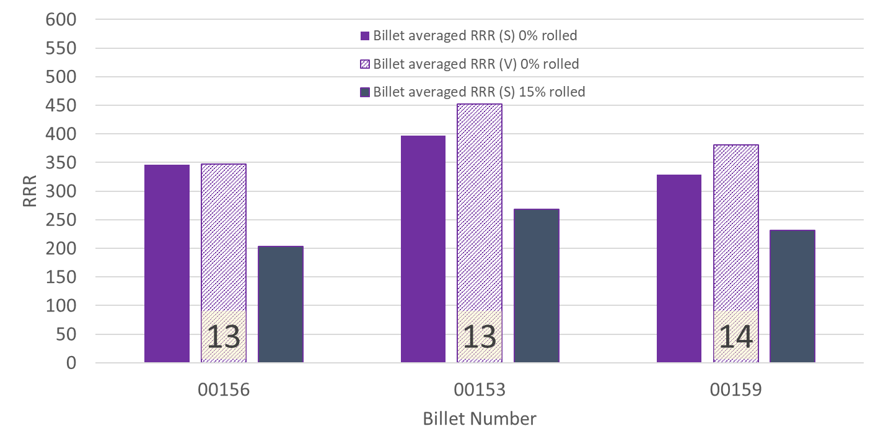
P43OL1091 – Wire Parameters
Supplier (S) and Verification (V) RRR Data
Number of spools from that billet used in the cable

Slide 36
P43OL1091 – Extracted Strand RRR
 | Cable ID | No. of Units from Billet (spool) | HT/sample ID | RRR
ID #1 | P43OL1091AE05E PO08S00153A02U | 13 (13) | FRFC180502 | 352
ID #2 | P43OL1091AE06E PO08S00153A02U | 13 (13) | FRFC180502 | 378
ID #3 | P43OL1091AE21E PO08S00156A03U | 13 (13) | FRFC180502 | 284
ID #4 | P43OL1091AE23E PO08S00156A03U | 13 (13) | FRFC180502 | 294
ID #5 | P43OL1091AE43E PO08S00159A02U | 14 (14) | FRFC180502 | 310
ID #6 | P43OL1091AE45E PO08S00159A02U | 14 (14) | FRFC180502 | 304
Vector #464342

Slide 37
P43OL1091 – Witness Samples
Sample ID | No. of Units from Billet (Spool) | I_{c,} I_{q} (15 T) | I_{c,} I_{q} (14 T) | I_{c,} I_{q} (13 T) | I_{c,} I_{q} (12 T) | RRR (20 K) | RRR IEC
PO08S00153A02U | 13 (13) | 401 408 | 501 505 | 610 616 | 732 742 | 206 | 234
P43OL1091AE01E PO08S00153A02U | 13 (13) | 391 394 | 487 487 | 592 591 | 710 710 | 166 | 188
P43OL1091AE41E PO08S00159A02U | 14 (14) | 385 383 | 479 475 | - 580 | 701 699 | 141 | 152
P43OL1091AE42E PO08S00159A02U | 14 (14) | 387 388 | 482 481 | 587 586 | 707 707 | 155 | 170

Slide 38
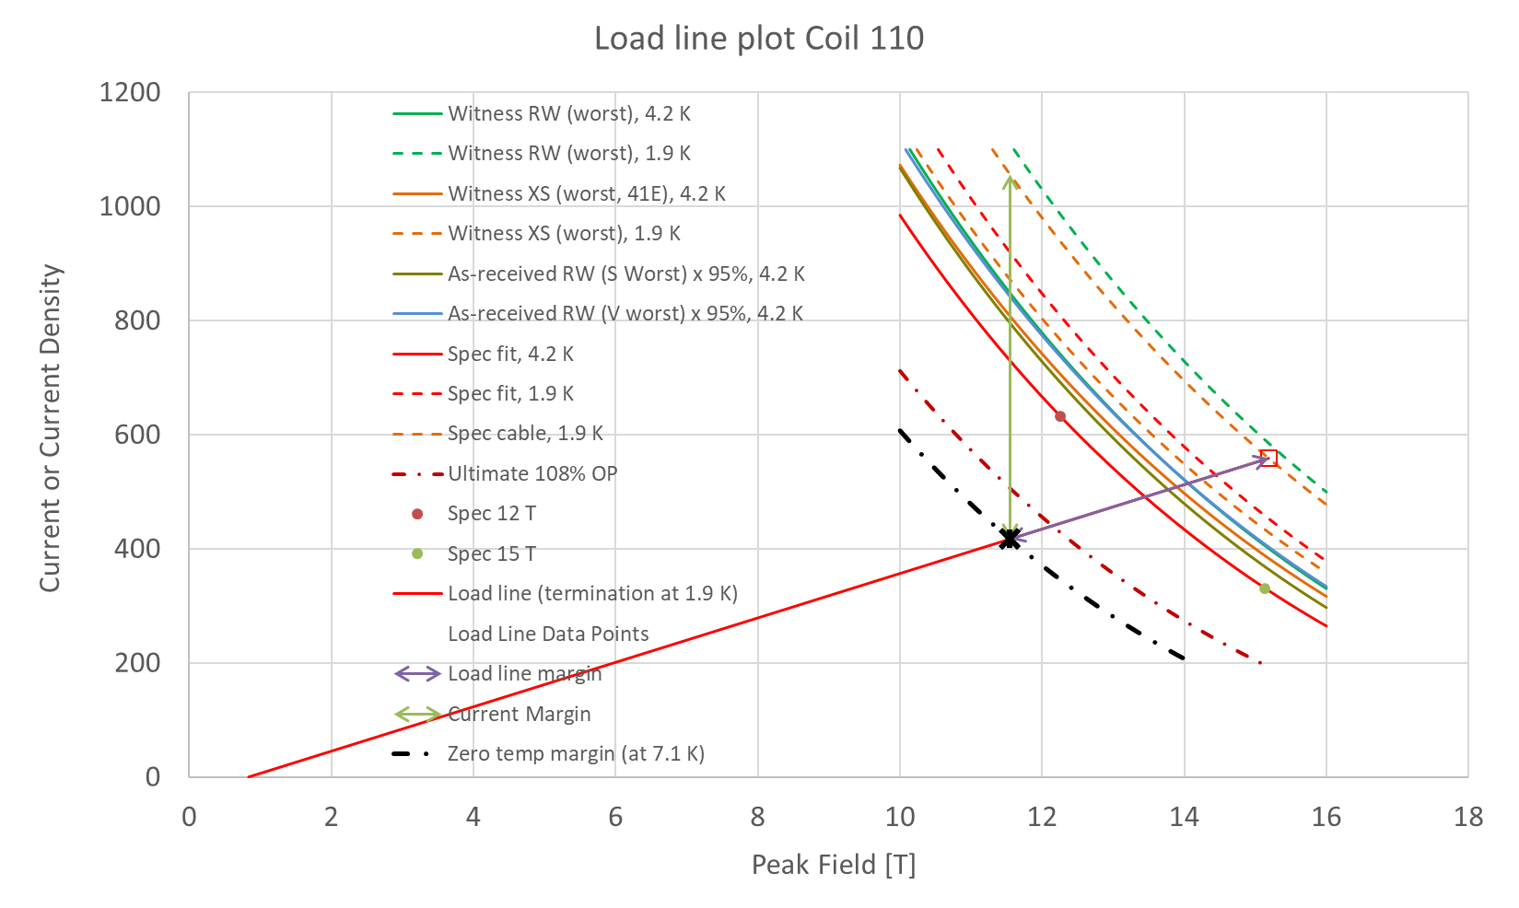
SSL

Slide 39
SSL
Requirements in red
1.9 K SSL intercept 15.19 T, 22.34 kA
16.5 kA Operating point at 73.7% SSL (< 80%)
SSL crosses 11.4 T, 16.5 kA @ T_{CS} = 7.2 K (> 6.1 K)
T_{CS} – T_{OP} = 5.3 K (4.2 K)
Cable I_{C} at 11.4 T = 43.19 kA
16.5 kA I_{OP} = 38.1% Cable I_{C}
RECOMMENDATION: PROCEED

Slide 40
P43OL1092 / Coil 202

Slide 41
P43OL1092 – Cable Date, Lengths
Cable Manufacture Date
  2017 11 13 (Production Run)
Cable Length:
  468 m (LBNL, fabricated, including LBNL samples)

Slide 42
P43OL1092 – Strand and SS Core ID
Spool:
  PO08S00078A04U x 1 ULs,
  PO08S00119A03U x 8 ULs,
  PO08S00153A01U x 5 ULs,
  PO08S00155A01U x 5 ULs,
  PO08S00155A03U x 7 ULs,
  PO08S00157A10U x 5 ULs,
  PO08S00159A01U x 2 ULs,
  PO08S00162A02U x 5 ULs,
  PO08S00162A06U x 2 ULs,
Core:
  120L52A7322313
    Core width: 12.0 mm; material: 316L;
    Heat: 844979; Lot: 16-597;
    Chemical Properties CoT/CoC 172660-1: 0.14 wt% Co
From 7 billets

Slide 43
P43OL1092 Respooling Wire Diameter
Below LSL: 0.18%
Above USL: 0.00%
LSL: 0.847 mm
USL: 0.853 mm

Slide 44
P43OL1092 – QC Data Summary
CME:
Residual Twist:
  100°
10-stack:
  Qualification: 1.540 mm
  Production tail end: 1.535 mm
 | Pressure (MPa) | Angle (°) | Width (mm) | Thickness (mm)
Maximum | 17.1 | 0.403 | 18.156 | 1.536
Average | 17.0 | 0.375 | 18.134 | 1.530
Minimum | 16.9 | 0.344 | 18.126 | 1.526
Sigma | 0.01 | 0.010 | 0.003 | 0.002

Slide 47
DR number: 11359

Slide 48
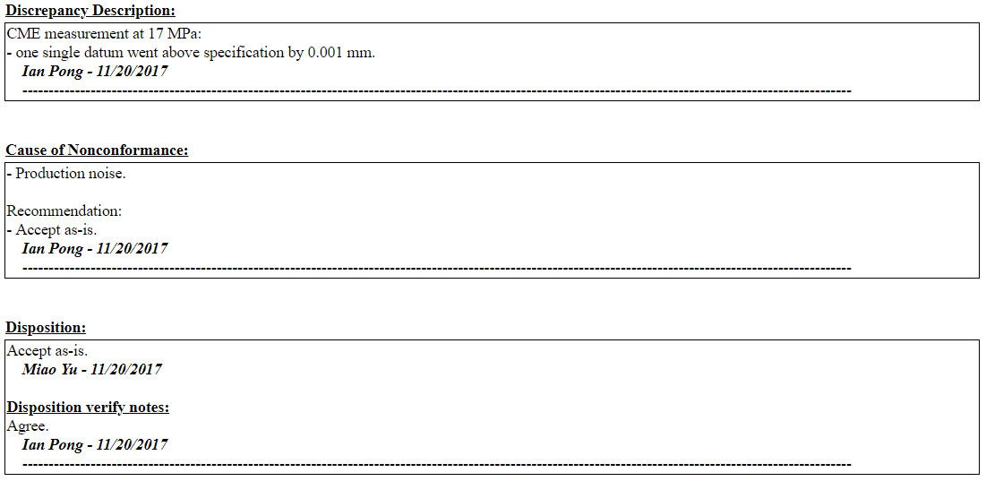
DR number: 11359

Slide 49
P43OL1092 – Braiding
Fibreglass Lot #91309
P/I: 18.0
Spool tension: 10 lbs. (payoff); 12 lbs. (takeup)
Bobbin payoff tension: 0.125 lbs. (min), 0.250 lbs. (max)
NEWT 10-stack QC:
  Cycle #1) 0.151 mm; #2) 0.148 mm; #3) 0.146 mm;
  Mean 0.148 mm
LBNL 10-stack verification QC:
  Cycle #1) 0.148 mm; #2) 0.145 mm; #3) 0.141 mm;
  Mean 0.145 mm
Vector #464342

Slide 50
P43OL1092 – Wire Parameters
Properties | Inspected Average
Wire Diameter | 0.850 ± 0.001 mm (LBNL)¹
Cu ratio ª | 53.6% (OST)
Strand twist pitch ª | 19.1 mm (OST)
RRR (RW) ª | 342 (OST)
RRR (15% rolled) ª | 204 (OST)
I_{C} (4.2 K, 15 T) ª | 373 A (OST)
I_{C} (4.2 K, 14 T) ª | 468 A (OST)
I_{C} (4.2 K, 13 T) ª | 577 A (OST)
I_{C} (4.2 K, 12 T) ª | 700 A (OST)
ª First billet averaged, then weighted average according
to the spool distribution in the cable
¹ As-received, all LBNL respooling data; mean ± 1 sigma

Slide 51
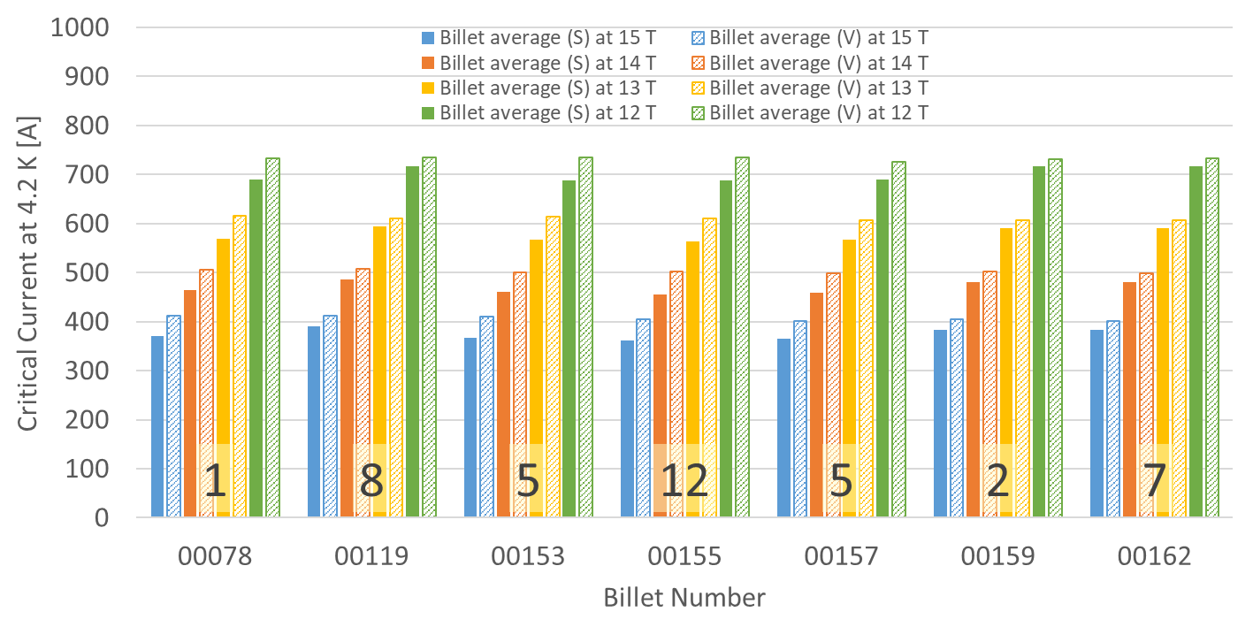
P43OL1092 – Wire Parameters
Supplier (S) and Verification (V) I_{C} Data
Number of spools from that billet used in the cable

Slide 52
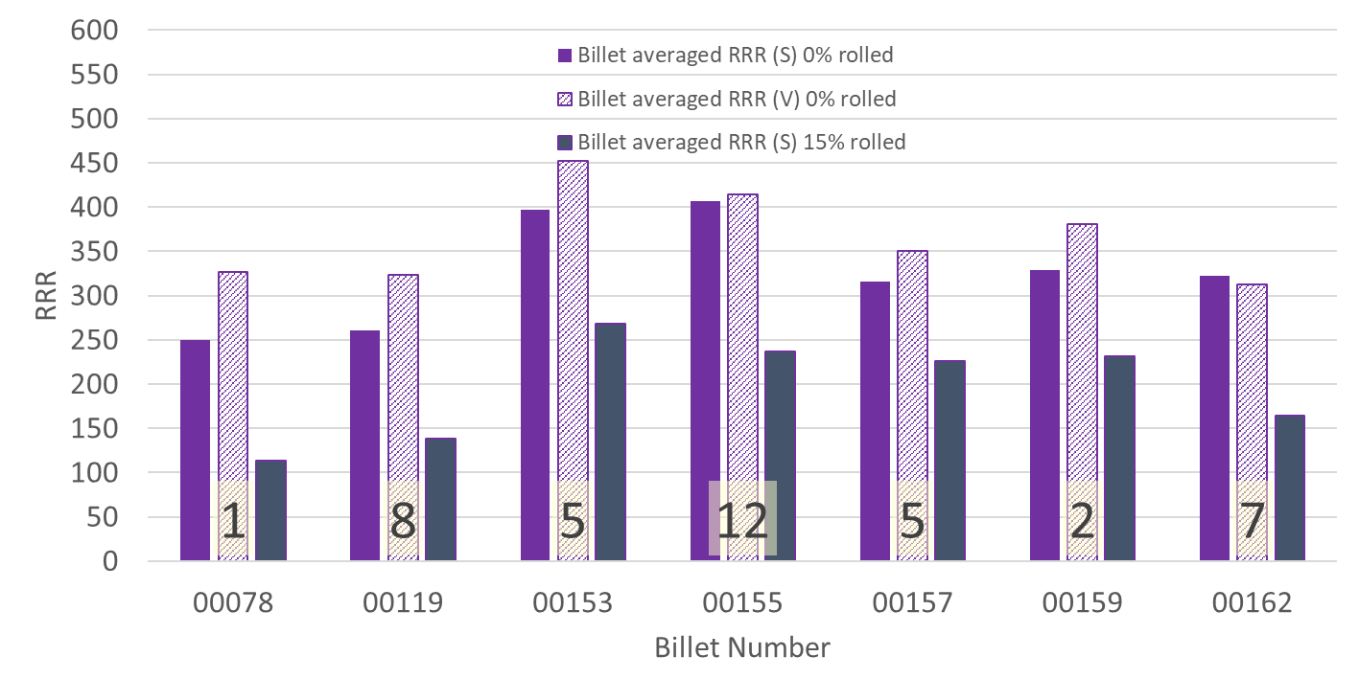
P43OL1092 – Wire Parameters
Supplier (S) and Verification (V) RRR Data
Number of spools from that billet used in the cable

Slide 53
P43OL1092 – Extracted Strand RRR
 | Cable ID | No. of Units from Billet (spool) | HT/sample ID | RRR
ID #1 | P43OL1092AE06E PO08S00119A03U | 8 (8) | FRFC180502 | 258
ID #2 | P43OL1092AE15E PO08S00153A01U | 5 (5) | FRFC180502 | 410
ID #3 | P43OL1092AE23E PO08S00155A01U | 12 (5) | FRFC180502 | 425
ID #4 | P43OL1092AE41E PO08S00157A10U | 5 (5) | FRFC180502 | 284
ID #5 | P43OL1092AE51E PO08S00162A02U | 7 (5) | FRFC180502 | 315
ID #6 | P43OL1092AE33E PO08S00155A03U | 12 (7) | FRFC180502 | 359
Vector #464342

Slide 54
P43OL1092 – Witness Samples
Sample ID | No. of Units from Billet (Spool) | I_{c,} I_{q} (15 T) | I_{c,} I_{q} (14 T) | I_{c,} I_{q} (13 T) | I_{c,} I_{q} (12 T) | RRR (20 K) | RRR IEC
PO08S00119A03U | 8 (8) | 419 428 | 515 526 | 625 635 | 747 762 | 294 | 335
P43OL1092AE03E PO08S00119A03U | 8 (8) | 405 413 | 499 502 | 605 611 | 725 730 | 261 | 289
P43OL1092AE30E PO08S00155A03U | 12 (7) | 400 409 | 496 496 | 604 613 | 727 736 | 343 | 387

Slide 55
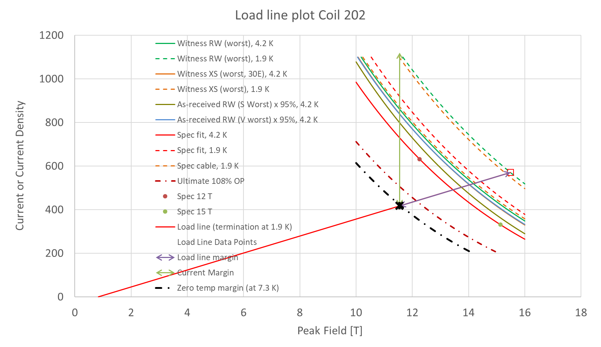
SSL

Slide 56
SSL
Requirements in red
1.9 K SSL intercept 15.49 T, 22.82 kA
16.5 kA Operating point at 72.2% SSL (< 80%)
SSL crosses 11.4 T, 16.5 kA @ T_{CS} = 7.5 K (> 6.1 K)
T_{CS} – T_{OP} = 5.6 K (4.2 K)
Cable I_{C} at 11.4 T = 45.78 kA
16.5 kA I_{OP} = 36.0% Cable I_{C}
RECOMMENDATION: PROCEED

Slide 57
P43OL1098 / Coil 111

Slide 58
P43OL1098 – Cable Date, Lengths
Cable Manufacture Date
  2018 02 26 (Production run)
Cable Length:
  468 m (LBNL, fabricated, including LBNL samples)
  445 m (Measured by FNAL)

Slide 59
P43OL1098 – Strand and SS Core ID
Spool:
  PO08S00192A03U x 10 ULs,
  PO08S00207A02U x 15 ULs,
  PO08S00214A03U x 15 ULs,
Core:
  120L47A7322313
    Core width: 12.0 mm; material: 316L;
    Heat: 844979; Lot: 16-597;
    Chemical Properties CoT/CoC 172660-1: 0.14 wt% Co

Slide 60
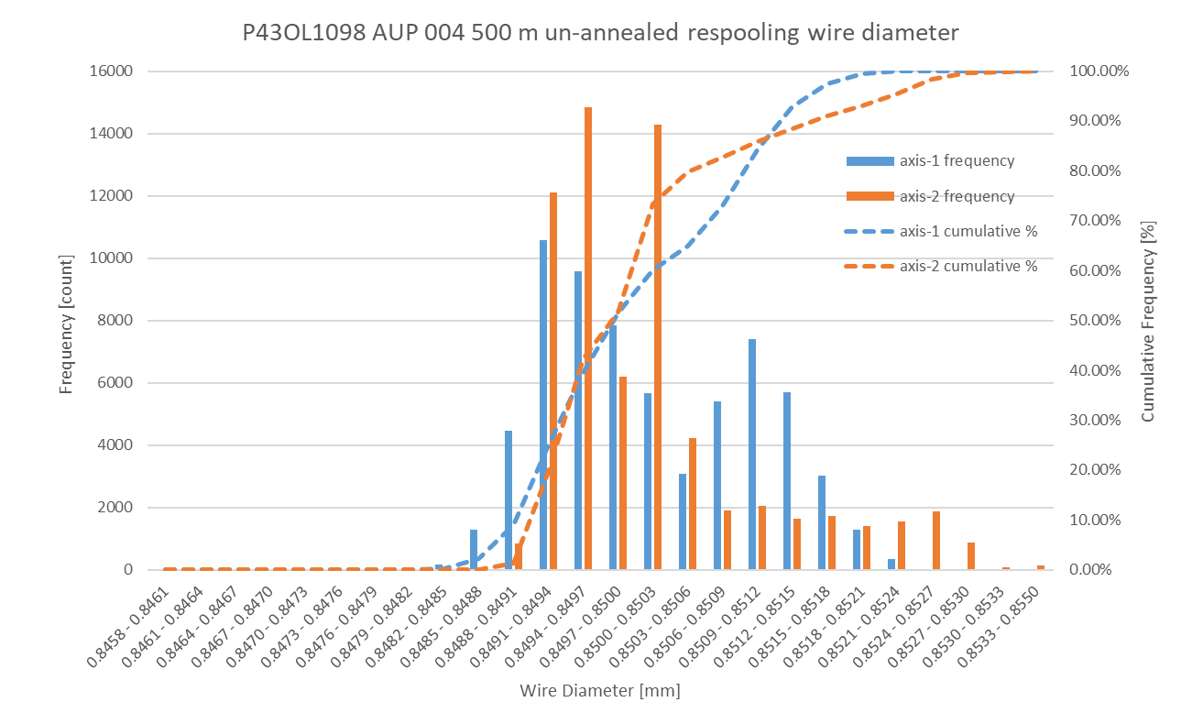
P43OL1098 Respooling Wire Diameter
Below LSL: 0.00%
Above USL: 0.11%
LSL: 0.847 mm
USL: 0.853 mm

Slide 61
P43OL1098 – QC Data Summary
CME:
Residual Twist:
  135°
10-stack:
  Qualification: 1.529 mm
  Production tail end: 1.533 mm
 | Pressure (MPa) | Angle (°) | Width (mm) | Thickness (mm)
Maximum | 17.1 | 0.458 | 18.168 | 1.531
Average | 17.0 | 0.435 | 18.153 | 1.524
Minimum | 17.0 | 0.411 | 18.146 | 1.520
Sigma | 0.01 | 0.008 | 0.004 | 0.002

Slide 64
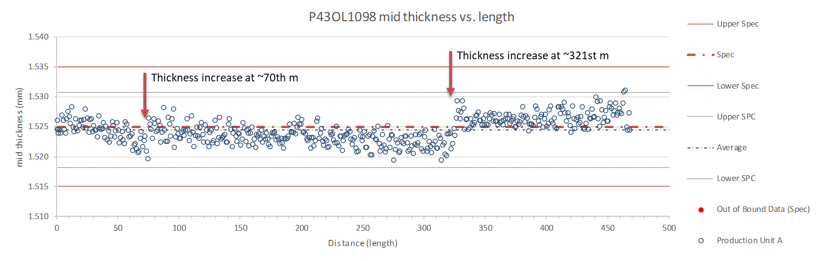

Slide 65
P43OL1098 – Braiding
Fibreglass Lot #100104
P/I: 19.6
Spool tension: 10 lbs. (payoff); 12 lbs. (takeup)
Bobbin payoff tension: 0.125 lbs. (min), 0.250 lbs. (max)
NEWT 10-stack QC:
  Cycle #1) 0.150 mm; #2) 0.147 mm; #3) 0.146 mm;
  Mean 0.148 mm
LBNL 10-stack verification QC:
  Cycle #1) 0.150 mm; #2) 0.147 mm; #3) 0.146 mm;
  Mean 0.148 mm
Vector #464342

Slide 66
P43OL1098 – Wire Parameters
Properties | Inspected Average
Wire Diameter | 0.850 ± 0.001 mm (LBNL)¹
Cu ratio ª | 53.8% (OST)
Strand twist pitch ª | 18.9 mm (OST)
RRR (RW) ª | 353 (OST)
RRR (15% rolled) ª | 246 (OST)
I_{C} (4.2 K, 15 T) ª | 372 A (OST)
I_{C} (4.2 K, 14 T) ª | 464 A (OST)
I_{C} (4.2 K, 13 T) ª | 570 A (OST)
I_{C} (4.2 K, 12 T) ª | 690 A (OST)
ª First billet averaged, then weighted average according
to the spool distribution in the cable
¹ As-received, all LBNL respooling data; mean ± 1 sigma

Slide 67
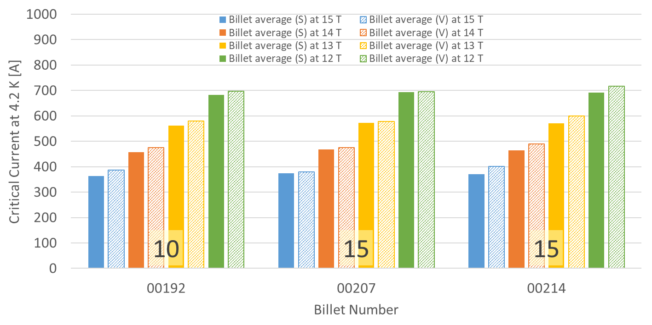
P43OL1098 – Wire Parameters
Supplier (S) and Verification (V) I_{C} Data
Number of spools from that billet used in the cable

Slide 68
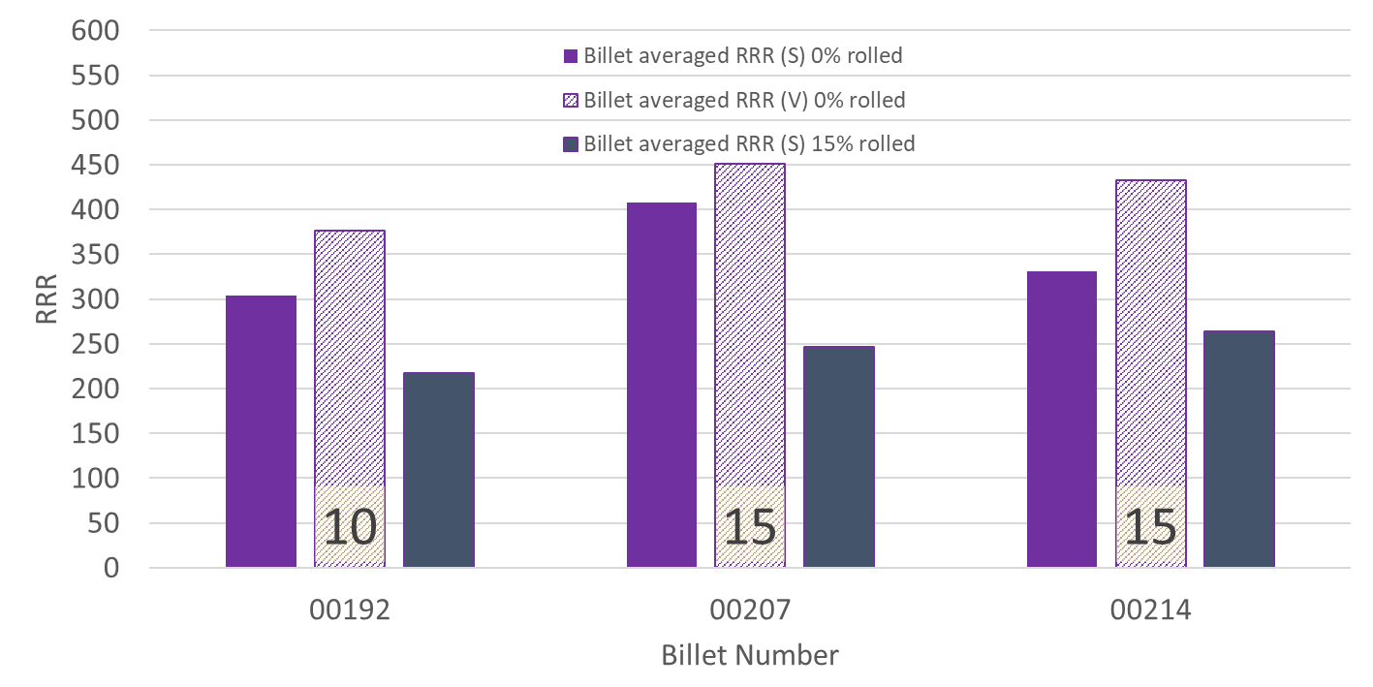
P43OL1098 – Wire Parameters
Supplier (S) and Verification (V) RRR Data
Number of spools from that billet used in the cable

Slide 69
P43OL1098 – Extracted Strand RRR
 | Cable ID | No. of Units from Billet (Spool) | HT/Sample ID | Major (Minor) Edge RRR | Straight Section 1 (2) RRR
ID #1 | P43OL1098AE03E PO08S00192A03U | 10 (10) | LRLK180509ALC1 | 328 (254) | 331 (344)
ID #2 | P43OL1098AE15E PO08S00192A03U | 10 (10) | LRLK180509ALC1 | 317 (274) | 373 (368)
ID #3 | P43OL1098AE19E PO08S00207A02U | 15 (15) | LRLK180509ALC1 | 389 (283) | 422 (452)
ID #4 | P43OL1098AE45E PO08S00214A03U | 15 (15) | LRLK180509ALC1 | 413 (328) | 412 (425)
ID #5 | P43OL1098AE47E PO08S00214A03U | 15 (15) | LRLK180509ALC1 | 447 (352) | 445 (447)
Vector #464342

Slide 70
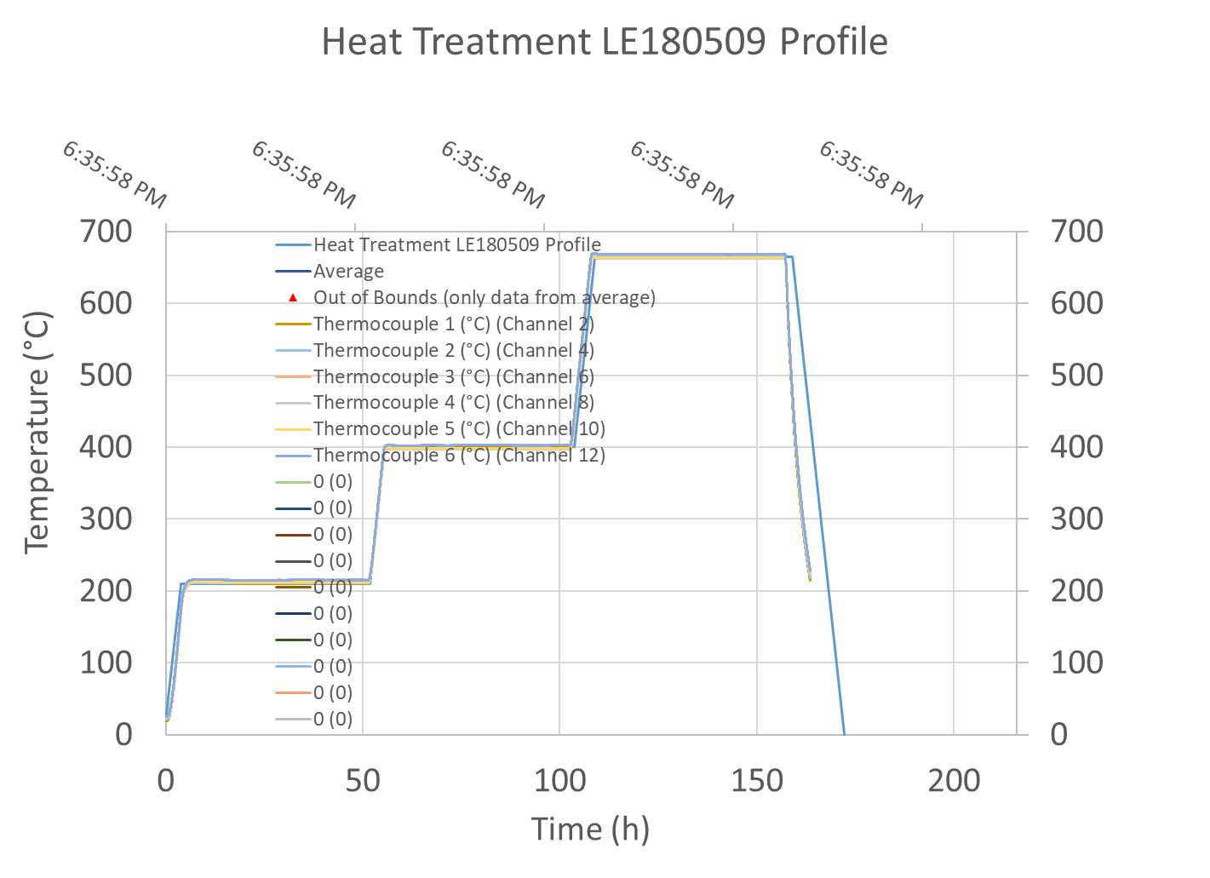
P43OL1098 – Extracted Strand HT

Slide 71
P43OL1098 – Witness Samples
Sample ID | No. of Units from Billet (Spool) | I_{c,} I_{q} (15 T) | I_{c,} I_{q} (14 T) | I_{c,} I_{q} (13 T) | I_{c,} I_{q} (12 T) | RRR (20 K) | RRR IEC
PO08S00207A02U | 15 (15) | 366 366 | 461 460 | 569 569 | 694 691 | 224 | 252
PO08S00214A03U | 15 (15) | 386 387 | - 461 | 561 591 | 712 708 | 218 | 244
P43OL1098AE27E PO08S00207A02U | 15 (15) | 373 384 | 465 476 | 569 581 | 684 701 | 195 | 216
P43OL1098AE42E PO08S00214A03U | 15 (15) | 377 377 | 471 468 | 572 572 | - 650 | 177 | 193
P43OL1098AE47E PO08S00214A03U | 15 (15) | 376 376 | 470 466 | 576 572 | 696 687 | 183 | 204

Slide 72
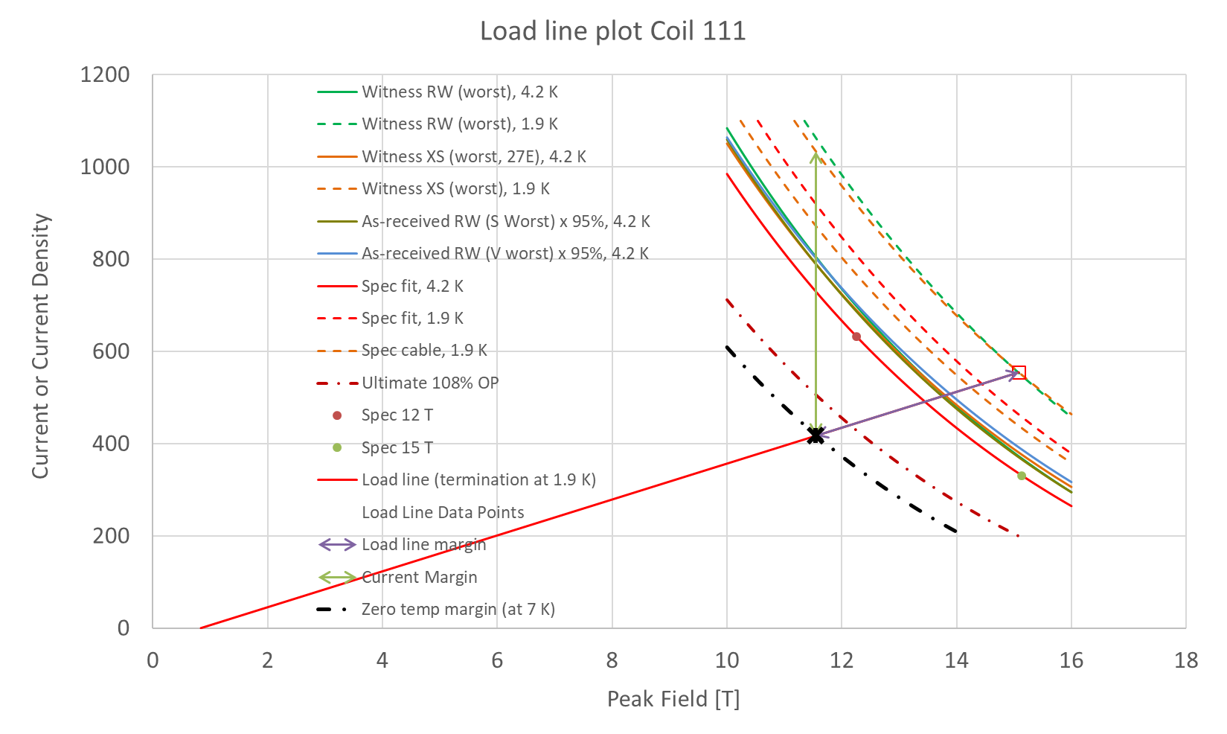
SSL

Slide 73
SSL
Requirements in red
1.9 K SSL intercept 15.08 T, 22.18 kA
16.5 kA Operating point at 74.3% SSL (< 80%)
SSL crosses 11.4 T, 16.5 kA @ T_{CS} = 7.2 K (> 6.1 K)
T_{CS} – T_{OP} = 5.3 K (4.2 K)
Cable I_{C} at 11.4 T = 42.29 kA
16.5 kA I_{OP} = 38.9% Cable I_{C}
RECOMMENDATION: PROCEED

Slide 74
QA
Vector 464234 – signed and closed by QA (Jan Szal) on 2018 03 22
Vector 464342 – signed and closed by QA (Tim McKenna) on 2018 09 19
P6 Milestone “HO: RQD Finish UL Cable Fab (001)” on 2018 09 14
Interface: 302.2.04 acknowledged receipt of insulated cable on 2018 05 15

Slide 75
Summary of Data
Coil | SSL field (T) | SSL current (kA) | I_{OP}/I_{SSL} (%) | T margin (K) | Cable I_{C} (kA) | I_{OP}/I_{C} (%)
QXFA109 | 14.94 | 21.95 | 75.0 | 5.1 | 40.57 | 40.6
QXFA110 | 15.19 | 22.34 | 73.7 | 5.3 | 43.19 | 38.1
QXFA202 | 15.49 | 22.82 | 72.2 | 5.6 | 45.78 | 36.0
QXFA111 | 15.08 | 22.18 | 74.3 | 5.3 | 42.29 | 38.9
RECOMMENDATION: PROCEED

