Slide 1
High Energy Physics Data Processing on LONI
OSG All Hands Meeting
LIGO Livingston Observatory, 4Mar09
Dick Greenwood
Louisiana Tech University

Slide 2
Outline
Beginning on the Grid in Louisiana…DOSAR
DOSAR History
Early remote computing at the CCT
Open Science Grid
LONI
Two HEP Experiments: Dzero and ATLAS
Problems and challenges
Present Configuration and status
Conclusions

Slide 3
LaTech Grid Computing Started with DOSAR
Distributed Organization for Scientific & Academic Research
Community and campus based grid organization
Its primary goal is spreading/enabling grid use
DOSAR in Korean is the God of Martial Arts
DOSAR evolved from the DØ Remote Analysis effort
Coordinated group efforts in DØ simulation/reconstruction/production
One goal is to work closely with other disciplines
Each group should play a leadership role in realization of computing grids in corresponding campuses and states

Slide 4
Who is DOSAR ?
First Generation IAC’s
University of Texas at Arlington
Louisiana Tech University
Langston University
University of Oklahoma
Tata Institute (India)
Second Generation IAC’s
Cinvestav, Mexico
SPRACE - São Paulo Regional Analysis Center, Universidade Estadual Paulista; Brazil
University of Kansas
Kansas State University
Third Generation IAC’s
University of Arizona, Tucson
Rice University
Ole Miss, University of Mississippi
Iowa State University
Louisiana State University
Oklahoma State University
…
DOSAR now has a new home at http://www.dosar.org

Slide 5
SAMGrid
Fermilab developed grid predates OSG, first used by DZero for global computing
SAMGrid = SAM + Job and Information Management (JIM) components
Provides the user with transparent remote job submission, data processing and status monitoring.
VDT based (Globus + Condor)
Logically consists of
Multiple execution sites
Resource selector
Multiple Job Submission (Scheduler) sites
Multiple Clients (User Interface) to Submission site.

Slide 6
SAMGrid
Installed at LTU in Spring 2004
Replaced non-grid farm which used SAM for data handling and scripts for control and job submission
Later also installed at LSU CCT by LTU
Installation and configuration difficult
As Open Science Grid (OSG) and LHC Computing Grid (LCG) became operational it was desirable to leverage these resources for DZero
FNAL and DZero developed and deployed SAMGrid interoperability with both LCG and OSG
Forwarding node packages SAMGrid jobs for OSG/LCG job submission via Condor-G

Slide 7
SamGrid Execution Site: ltu-cct Sam Station: ltu.cct.lsu.edu
Operating as Samgrid site from Dec 2005 to 2007.
Then we switched to the Open Science Grid software stack
In 2007, ltu_cct registered as an ATLAS UTA PanDA computing_Site

Slide 8
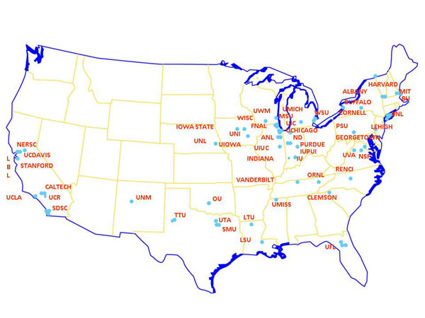
Open Science Grid Locations
(Courtesy Open Science Grid)

Slide 9
First Allocation on ERIC
LTU established an OSG compute element (CE) enabling HEP grid computing on the 5TF machine (ERIC) located at LSU. Each Dell cluster has 128 nodes (512 CPUs), two 2.33 GHz dual-core Xeon 64-bit processors and 4 GB RAM per node.
The LTU group was the first user of ERIC when they were granted a special allocation to participate in the massive spring 2007 DØ reprocessing effort.
>200 LONI CPUs managed by the group.
LONI was connected to Fermilab by National Lambda Rail.

Slide 10
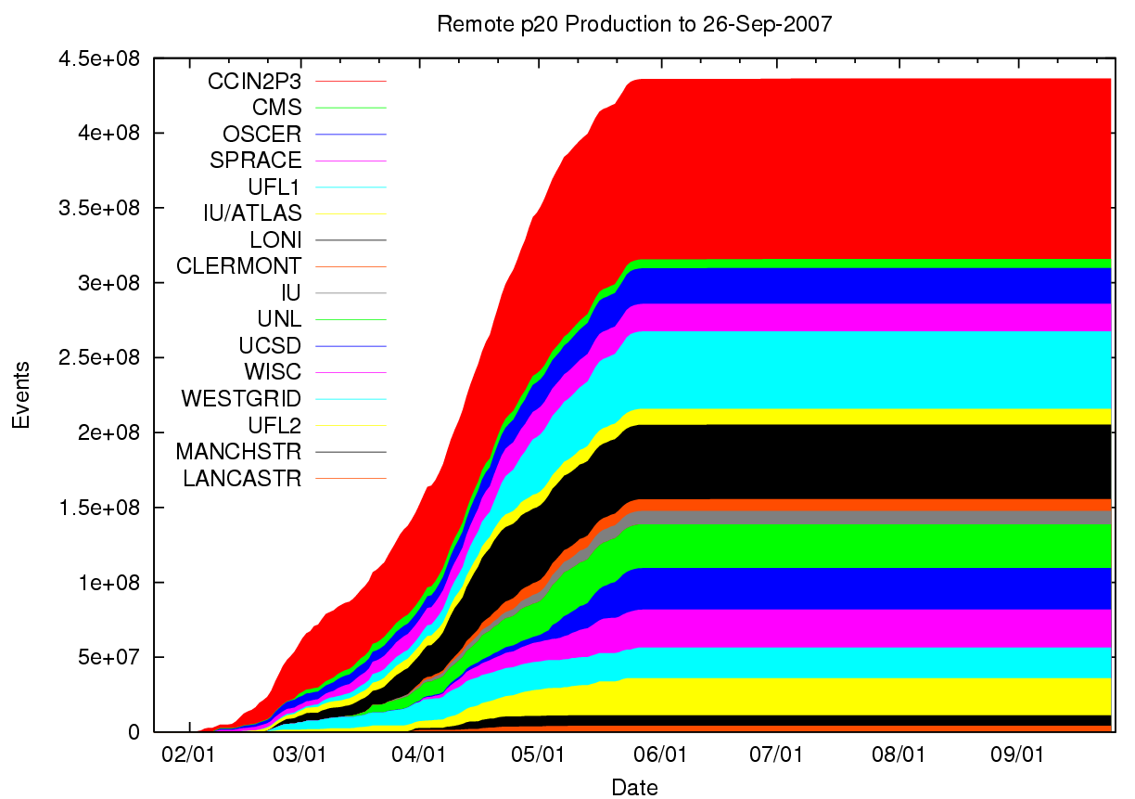
Dzero Reprocessing, 2007
Of the 455 million events processed remotely, LONI processed 47,755,321 (more than 10%), and was one of the top two performing OSG sites (tied with the University of Florida)!
Included in the OSG resources were >200 LONI CPUs managed by the group.

Slide 11
Some Big Challenges
Currently On-going Experiments at Tevatron
Has been taking data for the past 5 years and will continue throughout 2009 ➔ It is the problem at hand, not in a distant future
Current data size close to 2PB and will be over 4 PB by the end (~100km stack of 100GB disk drives)
10 – 20 times (~100PB) increase at the LHC experiments that turn on 2009-2010
Detectors are complicated ➔ Need many people to construct and make them work
Collaboration is large and scattered all over the world
➔ Grid Computing is a viable remedy

Slide 12
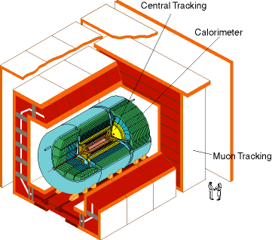
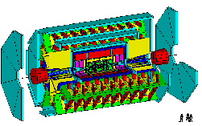
DØ Detector
ATLAS Detector
30’
30’
50’
Weighs 5000 tons and 5 story tall
Can inspect 3,000,000 collisions/second
Record 75 collisions/second
Records approximately 10,000,000 bytes/second
Records 0.5x10¹⁵ (500,000,000,000,000) bytes per year (0.5 PetaBytes).
Weighs 10000 tons and 10 story tall
Can inspect 1,000,000,000 collisions/second
Will record 100 – 200 collisions/second
Records approximately 300,000,000 bytes/second
Will record 1.5x10¹⁵ (1,500,000,000,000,000) bytes each year (1.5 PetaByte).

Slide 13
OSG Compute Elements
LTU_OSG
LONI_OSG1
caps10.phys.LaTech.edu
Located at Louisiana Tech
OSG 0.8.0 production site
Connected to our small cluster
Dedicated Condor Pool
8 nodes, 20 of the 28 CPUs
Other 8 CPUs used by local researchers.
Waiting to be replaced…
LONI_OSG3 → Dell 5TF cluster
Official LONI CE (osg1.loni.org)
Located at LSU
OSG 0.8.0 production site
Connected to Dell 5TF cluster
Opportunistic PBS queue
64 CPUs out of 512 CPUs
The 16 nodes are shared with other PBS queues.
Replaced LTU_CCT
Reason: aging hardware

Slide 14
OSG CE’s on LONI
OSG CE | LONI CLUSTER
LONI_OSG1 | ERIC (LSU)
LONI_OSG2 | ERIC (LIGO Testing)
LONI_OSG3 (coming soon) | PAINTER (LaTech)

Slide 15
Current Status of LONI_OSG1
Installed OSG 0.8.0 on node at LSU at the end of February 2008
Registered with the OSG
LTU_CCT was removed from OSG and VORS (3/26/08)
We are running DZero jobs and will begin running ATLAS jobs soon.
Waiting on PetaShare storage and Painter to come on line.

Slide 16
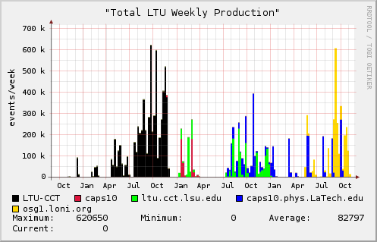
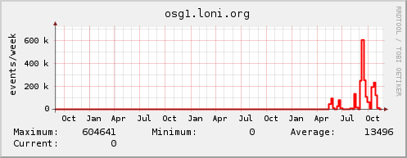
LTU 3 Year Production

Slide 17
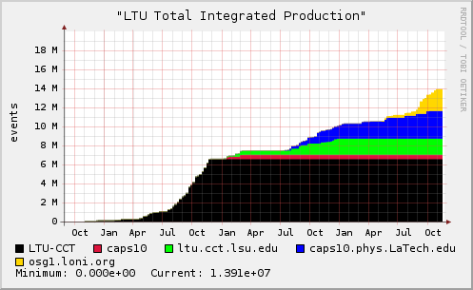
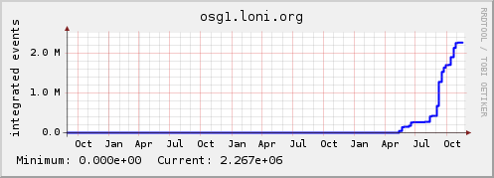
LTU 3 Year Cumulative Production

Slide 18
OSG Roadmap
Establish three LONI OSG CEs around the state:
LONI_OSG1
LONI_OSG3
LONI_OSG4
In planning
Complete
Upcoming
ULL or UNO?
Highly available

Slide 19
LONI_OSG3
In planning phase
Located at Louisiana Tech
Dual headnode using HA techniques
HA framework using:
Linux-HA
DRDB (Distributed Replicated Block Device)
Think “network RAID1”

Slide 20
PetaShare storage
Tevfik Kosar (LSU/CCT), PI
Provides LONI sites 200TB disk and 400TB tape storage
Employs iRODS (Integrated Rule-Oriented Data System- successor to SRB); investigating how to install BeStMan (in gateway mode which will directly access the Lustre filesystem; and/or create a BeStMan-iRODS plugin)
initially, 10TB at each site for ATLAS production

Slide 21
Conclusions
LaTech HEP has enjoyed state-supported grid computing opportunities through
Pre-LONI: LSU/CCT HPC facilities SuperMike and HELIX and locally at LaTech
LONI Fiber Connections to ERIC, the National Lambda Rail and Internet 2, OSG CE➔ Dzero Reprocessing a big success
The ERIC Dell Cluster: presently employed for Dzero MC production.
In the very near future,
Will create ATLAS T3 on PAINTER with storage available through PetaShare

Slide 22
Acknowledgements
LONI personnel
Sam White, Lisa Giaime, Lonnie Leger
LSU collaborators
Tevfik Kosar, CCT faculty and staff
LaTech
Michael Bryant, Chris Womack
DOSAR Collaborators
Joel Snow, Horst Severini

Slide 23
Backup

Slide 24
SAMGrid Components
Exec
Site
Broker
Durable
Storage
Exec Site
Site
Gateway
Node
Scheduler Node
Client
FNAL
Cache
SAM
Station
SAM Station
FNAL
ENSTORE
Tape
Stager

Slide 25
SAMGrid OSG/LCG
Grid
Broker
Forwarding
Node
Broker
Forwarding
Node
Site
Gateway
Node
Scheduler Node
Forwarding
Node
Client
SAM
Stager
FNAL
Cache
Storage
Element
SAM Station
FNAL
ENSTORE
Tape
Stager
SAM
Station
Durable
Storage

Slide 26
MC Grid Job Flow
SAMGrid jobs are broken into 250 events chunks at the Exec/Fwd node for submission to the batch/Condor_g system
Execution time trade-off
Output file size too small for efficient tape storage (20-30MB)
Merged in separate grid job
The 10k event merged files (1GB) are stored on tape via SAM and unmerged files are deleted.

