Slide 1
Beam Transfer Line and Beam Absorber (BTLBA)
Meiqin Xiao
PIP-II PDR
19 March 2019

Slide 2
Outline
Layout of Transfer Lines
Phased Commissioning approach
Lattice functions and 3D view of the Transfer lines
Beam absorber line
Summary

Slide 3
Layout of Transfer Lines from Linac to the Booster and to the DUMPs
50 KW Beam Dump
5 KW Removable Beam Dump

Slide 4
Phased Commissioning approach
courtesy of Fernanda G. Garcia
the MEBT absorber
Portable dump?
Portable dump
Portable dump
Parameters Affecting the Commissioning Strategy
Warm Front End (WFE) (2.1 MeV)
Superconducting Linac – Phase 1 & 2
Phase 1 (~ 35 MeV – end of SSR1)
Phase 2 (~185 MeV – end of SSR2)
temporary diagnostic line with a low-power beam stop for each
Beam transmitted to the straight ahead dump
Beam transmitted to the main absorber (BAL)
Beam transmitted to the Booster injection region (BTL)

Slide 5
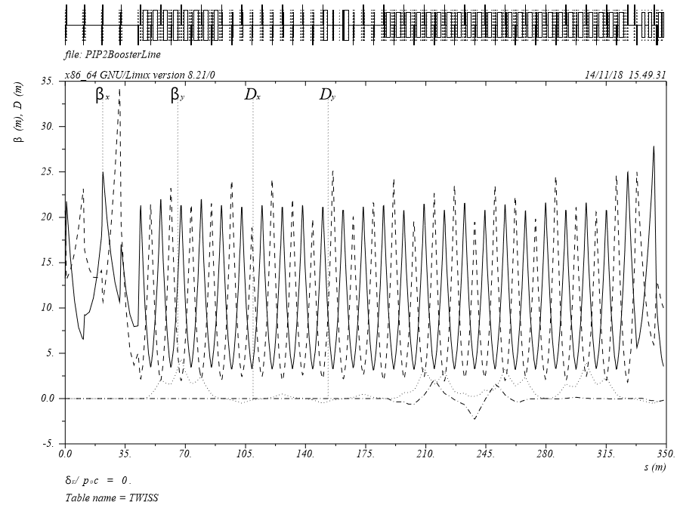
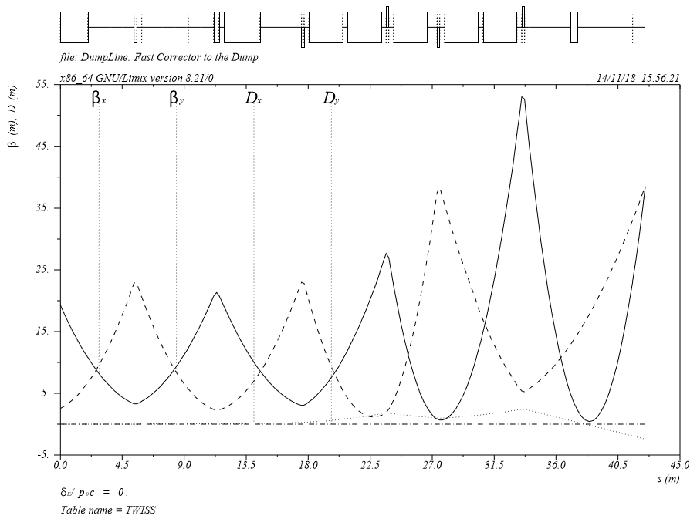
Beam Transfer lines -- Lattice functions
From Linac
to the Booster
Fast corrector
Total length:326.426 m
to the Dump
Total length:27.059 m

Slide 6
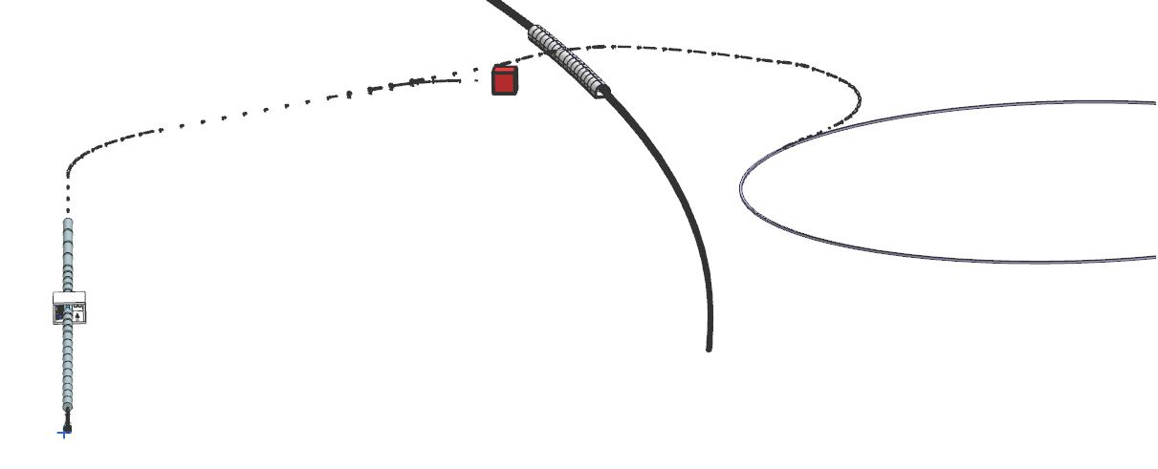
CAD-3D View
Beam dump
Booster
Linac
Over View from North
Tevatron Tunnel crossing
Booster
Beam dump
Over View from South-east

Slide 7
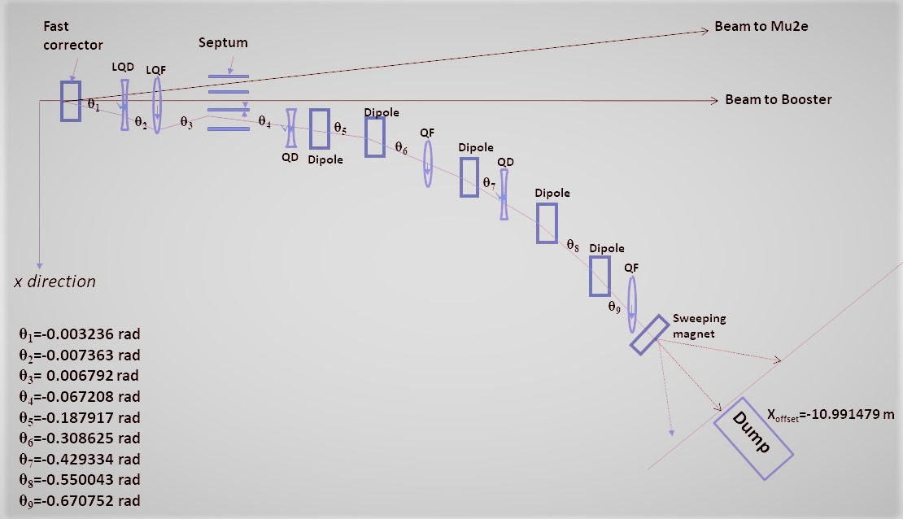
The cartoon of the Dump line
Quadupoles (QF and QD) are powered respectively, uncoupled from those in the BTL
to the Dump: 4 m
The maximum bending angle: 0.023 rad
the sweeping radius: 0.115 m
Beam size @absorber:
round beam with 2.5 mm
(38.43 degree)

Slide 8
Summary
The lattice of the beam lines, particularly the beam absorber line is fixed.
Quads in this line are powered independently, so the beam size is adjustable. Sweeping magnet is also adjustable.
Thank you for your attention.

