Slide 1
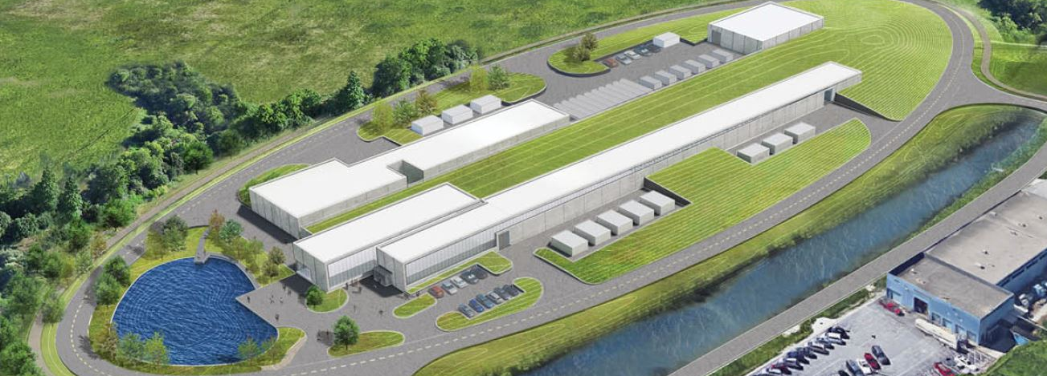
Introduction
Ioanis Kourbanis
PIP-II BTLBA Beam Absorbers PDR
19 March 2019

Slide 2
Outline
Requirements
Beam Absorbers
Organization
Review Charge
Agenda

Slide 3
PIP II Requirements (Existing Accelerators)
Project FRS requirements: Deliver ≥1.0 MW of proton beam power from Main Injector, over the energy range 60-120 GeV.
All Accelerator Upgrades required to meet the FRS requirements are part of 121.05 L2 WBS.
In addition WBS 121.05 WBS includes the Transfer Line from the Linac to the Booster the Beam Absorber Line and the Beam Dump.

Slide 4
121.05 L2 System Scope
WBS Dictionary Definition: pip2-docdb #599
Labor, materials, travel, and costs associated with the management, design, procurement, fabrication, and installation of and upgrades to the Booster, Recycler, and Main Injector to accommodate increased injection energy, increased intensity and higher repetition rates. Includes the design and installation of the beam line from the superconducting Linac to the Booster and the Beam absorber line and beam dump.

Slide 5
121.05 L2 System Requirements
Necessary to achieve 2 Objective Key Performance Parameters (2,3).
# | Description of Scope | Threshold KPP | Objective KPP
1 | SRF Linac Beam Energy | 600 MeV | 800 MeV
2 | Linac Beam | Beam delivered to the Beamline Dump | 5.4E12 particles per pulse (H-) at 20 Hz beam delivered to the Beamline Dump
3 | Booster/Recycler/Main Injector upgrades | Booster injection region, Recycler RF upgrades, and Main Injector RF upgrades, hardware installed and tested without beam in respective machines. | Linac beam injected and circulated in the Booster
4 | Cryogenic Infrastructure | Cryogenic plant and associated distribution system are installed and capable to support cavities operation at 2 K | Cryogenic system installed and is capable to support Linac operation in the CW mode

Slide 6
Organization
WBS 121.05
ACCELERATOR COMPLEX UPGRADES
I. Kourbanis
System Manager
WBS 121.05.01 Project Management
I. Kourbanis
WBS 121.05.02
Transfer Line/Beam absorber
M. Xiao
MARS calculations (I. Rakhno)
Beam Absorbers Design (Y. He)
WBS 121.05.03
Beam Transfer Line Installation
D. Morris
WBS 121.05.04
Booster
D. Johnson
WBS 121.05.05
MI/RR
J. Dey

Slide 7
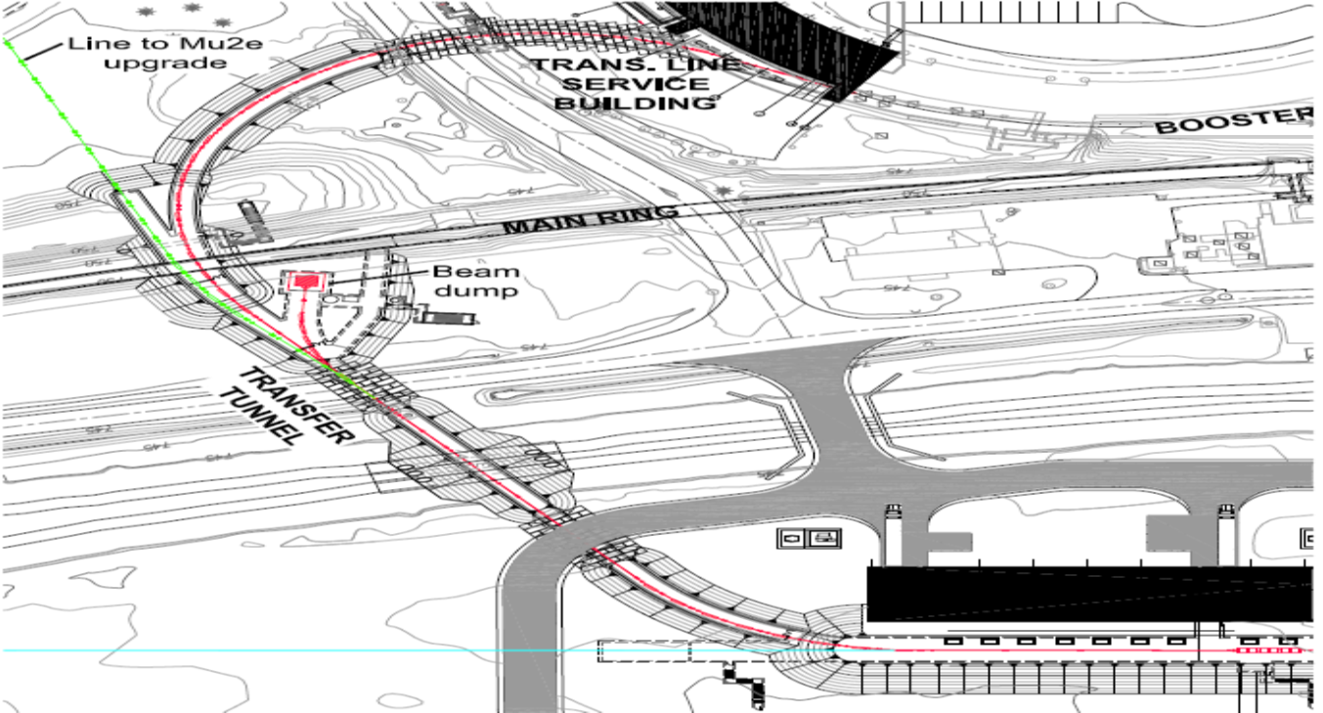
BTLBA WBS
121.05.02 Transfer Line and Beam Absorber (BTLBA)
Beam Absorbers and Collimators
Beam optics and Lattice
Beam Absorbers
One permanent 50 KW Absorber
Beam commissioning
Beam energy stabilization
One portable 5 KW Absorber
Used for Linac commissioning

Slide 8
Review Charge Questions
Are the requirements documented, clear, complete and appropriate?
Is the proposed design for the beam absorbers likely to meet requirements? Explain any deficiencies or concerns.
Are there any features present (or absent) that threaten the intended function and performance of this design?
Is the proposed shielding of the main absorber adequate?
Have safety and environmental aspects been appropriately considered?
Have quality aspects been appropriately considered?

Slide 9
Review Agenda
Introduction: I. Kourbanis
PIP-II Transferline and Absorber Line: M. Xiao
MARS Calculations: V. Pronskikh
Beam Absorbers Design: Y. He
Closeout – Review Chair

Slide 10
END

