Slide 1
Design Analysis and Review for the Decay Pipe Window Replacement System
Quinn Peterson
Design Analysis and Review
Day Month Year

Slide 2
Scope
Objective: Design mechanism that is capable of accessing the Decay Pipe Window and remotely removing and replacing it in the event of seal leakage. Chamber is highly radioactive after beam on activity so no human contact is allowable.
Parameters:
Must maintain pressurized helium in decay pipe
Be able to reach optimal seal compression on window
Fit within tight space of shaft leading into target chase
Components survive 3 days of exposure
Must be remotely operable

Slide 3
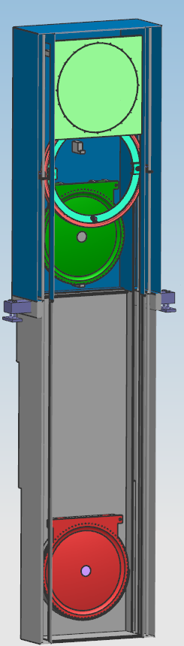
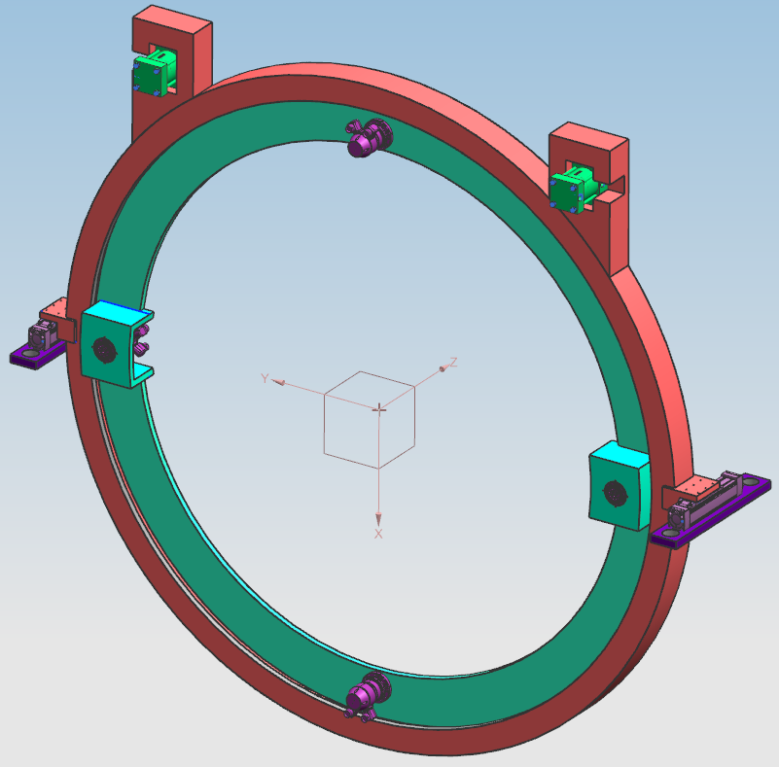
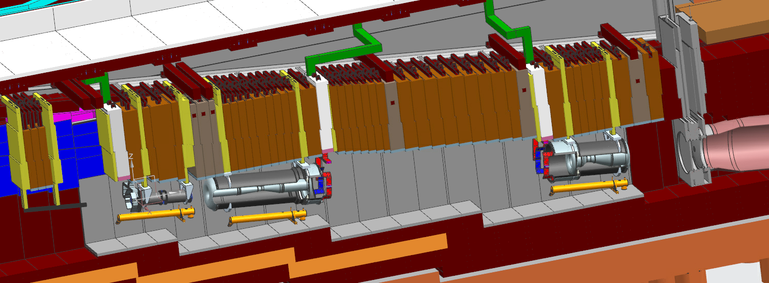
Design Overview
Storage box containing replacement window and bolting mechanism placed over chute to decay pipe window after removal of shielding within the chute.
Mechanism descends, unbolts, removes, and replaces window remotely.
Mechanism will be operated remotely from a safe area to insure operator safety.

Slide 4
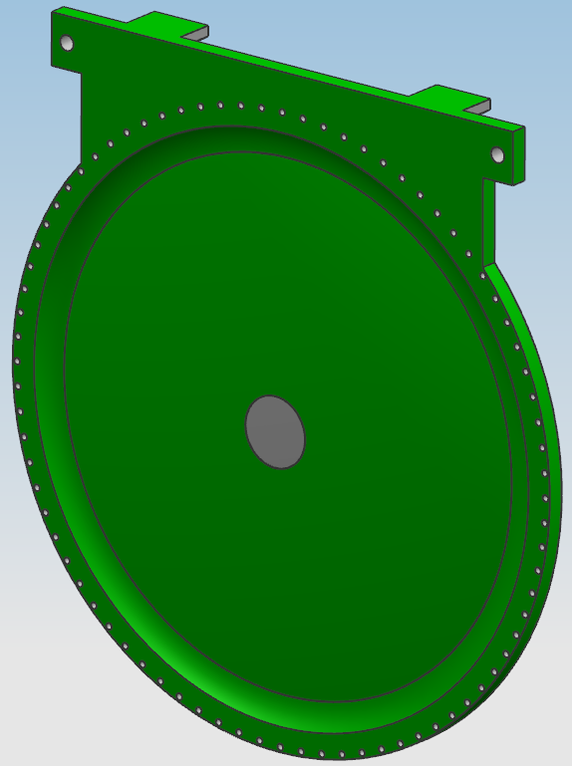
Decay Pipe Window
Uses 3/4 in Titanium Bolt
Total Internal pressure against window.
At 5 psig = 13697.5 lbs
At 3 psig = 8218.5 lbs
These forces add to the stress the bolts will need to endure.
Bolt hole pattern diameter
70 in
Pegs on back of plate to act as guides when installing window.
Holes on plate act as slots for gripper mechanism to retrieve the window.
Bolts screw into stainless tapped holes in window housing.

Slide 5
Bolting Mechanism General Overview
Circular disk inside bearing housing
Disk contains 4 LynxDrive Servo Actuators to bolt/unbolt
2 Sheffer Heavy Duty Pneumatic Cylinders
Move window along beamline after unbolting/during transportation
2 Thomson Linear Motion Actuators
Move mechanism linearly along beamline
Stepper Motor
Control rotation of interior ring
Vertical Motion Guides
Guide mechanism along guide rods when moving up and down
Mounted Cameras
Cameras will be mounted around the mechanism to help operators during operation.

Slide 6
Window Change Phases

Slide 7
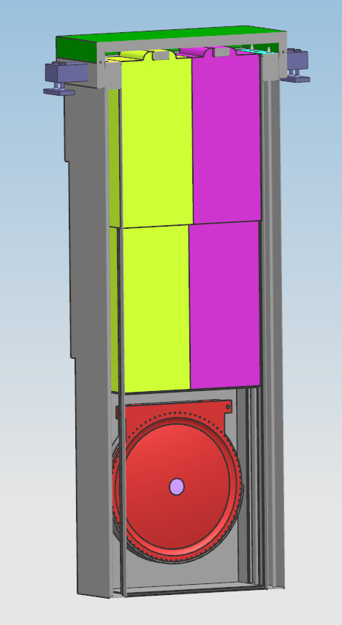
Window Change Phase 0 (Beam On)
Shielding and decay pip window are in place
When there is no operations performed on the window, a cover will remain bolted over the chute leading to it.
In addition, shielding is located within the shaft to absorb the energy form beam on activity.

Slide 8
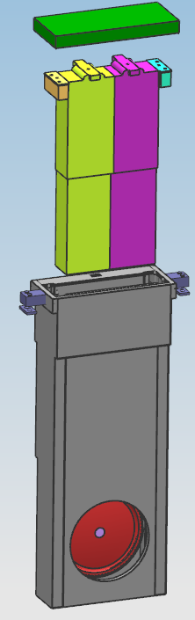
Window Change Phase 1
In the event of unacceptably high helium leakage, this mechanism will be used to replace the window.
The top plate to the chute, as well as the shielding leading to the decay pipe window will be removed, after significant cooldown time, before the storage container is fastened in place.

Slide 9
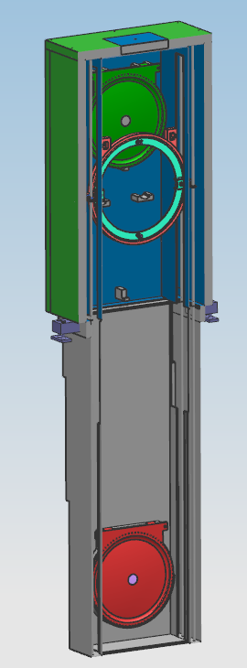
Window Change Phase 2
After the top plate and shielding is removed, the storage container will be fastened into place.
When aligned correctly, the vertical guide rods will align to create a continuous guide system into the chute

Slide 10
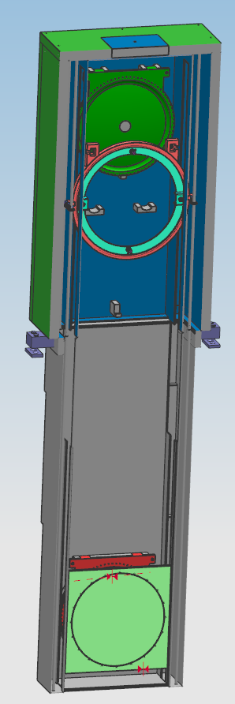
Window Change Phase 3
Before the damaged window can be removed, the passage opposite to the window must be sealed.
To do so, a plate is lowered into the chute and awaits bolting from the mechanism.

Slide 11
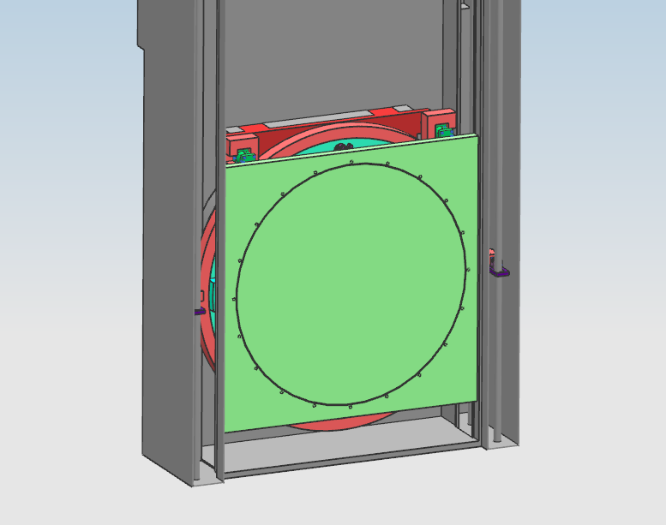
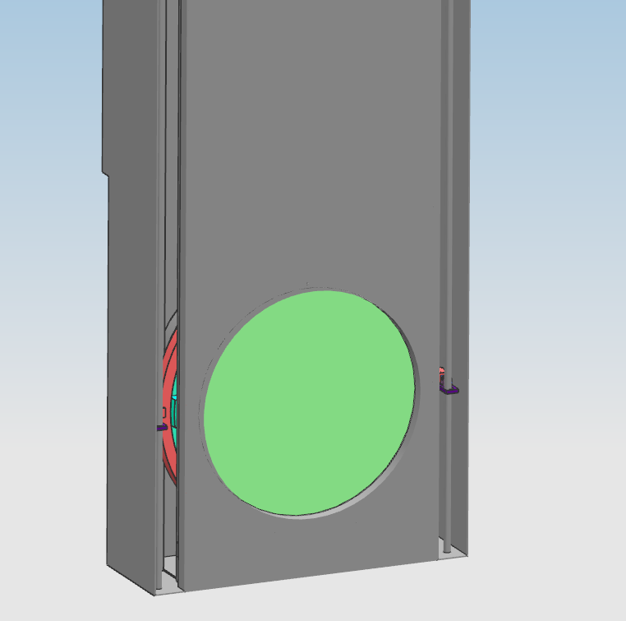
Window Change Phase 4
After the plate seal is in place, the bolting mechanism will lower into the chute, align itself with the bolt pattern on the seal, and fasten it into place.
After passage sealing, the chamber will be purged of the remaining air and pressurized with helium equal to that of the beamline.
The air will be removed from the bottom of the chamber and helium delivered through the top of the chute.

Slide 12
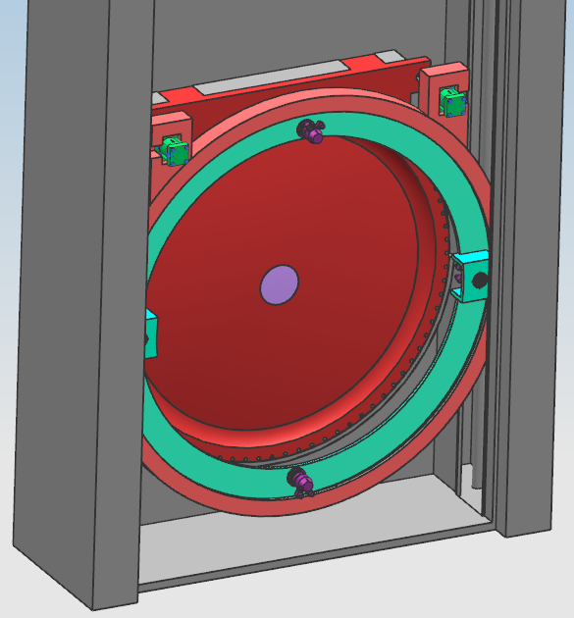
Window Change Phase 5 (Window Change Out Starts)
After sealing of the opposing opening and pressurizing of the chute, the damaged window can now be unbolted from its seating.
To do so, the mechanism will move along its linear motion system and rotate the internal ring housing the unbolting servos to align with the bolt holes.

Slide 13
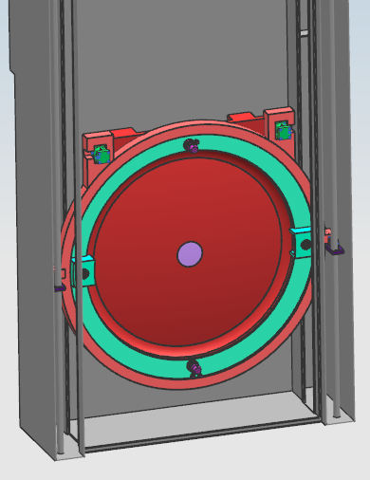
Window Change Phase 6
Once all bolts have been removed, the window will be retrieved by the transport system located on the upper portion of the mechanism.
Two pneumatic cylinders will extend rods in the transport holes on the side of the window and lift it out of the seating.

Slide 14
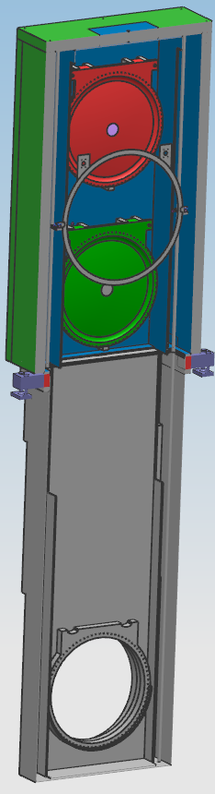
Window Change Phase 7
The damaged window will then be brought into the storage container and placed onto a storage rack.
Once placed onto the rack, the pneumatic cylinders will retract their rods.

Slide 15
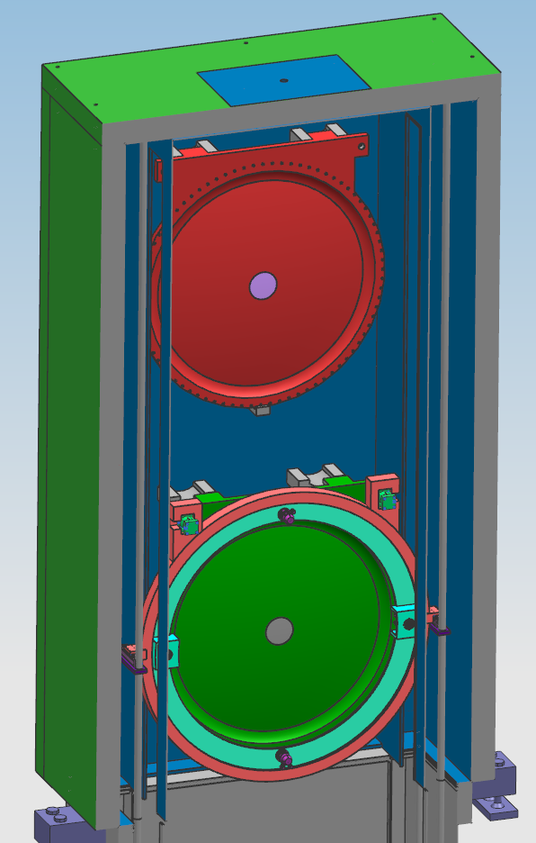
Window Change Phase 8
Once the damaged window is safely stored, the mechanism will then move to retrieve the replacement window located on the rack below.
The pneumatic cylinders will once again engage and retrieve the new window.

Slide 16
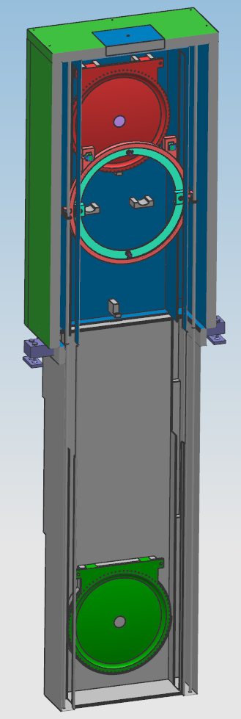
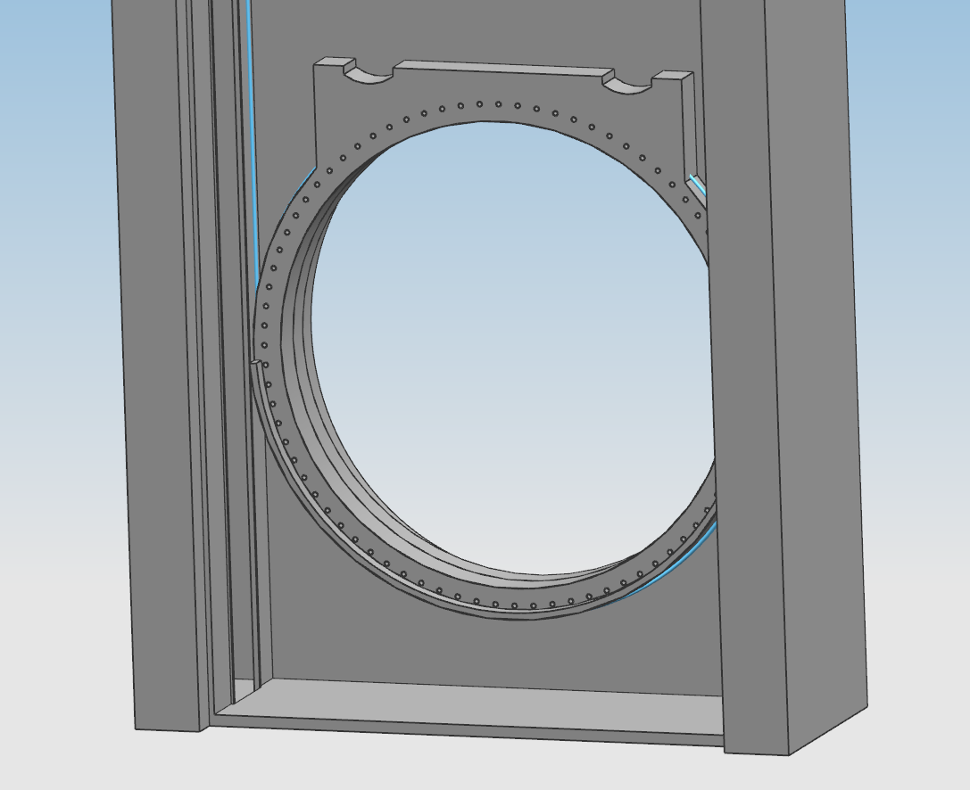
Window Change Phase 9(Window Change Out Complete)
After the new window has been retrieved, the mechanism will descend into the chute and place the window into the seating and begin the bolting process.
The window will be aligned using the pegs on the back of the shielding to seat into the slots on the bolting housing.
After the window is properly seated, it will be fastened into place.

Slide 17
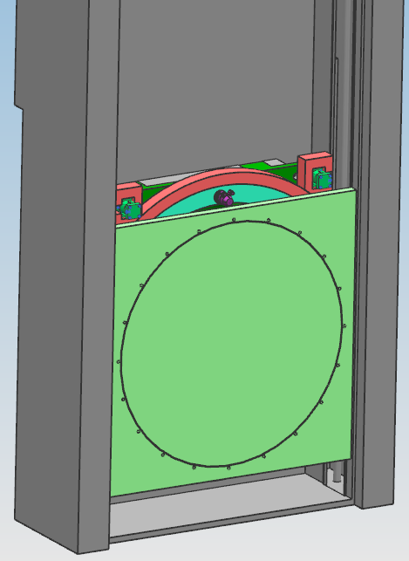
Window Change Phase 10
Air will be reintroduced to the chamber and will be pressurized equal to atmosphere and a leak check will be held on the new window.
The bolting mechanism will then unbolt the plate seal on the opposing passage from the window.

Slide 18
Window Change Phase 11
After the plate seal is unbolted, the mechanism and the seal will rise into the storage container to complete the change operation.
Once all components have been returned to their storage positions, the removal process for the storage container can begin.

Slide 19
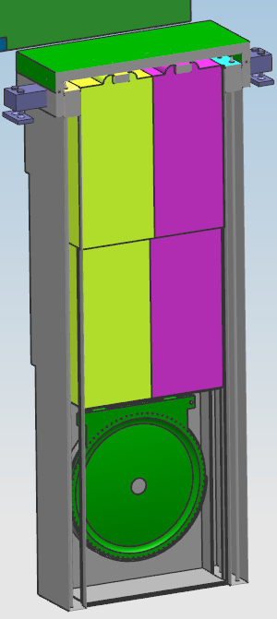
Window Change Phase 12
With all components within the storage container, the container will be unbolted and removed from the chute.
After the storage container is removed, the additional shielding for the chute and the top plate will be returned to their original positions

Slide 20
Appendix

Slide 21
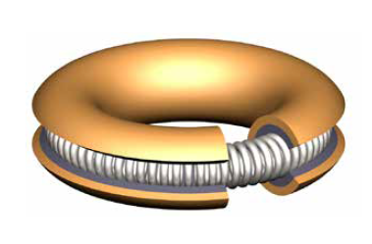
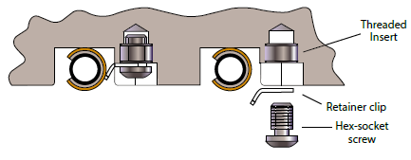
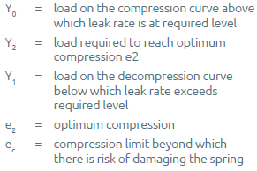
The Seal – Helicoflex Seal
Aluminum Ring Seal:
1542 lbs/in Compression Force
Total force per linear inch needed to compress seal
Total circumference = 222.61 in
Held into place with tabs
Total Seal Compression
343269.64 lbs
w/ 80 bolts = 4290.87 lbs/bolt
Force to be applied per bolt
5000 lbs
Requires 62.5 ft-lbs of torque w/ ¾ in bolt
5 psi differential across seal

Slide 22
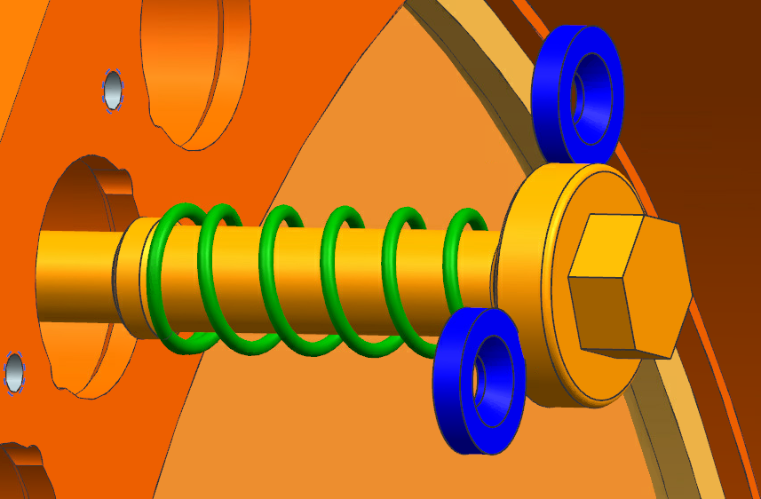
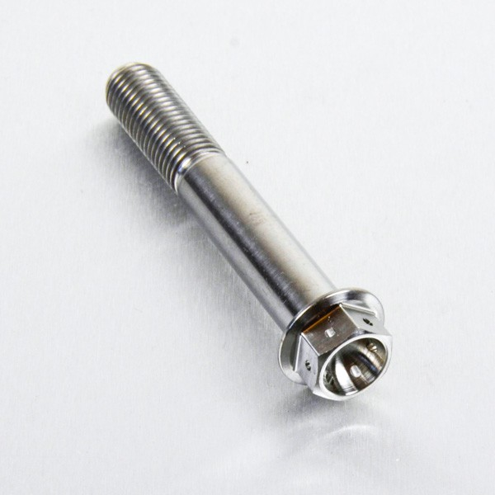
Capture Bolts
Copy of design for Mu2e
Allows for bolts to remain seated within the individual bolts holes
Removes need for bolt retrieval system within the chute
Material
Grade 5 Titanium
Material is not harmed by radiation
M20 Hex Head

Slide 23
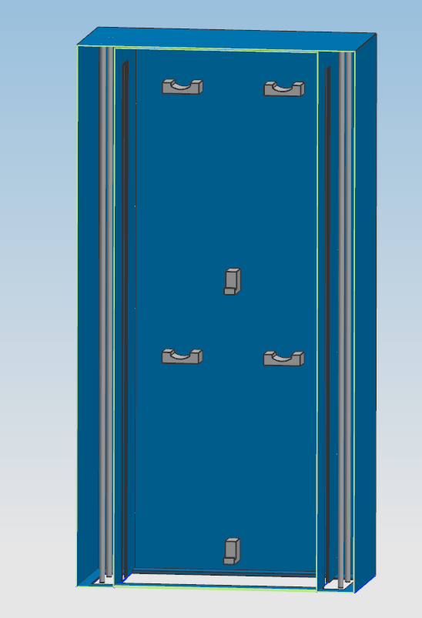
Storage Container
Dimensions
Height = 198 in
Width = 94 in
Depth = 53 in
Two racks for storage of Decay Pipe Window and Replacement Window
Guides in walls for Bolting Mechanism to move along
Bolted to top of chute
1 in thick walls to provide some radiation shielding from activated window
Actual required thickness to be determined

Slide 24
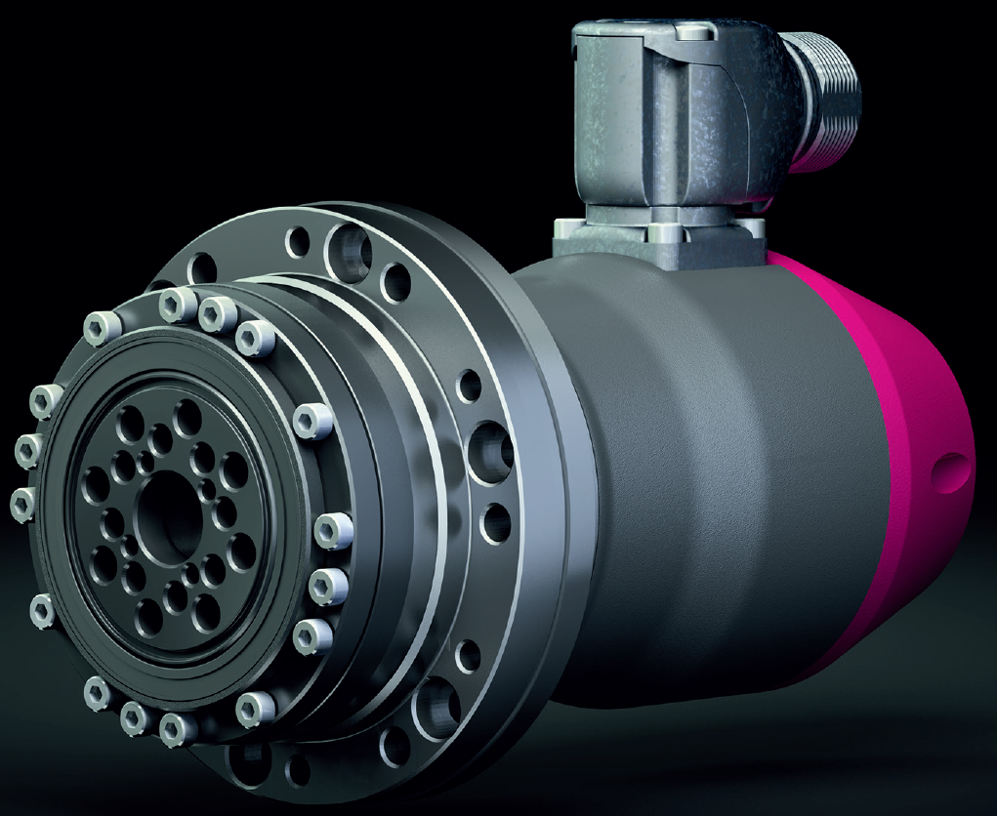
LynxDrive Servo Actuator
Hydraulic Servo’s used to apply precise torque to bolts on decay pipe window.
Max Torque
160 ft-lbs
Torque required
62.5 ft-lbs
Well exceeds the Torque requirement giving ample room for situations where more Torque would be required for removal due to corrosion or swelling.

Slide 25
Thomson Linear Motion Actuator
Using a motor, a shaft is turned that allows for precise linear movement.
Stroke
54 mm or 2 1/8 in
Will provide linear motion to the bolting mechanism.
Allows for motion along interior of chute to remove the window from the sealing surface and to place into storage container.

Slide 26
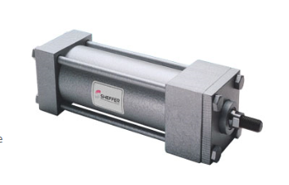
Sheffer Heavy Duty Pneumatic Cylinder
Used to move windows to and from storage container
Pressure rating
800 to 2000 PSI working pressure
1 in Rod
Low friction

Slide 27
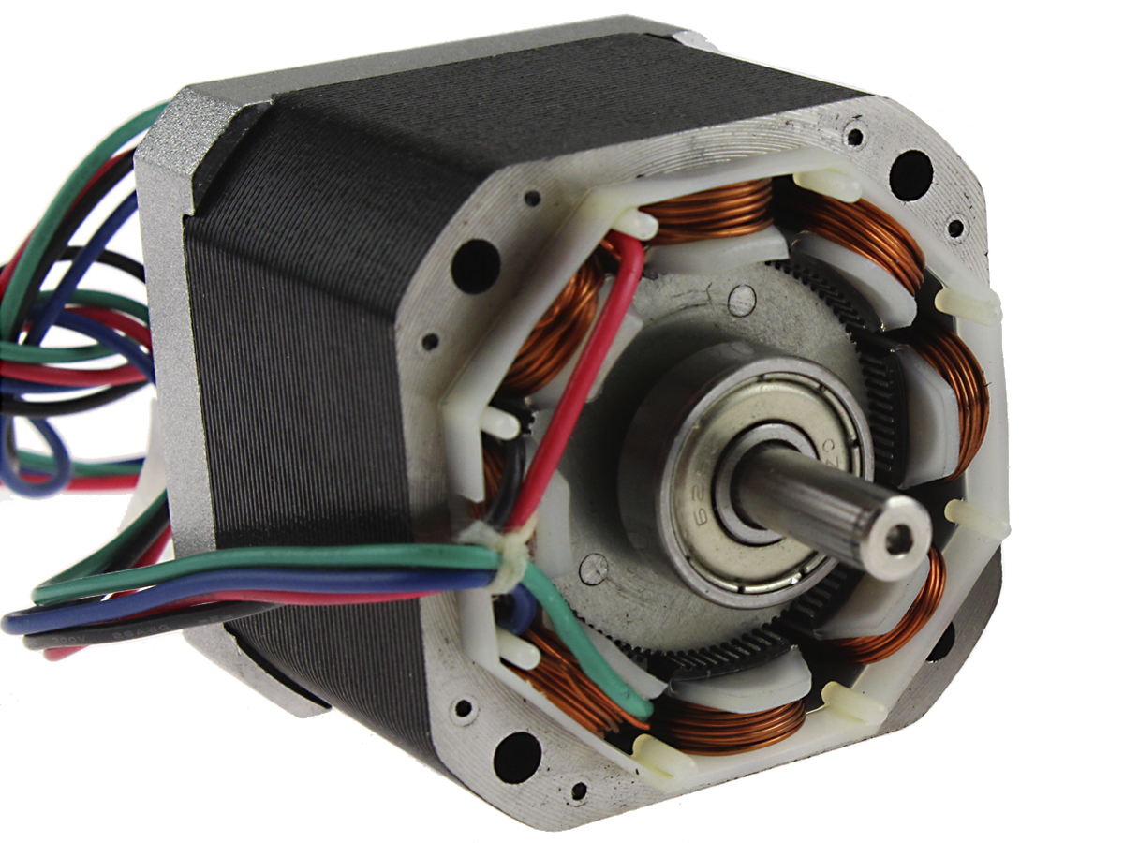
Stepper Motor
Allows for precise rotation of the interior ring and bolting servos.
Program exact steps into motor in order to align bolt driver with bolt.
Correct positioning will be confirmed with camera and adjustments made if necessary.

Slide 28
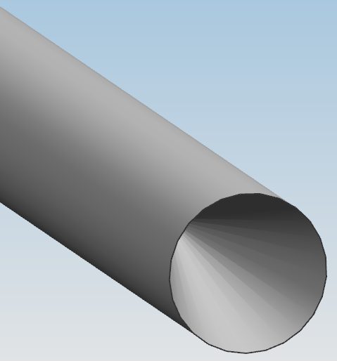
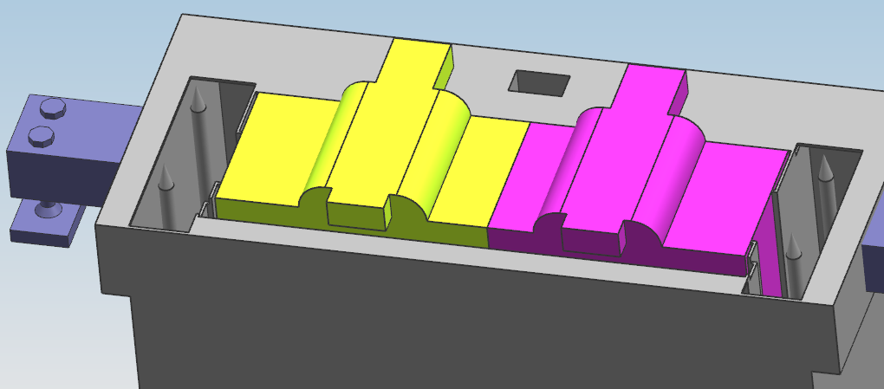
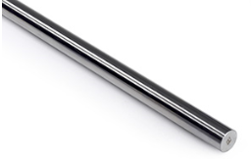
Vertical Motion System
4 Guide rods on either side of mechanism
Guide rods will connect at male and female ends to form continuous guide when mechanism is in use
Cable system will provide the vertical motion for the system

Slide 29
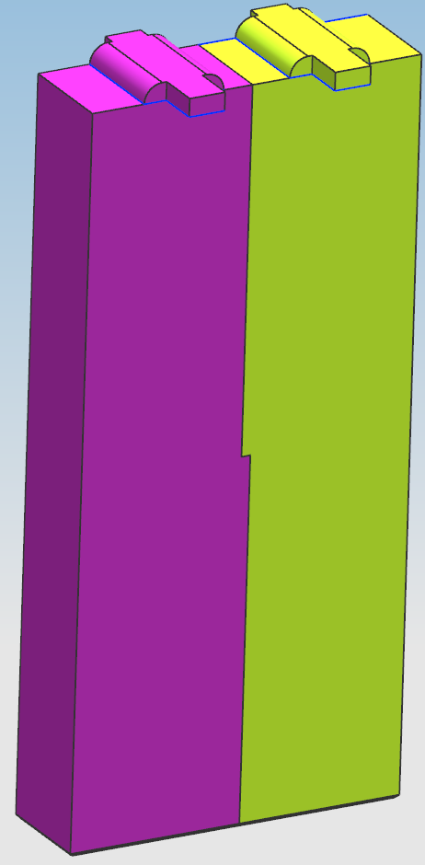
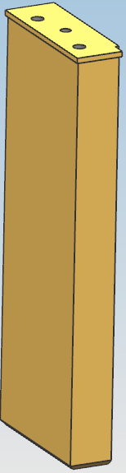
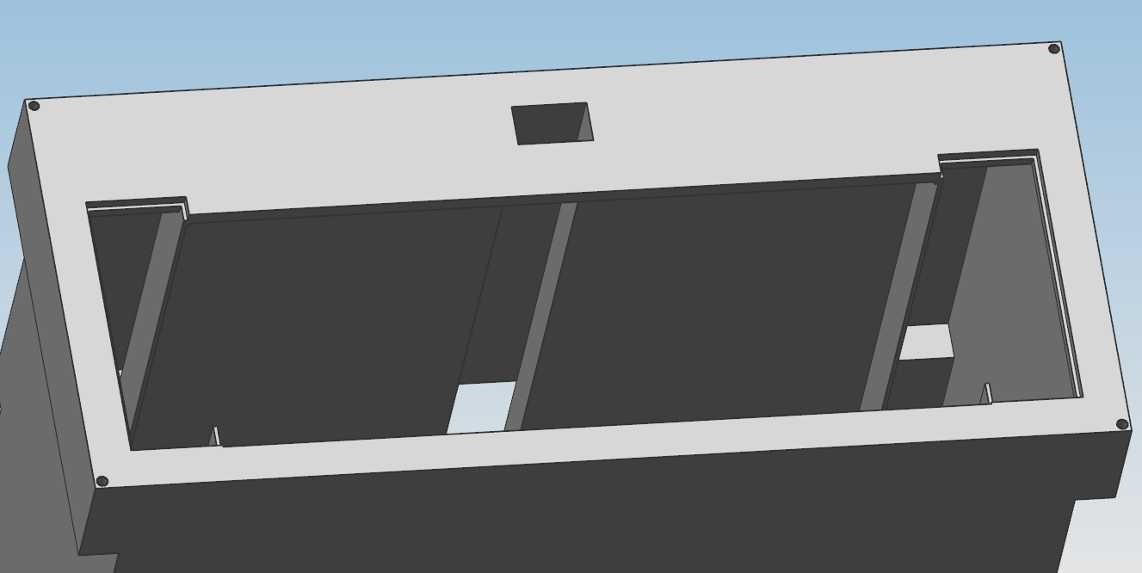
Additional Shielding
Additional shielding will be set into the chute to protect components from beam on activity.
Chute shielding is separated into 2 individual shields to reduce weight.
Material
Steel
Individual Weight
Main Shielding Roughly 17 tons
Side Chute Shielding
Mounting pegs are able to withstand the weight of the shielding

Slide 30
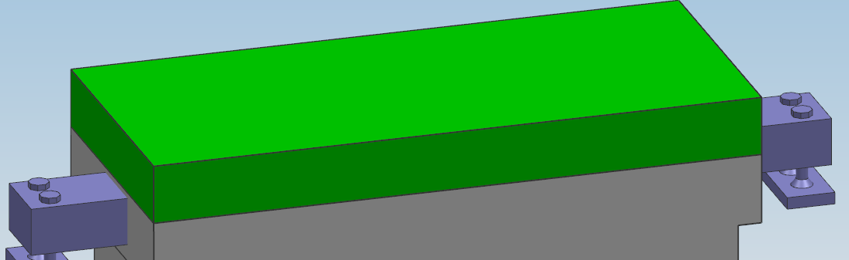
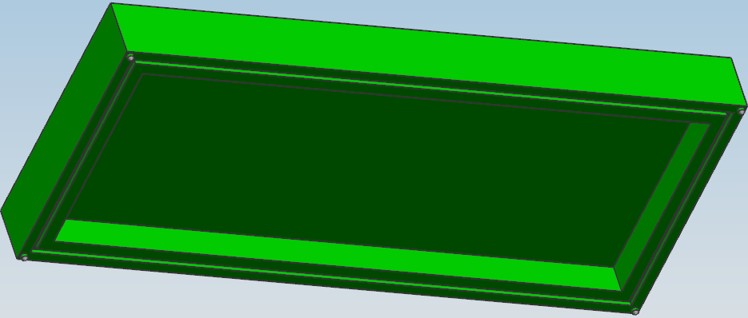
Top Plate
The top plate will be used to seal the chute when no window changeout is occuring.
The Plate has a cavity within it to accommodate the male ends of the vertical motion system guide rods as well as the additional shielding in the chute.
60 Durometer O-Ring Seal
Requires 5610 lbs of force to compress
Weight of plate is 7984 lbs. Will compress O-Ring without need for bolting.

Slide 31
Interior Chute Seal
Plate will be lowered into the chute and secured to opening
Seals chamber allowing for removal of Decay Pipe Window
Seal will be 60 Durometer O-Ring
Total Seal Compression
4229.8 lbs total
w/ 20 bolts, 31.7 in-lbs required per bolt
Capable of outputting 1920 in-lbs

Slide 32
Cameras
Cameras will provide feedback to operators on positioning of individual components within the mechanism.
Positions:
Each bolting servo
Ensure accurate bolting/unbolting
Gripping mechanisms
Ensure that windows have been retrieved properly
Show each rack in storage container
Ensure that windows have been mounted correctly
Show stops
Ensure that all mechanisms and objects have reached their stopping points
Cameras will be exposed to 100 rads/hr over 3 days.

