Slide 1
Mu2e Target Primer for TSD topical meeting 3-21-2019
Dave Pushka
3-21-2019 TSD Topical Meeting
21 March 2019

Slide 2
What are the Target Requirements
8 GeV Protons from Delivery Ring
8 Slow Spill bunches to Mu2e each 43 msec long for 380 ms.
Then, 1020 msec of no beam
Operate for 1 year (2 x 10⁷ seconds ~ 5555 hrs ~ 33 weeks)
Goal is to make pions which decay to muons, and the muons transported to and absorbed in a stopping target.
Effect of a target change not during a scheduled shutdown:
  Duration ~ 4 weeks
  Each change is a 12 % reduction in muons over the year of running.

Slide 3
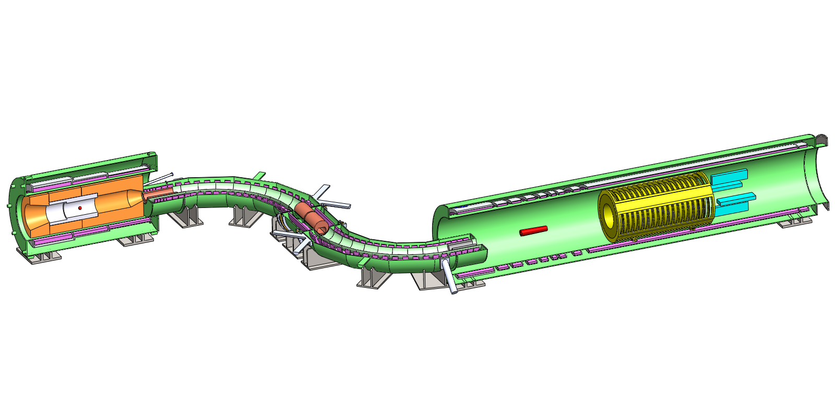
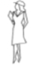
Production
Solenoid
Detector
Solenoid
Transport
Solenoid
Production
Target
Stopping
Target
Tracker
Calorimeter
Collimators
about 75 feet end-to-end

Slide 4

What are the Target Failure Modes:
Melting, Tungsten melting temperature ~ 3500 K
But, long before it melts, it softens and low mechanical stresses result in plastic deformations.
  think of a stick of butter on a warm summer day.
  Usually called Creep which is a function of Temperature, Stress, and Time. Strain, ϵ, Described by Norton Creep Law:
    Stress to the 0.9 power
    Time to the 0.3 power
    Constant B = 0.4, Q = 122 kJ/mol for 1% La₂O₃ doped W.
    Conclude: Support target to minimize mechanical stress.
Thermal Stresses.
  Parts that heat up are constrained by those that heat up less, resulting in thermal stresses.

Slide 5
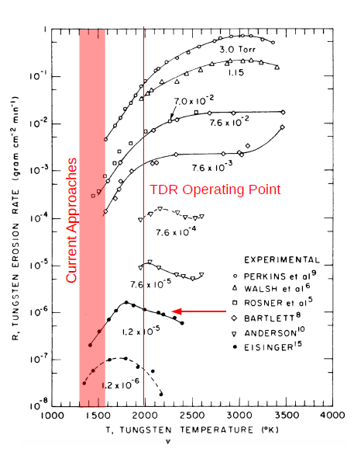
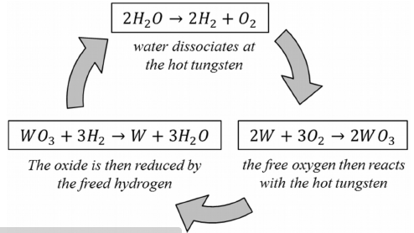
Target Failure Modes Continued, Oxidation:
Oxidation driven by residual Oxygen and Water Vapor in the vacuum.
Depends on the concentrations of O2 and H2O and on the temperature. A non-affect if the temperature is sufficiently low.
Oxygen Cycle:
Water Catalyst:

Slide 6
Target Failure Modes Continued, Oxidation:
The two photographs show before and after oxidation tests performed by RAL with an air leak to a vacuum.
Better Vacuum lowers residual Oxygen and water vapor, reducing the material loss.
Vacuum Calculations indicate 1x10⁻⁵ torr around target.
Better vacuum limited by conductance of high vacuum line.

Slide 7
Difficult to Quantify Failure Modes: Recrystallization & Radiation Damage.
Recrystallization:
  Deformed grains in the material are replaced by defect free grains.
  Usually results in loss of strength & reduced hardness.
  Ductility usually increases
  For tungsten, starts around 1300 C, 1% La₂O₃ doped W raises this to about 1500 C.
  Conventional wisdom is to avoid recrystallation if possible.
Radiation Damage:
  Very large DPA (Displacement Per Atom).
  Production of Hydrogen and Helium within the Tungsten Material.
  Flying blindly into this with no way to test prior to operation

Slide 8
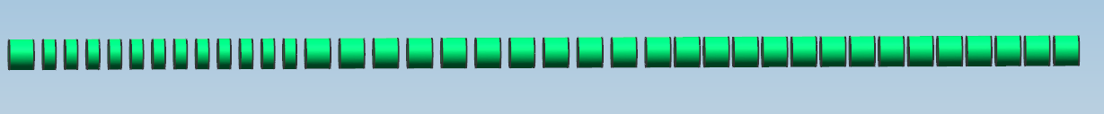
Solutions to the Target Failure Modes:
Reducing the temperature of the target solves some of the problems:
  Oxidation
  Creep
  Recrystallization
Temperature does not necessarily affect the radiation damage or the production of hydrogen and helium.
Thermal Stress can be reduced by separating the core elements and giving the hot part room to expand:
So, How to reduce the Target Temperature?

Slide 9
Start with the Governing Thermal Equation:
P = σ*ϵ*A*(T⁴⁻ T_{b}⁴ )
P = Energy Deposition from the Protons in the Target
σ = Stefan-Boltzmann constant (5.67x 10⁻⁸ W/m2* K)
ϵ = emissivity (temperature dependent)
A = surface area of the target
T⁴ ⁼ temperature of the target
T_{b}⁴ ⁼ temperature of the surroundings (about 305 K , 90 F)
Conclusion, only two parameters can be adjusted to change the target temperature with constant power input, ϵ & A.
Absorber Power (P) is between 600 and 700 Watts.

Slide 10
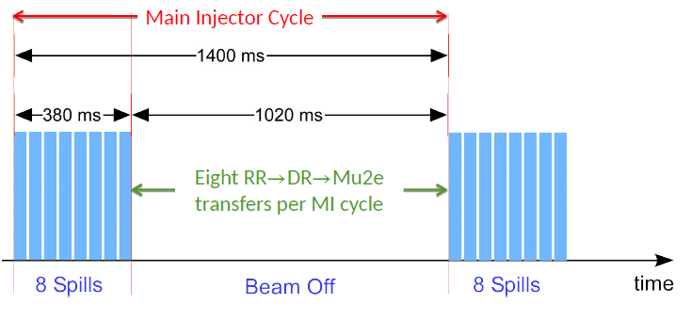
Beam Heating (the Power Input to the Target):
Thermal results indicate higher temperatures when the Input Power is over 380 milliseconds (ms) verses 1.4 seconds.
  Above Graphic From Steve Werkema, see docdb 2771.

Slide 11
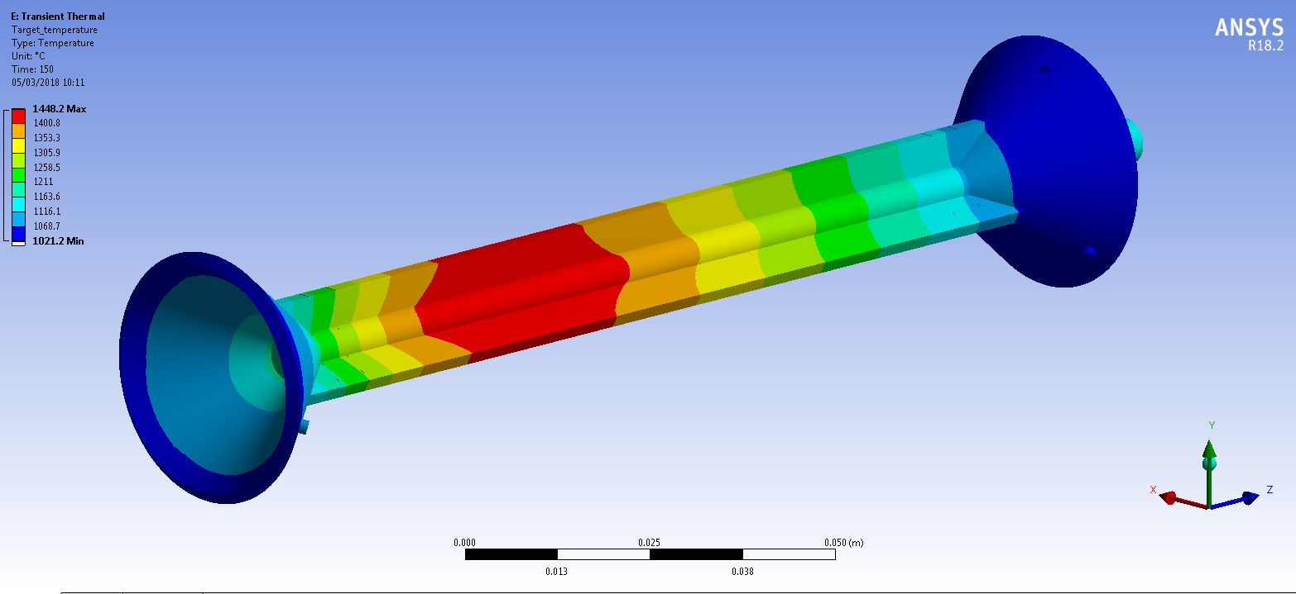
Tier 1 Milestone Target (aka Tier 1 Target):
Power Density in W/mm^3 (comes from G4 Beamline (or MARS) along the target length 0 to 160 mm:
Commonly called Edep.
Used as an input to ANSYS to generate the Temperatures and stresses based on the emissivity. Have been using variable emissivity (ϵ = f(T)) and averaging Edep over 380 Msec.
Power Density from Kevin Lynch docdb 24232
ANSYS image from Tristan Davenne in docdb 16265
1020 C
1450 C

Slide 12
Emissivity of Tungsten with Temperature:
Emissivity Reduces with reducing temperature.
Assume 1% La₂O₃ doped tungsten is the same. But need to measure to confirm.
  Emissivity Curve From RAL Report, Original Source, not known.
TDR
Current Focus

Slide 13
Can we Improve the emissivity with a surface treatment or coating?
Maybe….
We have an SBIR with 4 or 5 companies that have submitted phase 1 proposals.
  Phase 1 Awards are scheduled in May 2019.
  Phase 1 is typically 9 month duration.
  We are nearly a year away from testing a coated tungsten target.
Tungsten is a bit difficult to coat:
Sample Tungsten rod (~ 1 mm diameter) with iridium vacuum deposited on the surface (at Lab 7), after heating at RAL (see docdb 8376)

Slide 14
So, What is left to change to reduce the temperature?
The area term by adding fins to increase the area:
  The Strawman 1
    Peak at 1000 C
  The Strawman 3
    Peak at 1000 C
  Hangman
    Peak at 1400 C
  Hayman
    Peak at 1120 C
So we are done, Right?
T ~ 1000ºC
T ~ 1000ºC
T ~ 1400ºC
T ~ 1120ºC

Slide 15
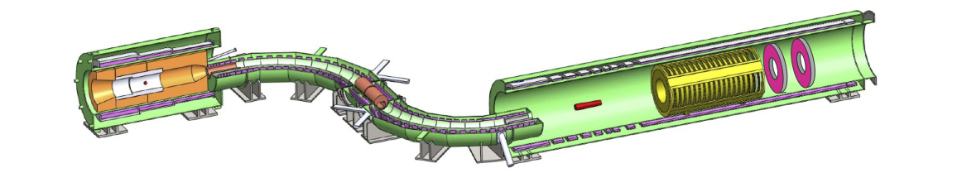
Does It make Muons?
The purpose of the target is to make Muons
Made by Protons interacting in the target, making Pions, which then decay (in about 26 nanoseconds) into Muon and a Neutrino (99+% of the time).
The experiment measures the production of muons by the number of muons captured in the stopping target.
Proton target
Stopping Target

Slide 16
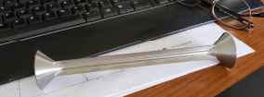
Quantifying Muon Production
Bare rod 6.3 mm diameter, 160 mm long
  About 1800 x 10⁻⁶ muons per POT
  Very similar results for G4 Beamline and Framework models.
  Experiment optimized rod dimensions to maximize stopped muons.
TDR Target (bare 6.3 mm rod with cones at both ends.
  About 1650 x 10⁻⁶ muons per POT
  Cone geometry supports target with non-minimum mechanical stress.
Tier 1 and Other Targets ?
  Work on resolving different results for G4 Beamline and Framework models is still underway.
  Could see a 20 to 50% reduction in stopped muons.

Slide 17
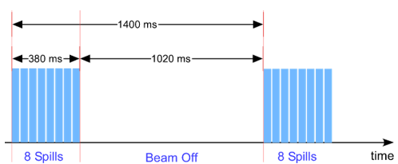
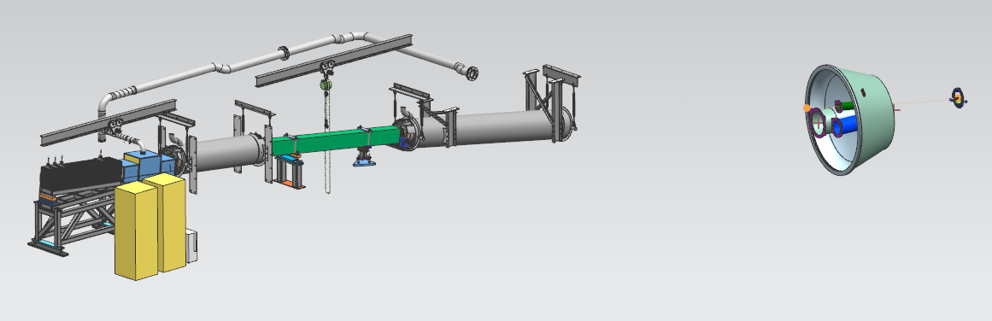
Its not just Muon Production…No out of time Protons!
For the experiment to reach its goals, they have to measure protons coming out of the accelerator in the 1.02 second gap between spills.
The extinction monitor “looks at” the target to do this.
  It needs a clear line of sight to the target core to reach its sensitivity goals. And its location is cast in concrete.

Slide 18
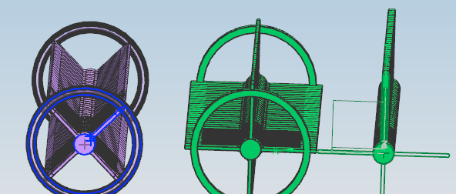
Fins Rotated to Provide Clear sight of the Core from the Extinction Monitor
Hayman 2 Hayman 1 Hangman
Approximate view of target core for the extinction monitor point of view.

Slide 19
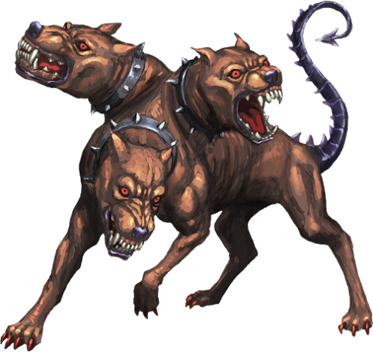
Conclusions:
Mu2e Target attempts to satisfy a three headed beast:
  Survive the harsh thermal environment
  Maximize stopped muons
  Maximize Extinction Monitor performance.
To put a face on the Problem…

Slide 20



Conclusions:
Mu2e Target attempts to satisfy a three headed beast:
  Maximize stopped muons
  Maximize Extinction Monitor performance.
  Survive the harsh thermal environment
And these three requirements conflict with one and another.

Slide 21
Back-Up Material
  Simulation Tools Used
  Image of Model from G4 Beamline
  Stopped Muon Production for Various Target Diameters
  Stopped Muon Production vs Target Length
  Layout of the Mu2e Experiment
  Images of Targets Modeled and Simulated (G4, ANSYS)
  A few words about Active Cooling

Slide 22
Some Back-Up Slides from Kevin Lynch, York College/CUNY :
Yields are calculated on the grid with G4Beamline 2.16
  Geant4 9.6p2
  QGSP_BERT
Power deposition is calculated off the grid with G4Beamline 3.04
  Geant4 10.3
  QGSP_BERT
Our beam has been held constant:
  8 GeV KE
  7.3 kW average power

Slide 23
From Kevin Lynch, York College/CUNY :
Software
  G4Beamline for yields and power deposition
  ANSYS for thermal and stress analyses
Pros
  Significantly reduced temperatures through increased surface area
Cons
  Increased pion reabsorption reducing muon yields
  Additional thermal stresses at fin/core interface
  More complicated fabrication

Slide 24
From Kevin Lynch, York College/CUNY:
TDR Target
  Bicycle wheel design
  Refractory metal: Tungsten
  Pencil sized cylinder:
    3.15 mm radius
    160 mm length
  Conical hubs
    ~ 25 mm at 42º
1mm tungsten spokes
  Ball and socket at hub
  Sprung attachment to wheel
~ 700 W power absorption
~ 2000 K temperature

Slide 25
Kevin Lynch Plot of target diameter vs muons vs Beam Sigma:

Slide 26
Kevin Lynch Plot of target diameter & length vs muons :

Slide 27
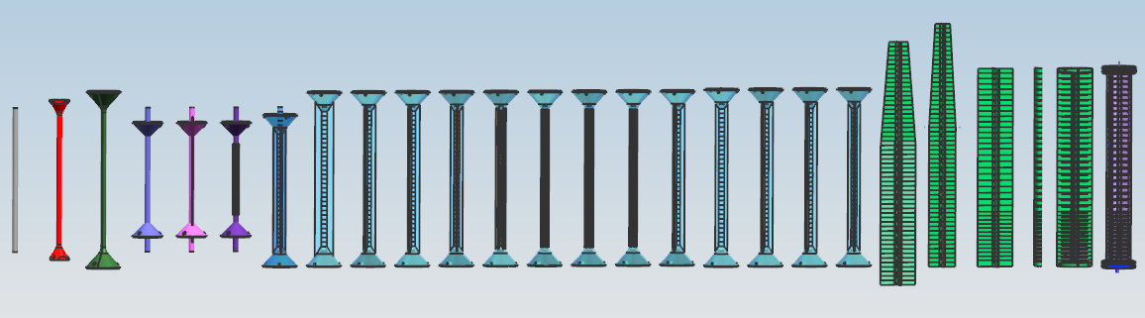
Examples of Targets Modeled, with Edep and FEA Performed:

Slide 28
Why Radiatively Cooled, and not Actively Cooled?
Previous MECO (a similar experiment proposed at BNL) was to use a water cooled gold target and a 50 kW, 8 GeV beam
FNAL Mu2e proposed 25 kW, 8 GeV beam with a water cooled target.
Then the cost scrubbing…
  Baselined with a radiatively cooled target & Lower beam power to reduce project cost.
Project does not have sufficient remaining contingency to approve a change to add an actively cooled target into the scope.
That doesn’t preclude some work by TSD (off project) to scope an actively cooled target being.

