Slide 1
Optics of the LBNF Primary Proton Line
“Lucky 13”
John A Johnstone
TSD Monthly Meeting.
March 21st, 2019

Slide 2
The other “Lucky 13”

Slide 3
Outline
Design Overview
  Trajectory
  Magnets
  Optics
    Lattice Functions
    Beam Envelope & Magnet Apertures
    Final Focus & Spot Size Tuning
    MI-10 Extraction
Summary
Moving Forward
Other
  Sensitivity to Gradient Errors
  Trajectory Control
  MARS Confirmation of Lossless Extraction
  Magnet Parameters
  Final Focus Gradients
  Conflict Examples Revealed by 3D Modeling

Slide 4
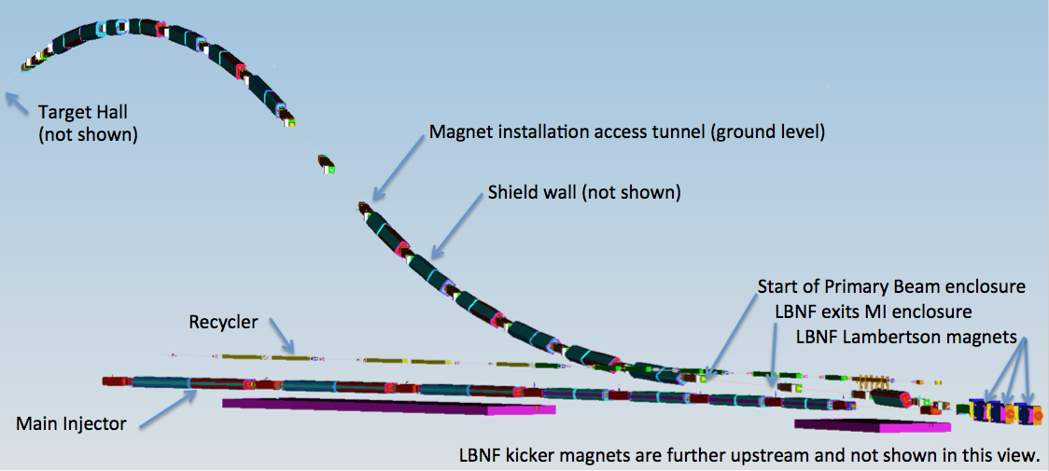
Trajectory (1)
Beam is extracted vertically from MI-10 via 6 horizontal kicker modules d/s of MI quad Q100, and 3 Lambertsons plus a C-magnet straddling MI Q102.
A rolled dipole steers the beam through the enclosure wall, while bisecting the MI & Recycler magnet elevations.

Slide 5
Trajectory (2)
In the LBNF tunnel 12 rolled dipoles (grouped as 3 sets of 4) bend the beam 7.2º horizontally to align with SURF in South Dakota, and upwards by 143 mr.

Slide 6
Trajectory (3)
A second series of vertical dipoles bend the beam down through 244 mr to complete vertical alignment to SURF, with φ = -101 mr.
Target elevation is fixed at 750 ft (~10 ft above grade) & maximum BLC elevation is 770 ft (~3 stories above grade).
Distance from MCZERO (Target) to center of FD = 1286873.76 m ±

Slide 7
Magnet Complement
All major magnets are well-understood, proven designs
  In the main body of the line all dipoles are Main Injector-style IDA (6m) & IDD (4m) magnets
  Quadrupoles are all of the MI-style 3Q120 (3.048 m) or the shorter 3Q60 version (1.524m)
  New IDS trims have 3” pole tip gap & design spec of 250 μr (RMS).
  IDA sagitta = 11.7 → 18.6 mm c.f. 16 mm design nominal
  IDD sagitta = 5.2 → 8.3 mm c.f. 7 mm design nominal
Magnet | Common Name | Steel Length | Strength at 120 GeV | Count
RKB | LBNF Extraction kicker | 1.295 m | 0.0589 T | 6
ILA | MI Lambertson | 2.800 m | 0.532 / 1.000 T | 3
ICA | MI C Magnet | 3.353 m | 1.003 T | 1
IDA | MI Dipole 6 m | 6.100 m | 1.003 – 1.604 T | 13
IDD | MI Dipole 4 m | 4.067 m | 1.003 – 1.604 T | 12
QQQ | MI 3Q120 quadrupole | 3.048 m | 9.189 – 16.546 T/m | 17
QQU | LBNF 3Q60 quadrupole | 1.524 m | 11.135 – 17.082 T/m | 4
IDS | LBNF trim dipoles | 0.305 m | Up to 0.365 T | 23

Slide 8
Optics Overview
To avoid losses the beam size in the LBNF transfer line can not exceed that of the Main Injector circulating beam.
The ultra-clean transport requirements virtually compel the lattice to be configured from distinct optical modules.
  MI→LBNF matching
  LBNF 120º FODO cells
  Final Focus on target
Every focusing center has a dual-plane BPM & dipole corrector
Every half-cell has space reserved for a multi-wire or other diagnostics.
Spot-size on target must be tunable over a wide range: from σ ~ 1.0 → ~4.0 mm to accommodate a beam power upgrade to 2.4 MW.
Physics dictates it must also be continuously tunable over the range 60 → 120 GeV/c for optimizing the neutrino oscillation spectrum.
To satisfy these conditions β* must be tunable by a factor of x32 over this range (!).
___________________________________________________________________________________________________
Subsequent discussions , unless stated otherwise, assume nominal MI beam parameters of ε₉₉= 30π mm-mr (normalized) & Δp₉₉/p = 11.e-4, with σ* = 1.70 mm.

Slide 9
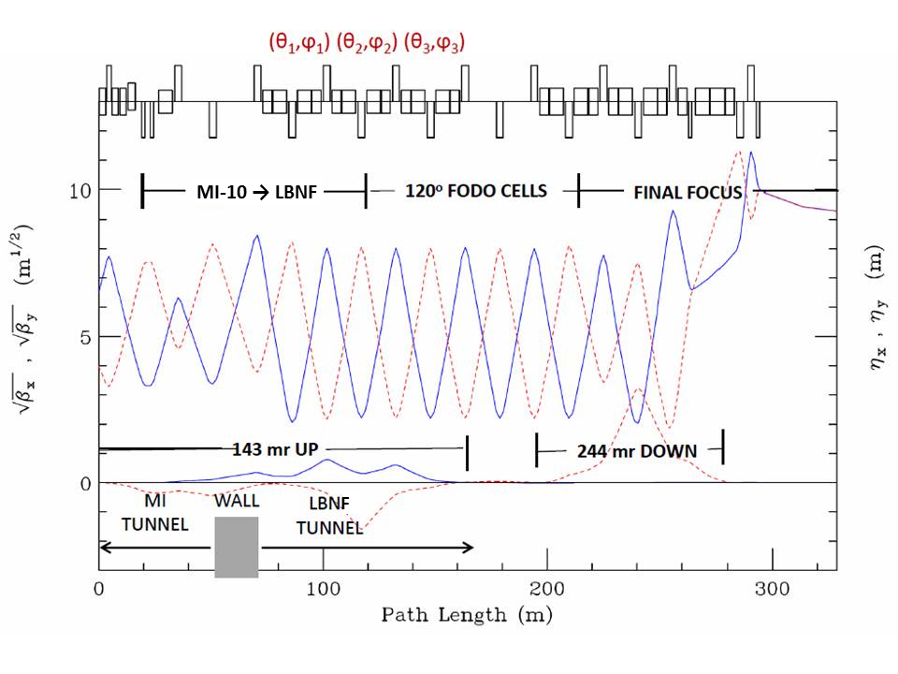
Lattice Functions
Horizontal (solid) and vertical (dashed) lattice functions of the LBNF transfer line
[Dipoles are represented by boxes centered on the top axis, and quadrupoles are boxes extending up (F) and down (D)]
The final focus is tuned for σ_{x} = σ_{y} = 1.70 mm at 120 GeV/c with β* = 110.88 m with nominal MI beam parameters
ε₉₉ = 30π mm-mr & Δp₉₉/p = 11x10⁻⁴
[

Slide 10
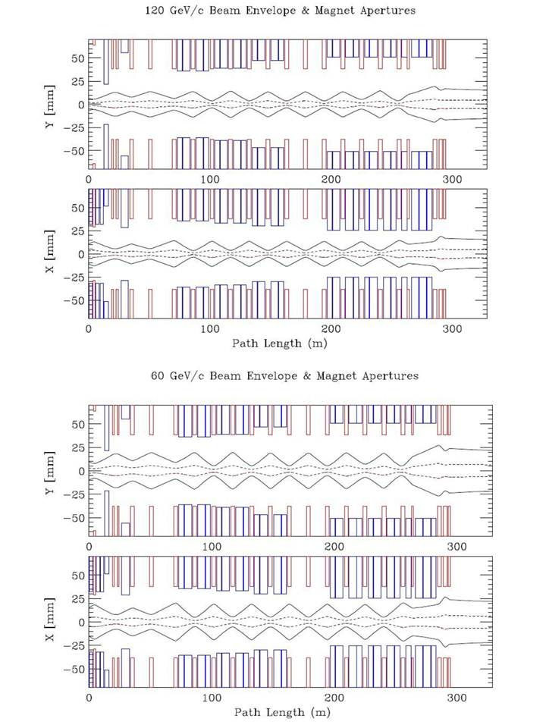
Beam Envelopes & Magnet Apertures
Dipole apertures, shown in blue, include the effects
of sagitta & rolls.
Quadrupole apertures are red.
The 99% envelopes (dashed) represent nominal MI beam parameters
[ ε₉₉ = 30π mm-mr & Δp₉₉/p = 11.e-4 ];
The 100% envelopes (solid) correspond to the MI admittance at transition .
[ ε₁₀₀ = 360π mm-mr^{Ϯ} & Δp₁₀₀/p = 28.e-4 (γ_{t} = 21.600) ]
The beamline can transport, without losses, the worst quality beam that the MI could conceivably spew forth.
__________________________
^{Ϯ} 360π mm-mr → 10.6σ for a Gaussian

Slide 11
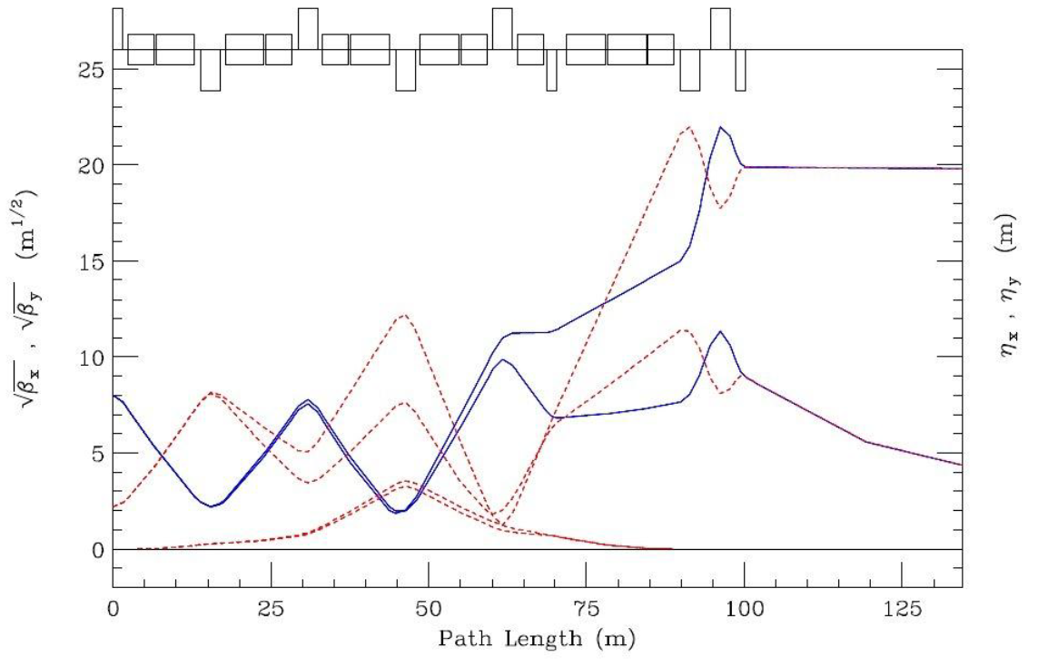
Final Focus & Spot-Size Tuning
120 GeV : σ* = 3.2mm
60 GeV : σ* = 1.0mm
η_{y}
The extremes shown correspond to: 60 GeV/c with σ* = 1.0mm; β* = 19.184m and βmax = 104m (lower), and; at 120 GeV/c with σ* = 3.20mm; β* = 393 m and βmax = 483 m (upper). Horizontal values are displayed as solid curves & vertical values are dashed.
[In principle the spot –size can be tuned to σ* = 4.00mm, but the 3.20mm shown is a self-imposed maximum limit of 360π mm-mr horizontal acceptance (10.6σ) in the final down bend].

Slide 12
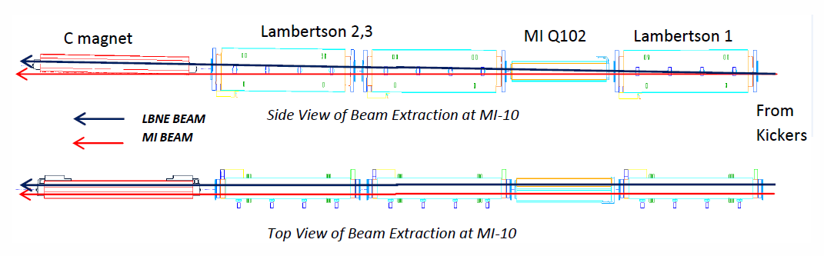
MI-10 Extraction (1) -- Extraction Element Configuration
LBNF BEAM
LBNF extraction Lambertsons and C-magnet straddling MI quad Q102
LBNF extraction elements and their configuration are clones of those found at other MI extraction points.

Slide 13
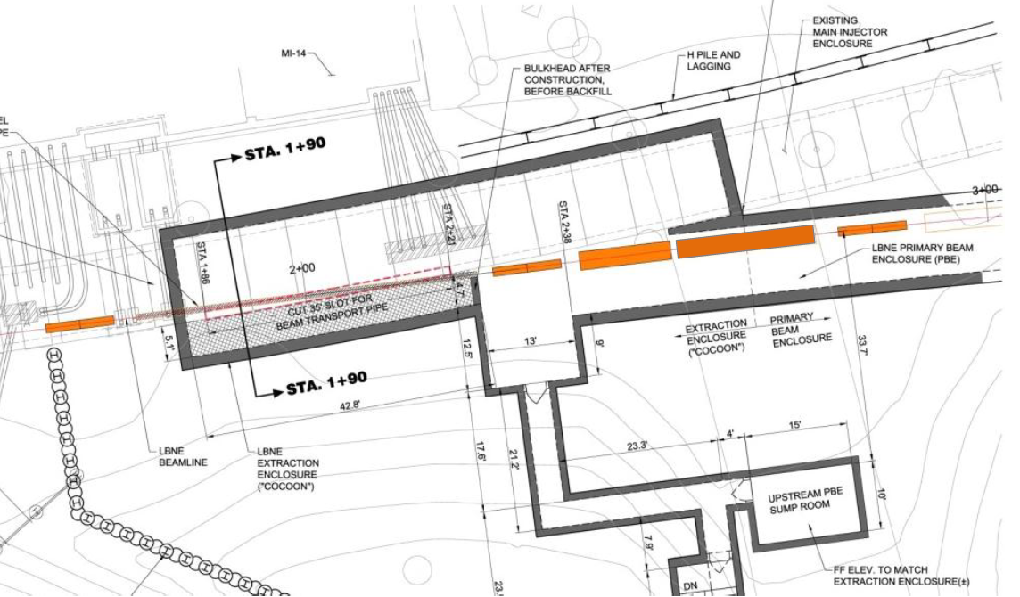
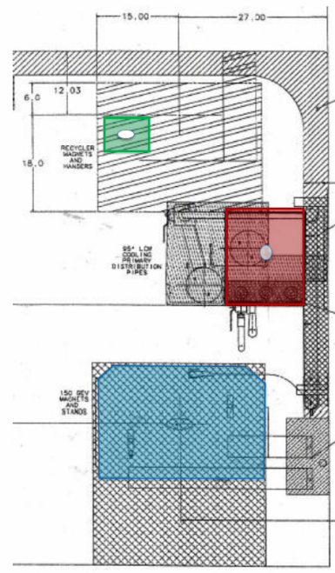
Extraction (2) -- MI-10 → LBNF Enclosure
Transport from the existing MI tunnel enclosure into the new LBNF enclosure showing the carrier pipe connecting the MI-10 & LBNF enclosures (left), and separation of Q203 at the u/s end from the Main Injector & Recycler Rings (right).

Slide 14
Extraction (3) -- Closed Orbit & Extracted Beam Trajectories
CLOSED ORBIT BUMP QUAD OFFSETS (mm) |  |  | EXTRACTION ELEMENTS
QUAD |  |  | MAGNET | LENGTH (in) | FIELD (T)
Q100 | 2.464 |  | KICKERS (6) | 51 | 0.0589 / module
Q102 | 2.358 |  | LAM1 | 110.25 | 0.5270
Q104 | 2.573 |  | LAM2 & LAM3 | 110.25 | 0.9985
Q106 | 2.154 |  | C-MAG | 132 | 0.9918
120 GeV/c parameters of the circulating & extracted beam elements.

Slide 15
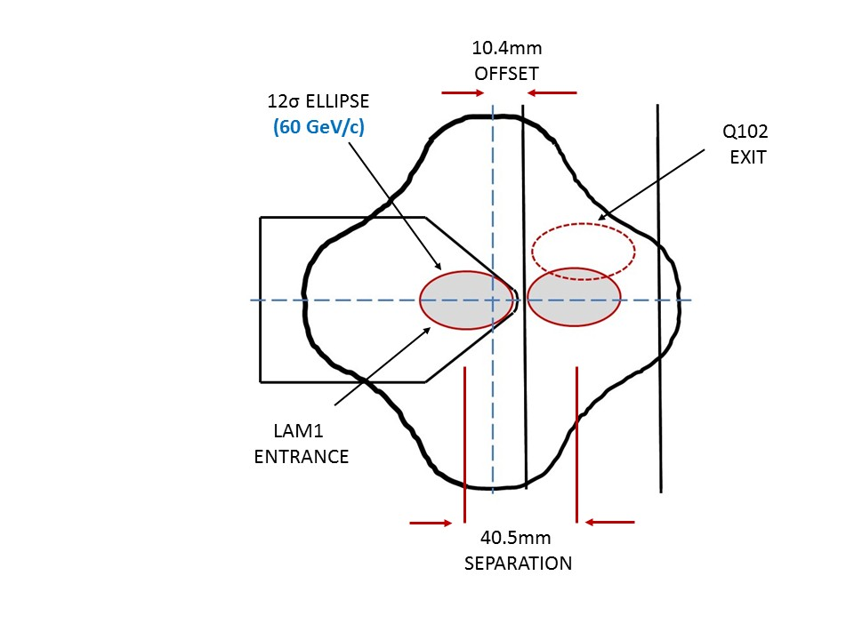
Extraction (4) -- Beam-Beam Separation in Q102
6 Kicker modules create 40.5 mm separation at the 1st Lambertson entrance between circulating & extracted beams.
Large Aperture Quad
5⁵/₈ x 5⁵/₈ Star Chamber
60 GeV/c Circulating & Extracted beam ellipses at the entrance to LAM1 and the exit from Q102. (ε₉₉ = 30π mm-mr )

Slide 16
Summary to date
Beam is extracted at MI-10 & transported to a target above grade.
The lattice design is comprised entirely of proven MI-style magnets.
MI-10 extraction configuration & the beamline provide for loss-free transmission of a 10.6σ beam.
The final focus is continuously tunable from σ* = 1.00 → 4.00 mm over the entire momentum range 60 → 120 GeV/c

Slide 17
After 3 years or so enforced LBNF beamline hibernation . . .
'Fight on, my men,' Sir Andrew sayes,
'A little Ime hurt, but yett not slaine;
Ile but lye downe and bleede a while,
And then Ile rise and fight againe’.
Lattice design is up & running again – major design features are all stabilized, but small adjustments are still needed:
  A few minor interferences still need to be resolved
  Some additional instrumentation & devices are being added
  Positions of a corrector/multiwire+bpm package are being interchanged in the FF triplet to improve steering control.
  Center of the far detector shifted by ~50m during the beamline hiatus so the line now needs to be re-aimed.
Coraggio ! Avanti !
Ω

Slide 18
Other
  Sensitivity to Gradient Errors
  Trajectory Control
  MARS Confirmation of Lossless Extraction
  Magnet Parameters
  Final Focus Gradients
  Conflict Examples Revealed by 3D Modeling

Slide 19
Sensitivity to Gradient Errors
Not An Issue!
Experience has shown the MI-style 3Q120 quadrupoles to be of very high accelerator quality^{Ϯ}
  σ(ΔG/G) ∼ 0.08% or less, which can be reduced even further for the FODO section with only rudimentary sorting.
  A simple thin-lens calculation predicts that even the largest error-wave generated in the 99% beam envelope [±3.74mm at β = 59.6m] would be < 70 microns.
_________________________________________________________________
Ϯ Magnet Test Facility measurement data base.

Slide 20
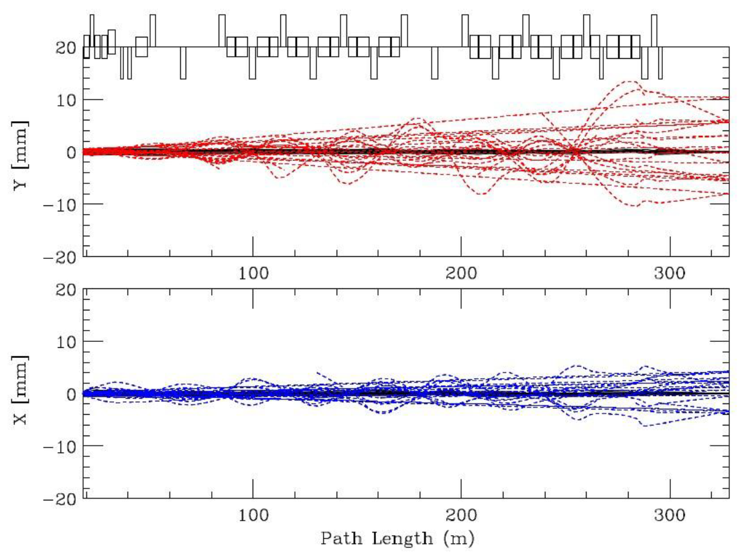
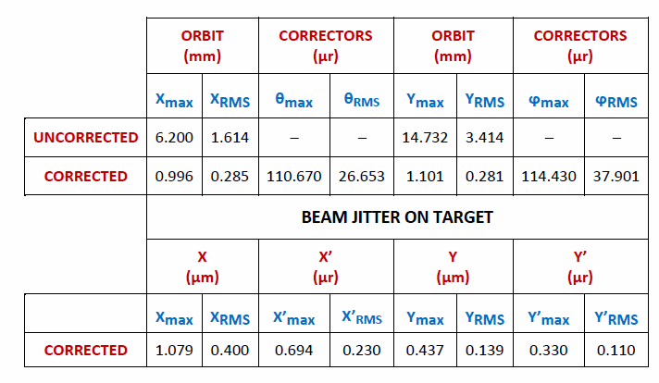
Trajectory Control
Misalignments (including BPM’s)Ϯ
  σ(Δx,Δy) = 0.25 mm
  σ(ψ_{roll}) = 0.50 mr
Dipole Field Errors
  σ(ΔB/B) = 10e-4
Uncorrected/corrected trajectories with random misalignments and dipole field errors
(Corrected trajectories appear as solid black)
The plot begins at the u/s end of the 1st Lambertson.
________________________________
Ϯ Main Injector Technical Design Handbook
New IDS design spec is 250 μr (RMS).

Slide 21
MARS Confirmation of Lossless Extraction (1)
The extraction region in MI-10 was modeled in MARS for tracking
A 4-dimensional (x,x’ ; y,y’) surface in phase space was populated with a 360π mm-mr (100%, normalized) emittance in both planes.
10,000 particles were tracked through to the end of the 3rd Lambertson.

Slide 22
MARS Confirmation of Lossless Extraction (2)
Entrance & exit of Q102
No particles were lost on any aperture

Slide 23
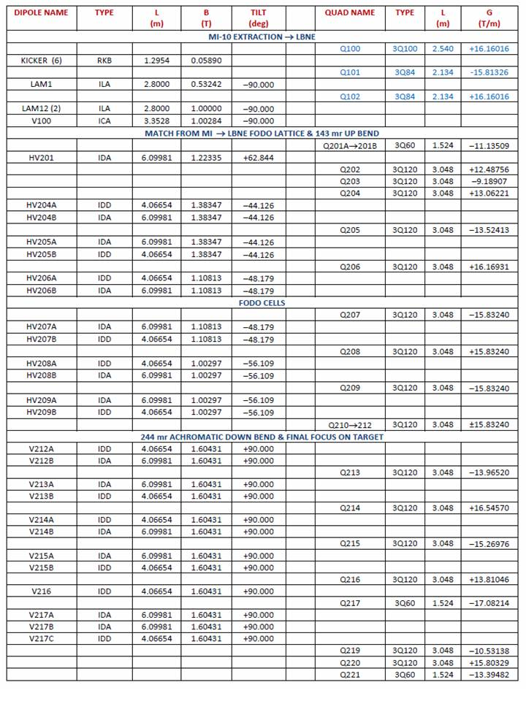
Magnet Parameters

Slide 24
Final Focus Gradients for Extremes of Spot-Size Parameters
 |  |  | σ = 1.00mm @ 60 GeV/c β* = 19.184 m | σ = 3.20mm @ 120 GeV/c β* = 392.89 m
QUAD | TYPE | L (m) | G (T/m) | G (T/m)
Q213 | 3Q120 | 3.048 | −6.97624 | −12.01223
Q214 | 3Q120 | 3.048 | +8.40581 | +17.38185
Q215 | 3Q120 | 3.048 | −7.64787 | −14.48899
Q216 | 3Q120 | 3.048 | +7.03514 | +7.68385
Q217 | 3Q60 | 1.524 | −8.56034 | −3.99561
Q219 | 3Q120 | 3.048 | −6.66201 | −11.74485
Q220 | 3Q120 | 3.048 | +10.76572 | +15.68461
Q221 | 3Q60 | 1.524 | −10.11021 | −12.62987

Slide 25
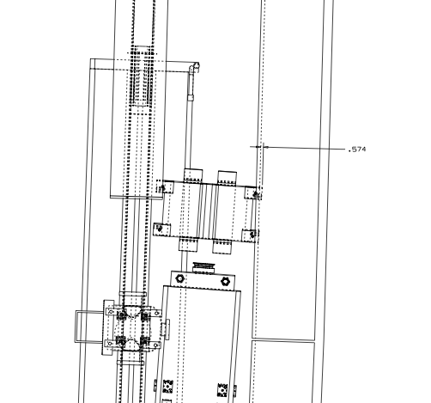
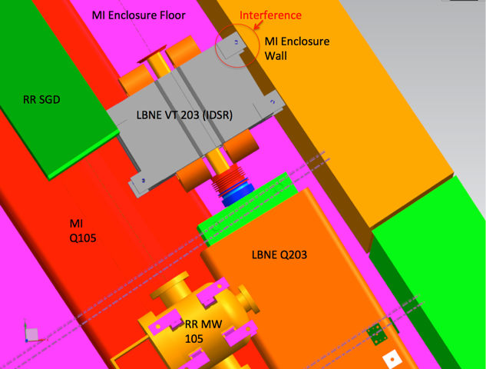
Conflict Example #1: VT203 – MI Tunnel Wall
Problem:
  Trim IDS embedded in wall
Resolution:
  Interchange the d/s corrector and the u/s multiwire plus BPM

Slide 26
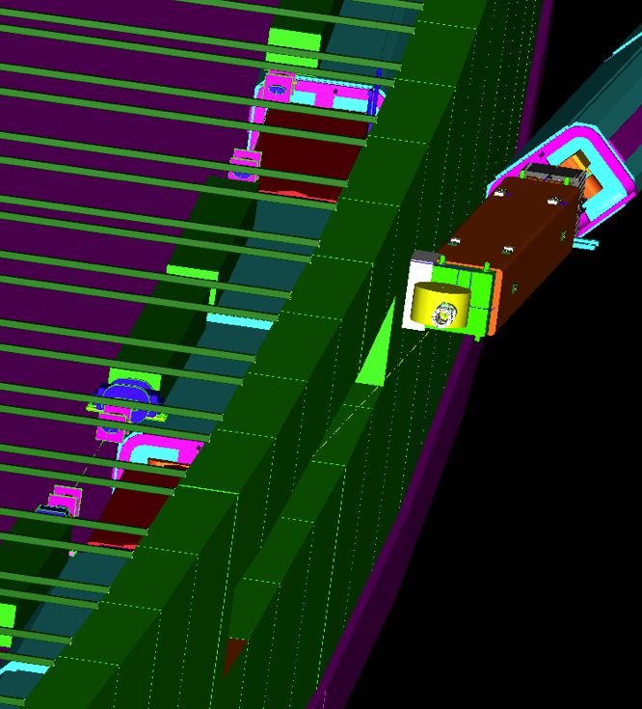
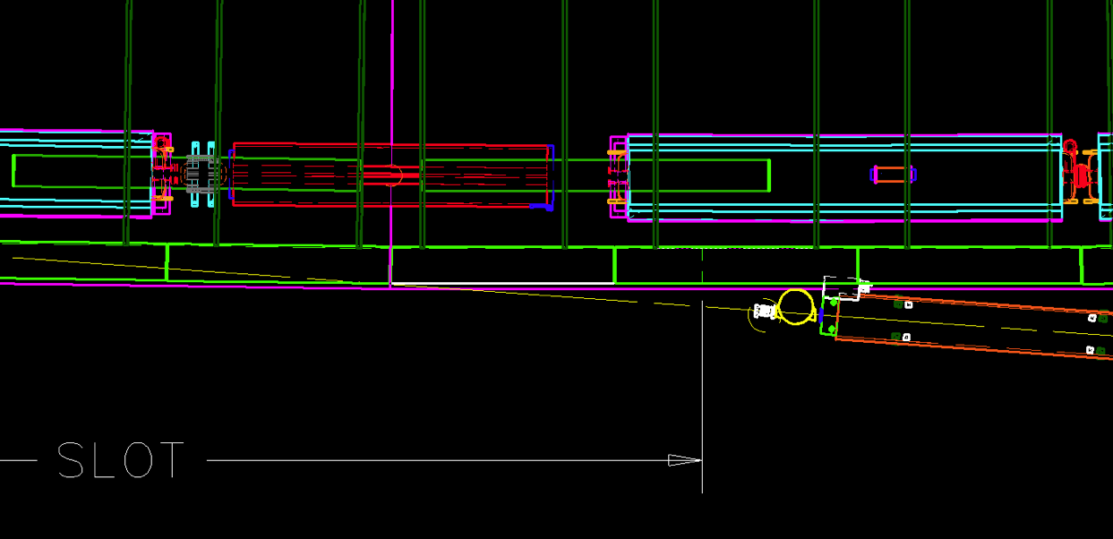
Conflict Example #2: Q204 – LBNF Enclosure Wall
Problem:
  Q204 u/s water manifold embedded in wall.
Resolution:
  Reverse quad installation direction
  Roll through 90º to get the water connections out of the aisle & onto the top of the magnet.

Slide 27
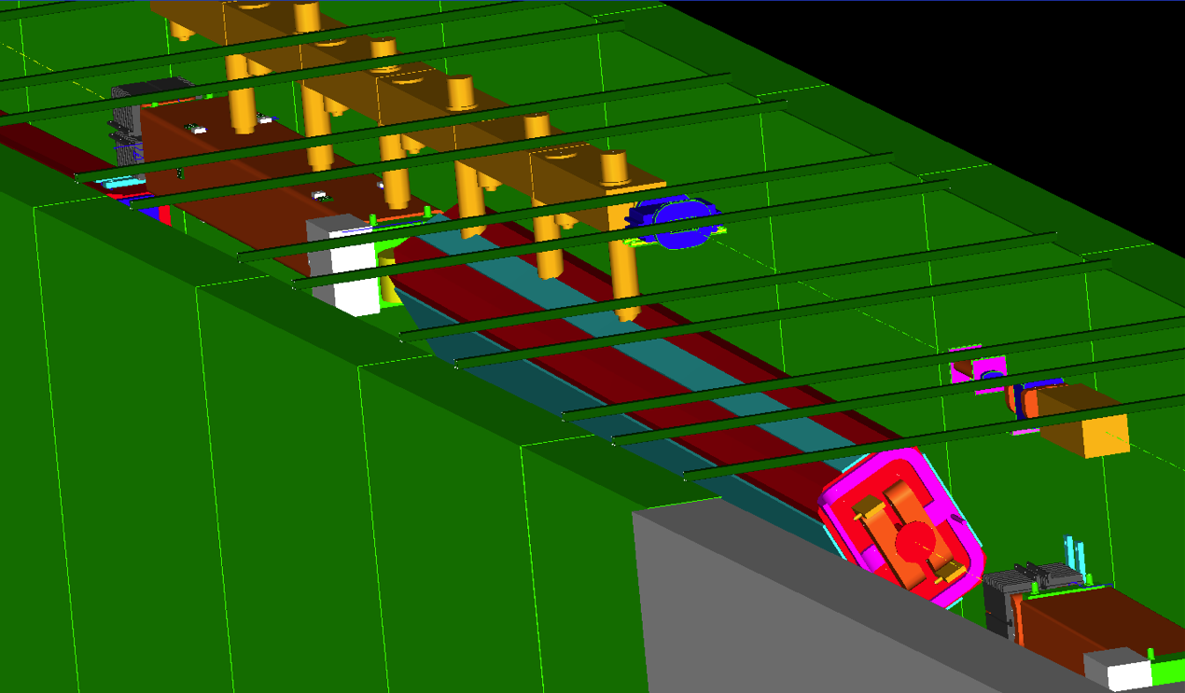
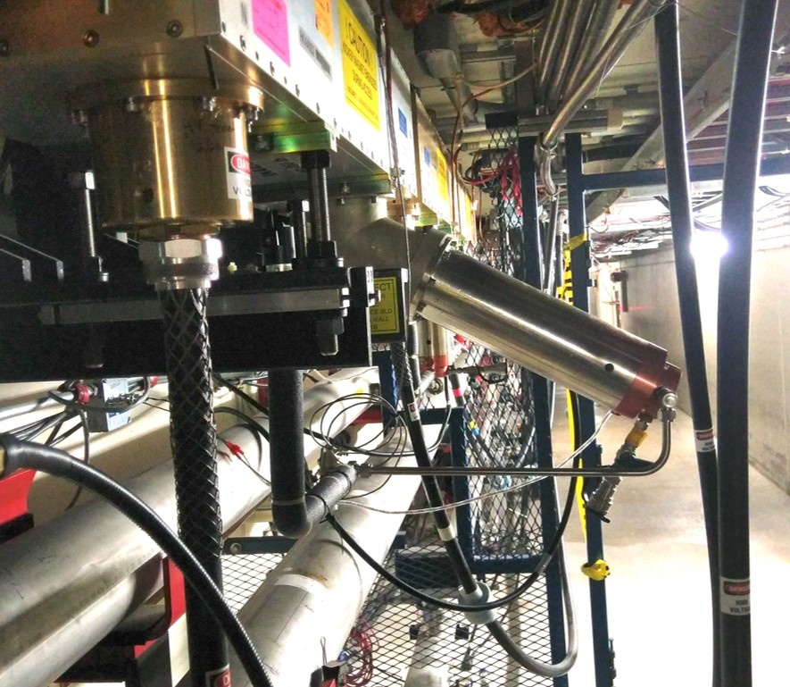
Conflict Example #3: RR Kickers -- HV201
Problem:
  RR kickers embedded several inches into LBNF dipole HV201.
Resolution:
  Bend the RR kicker loads out of the way.
bent load

