Slide 1
Update in Signal Processing
Wenqiang Gu (BNL)
on behalf of the WireCell team

Slide 2
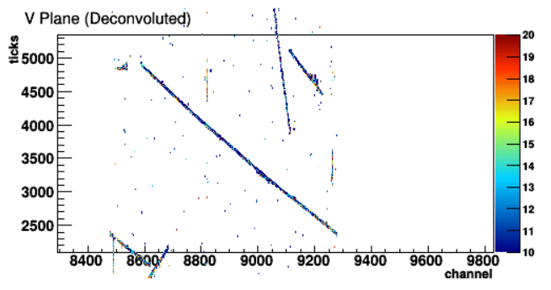
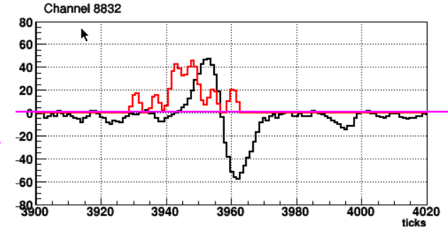
Issues
Run 5809, event 4503
Why is the double peak? (Field response?)
Why two peaks near the tails? (Wire filter? Field Response?
[Tingjun] strange SP results in some V plane channels
Multiple peaks after deconvolution, while expect a single peak

Slide 3
Basics of Signal processing (SP)
Previous talk
Principal method to extract wire charge S(t) is deconvolution
By given a response function R(t), signal S(t) can be easily derived via Fourier transform
A filter function F($ω$) introduced to suppress the big fluctuation after deconvolution
Fourier transform
Deconvolution + Filter
Inverse Fourier transform
Liquid Argon TPC Signal Formation, Signal Processing and Hit Reconstruction
Bruce Baller, JINST 12 (2017) no.07, P07010

Slide 4
Thoughts
Can we reproduce this feature in MC for a similar angle track?
If so, we would have a easier time to understand
If not, would indicate discrepancy in absolute field response
Field response
Why U plane seems to be fine?
If we use U plane response instead of V, what will the SP looks like?
Wire filter
How about remove the filter?
How about a harder filter?
Time filter
A harder filter?

Slide 5
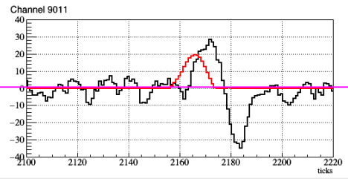
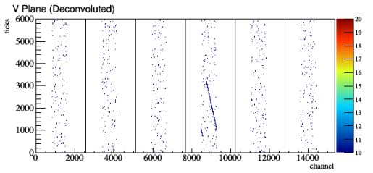
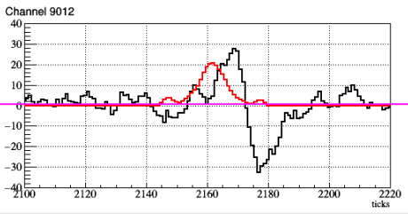
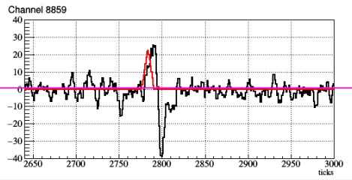
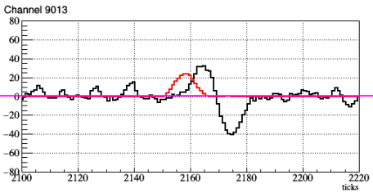
Wire-Cell drift simulation
Cannot reproduce the behavior in simulation

Slide 6
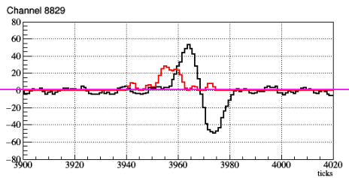
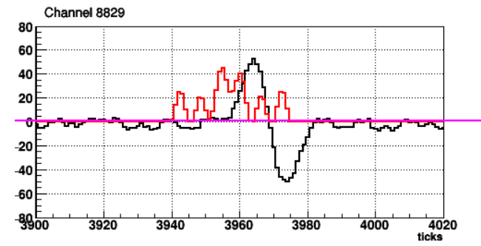
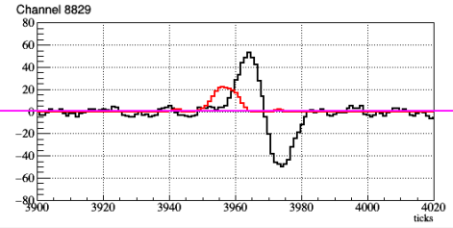
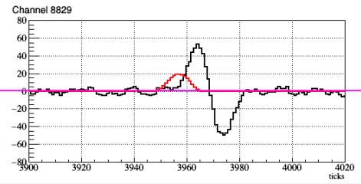
Investigations (i): Time high-freq. (HF) Filter
Sigma: 0.1
A tighter time filter can help
Default
Sigma : 1.11408e-1
Sigma: 0.09
Sigma : 0.2
Sigma: 0.08

Slide 7
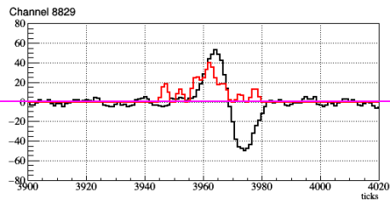
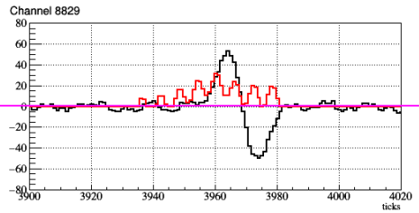
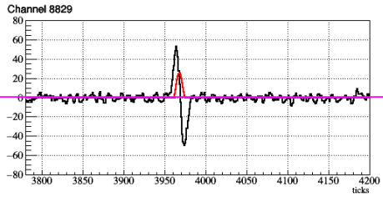
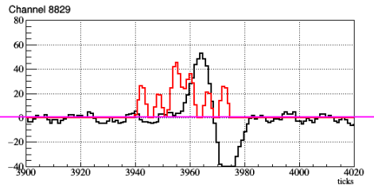
Investigations (ii)
Wire HF filter
- Change of wire filter does not help
Default
Sigma 3.0
Change response for V plane
U/V exchange
response
sigma 0.3
$μ$BooNE field response
sigma 6.0
Change of field response can help
Field response is the largest suspect given all evidence above

Slide 8
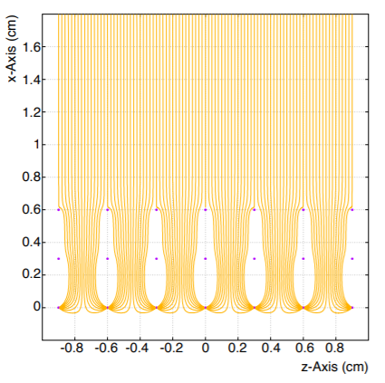
GARFIELD simulation: field response
Hanyu, Yichen
Ramo theorem
i = −q · Ew · vq
Electron drift path
in a GARFIELD simulation (2D)
Caveat: this is a uboone version
Field response: induced current as function of time

Slide 9
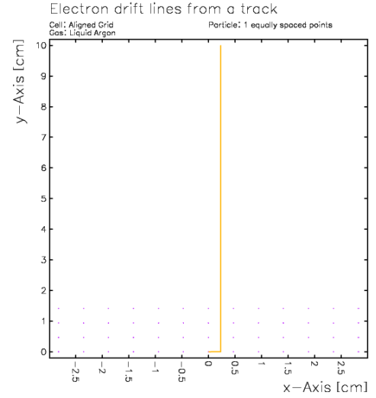
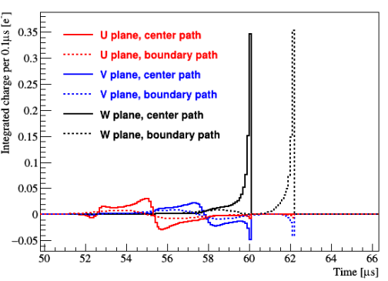
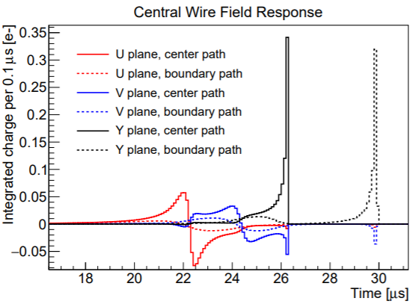
Central wire field response
Boundary drift path at 2.355mm
protoDUNE
(old version)
~4$μ$s
At boundary (saddle point), zero E-field
Field response simulation is not precise:
2D geometry & absence of electron diffusion
$μ$BooNE case
- Collection of the boundary-path electron is largely delayed

Slide 10
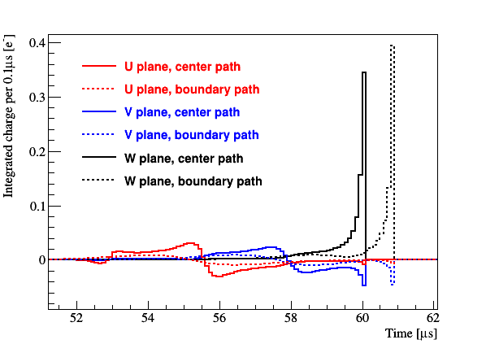
Revised field response simulation
Boundary path
2.355mm => 2.2608 mm
Central wire field response
Solution: slightly push the electron off the boundary in the GARFILED simulation
In real case, a 3D field response simulation would reduce the number of saddle points
Electron diffusion would further eliminate saddle points

Slide 11
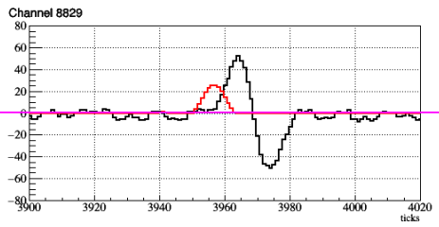
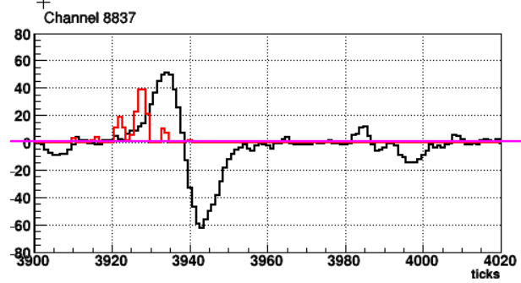
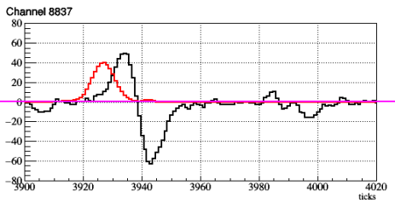
Improvement with the revised field response
Run 5809, event 4503
Revised field response

Slide 12
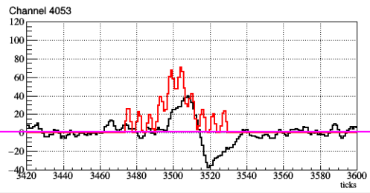
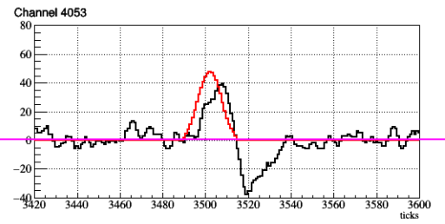
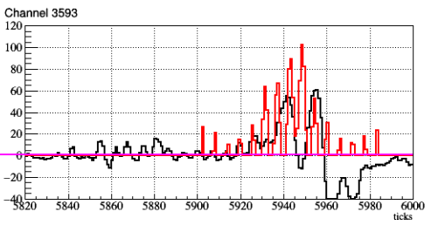
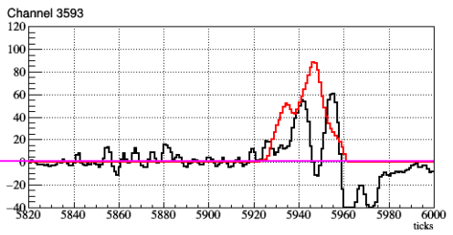
More examples in run 5387, event 23467
Revised field response

Slide 13
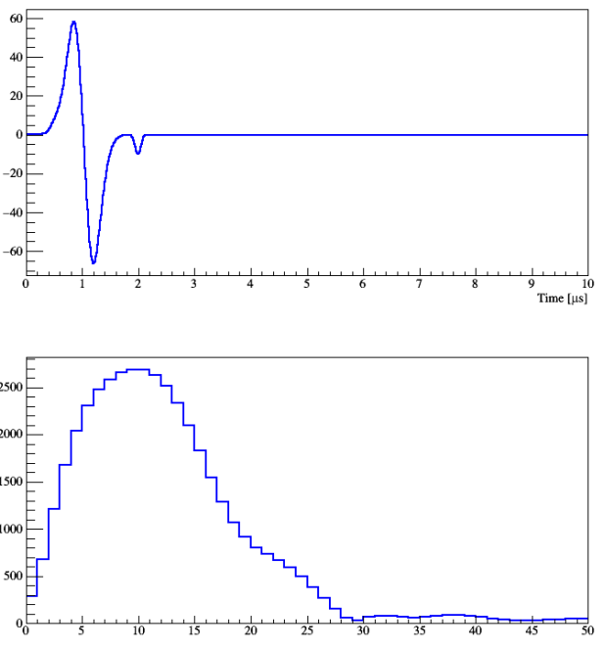
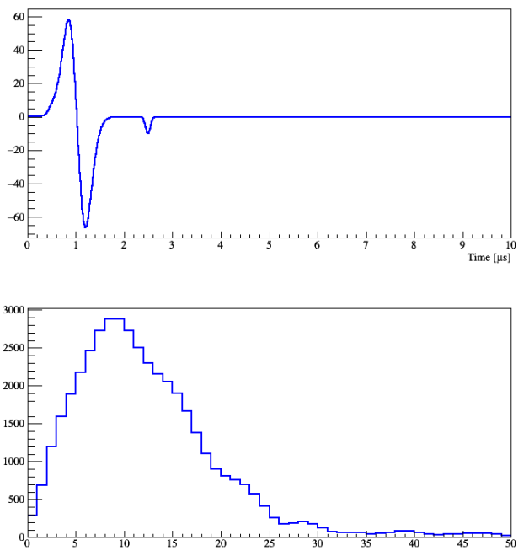
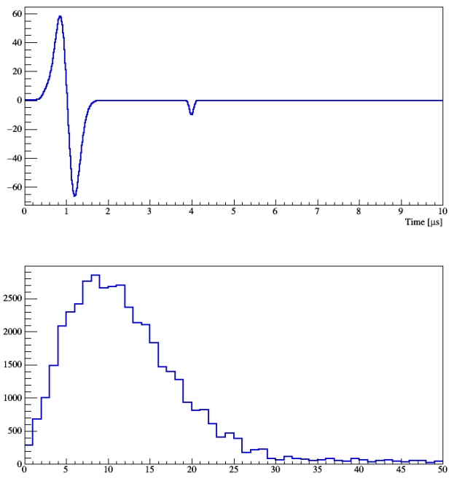
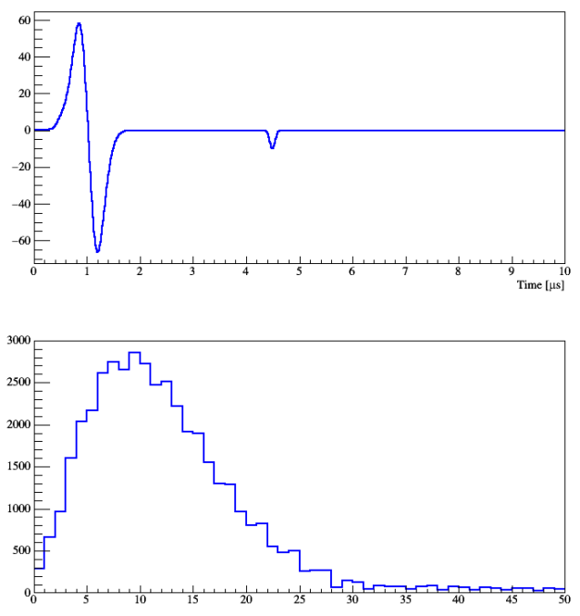
Discussion
Q: Why U plane doesn’t have such issue?
Q: Why is there no double peaks w/ uboone’s field response?
Answer to both: Because the collection of boundary-path electron is largely delayed for U plane or in the uboone case.
impulse
Freq. spectrum
small signal: t= 2 us
t= 2.5 us
t= 4 us
t= 4.5 us
A non-quantitative illustration:
If the small impulse is largely delayed, it is negligible (4us vs. 4.5us)
Otherwise, the frequency spectrum is very sensitive (2us vs. 2.5us)

Slide 14
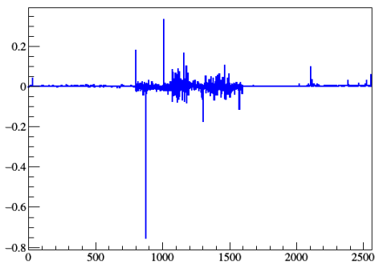
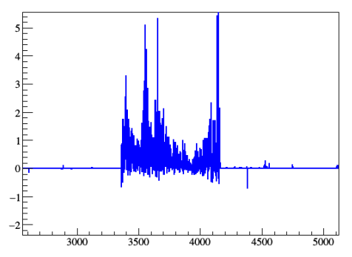
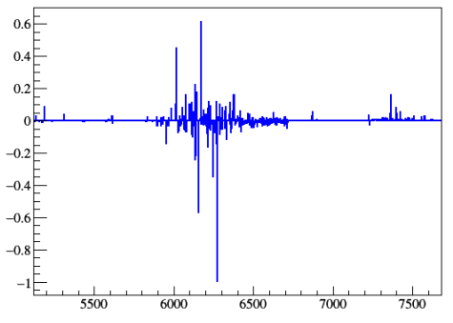
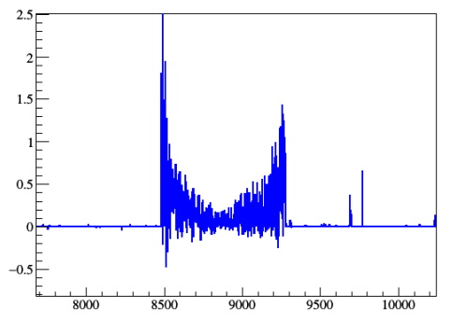
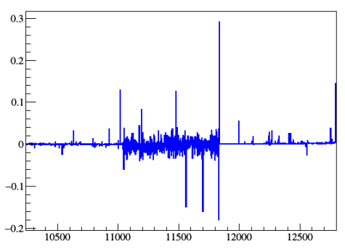
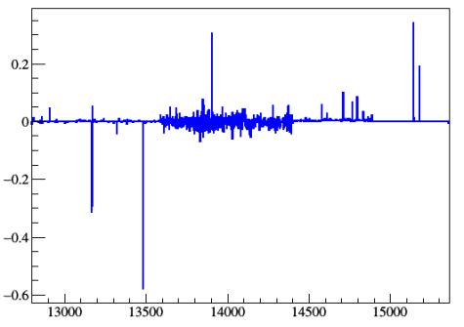
Charge bias: (Q_{old} – Q_{new})/Q_{new} vs. channel
No charge bias in collection plane
run 5387, event 23467
channel

Slide 15
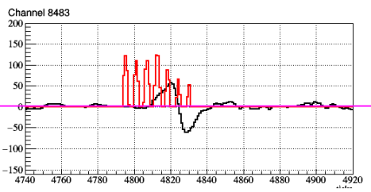
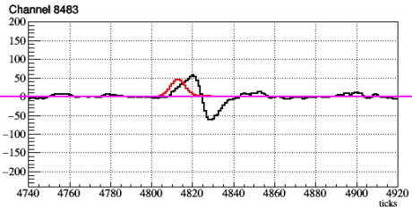
Change in charge reconstruction of induction channels (V plane) is understood:
Poor reconstruction previously
(Q_{old} – Q_{new})/Q_{new}
Revised field response

Slide 16
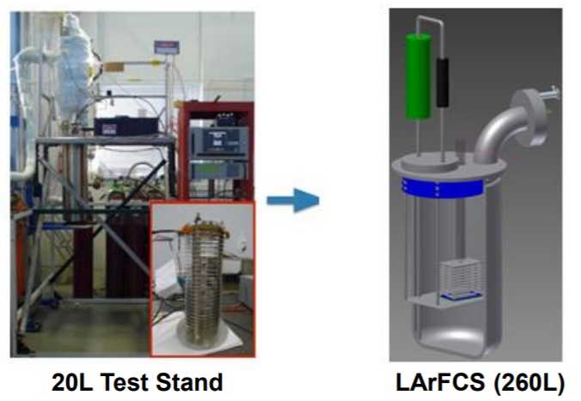
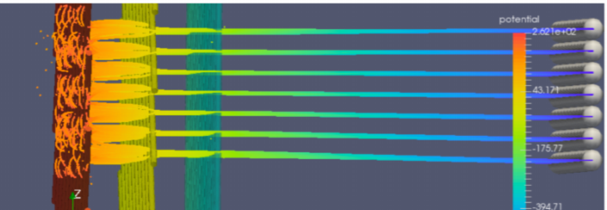
Current efforts in studying 3D field response
LArFCS @BNL
A dedicated test-stand facility would greatly aid in validating the residual 3D effect to a 2D field response calculation
3D simulation
Brett Viren @BNL is exploring a Boundary Element Method solution

Slide 17
Summary
An issue of SP in some V-plane channels is visited, a good practice before we fine tune the SP algorithm
More precise measurement and 3D simulation can be done in the future

Slide 18
Backup slides

Slide 19
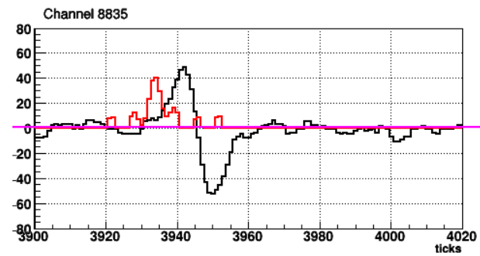
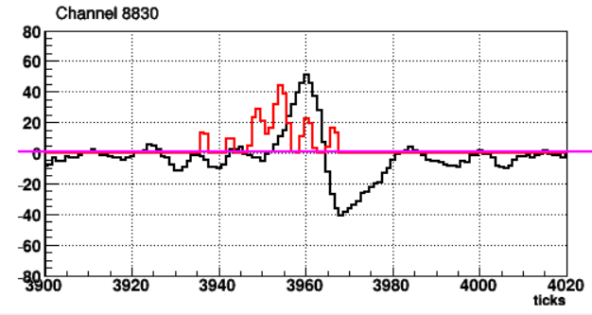
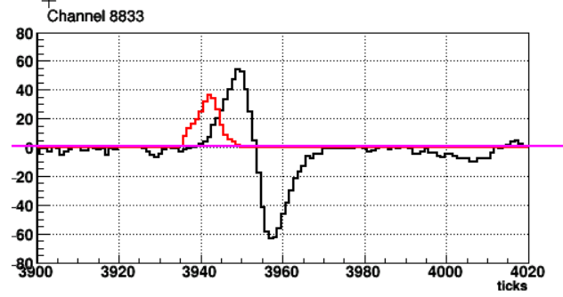
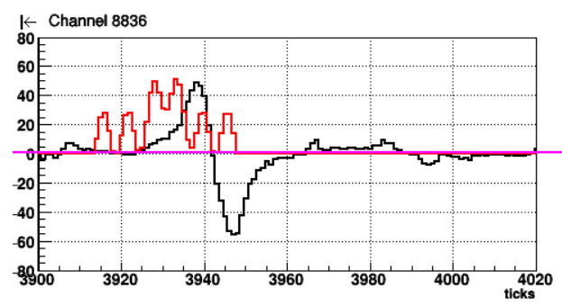
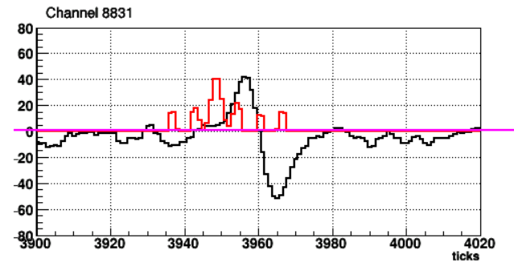
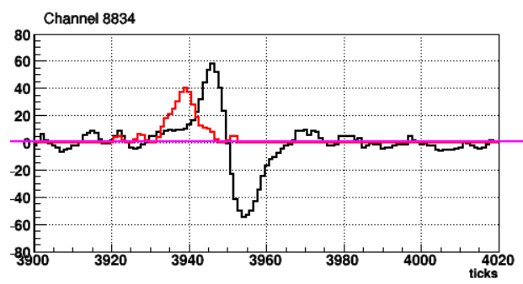
Observation in ProtoDUNE
Run 5809, event 4503

Slide 20
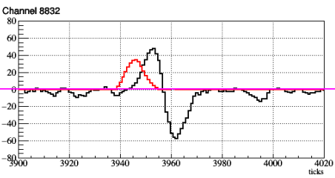
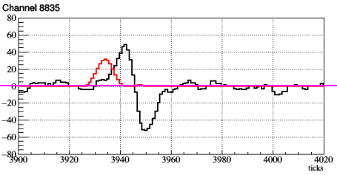
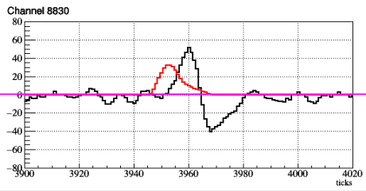
Updated SP result

Slide 21
V plane
V plane (revised)
GarField simulation: to avoid saddle point effect, the boundary electron is slight off by 0.1mm
A significant change of the “final” impulse due to the electron’s sudden velocity change at collection
boundary path
2.355mm
boundary path
2.2608mm
0.1$μ$s / tick

