Slide 1
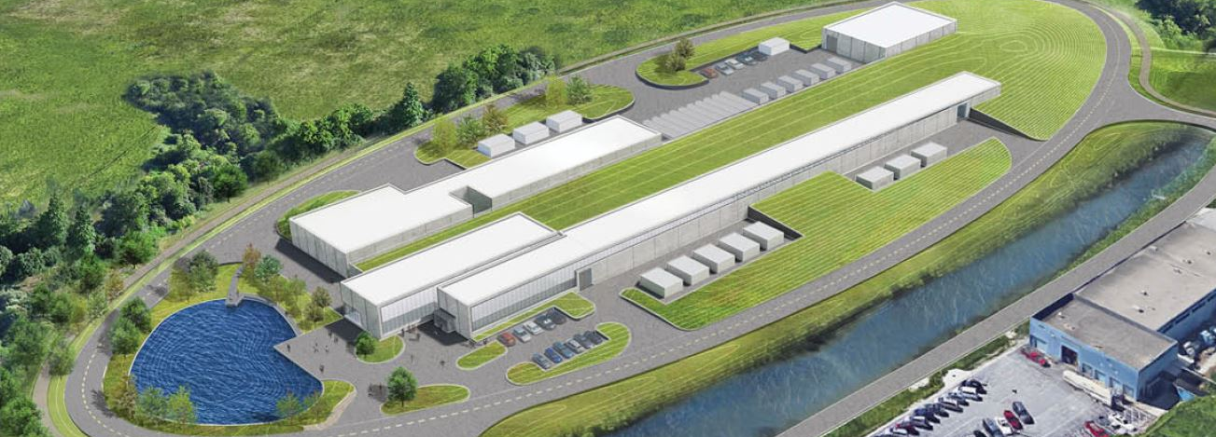
PIP-II Project Manager’s Report
Marc Kaducak
Project Management Group
20 Mar 2019

Slide 2
Outline
Staffing/Organization
Funding, financials
Technical Updates
CD-2/3a Preparations

Slide 3
Staffing
Project Controls Manager:
  Contractor was scheduled to start 11-Mar, but withdrew. Position re-opened.
Quality Assurance
  QA Engineer started 18-Mar-2019

Slide 4
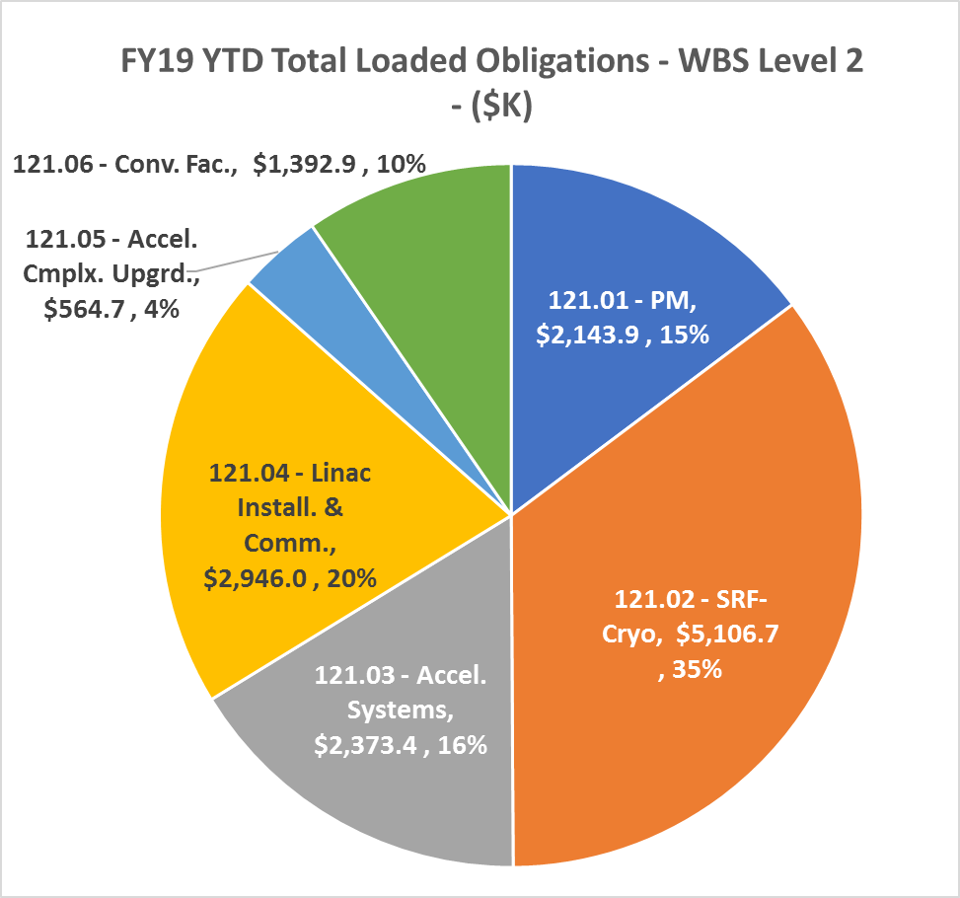
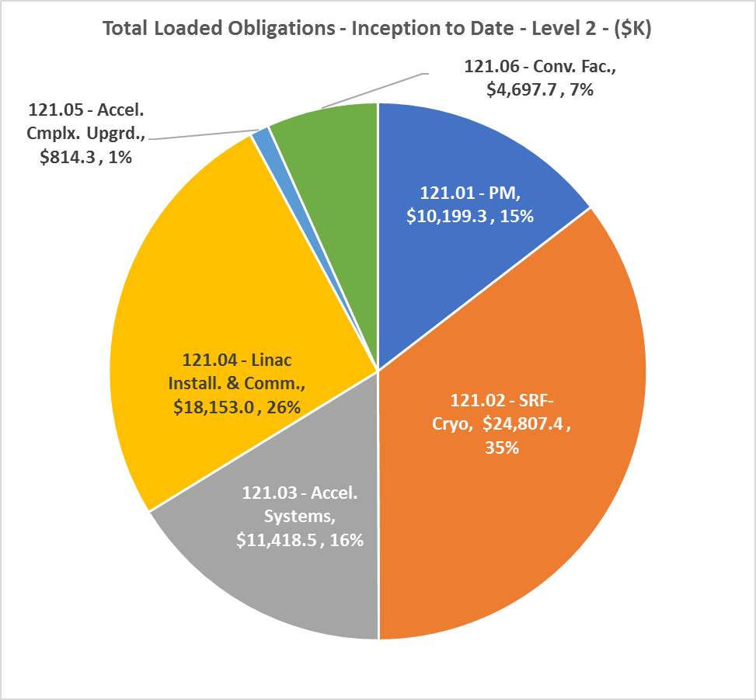
Financials Thru Feb. 2019
YTD FY19 | Inception to Date

Slide 5
ESH Update
State of Illinois Storm Water Industrial Activities Permit was issued March 1st for the PIP-II site.
Whittaker Construction was issued a Notice to Proceed for the PIP-II Site Clearing Contract on March 14th.
PIP-II Integrated Safety and Health Plan has been approved.
PIP-II Construction Safety and Health Plan has been approved.
PIP-II Safety by Design implementation documents have been approved.
P2MAC comments on the ESH Section of the Preliminary Design Report (PDR) have been incorporated.
Comments from the Fermilab review of the PIP-II Hazard Analysis Report (HAR) have been incorporated. HAR is being reviewed to include P2MAC PDR ESH comments.
ESH Section Radiation Physics Science Department continues to assist with running MARS models of PIP2IT for the updated Shielding Assessment.
John Anderson met with Dave Mertz, Fermilab Electrical Authority Having Jurisdiction, to discuss electrical requirements for international in-kind contributions. Reviewed items to be included in requirements documents, what to expect from international partners, Fermilab’s electrical inspection process, code equivalencies, and lock out tag out provisions.

Slide 6



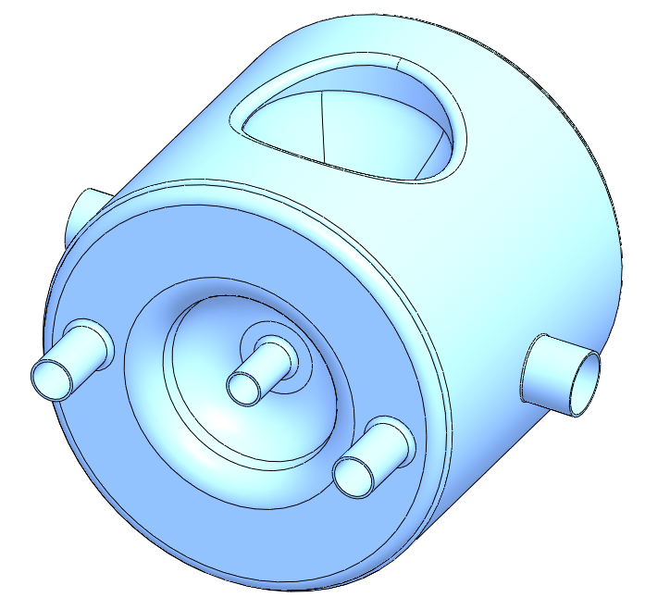
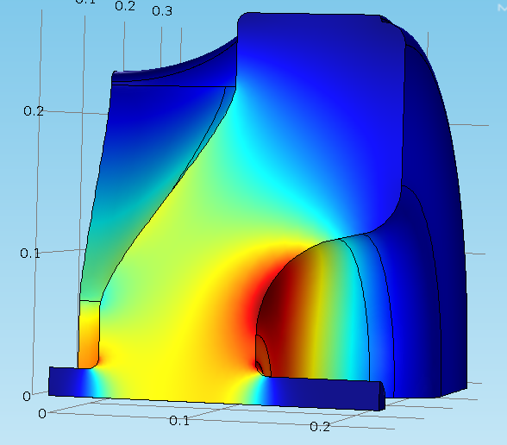

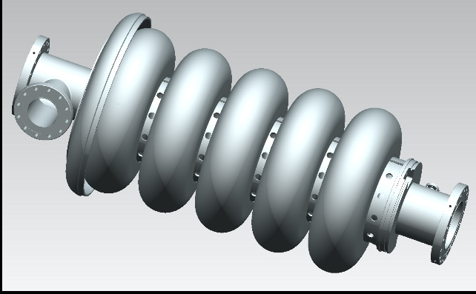
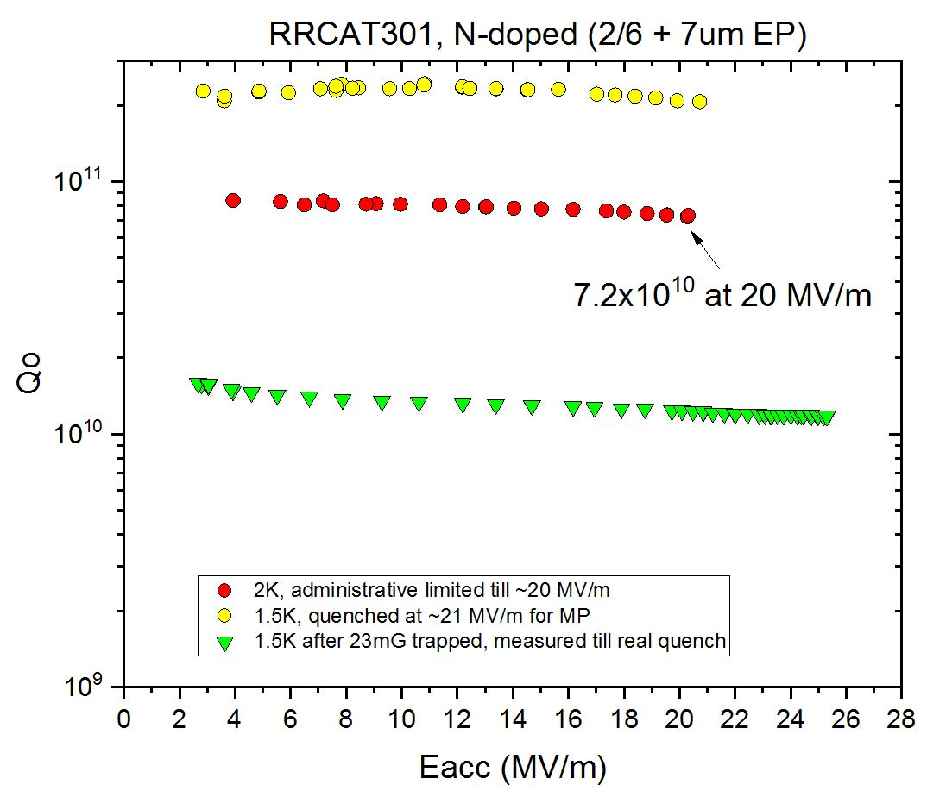

SSR2
Cavity RF design completed
Cavity mechanical design in progress
Prototype cavities expected in FY20
INFN 3D model of LB650 cavity
LB650
Cavity RF and mechanical design completed
Two prototype cavities will be delivered in 8/2019
HB650
Cavity RF and mechanical design completed
Cavity high Q R&D is in progress
Cryomodule design is in progress

Slide 7
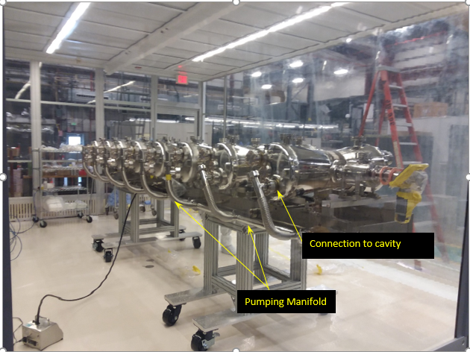
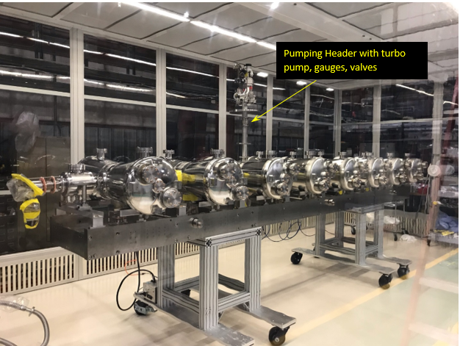
WBS 121.2 SRF Updates – HWR Cryomodule
  String is ready for pumpdown
    cavity vacuum manifold installed
    connections to all cavities made
    cavity pumping header (including turbo pump, gate valve, and vacuum gauges) installed
  Argonne Transportation fixture is being fabricated at vendor.
  Shipping quotes received from transportation vendors.
  Transportation test is scheduled in March and final transportation review in April.

Slide 8
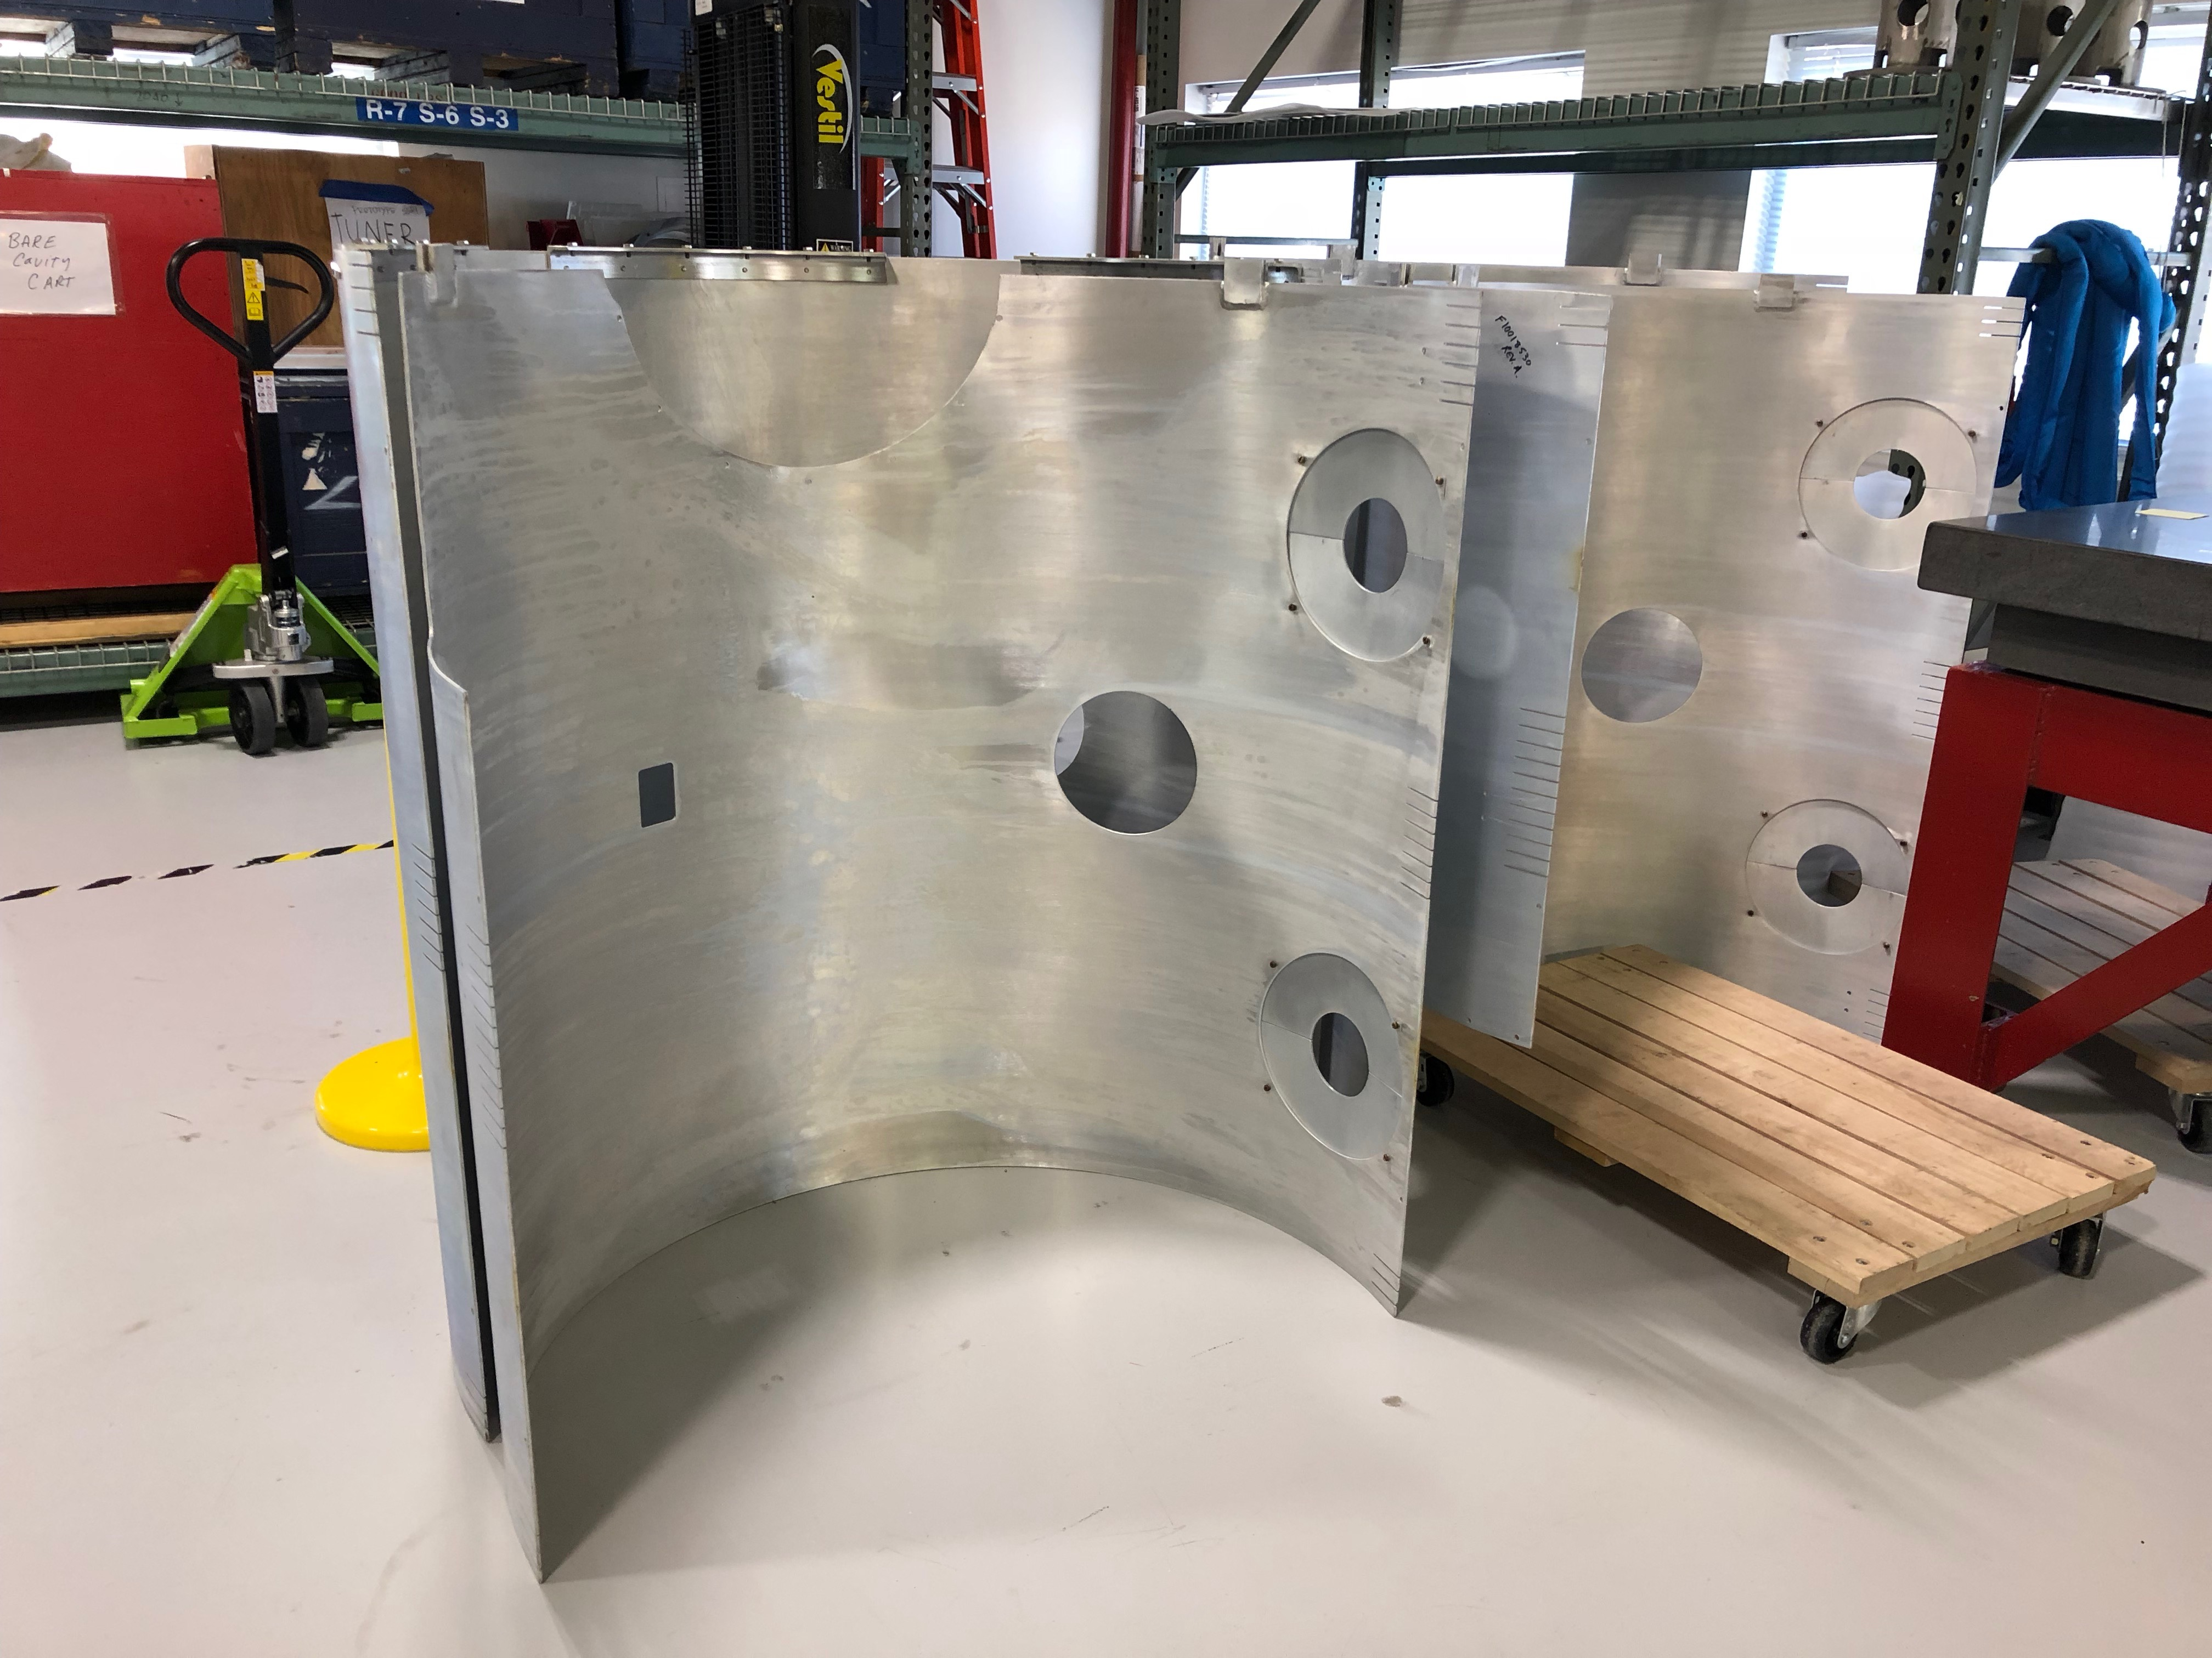
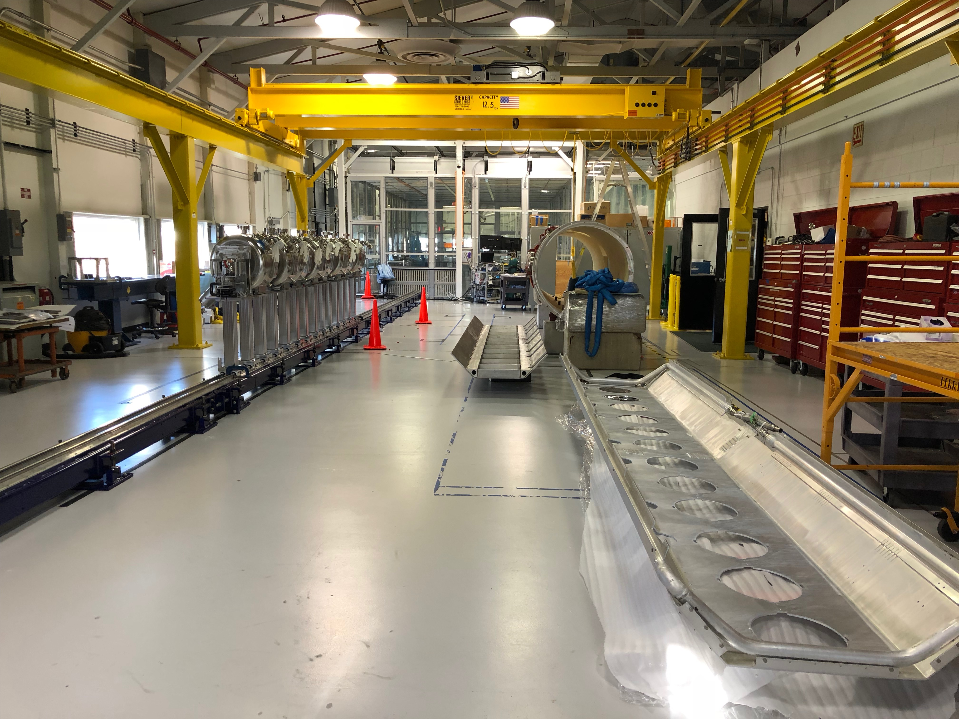
WBS 121.2 SRF Updates – SSR Cryomodules
SSR1: String assembly was completed.
  Lifting tooling delivery will be in May. Vendor scheduled to visit Fermilab to discuss expedited options.
  String rolled out of the clean room
SSR2: Jacketed cavity mechanical design is in progress. Preliminary design review is scheduled on 4/3/2019
String Assy
Strongback
Upper thermal shield
Lower thermal shield

Slide 9
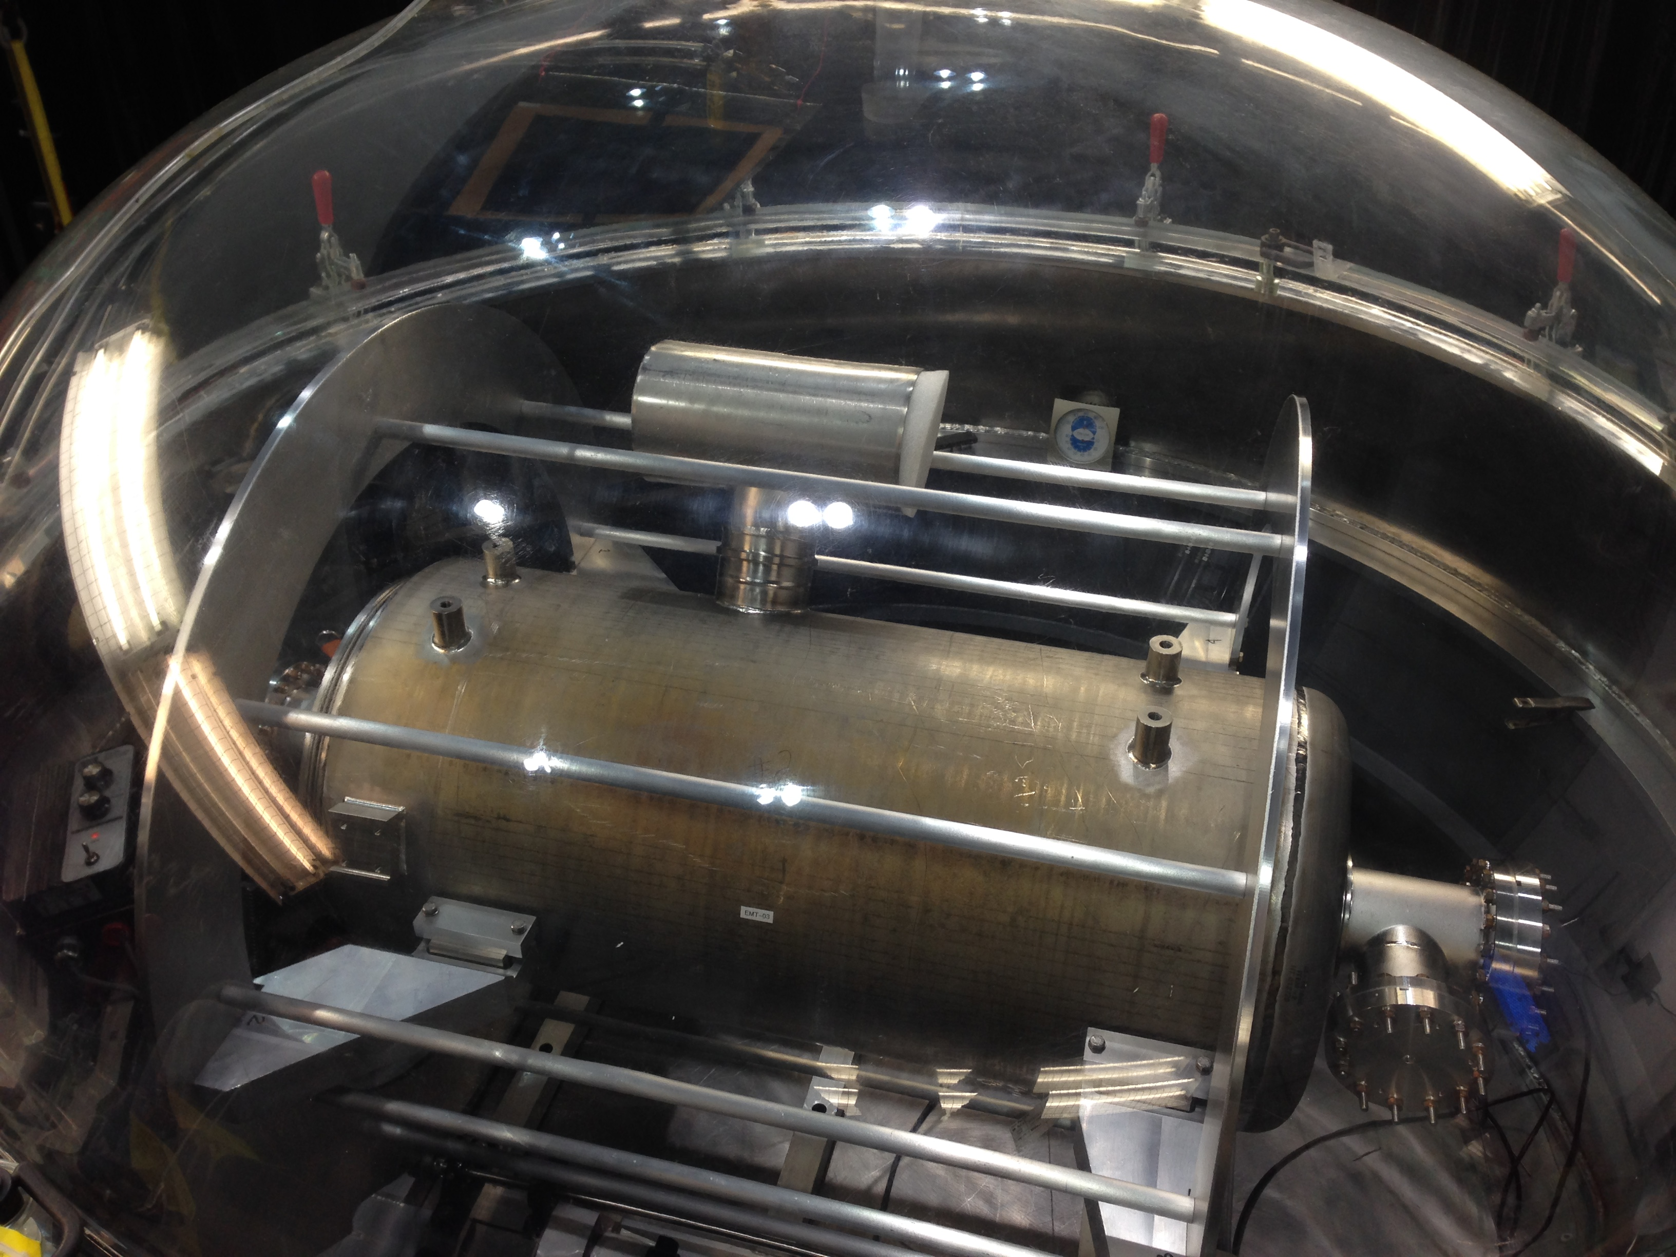
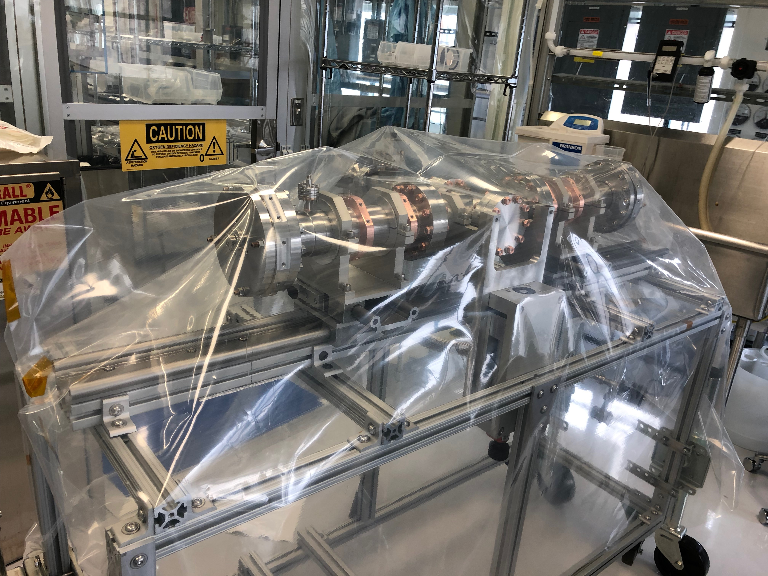
WBS 121.2 SRF Updates – 650 Cryomodules
B9A-AES-010 Cavity Dressing was Completed.
Coupler test preparation is in progress.
Cryomodule design is in progress
B9A-AES-010 dressing completed
Coupler test stand cleaned and baked

Slide 10
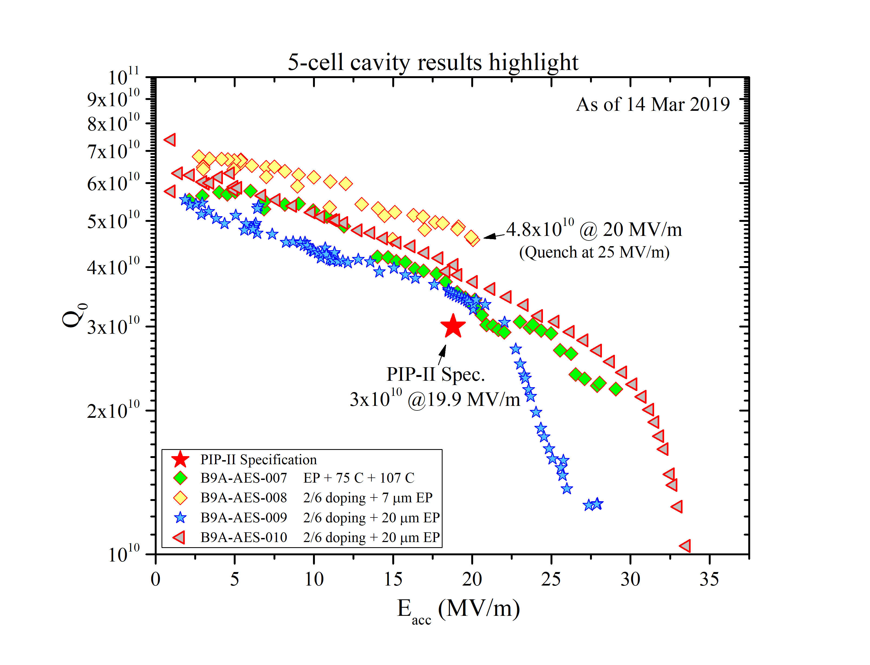
WBS 121.2 SRF Updates – 650 Cryomodules
EP + low temperature baking meets spec, but limited on margin.
N-dope has high Q (4.8e10@ 20MV/m).
Field emission and multipacting are the challenges for now.
  Request 650 MHz tumbler early commissioning to aid the soapy water rinsing
  Accelerate lab2 HPR tool to allow one pass rinsing instead rotating cavity half way during ANL HPR.
Recently processed, experienced heavy x-ray
Previously processed

Slide 11
WBS 121.2 SRF Updates
Cryogenics
Continue the bayonet thermal mechanical analysis
Received updated 3D models from WUST
  Bayonet Can
  SSR and 650MHz Cryomodules connections
  Interconnect Transferline
  Bayonet Can, HWR Cryomodule connections
  Turnaround Can – Michal Stanclik
  Distribution Valve Box - Pawel Duda
Management
Completing SRFCRYO BOEs
Evaluate value engineering options
Draft PPD with SRF partner labs

Slide 12
WBS 121.3 Accelerator Systems Update
Preparation for HWR / SSR1 arrival and RF tests
  Coupler Bias Supplies delivered, testing for HWR supplies will be complete this week
  Quench Protection Monitor systems are in assembly
Preliminary Design Report from IIFC (BARC) on 650 MHz section warm quads/dipoles
  working towards preliminary design review prior to CD2 review

Slide 13
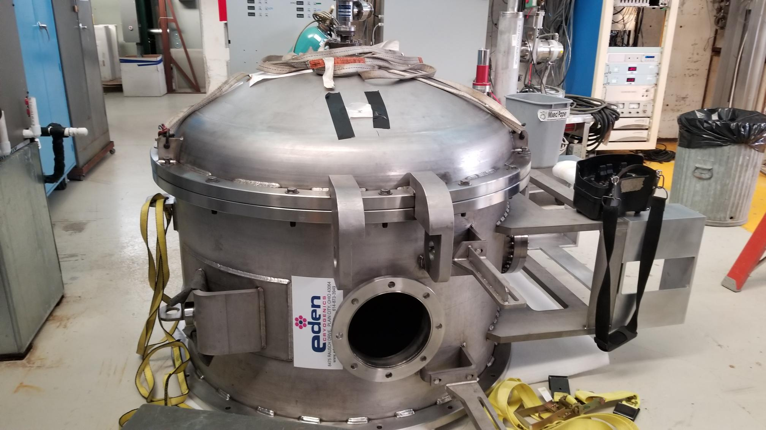
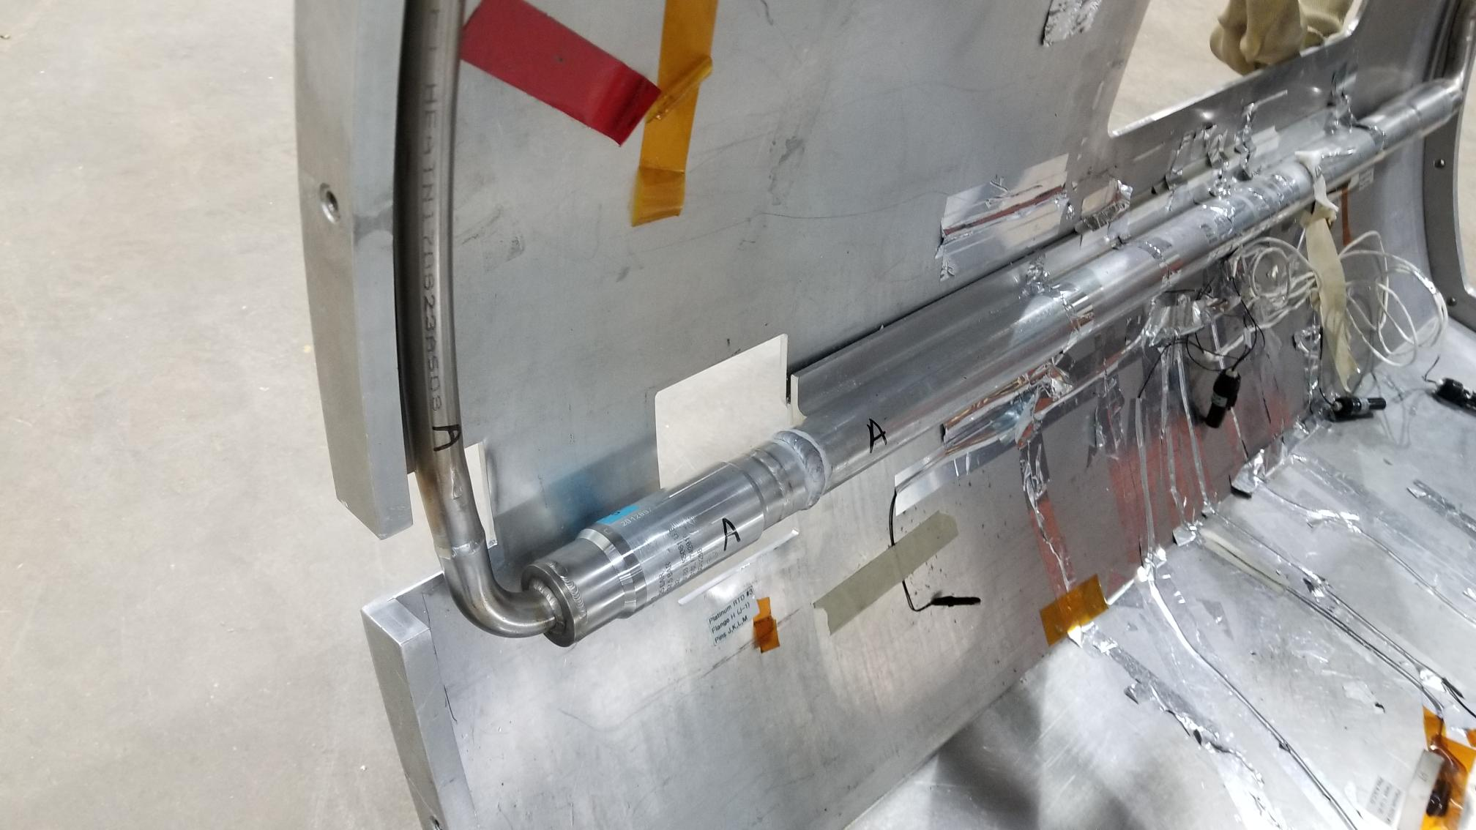
Updates - WBS 121.04 Linac Installation & Commissioning
General Report
  L3Ms have been actively working on the BOE documentation and supporting documentation
    Internal peer review of the BOE documentation ongoing
    External review of the BOE/Scope conducted Mar.4-5
    Team has been refining the documentation according to the recommendations
Test Infrastructure
  STC
    Progress on the outfitting the horizontal test stand chamber to accept 650 MHz cavity size is ongoing
Extension weldment
2-phase pipe welded

Slide 14
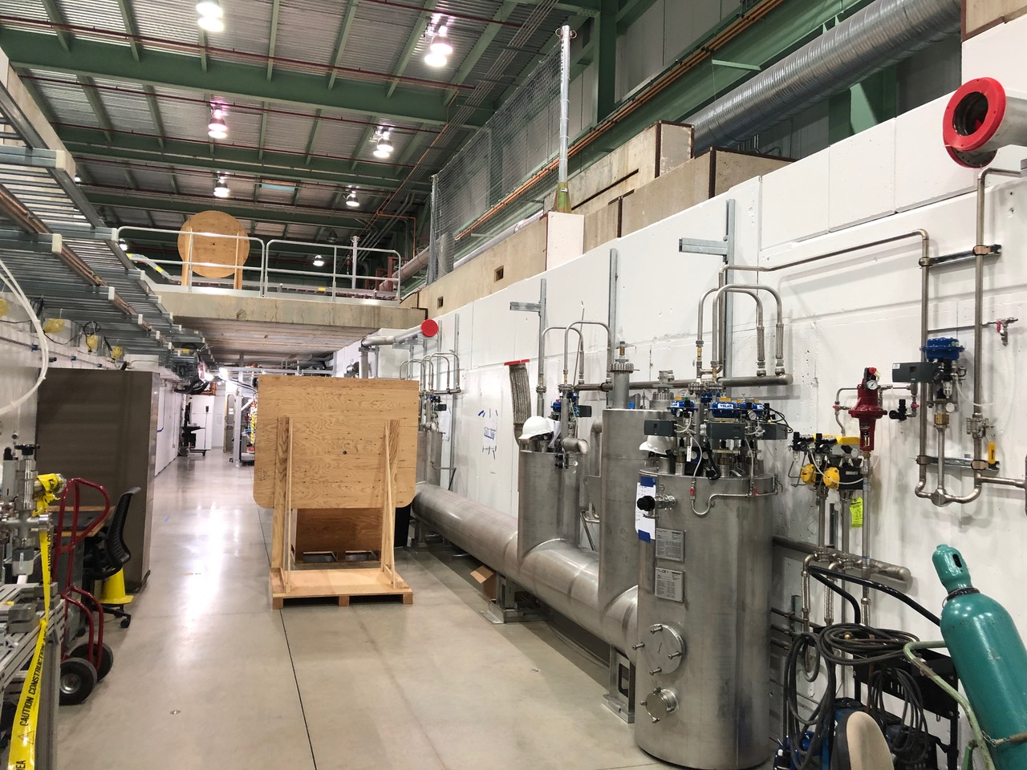
Updates - WBS 121.04 Linac Installation & Commissioning
Test Infrastructure (cont.)
  PIP2IT - Work continues to progress well at PIP2IT Cave
    CTL installation work in cave is complete (will continue when HWR arrives)
    CTL warm suction transferline installation has begun
    Clean nitrogen line installation into PIP2IT cave is complete (used for particle-free vent up of vacuum systems)
    Dry air system skid and piping into cave is nearly complete
    Requisition for installation of lighting in new cave extension is in Procurement
    Removal and cleaning of particle-free section of MEBT has begun
    Assembly of beam absorber is progressing

Slide 15
Update – Conventional Facilities
Site Clearing Construction
  Notice to Proceed Issued 14MAR19;
  NPDES Permit No. ILR10AP48 Issued 01MAR19;
  Excavation Permit Issued 18MAR19;
  Surveying work this week
  Milestones:
    28MAR19 – Material Submittals Received
    12JUN19 - Substantial Completion
    12JUL19 – Project Complete (establish vegetation)
Cryo Plant Building Design
  60% Design Documents Received 15MAR19;
  Incorporating Utility Plant Building functions;
  Architectural Advisory Board meeting scheduled for 05APR19.
Linac Complex
  Linac Tunnel Mock Up proposals were higher than expected. Looking at alternate locations/construction;
  Update to conceptual design scheduled to begin in April 2019.

Slide 16
P2MAC – 25-27-March-2019
Charge Topics:
  a) the project’s readiness to baseline,
  b) maturity of the Preliminary Design Report (PDR), and
  c) approach to management of international in-kind contributions
Incorporating committee’s comments on the Preliminary Design Report

Slide 17
First (prototype) EVMS Stoplight Report
Need to sort out actuals to date, which caused current period variances
Data uploaded to eCAM Toolbox 19-Mar-2019
Still much to do…
  RLS housekeeping
  TPC reduction
  Change Control
…but we have started the EVMS statusing process!
Thanks to the team for their hard work!

Slide 18
Cost Estimate Status
TPC as of 20-Mar-2019 - $913M
We have identified viable solutions to achieve TPC ~$835M:
  Potential In-kind contributions ~$40M
  Value Engineering ~$15M
  BOE Reviews/Scrubbing ~$23M
Next Steps toward ~$800M:
  Implement identified savings as soon as possible – some require further analysis, validation, planning adjustments
  Pursue overhead rate reduction – currently under discussion
  Develop descoping list
Could be adjustments from integrated lab infrastructure plan (next slide)
Planning to preserve 35% contingency on cost-to-go in all cases.

Slide 19
Scope, Integration with Lab Plans
Guidance from DOE OHEP:
  Fermilab needs to identify and prioritize infrastructure projects that are critical to projects or continued operations.
  Budget not available for unexpected projects/expenses.
  Could be funded through adding scope to existing projects, new 413.3 projects (HEP or SLI), GPP, AIP, other
PIP-II is working with COO, AD, APS-TD for PIP-II related items
  Could affect PIP-II scope/cost/schedule

Slide 20
Procurement Initiatives
Housekeeping
  Electronic Files, File Review, Process Review, Price Analysis, Reports (Suppliers, Price, Controls)
Procurement Plan
  In-kind contributions, Pre-Award Lead Time, Reporting, Best Practices
Improve Speed and Accuracy of Processes
  Price Analysis Tool (PAT), Contract Writing
Ready Path for In-Kind Contributions
  Tariffs, Logistics, Quality, Observation
Transparency
  Pre-Award, Electronic Files, Prices Paid, Responsibility Determination

Slide 21
Communications – Top 3
PIP-II broke ground in March 2019, and is preparing to baseline later in the year.
The project is working with international partners to formalize management plans and the list of in-kind contributions.
An integrated systems test of the front end of the PIP-II linac, including the first two cryomodules, is planned in 2020.

Slide 22
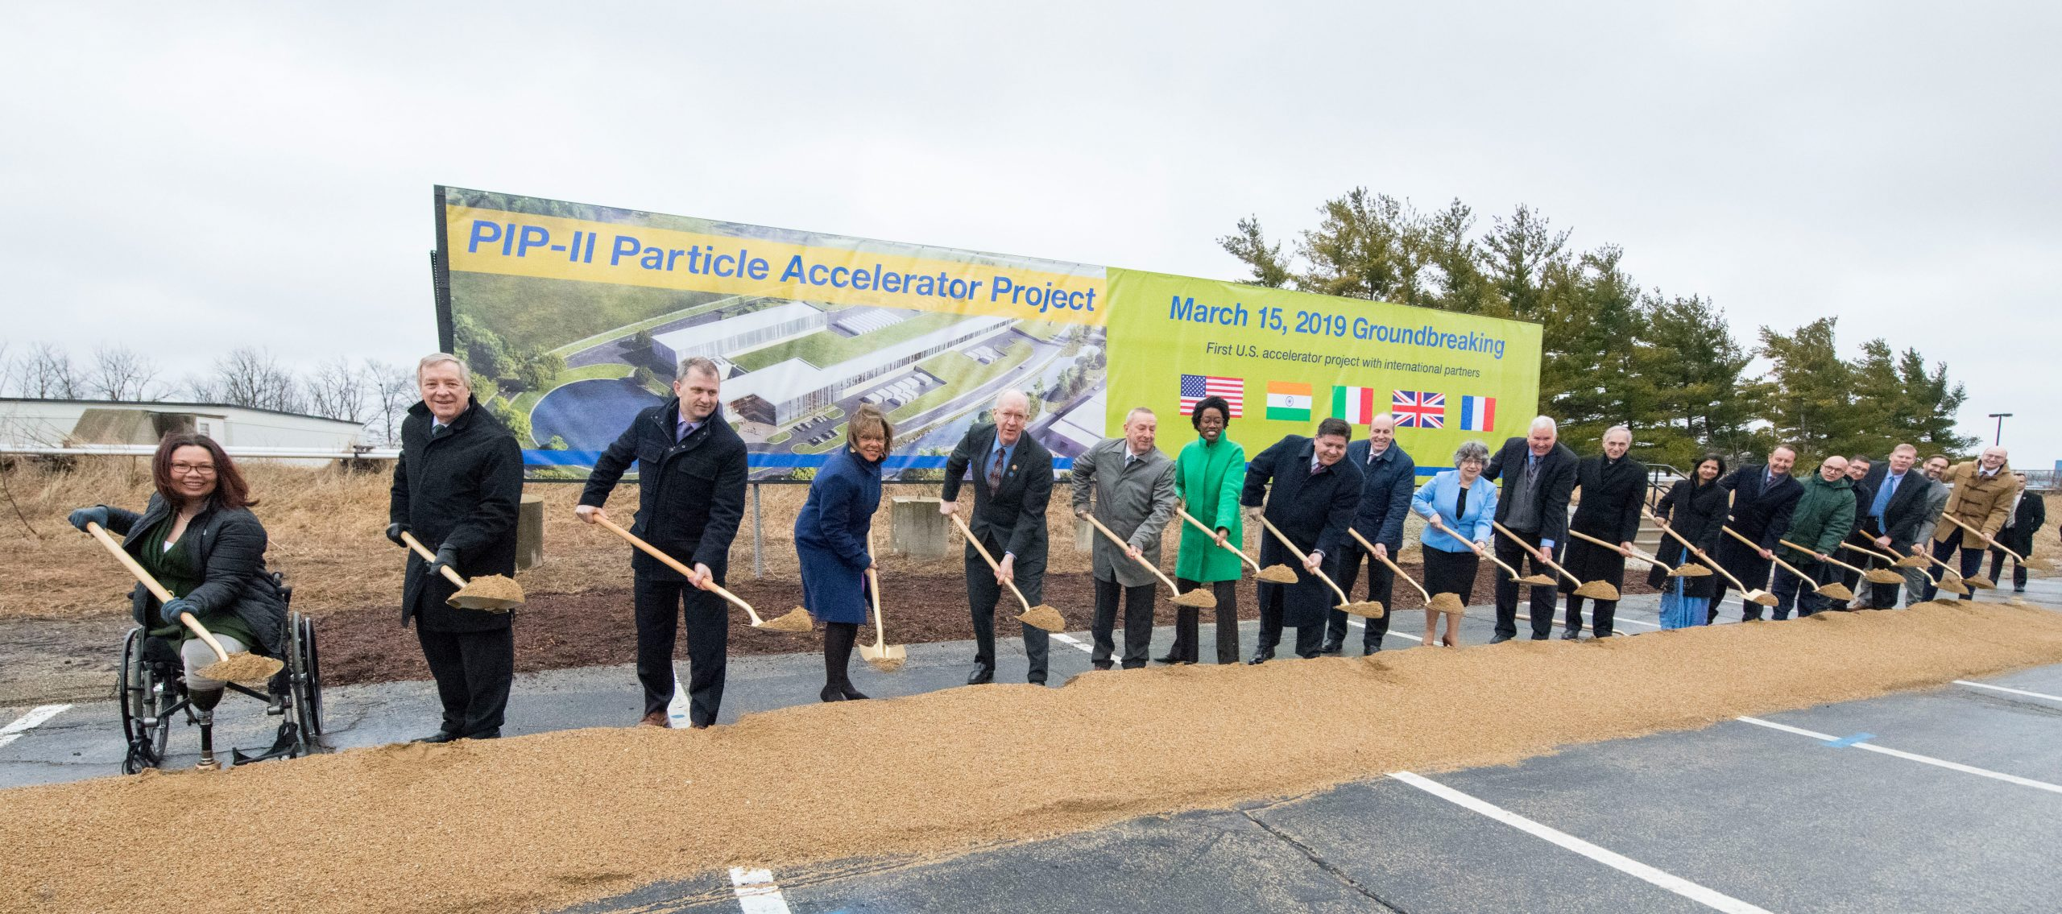

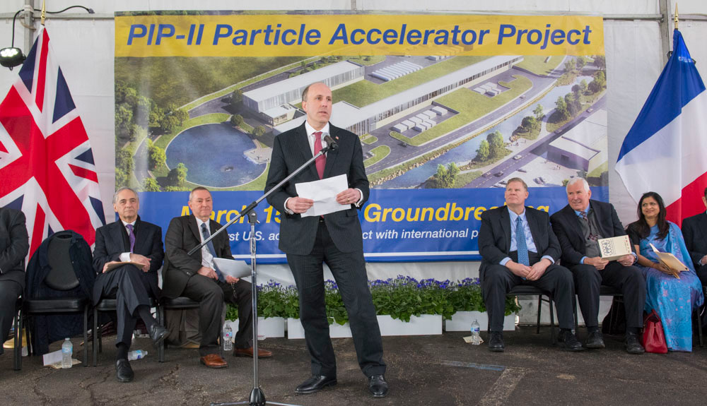
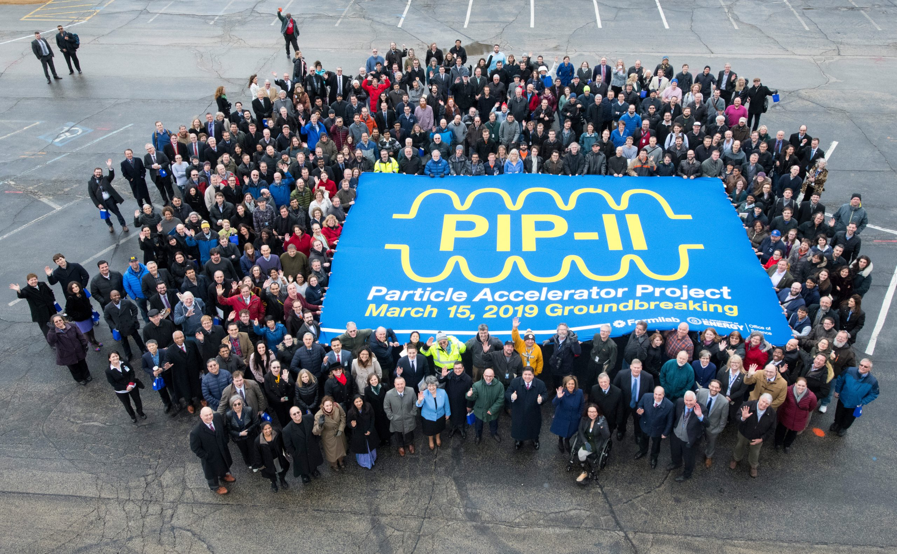
Groundbreaking

Slide 23
Summary
Groundbreaking a success
Continue to make good progress toward PIP2IT completion
Notice to proceed with site clearing issued
EVMS monthly reporting has begun. Major accomplishments - working out kinks.
CD-2/3a IPR, ICE schedule linked to resolution of integrated infrastructure plan

