Slide 1
PIP-II Project Executive Board Meeting (P2PEB) Report
Luisella Lari
PIP-II PMG
19 March 2019

Slide 2
Outline
P2PEB Mandate
The role of Project Planning Documents (PPDs) for the PEPEB
PPDs completion schedule & Partner Engagement Plan
Some abstracts from the PIP-II IKC talks
Summary

Slide 3
P2PEB Mandate (1/2)
Lia’s talk
https://indico.fnal.gov/event/19870/

Slide 4
P2PEB Mandate (2/2)
Lia’s talk
https://indico.fnal.gov/event/19870/

Slide 5
Framework for handling IKC
Technical description/specification
Project Plan – schedule, deliverables, milestones
Terms of delivery, transportation
Quality control
Technical control system
Formal evaluation
Documentation - operational manual, part lists, etc.
Risks assessment and management
Appointment of responsible personnel
Roles and responsibilities
Acceptance Criteria
Monthly Report
Transfer of ownership
….

Slide 6
PPD – Part 1/Part 2
The PPD – Part 1 describes the management and oversight structure, PIP-II Review Plan, Project Phases and Project Management principles applicable to the <partner institution> proposed in-kind contribution to the PIP-II Project. These principles are to be considered as the requirements and specifications of Project Management.
The PPD – Part 2 describes the Scope of Work (SoW) required to complete the proposed <In-Kind Deliverable> contribution by the <partner institution> to the PIP-II Project, which includes components and technical documentation. It covers a technical description of the deliverables, project activities, schedule and key milestones.

Slide 7
PPD – Part 1 / some abstracts from the template
PPD – Part 1 is manly related to describing the IKC Governance and the DOE framework in which the IKC will be included.

Slide 8
PPD – Part 2 / some abstracts from the template
SOW detailed description
Design Responsibilities, Procurement Process, Acceptance Criteria
List of IKC Milestones included in our DOE RLS schedule
(Needed a detailed schedule analog to P6 to track progress @ Partners)

Slide 9
PPD – Part 2 / some abstracts form the template
IKC Management Plan section to check alignment with the FNAL/DOE related ones

Slide 10
P2PEB Meetings
Lia’s talk
https://indico.fnal.gov/event/19870/

Slide 11
IKC Partner Check list
Before CD-2 review, need to be in detailed finalized:
  Org Chart
  SOW detailed description
  List of deliverables
  MS/delivery dates
    Develop your schedule
  Technical Documents
  PM management plans

Slide 12
IKC Partner Check List up-to-date
 | Org. Chart | SOW | List of Del. | MS | Tech. Doc. | PM plans
DAE
INFN
UKRI
CEA
IN2P3

Slide 13
TimeFrame
In order to Baseline PIP-II @ CD-2 Review, PPD Part 1 and PPD Part 2 need to be finalized.
  End of April: First draft
  May: Draft available for the Director Review in preparation for CD-2
  July: Final Draft available for CD-2 Review
Progress with PIP-II Partners will be monitored through Milestones and Monthly Reports (as reported in PPD – Part 2).

Slide 14
Project Planning Document Completion Schedule & Partner Engagement Plan
DAE | April 21-28, 2019 DAE leadership team at FNAL for IIFC PC/TC;
INFN | March/April, 2019 Carlo Pagani at FNAL March 14-15; Carlo & Rocco visiting Fermilab April 15-18;
UKRI | March, 2019 Pater McIntosh team at FNAL, March 12-15
CEA | March/April, 2019 Olivier Napoly at FNAL March 14-15; PIP-II at CEA April 10-11
IN2P3 | Marc/April, 2019 David Longuevergne at FNAL March 14-15; PIP-II at IPNO April 8-9
Poland | Lia Merminga, Nigel Lockyer, Hema Ramamoorthi ,Arkadiy Klebaner meet with Director of the National Center for Research and Development at the Wrocław University of Technology April 19, 2019
Spain | April 17&18, 2019 Lia Merminga, Nigel Lockyer, Hema Ramamoorthi visit ESS-Bilbao

Slide 15
UKRI talk - Abstracts
DRAFT PPD for PIP2MAC

Slide 16
INFN talk - Abstracts

Slide 17
CEA talk - Abstracts

Slide 18
IN2P3 talk - Abstracts

Slide 19
Summary
P2PEB meeting 1 was a successful starting of the PIP-II international collaborations.
P2PEB meeting 1 has received a positive feedback from the PIP-II International Partners.
In detail all the partners shown:
  Strong Motivations and Interest in PIP-II Project;
  Capabilities to fulfill scope of work;
  Engagement to develop PPDs draft docs in preparation of the CD-2 review;

Slide 20
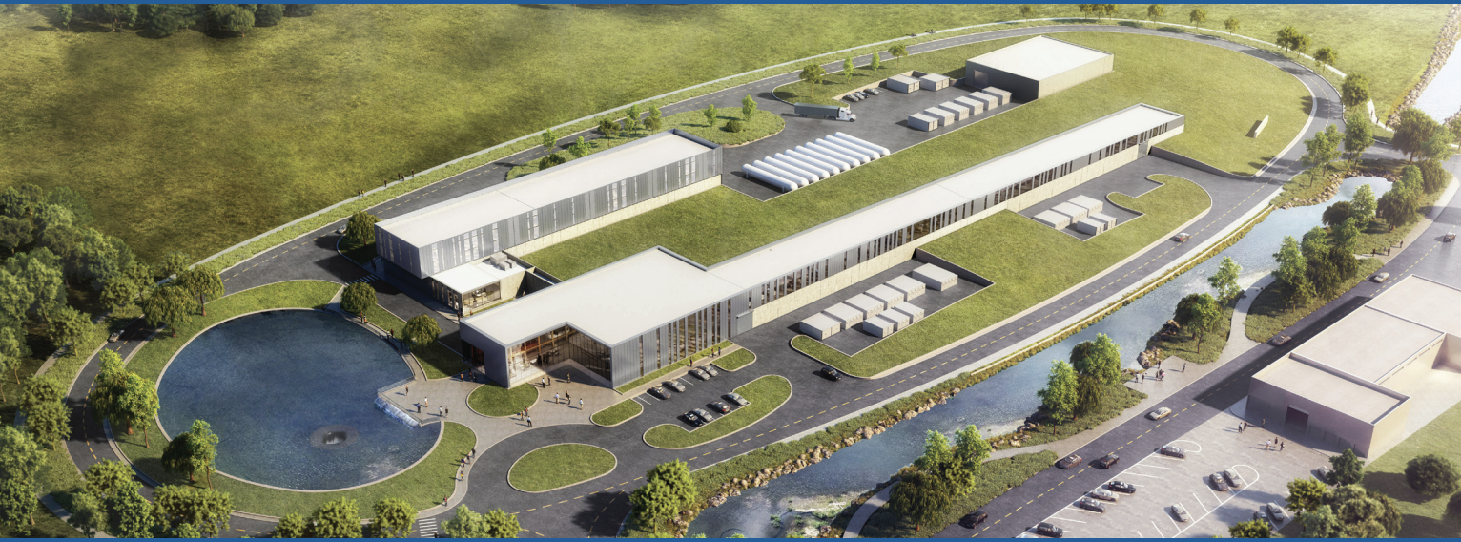
Thanks

