Slide 1
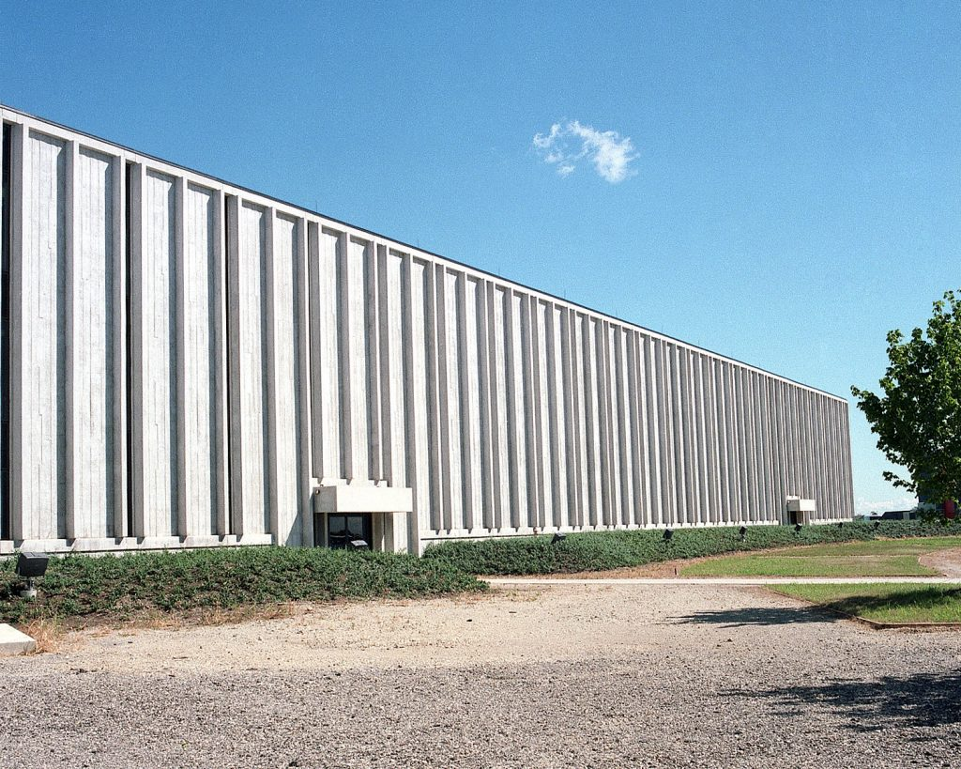
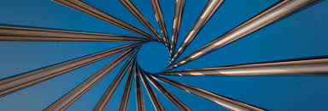
Applied Physics and Superconducting Technology Division at FNAL
Tiziana Spina
52nd Annual Users Meeting
12 June 2019
The Industrial Center Building (ICB), 1986.

Slide 2

Historical background:
1980
Technical Support Section - TSS
1996
Technical Division - TD
2018
Applied Physics and Superconducting Technology Division – APS-TD
1981 – Installation of 1st Tevatron Magnet
1998 - U.S. and CERN sign LHC Agreement
2001 – SRF field was added to the Division
Notes:
Which has substantially evolved from the days since the division was created.

Slide 3
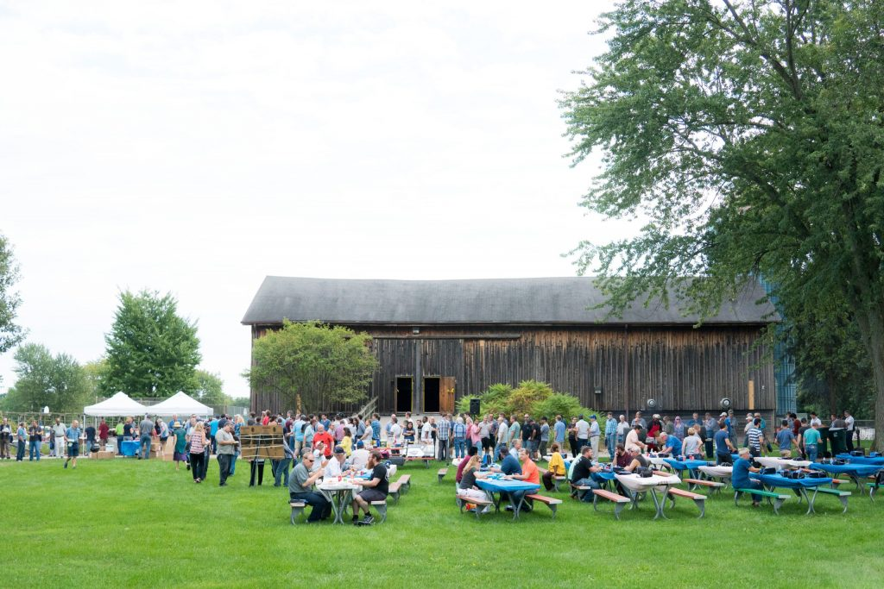
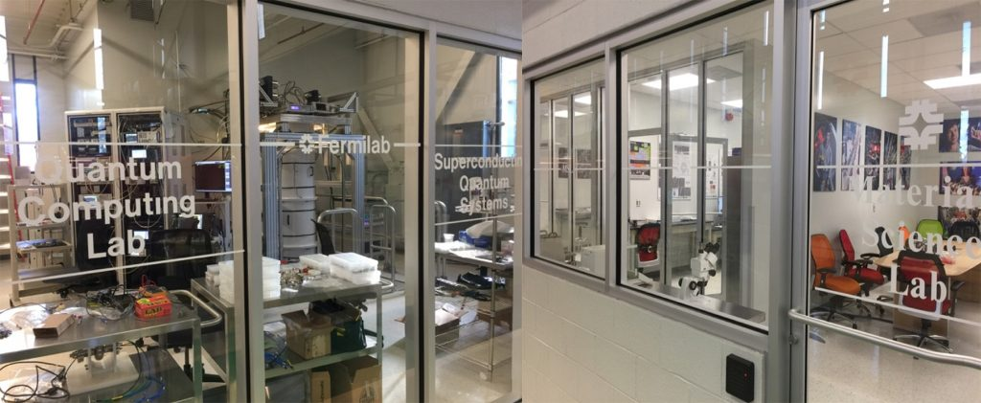
APS-TD MISSION
https://td.fnal.gov/
Pursue highly innovative R&D program in s.c. MAGNETS and SRF for accelerators to advance the lab’s scientific mission and to help in defining the lab’s future direction
Operate accelerator test facilities to maximize the lab’s scientific productivity and impact
The division has its 2018 picnic. Ph.: T. Nicol
Develop and build next generation accelerators and detectors using cutting-edge technologies
Educate and train the next generation of physicists and engineers
The Quantum Computing Lab and Materials Science Lab are part of the new TD.
Ph.: A. Grassellino

Slide 4
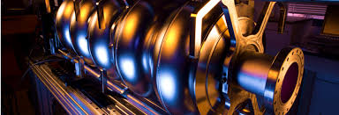
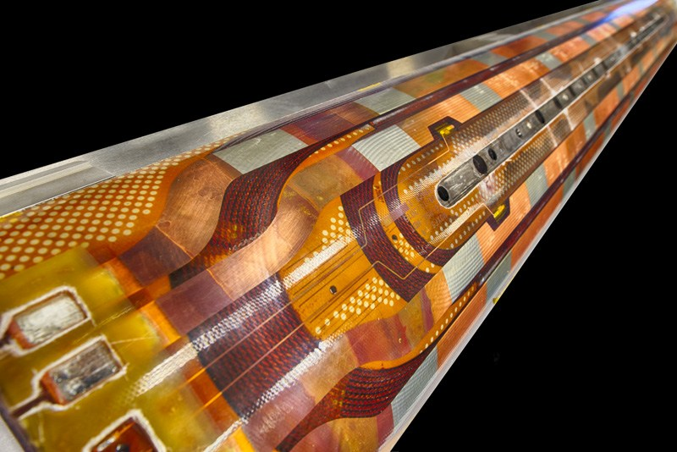
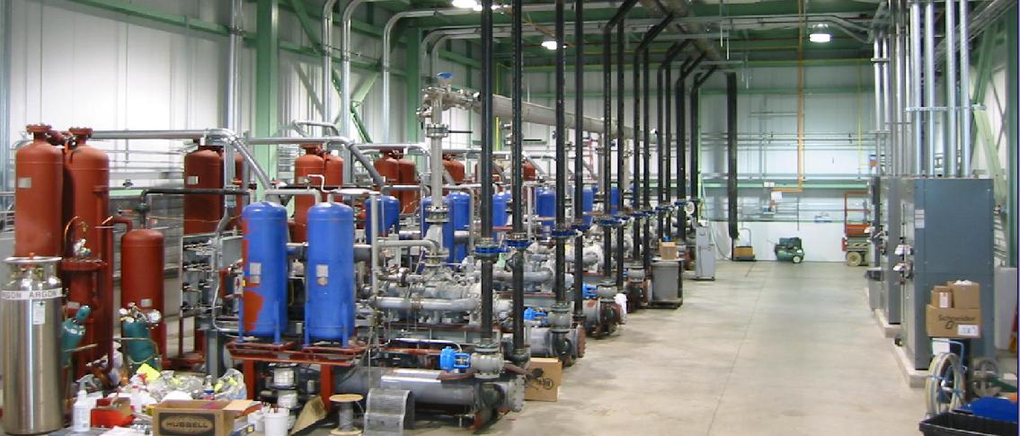
APS-TD Leadership
Sergey Belomestnykh
Division Head
Anna Grassellino
Deputy Division Head
Alexander Romanenko
Associate Division Head/SRF sector
George Velev
Associate Division Head /Magnets sector
Jay C. Theilacker
Associate Division Head / Cryogenics sector
Romesh Sood
Associate Division Head

Slide 5
Outline
Basic R&D:
  For SRF cavity
  For Superconductive magnets
Projects:
  LCLS-II
  PIPII
  HL-LHC AUP
  Mu2e
Summary

Slide 6
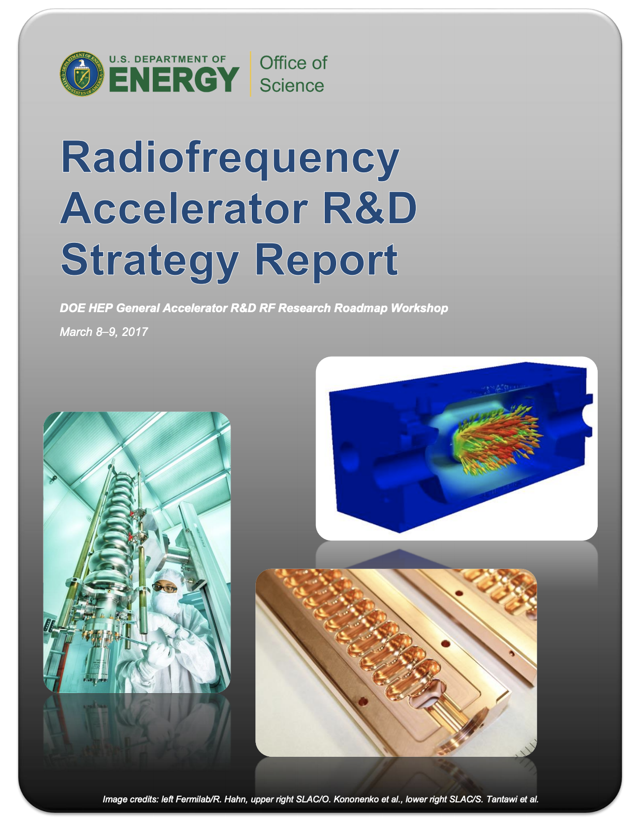
Outline
DOE HEP GARD (General Accelerator R&D) program
Basic R&D:
  For SRF cavity
  For Superconductive magnets
Projects:
  LCLS-II
  PIPII
  HL-LHC AUP
  Mu2e
Summary

Slide 7
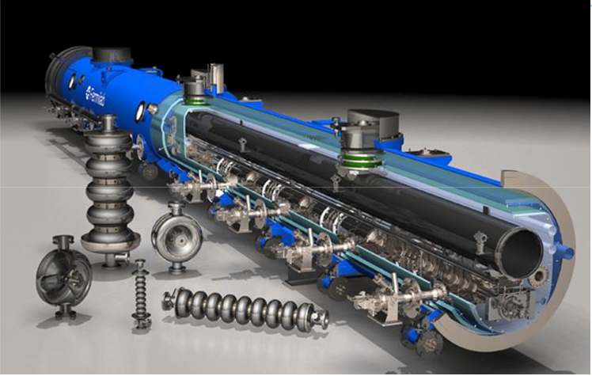
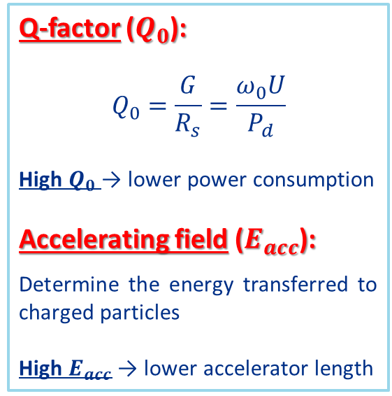
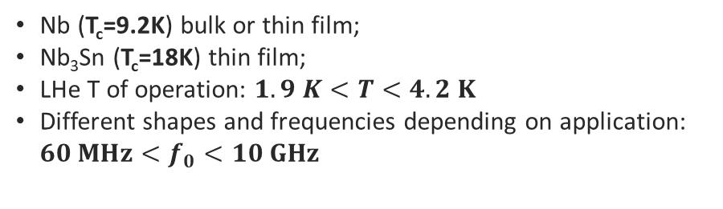
R&D: SRF sector
SRF Cavities: main features
Nb (T_{c}=9.2K) bulk or thin film;
Nb₃Sn (T_{c}=18K) thin film;
LHe T of operation: $1.9 K<T<4.2 K$
Different shapes and frequencies depending on application: ${60 MHz<f}_{0}<10 GHz$
Figures of Merit
Keys focus of the research:
Q-factor ($Q_{0}$):
$$Q_{0}=\frac{G}{R_{s}}=\frac{ω_{0}U}{P_{d}}$$
High $Q_{0}$ → lower power consumption
Accelerating field ($E_{acc}$):
Determine the energy transferred to charged particles
High $E_{acc}$ → lower accelerator length
Standard ILC cavity
improvement of the cavity performance (Q₀ and achievable E_{acc});
full understanding of the underlying physics and materials science (doping/infusion; hydrides formation; flux trapping);
High Q at large gradient may reduce both capital and operational costs of accelerators

Slide 8
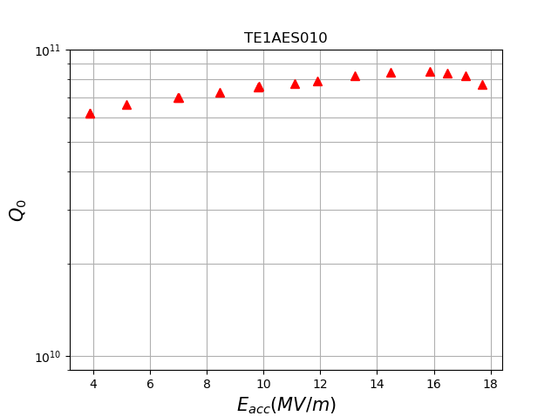
Pushing the state of the art in High Q and high G driven by Fermilab SRF R&D program – A. Grassellino et al.
World Record in E_{acc}!
New World Record in Q₀!
N doping
N infusion
75/120C
9x10¹⁰ !
120C bake
EP
Grassellino et al., to be published 2019
Grassellino and Bafia, to be published 2019
New optimized doping recipe is also capable of yielding record breaking Q₀!
Q>3e10 at 35 MV/m with N doping
Q >1e10 at 50 MV/m with 75/120C bake

Slide 9
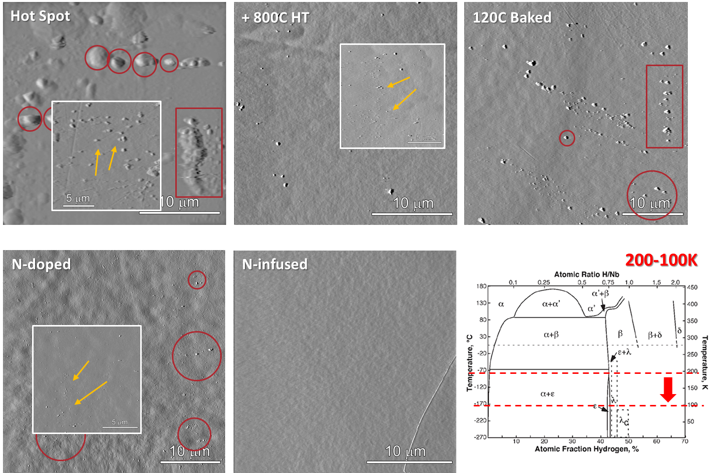
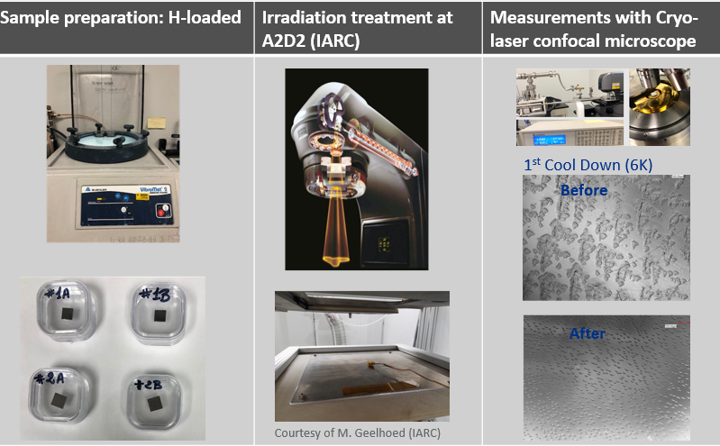
Hydrides R&D studies:
AFM measurements at Materials Science Lab in ICB
Irradiation experiment and microscopy
Surface features on cavity cut-out samples: nanohydrides studies – A. Romanenko and Z. Sung
9 MeV RT Electron Irradiation up to fluence of 10²²e/m²
T. Spina

Slide 10
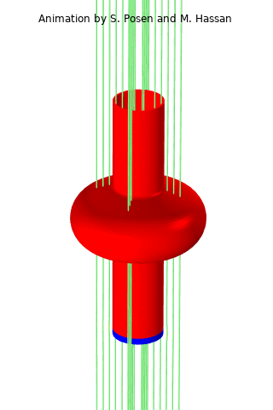
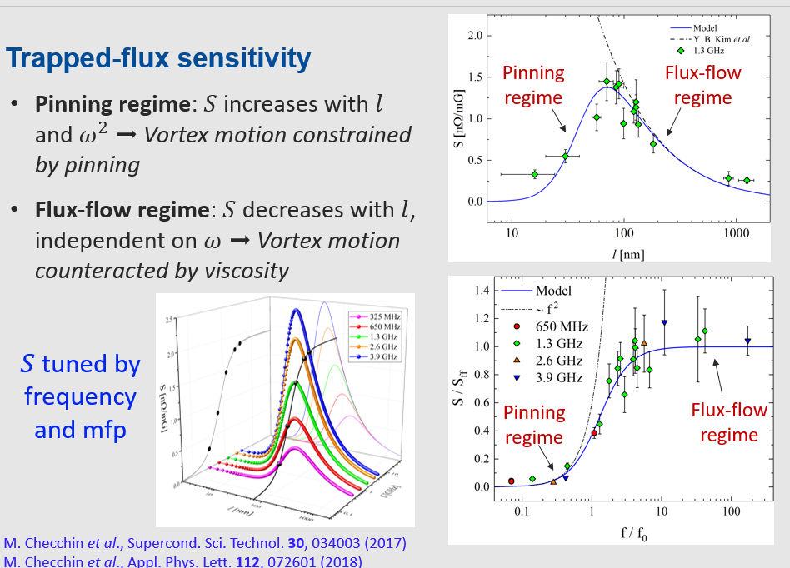
Magnetic Flux Expulsion R&D
M. Checchin et al.
R&D in Vertical Test
Fermilab SRF R&D in the last 5 years has led to significant improvement in understanding of how to prevent magnetic fields from being trapped during cooldown
Lessons learned were applied design of LCLS-II cryomodules (ability to do fast cooldown) and cavity processing treatment (higher temperature heat treatment)
Ambient magnetic field during cooldown

Slide 11
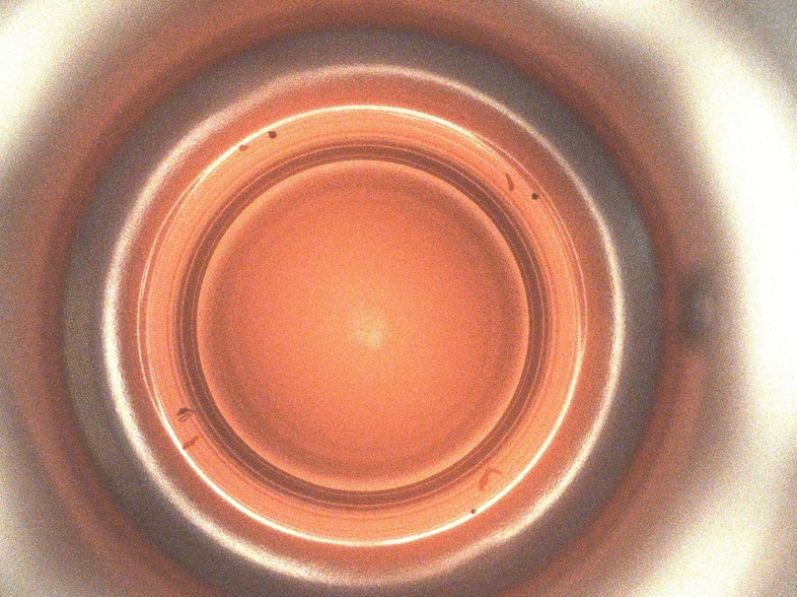
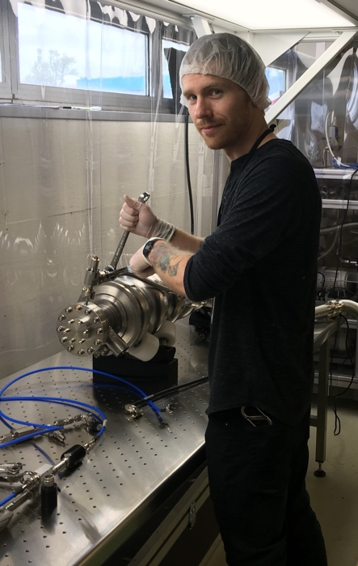
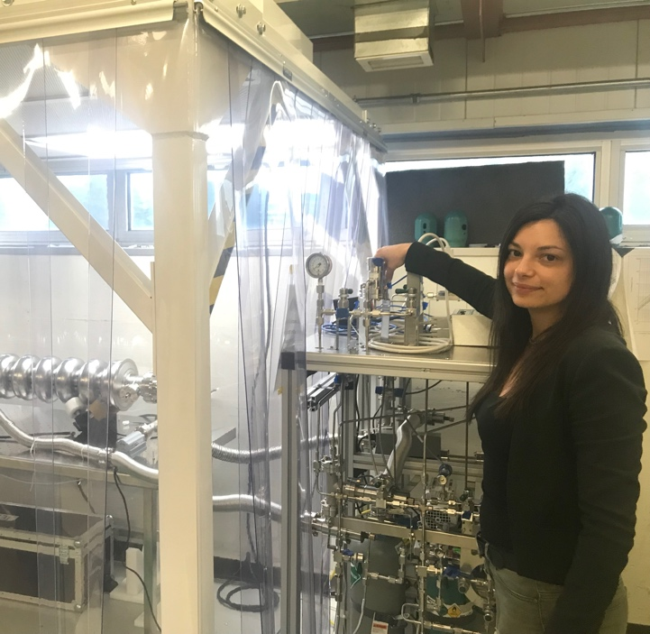
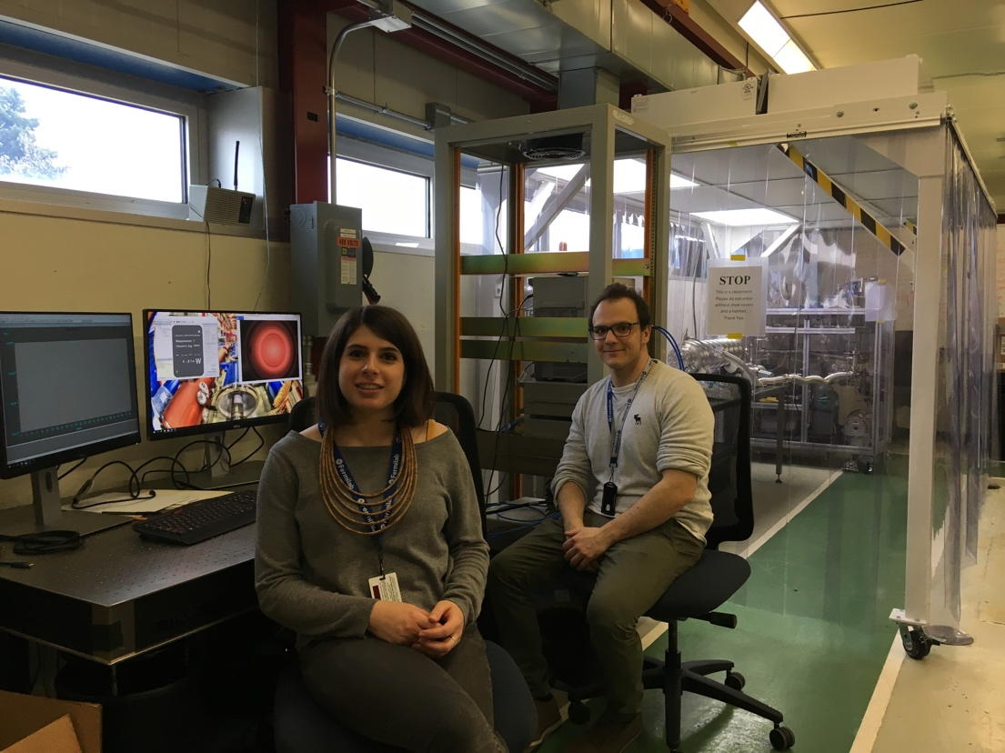
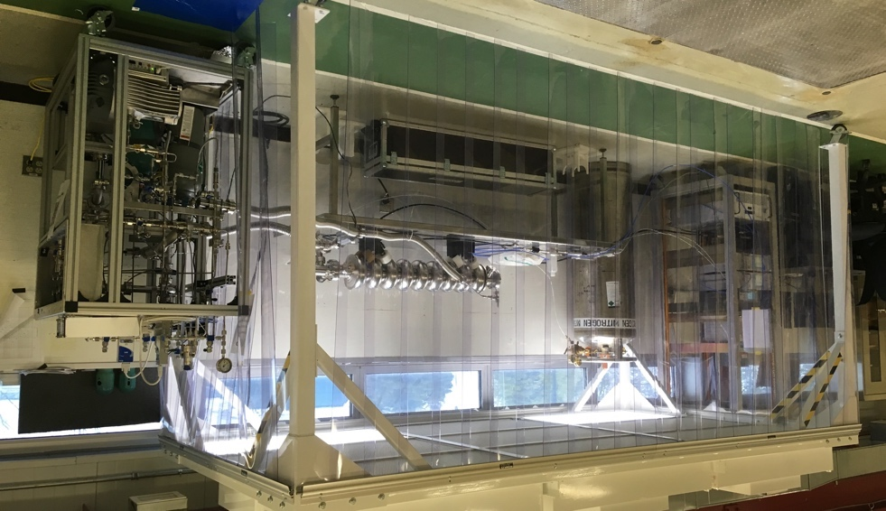
Plasma processing R&D
Martinello, Berrutti, Giaccone, Penhollow
https://indico.fnal.gov/event/20381/timetable/#20190610.detailed

Slide 12
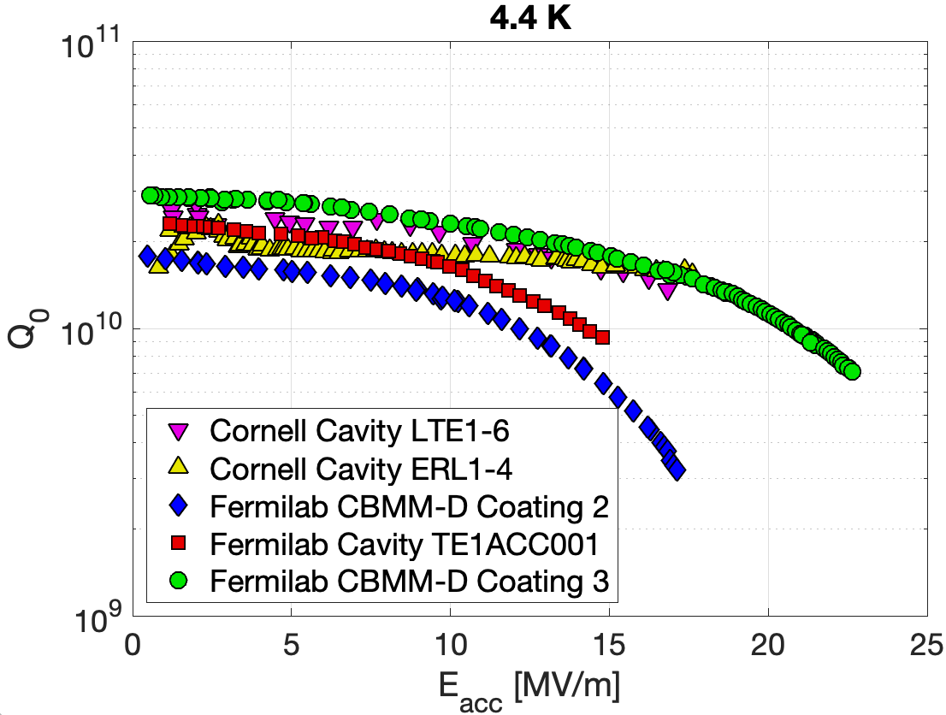
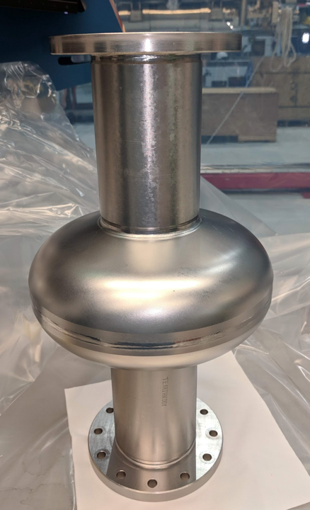
New Progress in Maximum Accelerating Gradient of Nb₃Sn Cavities – S. Posen
Nb₃Sn accelerator cavities have been limited consistently to 17-18 MV/m for ~20 years, though theoretical predictions indicate ultimate limit is far higher
World record CW gradient for Nb₃Sn accelerator cavities – 22.5MV/m: (~25% increase)
All 1.3 GHz single cell cavities
Cornell data from D. Hall and R. Porter
Research supported by S. Posen Early Career Award
New result proves that Nb₃Sn had not reached an intrinsic limit
Notes:
Nb₃Sn accelerator cavities have been limited consistently to CW accelerating gradients of 17-18 MV/m for ~20 years, though theoretical predictions indicate ultimate limit is far higher

Slide 13
Quantum technology R&D:
Material treatment to suppress TLS dissipation
A. Romanenko, R. Pilipenko, S. Zorzetti, D. Frolov, M. Awida, S. Posen, A. Grassellino, arXiv:1810.03703
Nb
5 nm
Nb₂O₅
Nb
Record: high photon lifetimes up to 2s
Notes:
2 s

Slide 14
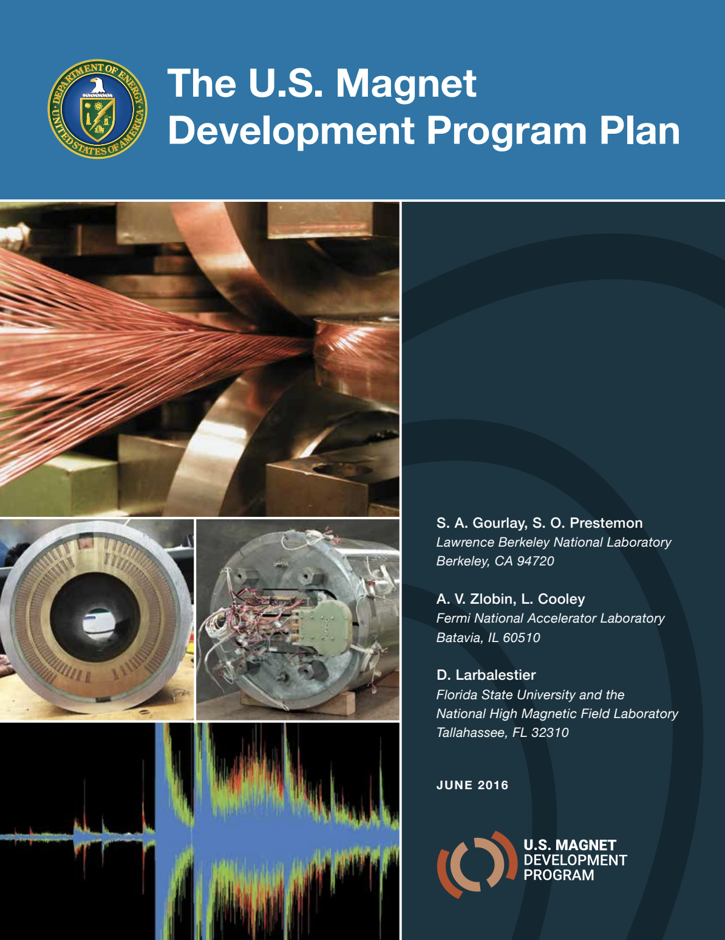
Outline
DOE HEP GARD (General Accelerator R&D) program
Basic R&D:
  For SRF cavity
  For Superconductive magnets
Projects:
  LCLS-II
  PIPII
  AUP
Summary

Slide 15
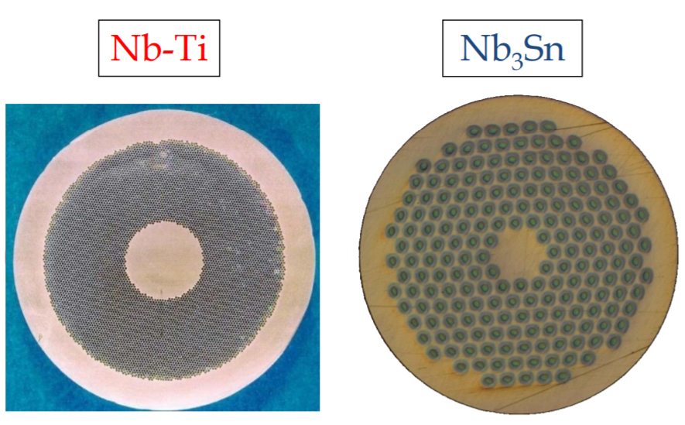
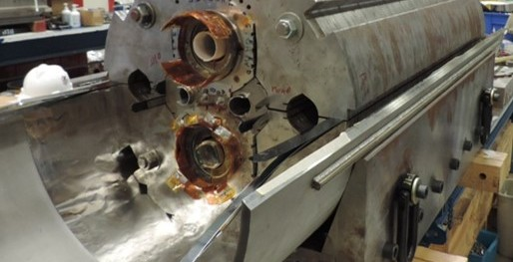
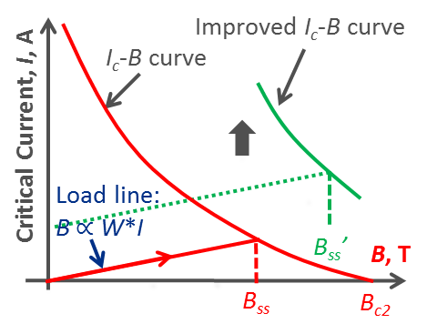
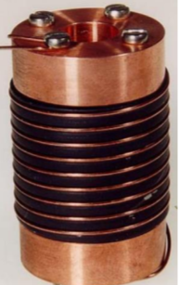
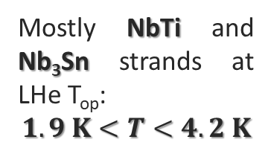
R&D: Magnets sector
Mostly NbTi and Nb₃Sn strands at LHe T_{op}:
$$1.9 K<T<4.2 K$$
Twin-aperture NbTi dipole during fabrication (HFM)
Keys focus of the research:
Superconducting materials R&D (wires, cables)
Insulator materials R&D
High field accelerator magnets R&D (Nb₃Sn dipoles/quads; hybrid with HTS insertion)
Magnet diagnostics R&D (to reduce the quench training)

Slide 16
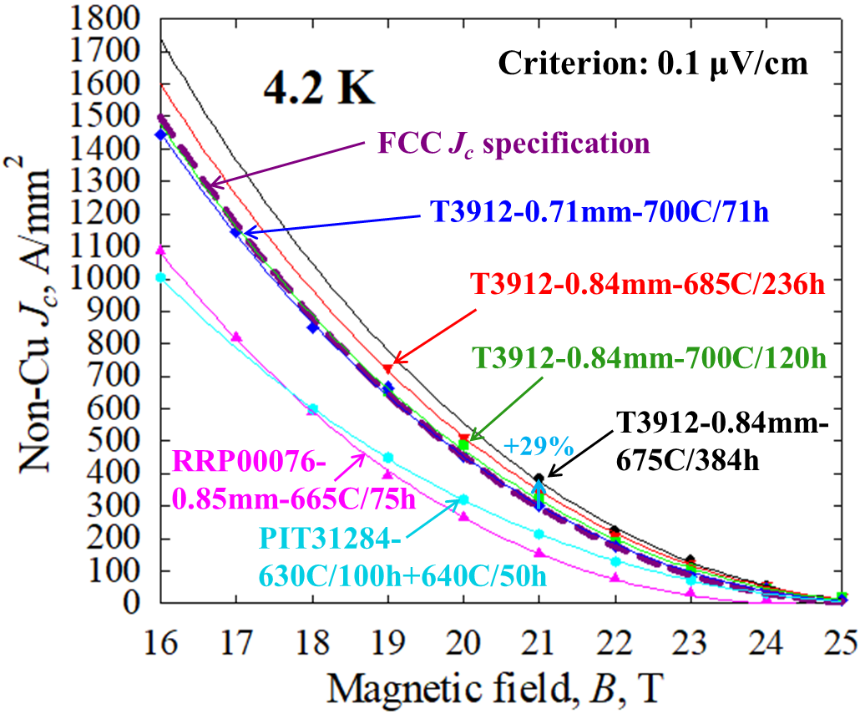
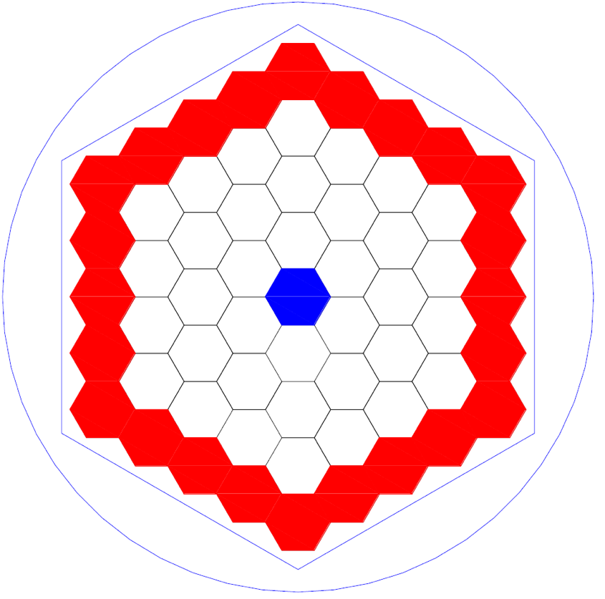
Nb₃Sn - Conductor R&D: X. Xu et al.
Gd₂O₃
Artificial Pinning Center (APC):
Fermilab LDRD support, Hypertech and OSU
A Nb₃Sn wires, record J_{c}, meet or exceed the FCC specifications
Nb₃Sn with high heat capacity additives:
First wires produced by Hypertech - promising results
Optimize the recipe of high-C rods by Bruker-EAS

Slide 17
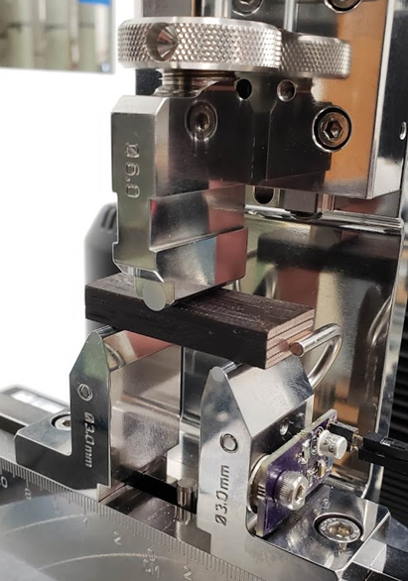
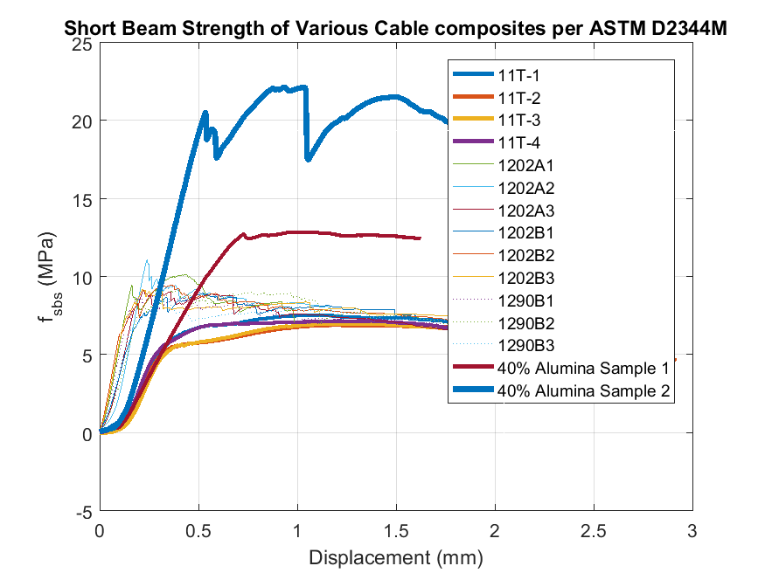
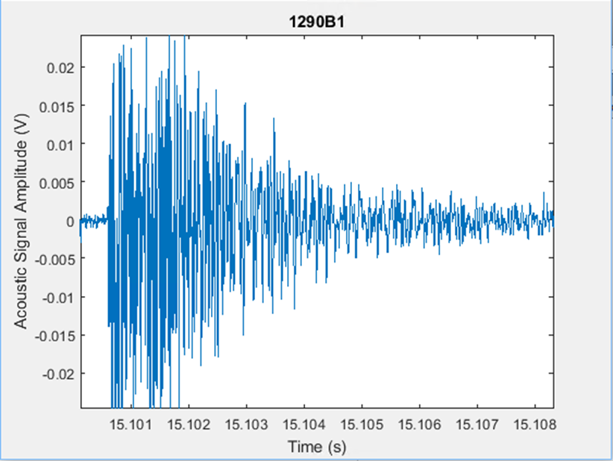
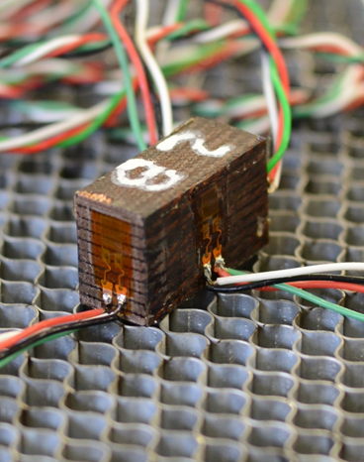
Nb₃Sn Composite R&D S. Krave et al.
Work on the Nb₃Sn-Insulation Composite is ongoing:
Improve and homogenize material properties
  SBIR and other programs
Improve analysis techniques to better understand material behavior by
  Application of acoustic sensors to different loading configurations to characterize types of cracking events
Initial Acoustic data for event characterization
Reduce magnet training
  Examining experimental materials under SBIR and other programs

Slide 18
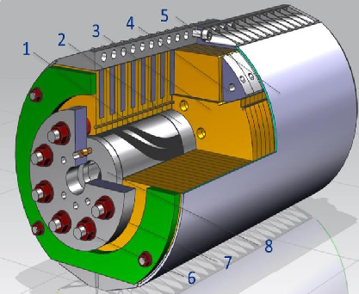
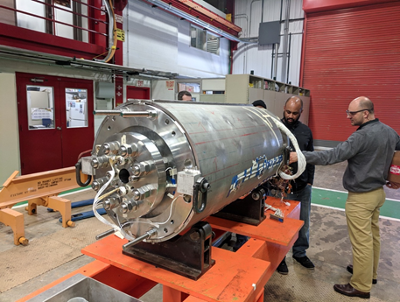
Magnet R&D: 15 T dipole - A. Zlobin et al.
First-in-the-world 15T demonstrator, paving the way to 16 T dipoles: Magnet Dipole Prototype Cos-Theta type 1 (MDPCT1);
Main Features
1 m long, 60 mm bore diameter Nb₃Sn dipole magnet
Demonstrator
Assembly

Slide 19
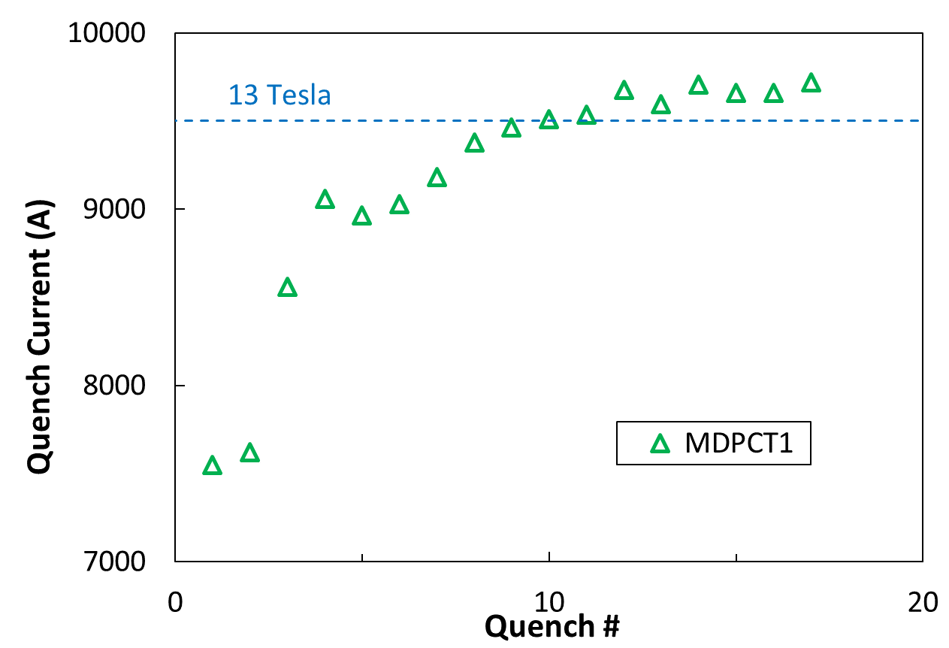
Magnet R&D: 15 T dipole First Test A. Zoblin, S. Stoynev et al.
15 T magnet test started in May at VMTF/APS-TD
The magnet pre-stress level was set for the magnet to safely reach 13 T with possibility to continue to 14 T
The goal (13 T) was reached after 9 quenches:
B_{max}=13.3T
Courtesy of S. Stoynev
Record B_{max} for accelerator magnets at FNAL!
Highest field ever reached for an accelerator magnet with 60mm aperture

Slide 20
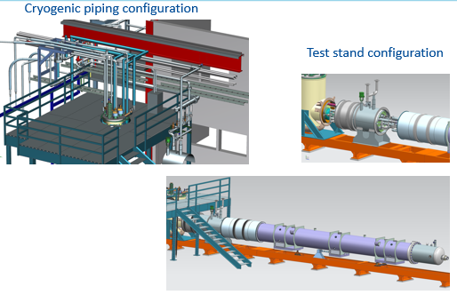
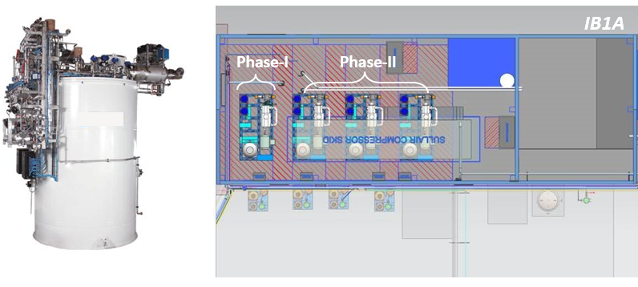
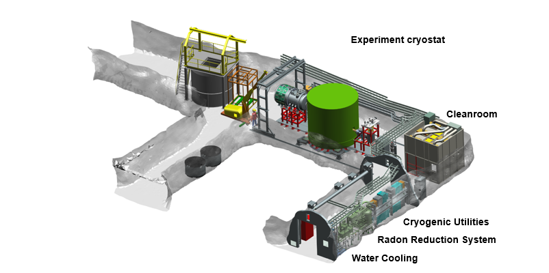
Cryogenics at APS-TD
Courtesy of J. Theilacker
APS TD Cryogenics sector is responsible:
IB1 Test Stand 4 Upgrades for HL-LHC Magnet Testing
To design and operate the cryogenic test facilities to qualify superconducting accelerator components LHC’s HILUMI, SLAC’s LCLS-II, and Fermilab’s PIP-II and Mu2e.
To deliver large scale superfluid He cryogenic system for the future SRF Linac, PIP-II
New IB1 He Liquefier
To support various mK cryogenic systems, utilizing cutting edge dilution refrigerators for Dark Matter Quantum Sensor experiments and Quantum Computing R&D.
Sub-Kelvin Cryogenics
Notes:
Every project at FNAL requires cryogenic refrigeration of some kind……

Slide 21
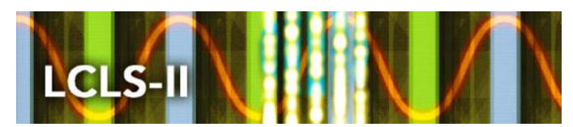
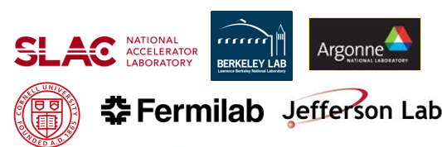
Outline
Basic R&D:
  For SRF cavity
  For Superconductive magnets
  For Cryogenics
Projects:
  LCLS-II
  PIPII
  AUP
  Mu2e
Summary

Slide 22
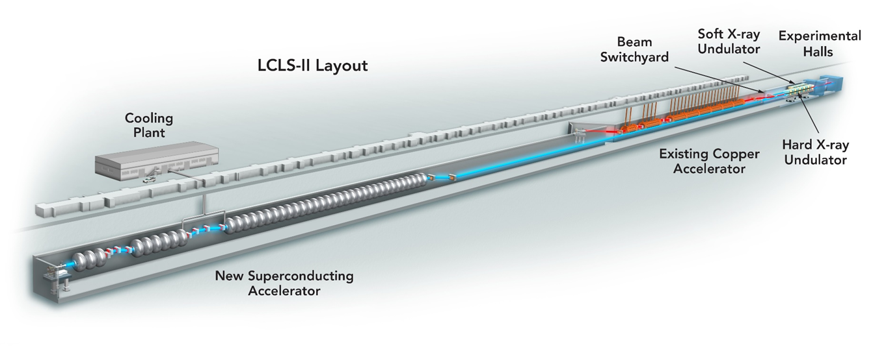
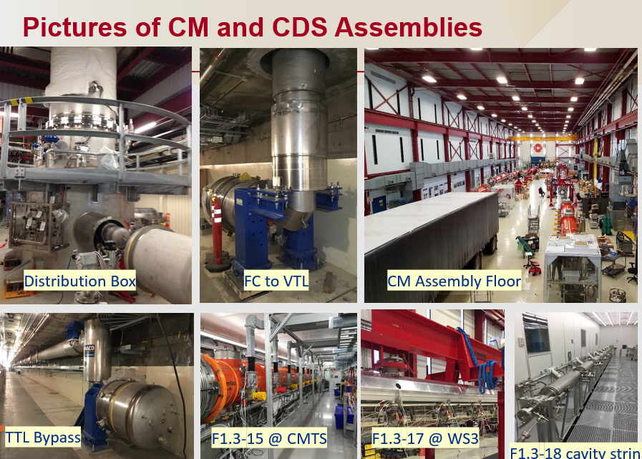
APS-TD and LCLS-II
Upgrade of the Linear Coherent Light Source at SLAC
Nitrogen doping breakthrough from R&D to production-ready technology
A. Grassellino et. al
New 4 GeV linac based on superconducting radio frequency (SRF) technology.
FNAL single cell cavities
APS-TD plays a key role in designing and building:
Cryomodule (CM) assembly
Cryogenic Distribution System (CDS)
Courtesy of Rich Stanek
.

Slide 23
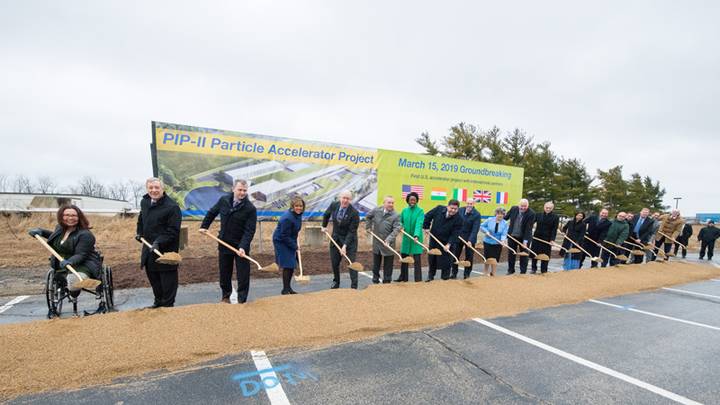
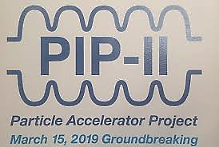
Outline
Basic R&D:
  For SRF cavity
  For Superconductive magnets
Projects:
  LCLS-II
  PIPII
  AUP
  Mu2e
Summary

Slide 24
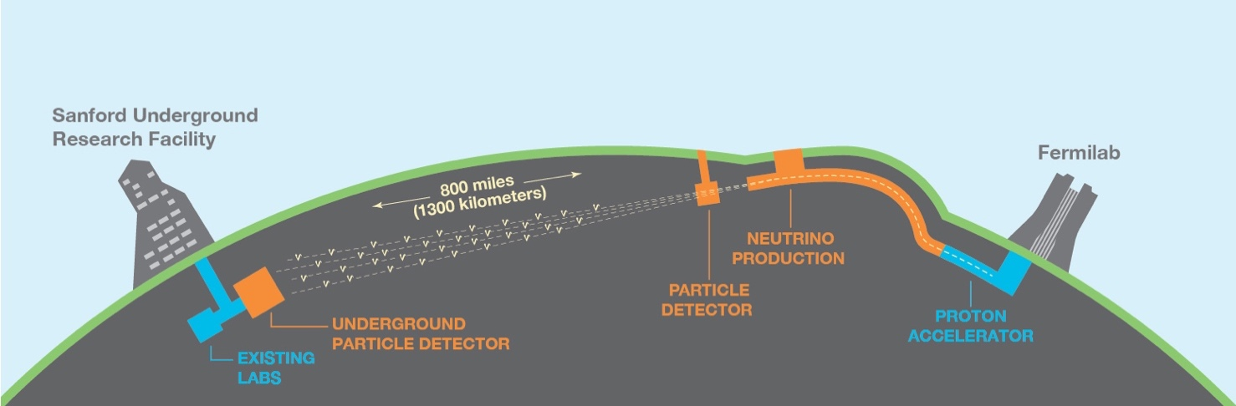
APS-TD and PIP-II
What is it?
Proton Improvement Plan-II (PIP-II) is Fermilab's plan for providing powerful, high-intensity proton beams
APS-TD plays a key role in designing and building:
Modern SRF linac
New Cryogenic Distribution System (CDS)
To provide powerful beam for generating neutrinos for LBNF/DUNE
HWR SSR1 SSR2 LB650 HB650
Notes:
HWR:Half Wave Resonators

Slide 25
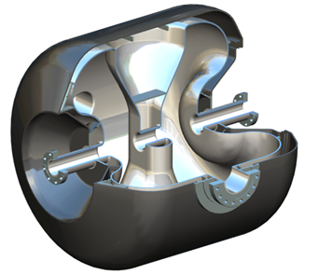
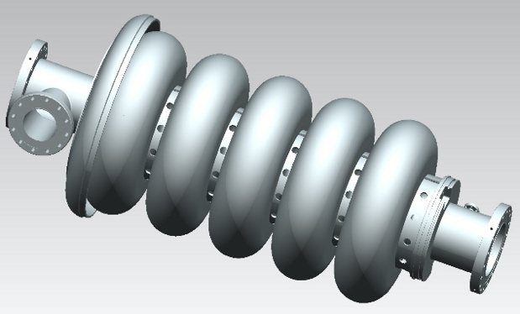





SRF cavities and cryomodules for PIP-II: status
Single spoke resonators (325MHz) | LB/HB (650MHz) | Results and PIP II spec
Spoke cavity (SSR1)
SSR2 jacketed cavity preliminary design review completed
LB650 bare cavity from INFN
prototype cavities are being fabricated at vendor site.
SSR1 string assembly Cold mass preparation and assembly is in progress.
650MHz
HB650:
First cavity jacketed
650 MHz Cavity Jacketing at MP9
SSR1 cryomodule assembly preparation
SSR1 cryomodule assembly completes in October 2019.
Notes:
HB650 cryomodule design is in progress with international design team.
Spoke cavity SSR1 - Processed and qualified in VTS and qualified post-dressing in horizontal test stand
650MHz - N-dope recipe well exceeds specification (4.8e10@ 20MV/m).
Field emission is challenging without a proper HPR tool.

Slide 26


Outline
Basic R&D:
  For SRF cavity
  For Superconductive magnets
  For Cryogenics
Projects:
  LCLS-II
  PIPII
  HL-LHC AUP
  Mu2e
Summary

Slide 27





APS-TD and U.S. HL-LHC AUP
What is it?
U.S. HL-LHC Accelerator Upgrade Project (AUP): to increase the luminosity of a factor of 10. High-Luminosity LHC (HL-LHC) at CERN will produce five to seven times more proton-proton collisions than the currently operating LHC, powering new discoveries about our universe.
APS-TD plays a key role in the fabrication and test of:
MQXF Nb₃Sn low β quadrupoles
RFD Crab Cavity

Slide 28




Nb₃Sn low β quadrupoles (MQXFA): status
HL-LHC AUP Coil Fabrication at FNAL
Target: 132.6 T/m
- 150mm aperture, 11.4T B_{peak}
Rutherford cable
Q1/Q3 (by AUP)
2 magnets MQXFA with 4.2m
  Series:20 magnets
Efficient coil production ramping up
➔$\sim$10 (out 49) Coils completed or in production
Q2a/Q2b (by CERN)
1 magnet MQXFB with 7.15m
  Series:10 magnets

Slide 29






RFD crab cavities: status
Processing and Facilities validation is complete
  New rotational Bulk & Light BCP
  600 C degassing and 120 C bake
  HPR and clean assembly
  VTS test
RFD-LARP-001 has been successfully tested at FNAL, after undergoing full processing at APS-TD and ANL facilities
RFD HPR and Cleanroom Assembly
RFD cavity 600 C and 120 C heat treatments
RFD-LARP-001 Q vs V_{t}, exceeding requirement for HL-LHC
(Nominal: 3.4 MV, Acceptance: 4.1 MV)
Rotational BCP tool for RFD cavity

Slide 30

Outline
Basic R&D:
  For SRF cavity
  For Superconductive magnets
  For Cryogenics
Projects:
  LCLS-II
  PIPII
  AUP
  Mu2e
Summary

Slide 31


APS-TD and Mu2e
What is it?
The Mu2e Experiment at Fermilab is designed to detect CLFV in the specific mode of a conversion of a muon to an electron. If detected, it would be the first clear evidence for Physics Beyond the Standard Model.
APS-TD plays a key role in designing and procuring:
Superconducting Solenoid Magnets (PS/DS/TS)
Feedboxes, HTS Current Leads, Cryogenics
The three solenoid magnets of the Mu2e Experiment.
Four members of APS-TD standing beside the prototype Transport Solenoid (TS) module

Slide 32



TS/DS/PS status
Vendor has given permission to start winding production coils
Notes:
Vendor has given permission to start winding production coils
Completed demonstration coil
Autopsy performed

Slide 33
Outline
Basic R&D:
  For SRF cavity
  For Superconductive magnets
Projects:
  LCLS-II
  PIPII
  AUP
  Mu2e
Summary

Slide 34
Summary
APS-TD: The new name to reflect the division’s work which has substantially evolved from the days since the division was created
R&D for SRF and Magnets:
  Improvement of the cavity performance: record on Q₀ and E_{acc}
  Good understanding of how to prevent flux expulsion
  Hydrides study and Plasma processing
  Quantum technology
  Record in J_{c} values of Nb₃Sn wires
  Record in B_{max} for 15T Nb₃Sn dipole
Design, installation and operation of cryogenic refrigeration for every project at FNAL
Involvement of APS-TD in many projects as: LCLS-II; PIP-II; HL-LHC AUP; Mu2e.

Slide 35


Thank you for your attention!

Slide 36




Feedboxes, HTS Current Leads and Cryogenics

Slide 37


PIP-II Cryogenic Distribution System (CDS)
Scope: Distribute 2 kW of 2 K refrigeration between Cryogenic Plant (CP) and Cryomodule (CM) Linac
  Distribution Valve Box
  > 200 m of Multi-circuit Transfer-Line between DVB and Linac
  Bayonets + U-tubes at each CM interface
Distribution Box
CM interface
Cryogenic Sector

