Slide 1
The Application
Sarah Demers
Thursday, June 13, 2019

Slide 2
The Written Components
Letters of Recommendation
Caveat 1: This is for academic jobs.
Caveat 2: Represents my opinion.
Cover Letter
CV
Research Statement
Teaching Statement
Diversity Statement

Slide 3
Letters of Recommendation
Opportunity: Others can make your case for you and compare you favorably with your peers.
Challenge: Finding people who are well-known who know you well across the full
breadth of your relevant experience.
Questions to consider:
Do these people know my work well enough to be specific?
Am I avoiding leaning too heavily on my home institution(s)?
Can they speak to different aspects of my career? (hardware, analysis, mentoring,
teaching, computing…) and have I communicated with them what I hope they
would focus on?
Is everyone in a role (senior enough) that is appropriate?
Note: If the ad asks for three letters, you can think of it as a minimum and have ~5...
PhD advisor
postdoc advisor
you
technical
collaborator
analysis collaborator

Slide 4
Cover Letter
Opportunity: Make a case for how you fit into the specific job to which you’re applying
Challenge: Tell a story in approximately a page.
Possible Outline:
Dear Person (or admissions committee).
I am writing to apply to your XYZ position listed in ABC publication.
Brief history (education, experience)
Fit with institution
Summary of app and thanks for consideration

Slide 5
CV
Opportunity: Show that you are prepared to do the job with the right skills and experience
to hit the ground running.
Challenge: Organization! Comprehensiveness!
Questions to consider:
Does the first page include my educational and work experience?
Do my fellowships/honors/awards stand out?
Is the CV matched to the job? (research experience first for a research oriented place,
teaching experience first for a teaching oriented place?)
Have I included all relevant details? (workshop organization, service to the field)
Have I included irrelevant details? (picture, personal information like marital or
or parental status, political or religious signaling for a non-political or religiously
unaffiliated institution)
Am I using numbering, indenting, headings, fonts, etc in ways that help readability?
Ask a mentor for an example/template, and to give you feedback!

Slide 6
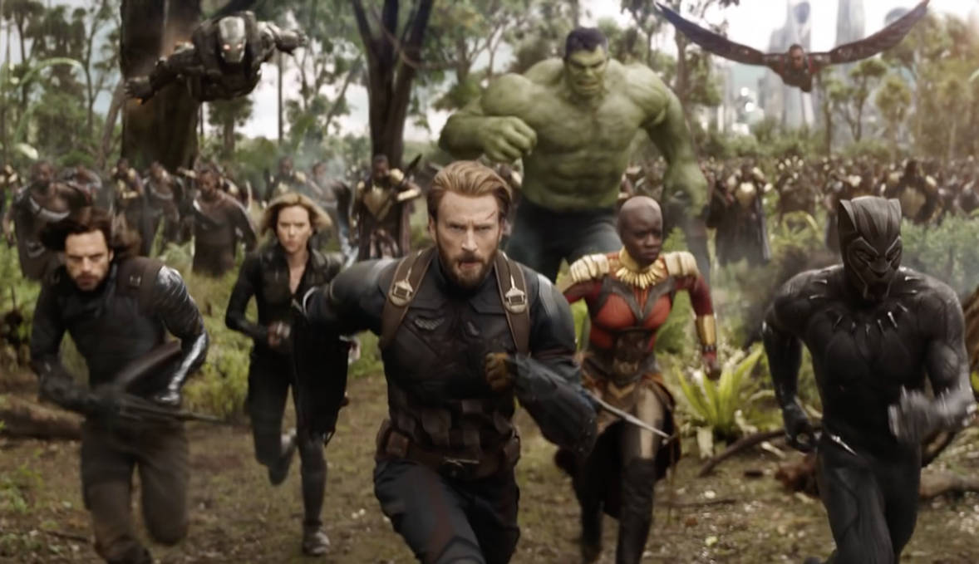
Research Statement
Opportunities: Show that you have an exciting research plan that your prior work has
prepared you to lead. Demonstrate that you will be able to successfully write a grant
proposal.
Challenge: Organization, balancing past work with proposed future work, avoiding a re-hash
of your graduate or postdoctoral work while still within the bounds of your expertise.
Questions to consider:
Have you answered the “So what?” question?
Do you include possible thesis projects for your first few graduate students?
Is it written well enough (and typo free) to show that you will be able to write a grant?
Is the level of jargon appropriate for non-experts in my field?
Have you situated the work in the context of other ongoing work at the institution?

Slide 7
Teaching Statement
Opportunities: Show that you can be a caring and innovative teacher, and that you can
manage this work without delaying your research agenda.
Challenge: Specificity.
Questions to consider:
Have you included your teaching philosophy and grounded it with specifics?
Have you given examples of successful teaching/mentoring?
Have you described
https://www.compadre.org/per/
https://journals.aps.org/prper/
There is a wealth of information out there.
Search on “Physics Education Research”

Slide 8
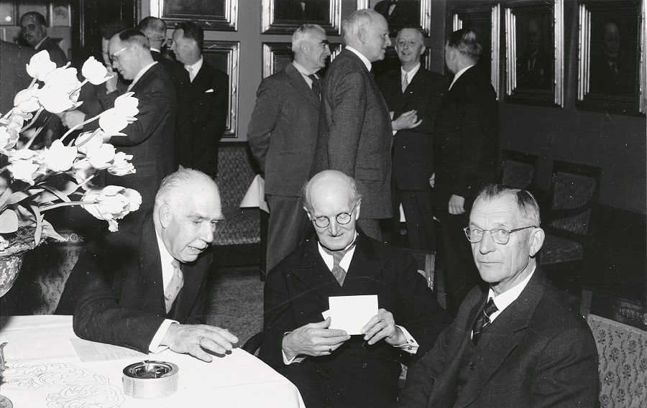
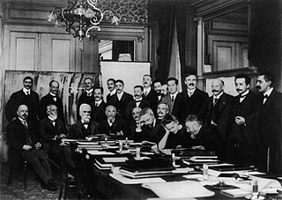
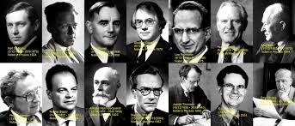
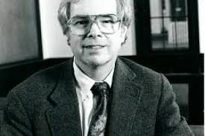
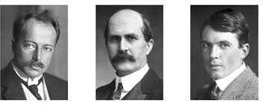
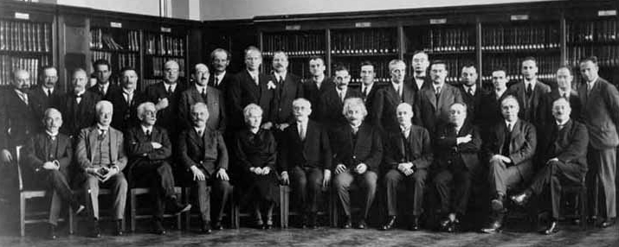
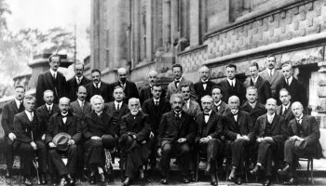
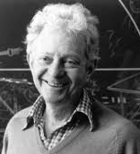
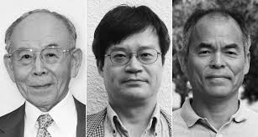
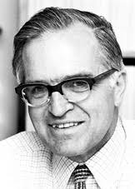
Diversity Statement
Opportunities: Show that you can help the institution become more inclusive and that you
understand the importance of diversity in groups.
Challenge: Be yourself, be honest, be thoughtful, be humble, be specific.
Questions to consider:
Are you thinking about diversity
broadly? (gender, race, ethnicity
socioeconomic status, first generation,
gender identity, international, blue/white collar, mobility, vision, hearing, training)
Have you identified a problem? How have you been (and will continue to be) part of the
solution?
Are there particular challenges to address at this institution?

Slide 9
Resources
Be sure to have a (or several) trusted advisor(s) read your materials to give you
feedback.
It takes time to write a strong application. Finding your next job should be considered
part of your current job, so try to make the time you need.
There are MANY resources out there! Try not to obsess, but do your research!
www.chronicle.com
www.thefora.org
Cover Letter: https://www.chronicle.com/article/the-basics-of-cover-letter/46259
Research Statement:
https://postdocs.stanford.edu/sites/g/files/sbiybj10161/f/events/writing_res_statement_oct_2017.doc
Teaching Statement: https://chroniclevitae.com/news/734-teaching-statement-as-self-portrait?

Slide 10
Success on the academic job market requires a lot of work and no small amount of luck.
Rejection is part of being engaged with the world. Try to not take it personally and don’t let
your self-worth be determined by external forces that you can’t control.
There are many ways that each of us can use our skills to support ourselves and make the
world a better place, so think broadly and boldly about what you want to do with your time
on this planet.

