Slide 1

Muon g-2: Measuring the Muon Magnetic Anomaly to High Precision
Sudeshna Ganguly
52nd Annual Fermilab Users Meeting
13 June 2019

Slide 2
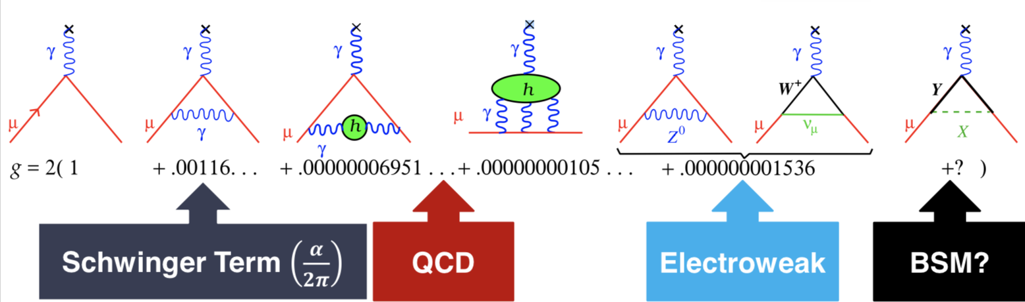

The Magnetic Moment and the Anomaly
Dirac: g = 2 for s = 1/2 particles (1928)
Hyperfine structure experiments on hydrogen: g ≠ 2 (Nafe, Nelson, Rabi 1947)
Anomaly arising from quantum fluctuation a ≡ (g-2)/2 = α/2π (Schwinger, QED, 1948)
Radiative corrections from virtual particles in loops

Slide 3
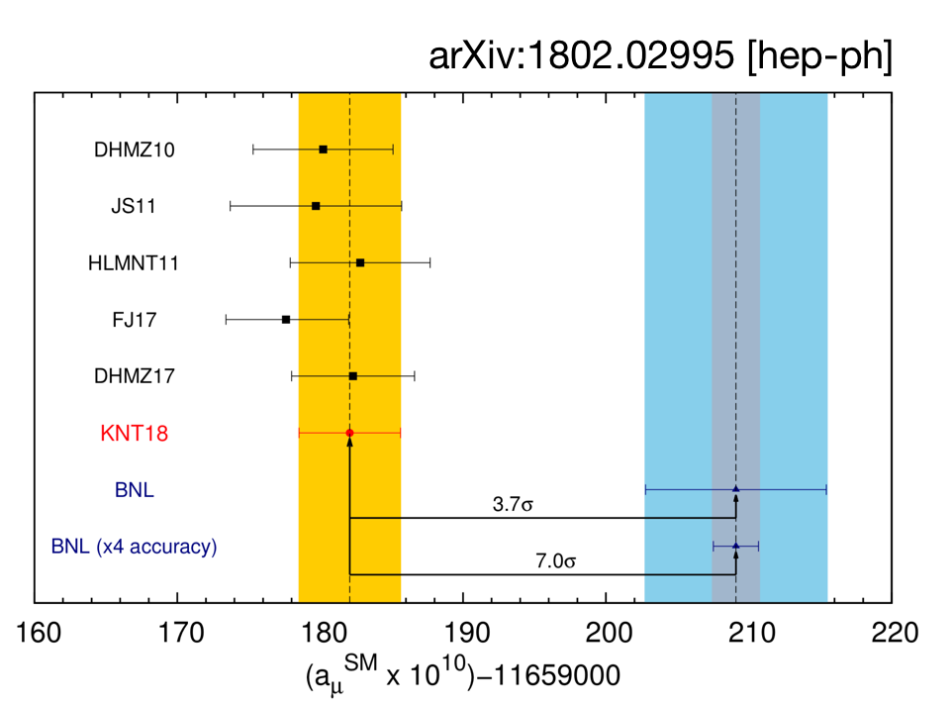
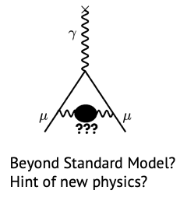


What is the Magnetic Anomaly?
From g_{µ} we define the magnetic anomaly: a_{µ} = $\frac{g_{μ}−2}{2}$
aµ SM = 11659 182.05 (3.56) X 10⁻¹⁰ (Theory total)
aµ ^{EXP} = 11659 208.9 (6.3) X 10⁻¹⁰ (World average)
aµ ^{EXP} - aµ SM = 27.05 (7.26) X 10⁻¹⁰ > 3σ discrepancy
PRD 97 114025 (2018)
[1]
Hypothetical
[1] KNT2018,arXiv:1802.002995v1[hep-ph]

Slide 4
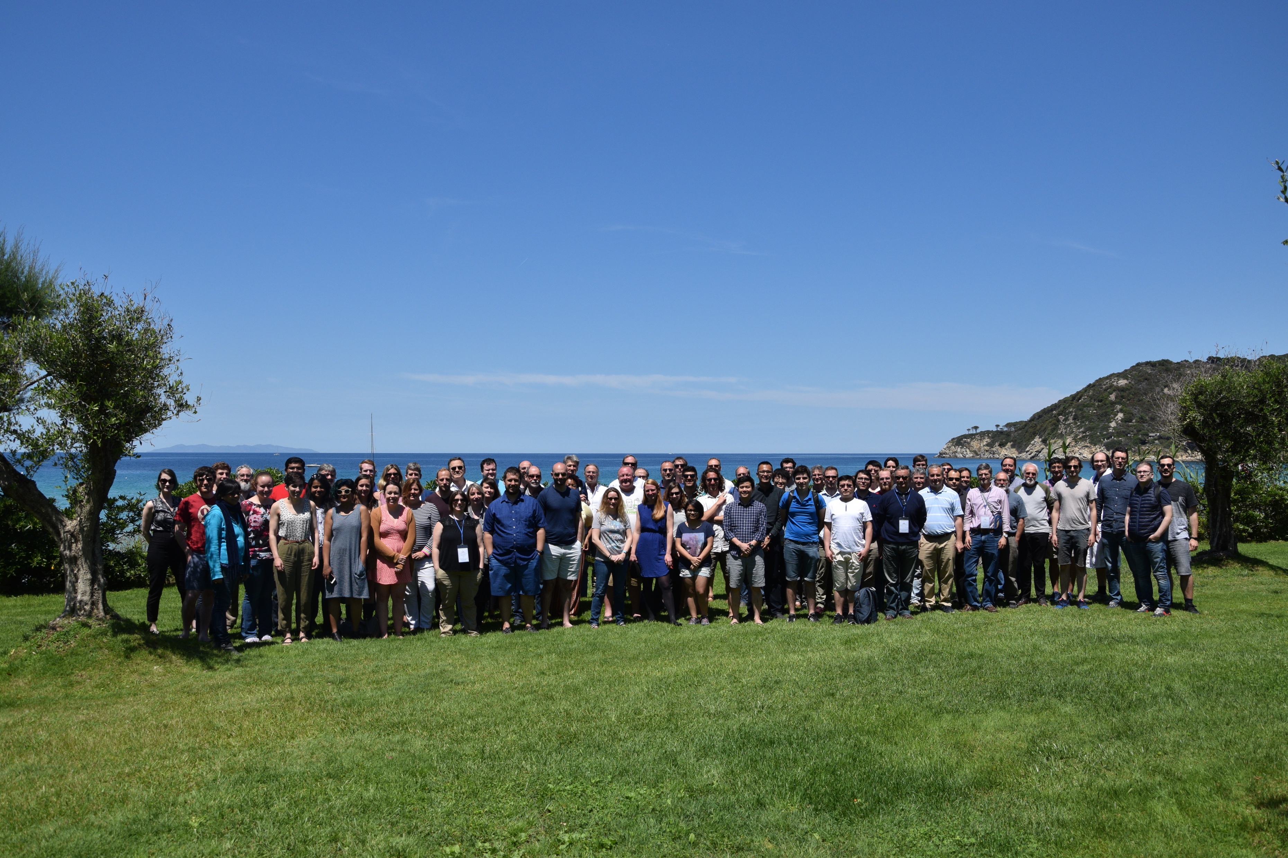
Muon g-2: 33 Institutions, 7 countries, 203 Members
Domestic Universities
  Boston
  - Cornell
  Illinois
  James Madison
  Kentucky
  Massachusetts
  Michigan
  Michigan State
  Mississippi
  Northern Illinois
  Regis
  Virginia
  Washington
National Labs
  Argonne
  Brookhaven
  Fermilab
China
  Shanghai
Germany
  Dresden
Russia
  -JINR Dubna
  -Novosibirsk
Italy
  Frascati
  Molise
  Naples
  Pisa
  Roma 2
  Trieste
  Udine
England
  Lancaster
  Liverpool
  Manchester
  University College London
Korea
  CAPP/IBS
  KAIST

Slide 5
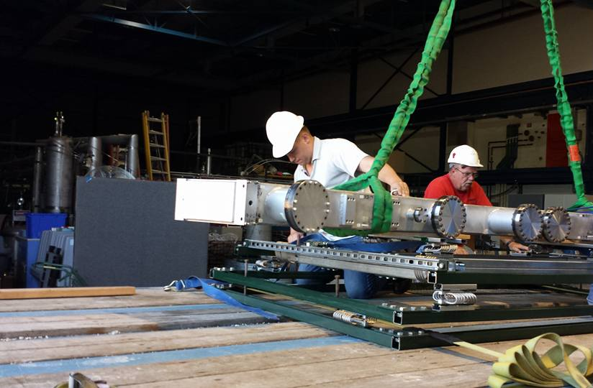
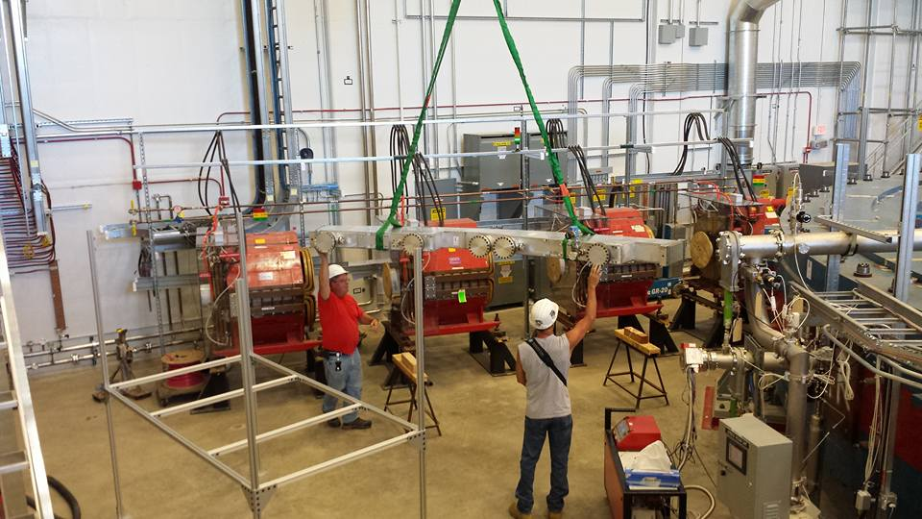
It takes a lot of local Fermilab support to make this experiment work!
We couldn't do the experiment without help from PPD/ND engineers,
technicians, AD and it's engineers and technicians and administrators!!!!

Slide 6
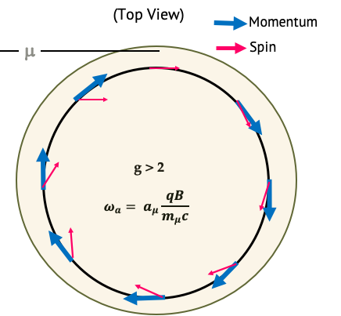
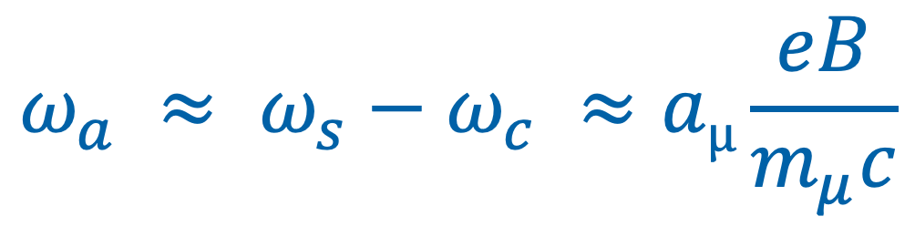
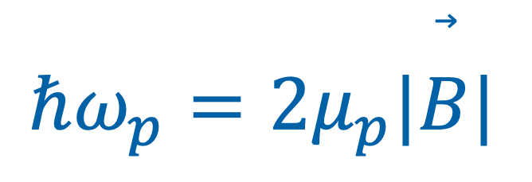
How Do We Measure aµ ?
Anomalous precession frequency:
$$ω_{a} ≈ ω_{s}−ω_{c} ≈aµ\frac{eB}{m_{μ}c}$$
Average magnetic field seen by the muons;
measured with NMR:
$$ℏω_{p}=2μ_{p}|\overset{⃗}{B}|$$

Slide 7
How Do We Measure aµ ?
Anomalous precession frequency:
$$ω_{a} ≈ ω_{s}−ω_{c} ≈aµ\frac{eB}{m_{μ}c}$$
Average magnetic field seen by the muons;
measured with NMR:
Measured experimentally
$$ℏω_{p}=2μ_{p}|\overset{⃗}{B}|$$
3 ppb
0.3 ppt
22 ppb
CODATA values:

Slide 8
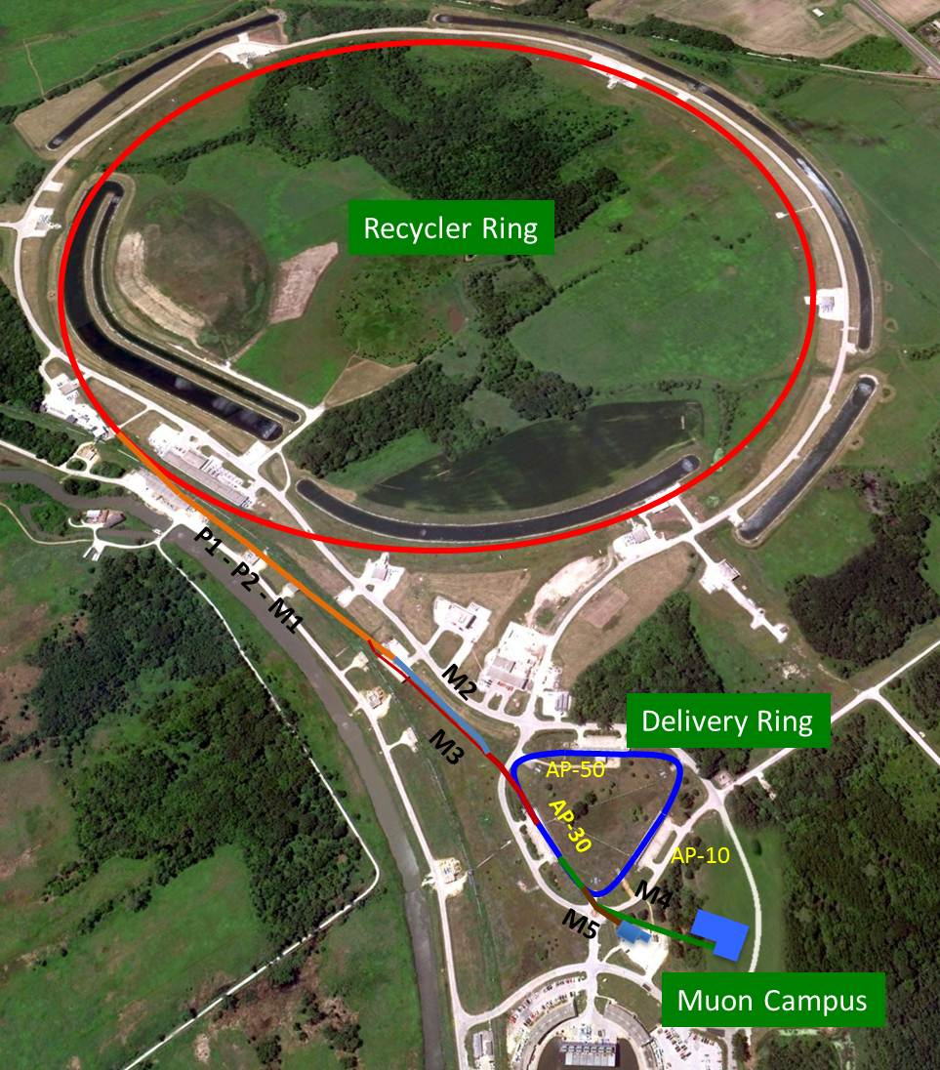
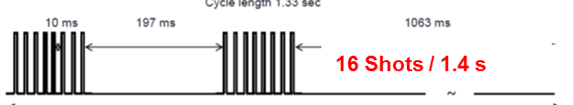
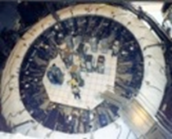
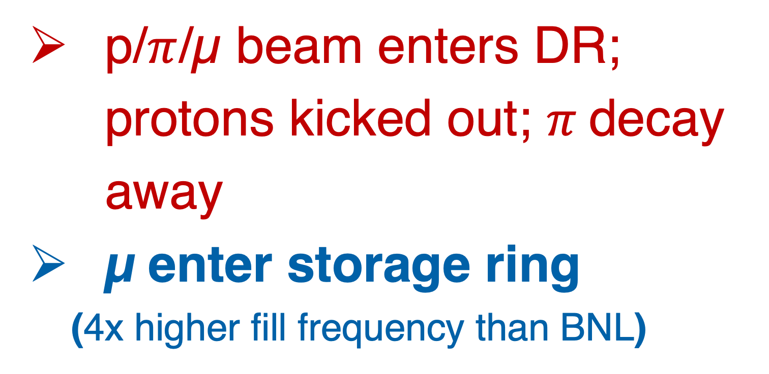

Muon Production
Short batches of 8 GeV protons into Recycler
Each batch divided into 4 bunches of 10¹² protons each
Extract each bunch at a time and directed to target
Long FODO channel to collect $π$ → µ
target
p/$π$/µ beam enters DR; protons kicked out; $π$decay away
µ enter storage ring
(4x higher fill frequency than BNL)

Slide 9
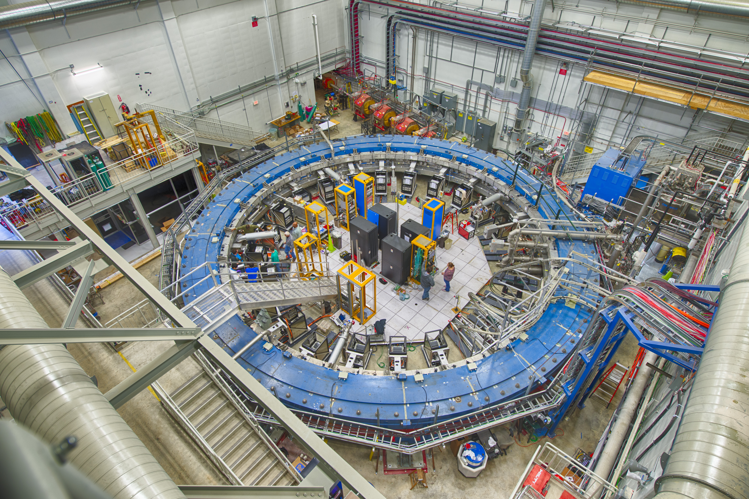
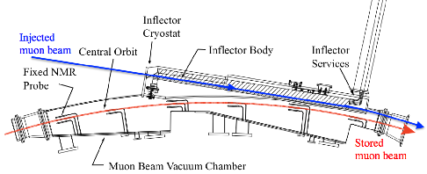
Muon Beam Injection
μ⁺
Inflector Magnet
Provides field free region to deliver beam to edge of storage region
Stops strong deflection of the beam

Slide 10
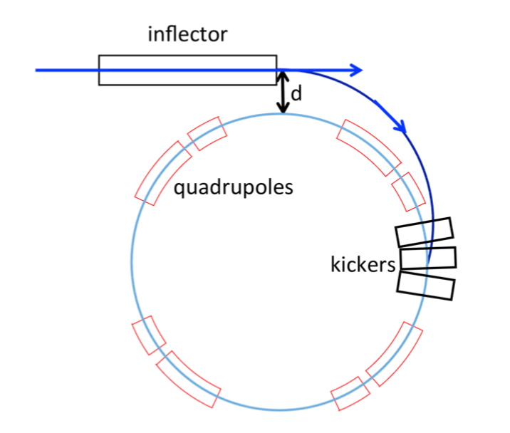
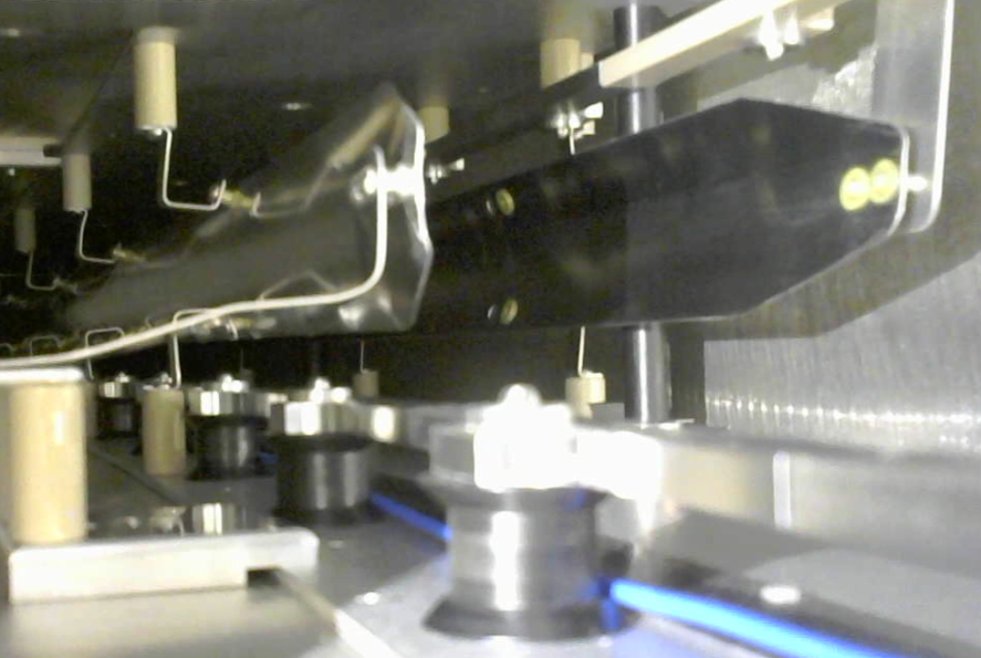
Muon Beam Storage and Focusing
μ⁺
3 Kicker Magnets
Incident beam center 77 mm off from center of storage region
Provide 10.8 mrad “kick” to put muons onto the storage orbit

Slide 11
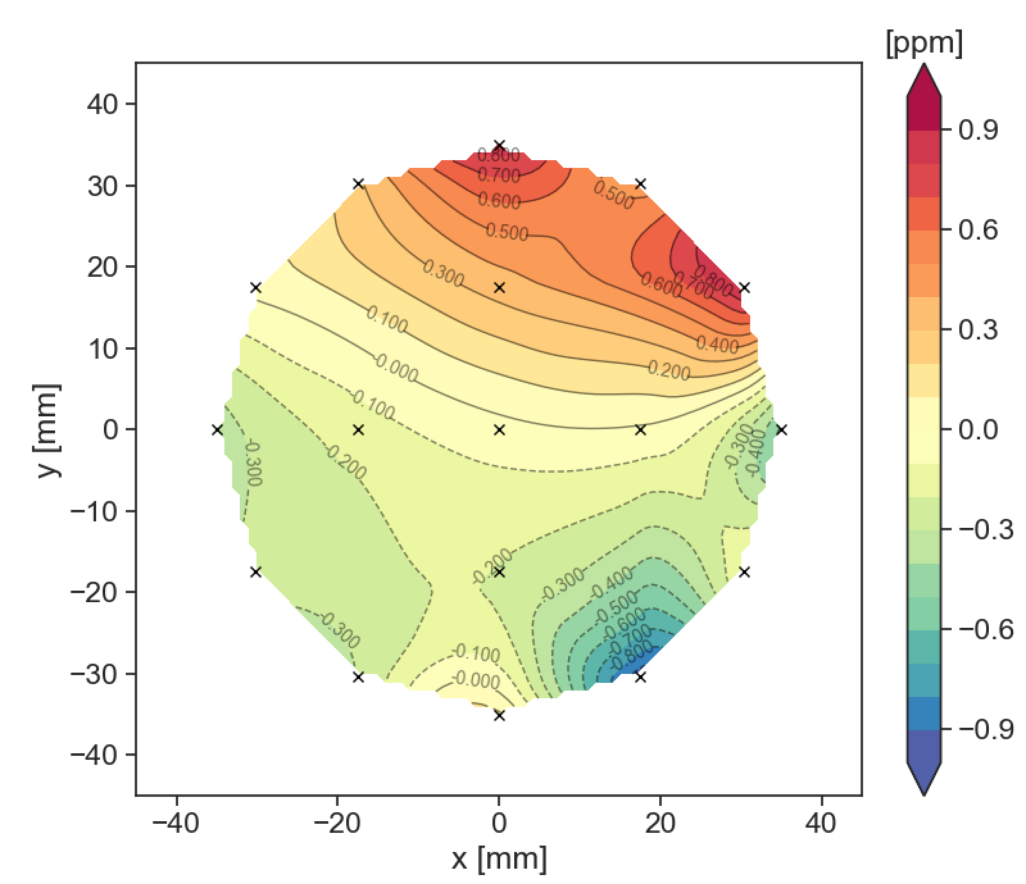
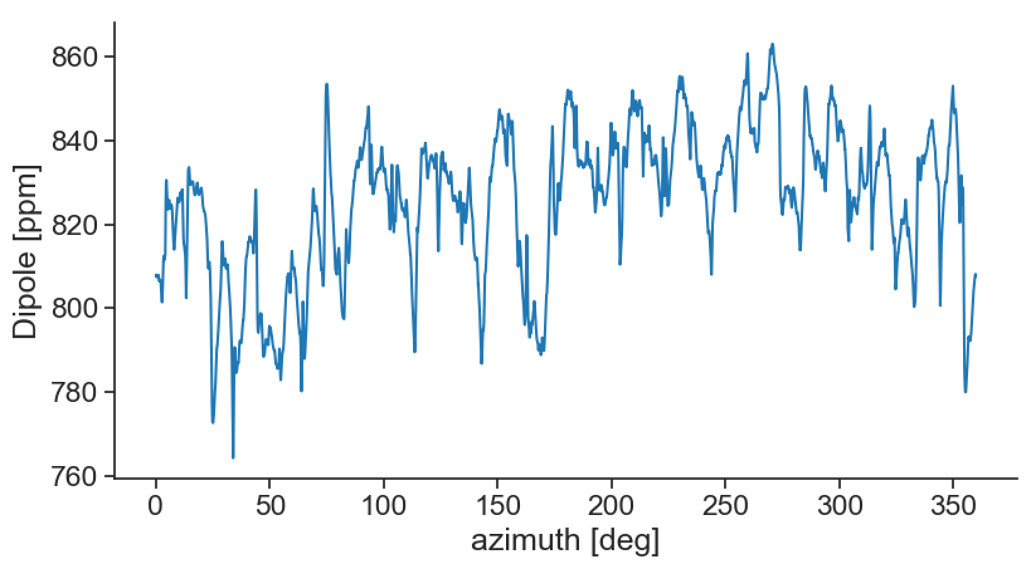
Muon Beam Storage and Focusing
Storage Ring Magnetic Field:
Needed for physics measurement
Provides radial focusing
Measured using a proxy: pulsed NMR of protons
Integral of the dipole projected
in the transverse (radial, x; vertical, y) plane
Dipole as a function of azimuth

Slide 12
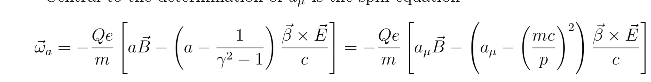
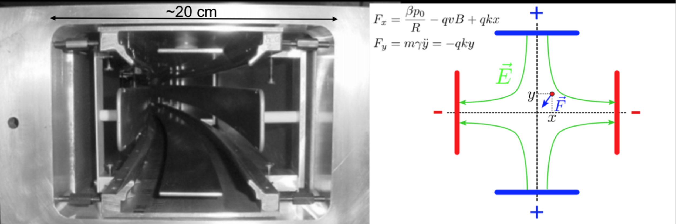
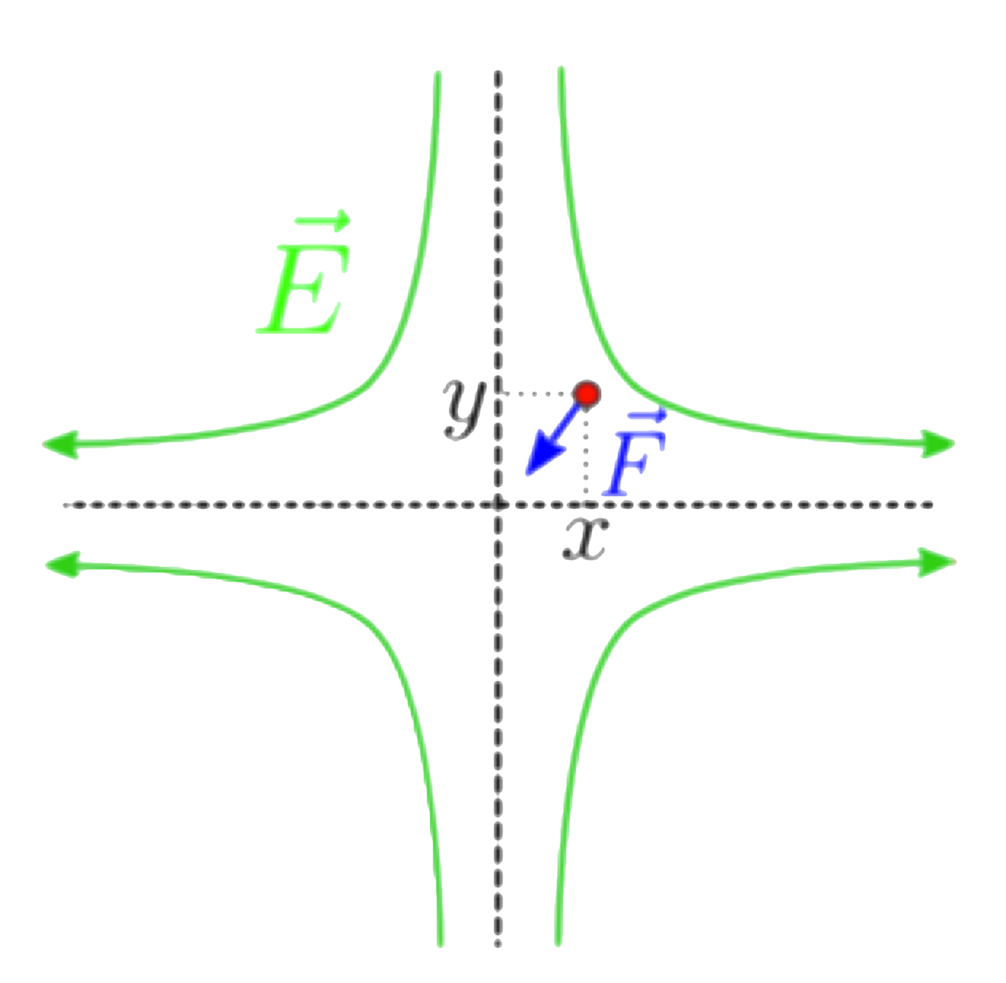
Muon Beam Storage and Focusing
μ⁺
= 0
At p_{magic}= 3.094 GeV/c
for γ_{magic}= 29.3
Electrostatic Quadrupoles
Focuses muon beam vertically
+
-
-
+

Slide 13
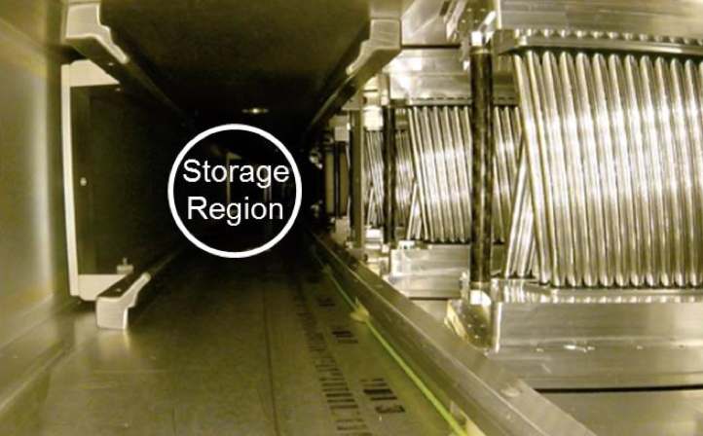
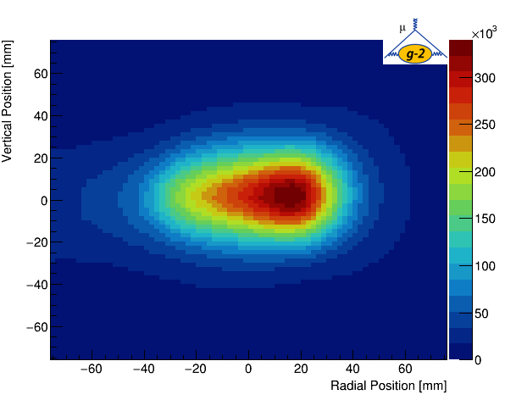
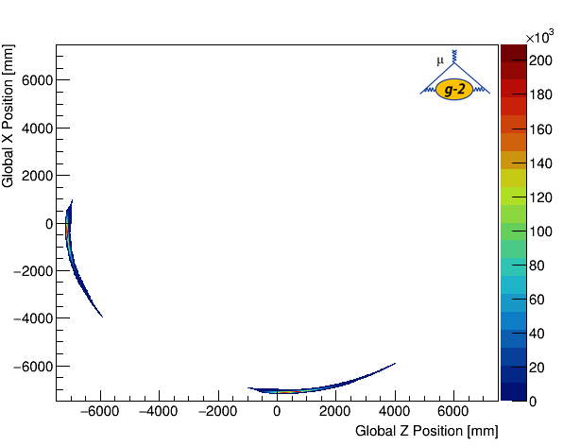
Track Reconstruction
μ⁺
Straw Tracker in vacuum provides muon distribution
Transverse Distribution
Decay Vertices
Two straw-tracker stations installed and operational
Provides trajectory reconstruction of the decay e⁺
r_{magic} – 5 cm
Trackers at 180°
& 270°

Slide 14
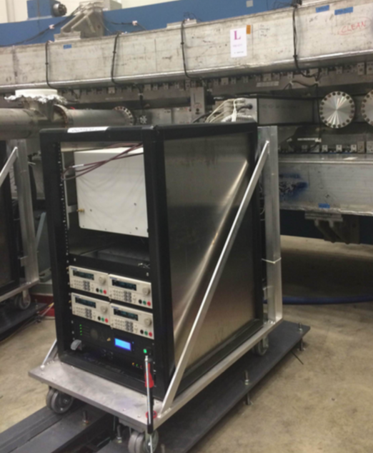
Muon Spin Precession (ωa) in g-2 Ring
μ⁺
24 Calorimeters with 54 Cherenkov PbF₂ crystals with very fast SiPMs
Measure arrival time & energy of the decay e⁺

Slide 15
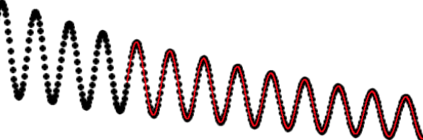
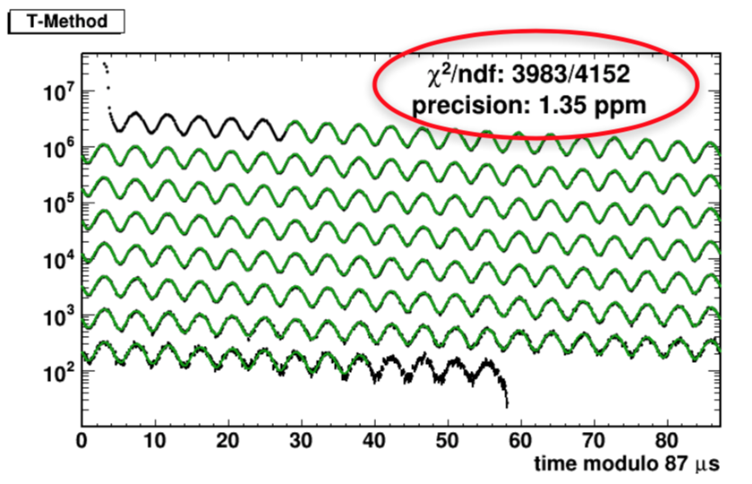
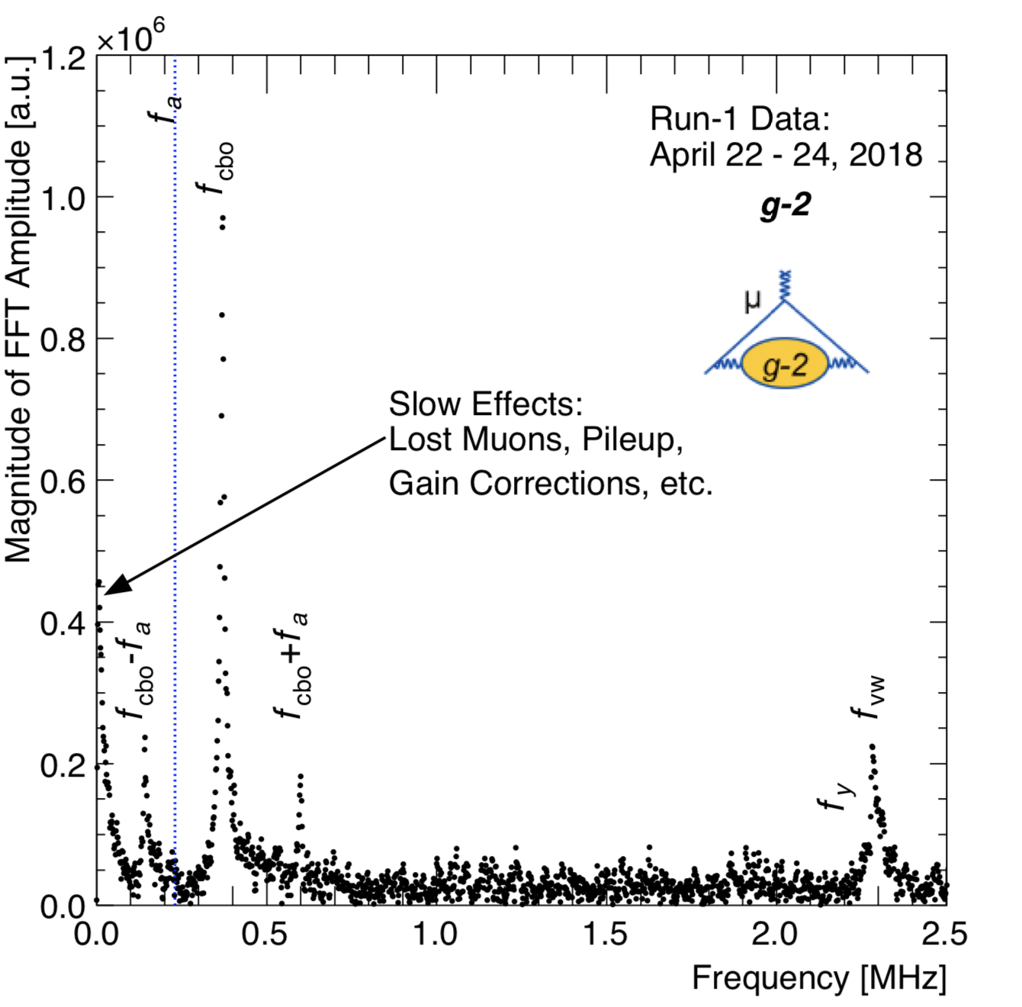
Muon Spin Precession (ωa) in g-2 Ring
~1.8 GeV energy cut on decay e⁺ events to see a wiggle plot
FFT of fit residuals
PRELIMINARY
PRELIMINARY

Slide 16
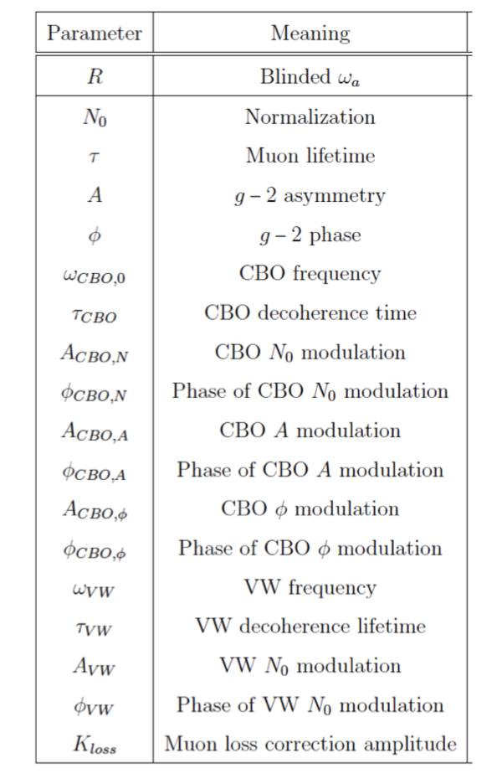
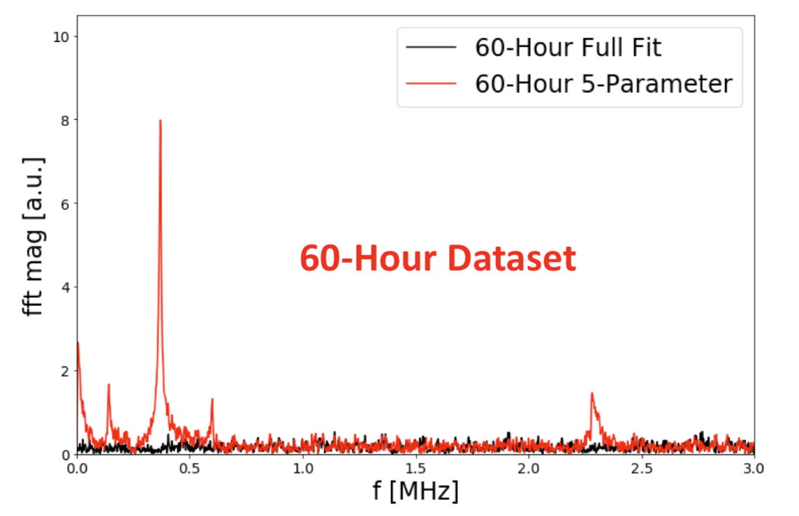
Muon Spin Precession (ωa) in g-2 Ring
$$N\left(E,t\right)= N0 \left(E,t\right)Λ\left(t\right)NCBO\left(E,t\right)NVW(E,t)e_t/Γ\{1+A\left(E,t\right)\cos\left[ωat+φ\left(E,t\right)\right]\}$$
f_{a}
f_{CBO}
PRELIMINARY
Run 1 data subset
f_{VW}
f_{CBO} - f_{a}
f_{CBO +} f_{a}

Slide 17
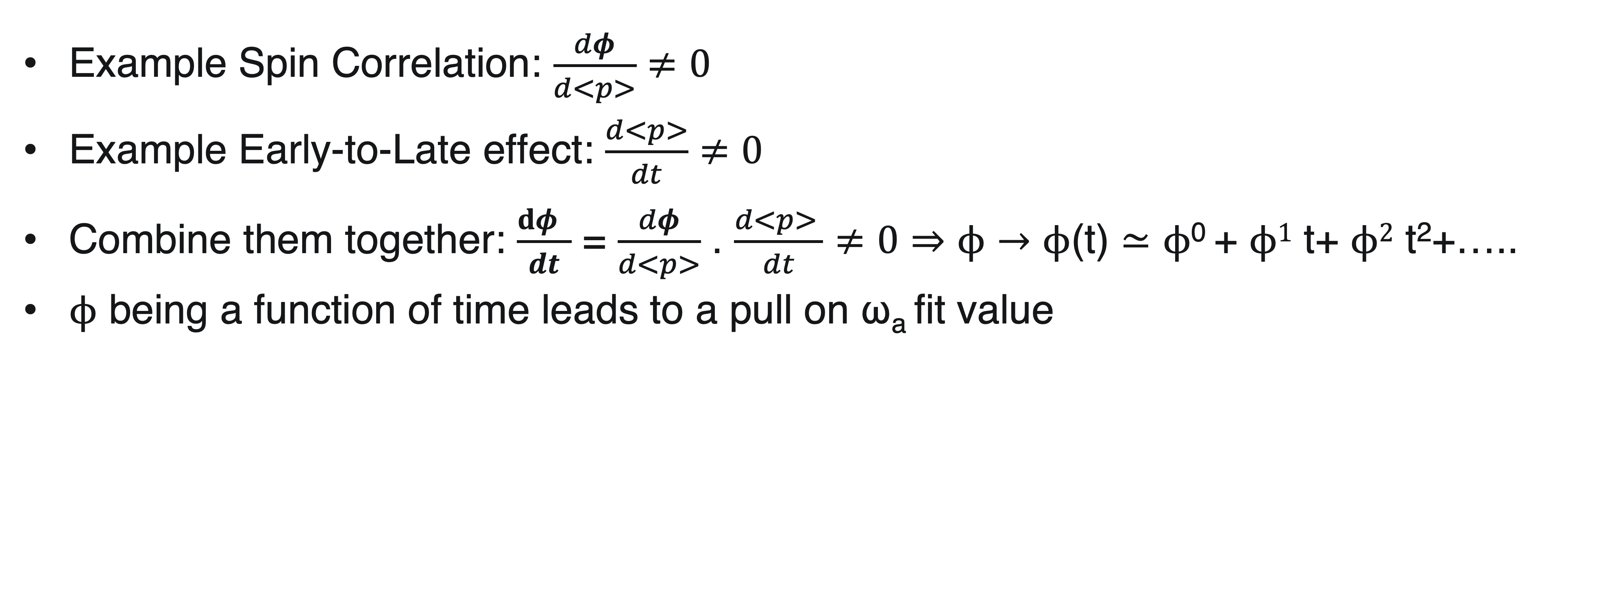
Spin Correlations And Early-to-Late Effects
Spin correlations can combine with early-to-late effects to cause a pull on the ω_{a} fit value (a class of systematic effects)
Example Spin Correlation: $\frac{dφ}{d<p>}$ $≠0$
Example Early-to-Late effect: $\frac{d<p>}{dt}$ $≠0$
Combine them together: $\frac{dφ }{dt}$ = $\frac{dφ}{d<p>}$ . $\frac{d<p> }{dt}$ $≠0$ $⇒ϕ$ $→ϕ$(t) $≃ϕ$⁰ + $ϕ1$ t+ $ϕ2$ t²+…..
$ϕ$ being a function of time leads to a pull on ω_{a} fit value

Slide 18
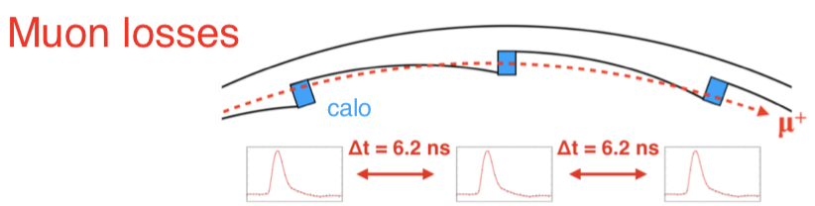
Muon Loss Spin Systematic Effect
Lost muon spin systematic ( muons that may be lost! )
Lost muon population:
Deplete muons via exponential decay & material effects, e.g. collimators
Assume all muons have the same initial spin, which is different from the other population
Muons that are actually lost:
Get kicked out by the collimators and punch through calorimeters (MIPs) during measurement
Need to determine: how many muons are lost, and where they originated
The loss rate is time dependent and needs to be incorporated in the muon precession frequency fit
Muons can pass through many calorimeters without stopping
Stored muon population:
Deplete muons via exponential decay.
Assume all muons have the same initial spin, which is different from the other population

Slide 19
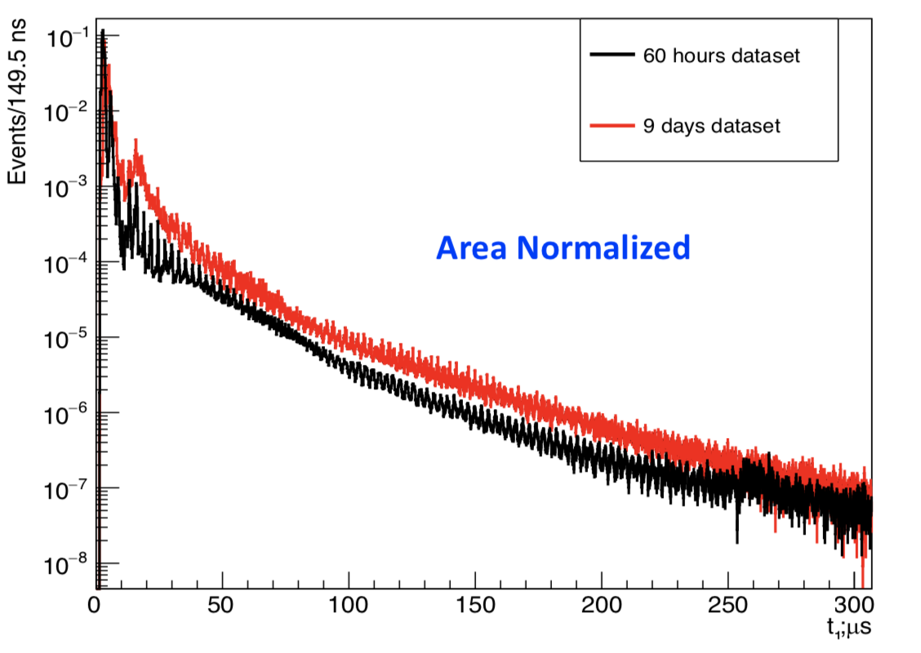
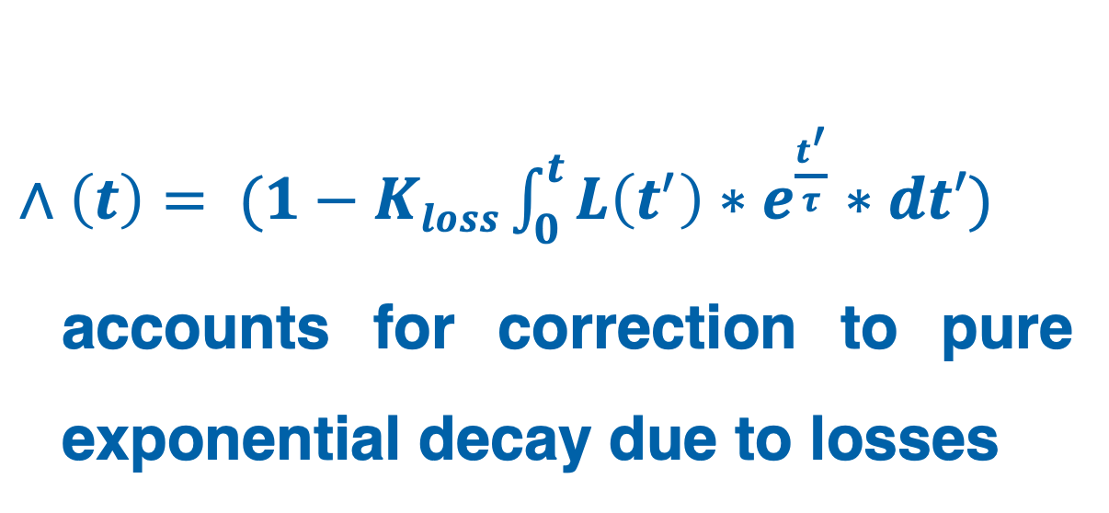
Lost Muon Function
$∧\left(t\right)= (1−Kloss\int_{0}^{t}{L\left(t^{′}\right)∗e^{\frac{t^{′}}{τ}}∗dt′)}$ accounts for correction to pure exponential decay due to losses
Run 1
Subset A
Subset B
Lost Muon Function:
Muon depletion due to material effects, e.g. collimators. Get from data!
Muon depletion due to exponential decay
PRELIMINARY
L(t)

Slide 20
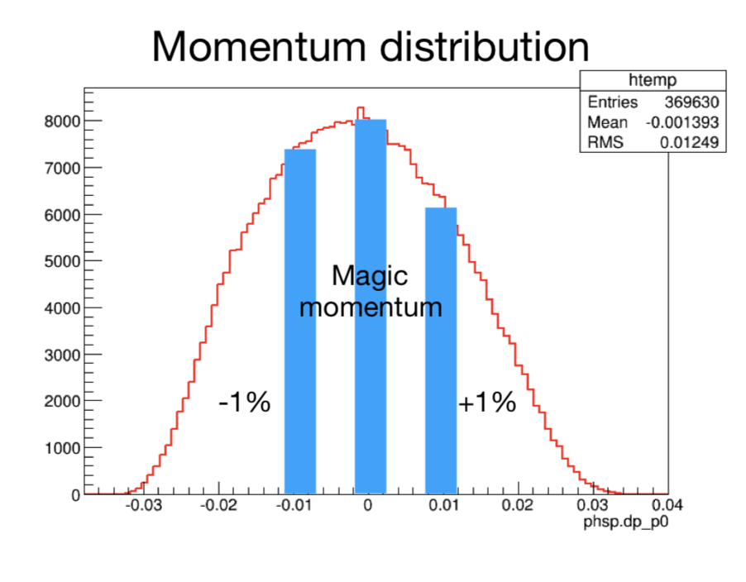
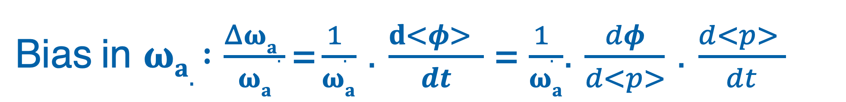
Muon Phase-Momentum Coupling
$\text{Bias}$in $ωa. :\frac{Δωa. }{ωa}\text{=}\frac{1. }{ωa}$ . $\frac{d<φ> }{dt}$ = $\frac{1. }{ωa}$. $\frac{dφ}{d<p>}$ . $\frac{d<p> }{dt}$
Measured with dedicated systematic runs
Indication of phase-momentum correlation
Increasing field increases phase
Take data at higher than nominal momentum
Compare higher momentum phase to nominal momentum phase

Slide 21

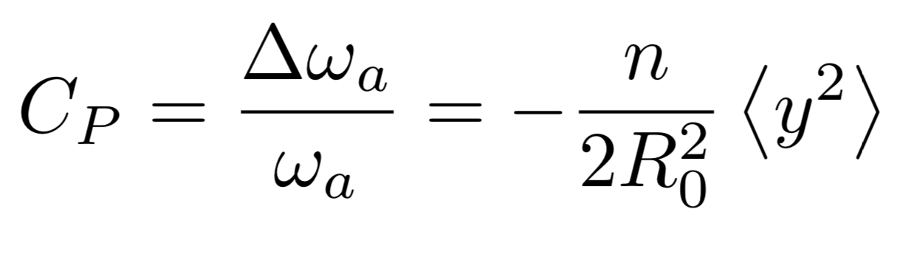
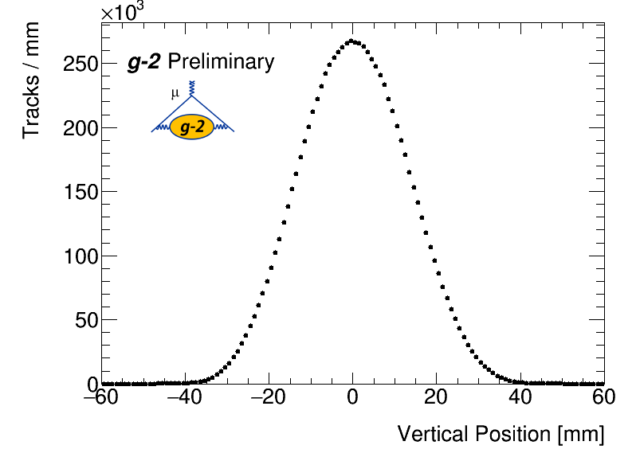
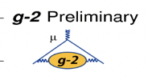
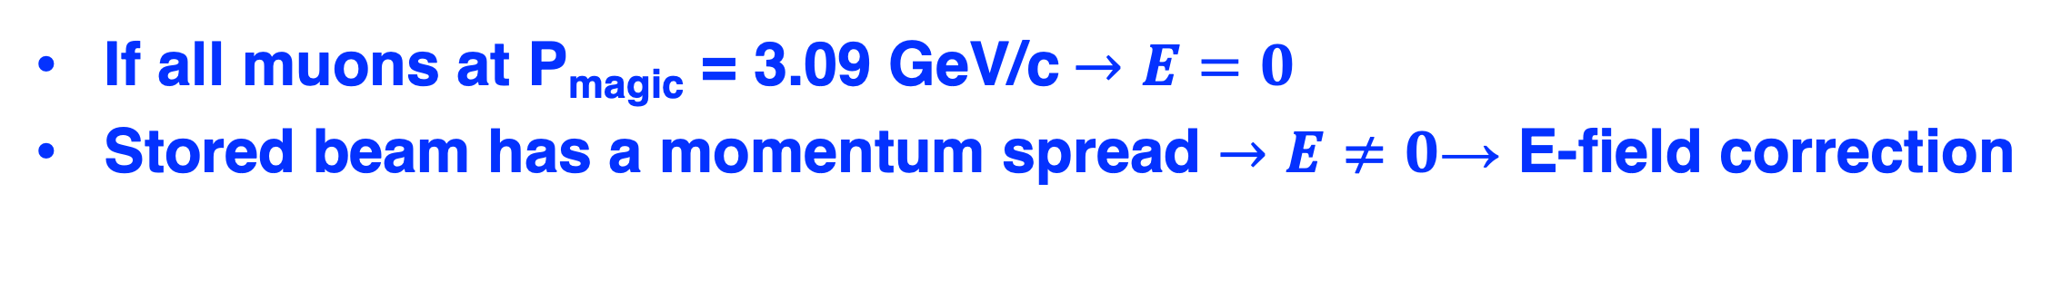
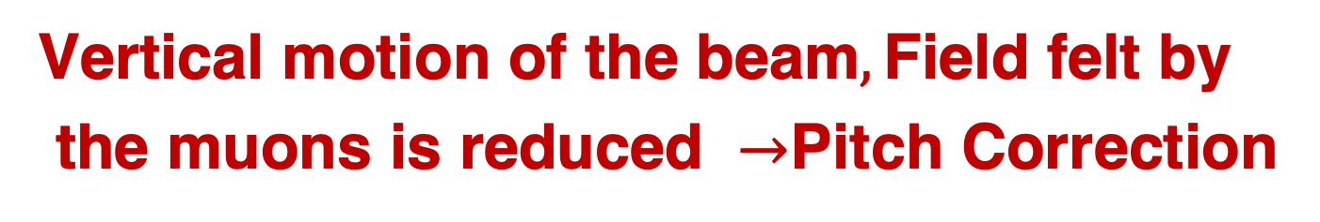
Other Beam Dynamics Corrections
Full expression for ωa:
Chosen γ = 29.3 (pμ = 3.094 GeV/c)
If all muons at P_{magic} = 3.09 GeV/c$→E=0$
Stored beam has a momentum spread $→E$ $≠0$→ E-field correction
Vertical motion of the beam$,\text{Field} \text{felt} \text{by} \text{the} \text{muons} \text{is} \text{reduced} →$Pitch Correction
PRELIMINARY
PRELIMINARY

Slide 22
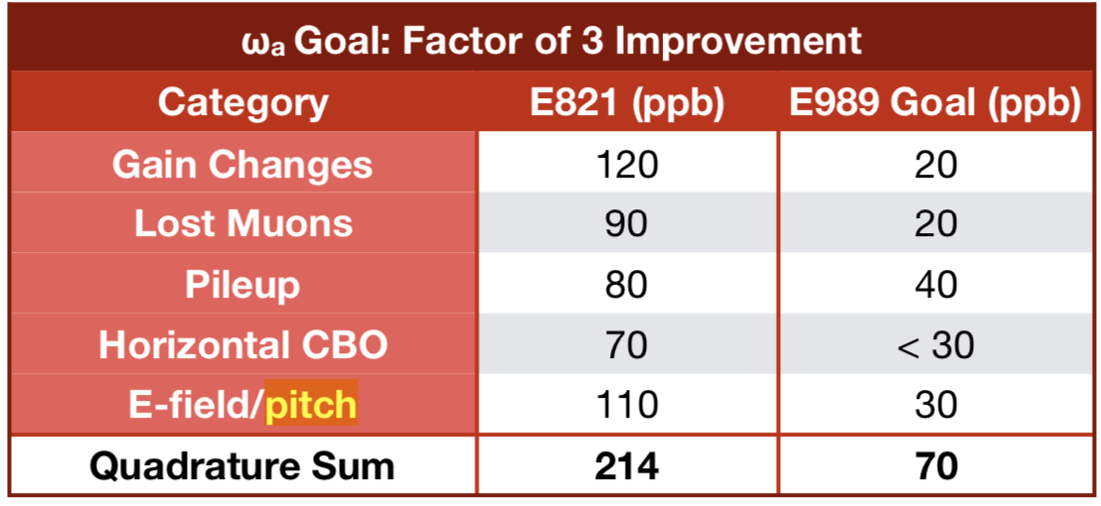
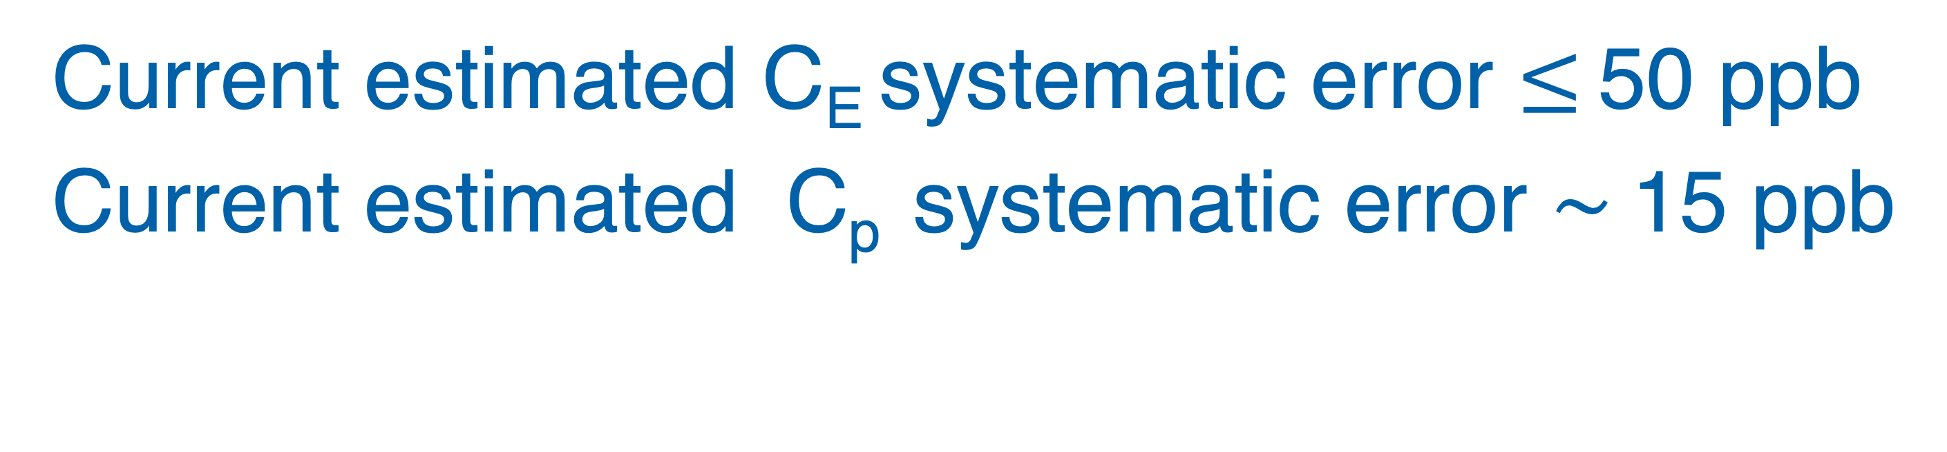
Other Beam Dynamic Corrections
for 20X BNL
Current estimated C_{E} systematic error $≤$ 50 ppb
Current estimated C_{p} systematic error $\sim$15 ppb
For 0.1X BNL statistics

Slide 23
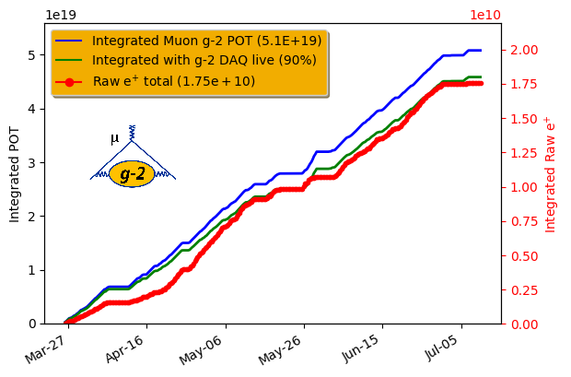
Run 1 Overview
Data taking period: April—July 2018
Accumulated ~ 1.3 x BNL statistics (after data quality cuts) — δωa(stat) ~ 350 ppb (BNL δωa(stat) ~ 460 ppb)
Field uniformity ~ 2x better than BNL
Accumulated statistics

Slide 24
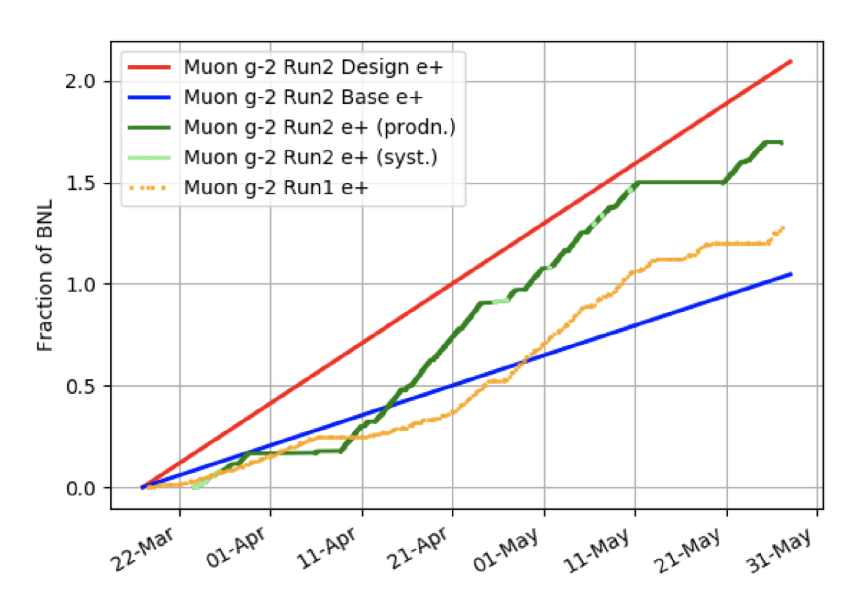
Run 2 Status & Outlook
Started production running in late March
Recording ~ 4% of BNL statistics per day
Aim to accumulate 2XBNL in Run 2
Accumulated statistics

Slide 25
Summary
Muon g-2 provides a unique window into new physics
Collected 1.3XBNL in Run 1 and are in the process of finalizing systematic errors like muon losses, E-field, Pitch correction…on track to publish Run 1 results this calendar year!
Collecting 2XBNL in Run 2 under improved running conditions with reduced systematics
PRD 97 114025 (2018)
Stay tuned for later this year!

Slide 26
BACKUP

Slide 27
It takes a lot of local Fermilab support to make this experiment work!
Del Alspach
Jake Kinter
Jordan Bohn
Erik Voirin
Carey Kendziora
Steve Chappa
Kelly Hardin
Jerry Judd
Ronald Davis
Jerry Makara
Daniel Markley
Howie Pfeffer
Josh Frieman
Jonathan Lewis
Kevin Burkett
Raymond Lewis
Nino Chelidze
Maddie Schoell
Katie Swanson
Dee Hahn
Kim Overhage
Barbara Hehner
Latoya R. Woods
John Najdzion
Skyler Sherwin
Adrian Marquez
Bill Frank
Jeff Duncan
Dean Beckner
Pete Simon
Robyn Madrak
Chris Jensen
Howie Pfeffer
Jerry Annala
George Deinlein
Dave Featherston
Tyler Griffin
Stanley Johnson

Slide 28
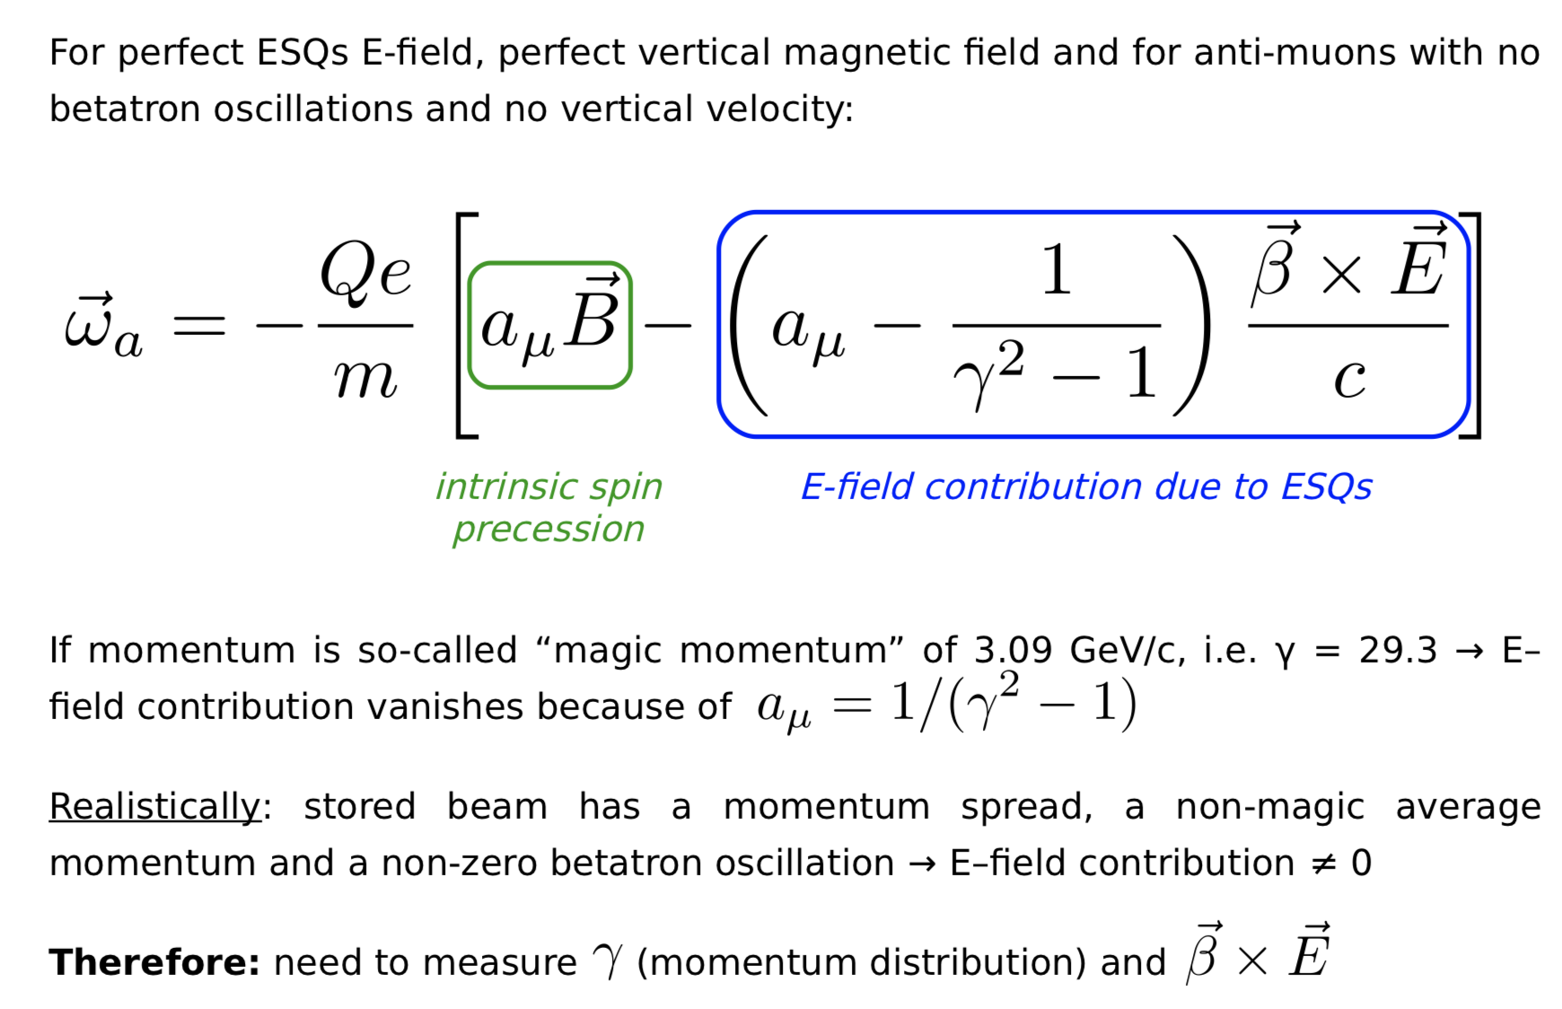
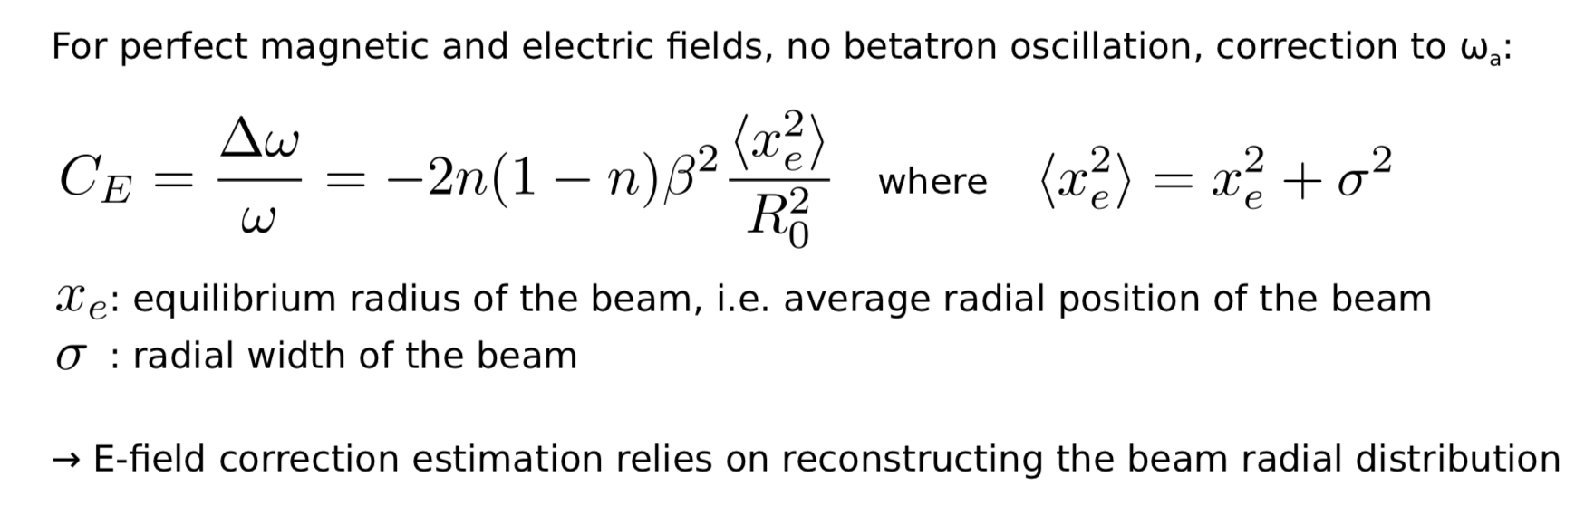
E-field Correction

Slide 29
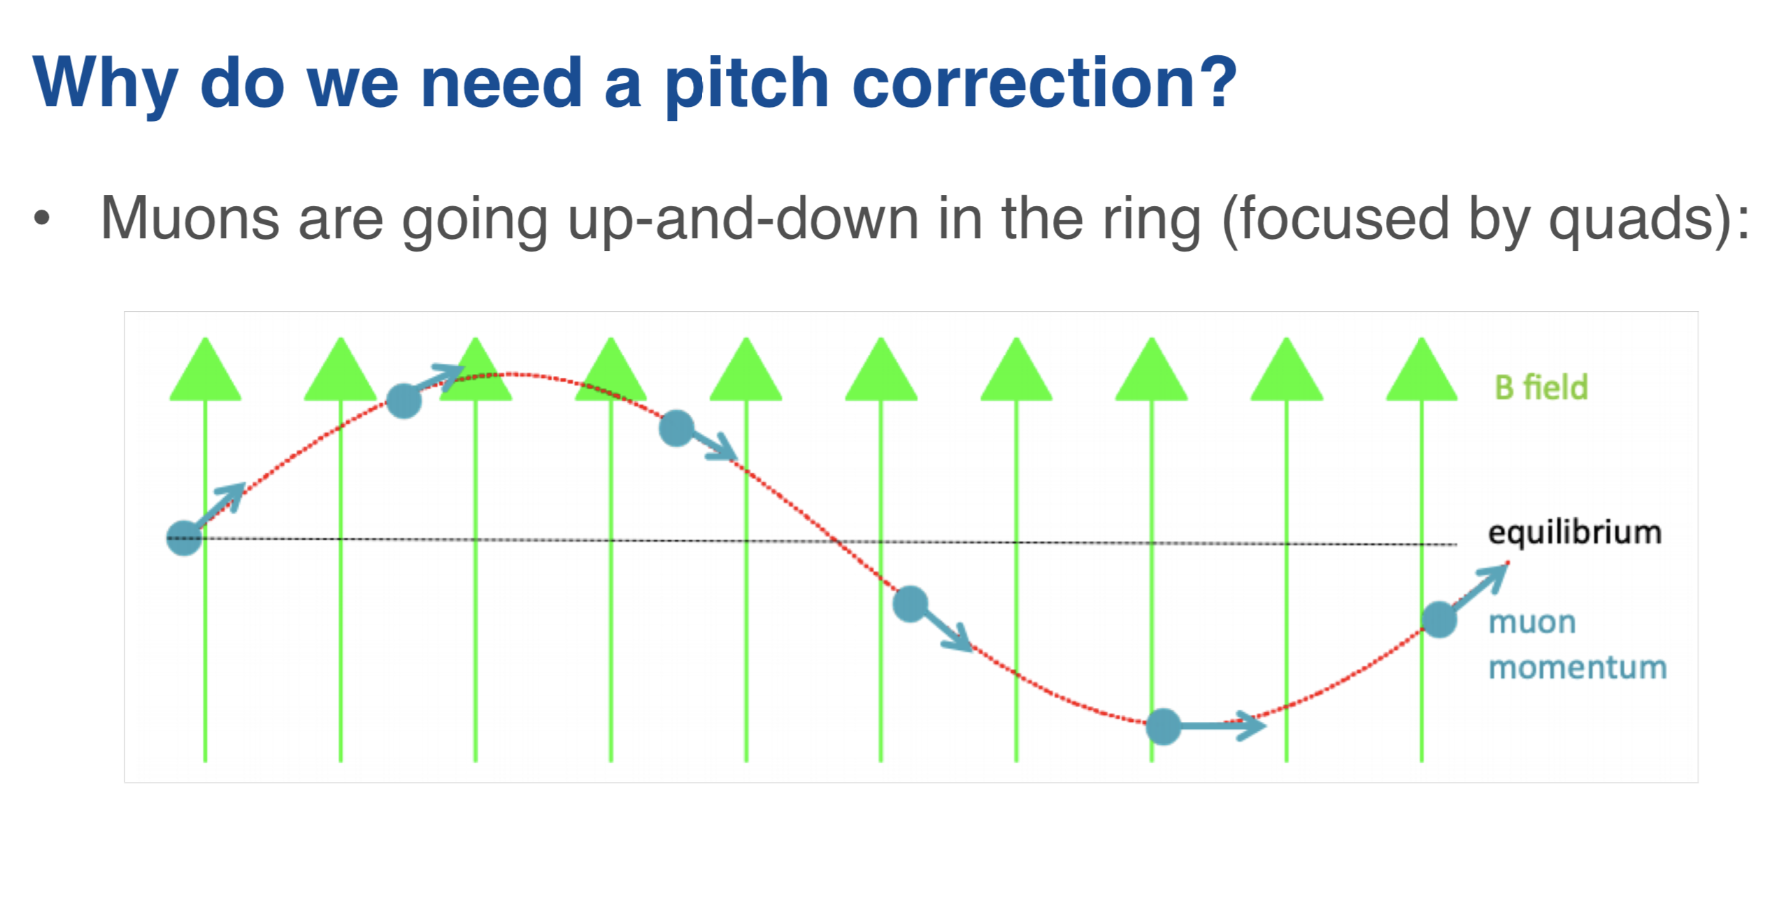

Pitch Correction
Always positive

Slide 30

Pitch Correction

