Slide 1
Recent Fermilab Achievements in Accelerator Science and Technology
Dr. Aleksandr Romanov
52nd Annual Users Meeting
11 June 2019

Slide 2
Motivation

Slide 3
Accelerators & technology at Fermilab

Slide 4
Accelerators for high intensity beams
High number of particles
Low losses
High beam quality
Efficiency
Reliable targets

Slide 5
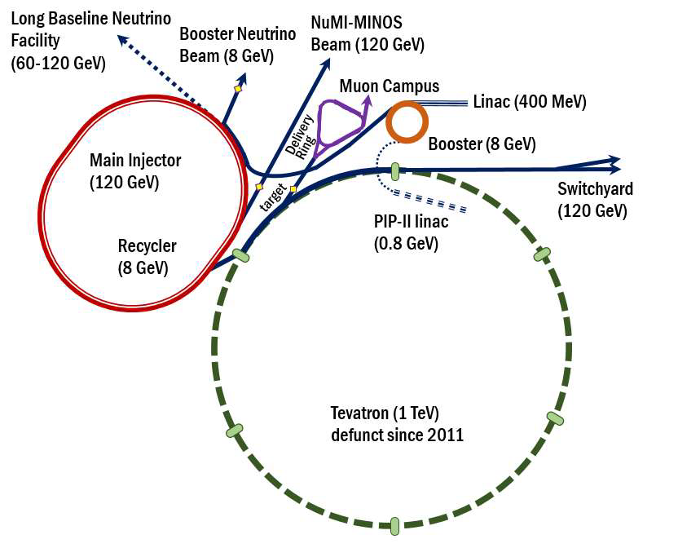
High beam intensity: Accelerator & beam physics
Of particular interest to FNAL and HEP:
Mitigation of beam losses at high-intensity:
Booster, Recycler and MI are intensity-limited by losses (~1 W/m).
Mitigation of instabilities in high-brightness beams:
Fast instabilities which can not be suppressed by external dampers, e.g. an “electron cloud” instability (observed in the Recycler)
Beam cooling
Future colliders
Quantum limits/properties of beams

Slide 6
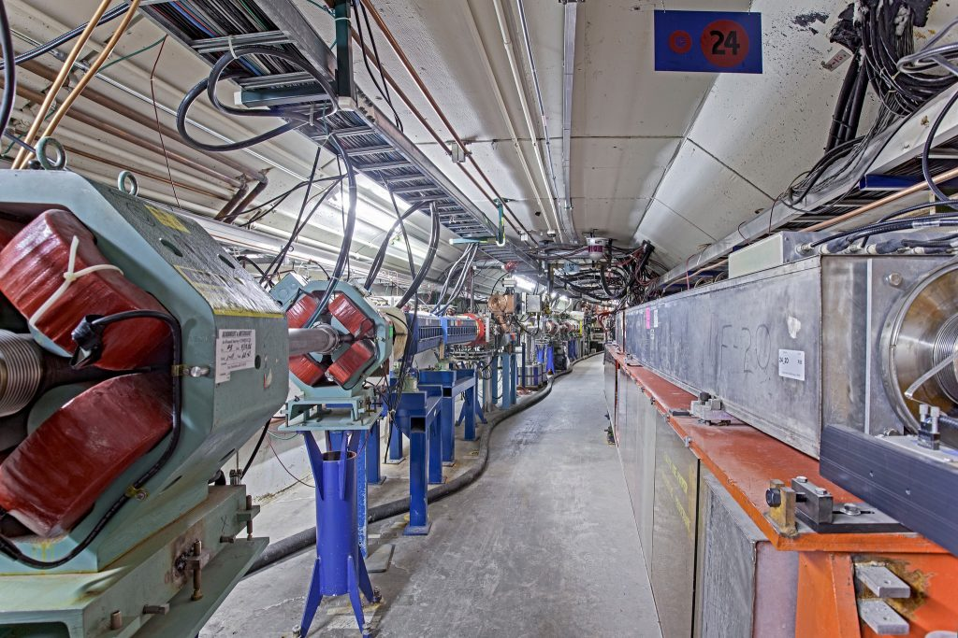
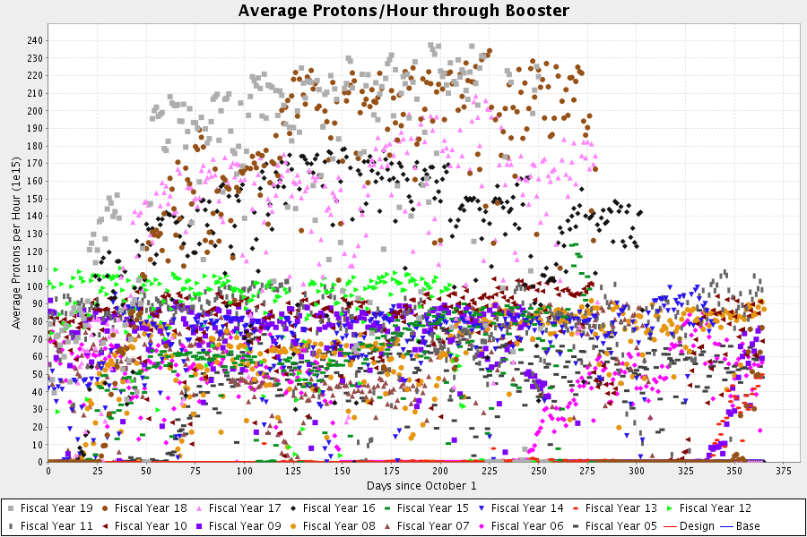
Fermilab Booster for record-intensity beams
Built: First reached full energy in 1971; upgrades for 15-hertz beam completed in 2018
Present: 2.561 E17 – Highest sum of protons through Booster in one hour on June 11, 2018
Future: PIP-II ~40% intensity increase
Far future: Beyond PIP-II research is necessary

Slide 7
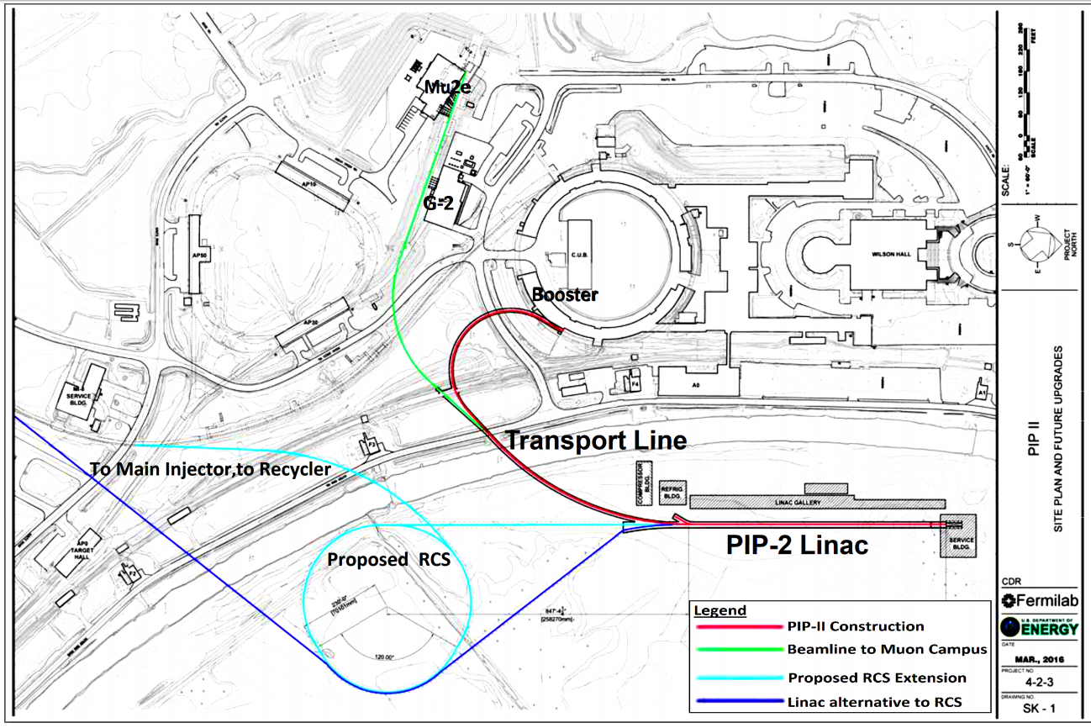
Beyond PIP-II
Two options are considered for post PIP-II upgrades:
Rapid-Cycling Synchrotron
SRF based linac

Slide 8
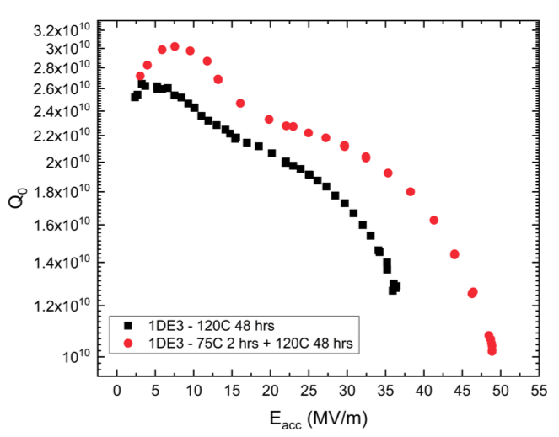
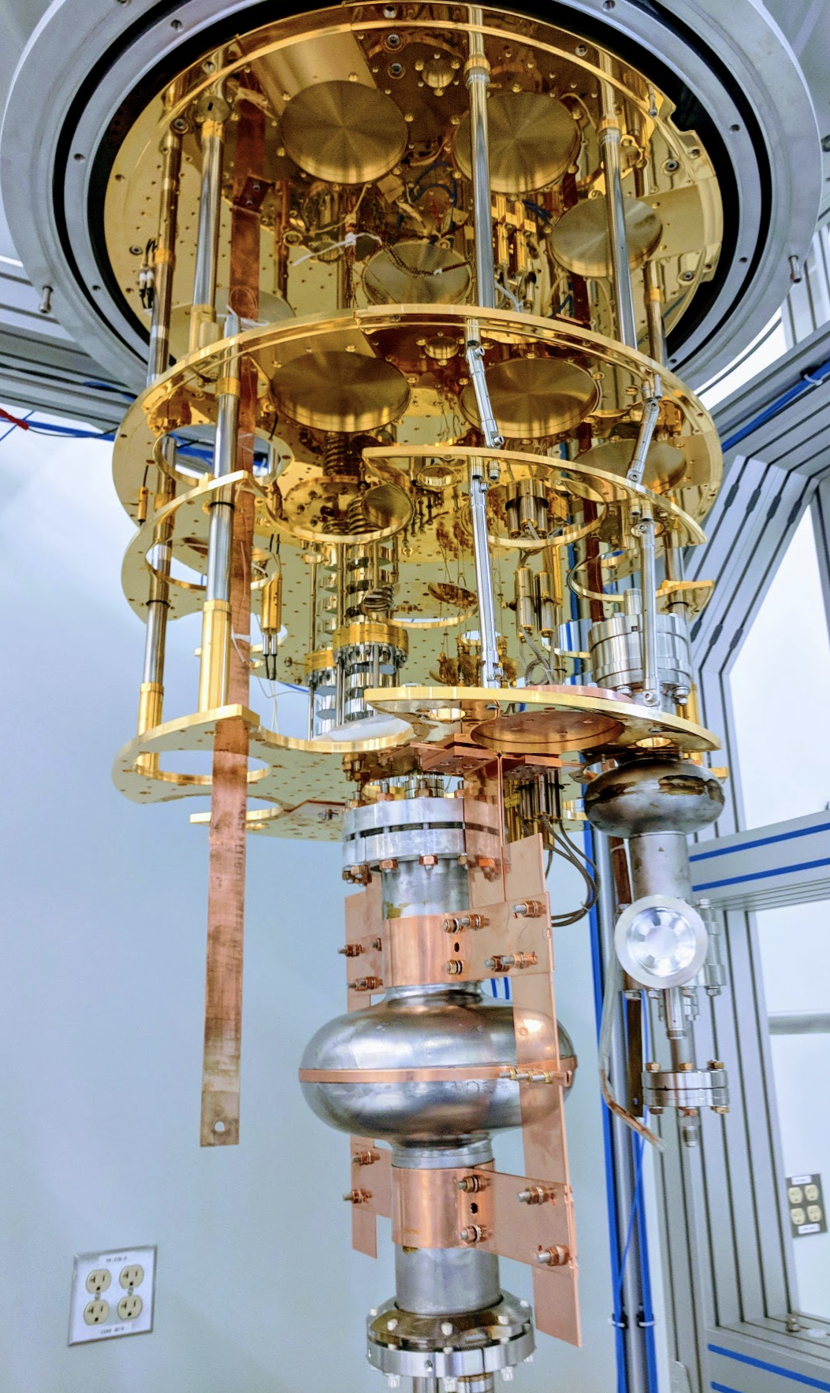
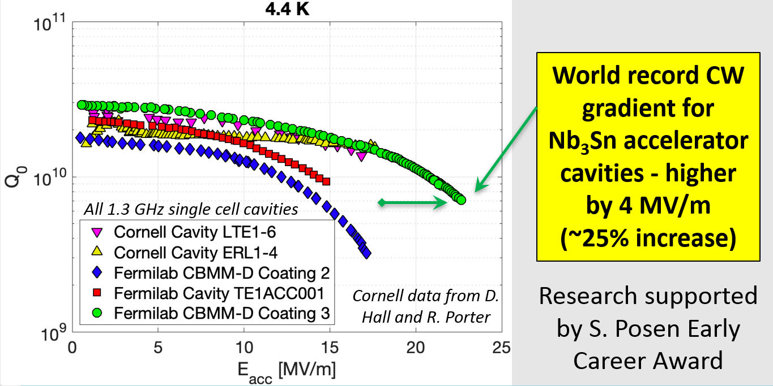
High efficiency: advanced SRF research
New Processing Method for Record Fields in SRF Cavities: 75/120 bake
High Q SRF Cavities for Improved Coherence for quantum information science
New Progress in Maximum Accelerating Gradient of Nb₃Sn Cavities
New 75/120 bake
Typical previous state of the art
A. Romanenko et al.
A. Grassellino et al, https://arxiv.org/abs/1806.09824

Slide 9
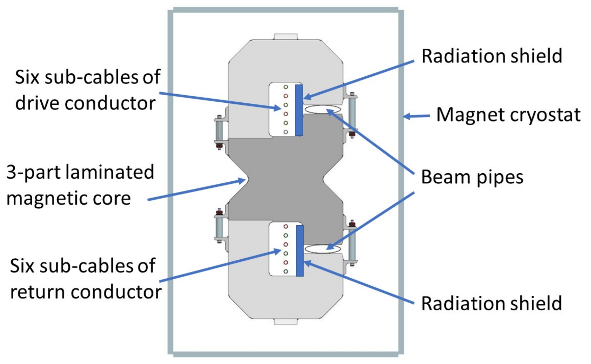
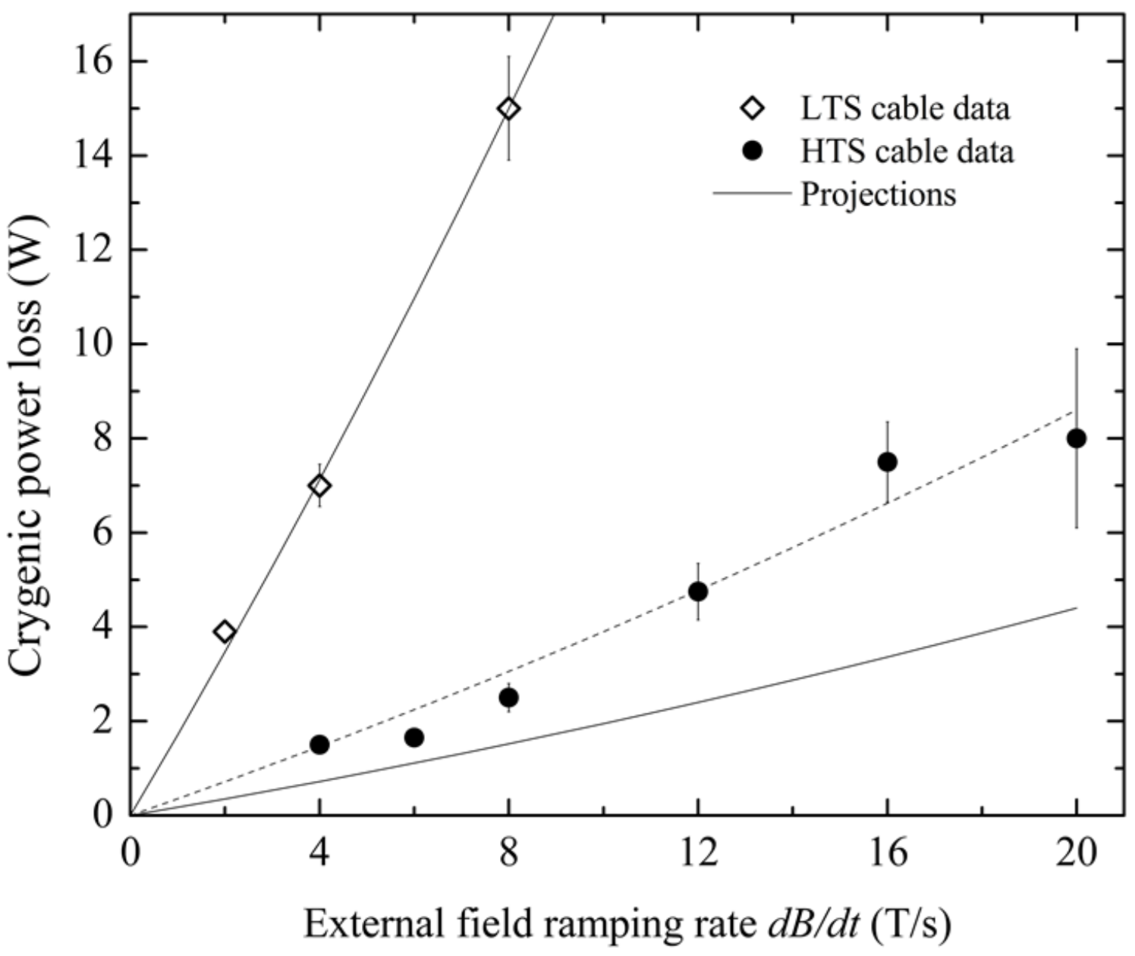
High efficiency: Fast-ramping Super-ferric Magnets
Piekarz et al.
NIM A 2019
YBCO-based HTS super-ferric dipole demonstrated >12 T/s.
World Record!
Super-ferric → Less circum. / energy → less RF power, less intensity
300m, 2x 15e12 protons, 5Hz boxcar stacking, storage ring = 2.4 MW*
*J. Eldred

Slide 10
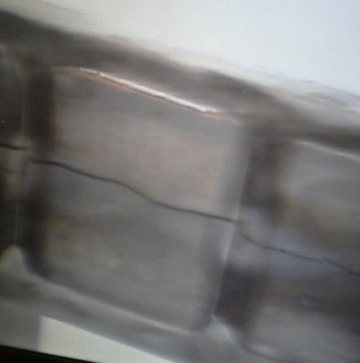
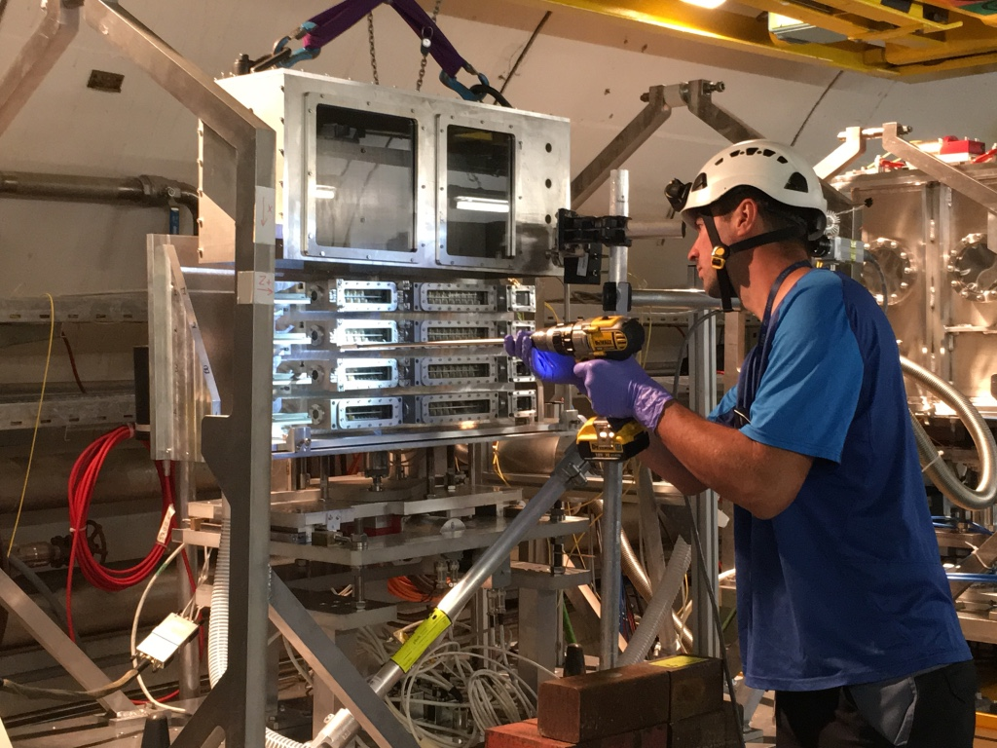
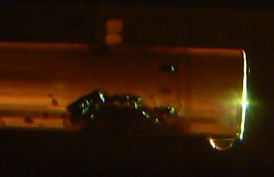
Fermilab HPT R&D Program
SNS Liquid Hg Target Inner window cavitation/erosion
NuMI-MINOS target: Internal water leak
NuMI-MINOS target: cracked graphite fins
Irradiated specimens being installed at CERN’s HiRadMat beamline facility
Goals: Enable reliable design and operation of multi-MW target facilities
Evaluate material response under prototypic multi-MW conditions
Develop required simulation/modeling methods
Develop advanced targetry technologies
Discover/design new radiation and thermal shock compatible materials

Slide 11
IOTA/FAST Facility: a center for Acc. and Beam Physics
IOTA/FAST establishes a capability at FNAL, unique in the world, to address frontier topics in Accelerator and Beam Physics
The only dedicated facility for intensity-frontier accelerator R&D; ranked as top facility (“Tier 1”) for acc. & beam physics thrust by recent GARD review (Jul 2018)
~30 Collaborating institutions
Nat. Lab Partnerships: ANL, BNL, LANL, LBNL, ORNL, SLAC, TJNAF
Many opportunities for R&D with cross-office benefit in DOE/SC

Slide 12
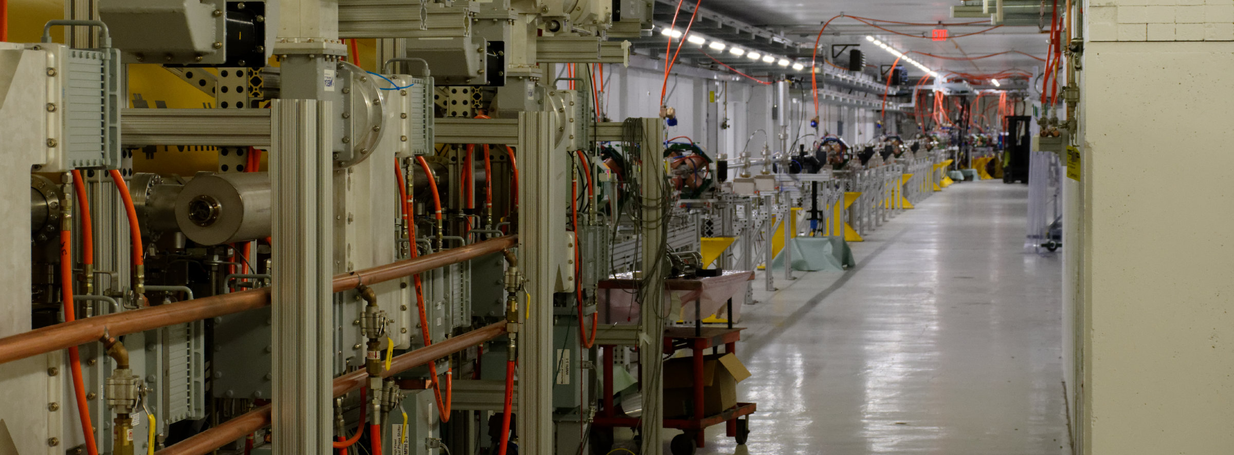
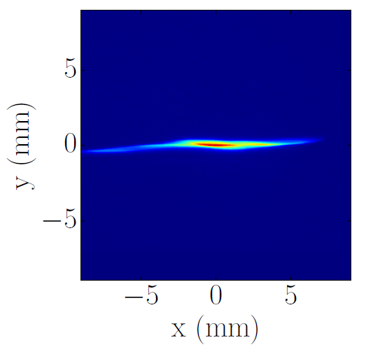
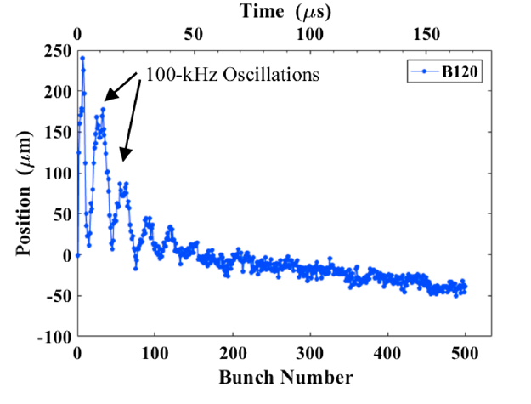
FAST SRF linac has successfully met ILC design
Commissioned to full design energy of 300 MeV; ~90% up-time eff.
World-record beam acc. by ILC-type CM: >31.5MV/m (~250MeV gain)
Successful beam delivery to IOTA
Active & expanding scientific program with new results in:
HOM excitation in SRF cavities & effects on beam emittance
Advanced beam diagnostics using synchrotron radiation
Machine learning algorithms for optimization of accelerator controls
4D phase-space tomographic reconstruction of the beam
Flat-beam transformations of high-intensity magnetized beams
Flat-beam
transformation
Multi-bunch
HOM effects
Adv. Beam
diagnostics
Tomographic reconstruction of 4D phase space

Slide 13
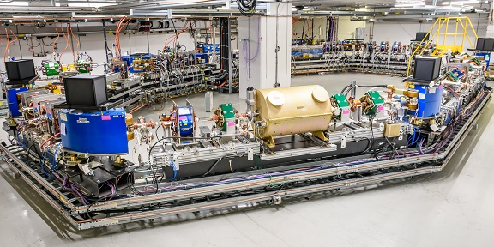
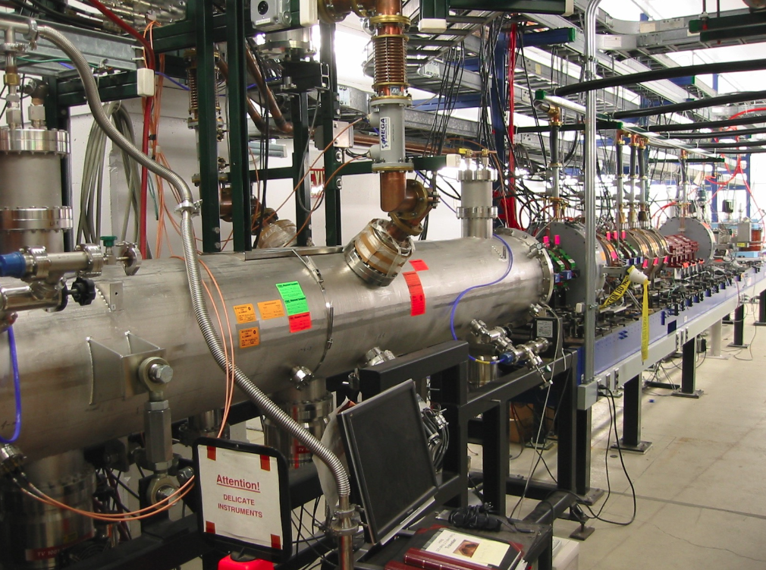
IOTA successfully constructed and commissioned
Commissioned with electrons at 47 MeV and 100 MeV; design charge achieved ~100pC
Proton injector being completed in FY20; available for start of proton science program in FY’21
IOTA proton injector

Slide 14
Accelerator Science at IOTA/FAST
IOTA Ring – priority research focused on high-intensity proton rings, driven mostly by Fermilab
Nonlinear Integrable Optics
Optical Stochastic Cooling
Space-charge compensation
Suppression of coherent instabilities
FAST e- Linac and IOTA – opportunities concurrent with main IOTA program, driven mostly by external partners
Radiation generation
High average current experiments (ILC-like electron beams)
Collaboration with the FACET-II team
EIC R&D
Quantum science: single and few-electron experiments
Near-term, high-impact
science with electrons
High-impact
science with protons

Slide 15
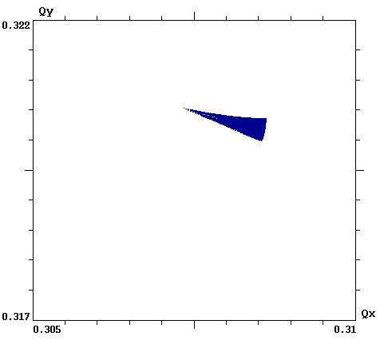
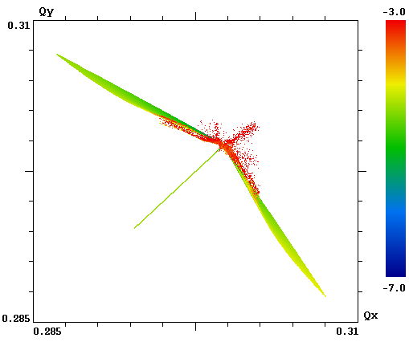
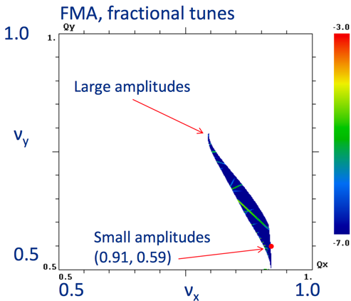
NIO could yield important benefits for future HEP machines
Reduced chaos in single-particle motion: e.g helpful for space-charge suppression
Strong immunity to collective instabilities via Landau damping: provides for higher beam current and brightness
Low cost: brighter beams produce a cascade of cost savings throughout the design, engineering and construction of accelerators
LHC
IOTA w/ Oct.
IOTA w/ NL mag.
ΔQ = 0.001
ΔQ = 0.025
ΔQ = 0.25
Fig. of merit is “tune spread” (ΔQ): the spread in oscillation freq. for beam particles

Slide 16
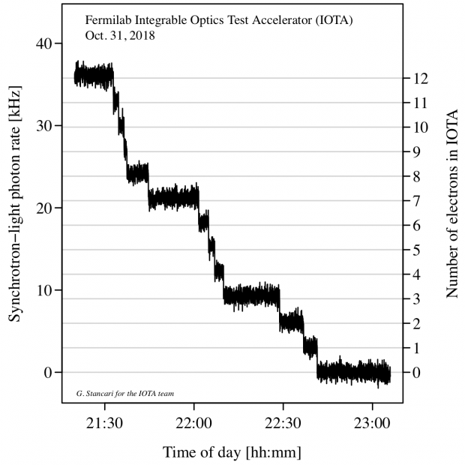
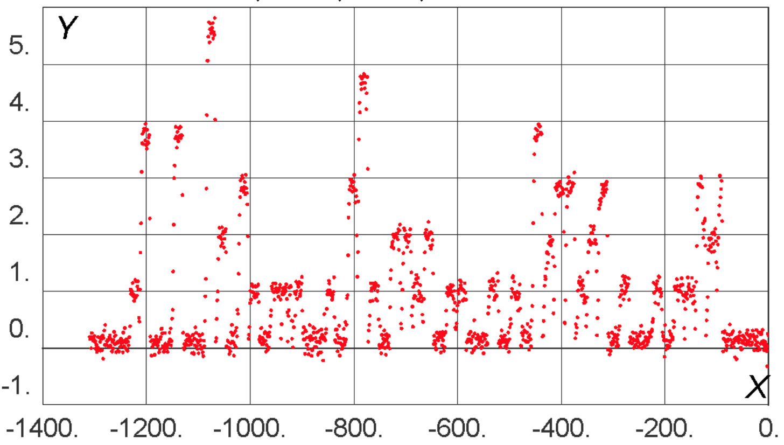
IOTA presents unique opportunities in QS
IOTA demonstrated storage of a single relativistic electron for long periods of time (~10 minutes).
High particle energy (100 MeV) enables observation of SR emission
This opens the way to a wide variety of quantum experiments
Nov. 2018: A one-day Workshop on Single-Electron experiments in IOTA – 30 participants from U.Chicago, LANL, SLAC, ANL, Princeton, RadiaBeam, BNL, UC Berkeley, Fermilab
PMT count rate
Discrete steps from loss
of single electrons
single e- beam
injection every 20 s
Number of Electrons in IOTA
Time (s)

Slide 17
Summary
Fermilab is an established leader in accelerator science and technology support with focus on high-intensity beams research
Effective upgrades of existing infrastructure
Breakthroughs in the SRF technology
Strong R&D for the future accelerators
IOTA/FAST facility establishes a capability at FNAL, unique in the world, to address frontier topics in Accelerator and Beam Physics
As an operational SRF accelerator, FAST cuts across GARD thrusts as a valuable tool for studying SRF technology and its interaction with an intense beam;
Attracts significant interest from global partners

