Slide 1
PIP-II: Groundbreaking and Beyond
A.L. Klebaner
PIP-II Technical Director
52nd Annual Users Meeting
12 June 2019

Slide 2
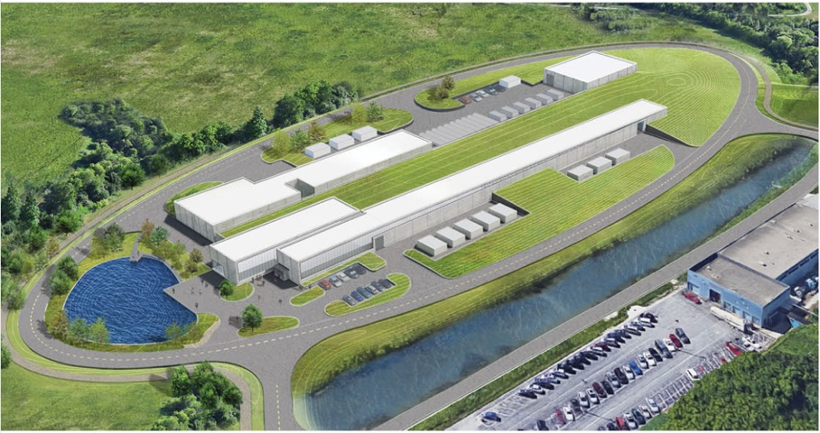
PIP-II Mission
PIP-II will enable the world’s most intense beam of neutrinos to the international LBNF/DUNE project, and a broad physics research program, powering new discoveries for decades to come.
PIP-II will provide:
Beam Power
Meeting the needs for the start of DUNE (1.2 MW proton beam);
Upgradeable to multi-MW capability;
Flexibility
Compatible with CW-operations which greatly increases the Linac’s output;
Customized beams for specific science needs;
High-power beam to multiple users simultaneously;
Reliability
Fully modernizing the front-end of the Fermilab accelerator complex.
June 12, 2019

Slide 3
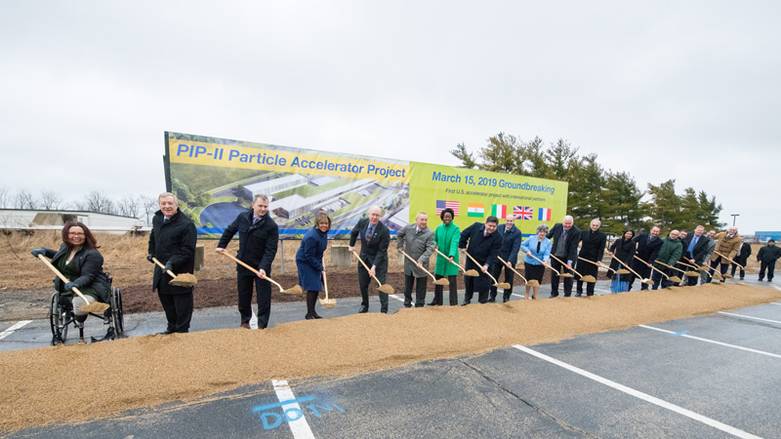
Breaking Ground
March 15, 2019
June 12, 2019

Slide 4
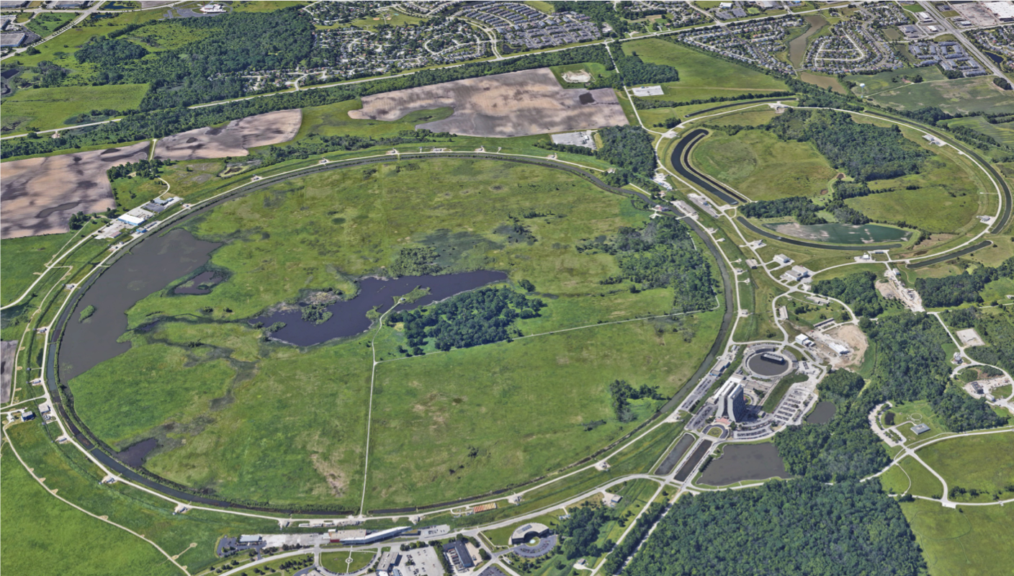
June 12, 2019

Slide 5
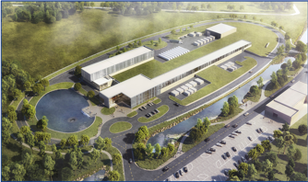
PIP-II Site
June 12, 2019

Slide 6
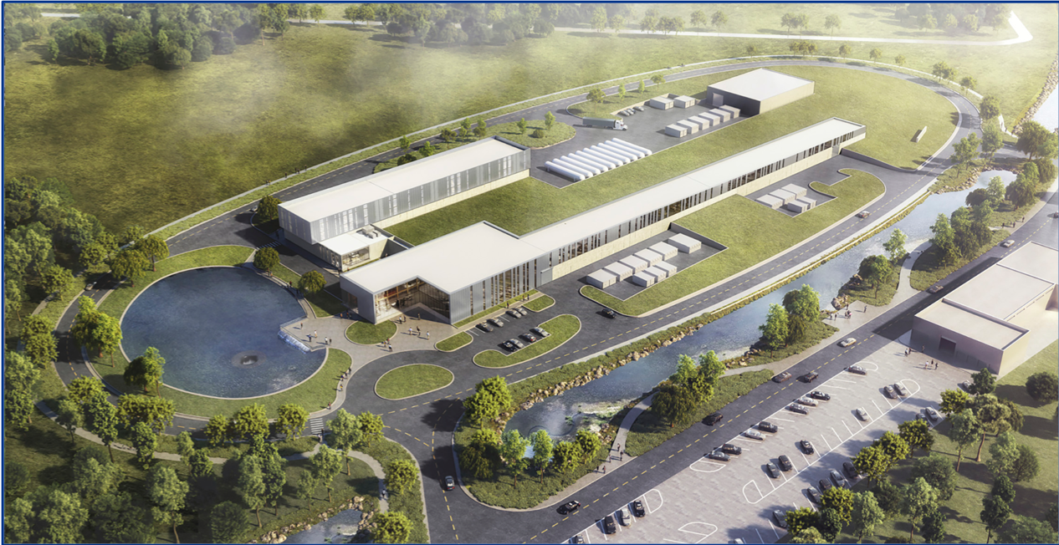
PIP-II Site
June 12, 2019

Slide 7
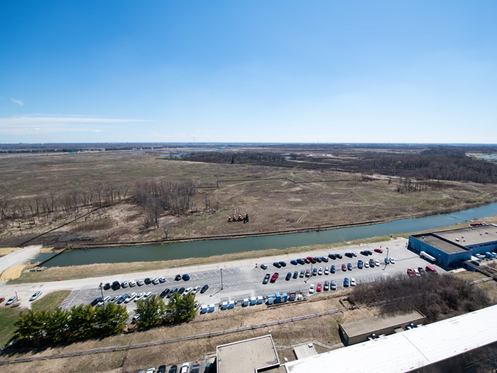
Site Preparation ➔ April 9, 2019
June 12, 2019

Slide 8
Site Preparation ➔ June 11, 2019
June 12, 2019

Slide 9



International Partnership
PIP-II is the first accelerator project in the U.S. with substantial international contributions
June 12, 2019

Slide 10
Technical Approach
Modern 800-MeV Linac;
  Increase Booster power;
Upgrade Recycler Ring and Main Injector.
June 12, 2019
Notes:
80 ➔ 160 kW;
Increase Booster/Recycler/Main Injector per pulse intensity by ~50%;
Increase Booster repetition rate to 20 Hz;
Accommodate higher intensities and higher Booster injection energy.

Slide 11
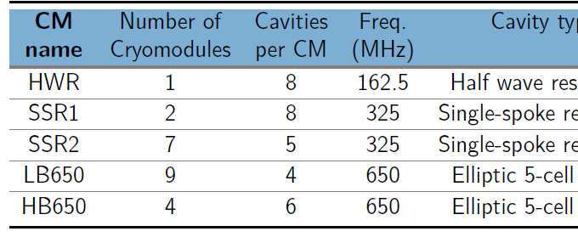
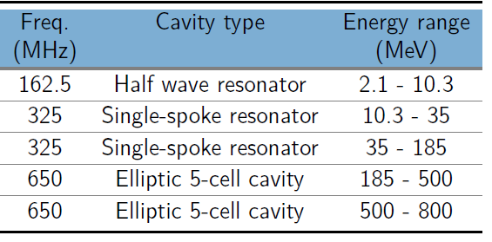
The PIP-II 800 MeV Linac
2.1 MeV
10.3 MeV
35 MeV
185 MeV
500 MeV
800 MeV
IS
LEBT
RFQ
MEBT
HWR
β=0.11
SSR1
β=0. 22
SSR2
β=0.47
LB650
β=0.61
HB650
β=0.92
Room Temperature
Technology
Superconducting
Radio Frequency Technology
WARM FRONT END
15 mA, 30 kV ion source
2 m Low Energy Beam Transport
2.1 MeV, 162.5 MHz RFQ
14 m Medium Energy Beam Transport
June 12, 2019

Slide 12

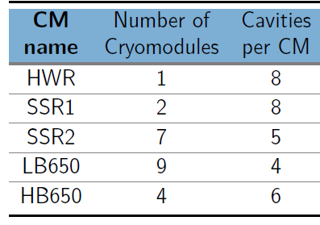
Superconducting Section
2.1 MeV
10.3 MeV
35 MeV
185 MeV
500 MeV
800 MeV
HWR
β=0.11
SSR1
β=0. 22
SSR2
β=0.47
LB650
β=0.61
HB650
β=0.92
To Cryogenic Plant 2kW @ 2K (31 mbar)
Cryogenic Transferline with connecting boxes
June 12, 2019

Slide 13
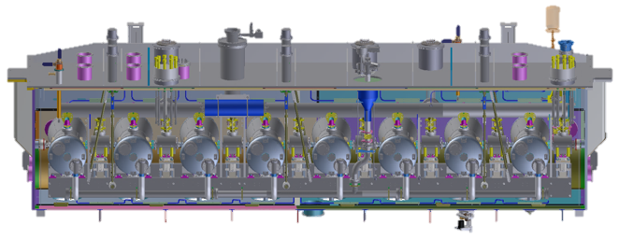
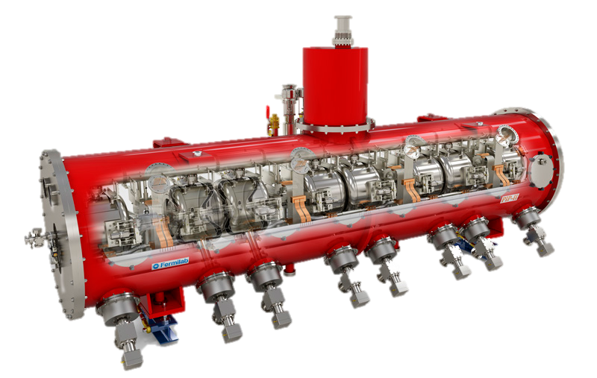
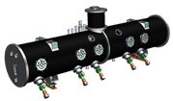
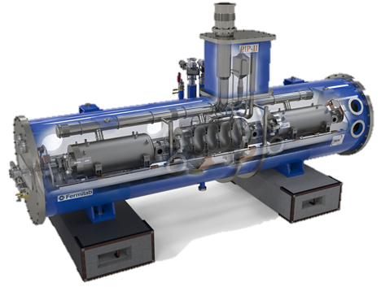
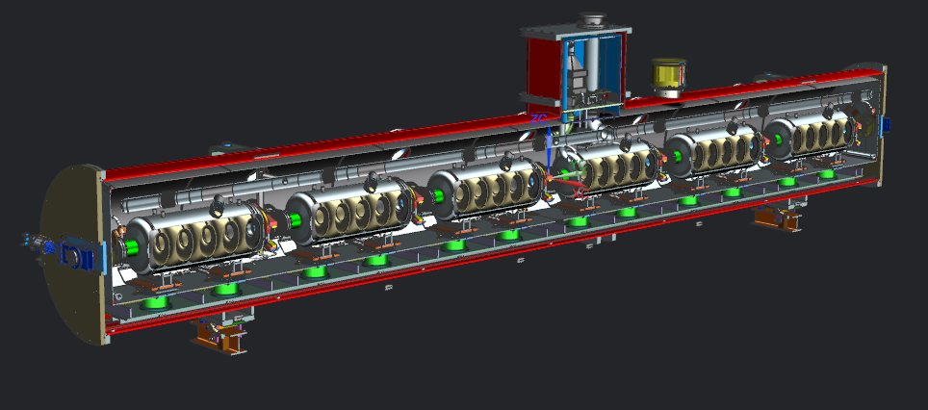
Partner’s Contribution
IS
LEBT
RFQ
MEBT
HWR
β=0.11
SSR1
β=0. 22
SSR2
β=0.47
LB650
β=0.61
HB650
β=0.92
June 12, 2019

Slide 14
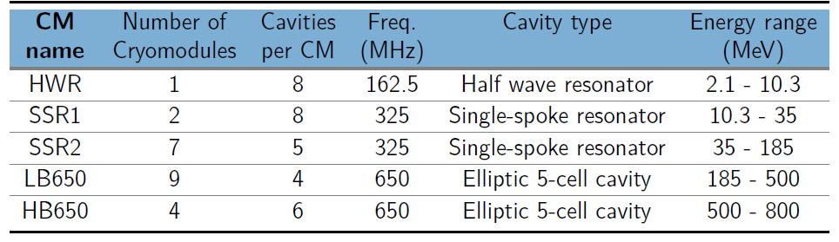
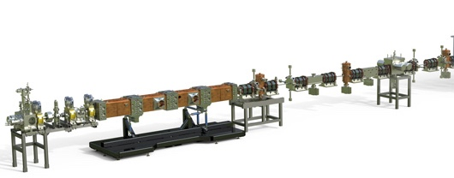
The PIP-II Front End
2.1 MeV
10.3 MeV
35 MeV
185 MeV
500 MeV
800 MeV
IS
LEBT
RFQ
MEBT
HWR
β=0.11
SSR1
β=0. 22
SSR2
β=0.47
LB650
β=0.61
HB650
β=0.92
Room Temperature
Technology
Superconducting
Radio Frequency Technology
WARM FRONT END
Warm Front End (WFE)
15 mA, 30 kV ion source
2 m LEBT (chopper, dif. pumping, envelope match to RFQ)
2.1 MeV, 162.5 MHz RFQ
14 m MEBT (bunch-by-bunch chopper, shielding wall, envelope match)
June 12, 2019

Slide 15
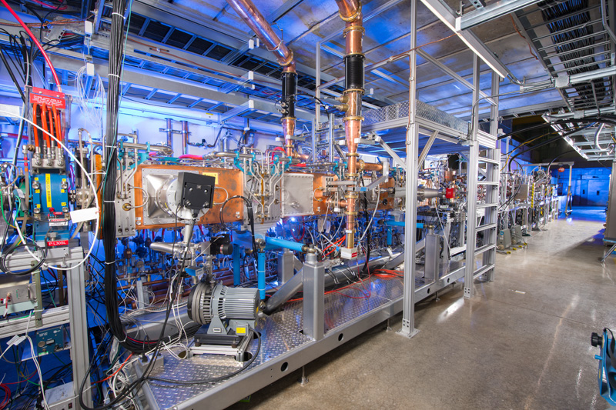
PIP2IT at CMTF
June 12, 2019

Slide 16
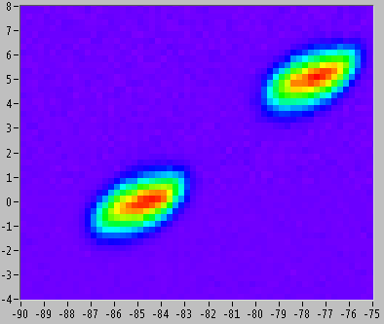
WFE ➔ Operational
  Beam characteristics meet PIP-II requirements at 2.1 MeV
  Observed removal of individual (162.5 MHz) bunches with 200 Ω chopper
Emittance Scanner
‘Missing’ bunches
June 12, 2019

Slide 17
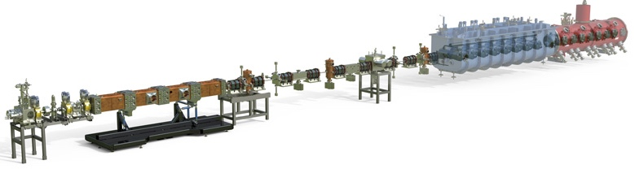
PIP2IT ➔ Next Step: commissioning with beam
2.1 MeV
10.3 MeV
35 MeV
185 MeV
500 MeV
800 MeV
IS
LEBT
RFQ
MEBT
HWR
β=0.11
SSR1
β=0. 22
SSR2
β=0.47
LB650
β=0.61
HB650
β=0.92
Room Temperature
Technology
Superconducting
Radio Frequency Technology
WARM FRON END
15 mA, 30 kV ion source
2 m LEBT (chopper, dif. pumping, envelope match to RFQ)
2.1 MeV, 162.5 MHz RFQ
14 m MEBT (bunch-by-bunch chopper, shielding wall, envelope match)
June 12, 2019

Slide 18
Road to Critical Decision 2 (CD-2)
Achieved CD-1 in July 2018;
PIP-II Findings of No Significant Impact (FONSI) was approved;
Preliminary Design independently reviewed and vetted by PIP-II Machine Advisory Committee (P2MAC);
Strong engagement with International partners;
Focus on advancing technical design, tracking progress using Earn Value Management System, finalizing CD-2 project documents;
DOE/SC Project Assessment, Independent Project Review – October 8 -10, 2019 ➔ baseline review.
June 12, 2019

Slide 19
PIP-II Schedule – top level
FY18 | FY19 | FY20 | FY21 | FY22 | FY23 | FY24 | FY25 | FY26 | FY27
Shutdown
SY120
CD-1
CD-2
CD-3
CD-4
Shutdown
Acc Complex
Preliminary Design
Final Design
Construction
Installation
Commissioning
FY18 | FY19 | FY20 | FY21 | FY22 | FY23 | FY24 | FY25 | FY26 | FY27
June 12, 2019

Slide 20
Summary
PIP-II will enable the world’s most intense beam of neutrinos to the LBNF/DUNE; modernize Fermilab’s accelerator complex enabling science for decades to come;
PIP-II is breaking a new ground➔ first DOE/SC accelerator to be built with significant international contributions;
Strong support from Fermilab, Partners, OHEP, Office of Science, DOE, Congress;
On track to be baselined in 2019.
June 12, 2019

Slide 21
Thank you for your attention!
June 12, 2019

