Slide 2
Slow Extraction of High Energy Leptons with RF on and SR
Slow extraction workshop 2019
Fermi National Accelerator Laboratory, Batavia, IL, USA
Y. Dutheil, M. Barnes, J. Borbugh, M. Fraser, B. Goddard, F. Velotti CERN, Switzerland

Slide 3
Content
Physics case
Electron complex at CERN
SPS electron beam dynamics
SPS extraction dynamics
SPS extraction layout

Slide 4
Physics case
Strong gravitational evidence for dark matter
But gives little insight on the mass of its constituents
The range of mass ~MeV to ~GeV is largely unexplored
A thermal origin requires an interaction between dark matter and familiar matter
Implies a production mechanism by the addition of a new force carrier
A particularly sensitive way to search for this reaction is to use an electron beam to produce dark matter
T. Åkesson et. al., Dark Sector Physics with a Primary Electron Beam Facility at CERN, CERN-SPSC-2018-023, 2018

Slide 5
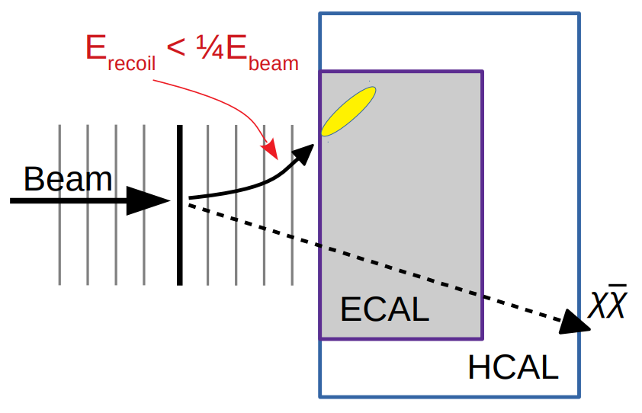
Light Dark Matter eXperiment
Magnetic field and tracking planes
Missing energy/momentum method
Incoming electrons individually tagged
Thin target produces bremsstrahlung photons and dark matter
Recoil electron momentum measured
Produced photon measured by ECAL
Incoming electrons at 200MHz
Limited by detector technology
Electron beam optimal energy 15-20GeV
Minimizes background
arXiv:1808.05219
Thin target
T. Åkesson et. al., Dark Sector Physics with a Primary Electron Beam Facility at CERN, CERN-SPSC-2018-023, 2018

Slide 6
Status
Concept for LDMX at CERN is being studied under the Physics Beyond Collider initiative
A first investigation of the concept was done in 2018 and submitted to the SPS scientific committee
Submitted at the end of 2018 to the ESPP-update process
Update to the European guidelines for particle physics expected by March 2020
Ongoing efforts for more detailed studies to complete the CDR by the end of 2019

Slide 7
Electron complex
3.5GeV Linac
Acceleration to in SPS
Extraction
Notes:
Finish : I will now go in details about the elements of this electron complex

Slide 8
Electron complex
3.5GeV Linac
Notes:
Finish : I will now go in details about the elements of this electron complex

Slide 9
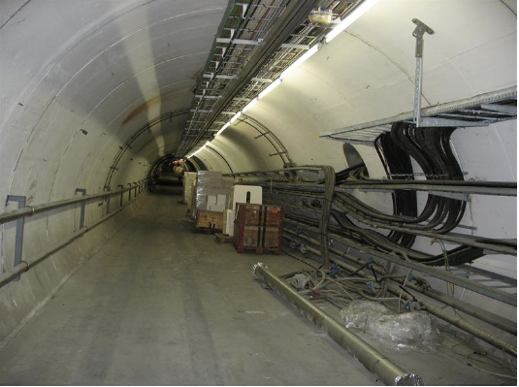
Transfer tunnel, TT60, from the Linac into the SPS
Injection into the SPS
Bunch to bucket injection in the 200MHz SPS longitudinal RF structure.
Total of 75 trains of 40 bunches
3000 bunches
10¹² electrons in the ring
Notes:
Up to 1.5E12
Discuss injection gap

Slide 10
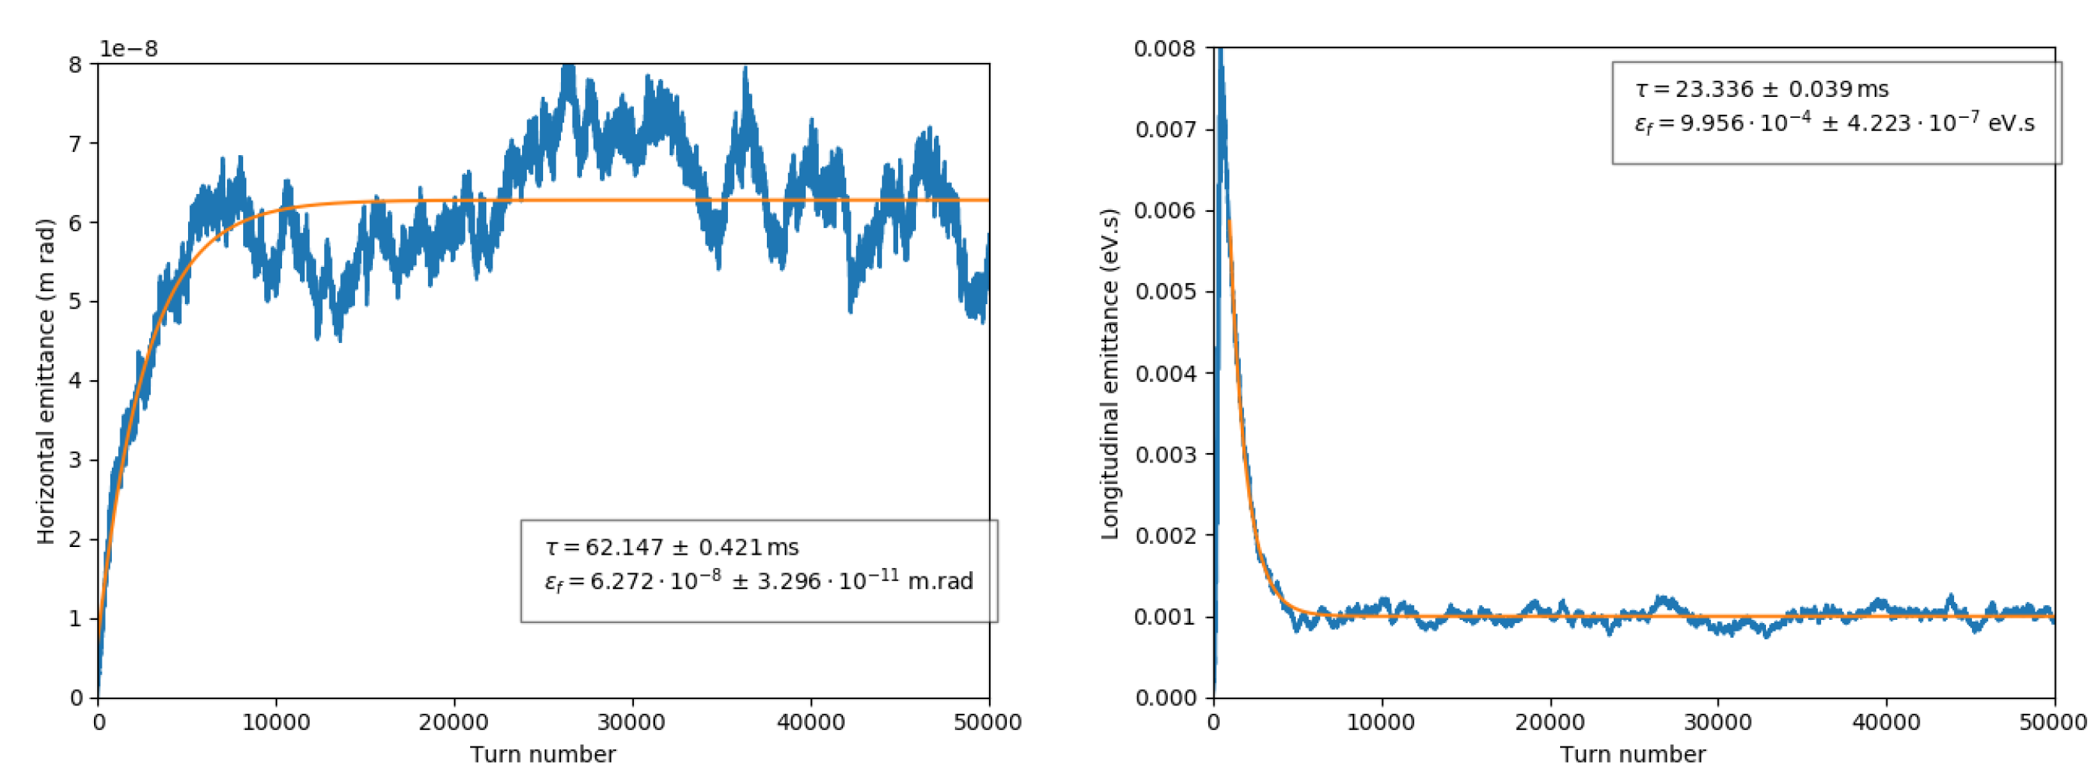
SPS beam dynamics
At 16GeV the energy lost per turn is 7.8MeV
Minimum of ~10MV RF voltage is needed
Beam dynamics is dominated by synchrotron radiation
MADX model and tracking predicts damping times <100ms
Model has no errors, hence zero vertical emittance
Some discrepancies between MADX tracking and MADX numerical computation of damping times and equilibrium emittance.
Zgoubi model of the lattice is being established based on F. Meot work during the SX-Workshop in CERN, 2017

Slide 11
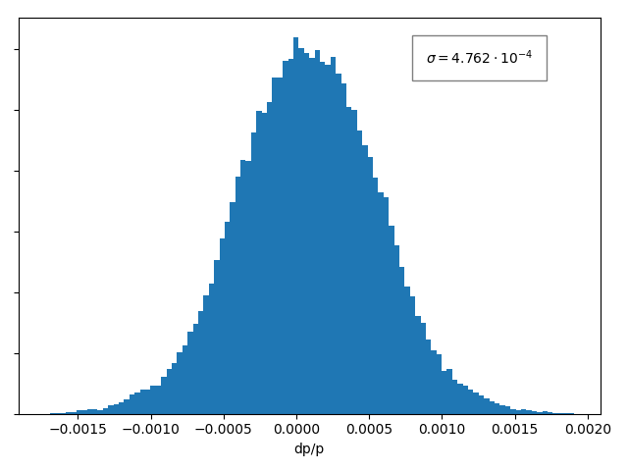
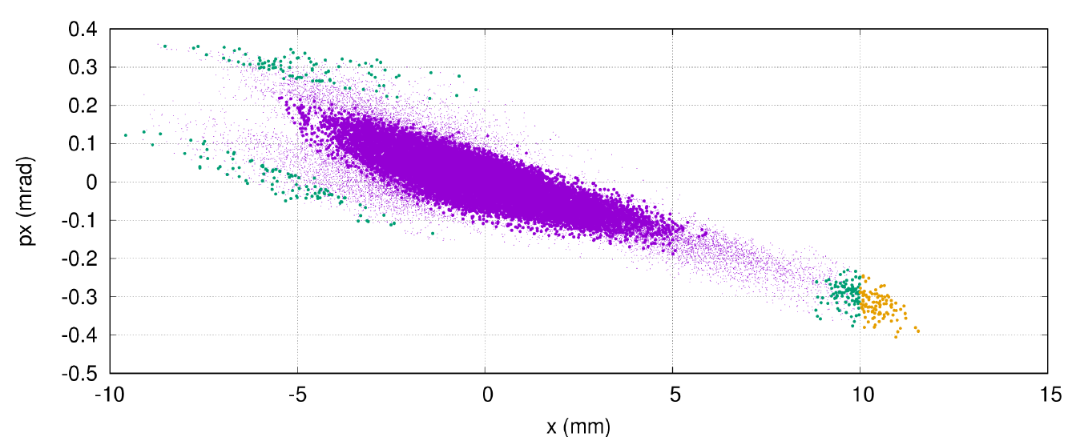
Chromatic slow extraction principle
Spread in tune from lattice chromaticity
Energy spread governed by equilibrium between SR damping and quantum excitation
Position of the resonant condition is set by the machine
Quantum excitation diffuses particles from the core to the unstable region
The extraction rate can be controlled by changing the position of the resonant condition
Resonant condition extraction
diffusion
Electrostatic Septum
Tune (frequency)
Extraction rate
Notes:
Explain phase space

Slide 12
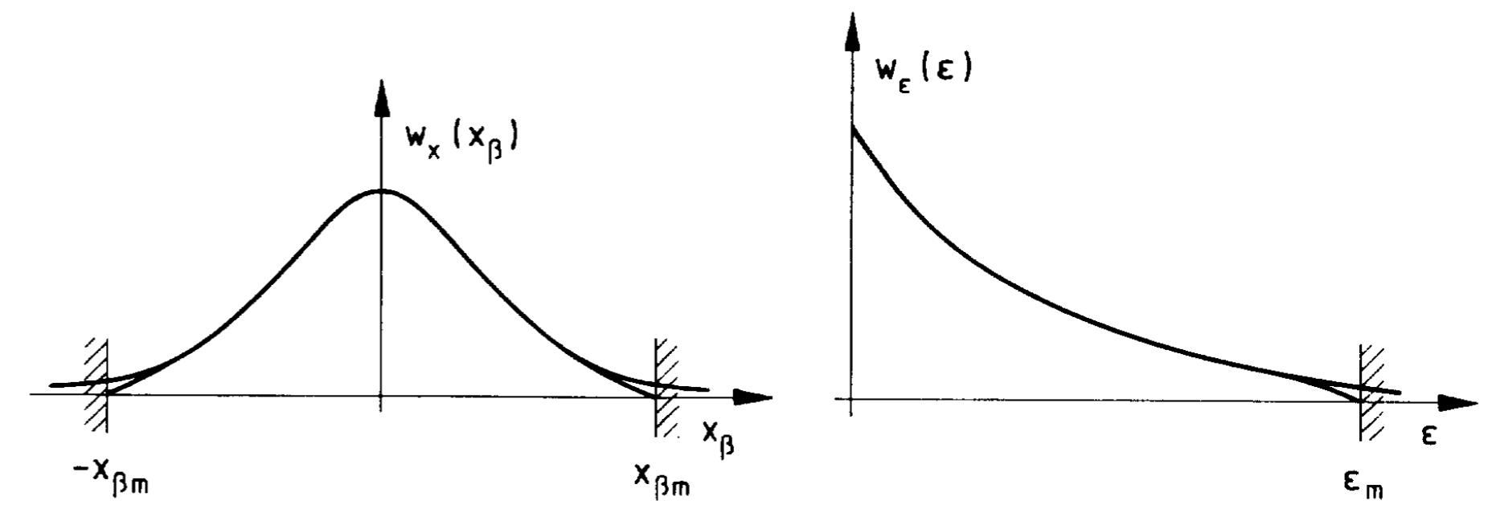
Extraction rate and control
Expected behavior similar to aperture restriction lifetime
Spill rate is $≡e^{−ε_{m}}$
Control of the spill rate should be feasible down to very low rates
Temporal structure and effects of machine ripples remain in question
What is the effect at very low spill rate?
A. Piwinski, Proceedings of the CERN Accelerator School 85-19 (CERN, Geneva, Switzerland, 1985).

Slide 13
Structure of extracted beam
up to 40 bunches with 5ns spacing
Gap of 100ns with 0.5m injection kicker
Beam in the SPS
Energy
200 ns
100 ns
~1s
Beam on target
0s
10s
20s
30s
Flexibility
Bunch spacing 5ns, 10ns, … 40ns
Average electrons per bunch can be chosen from <1 to anything
Transverse beam spot on target from very small up to hundred cm²
This flexibility can deliver the needs of LDMX
Phase 1 : 10¹⁴ electrons
Phase 2 : 10¹⁶ electrons

Slide 14
Extraction Layout
Extraction

Slide 15
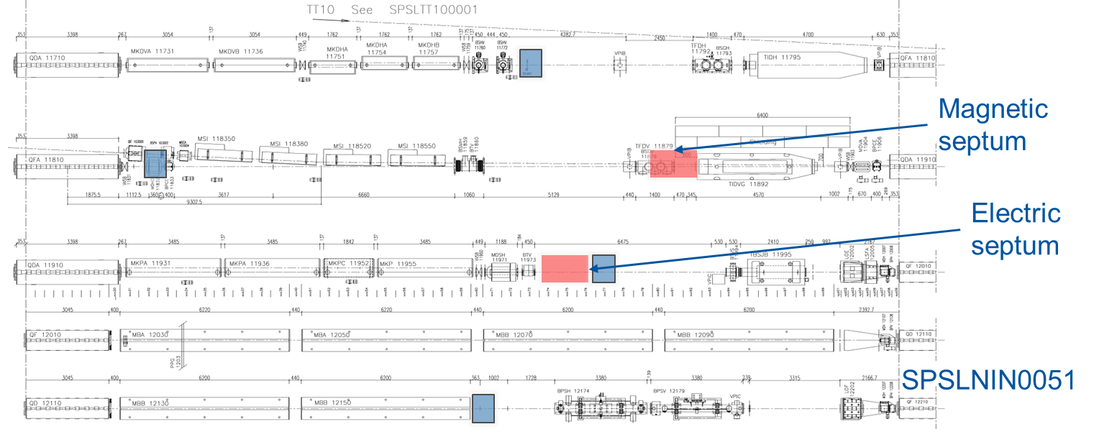
Extraction Layout
Hadrons
Electrons

Slide 16
Extraction layout
2.5 m electrostatic septum 5 MV/m 780 µrad
1.5 m thin magnetic septum 10 mm blade and 150 mT 4 mrad
Other thick magnetic septum are already in place and used for proton injection
Electron extraction scheme would make use of those same elements, with similar strength and same polarity as proton injection

Slide 17
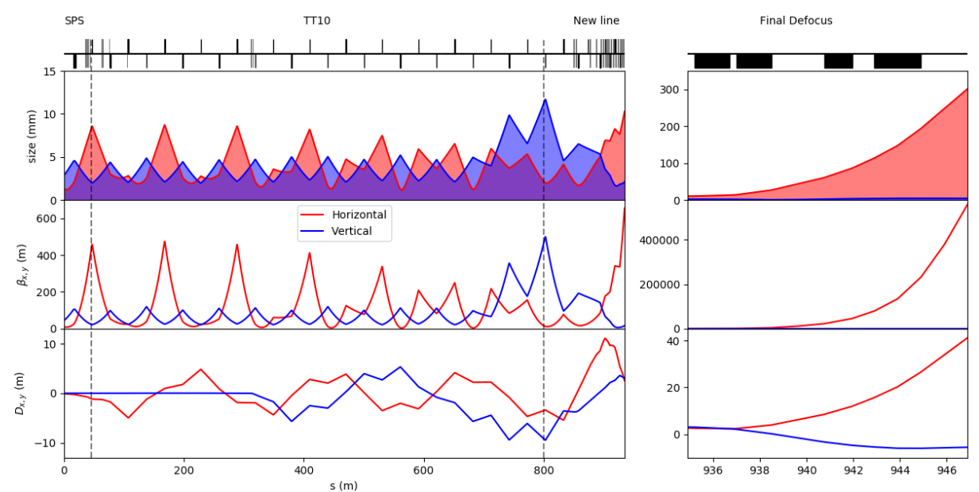
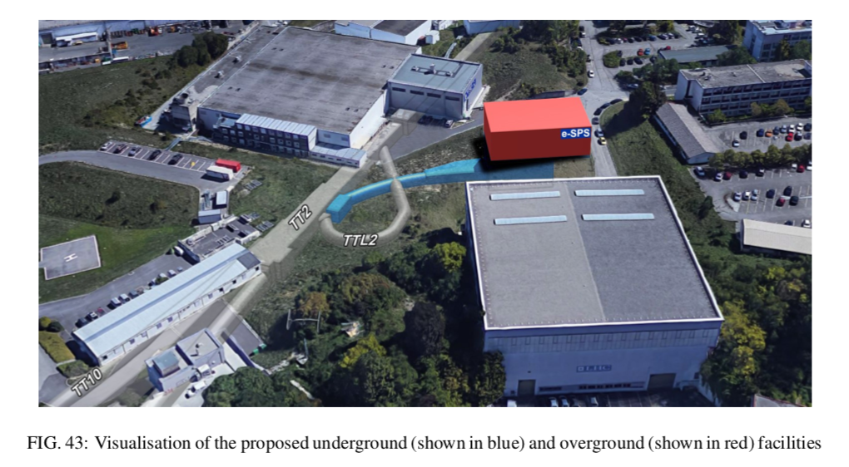
Transport to experiment
1 km transport line, used in the other direction for proton injection
New tunnel and experimental building branching off the existing line
Final beam manipulation to enlarge the beam on the experimental target
Possible beam scraping along the line to reduce the spill rate on the detector

Slide 18
Ongoing investigations
Very low spill rate control
Control of the spill rate and working point
Stability of the provided spill at the rates considered
Sensitivity of the spill rate to machine ripples (quadrupoles, dipoles, sextupoles and RF voltage)
Phase space transport
Phase space as a function of spill rate
Transport of the extracted spill to the experimental area (~1 km)

Slide 19
Thank you

Slide 20
Linac parameters
modulator
kl
kl
2 x 50MW
0.1GeV S-band injector
3.4GeV X-band linac
High gradient CLIC technology
13 RF units to get 3.4 GeV in ~70 m [1]
p
c
e⁻
~5.3m
RF DESIGN OF THE X-BAND LINAC FOR THE
EUPRAXIA@SPARC_LAB PROJECT M. Diomede Et al., IPAC18
Notes:
The proposed 3.5 GeV electron linac is the natural next step for CLIC development
Parameters
This is a reliable technology
52pC is 3E8 electrons

Slide 21
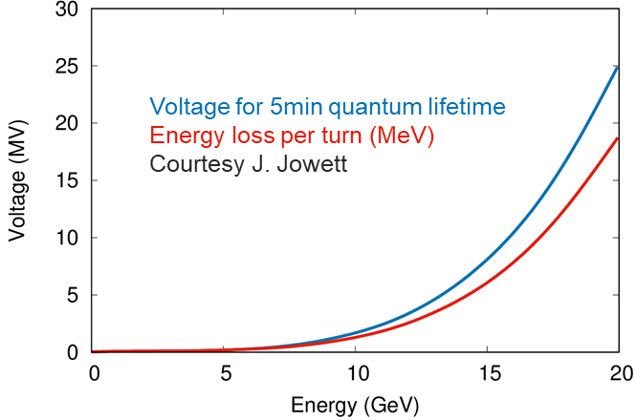
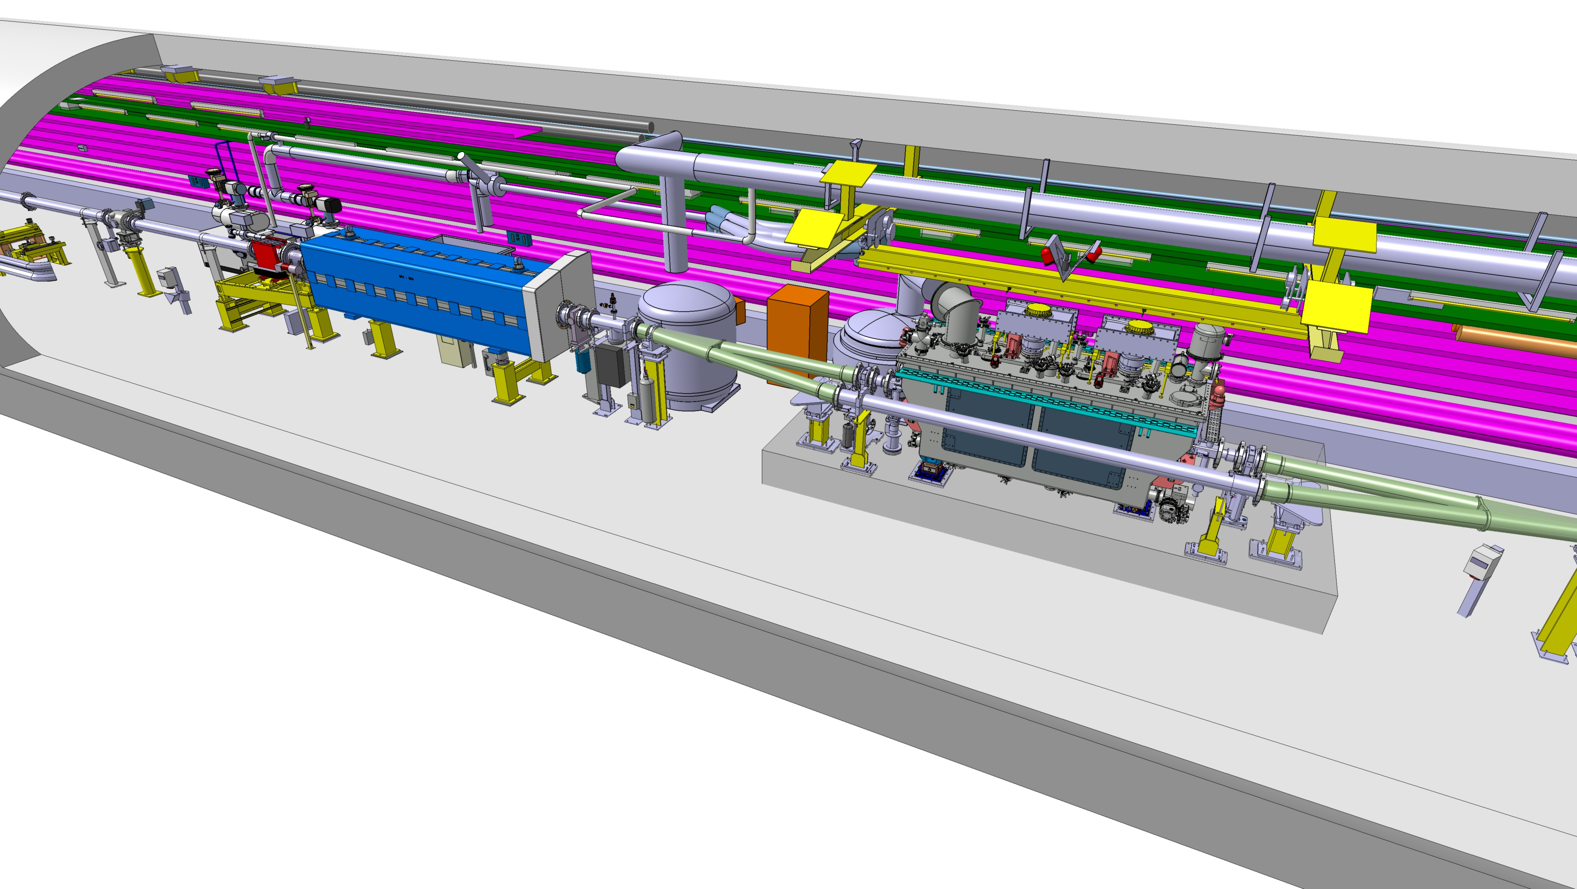
SPS RF system
16 GeV beam requires at least 10 MV of RF voltage
Existing 200 MHz cavities from LEP era can be re-installed
Expensive to refurbish and rebuilt the power amplifiers
Source of impedance
New SRF cavities at 800 MHz
Possibly using existing design
Could be placed in the existing CrabCavity cryostat table
Crab cavities fo ther HL-LHC : Status and first tests with beams at the SPS, R. Calaga, EPS-HEP 2019
Notes:
We reinstall part of the RF system from LEP era
Due to synchrotron radiation losses the beam needs to be bunched and RF on at all time
For quantum lifetime need 10MV to bring to 16GeV where U0~7.8MeV
We can confortably deliver beam from 3.5 to ~16GeV with available RF hardware

