Slide 1
Welcome to Fermilab and the
Slow Extraction Workshop 2019
Vladimir Nagaslaev, FNAL/AD/Muon

Slide 2
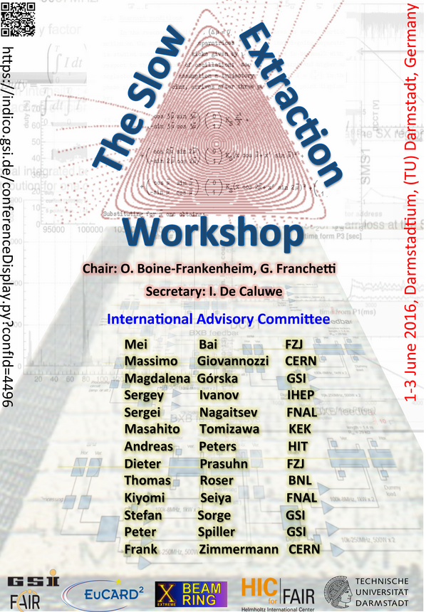
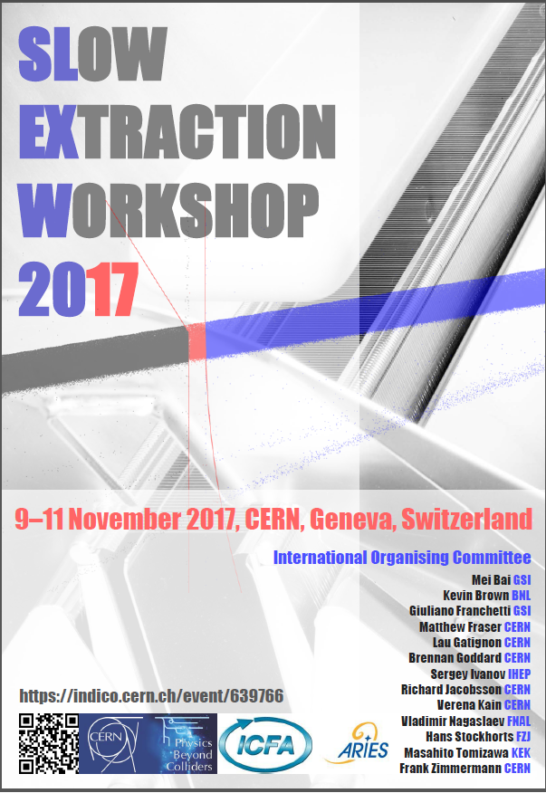
Slow Extraction Workshop 2019 (#3)
Building on success of
2016 SE Workshop #1, (GSI)
2017 SE Workshop #2, (CERN)
The 2019 workshop aims to address actual issues of Slow Extraction, and provide a forum for discussing between experts in this specialised domain.
Under the auspices of ICFA Supported by FRA .
54+ participants registered
Thank you for your participation!

Slide 3
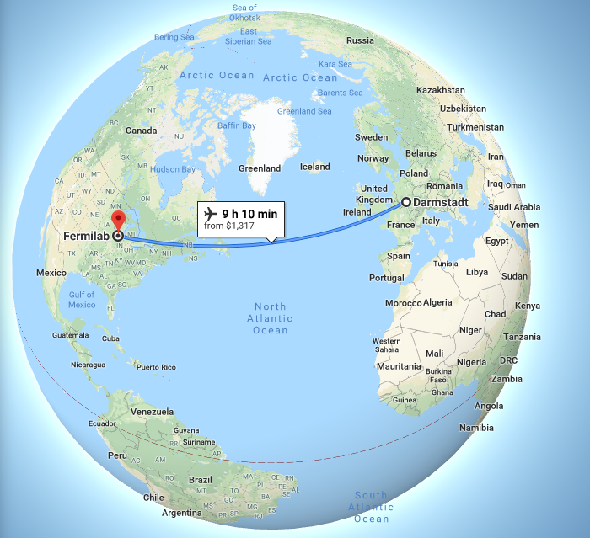
Slow Extraction Workshop 2019 (#3)
Building on success of
2016 SE Workshop #1, (GSI)
2017 SE Workshop #2, (CERN)
The 2019 workshop aims to address actual issues of Slow Extraction, and provide a forum for discussing between experts in this specialised domain.
Under the auspices of ICFA Supported by FRA .
54+ participants registered
Thank you for your participation!

Slide 4
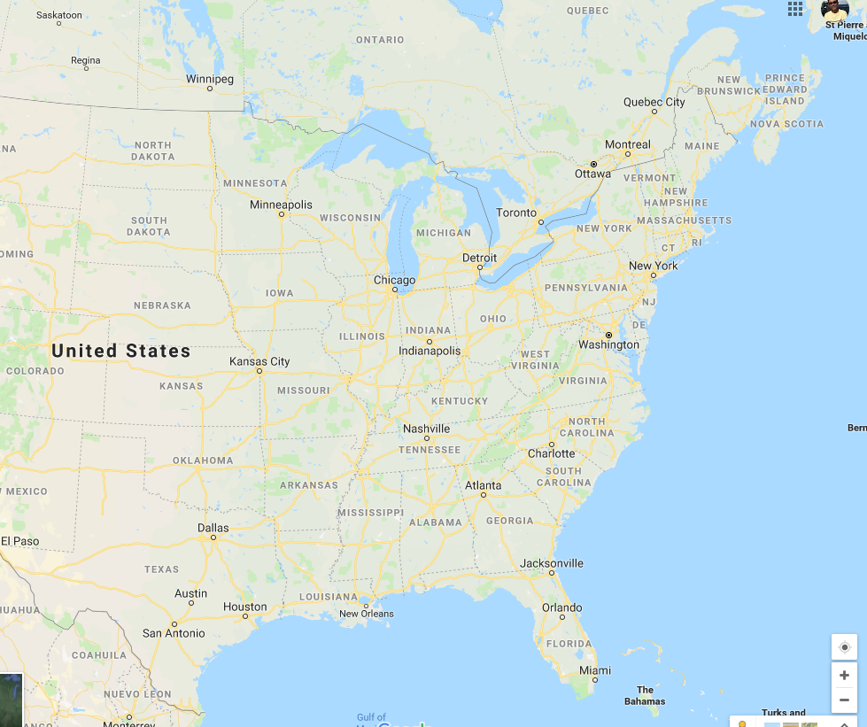
Slow Extraction Workshop 2019 (#3)
Building on success of
2016 SE Workshop #1, (GSI)
2017 SE Workshop #2, (CERN)
The 2019 workshop aims to address actual issues of Slow Extraction, and provide a forum for discussing between experts in this specialised domain.
Under the auspices of ICFA Supported by FRA .
54+ participants registered
Thank you for your participation!
Fermilab

Slide 5
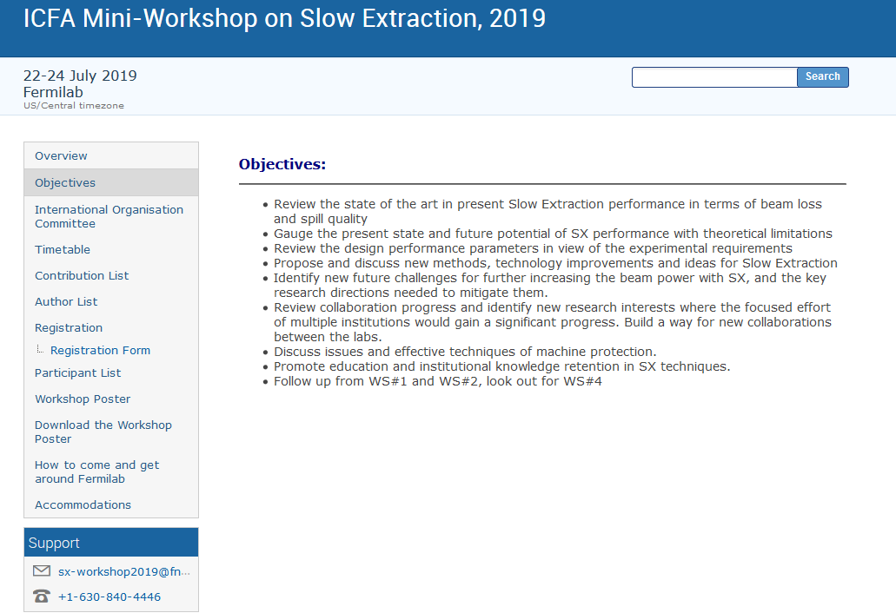
Workshop Objectives
At Fermilab:
Decades of experience at MI-52
New SX facility
Challenging performance requirements
Want to learn from the front line runners
Gauge our design understanding with the current state of the art

Slide 6
Workshop Objectives
General community needs:
Beam loss and spill quality: state of the art
Theoretical limitations
Experimental requirements
New technologies and methods
Challenges of beam intensity growth in future machines
New collaborations
Machine protection
Promote education knowledge
Follow up from previous workshops

Slide 7
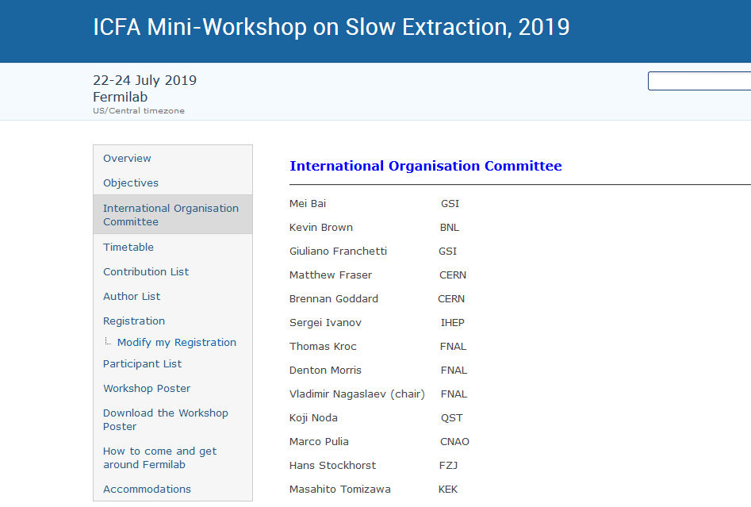
International Organizing Committee

Slide 8
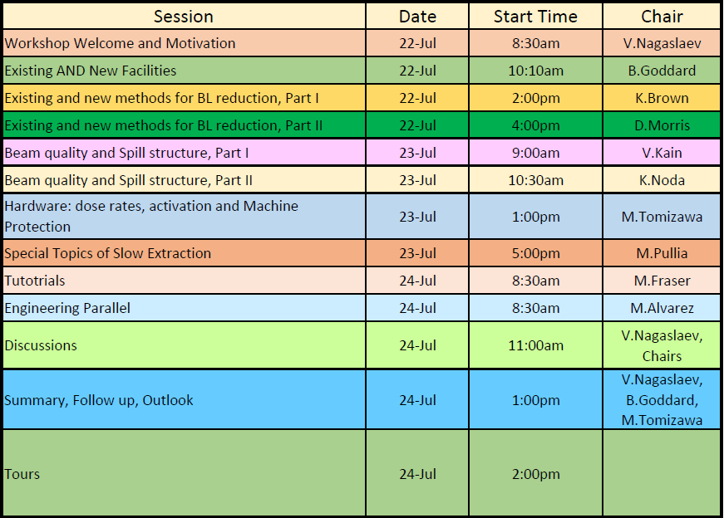
Sessions

Slide 9
Coffee and lunch breaks
Coffee breaks:
We believe coffee at the workshop is very important
Coffee breaks will be served by an outside contractor firm
Served near the meeting room
Break time varies – follow the schedule
Lunch breaks:
Not covered
Wilson Hall cafeteria
Across the lobby
Food services also available nearby Fermilab

Slide 10
Workshop dinner: Thursday 19:00
The dinner will be served at the 2nd floor in the Wilson Hall
The dinner is provided by the Fermi Research Alliance, (FRA)
Same level of service as we provide to the US congressmen!
Make sure you have the mark “D” on your badge!

Slide 11
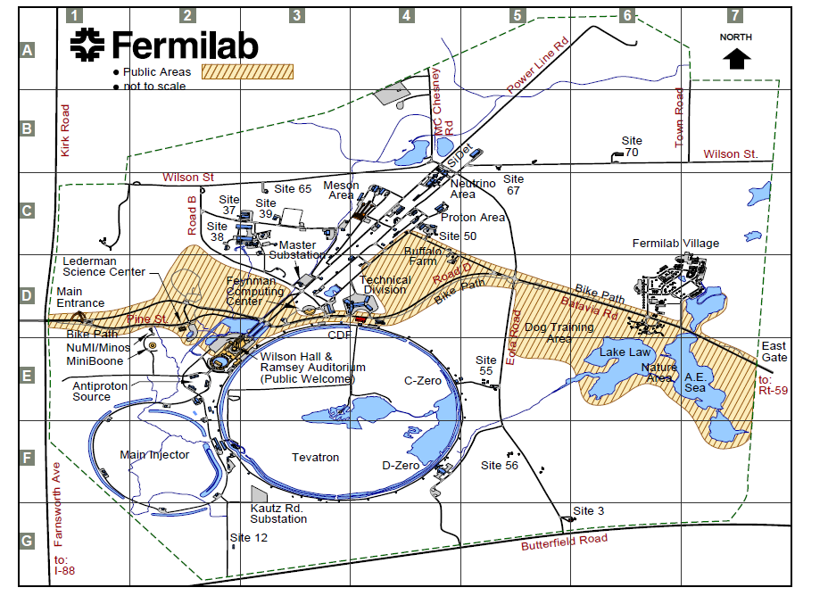
Venue, site navigation, wi-fi, etc.
Bison field
Wilson Hall
Tour 2
Tour 1

Slide 12
Venue, site navigation, wi-fi, etc.
The Fermilab site map can be viewed and downloaded at
https://www.fnal.gov/pub/visiting/map/site.html
Workshop agenda and other information at: https://indico.fnal.gov/event/20260
All sessions will take place in the One West conference room
Parallel session in the Comitium room
You should be able to connect to the wi-fi service “Guest”

Slide 13
Tours
Places to tour:
Site 1: Main Injector MI-52 enclosure
Site 2: Mu2e building, beam transport, Delivery Ring Extraction
Safety orientation here, before walk
Please sign up!
Be sure to be here at 2:00pm on Wednesday!
Dress for tunnel:
Covered shoulders, no tank tops
Flat shoes, closed toes
No food/ drinks
Split in two groups ?

Slide 14
In case of any problems/questions…
Vladimir Nagaslaev (cell) +1-630-476-1264
Cara Kachel sx-workshop2019@fnal.gov +1-630-840-4446
Jerry Annala annala@fnal.gov +1-630-840-3804

Slide 15
In conclusion
Slow Extraction is a very important field
Presents new challenges and that indicates moving forward
Communication and collaboration makes effort the most effective
Enormous progress in the field recently
Lots of good news
Thanks to everyone for bringing this here!
Looking forward for exciting and intense days in the SX Workshop 2019!

