Slide 1
Slow Extraction Operations:
Fermilab Main Injector
Denton Morris
Slow Extraction Workshop
22 July 2019

Slide 2
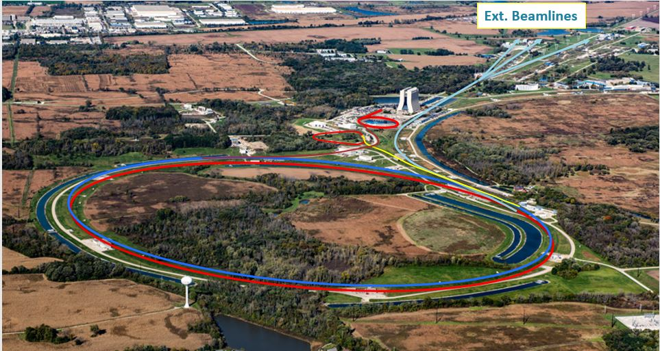
Fermilab Overview: Beam Transport

Slide 3
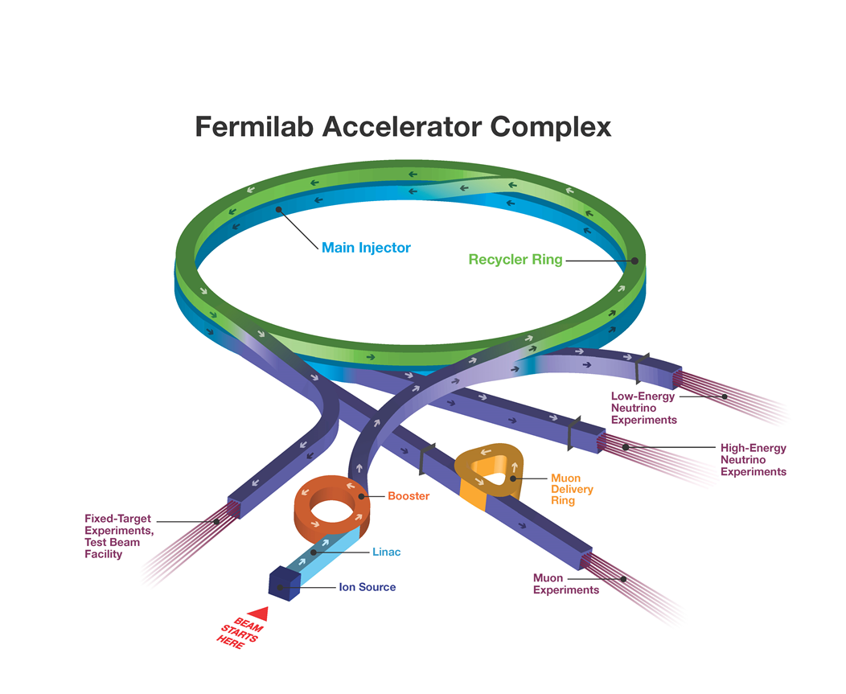
Fermilab Overview: Beam Transport
The Fermilab Main Injector :
120GeV/c
53MHz RF bunch structure
588 RF bucket circumference
486 bunches @ 2e10 ppb
4 second slow spill
½ Integer

Slide 4
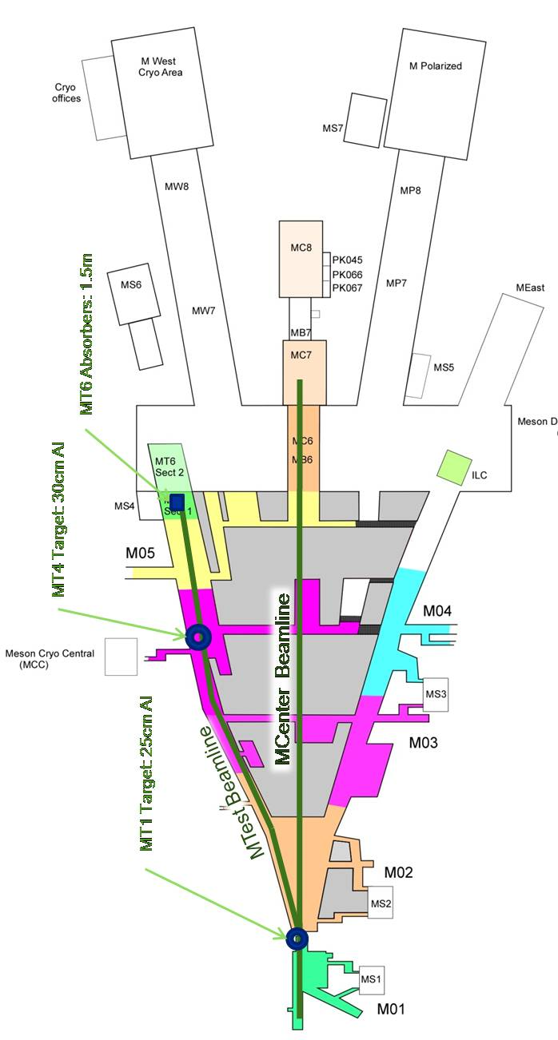
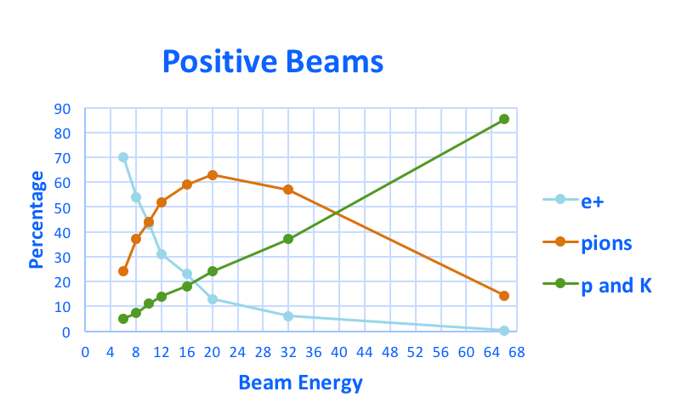
Low and Medium Energy User Test Beams at Fermilab
Mixed test beams available at Fermilab
Low to medium energies, two production targets
Two test beam lines; 2% Δp/p
120 GeV primary protons from MI (up to 10¹³p/spill)
32-60 GeV pions and some protons (MT1 target)
1-30 GeV pions, electrons, kaons, or broadband muons
      (MT4 target)
    High energy positrons (60 GeV) have been observed
    0.2-2 GeV pions, protons, kaons (tertiary target, MCenter line, MC5)

Slide 5
Drell-Yan Experimental Beam at Fermilab
SpinQuest/E1039:
120 GeV protons
1e13 protons per 4 sec. spill
Cryogenic polarized
proton target
Spectrometer
Hodoscope array

Slide 6
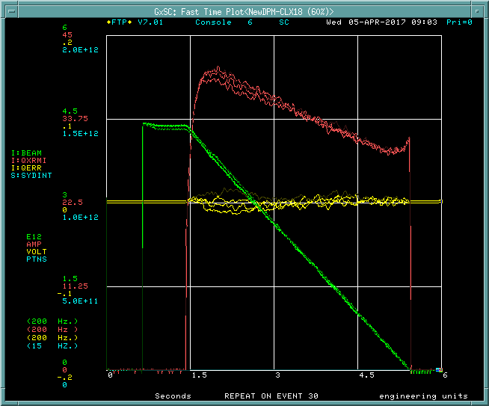
How We Spill At Fermilab

Slide 7

How We Spill At Fermilab
At 120 GeV:
Increase the horizontal tune to 26.485
Ramp up 53rd harmonic quad circuits
Two orthogonal circuits with eight magnets each
Ramp octopole circuits
Enable 0th order quad circuits (QXR) to
regulate spill
QXR:
Two air core quadrupole magnets
Three tap fir-filter learning algorithm
~300 Hz response
50 Amp drive

Slide 8
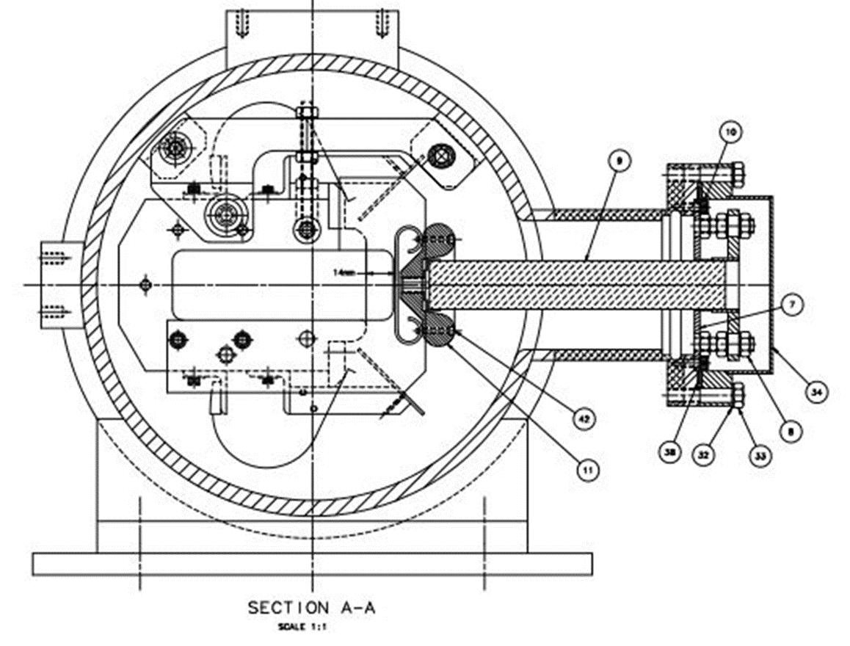
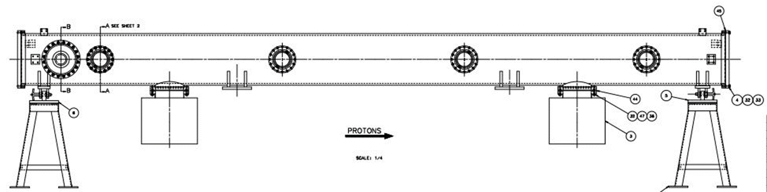
How We Spill At Fermilab: Extraction Region
Extraction Septa:
Two 3m tanks
Wire plane is 0.1 mm Tungsten-Rhenium wire
1440 wires per tank spaced 2.5 mm apart
Cathode runs -100 Kvolts
Wire plane to cathode = 14 mm

Slide 9
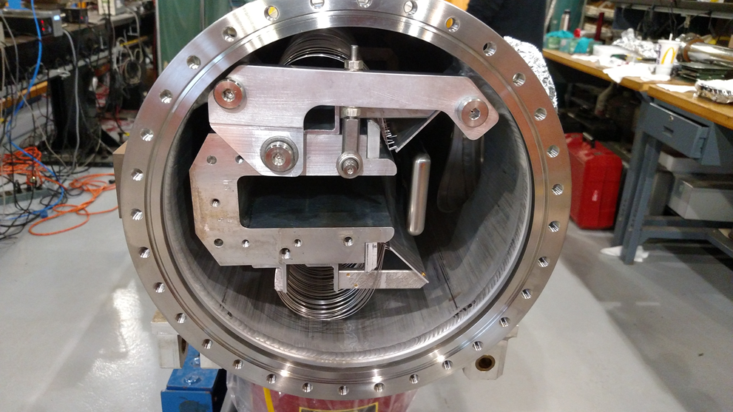
Main Injector Septa

Slide 10
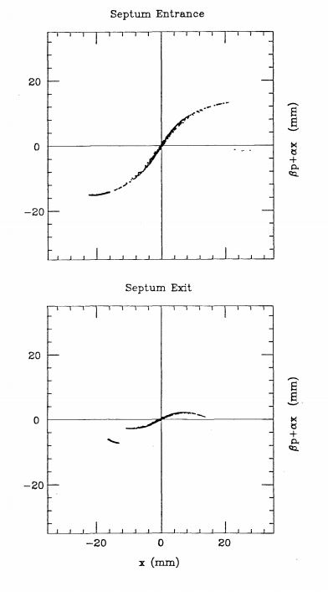
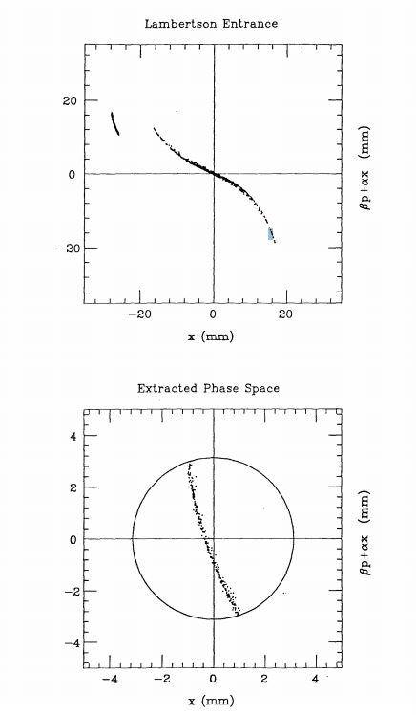
How We Spill At Fermilab: Extraction Region

Slide 11
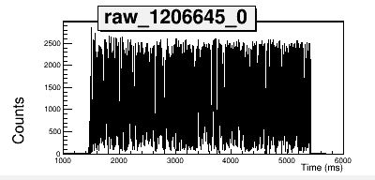
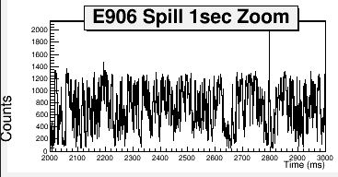
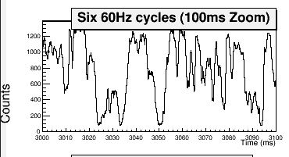
Extracted Beam Properties
4 seconds of spill looks good at 4e12, not so good at 4e4 ppb

Slide 12
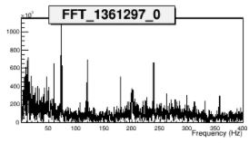
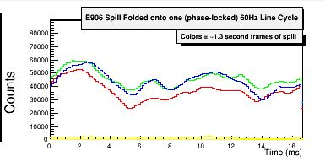
Extracted Beam Properties
Main bus power: 13.8 KV through ΔY transformer
= a lot of 60 Hz harmonics
Spill duty factor (53 MHz) is 45%
Proton extraction efficiency is ~95%

